Slide 1

The Project Graveyard
Unfinished isn’t failed. Lay old projects to rest, understand why they stopped, and decide whether they deserve a second life.
Code Variant · Build 01 · Final submission · Problem Statement 05
Rajnish Kumar Verma (solo)
Live: project-graveyard-codevariant.vercel.app Code: github.com/erajneeshverma/rajnishkver-CodeVarient
Notes:
Hi, I’m Rajnish. The Project Graveyard is a place for every project you started and didn’t finish: it records why it stopped and gives an honest, explained answer about what to do with it next. Everything I show is live at the URL on screen.

Slide 2
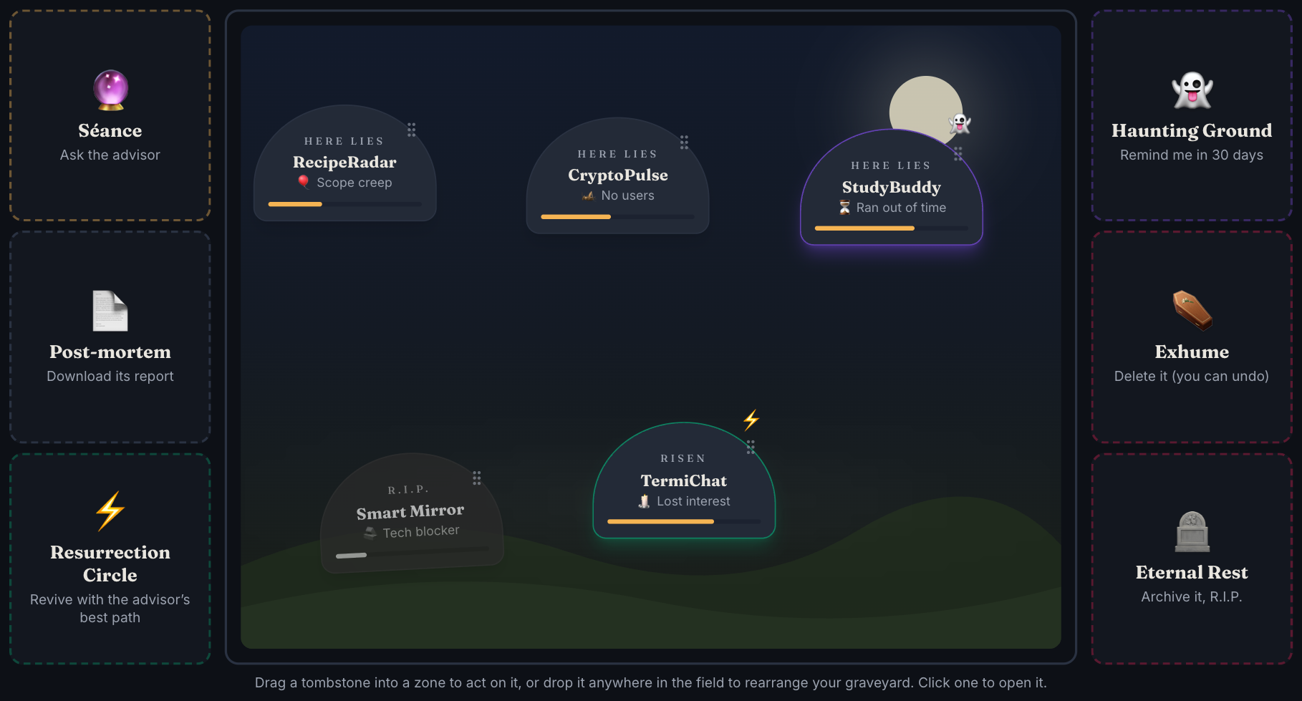
What we shipped in 12 hours
6
screens, all drag-and-drop
31
automated tests passing
0
accessibility violations (axe-core)
30+
commits, each one deployed live
A working, deployed product: bury a project, run its autopsy, get explained advice, decide its fate. Then the hour-6 twist turned the whole app into a drag-and-drop canvas.
Notes:
Here’s what exists right now, live: six screens, every primary action done by drag and drop, 31 automated tests, and zero accessibility violations on every page in both themes.

Slide 3



Unfinished projects don’t die, they get forgotten
Context decays
Months later you can’t remember what was done, what was left, or why you stopped.
Our reading of the problem
Storage isn’t the problem. GitHub already keeps the code.
No honest post-mortem
Projects stall for very different reasons (time, scope, a blocker, lost interest), but nobody records which one.
The missing piece is a decision: what is this project worth now, and what should I do with it?
Only two choices today
“Ignore it” or “delete it”. Restarting, pivoting or salvaging parts is never seriously considered.
Notes:
Every builder has a folder of half-finished projects. The code is safe on GitHub. What’s lost is the context and the decision, so today people only ever ignore or delete.

Slide 4
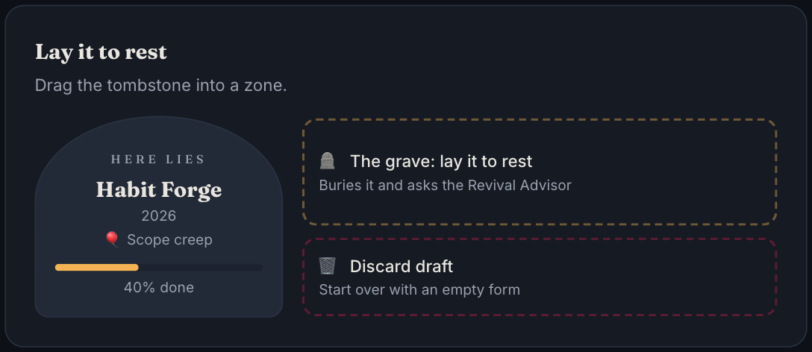
Bury it in under two minutes
1
The Tombstone
What it was, the goal, what got done and what didn’t. Paste a GitHub URL and the stack, dates and README fill themselves in.
2
The Autopsy
Why it stopped: time, scope creep, tech blocker, tech debt, lost interest, no users, plus an honest note.
3
Assess
Finish by dragging the live tombstone into the grave. Progress autosaves; discarding a draft can be undone.
Interest today (1–5) and is it still relevant? The advisor previews its pick before you finish.
Notes:
Burying takes three short steps. GitHub import fills the boring fields from a public repo. The last step is a drag: the live tombstone goes into the grave.

Slide 5
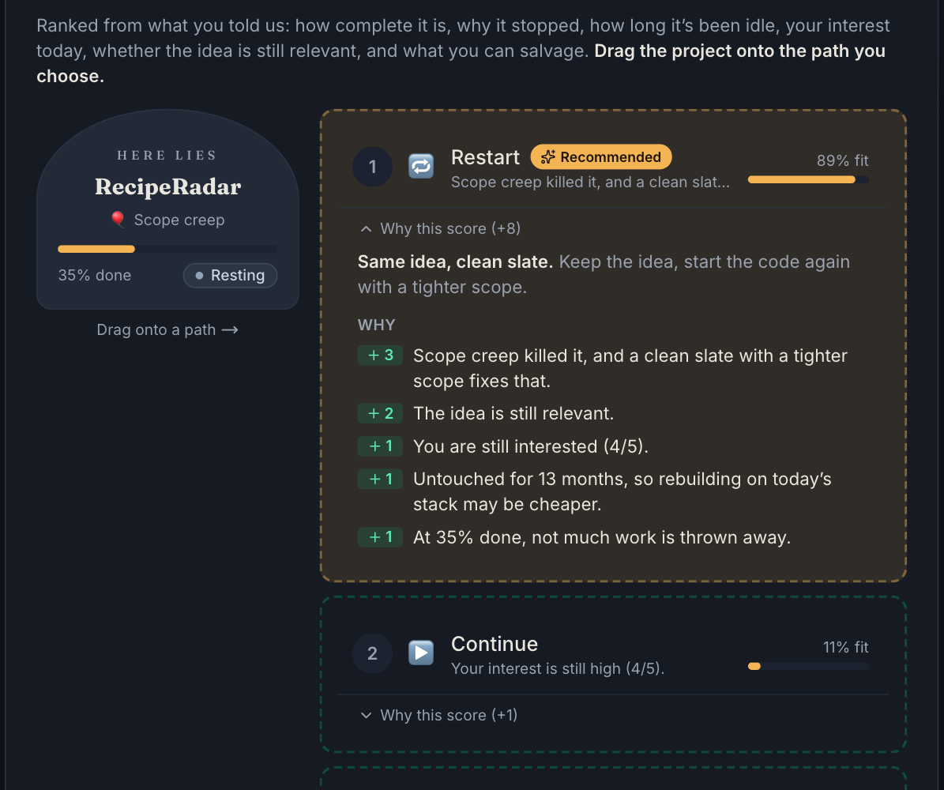
The Revival Advisor shows its working
Six signals
Completion %
Cause of death
Months idle
Interest today
Still relevant?
Salvageable parts
Five paths
Continue · Restart · Change the idea · Repurpose · Archive
+3 Scope creep killed it, and a clean slate with a tighter scope fixes that.
Rule-based on purpose: every point has its sentence, fit % shares one scale so it always agrees with the ranking, and the rules live in one config file. You always make the final call, and overriding is logged.
Notes:
The advisor turns each project into six signals and runs weighted rules over them. Every point comes with the sentence you see. Drag the project onto the path you choose.

Slide 6
The Canvas Protocol
HOUR 6 · 18:00
“No standard buttons for primary actions. Users must drag data cards into Action Zones.”
First drag-and-drop screen shipped 16 minutes later. Every primary action converted by 18:28.
Notes:
At hour six the rules changed: no standard buttons for primary actions. The first converted screen shipped sixteen minutes later.

Slide 7
Every button became a drag
Action | Before | Now: drag … into …
Bury a project | “Lay it to rest” button | the live tombstone → The grave
Decide its fate | “Choose” + modal | the project card → a ranked path zone
Revive or archive fast | open project, choose | a tombstone → Resurrection Circle / Eternal Rest
Record a revisit | “Update advice” | the assessment card → Record revisit
Haunt · Export · Delete | buttons + confirm | the project → Haunt / Post-mortem / Exhume
Salvage · Timeline | “Add” buttons | the new part / entry card → its list
Backup · Import | file buttons | the graveyard card → Export · a .json file → Import
Everything destructive can be undone from its toast. The logic didn’t change, only the way you trigger it.
Notes:
Here is every primary action, before and after. Each one is now a card dropped into a zone, and every destructive one has undo.

Slide 8
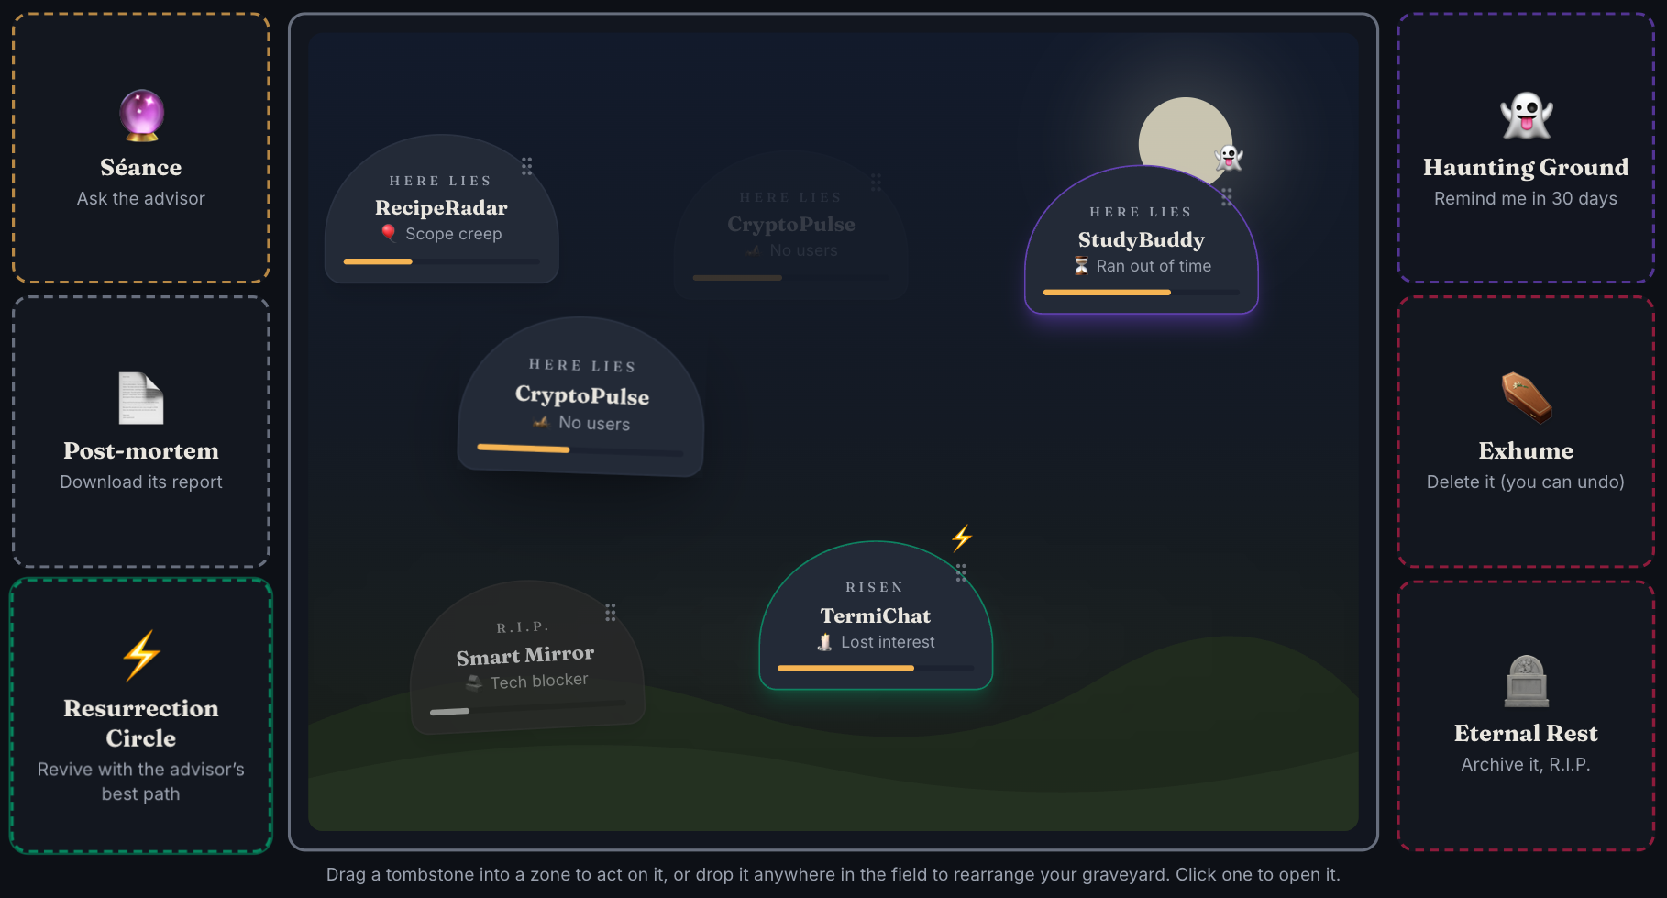






The home screen is now a canvas
Séance
ask the advisor
Resurrection Circle
revive with the best path
Eternal Rest
archive, R.I.P.
Haunting Ground
remind me in 30 days
Post-mortem
download its report
Exhume
delete, with undo
Tombstones stand in a field you arrange yourself; drop one anywhere to move it. Every drop plays an effect: light for a revival, dust for a burial, a ghost for a haunt.
Notes:
We didn’t just swap buttons for zones. The home screen became a real canvas: a graveyard field you arrange, with six themed zones around it.

Slide 9
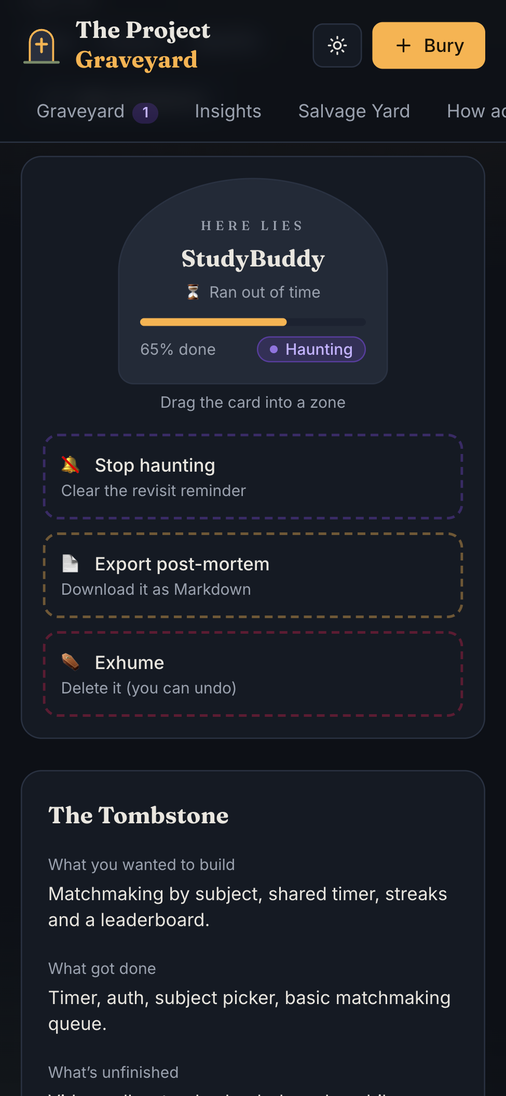




Drag and drop that works for everyone
Keyboard
Space picks a card up, arrow keys jump between zones (off-screen ones scroll into view), Space drops, Esc cancels.
Screen readers
Every pick-up, hover and drop is announced. Cards are named by what they show.
Touch
Long-press to lift on phones and tablets; scrolling still works. Dropping on empty space does nothing.
Safe by default
Undo on every destructive drop, plus zero axe-core violations on every page, light and dark.
Notes:
Drag and drop is usually where accessibility breaks. Here it works with the keyboard, is announced to screen readers, works with touch, and every destructive drop can be undone.

Slide 10

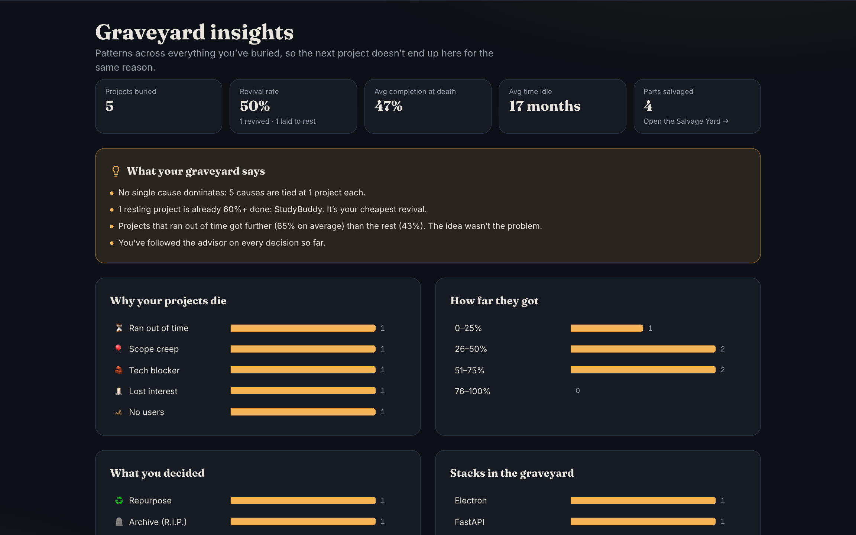




Beyond the brief
Graveyard Insights
Top cause of death, revival rate, plain findings.
Post-mortem export
Any project as a Markdown report for its repo.
Salvage Yard
Reusable code, lessons and assets from every project.
Haunt me later
Revisit reminders; due projects start haunting you.
GitHub import
Plus light and dark themes, JSON backup and restore, and a full timeline for every project.
Paste a public repo: stack, dates and README fill in.
Notes:
A few things beyond the brief: insights across your whole graveyard, post-mortem export, a salvage yard of reusable parts, reminders and GitHub import.

Slide 11

One canvas layer, zero backend
Config
Revival engine
Store
Canvas layer
Screens
causes, statuses, paths, every rule
pure TypeScript scoring, tested
Zustand, validated, persisted locally
DataCard + ActionZone (dnd-kit)
Canvas · Bury · Project · Insights
React 19 + Vite
TypeScript
Tailwind CSS v4
dnd-kit
Zustand
Framer Motion
Vitest
Vercel
Why the twist took minutes, not hours
Every screen reuses the same two canvas components, so mouse, touch, keyboard and screen-reader support were written once. The engine, store and rules were untouched: the twist changed how actions are triggered, not what they do. Data is validated on import and on load, so a bad file can never blank the app.
Notes:
Architecture: config drives the rules, a pure engine scores them, the store keeps everything in the browser, and one canvas layer handles every drag. That separation is why the twist was fast.

Slide 12
How the build went
12:00
13:24
14:16
18:00
18:28
19:24
Build starts
First release live
Hardened
Twist announced
All actions are drags
Graveyard Canvas
config-driven plan from Round 1
archive, bury, advisor, timeline
two code reviews, 14 fixes, a11y AA
the Canvas Protocol
four parts, tested live
spatial home, zones, effects
Every checkpoint was submitted with the same repo. Every commit deployed itself to the live site in about 20 seconds, and every change was checked by tests in a real browser.
Notes:
The timeline: first release at 13:24, hardened by two reviews, twist at 18:00, all actions converted by 18:28, and the full canvas by 19:24.

Slide 13
Every abandoned project deserves a second look
Understand it, decide its fate, and give the good ideas another chance. And when the rules change, evolve instead of starting over.
Try it live project-graveyard-codevariant.vercel.app
Source code github.com/erajneeshverma/rajnishkver-CodeVarient
Thank you · Rajnish Kumar Verma
Notes:
Thank you. Every abandoned project deserves a second look, and the app is live for you to try right now.

