Slide 1
Development of a Poker Game Simulator with Expectiminimax AI
CSE440 — Artificial Intelligence | Section 01 | Instructor: Mohammad Shifat-E-Rabbi (MSRB)
Final Project Presentation
Group 7
Kazi Eraj Al Minahi Turjo — 1831906642 Md. Sabbir Hossain — 2212642042 Nashita Tasneem Noor — 2132126642 Talha Imtiaz — 2012211642
Game type
Texas Hold’em (simplified)
AI core
Expectiminimax + Monte Carlo
Interface
Streamlit tabs
Focus
Decision-making under uncertainty
Group 7 | Kazi Eraj Al Minahi Turjo • Md. Sabbir Hossain • Nashita Tasneem Noor • Talha Imtiaz
Notes:
Start by introducing all group members. Then state the project title and one-line goal: a poker simulator where an AI makes decisions under uncertainty using Expectiminimax.

Slide 2
Project at a Glance
Why this project matters and what exactly we built
Problem
Goal
Output
Poker is an imperfect-information game.
The AI does not know the opponent’s hidden cards.
Random card draws create uncertainty at every stage.
Build a playable Texas Hold’em simulator.
Use Expectiminimax to select strategic actions.
Show how AI search can work with randomness.
Interactive Streamlit interface.
Single-hand play and kid-friendly mode.
Simulation tab for repeated evaluation.
Key idea
The system combines a game engine, hand evaluation, Expectiminimax search, and Monte Carlo sampling. The AI examines legal actions, estimates expected value (EV), and chooses the action with the highest EV.
Group 7 | Kazi Eraj Al Minahi Turjo • Md. Sabbir Hossain • Nashita Tasneem Noor • Talha Imtiaz
Notes:
This slide replaces a generic introduction. Briefly define the problem, the goal, and the final output. Keep it under 30–35 seconds.

Slide 3
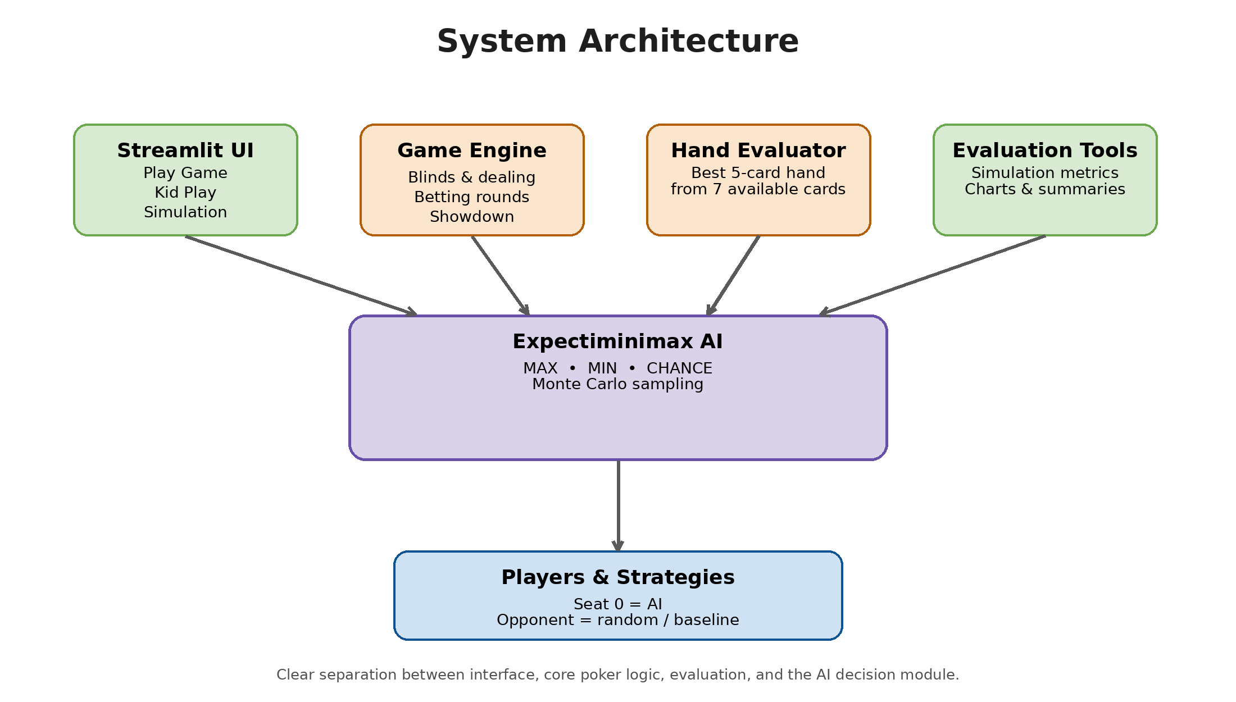
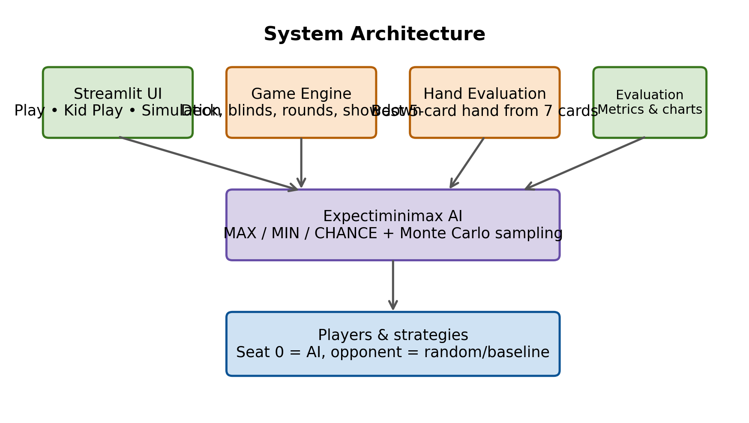
System Architecture
Clean overview of the main components and data flow
UI controls the interaction; the game engine manages each hand; the AI reasons over actions under uncertainty.
Group 7 | Kazi Eraj Al Minahi Turjo • Md. Sabbir Hossain • Nashita Tasneem Noor • Talha Imtiaz
Notes:
Walk from top to bottom. Emphasize modular design: UI, engine, evaluator, AI, evaluation. This is much clearer than the previous unreadable diagram.

Slide 4
Game Flow and Core Modules
How a hand progresses inside the simulator
2 private cards
3 community cards
4th card
5th card
Best hand wins
Pre-flop
Flop
Turn
River
Showdown
Main source files
deck.py: cards and shuffling | player.py: player states and opponent strategy | poker_rules.py: 7-card hand ranking | game_engine.py: flow of each hand | expectiminimax.py: search and EV estimation | evaluation.py: automated simulations | main.py: Streamlit entry point
Group 7 | Kazi Eraj Al Minahi Turjo • Md. Sabbir Hossain • Nashita Tasneem Noor • Talha Imtiaz
Notes:
Explain one hand from dealing to showdown, then mention the code modules that support this flow.

Slide 5
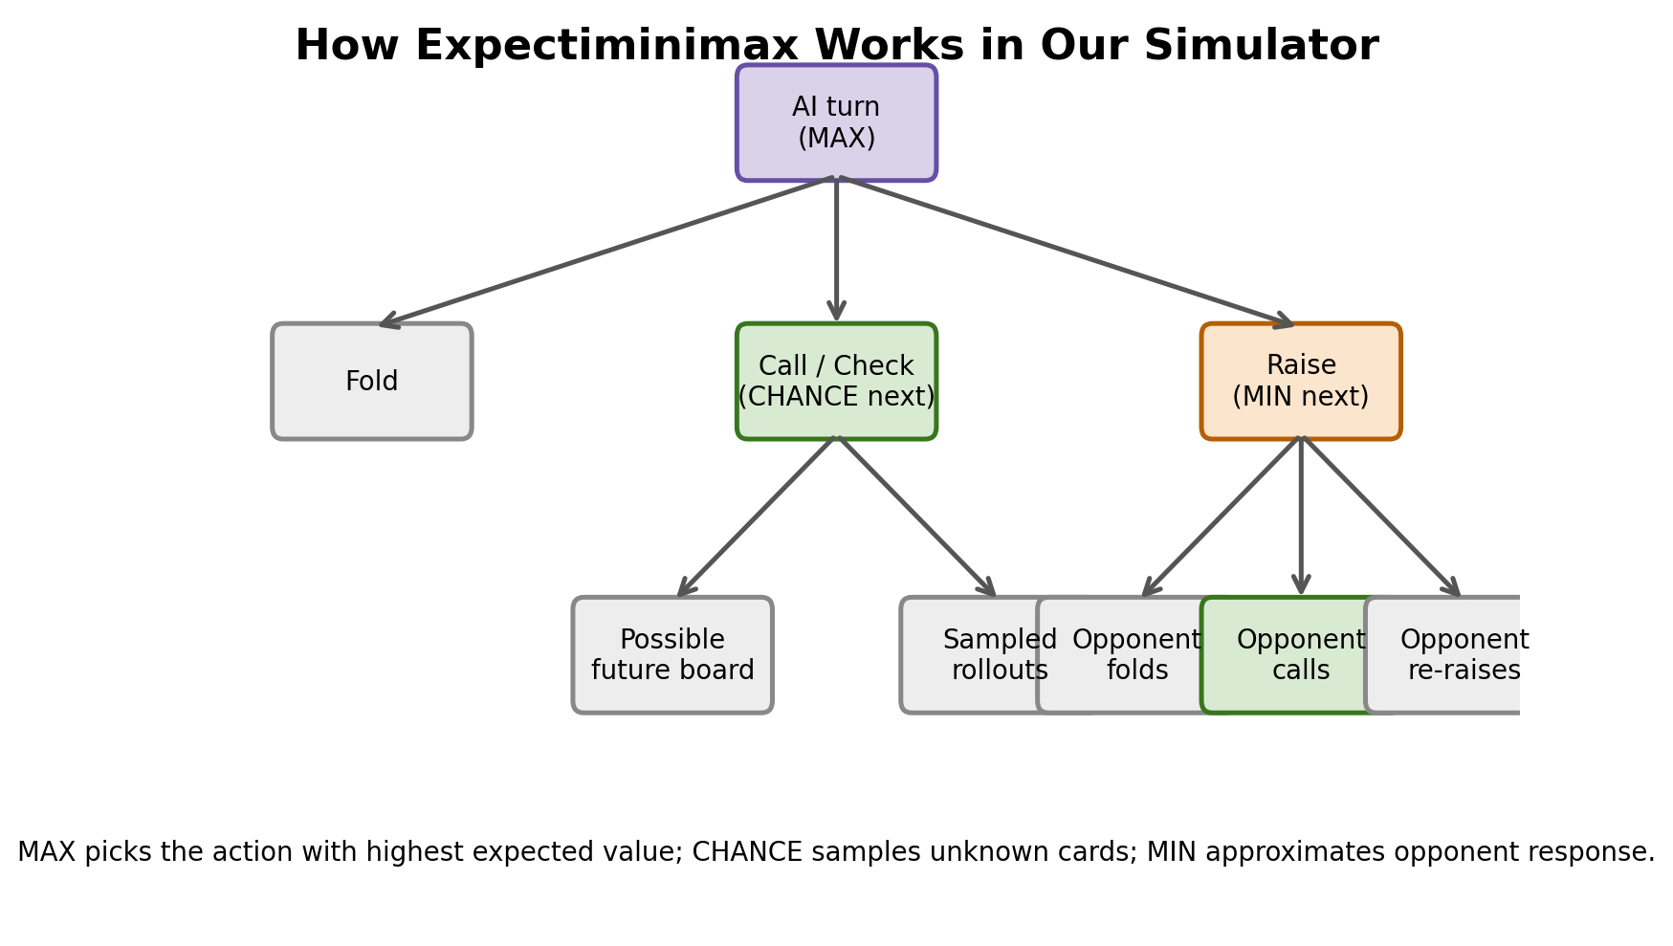
Expectiminimax in Our Simulator
Simple, readable view of the search process
How the AI decides
MAX node: the AI compares fold, call/check, and discrete raise sizes.
MIN node: the opponent response is approximated with a simple policy.
CHANCE node: unknown cards are sampled from the remaining deck.
Leaf evaluation: Monte Carlo rollouts estimate hand strength and expected payoff.
Final choice: the action with the highest expected value is selected.
Group 7 | Kazi Eraj Al Minahi Turjo • Md. Sabbir Hossain • Nashita Tasneem Noor • Talha Imtiaz
Notes:
First say why minimax alone is not enough: poker has randomness. Then explain MAX, MIN, CHANCE and Monte Carlo in one minute. This replaces the unreadable old algorithm figure.

Slide 6
Implementation and User-Facing Features
What the user can actually do in the system
Play Game
Kid Play 🎈
Simulation & Evaluation
Runs a hand between the AI and the opponent.
Shows chips, pot, stage, community cards, and winner.
Displays root decision analysis for AI actions.
Beginner-friendly tab with simpler interaction.
Helps explain poker stages and possible actions.
Useful for demonstration and teaching.
Runs many automated hands.
Reports win rate, profit trends, and decision time.
Lets us compare the AI against a simpler baseline.
Group 7 | Kazi Eraj Al Minahi Turjo • Md. Sabbir Hossain • Nashita Tasneem Noor • Talha Imtiaz
Notes:
This slide replaces screenshot clutter with clear feature cards. Mention that the system is built in Python using Streamlit, pandas, matplotlib, and numpy.

Slide 7
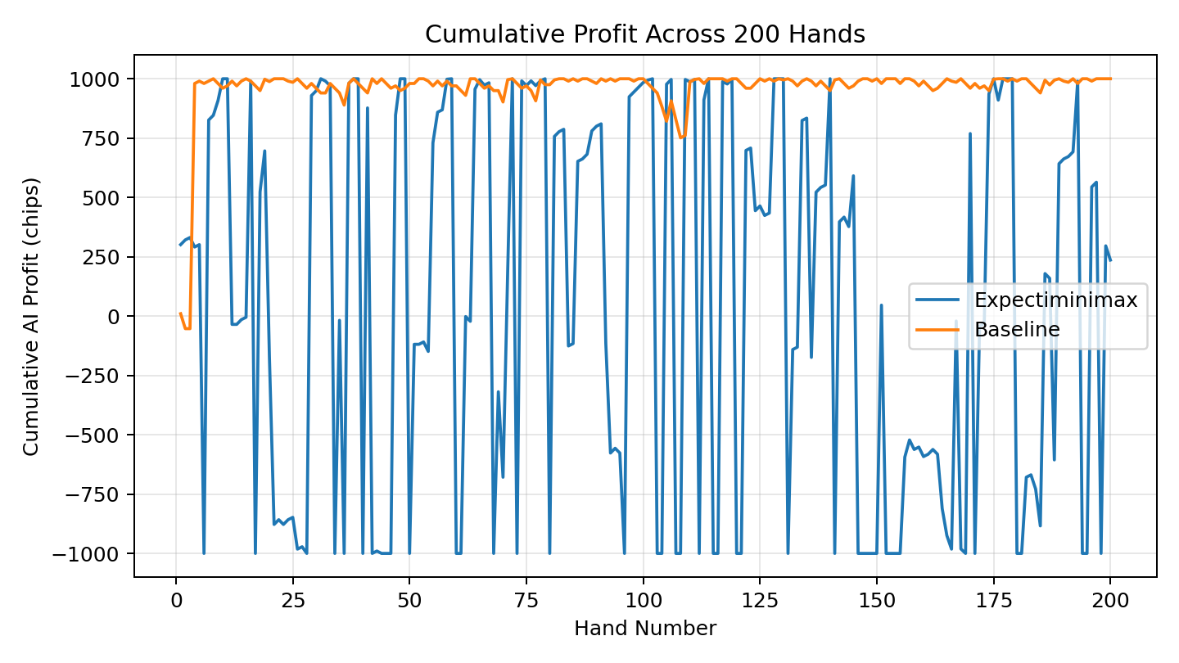
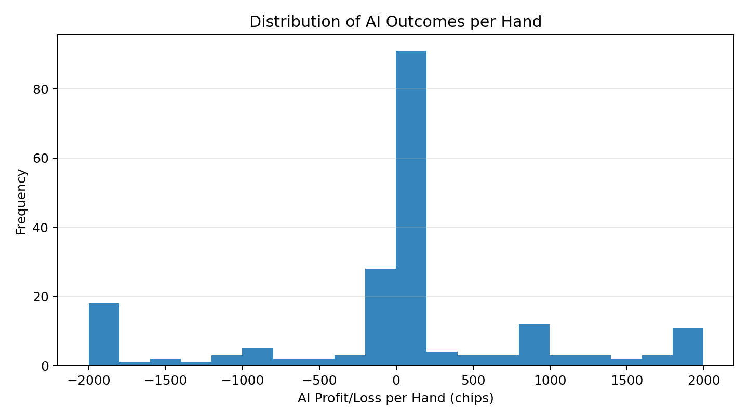
Experimental Evaluation
Representative automated run using the project code
Hands simulated
200
AI vs baseline mode
Expectiminimax win rate
55%
higher than baseline in this run
Avg decision time
0.050 s
more reasoning, higher cost
Group 7 | Kazi Eraj Al Minahi Turjo • Md. Sabbir Hossain • Nashita Tasneem Noor • Talha Imtiaz
Notes:
Mention that these charts were generated from the project simulation code. Highlight cumulative profit and the distribution of per-hand outcomes. Keep wording honest: “representative run”, not overclaiming.

Slide 8
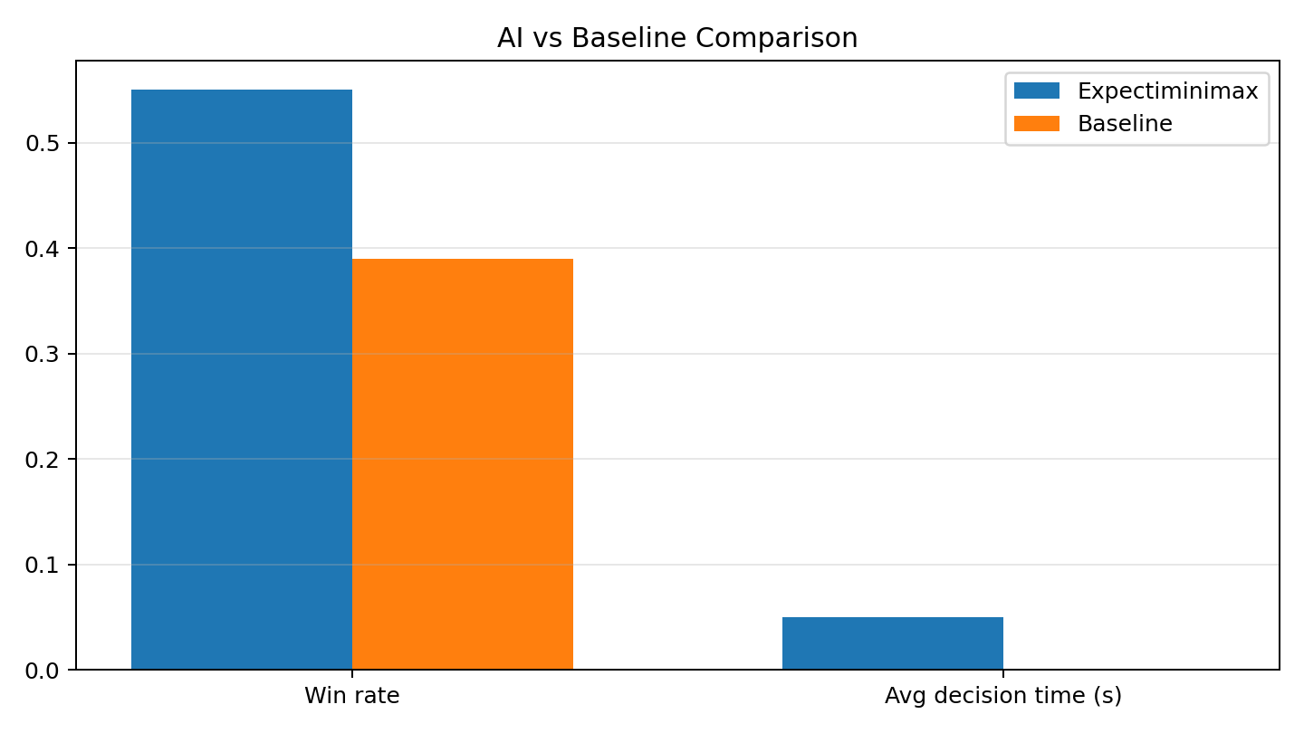
What the Results Tell Us
Expectiminimax gives better strategic quality, but at a higher computational cost
Observations
In our representative run, Expectiminimax achieved a higher win rate than the fallback baseline.
The trade-off is time: search and Monte Carlo sampling make each decision slower.
This is expected because the AI is doing look-ahead reasoning instead of acting greedily.
Increasing depth or samples may improve decision quality, but also increases latency.
Group 7 | Kazi Eraj Al Minahi Turjo • Md. Sabbir Hossain • Nashita Tasneem Noor • Talha Imtiaz
Notes:
Explain the trade-off: smarter decisions vs more computation. This is an excellent discussion slide and more useful than generic “results and analysis” text.

Slide 9
GitHub and Code Walkthrough Map
How we will explain the repository during the code part
Code explanation plan
main.py ├── poker_ai/ │ ├── deck.py │ ├── player.py │ ├── poker_rules.py │ ├── game_engine.py │ ├── expectiminimax.py │ ├── evaluation.py │ ├── visualization.py │ └── kid_ui.py ├── data/ ├── support/ └── others/
1. Show the repo home page and README first.
2. Open main.py to show tab structure and application entry point.
3. Open game_engine.py to explain hand flow and showdown.
4. Open expectiminimax.py to explain MAX / MIN / CHANCE and EV.
5. Open evaluation.py to show simulation logic and metrics generation.
6. Finally, show others/ and the one-minute demo video.
Group 7 | Kazi Eraj Al Minahi Turjo • Md. Sabbir Hossain • Nashita Tasneem Noor • Talha Imtiaz
Notes:
This slide is useful because sir explicitly checks repo organization and code walkthrough. It helps us present smoothly and in order.

Slide 10
Limitations and Future Work
What can be improved next
Current limitations
Future improvements
Simplified heads-up game setting.
Opponent model is basic rather than fully adaptive.
Search depth and sampling are limited to keep the UI responsive.
The evaluation is representative, not a full tournament-scale benchmark.
Stronger opponent modeling based on observed play style.
Alpha-beta style pruning or better abstractions for speed.
Richer GUI and more polished analytics dashboard.
Reinforcement learning or self-play for further improvement.
Group 7 | Kazi Eraj Al Minahi Turjo • Md. Sabbir Hossain • Nashita Tasneem Noor • Talha Imtiaz
Notes:
Keep this short and honest. These improvements are easy to justify and align with AI course expectations.

Slide 11
Conclusion
Final take-away
Summary
We developed a modular poker simulator that supports complete hand flow, hand evaluation, and an Expectiminimax-based AI.
The key contribution is showing how AI search can be adapted to an uncertain environment using chance nodes and Monte Carlo sampling.
Our results show a meaningful trade-off: better strategic quality than a simple baseline, but with higher computation time.
Overall, the project demonstrates practical AI decision-making under uncertainty in a clear, interactive application.
Thank you — Questions are welcome
Group 7 | Kazi Eraj Al Minahi Turjo • Md. Sabbir Hossain • Nashita Tasneem Noor • Talha Imtiaz
Notes:
Wrap up with the four points on screen and then stop. The Q&A happens after the code/demo part, but this works as a clean closing slide for the PPT section.

