Slide 1

Efficient Single-Image
Super-Resolution
Using SRCNN
CSE445 Machine Learning • Section 07 • Group 04
Project objective: reconstruct 256×256 images from 64×64 low-resolution inputs at 4× scale.
Members
Kazi Eraj Al Minahi Turjo — 1831906642
Shamira Hossain Mila — 2111089642
Salman Khan Fahim — 2031558642
Group 04 | Kazi Eraj Al Minahi Turjo • Shamira Hossain Mila • Salman Khan Fahim
CSE445 • Section 07

Slide 2
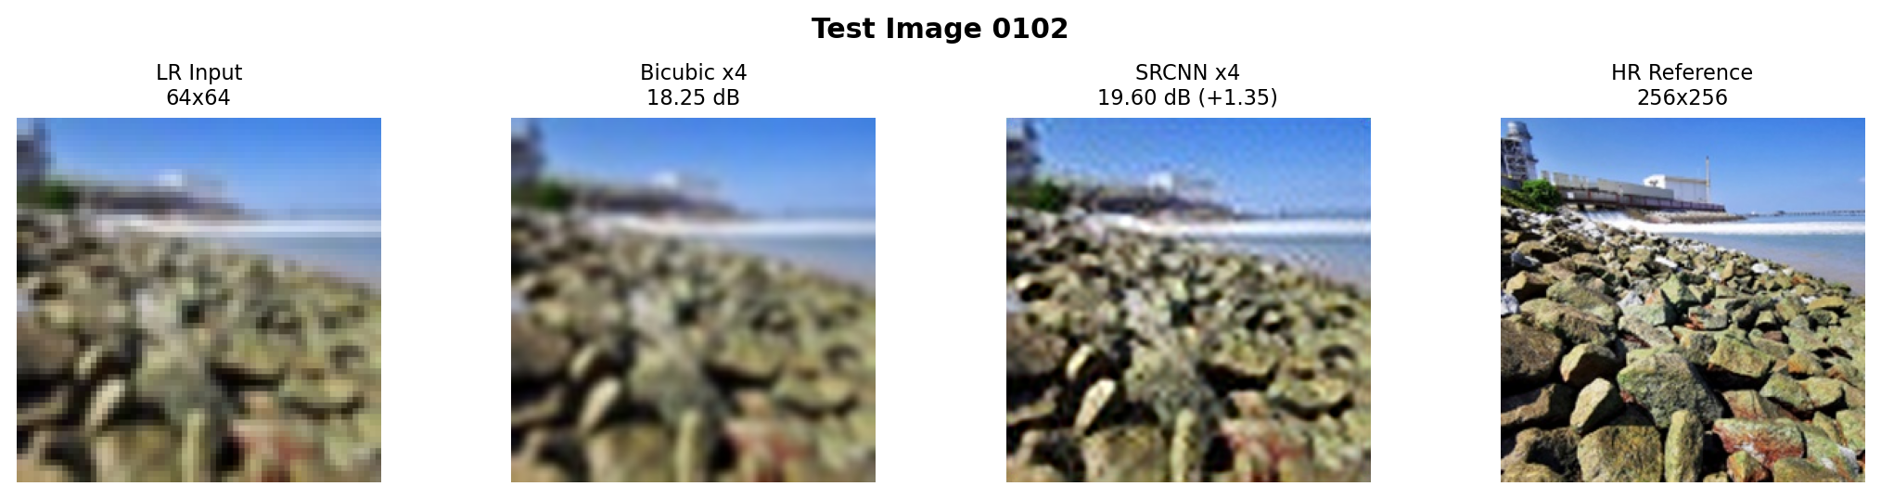
What problem are we solving?
Low-resolution inputs lose local details; super-resolution tries to recover a sharper high-resolution image.
Goal
Baseline
Evaluation
Learn a supervised mapping from 64×64 LR input to 256×256 HR output using paired examples.
Bicubic interpolation performs fixed mathematical resizing without learning image structure.
SRCNN output is compared against the HR reference using PSNR, then visually inspected.
Group 04 | Kazi Eraj Al Minahi Turjo • Shamira Hossain Mila • Salman Khan Fahim
CSE445 • Section 07

Slide 3
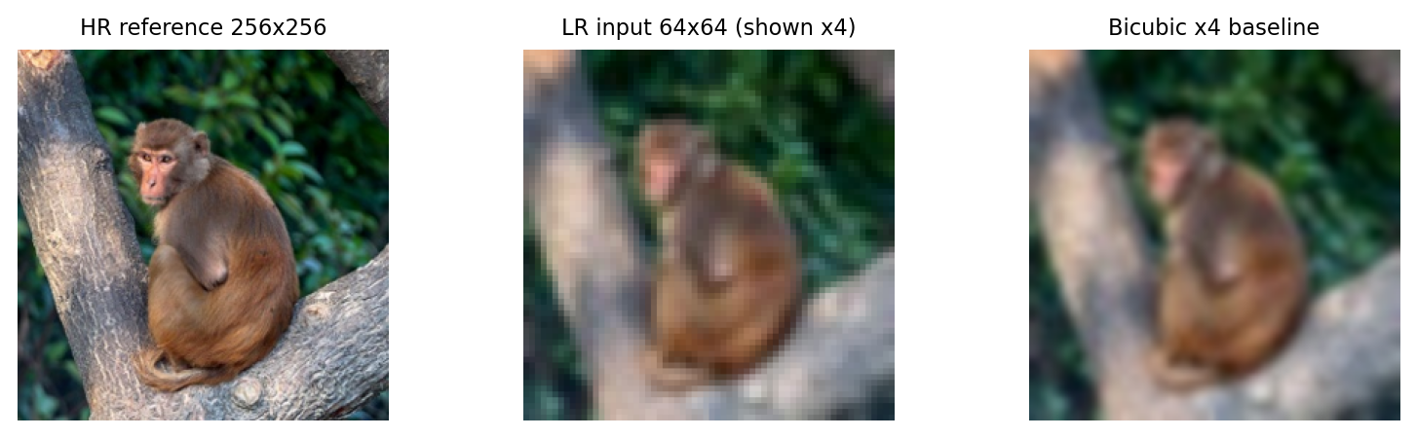
Project workflow
The implementation is built as a small, reproducible image-restoration pipeline.
HR image
256×256
Downscale
64×64
Bicubic
256×256
SRCNN
refinement
PSNR +
comparison
→
→
→
→
Key idea: the network does not create a new scene. It learns how to improve a resized image by restoring texture and edge-like patterns from training examples.
This is why both numerical score and visual inspection are needed.
Group 04 | Kazi Eraj Al Minahi Turjo • Shamira Hossain Mila • Salman Khan Fahim
CSE445 • Section 07

Slide 4

Dataset and preprocessing
A fixed paired dataset was used for training, validation and final testing.
Dataset split
Image sizes
90 training images
10 validation images
10 test images
HR target: 256×256
LR input: 64×64
Scale factor: ×4
Training patches
32×32 LR patches paired with 128×128 HR patches.
Augmentation
New evaluation/demo images
Horizontal flips, vertical flips and 90° rotations increase variation without changing the target relationship.
Used for presentation-facing comparison and generalization analysis
Group 04 | Kazi Eraj Al Minahi Turjo • Shamira Hossain Mila • Salman Khan Fahim
CSE445 • Section 07

Slide 5
SRCNN model used in the project
A shallow CNN refines the bicubic-upscaled input into the final 256×256 output.
LR input
64×64
Bicubic ×4
256×256
Conv 9×9
3 → 64 + ReLU
Conv 5×5
64 → 32 + ReLU
Conv 5×5
32 → 3
SRCNN output
256×256
→
→
→
→
→
Feature extraction
Non-linear mapping
Reconstruction
First layer captures local patches such as edges, corners and color transitions.
Middle layer maps low-resolution features into richer high-resolution representations.
Final layer produces the RGB image used for evaluation and comparison.
Model size: 69,251 trainable parameters
Group 04 | Kazi Eraj Al Minahi Turjo • Shamira Hossain Mila • Salman Khan Fahim
CSE445 • Section 07

Slide 6
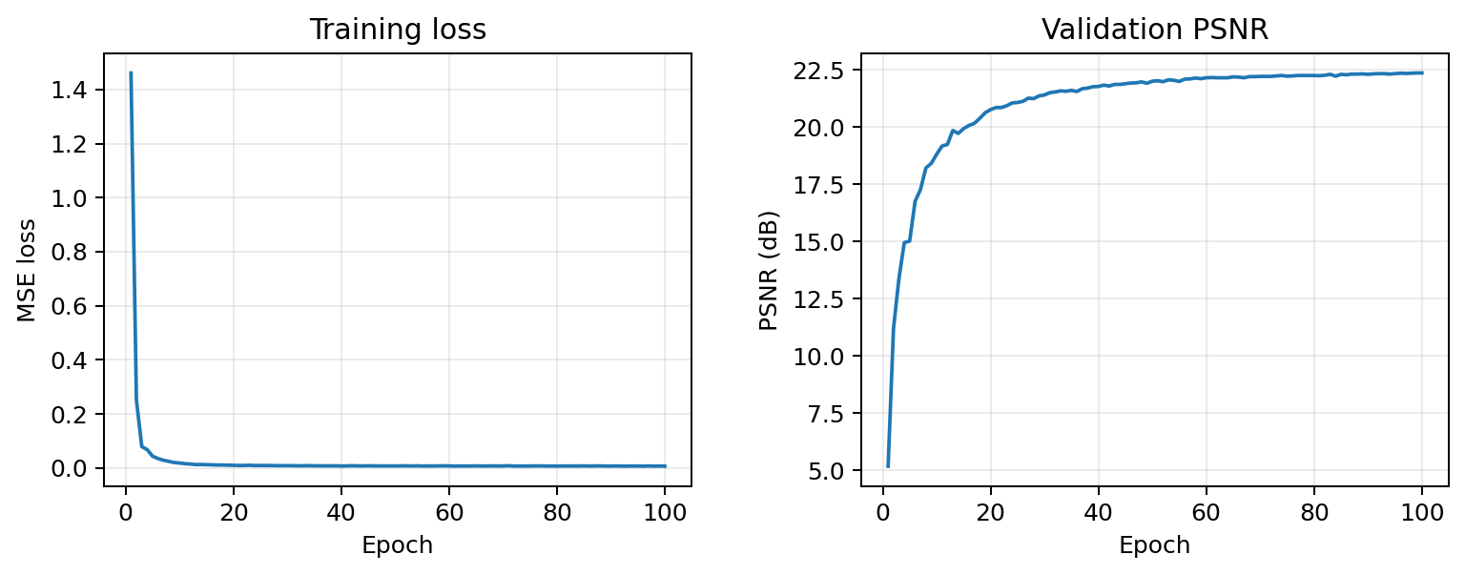
Training setup
The model was trained with a simple reproducible configuration and checkpoint selection.
Configuration
Loss: Mean Squared Error
Optimizer: Adam, learning rate 1e−4
Scheduler: StepLR, step 30, gamma 0.5
Epochs: 100
Batch size: 16
Observed behavior
22.36 dB
The largest improvement happens in the early epochs. Later epochs mostly refine the learned filters, so validation PSNR stabilizes.
Best validation PSNR
Group 04 | Kazi Eraj Al Minahi Turjo • Shamira Hossain Mila • Salman Khan Fahim
CSE445 • Section 07

Slide 7
Quantitative result
On the fixed project test set, SRCNN improves average PSNR over bicubic interpolation.
Bicubic ×4
SRCNN ×4
Improvement
23.05 dB
24.07 dB
+1.02 dB
average test PSNR
average test PSNR
average PSNR gain
Per-image PSNR gain (dB)
Strongest gain: image 0107 → +2.63 dB
All ten project-test images improved over bicubic in PSNR, which supports the model’s usefulness inside the trained distribution.
0100
0101
0102
0103
0104
0105
0106
0107
0108
0109
Group 04 | Kazi Eraj Al Minahi Turjo • Shamira Hossain Mila • Salman Khan Fahim
CSE445 • Section 07

Slide 8
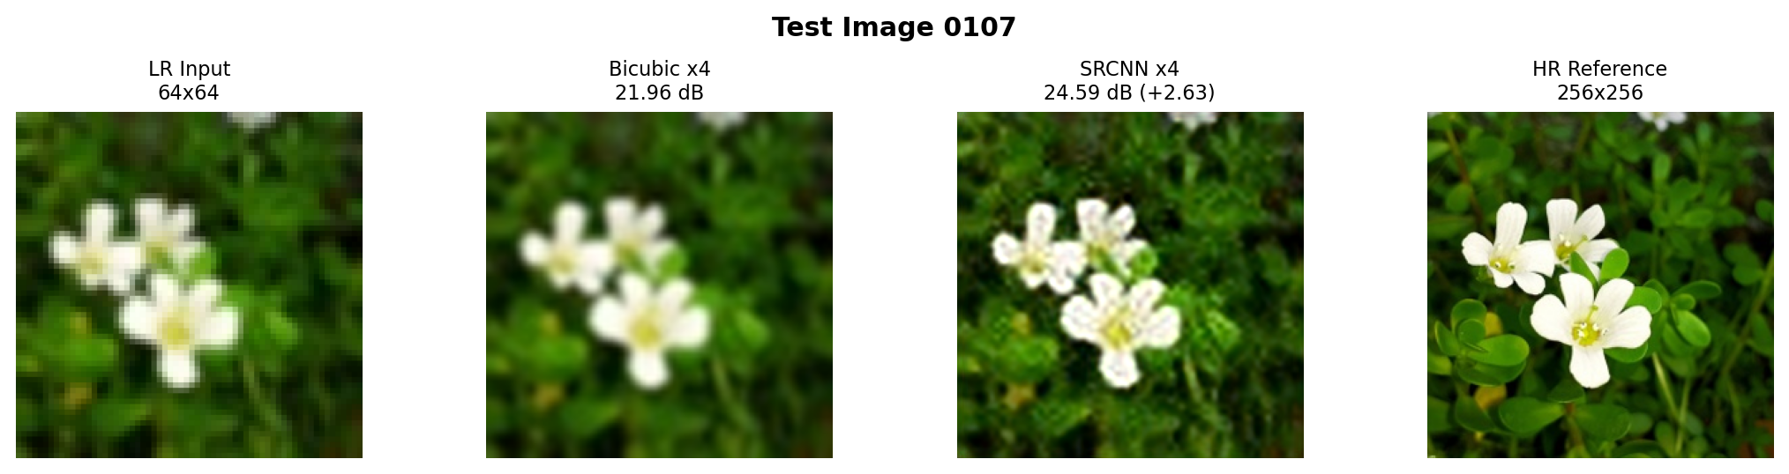
Visual result from the project test set
The strongest example shows why the learned model is useful inside the trained distribution.
Observation
Measured gain
Honest interpretation
SRCNN recovers sharper structure than bicubic and gives the largest PSNR gain in the test set.
Bicubic: 21.96 dB
SRCNN: 24.59 dB
Gain: +2.63 dB
The model improves the degraded image, but it still cannot fully reproduce the original HR reference.
Group 04 | Kazi Eraj Al Minahi Turjo • Shamira Hossain Mila • Salman Khan Fahim
CSE445 • Section 07

Slide 9
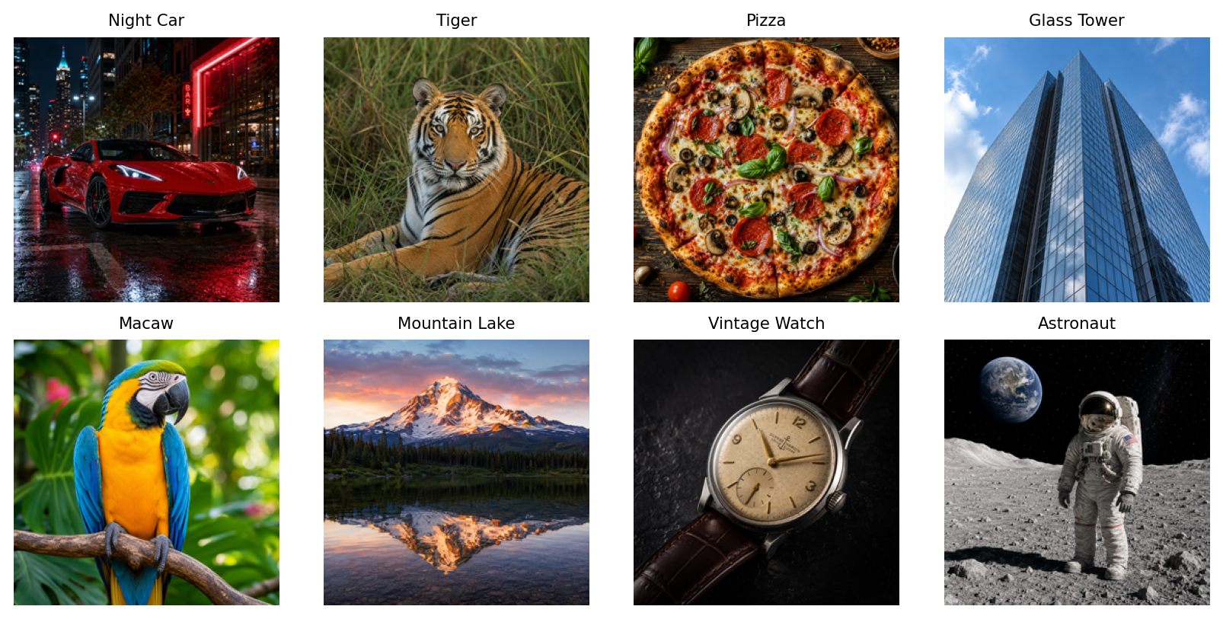
New image set: presentation and stress testing
These images make the project visually different and also test how the model behaves outside the original distribution.
Why this set was added
The old report images were replaced with a much broader set: car, tiger, pizza, glass tower, macaw, mountain lake, watch and astronaut.
What the stress test showed
On these unfamiliar images, bicubic often scores higher. This is not a failure to hide; it is a valid ML limitation caused by domain shift.
Final takeaway: SRCNN improves the project-test distribution, but larger and more diverse training data is needed for stronger generalization.
Group 04 | Kazi Eraj Al Minahi Turjo • Shamira Hossain Mila • Salman Khan Fahim
CSE445 • Section 07

Slide 10
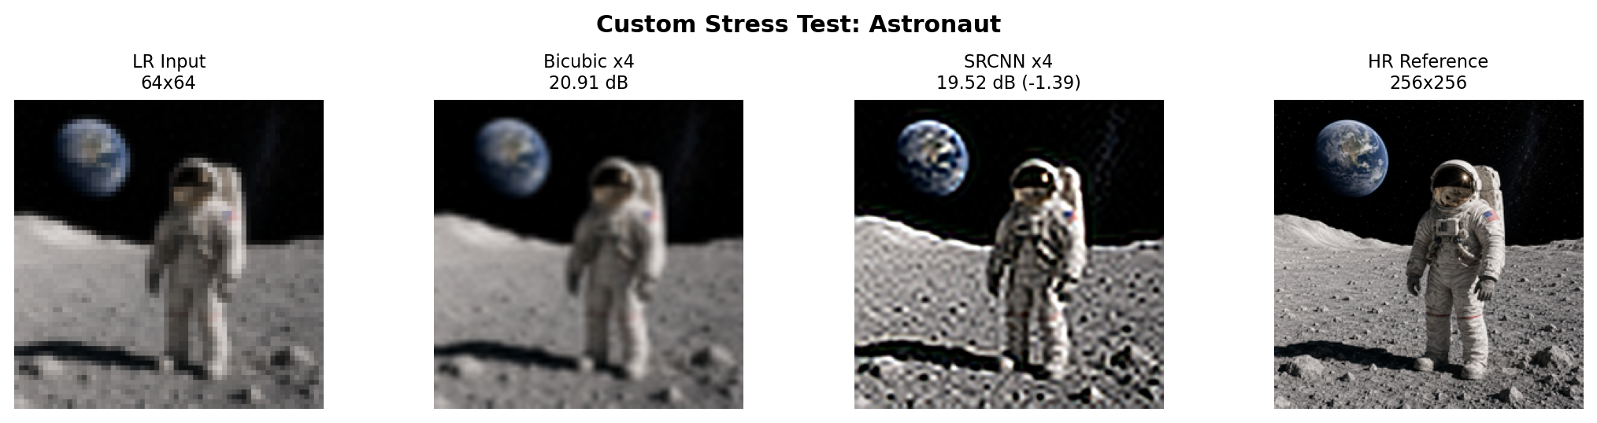
Limitations & Future Work
Limitations
Future Work
Small dataset limits generalization
Model works best on the trained image style
PSNR does not always match human visual quality
Some new demo images are too different from training data
Use a larger and more diverse dataset
Compare with VDSR, EDSR or ESRGAN
Add SSIM/perceptual quality metrics
Build a simple interface for real image testing
Project test-set example
Different-domain stress test
Group 04 | Kazi Eraj Al Minahi Turjo • Shamira Hossain Mila • Salman Khan Fahim | CSE445 • Section 07

Slide 11
Conclusion
SRCNN successfully improved:
Average test PSNR: 23.05 dB → 24.07 dB
Best visual/test improvement: +2.63 dB
Sharper edges and textures than bicubic interpolation
A complete pipeline from LR input to evaluation output
Final message
Best test-set comparison
The project shows that a small CNN can learn useful image-restoration patterns, but stronger real-world performance needs larger training data and deeper super-resolution models.
Group 04 | Kazi Eraj Al Minahi Turjo • Shamira Hossain Mila • Salman Khan Fahim | CSE445 • Section 07

Slide 12
Thank
you.
Questions?
Group 04 | Kazi Eraj Al Minahi Turjo • Shamira Hossain Mila • Salman Khan Fahim | CSE445 • Section 07

