Slide 2
This is an era of profound change.
Notes:
The Internet turns 25 this year, and while its creation changed the world forever, dramatic shifts have occurred even within this quarter century.
Consequently, we are living in an era of profound change.

Slide 3
Implications are massive, change is unavoidable
Users
Applications
Businesses
Users are demanding richer and more personalized experiences.
Yet, at the same time, expecting blazing fast load time.
Mobile and HTML5; Data and compute clouds; scaling on demand.
Modern application technologies are fueling the always-on, real-time user expectation.
Businesses are being pushed to react to these changing user expectations…
...and embrace modern application requirements.
Notes:
As new devices are created and used, shifting tech trends alter the way people consume online information. Users are demanding richer and more personalized experiences. Yet, at the same time, expecting blazing fast load time.
Modern application technologies - Mobile and HTML5; Data and compute clouds; scaling on demand - are fueling this always-on, real-time user expectation,
pushing businesses to react to these changing user expectations by embracing modern application requirements.

Slide 4
As a matter of necessity, businesses are going Reactive.

Slide 5
Reactive applications share four traits
Notes:
These new requirements are fueling a new class of Reactive software application that is:
Event-Driven—processing messages in parallel, asynchronously, without blocking.
Scalable—on-demand, across cores, nodes, and clusters; scaling predictably and elastically.
Resilient—recovering and repairing itself automatically for seamless business continuity.
Responsive—rich and engaging, providing instant feedback based on user interactions.
if you look across all the big ecosystem of application development platforms trying to solve these new requirements, there's really no platform that implements all of the four Reactive traits like Typesafe, especially where Resilience is concerned. Most other platforms required the developer to bend over backwards to get it there.
But let’s dive into each trait and take a closer took.

Slide 6
Reactive applications react to changes in the world around them.

Slide 7

Event-Driven
Loosely coupled architecture, easier to extend, maintain, evolve
Asynchronous and non-blocking
Concurrent by design, immutable state
Lower latency and higher throughput
“Clearly, the goal is to do these operations concurrently and non-blocking, so that entire blocks of seats or sections are not locked. We’re able to find and allocate seats under load in less than 20ms without trying very hard to achieve it.”
Andrew Headrick, Platform Architect, Ticketfly
Notes:
The foundation of Reactive applications is an event-driven architecture.
This loosely coupled architecture, is easier to extend; maintain; evolve
Under heavy load it leads to lower latency and higher throughput
More efficient resource utilization and management
Asynchronous sending of events and non-blocking execution of events (benefit statement goes here)
Concurrent by design
Immutable state
Fully reactive: Push instead of Pull plus on-demand execution
Less non-determinism

Slide 8
Reactive applications scale up and down to meet demand.

Slide 9

Scalable
Scalability and elasticity to embrace the Cloud
Leverage all cores via asynchronous programming
Clustered servers support joining and leaving of nodes
More cost-efficient utilization of hardware
“Our traffic can increase by as much as 100x for 15 minutes each day. Until a couple of years ago, noon was a stressful time. Nowadays, it’s usually a non-event.”
Eric Bowman, VP Architecture, Gilt Groupe
Notes:
Event-driven is the foundation for Scalability
It provides the elasticity required to embrace the Cloud, allowing you to scale up or down dynamically
by leveraging all cores with asynchronous programming
What’s really cool is that clustered servers can join and leave nodes dynamically
for more cost-efficient utilization of hardware.

Slide 10
Reactive applications are architected to handle failure at all levels.

Slide 11

Resilient
Failure is embraced as a natural state in the app lifecycle
Resilience is a first-class construct
Failure is detected, isolated, and managed
Applications self heal, avoid cascading failures
“The Typesafe Reactive Platform helps us maintain a very aggressive development and deployment cycle, all in a fail-forward manner. It’s now the default choice for developing all new services.”
Peter Hausel, VP Engineering, Gawker Media
Notes:
Resilience is to a large extent ignored by the industry
If not completely ignored then bolted on afterwards
In a Reactive Application resilience is not an afterthought
but part of the design, and a first class construct in the programming model
Failure will happen – whether you like it or not.
With the Typesafe Reactive Platform, we embrace this as a natural state in the application lifecycle
and not only react to failure but manage it
Delivering applications that self-heal and avoid cascading failures

Slide 12
Reactive applications enrich the user experience with low latency response.

Slide 13

Responsive
Real-time, engaging, rich and collaborative
Create an open and ongoing dialog with users
More efficient workflow; inspires a feeling of connectedness
Fully Reactive enabling push instead of pull
“The move to these technologies is already paying off. Response times are down for processor intensive code–such as image and PDF generation–by around 75%.”
Brian Pugh, VP of Engineering, Lucid Software
Notes:
But all of this is for not if your application is not highly responsive to the user.
Your application must respond in real-time, offering an engaging, rich and collaborative experience
that allows your business to create an open and ongoing dialog with your customers
This is achieved through a more efficient workflow that inspires a feeling of connectedness with a fully Reactive architecture that leverages Push instead of Pull through WebSockets, Server-Sent Events and Streaming APIs.

Slide 14
Reactive is being adopted across a wide range of industries.

Slide 15





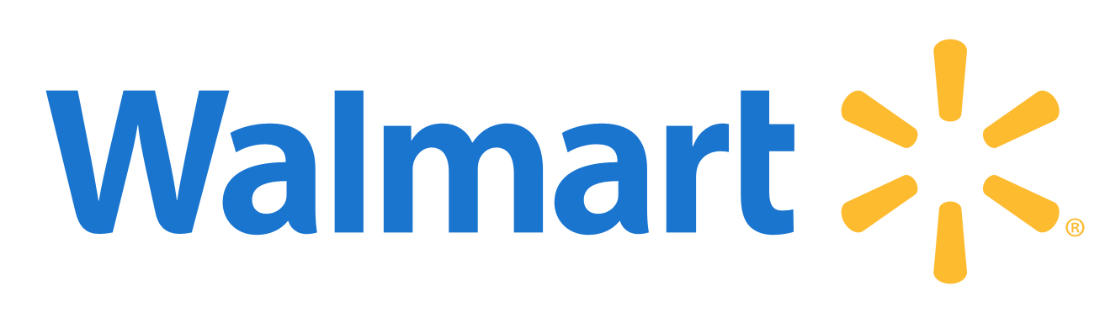










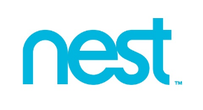

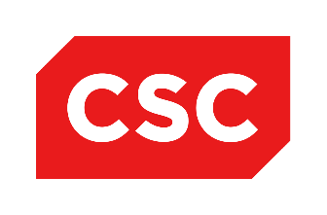














Finance
Internet/Social
Media
Mfg/Hardware
Government
Retail
Notes:
The Typesafe Reactive Platform is a horizontal stack that can be applied across an infinite number of use cases. What’s interesting to note is that In addition to typical early adopters – like Financial Services – industries that historically have been slower to embrace new technologies are making the move to Reactive.
For example,
The Typesafe Reactive Platform is the foundation of The Guardian’s digital first transformation - enabling them to re-architect their monolithic online system into a suite of microservices for more rapid innovation, resilience, and scalability.
It provides Gilt Groupe with the elasticity to handle a two-orders-of-magnitude increase in traffic over the course of a few seconds.
It’s a core component of Predix, GE’s Industrial Internet software platform for running industrial-scale analytics; connecting machines, data, and people.

Slide 16
Reactive is being embraced across a broad software landscape.

Slide 17
Typesafe spearheaded ReactiveManifesto.org with the goal of…
Defining a common vocabulary, both in terms of business values and technical concepts, to make it easier for developers, users, businesses, and vendors to discuss, collaborate, and innovate around this new class of applications.

Slide 18
Typesafe delivers the world’s leading Reactive platform on the JVM.

Slide 19
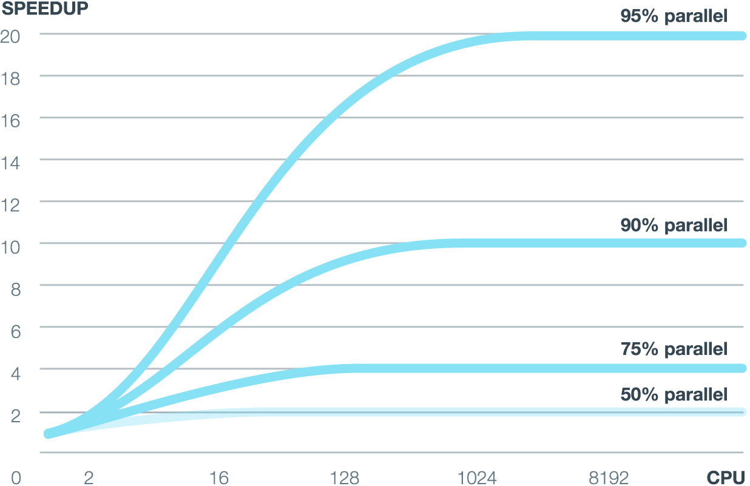
Fully event-driven apps are a necessity
Notes:
To truly implement Reactive applications that can scale up and out elastically, you need a fully event-driven platform, as indicated by Amdahl's Law, a classic computer science theorem, which is illustrated here.
On the horizontal access you see the number of processors - and on the vertical access, you see the speedup you can achieve if your application is parallel, or how much is executed in an event-driven fashion.
If your application is 90 percent parallel, the middle graph here, you can expect about 10 times the speedup of a system over a system that is completely single threaded. But what's really interesting is what you see around 200 or 300 cores and processors; the curve is completely flattening out. This means that even if you add more machines, your application will never, ever run more than 10x faster. Even if you add one million CPUs, it doesn't matter.
If your application is 95 percent parallel, with only 5 percent that's not event driven, you still see that it completely flattens out after about 1000 processors. Adding more processors or more power to your application after that doesn't help at all.
The only way to truly maximize a multicore architectures is by being 100 percent event driven.

Slide 20
Typesafe is event-driven through the entire stack
JVM Based Developer Tools and Runtime
Play Framework for Web Applications
Ideal for Responsive Web Apps
Rest based Services and Web Socket Apps
Supports Java and Scala
Akka Runtime
Highly Scalable Runtime for Java and Scala Applications
Implementation of the Actor Model
Scala Programming Language
Scalable and Performant
Activator
Integrated Console for Application Profiling
Ensures Adopters are Successful from the Start
Notes:
That’s where the Typesafe Reactive Platform comes in. It’s event-driven through the entire stack.
Play Framework is a high-velocity Web framework for Java and Scala.
It's developer-friendly, with a “just hit refresh" workflow. It hot-reloads changes without the need to restart the server. So you can see your modifications immediately, just as in a LAMP or Rails environment.
Play is ideal for responsive Web apps because it’s async and non-blocking out of the box. Plus, It's RESTful by default, with out-of-the-box support for push channels, such as WebSockets. This means you can scale predictably, horizontally, by simply adding new nodes.
The reason Play is Reactive is because it’s built on Akka, so it efficiently uses threads and resources within the system, so it’s event-driven from top to bottom.
Akka, in its most basic definition, is an actor system for managing concurrency on the JVM with both Java and Scala. It has event-driven foundation for all applications you build, and manages your concurrency for you with a built-in resilience supervision model that lets you build truly Reactive applications.
While the Scala programming language is an optional part of the Typesafe Reactive Platform, it is a very important part of our value offering. Scala is an elegant and concise programming language that integrates both functional and object oriented paradigms. Scala lets you be more productive, retain full interoperability with any existing Java infrastructure, and take advantage of modern multicore hardware. Consequently, it’s an excellent programming model for Reactive.
Scala was created around the ideas of Reactive from its inception; it’s functional, has first-class support for callbacks, and provides some great features that ease Reactive development - like type inference, and concurrency distribution - out of the box.

Slide 21
Typesafe is dedicated to delivering developer success.

Slide 22
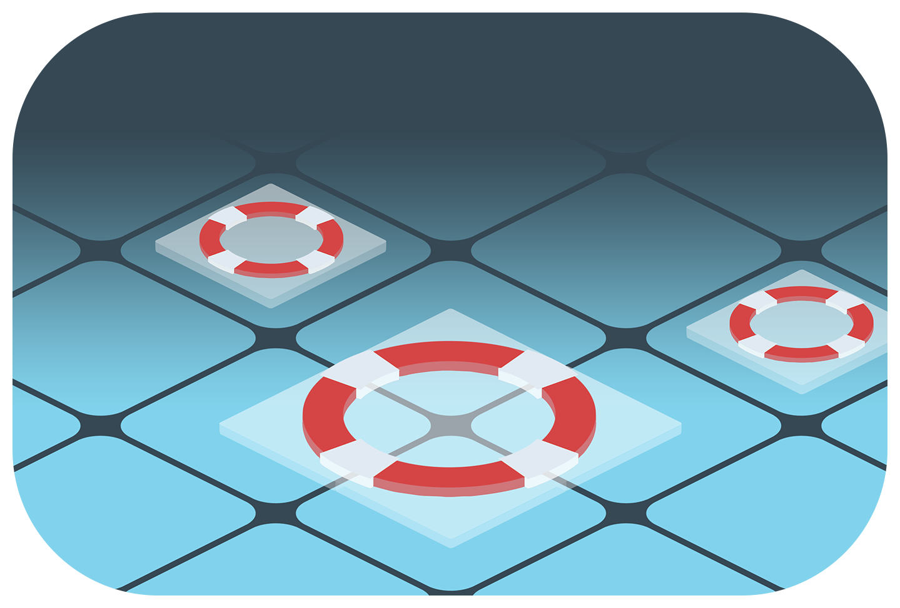
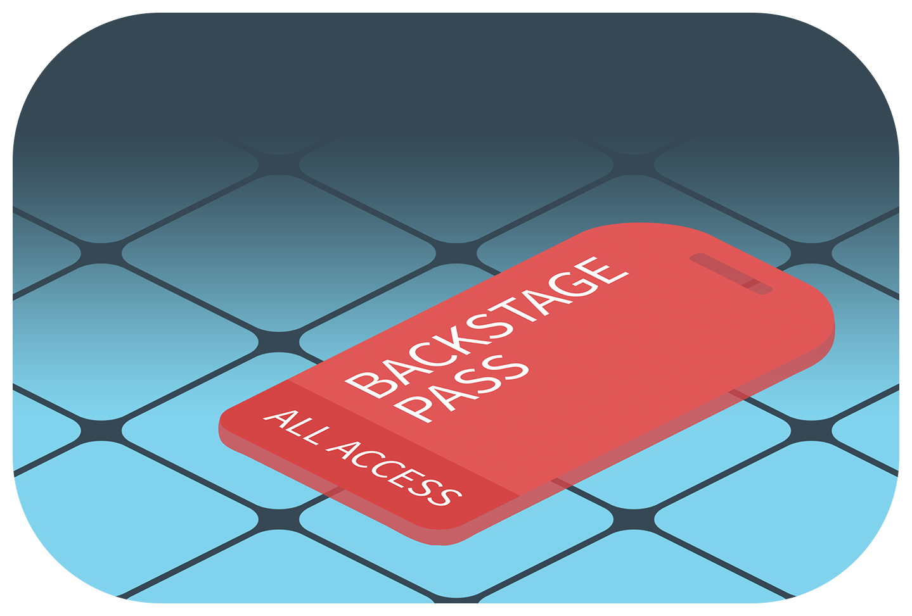
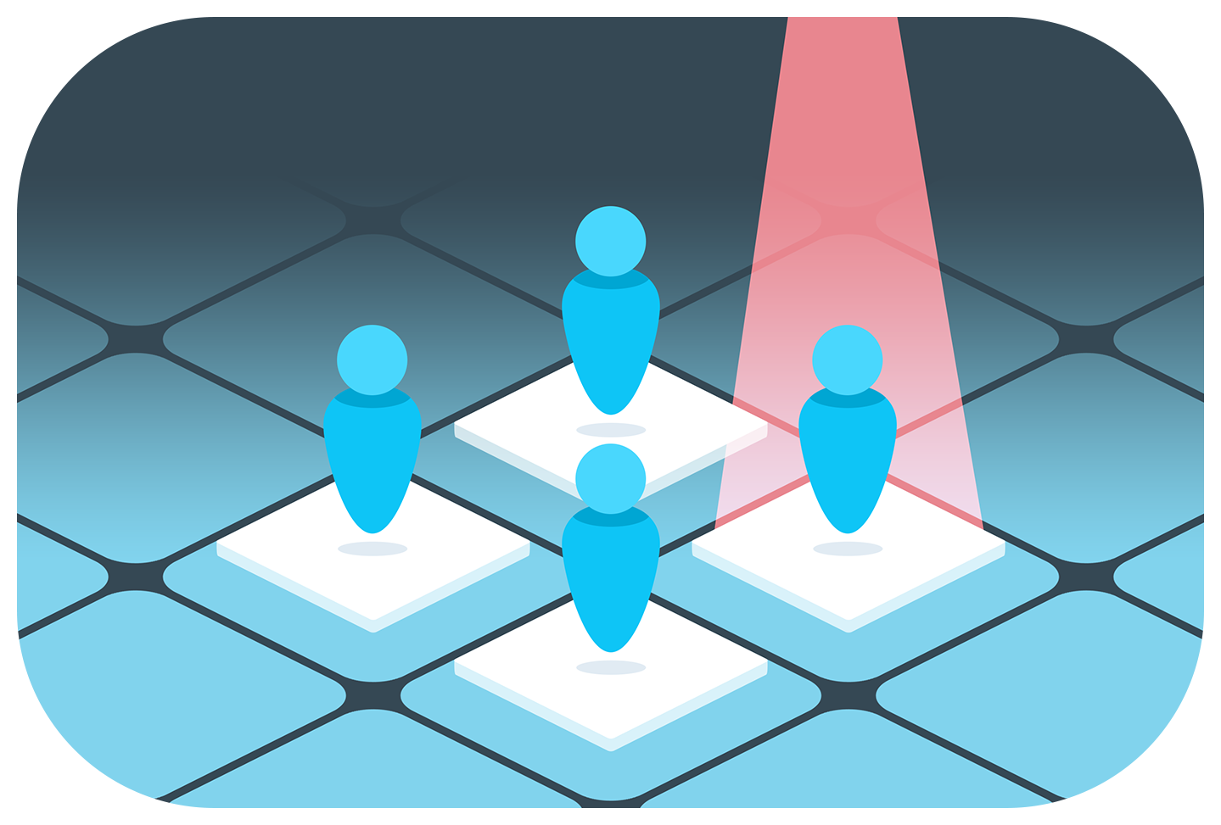
Receive ongoing high value – Typesafe Together
Developer and Production Support
Proactive tips and techniques
Older version maintenance
Security Vulnerability alerts
Backstage Pass
Ask the Expert Webinars
Early access to online courses
Other customer only content
Community Spotlight
Posting of job openings on community page
Projects highlighted on Typesafe content sites
Speaking opportunities at meet ups and conferences
“Scala was new to the group, so having commercial support and training was a big benefit. When we wanted some help with Slick, a Typesafe consultant came out for four hours. We got ten people in the room and got everyone up to speed. That’s the kind of responsiveness and engagement that we really like.” Adam Denenberg, VP Engineering, Huffington Post
Notes:
Typesafe is dedicated to helping developers build Reactive applications on the JVM.
To make going Reactive easier, we created Typesafe Together, a program that delivers ongoing value to developers, with commercial support and maintenance to mitigate risk when your applications launch in production.
We also offer access to training and consulting as well as community spotlight services, helping you gain exposure for your project so you can attract and build a winning team.

Slide 23
Together, we’re bringing Reactive applications to the world!

