Slide 1
Intro to Functional Programming in Scala
Joe Barnes
Senior Software Architect
System Design Division
October, 2013

Slide 2
Overview
Trends in software influencing the popularity
What is different about the paradigm?
How do I apply it?
More about Scala in particular

Slide 3
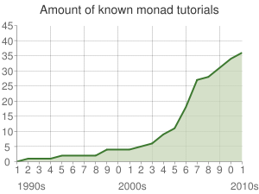
Monad tutorial trend
In functional programming, a monad is a structure that represents computations defined as sequences of steps.¹
The number of monad tutorials has exploded in the past 10 years.
2
¹Source: Wikipedia | Monad (functional programming)
²Source: Haskell.org | Monad tutorials timeline

Slide 4
Moore’s Law
Moore's law is the observation that, over the history of computing hardware, the speed of integrated circuits doubles approximately every two years.
Moore's law is the observation that, over the history of computing hardware, the number of transistors on integrated circuits doubles approximately every two years.
In fact, we’re no longer getting faster…
FALSE

Slide 5
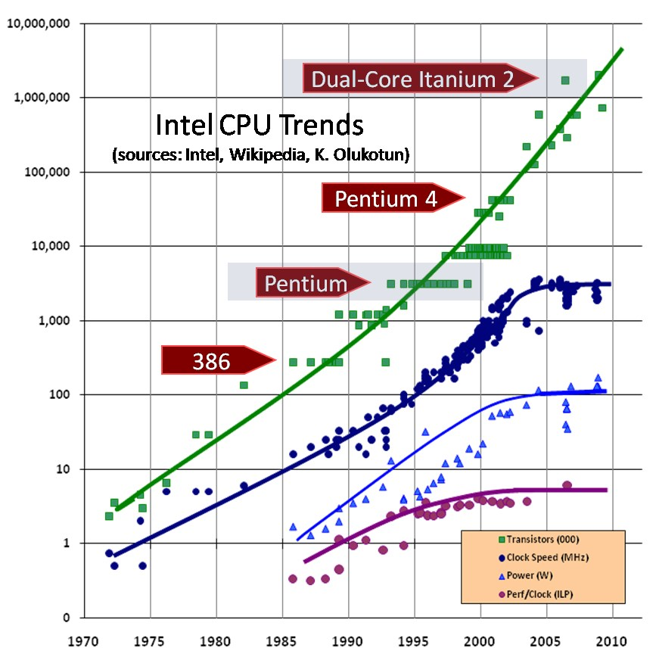
Moore’s Law
Source: Herb Sutter | The Free Lunch Is Over: A Fundamental Turn Toward Concurrency in Software

Slide 6
The free lunch is over!
“ Instead of driving clock speeds and straight-line instruction throughput ever higher, they are instead turning en masse to hyperthreading and multicore architectures”
“Applications will increasingly need to be concurrent if they want to fully exploit continuing exponential CPU throughput gains”
“The vast majority of programmers today don’t grok concurrency, just as the vast majority of programmers [25] years ago didn’t yet grok objects”
Source: Herb Sutter | The Free Lunch Is Over: A Fundamental Turn Toward Concurrency in Software

Slide 7

As Jimmy McMillan would say…
CONCURRENCY
IS TOO DAMN HARD!!!
Source: http://www.troll.me/images/rent-is-too-damn-high/rent-is-too-damn-high.jpg

Slide 8
Why is concurrency hard?
“The programmer must ensure read and write access to objects is properly coordinated (or "synchronized") between threads.”
- Java Concurrency | Wikipedia
“C++ has been designed for single thread programming, and parallel programming requires a revolutionary rather than evolutionary change. Two words: data races.”
- Bartosz Milewski
Source: Java Concurrency | Wikipedia
Source: Edward C++Hands | Bartosz Milewski

Slide 9
Data races: The recipe
A data race occurs when two concurrent threads access a shared variable and when
at least one access is a write and
the threads use no explicit mechanism to prevent the accesses from being simultaneous.
Restated:
Two concurrent threads
At least one write
Mechanism not used
Here to stay
Hmm…
Programmer error. Also here to stay
Source: Eraser: A Dynamic Data Race Detector for Multithreaded Programs | STEFAN SAVAGE, et al

Slide 10

We Want You
To Stop Using Variables
Source: Some random link via Google image search

Slide 11
Revoke My Writes?!
1968 – Structured Programming
Edsger Dijkstra writes “Go To Statement Considered Harmful”
Revoked GoTo
1966 – Object Oriented Programming
Ole-Johan Dahl and Kristen Nygaard create Simula 67
Revoked function pointers
1957 – Functional Programming
John McCarthy creates Lisp
Revoked reassignment of variables values
Source: Three Paradigms | Uncle Bob @ 8th Light

Slide 12
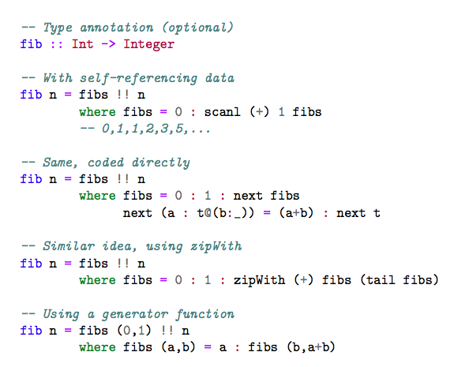
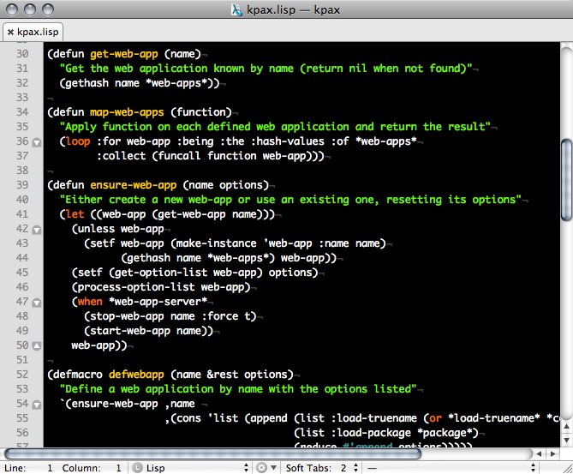
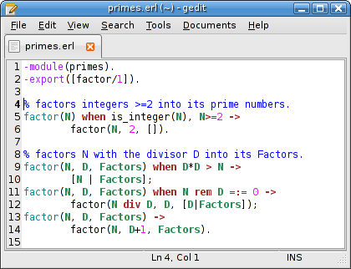
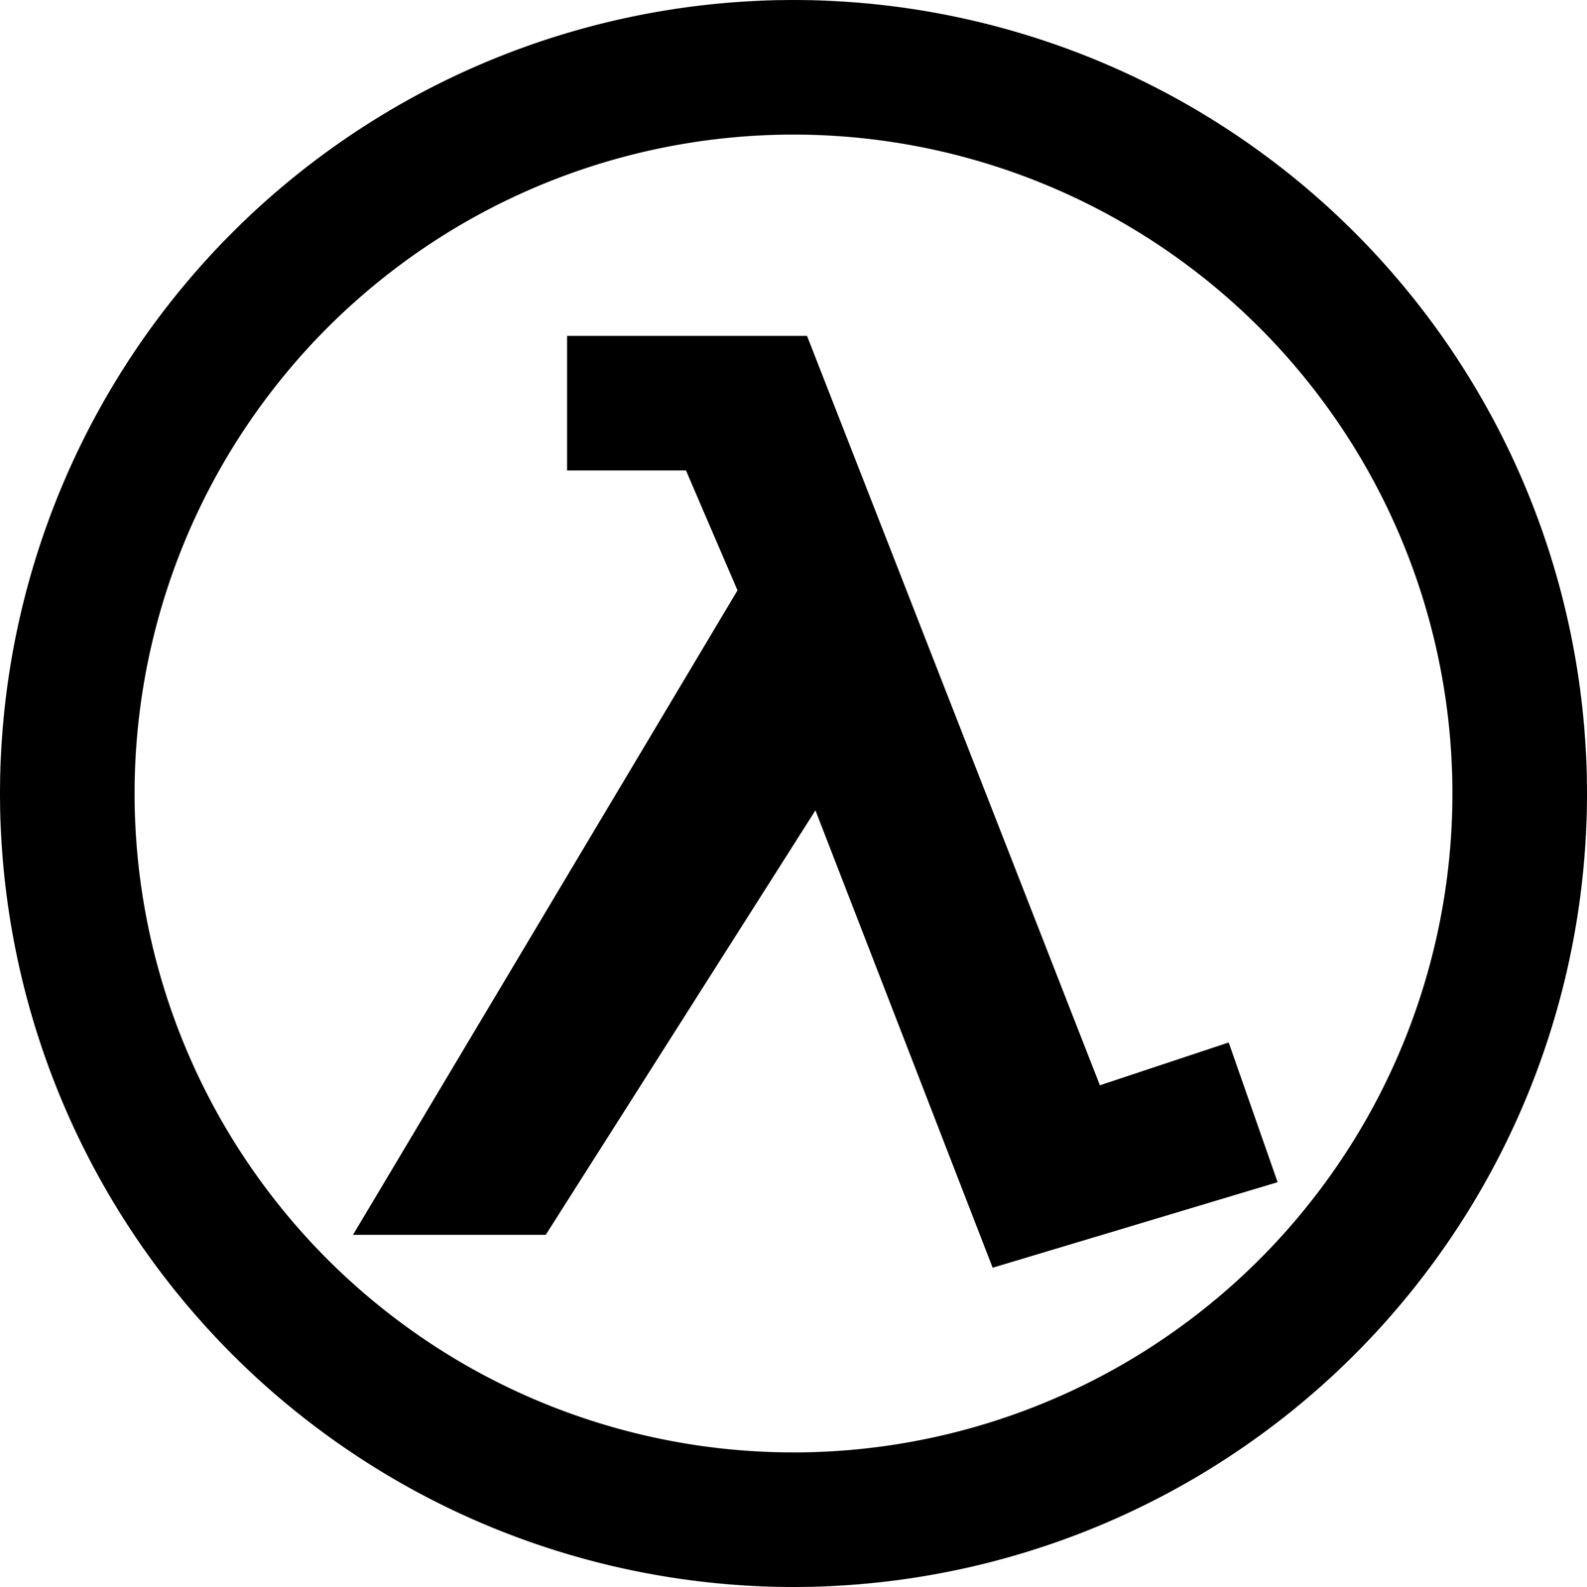
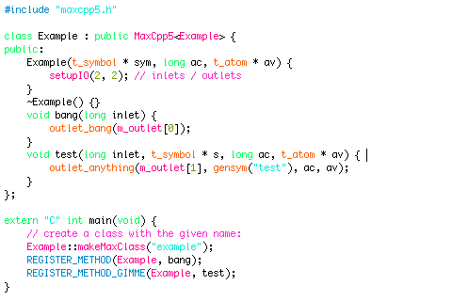
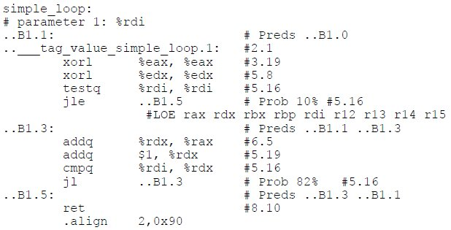
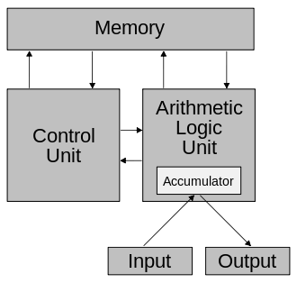
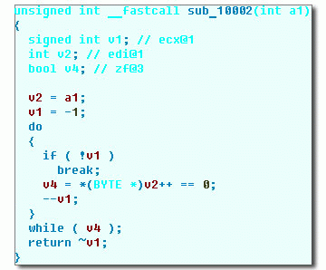
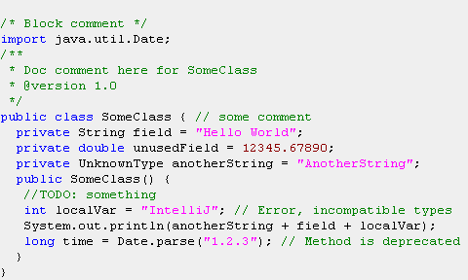
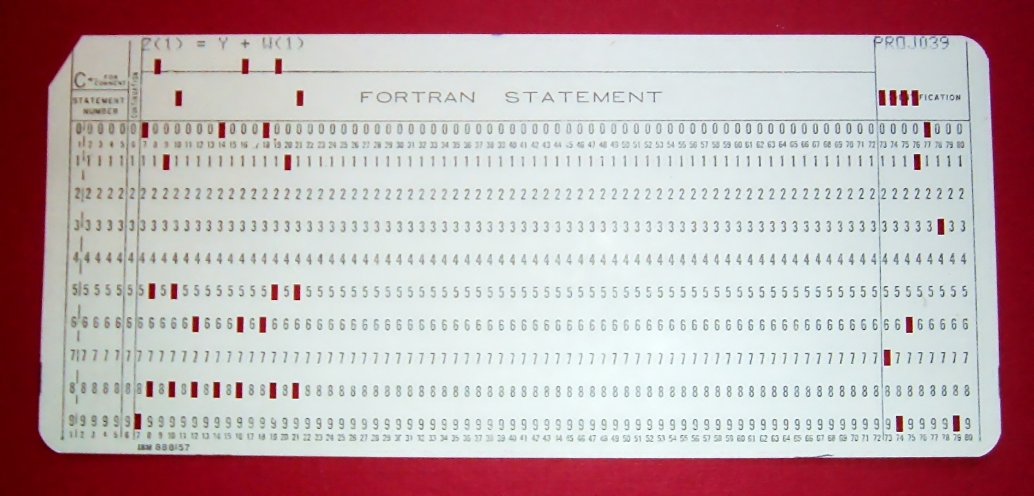
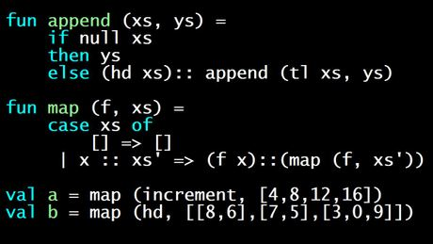
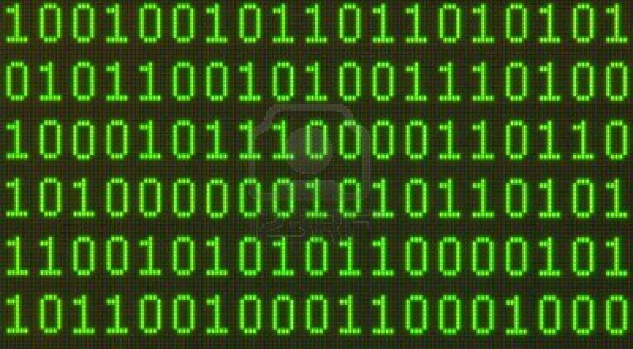
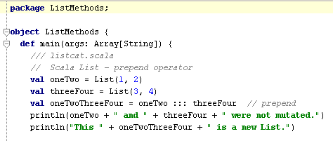
Two timelines
“Higher”
Levels
Theory
To
Practice
Source: Several random links via Google image search

Slide 13
Dichotomies
Von Neumann vs. Lambda Calculus
Manipulation of program state vs. Evaluation of mathematical formulas
Object-oriented vs. Functional?
False dichotomy per Martin Odersky (BDFL of Scala).
Object-orientation and functional are perpendicular.
Scala is both.
Imperative vs. Functional
The dichotomy defined along the assignment axis.

Slide 14

That’s right. You have no writes.
ALL YOUR WRITES
ARE BELONG TO US!

Slide 15
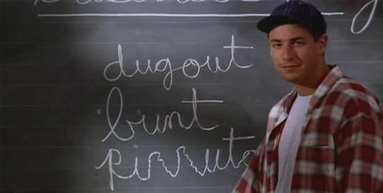
How can we program this way?
Back to school…
What is a function?

Slide 16
Function
Given a set S and a set T, a function f is a set of ordered pairs taken from S ×T where each s from S appears exactly once in f.
Given (s, t) ∈ f, we denote f(s) = t. f is said to “map s to t.”
Functions a.k.a. “mappings”
Given s ∈ S, f(s) is a defined value also known as t.
Can substitute the expression f(s) with t
Referential Transparency!

Slide 17
Function (visual)
S
T
A
B
C
D
E
F
1
2
3
4
5
f
f = { (1,D), (2,F), (3,A), (4,F), (5,C) }
f (1) ⬄ D, f (2) ⬄ F, f (3) ⬄ A, …
Identify any mutable state.

Slide 18
Programming with only functions (Bash)
OK, so how do we program with functions?
Notice this script/program doesn’t have mutable state
$ find . -name *.java | xargs grep -l "function" | wc –l

Slide 19
Programming with only functions (Excel)
fx = DIVIDE(SUM(-C2, C3),D3)
= DIVIDE(SUM(-158907, 159165),19.742)
= DIVIDE(258,19.742)
= 13.07

Slide 20
Referential Transparency
Find the roots/zeros of the equation ax ² + bx + c.
object Math {
def roots(a:Double, b:Double, c:Double) = {
val discriminant = sqrt(b*b - 4*a*c)
val root1 = (-b - discriminant) / (2*a)
val root2 = (-b + discriminant) / (2*a)
(root1, root2)
}
}

Slide 21
Partial ordering of evaluation
a
b
c
discriminant
Can run in parallel!
root1
root2
(root1, root2)

Slide 22
Yeah, but sometimes we need variables
Produce the first 25 even natural numbers.
public class EvensJava {
public static List<Integer> first25() {
List<Integer> squares = new ArrayList<Integer>();
for(int i=1; i<=25; i++)
squares.add(i*2);
}
}
FALSE

Slide 23
Squares without variables: Scala
object EvensScala extends App {
val first25 = (1 to 25).map { i => i*2 }
}
object EvensScala extends App {
val first25 = (1 to 25).map(_*2)
}
object EvensScala extends App {
val first25 = (1 to 25).par.map(_*2)
}

Slide 24
Calculate factorial: Java
public class FactorialJava {
public int looped(int n) {
if(n < 0) throw new IllegalArgumentException("n < 0");
int factorial = 1;
for(int i=1; i<=n; i++)
factorial *= i;
return factorial;
}
public int recursive(final int n) {
if(n < 0) throw new IllegalArgumentException("n < 0");
if(n <= 1) return 1;
else return n * recursive(n-1);
}
}

Slide 25
Calculate factorial: Scala
class FactorialScala {
def recursive(n:Int):Int = {
require(n >= 0, "n < 0")
if(n <= 1) 1
else n * recursive(n-1)
}
def reduced(n:Int):Int = {
require(n >= 0, "n < 0")
(1 to n).reduceLeftOption(_ * _).getOrElse(1)
}
}

Slide 26
First n primes: Java
public class PrimesJava {
public List<Integer> first(int n) {
List<Integer> primes = new LinkedList<Integer>();
for(int i=2; primes.size() < n; i++) {
if(isPrime(i)) primes.add(i);
}
return primes;
}
public boolean isPrime(int n) {
boolean isPrime = true;
for(int i=2; i<n; i++) {
if(n % i == 0) {
isPrime = false;
break;
}
}
return isPrime;
}
}

Slide 27
First n primes: Scala
class PrimesScala {
def isPrime(n:Int) =
(2 to (n-1)).forall {
i => n % i != 0
}
def first(n:Int) = Stream.from(2).
filter(isPrime(_)).take(n)
}

Slide 28
Persistent data structures
class Prepend extends FunSuite {
test("Prepend produces new instance") {
val oneTo3 = List(1, 2, 3)
val zeroTo3 = 0 +: oneTo3
assert(oneTo3.size == 3)
assert(zeroTo3.size == 4)
assert(oneTo3 != zeroTo3)
}
}

Slide 29
But isn’t that inefficient??
val oneTo3 = List(1, 2, 3)
oneTo3
0
1
2
3
zeroTo3
val zeroTo3 = 0 +: oneTo3

Slide 30
So why Scala?
Compiles to plain-ol’ JVM byte code
Fully interoperable with Java
Leverage solid existing Java technologies
Platform-independent
Multi-paradigm
Arguably more OO than Java
No primitives
No static
Multiple inheritance
Even functions are objects!
Idiomatically functional, but not strictly
Can declare a var
Be productively quickly, learn new paradigm gradually

Slide 31
So why Scala, continued…
Statically-typed with dynamically-typed syntax features
Richer type system than Java (Turing complete)
Type inference
Implicit conversions
Pattern matching
Malleable syntax allows domain-specific languages (DSL)
All of the aforementioned advantages of functional programming
Multi-processor scaling
High-productivity
Dynamically-typed syntax features
Typically takes one half to one third of the lines of code as Java¹
¹Source: Research: Programming Style and Productivity | scala-lang.org

Slide 32
Yay! The world’s problems solved!
No backwards compatibility across major releases
Ex. Scala 2.9.x byte code incompatible with 2.10.x byte code
Have to find and possibly recompile libraries to advance
Deprecated features get obsoleted
Compiler slower than Java
Does MUCH more for the developer than Java (see type system)
Defacto build tool (sbt) keeps compiler in memory which helps
Less mature
Tooling isn’t as stable

Slide 33
Java/Scala timeline
1995 – Java 1.0 released by Sun.
1995 – Odersky begins work on OO/FP language targeting the JVM. Efforts eventually lead to Java 1.5’s generics.
2001 – Odersky begins Scala from scratch due to restrictions imposed by Java.
2003 – First release of Scala
2004 – Java 5.0 released
2006 – Scala 2 released
2011 – Typesafe launched to provide commercial support, training, services for Scala.
2011 – Java 7 released; JVM includes InvokeDynamic.
Source: A Brief History of Scala | Martin Odersky
Source: Scala (programming language) | Wikipedia

Slide 34

Scala sounds nice, but does it work?
Twitter used Scala to kill the fail whale!
Source: The Secret Behind Twitter’s Growth | MIT Technology Review

Slide 35





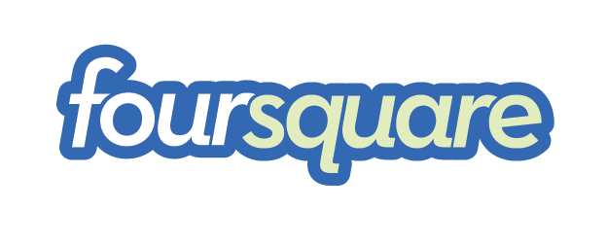









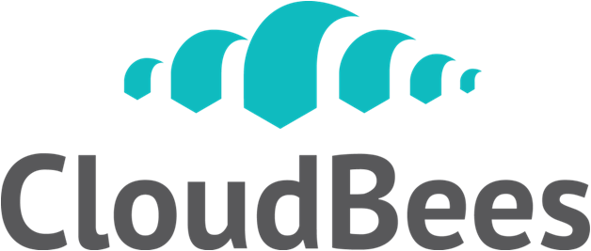



Adoption
?
?
?
?
?
?
?
?
Source: Sneaking Scala Through the Back Door | Dianne Marsh

Slide 36
Scala at Mentor Graphics?
Scala is NOT hereby endorsed by Mentor Graphics or System Design Division for use in production code.
Adoption of Scala in production code is a division-level decision.

Slide 37
Where might Scala fit, then?
Find problems where Scala is a great fit
Web applications
Application state belongs in the DB.
Static typing
Consumption of generated code, such as SOAP calls
Slow-running I/O-bound processes, such as building
Anywhere compiler checking can detect changes in dependencies
Domain-specific languages
Any time you want code to read fluidly
Utilize Scala in non-production/controlled environments
Hosted web applications
Internal applications
Testing

Slide 38
Testing DSL example
"The dashboard" should {
"filter journal when searching" in {
search "Knees to elbows"
eventually { entries.size should be (1) }
Entry(1).title should be (workout2.title)
click on Entry(1).resultBtn
eventually { Entry(1).notes should be ("I completed the workout!") }
}
}

Slide 39
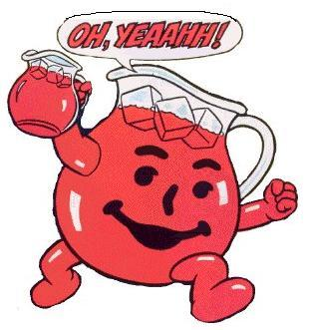
Taking the next step
Free online course!
Functional Programming Principles in Scala
Taught by Martin Odersky himself
Join the Scala User Group
Join the Scala Enthusiasts group on LinkedIn
Reference the Scala API
Ask questions at StackOverflow
Email me joe_barnes@mentor.com
User group?
Read my Scala ramblings
Image: Kool Aid Guy Wreaks Havoc at Presbyterian Seminary

Slide 40
QUESTIONS?

