Slide 1
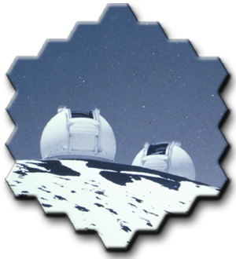
Keck AO the inside story
D. Le Mignant
for the Keck AO team

Slide 2
Topics
Scaling and System Definition
Let’s build our Keck AO system!

Slide 3
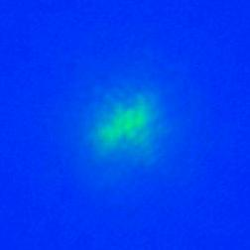
Scaling / parameters
D : telescope diameter
r0 : Fried parameter is a function of lambda
r₀ ^{6/5}
seeing()=  / r₀()
diffraction limit = /D (1.65e-6/10*206265=0.034”)
if seeing = 0.7” at 0.55microns then
  r_{0(0.55)}=0.55e-6/(0.7/206265)=16cm
  r_{0(1.65)}=(1.65/0.55)^{(6/5)}*16cm = 60 cm
(D/ r₀)² = nber of r0 contains on the telescope pupil

Slide 4
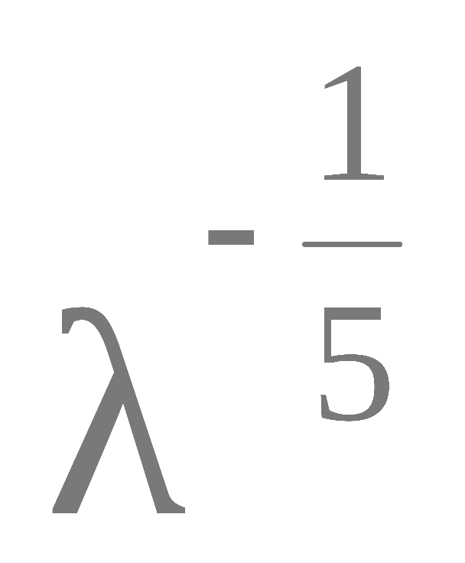
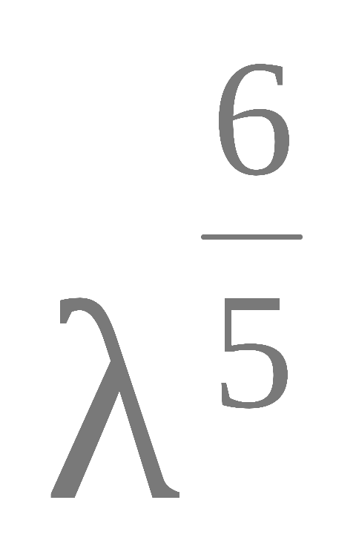
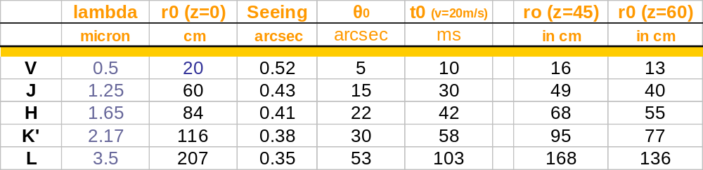
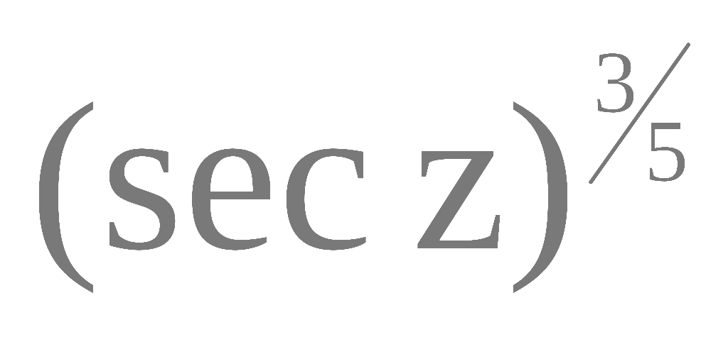
Scale of AO parameters (1)
Seeing: = λ / r0 ;
r0, θ0, and t0
Good seeing !
But r0, θ0, and t0
Require to know the seeing scale and speed in order to
understand AO performance
Notes:
r0= 20 cm, h=8km, then theta0=5arcsec for V
r0=

Slide 5
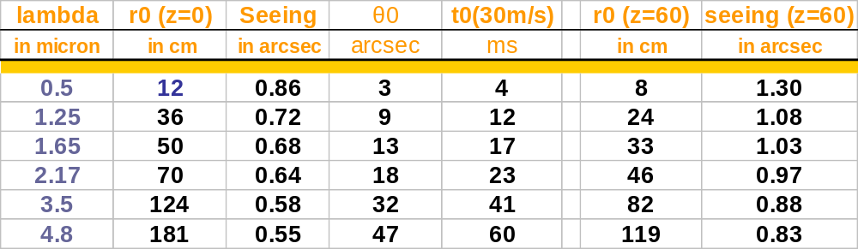
Scale of AO parameters (2)
Bad seeing!
to be compared to the ~50 cm sub.
To be compared to the system bandwidth: ~25Hz at 672Hz
Good performance in all bands under good, slow seeing
AO performance is function of seeing characteristics
Notes:
h=8km dans ce cas aussi

Slide 6
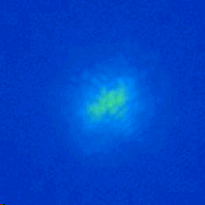
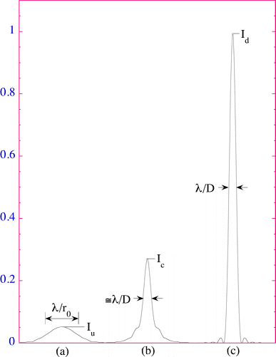
Imaging through the atmosphere

Slide 7
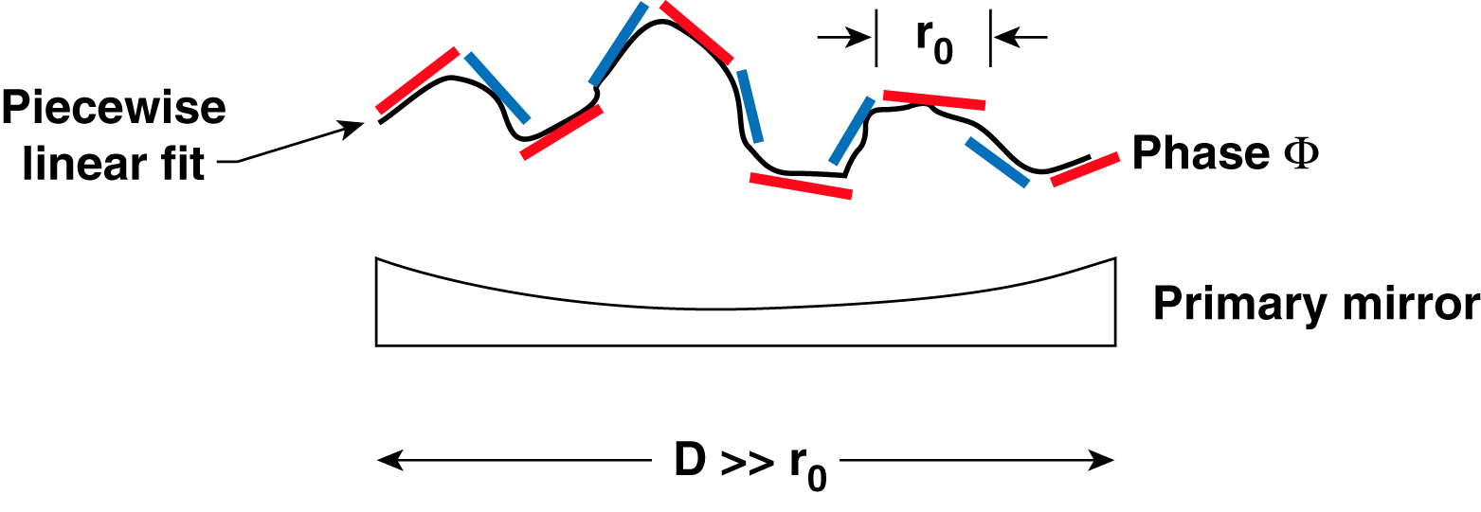
Shack-Hartmann wavefront sensing
Divide primary mirror into “subapertures” of diameter r₀
Number of subapertures ~ (D / r₀)² where r₀ is evaluated at the desired observing wavelength

Slide 8
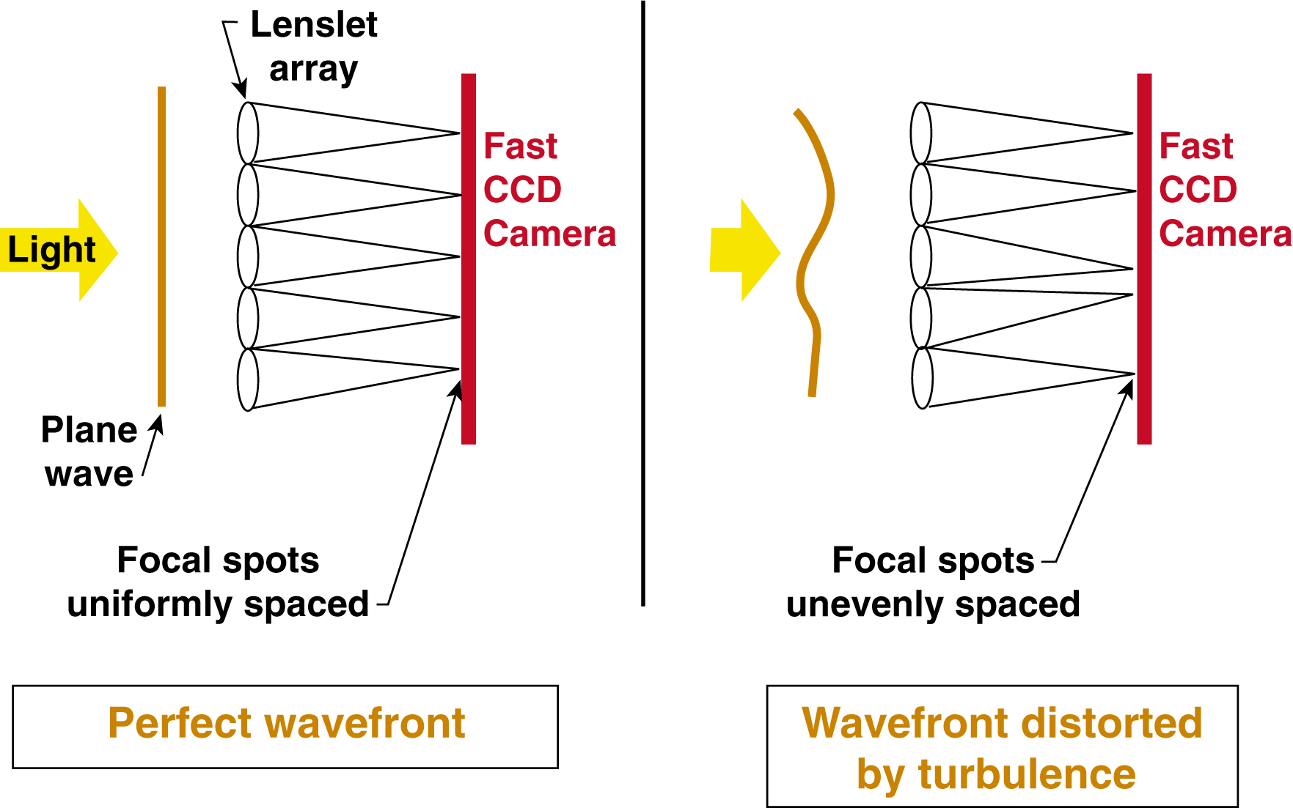
Shack-Hartmann wavefront sensing

Slide 9
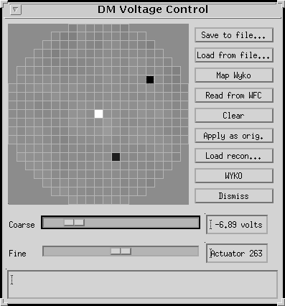
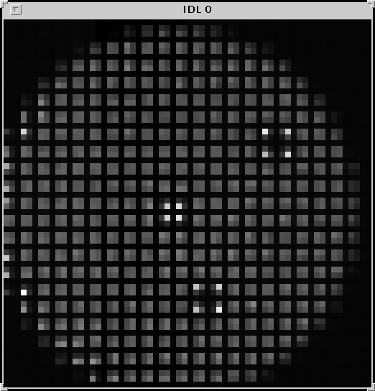
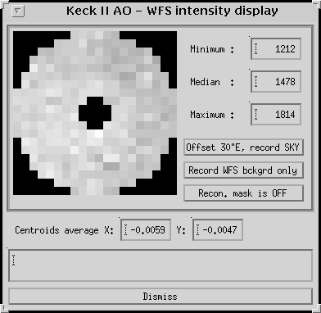
CCD raw frame
  grid of 20x20
  2x2 pixels per subap

Slide 10
Let’s start building our AO system...
we want
to optically re-image the pupil on a grid of lenslet
a lenslet to match the number/size of r₀ patches
  Keck lenslet size in pupil plane: 0.56m, but in reality 0.2mm; Grid of 20x20
  Would need a good CCD (low read-out noise)
  2x2 pixels per subaperture
a DM geometry that matches the lenslet (distance interactuator = 7mm)
a system that goes fast!

Slide 11
1 - The Keck AO WFS
Keck lenslets : 20x20, but have different characteristics
  options for field stop and camera plate scale
  different WFS configuration : 2.4x2.4 ; 2.4x1.0 and 1.0x1.0 (+ 0.6x0.6)
FSS
field stop
WLS
lenslet
WCS + CCD
camera plate scale

Slide 12
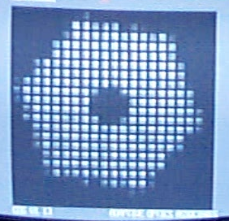
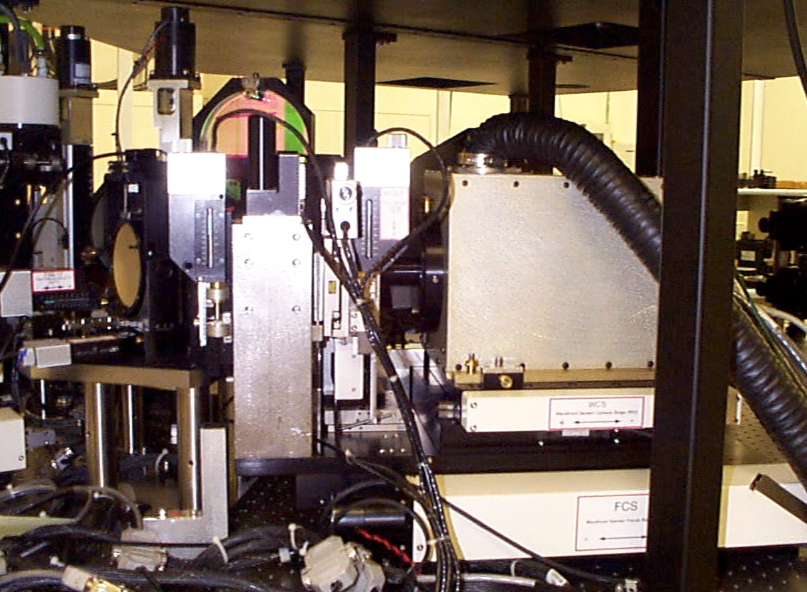
2 - Wavefront Sensor
Field Steering Mirrors (2 gimbals)
Sodium dichroic/beamsplitter
AOA Camera
Video Display
AOA Camera
Camera Focus
Wavefront Sensor Focus
Wavefront Sensor Optics: field stop, pupil relay, lenslet, reducer optics

Slide 13
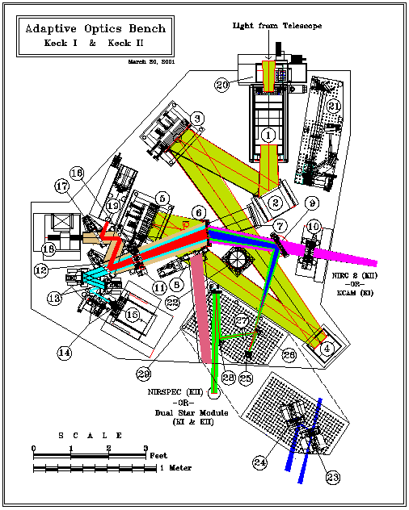
3- Optics....
ROT
Pupil re-imaging
Dichroic
TT
DM
FSMs
WFS
most stages are moving
→OBS

Slide 14
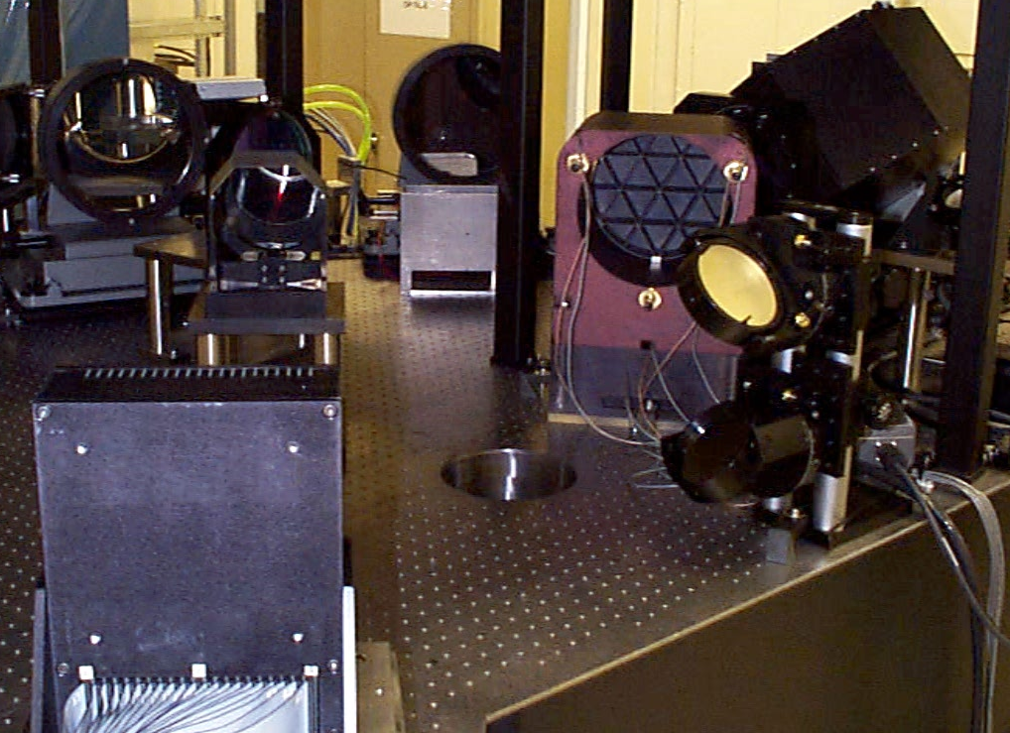
AO Science Path
OAP1
K1 Image
Rotator
OAP2
IR Dichroic
Tip/tilt
Mirror
To KCAM
or NIRC2
Deformable
Mirror

Slide 15
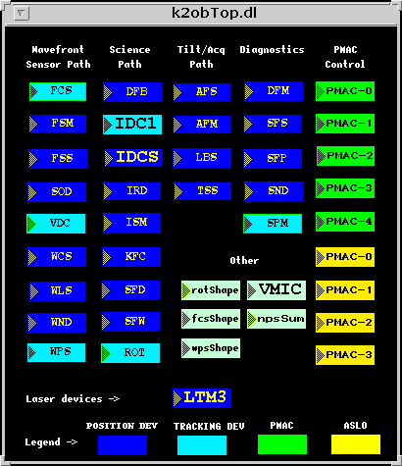
4 -OBS Motion Control
Science Path:
Image Rotator (ROT)
Instrument fold (ISM)
DSM fold (DFB)
Filters (KFC)
IR ADC (IDC,3)
Digital I/O:
White light
Servo amps
Encoders
25 stages operational on K2
22 on K1
Wavefront Sensor Path:
Sodium dichroic (SOD)
Field Steering Mirrors (FSM,4)
Field Stop (FSS)
Pupil Relay Lens (WPS)
ND Filters (WND)
Lenslet (WLS,2)
Camera Focus (WCS)
WFS Focus (FCS)
Tilt/Acquisition Path:
Acquisition Fold (AFM)
Acquisition Focus (AFS)
Tilt Sensor Stage (TSS,3)
Low Bandwidth Sensor (LBS,2)
STRAP Filter Wheel
STRAP Filter Diaphgram
Diagnostics:
ND Filters (SND)
Color Filters (SFS)
Simulator/Fiber Positioner (SFP,3)

Slide 16
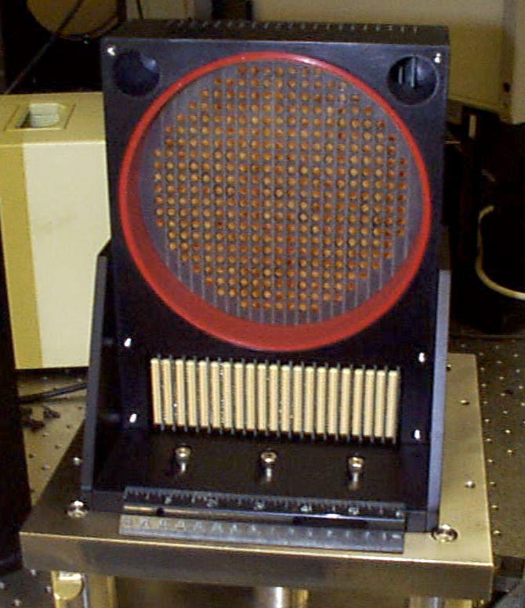
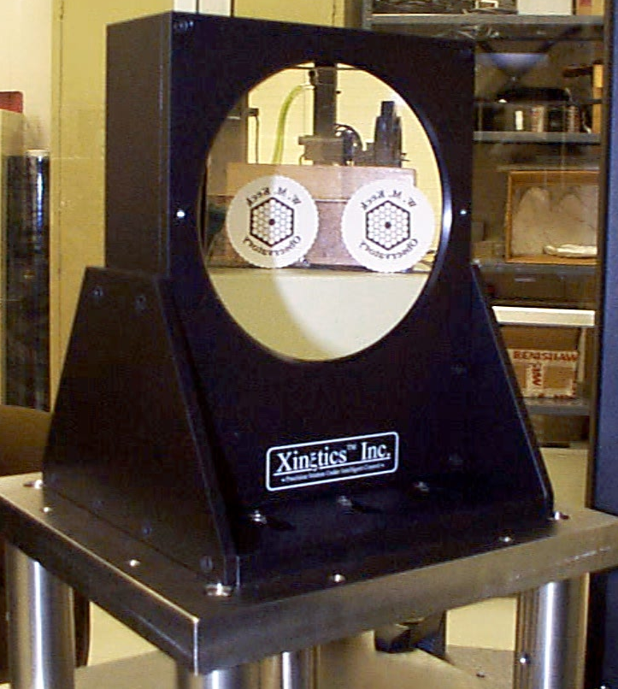
5 - Deformable Mirror
349 Actuators
on 7 mm spacing
146 mm diameter
clear aperture
Rear View
Front View

Slide 17
6 - Got the optics & wavefront sensor? still need a wavefront controller!
The wavefront controller
  inputs are CDD readout
  ouput is voltages to the DM actuators
operations on CCD readout:
  subtract background for 304 pixels for a given FR
  compute centroids : 304 pairs of (x,y)
  derive TT information from average over centroids
  subtract TT to all centroids (xt,yt)= (xi,yi) – (<x>,<y>)
  matrix multiplication to convert TT removed centroids into DM commands

Slide 18
7 - Reconstructor and the reconstruction matrix
Reconstructor takes centroid measurements from the wave-front sensor.
Outputs the change of voltage needed to cancel this aberration.
This is effectively a wave-front estimate.
Have 608 noisy centroid measurements to produce 349 actuator voltages.
Implemented in IDL

Slide 19
8 - Still need more...
some big pieces:
  An acquisition camera (ACAM)
  A science camera (NIRC2) !
  A supervisory control system
  A software to compute the reconstructor
  Calibrations unit
All alignment/calibrations software
Not even mentioning the LGS items..

Slide 20
Nodding & Offsetting
Telescope moves to position science object.
Field steering mirrors move to acquire guide star (~60” non-symmetric field)
During a nod or offset
  AO loops open
  Telescope moves
  FSMs move to
  reacquire guide star
  AO loops reclose

Slide 21
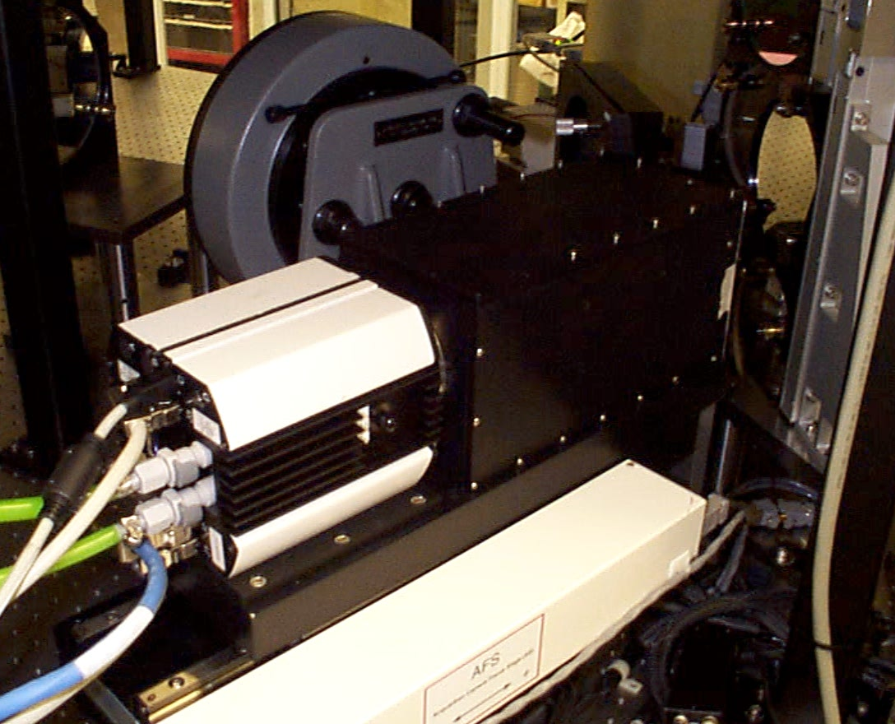
Acquisition Path
Fold mirror
Beamsplitter/mirror
Camera optics:
Field & Nikon lens
Acquisition:
plate scale = 0.125 arcsec/pixel
field = 2x2 arcmin
PXL Camera
Diagnostics:
Flip & move Nikon lens
plate scale = 0.0078 arcsec/pixel
Focus Stage

Slide 22
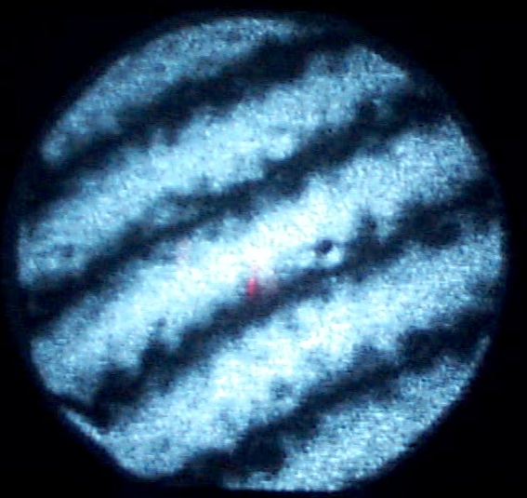
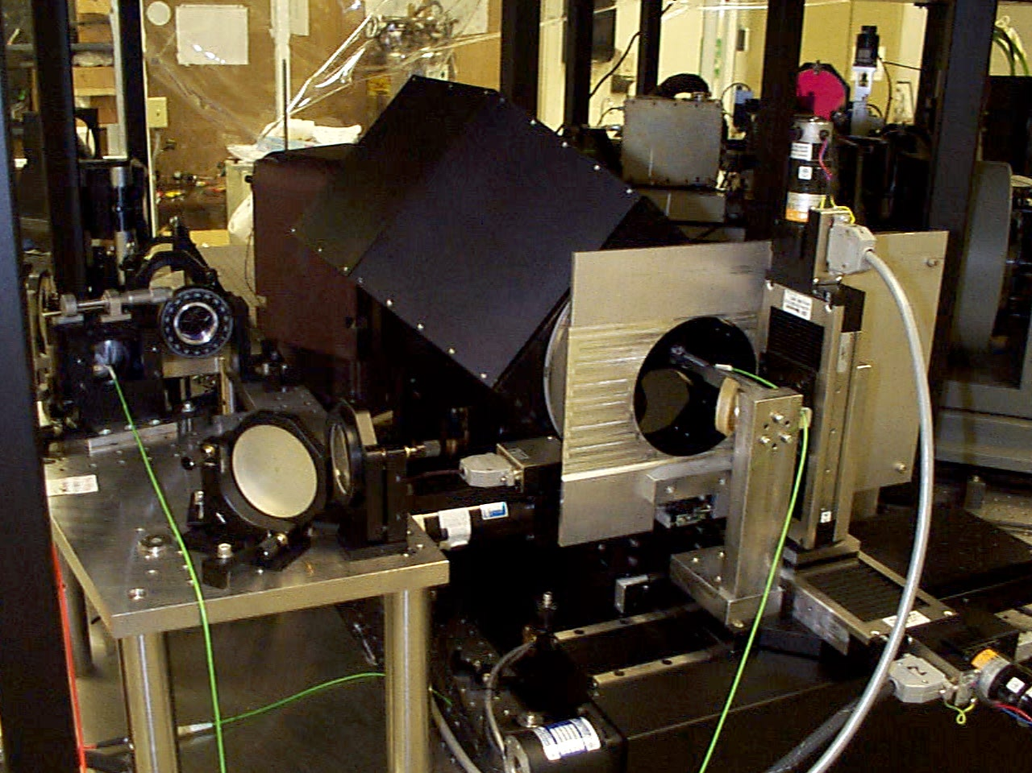
Alignment, Calibration &
Diagnostics
Wyko video display
Pupil Simulator:
- produces Keck telescope f/# & pupil location
- pupil mask in collimated beam
Wyko Phase Shifting
Interferometer:
- mounted under bench
looking at deformable mirror
- also used for alignment
Source Positioner:
-selects between pupil
simulator, fiber & sky
- fiber has 3 axes
Single mode fibers

Slide 23
AO Loops
Telescope
Pointing
Secondary
Mirror
Piston
TTO
WFO
DCS
TTM
Supervisory
Controller
TT Loop
Wavefront
Controller
WFS
DM Loop
DM

Slide 24
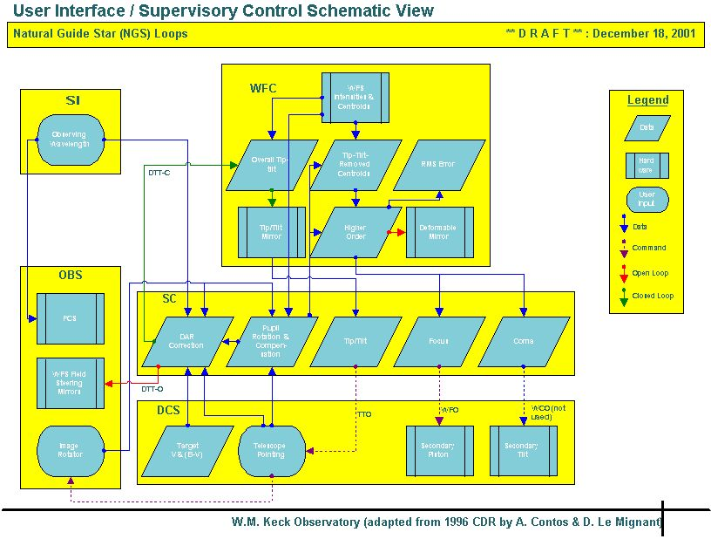

Slide 25
Software
Architecture
AO
supervisory
control
Telescope
DCS
obs
eng.
screen
Optics Bench Devices
IDL
pro
files
wfc
eng.
screen
WFC: AOCP - CAS
AOA camera
Wavefront Controller
slk
Java
User Interface
autom.
units
epics channels
cshow

Slide 26
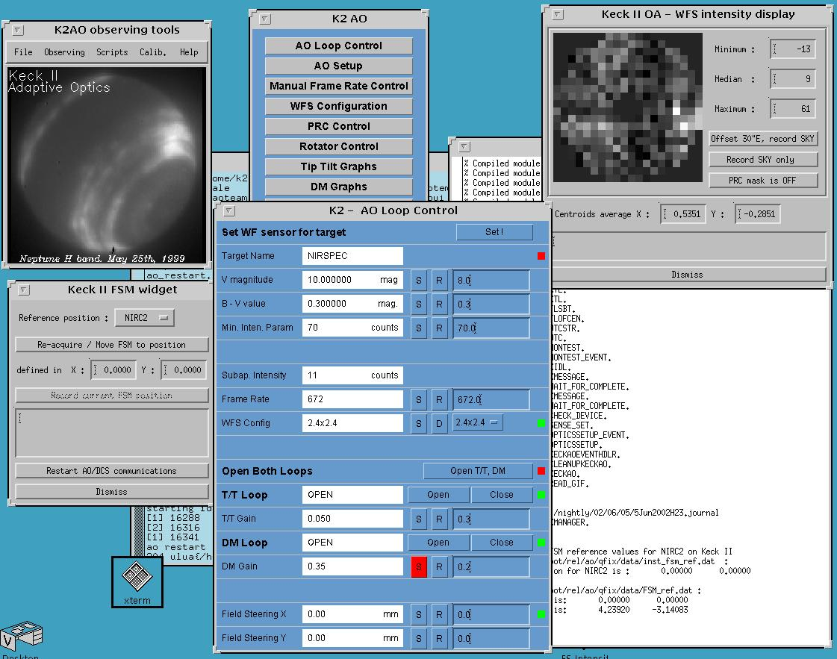
OA
Tool
s

Slide 27

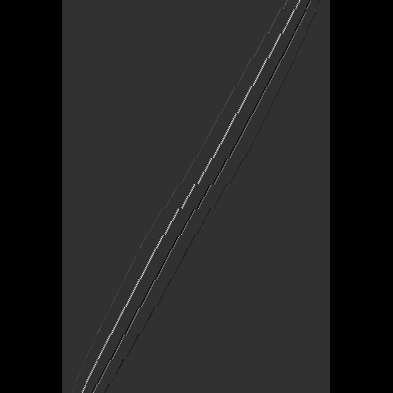


System matrix and its inverse
System matrix, H, describes how pushing an actuator, Δv, affects the centroids, s.
Inverting the system matrix
  We want to find the voltage that best cancels
  the observed centroids in the presence of noise:
  What is this matrix R?
  Least-squares solution is
  But the inversion is ill-conditioned!
To improve the conditioning of the
inversion, actuator modes are penalized
according to their probability of occurrence,
assuming Kolmogorov turbulence.

Slide 28
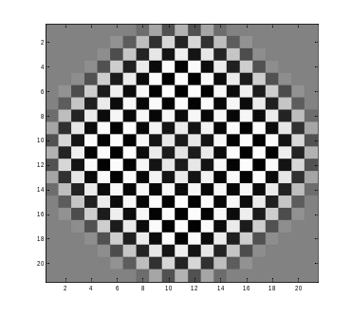
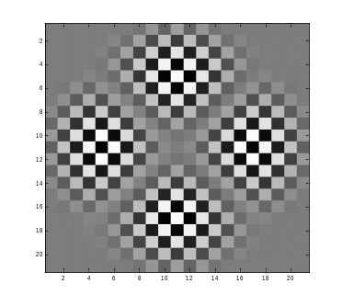
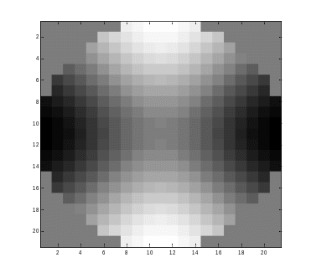
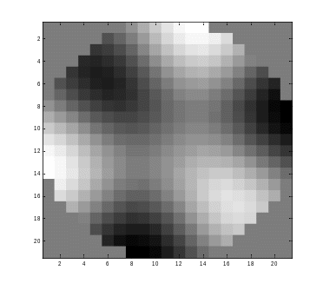
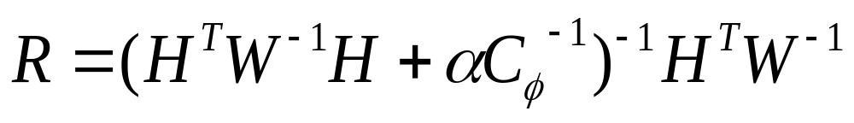
Inverse matrix: the conditions
Very heavily penalized modes:
Very lightly penalized modes:
Matrix R is calculated as:
Where C_{φ} is the covariance matrix for Kolmogorov turbulence and W is the weighting of the subapertures: partially illuminated subapertures have less weight.
Waffle is very heavily penalized and hence non-existent.

Slide 29
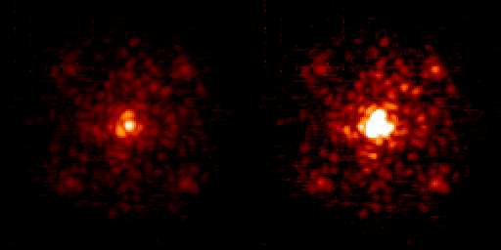
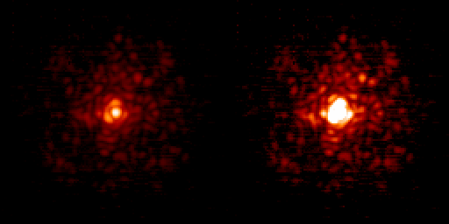
New reconstruction matrix
The matrices are created in IDL.
Much faster to generate than previous method.
  5 sec on the new AO host computers
Has an adjustable noise-to-signal parameter depending on the flux per frame level.
Has shown significant performance improvements
  10% SR increase in the example below

Slide 30
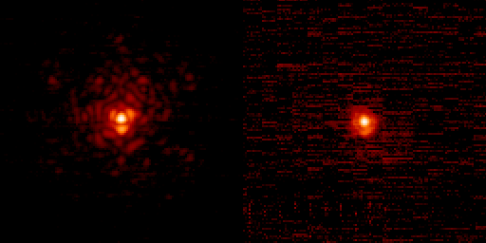
Keck AO performance
What we have learned..
Bright star (V=7.5)
  SR= 0.38 in Hcont
  Airmass: 1.3 ; seeing: 0.45” (H)
  Fwhm=36.5 mas
  15 sec integration time
  250 nm residuals@ 672Hz
Faint star (V=13.3 R=12.0)
  SR ~0.23 in Hcont
  Airmass:1.05 ; seeing: 0.45” (H)
  Fwhm=41 mas
  20 sec integration time
  310 nm residuals @200Hz
Notes:
HD 106965 - 1150 cts on the wfs -
U1125_15679947 - V=13.3 R=12.0 59Cts at 200Hz using the 1.0 plate scale

Slide 31
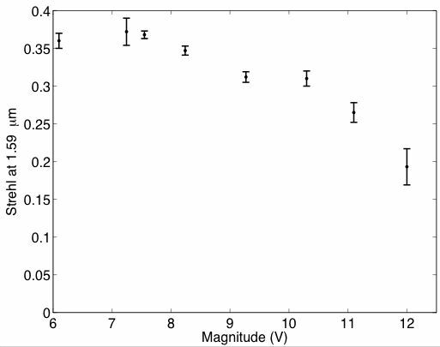
Keck AO performance

Slide 32
Keck AO error budget: main contributors
Fitting error (# degree of freedom - # subapertures/actuators):
    120 nm and higher
Bandwidth error (frame rate + time lag for DM and TT) :
    TT : 100 nm DM : 90 and higher
Uncorrected telescope :
    < 100 nm (more accurate number needed)
Noise term (measurement errors, changing spot size, etc)
    50 nm and higher
Internal image quality (AO bench + NIRC2 image quality):
    SR = 0.76 in H (narrow field camera)
    200 nm before image sharpening
    130 nm post image sharpening

