Slide 1
Defender telemetry dataset
Danny Hendler
hendlerd@post.bgu.ac.il
Amir Rubin
amirrub@post.bgu.ac.il

Slide 2
Agenda
Collection process
Issues – missing/ wrong/ anonymized data
Attributes
Labels
Getting the data

Slide 3






1. Collection process
File: X
Time: T1
Domain: D1
…
File: Y
Time: T2
Domain: D1
…

Slide 4
Data filtering
Filters used:
Valid Sha1 (Sha1 in the begging and end of the scan is the same)
Low-fidelity/threats files only
Non webmail - 1:10 of reports are used
Notes:
WebFileUrl only?

Slide 5
Missing/wrong data
Missing reports:
File not scanned - old defender version
File not scanned - file not running
File not scanned – tempering with AV
Not send to cloud:
Local machine setting
Network issues (can also cause delay)
Machine throttling
Signature based detection, no need to send report (TP event)
Wrong data:
Sha1 computed on partial file
File overwritten
Mislabeled due to version issues

Slide 6
Anonymization
Done due to privacy issues
File name – if seen on less than 100 machines – obfuscation
MachineGuid
SignatureName
ThreatName – also “null” was obfuscated! How can you find it?
WebFileUrl
Etc..

Slide 7
2. Attributes
Data description in the site
MachineGuid
Sha1
ReportTime
ThreatName (5644 is null)
ThreatFamily (2720 is null)
WebFileUrl

Slide 8
Pitfalls
Null/default value
String – lower/upper case
Times mismatch – should be all UTC
ThreatFamily – not unique per Sha1
Trends – weekends have less activity
IP – may have proxy issues
Domains – mixed purposes – file-shares

Slide 9
3. Labels
Malicious
ThreatName (not null)
Not always the same!
Clean
Prevalent file (more than X machines)
Make sure you don’t exclude them in the analysis! (as they are prevalent)

Slide 10
4. Getting the data
100 lines
https://mscoursebgu.file.core.windows.net/mscourse/January -17/Sample.tsv
Sampled data
https://mscoursebgu.file.core.windows.net/mscourse /January -17/Sampled/Obf_oneInTenWeek1_d1.tsv
WebMailOnly (Email providers only)
https://mscoursebgu.file.core.windows.net/mscourse /January -17/Webmail/Obf_webmails_fullWeek1_d1.tsv

Slide 11
How to get the data
Send a mail with your names, and the topic selected.
Get a key to be used in the browser as suffix to the paths seen before
Example:
https://mscoursebgu.file.core.windows.net/mscourse/January -17/Sample.tsv<Suffix from Amir>

Slide 12
Play with the data
Demo power BI

Slide 13
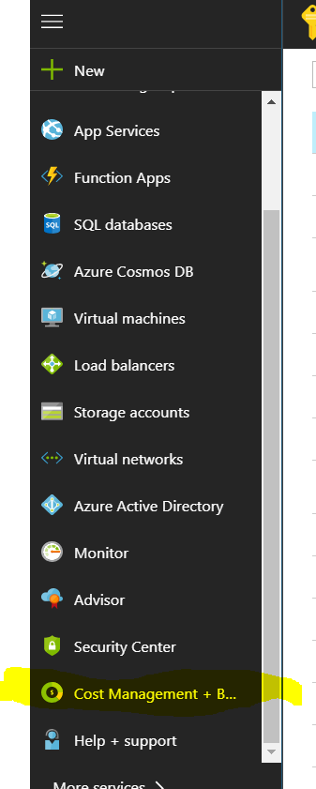
Azure pass – DO NOT MAKE MISTAKES
You need a Microsoft account – create here
Use it to sing in to Azure here
(you may need to place credit card)
Use your Azure token as explained here
You have 100$ a month for each member’s account
Cant use 200$ on a single account!
Verify in Cost and management that you have the credit

Slide 14
Azure pass DO NOT MAKE MISTAKES

Slide 15
VM machine
You have ~100 USD a month, per account (cant use 200 on one!)
Recommended >=16 RAM.
Use the calculator.
(I recommend one account for dev-test, and one for full run)
Example - Standard D8s v3 (8 vcpus, 32 GB memory), 2 days a week (~160 h a month) = 120$
The Region makes a difference of price (West US 2)
Make sure you write the user name and password some where
Make sure you deallocate when not in use
Install on it what ever you like
Java
Python
Notepad++

Slide 16
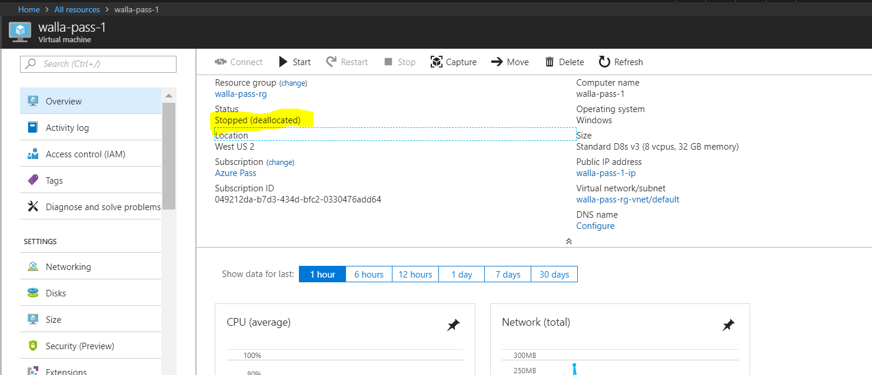
VM machine

Slide 17
Office hours
Mini-project selection

