Slide 1

Cyber Security Big-Data Analysis mini-project
Danny Hendler
Hendlerd<@>post.bgu.ac.il
Amir Rubin (Wednsday 14-16, 37/-109)
Amirrub<@>post.bgu.ac.il
https://www.cs.bgu.ac.il/~bda192/Main

Slide 2
Agenda
Mini project requirements
Introduction to cyber security
The dataset - overview
Mini projects - overview

Slide 3
Mini project requirements
3-4 lectures
3 mandatory “checkpoints”
A report
A presentation
A short discussing on your project
(Possible bonus)

Slide 4
Grade
Presentation – 15%
Final report + discussion – 85%

Slide 5
Mini project schedule
Week | Lecture | Project
1 | Lecture – intro+data | Find a partner!
2 | Lecture – mini projects | Select project
3
4
5
6 | Lecture – ML | Checkpoint 1
7
8
9 |  | Checkpoint 2
10
11
12 | Projects show case | Checkpoint 3

Slide 6
Technical notes
Data can be processed on a single machine
Python

Slide 7
Notes
Please write your mail
Signing a legal agreement to use the data

Slide 8
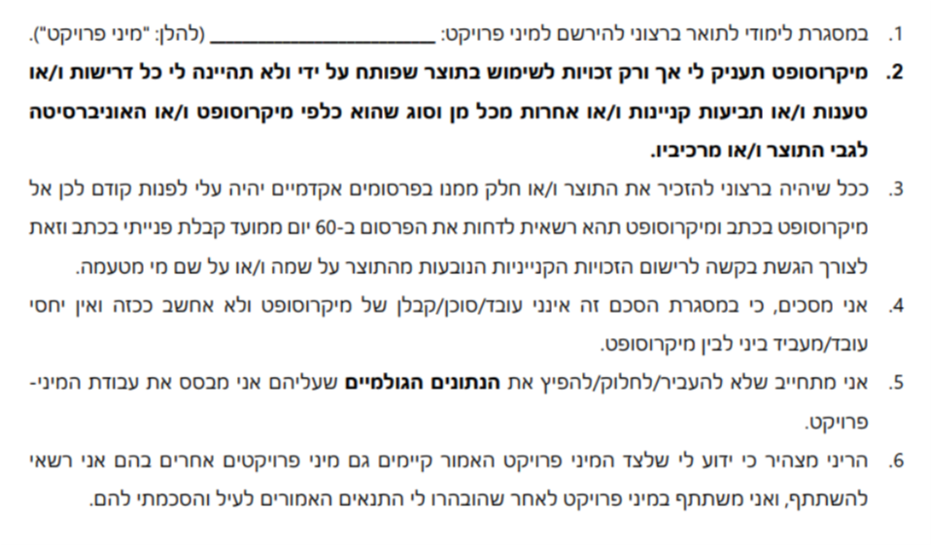

Slide 9
Agenda
Mini project requirements
Introduction to cyber security
The dataset - overview
Mini projects - overview

Slide 10
Introduction to cyber security
Malware definition
Types of malware + examples
Defense – static/dynamic analysis
Anti-malware systems

Slide 11
Introduction to cyber security
Malware definition
Types of malware + examples
Defense – static/dynamic analysis
Anti-malware systems

Slide 12
Introduction to cyber security
Malware definition
“Malware, short for malicious software, is an umbrella term used to refer to a variety of forms of hostile or intrusive software,
including computer viruses, worms, Trojan horses, ransomware, spyware, adware, scareware, and other malicious programs.
It can take the form of executable code, scripts, active content, and other software. Malware is defined by its malicious intent, acting against the requirements of the computer user — and so does not include software that causes unintentional harm due to some deficiency.”
Wikipedia

Slide 13
Introduction to cyber security
Malware definition
Types of malware + examples
Defense – static/dynamic analysis
Anti-malware systems

Slide 14
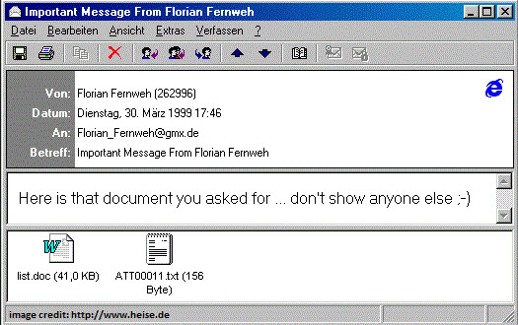
Introduction to cyber security
Viruses
“when executed, replicates itself by modifying other computer programs and inserting its own code.”
Notes:
Melisa (https://en.wikipedia.org/wiki/Melissa_(computer_virus) )
https://www.f-secure.com/v-descs/melissa.shtml
1999
Word97 macro.
1. Checkes in the registry for a “mellisa” entry – the value there should be :KWYJIBO. If not there:
2. Send itself via outlook to max of 50 entries (people/mailing list)
3. Copy itself to other opened word docs.
3.Also – on any X day in every hour+X minutes, if a document is open he will add to it -
"Twenty-two points, plus triple-word-score, plus fifty points for using all my letters. Game's over. I'm outta here".

Slide 15
Virus: Melissa (1999)
Word97 macro:
1. Checks in the registry for a “melissa” entry.
The value there should be :KWYJIBO.
If not there: Send itself via outlook to max of 50 entries (people/mailing list)
2. Copy itself to other opened word docs.
3. Also – on some random X day in every hour+X minutes, if a
document is open he will add to it -
Notes:
https://www.cartooncrazy.tv/watch/the-simpsons-episode-102-bart-the-genius/

Slide 16
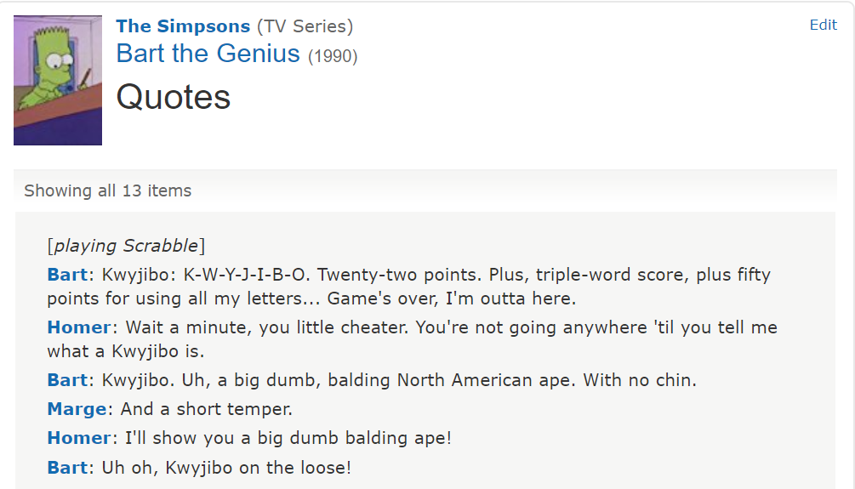

Introduction to cyber security
" Twenty-two points, plus triple-word-score, plus fifty points for using all my letters.
Game's over. I'm outta here."
Notes:
The text is from the simpsons!
Which gives a clue who is Mellisa…

Slide 17
Virus: Melissa (1999)
Hundreds of thousands machines
80M$ damage
FBI investigation
David L.Smith
10 years in jail (did 20 months)
5k$ fine.
Notes:
Or was it named after a stripper David had known in Florida?

Slide 18
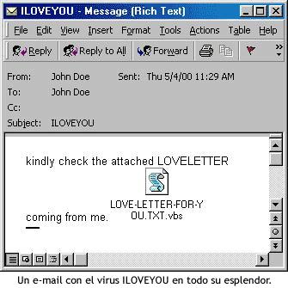
Introduction to cyber security
Viruses
“when executed, replicates itself by modifying other computer programs and inserting its own code.”
Worms
“a standalone malware computer program that replicates itself in order to spread to other computers.”
Notes:
I LOVE YOU
2000
Philipins – Hong kong – EU - US
Tens of millions 10% of all computers!
Vbs – visual basic script
overwriting random types of files (including Office files, image files, and audio files)
and sent a copy of itself to all addresses in the Windows Address Book used by Microsoft Outlook.
Petshop boys did a song (e-mail) about this
https://www.youtube.com/watch?v=AEF8hAAm_sg

Slide 19
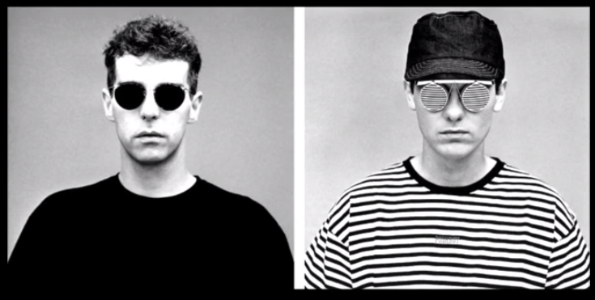
Worm: I love you (2000)
VBS – visual basic script
Overwriting random types of files (including Office files, image files, and audio files)
Send a copy of itself to all addresses in the Windows Address Book used by Microsoft Outlook.
Philipins, Hong-Kong, EU, US
Tens of millions - 10% of all computers at the time!
Notes:
Petshop boys did a song (e-mail) about this
https://www.youtube.com/watch?v=AEF8hAAm_sg

Slide 20
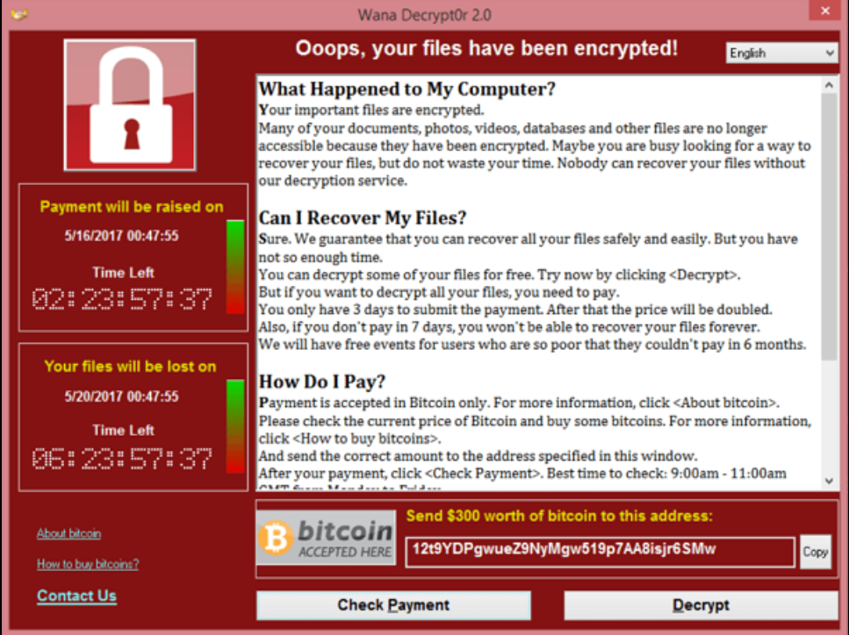
Introduction to cyber security
Viruses
“when executed, replicates itself by modifying other computer programs and inserting its own code.”
Worms
“a standalone malware computer program that replicates itself in order to spread to other computers.”
Trojan horses
“any malicious computer program which misleads users of its true intent.”
Ransomware
“threatens to publish the victim's data or perpetually block access to it unless a ransom is paid.”
Notes:
WannaCry
Using a worm
May 2017
4 days
200K machines
150 countries
Hundreds of M$
North Korea
Uses EthernalBlue – Developed by the NSA, leaked April 2017.
Also used in NotPetya in June 2017.
SMB(Server message block) protocol exploit.
MS published a patch on March 2017 – BUT not all installed it ☹
NSA knew about this for a long time – BUT, used it instead of reporting to MS

Slide 21
Ransomware: WannaCry (2017)
Worm spreading via SMB
Encrypts data
Spreads to other machines
Demands 300$ in BitCoin
Notes:
WannaCry
Using a worm
May 2017
4 days
200K machines
150 countries
Hundreds of M$
North Korea
Uses EthernalBlue – Developed by the NSA, leaked April 2017.
Also used in NotPetya in June 2017.
SMB(Server message block) protocol exploit.
MS published a patch on March 2017 – BUT not all installed it ☹
NSA knew about this for a long time – BUT, used it instead of reporting to MS

Slide 22
Ransomware: WannaCry (2017)
4 days
200K machines, 150 countries
Hundreds of Millions of $
North Korea
NSA knew about this for a long time –
BUT, used it instead of reporting to MS..
Uses EthernalBlue – Developed by the NSA, leaked April 2017.
(attack started 12.5.17)
MS published a patch on April 2017 – BUT not all installed it ☹
Notes:
WannaCry
Using a worm
May 2017
4 days
200K machines
150 countries
Hundreds of M$
North Korea
Uses EthernalBlue – Developed by the NSA, leaked April 2017.
Also used in NotPetya in June 2017.
SMB(Server message block) protocol exploit.
MS published a patch on March 2017 – BUT not all installed it ☹
NSA knew about this for a long time – BUT, used it instead of reporting to MS

Slide 23
Introduction to cyber security
Viruses
“when executed, replicates itself by modifying other computer programs and inserting its own code.”
Worms
“a standalone malware computer program that replicates itself in order to spread to other computers.”
Trojan horses
“any malicious computer program which misleads users of its true intent.”
Ransomware
“threatens to publish the victim's data or perpetually block access to it unless a ransom is paid.”
Notes:
Virus-worm – spreading mechanisem
Trojan – execution technique
Ransomware – intention of the malware
A worm can be a trojan
Ransomware can be a worm

Slide 24
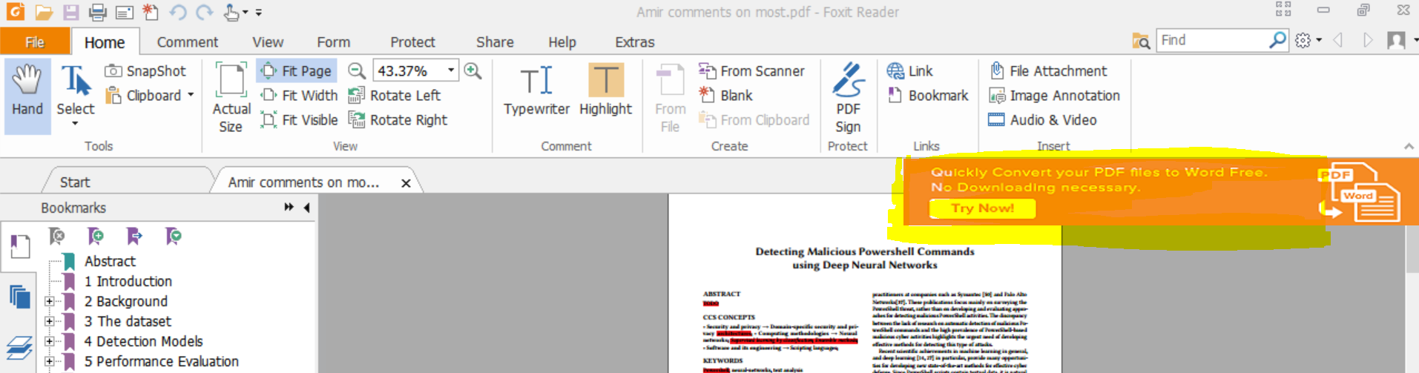
Introduction to cyber security
Spyware
“software that aims to gather information about a person or organization without their knowledge, that may send such information to another entity without the consumer's consent, or that asserts control over a device without the consumer's knowledge.”
Adware
“advertising-supported software, is software that generates revenue for its developer by automatically generating online advertisements in the user interface of the software or on a screen presented to the user during the installation process.”
Is all adware malware?
“presents unwanted advertisements to the user of a computer”
Notes:
Both are intention of malware

Slide 25
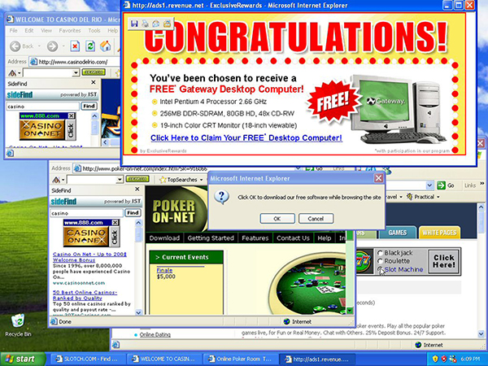
Introduction to cyber security
Greyware –(PUA/PUS)
“Programs that do not contain viruses and that are not obviously malicious, but which can be annoying or even harmful to the user. For example, hack tools, spyware, adware, and joke programs.“
Symantec

Slide 26


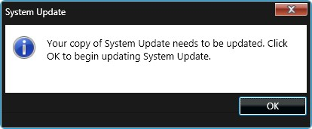
Meltdown and Spectre (2017)
Exploit critical vulnerabilities in modern processors. (hardware!)
Damage – unknown
Fix – patches available, but, people never really update.
Notes:
https://meltdownattack.com/
Meltdown and Spectre exploit critical vulnerabilities in modern processors. These hardware vulnerabilities allow programs to steal data which is currently processed on the computer. While programs are typically not permitted to read data from other programs, a malicious program can exploit Meltdown and Spectre to get hold of secrets stored in the memory of other running programs. This might include your passwords stored in a password manager or browser, your personal photos, emails, instant messages and even business-critical documents.
Meltdown and Spectre work on personal computers, mobile devices, and in the cloud. Depending on the cloud provider's infrastructure, it might be possible to steal data from other customers.

Slide 27
2019 - examples
Toyota japan (3M costumers data stolen)
City of Baltimore (ransomware)
Phishing via Instagram (the nasty list)
Phishing via Linkedin (more_eggs JScript malware)
Notes:
https://meltdownattack.com/
Meltdown and Spectre exploit critical vulnerabilities in modern processors. These hardware vulnerabilities allow programs to steal data which is currently processed on the computer. While programs are typically not permitted to read data from other programs, a malicious program can exploit Meltdown and Spectre to get hold of secrets stored in the memory of other running programs. This might include your passwords stored in a password manager or browser, your personal photos, emails, instant messages and even business-critical documents.
Meltdown and Spectre work on personal computers, mobile devices, and in the cloud. Depending on the cloud provider's infrastructure, it might be possible to steal data from other customers.

Slide 28
Introduction to cyber security
Malware definition
Types of malware + examples
Defense – static/dynamic analysis
Anti-malware systems

Slide 29
Defense – static/dynamic analysis
Static analysis
Code is not executed
Code is analyzed (if available)
Portable executable file analysis: PE header, strings, compression methods
Fast and safe, but not a lot of information
Notes:
Code can be xored/ encrypted / obfuscated / runtime only(fetch from net)

Slide 30
Defense – static/dynamic analysis
Dynamic analysis (behavioral)
Executed in a sandbox/post breach analysis
“Debug”
Collect artifacts:
Network connection, system calls, memory usage etc.
Real and rich information, but may take time, requires a sandbox, and can be dodged

Slide 31
Introduction to cyber security
Malware definition
Types of malware + examples
Defense – static/dynamic analysis
Anti-malware systems

Slide 32
Anti-malware systems
AV: Avast, Norton, McAfee, Kaspersky, Defender
VirusTotal
Local/Cloud based
Indicators:
Files/Domains/ips
System calls
Yara rules
rule silent_banker : banker
{
meta:
description = "This is just an example"
in_the_wild = true
strings:
$a = {6A 40 68 00 30 00 00 6A 14 8D 91}
$b = {8D 4D B0 2B C1 83 C0 27 99 6A 4E 59 F7 F9}
$c = "UVODFRYSIHLNWPEJXQZAKCBGMT"
condition:
$a or $b or $c
}

Slide 33






Anti-malware systems
File: X
Time: T1
Domain: D1
…
File: Y
Time: T2
Domain: D1
…
Notes:
https://cloudblogs.microsoft.com/microsoftsecure/2017/12/11/detonating-a-bad-rabbit-windows-defender-antivirus-and-layered-machine-learning-defenses/

Slide 34
Agenda
Mini project requirements
Introduction to cyber security
The dataset - overview
Mini projects - overview

Slide 35
Anti-malware systems
File: X
Time: T1
Domain: D1
…
File: Y
Time: T2
Domain: D1
…

Slide 36
The Dataset – overview
First 7 days of January 2017
Files arriving from the internet
Something suspicious about the files (zip/YARA/domain etc.)
# files? # machines? # reports? # domains?
Anonymized + Obfuscated
43 attributes:
ReportTime, FileNameID, Sha1ID, MachineGuidID, WebFileUrlDomain, Size ..
7 slices, each contains a day
Sampled ~1:10 from the real dataset

Slide 37
The Dataset – an example
ReportTime | FileNameID | Sha1ID | MachineGuidID | WebFileUrlDomain | Size
2017-01-04 14:55:02.935 UTC | bsplayer_free.exe | 840640 | 11002246 | giftnewgift.com | 1304096

Slide 38
Agenda
Mini project requirements
Introduction to cyber security
The dataset - overview
Mini projects - overview

Slide 39
Mini Projects - overview
Topics:
Community detection
Time-series analysis
Text analysis
Components:
Work with the data (exploration and preparation)
Process the data
Use machine learning
Figures and statistics illustrating insights from each step are required

Slide 40
Mini Projects - Community Detection
Build networks
Example: Machine – Files
Weighted?
Extreme values?
Community detection algorithms
What is a community?
Overlapping?
Machine learning
“Static” features (size, prevalence, etc..)
Features from communities

Slide 41
Mini Projects – Time Series Analysis
Build timeseries
Example: per file, #machines per hour
Window size?
Step size?
Extreme values?
Time series analysis (TSA)
Euclidean/DTW
Time complexity issues
Machine learning
“Static” features (size, prevalence, etc..)
Features from TSA

Slide 42
Mini Projects – Text analysis
Data exploration
Domain/file names
Features extraction
N-gram
Bag of Words (BoW)
Weights? (TF/TF-IDF)
Machine learning
“Static” features (size, prevalence, etc..)
Features from text columns

Slide 43
Not Mini Projects – LsHash
To be Published in knowledge based systems
Local sensitivity hash
Group similar LsHash files –
Different sizes?
Different signers?
Different names?
Server side polymorphism

Slide 44
“Homework”
Read projects’ description for next week
Start looking for a partner
Sign document sent via mail

Slide 45
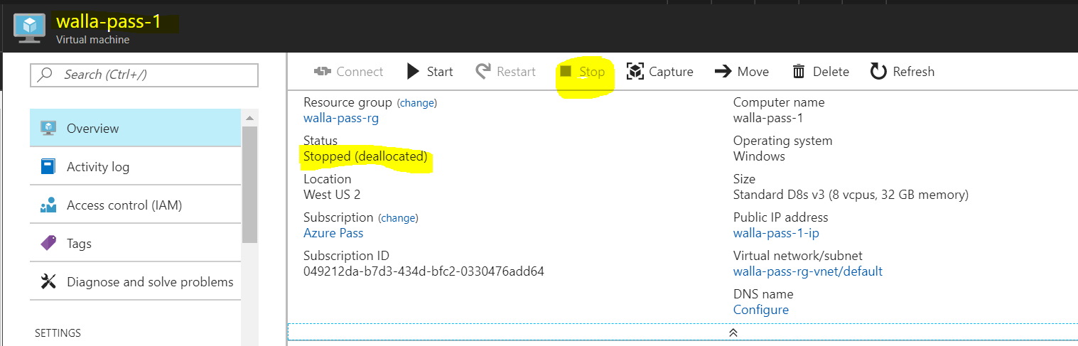
Azure machine – technical
Azure pass – 250$ monthly
Use it wisely:
VM which costs ~250$ a month – calculator
The “Region” is critical!
West US 2: A4m v2 (4 cores, 32GB RAM, 230$)
Make sure it is STOPPED when not in use
Keep track of the costs
Prepare the machine:
Get the data
Python/java
PyCharm/Eclipse
Notepad++

Slide 46
Azure machine – technical
Azure pass – 250$ monthly
Use it wisely:
VM which costs ~250$ a month – calculator
The “Region” is critical!
West US 2: A4m v2 (4 cores, 32GB RAM, 230$)
Make sure it is STOPPED when not in use
Keep track of the costs
Prepare the machine:
Get the data
Python/java
PyCharm/Eclipse
Notepad++

Slide 47
Task 1
Find a partner
Read projects description for next week
Azure
Request an azure “pass”:
Send an email to amirrub@post.bgu.ac.il with the partners names and ID numbers.
Create a Microsoft account , if you don’t have one. (you can work on a single account)
Activate your “pass”
Sign in to the Azure portal
Create a VM
Prepare it for your use (Python, Java, Eclipse..)
Get the data:
use the link from Amir’s mail, when logged on to the VM
Don’t forget to STOP the VM from the portal after you are done(!)

