Slide 1
Time series analysis mini-project
Danny Hendler
hendlerd@post.bgu.ac.il
Amir Rubin
amirrub@post.bgu.ac.il

Slide 2
Agenda
Introduction to time series analysis
Euclidean distance
Dynamic time wrapping
Mini project TSA

Slide 3
Agenda
Introduction to time series analysis
Euclidean distance
Dynamic time wrapping
Mini project TSA

Slide 4
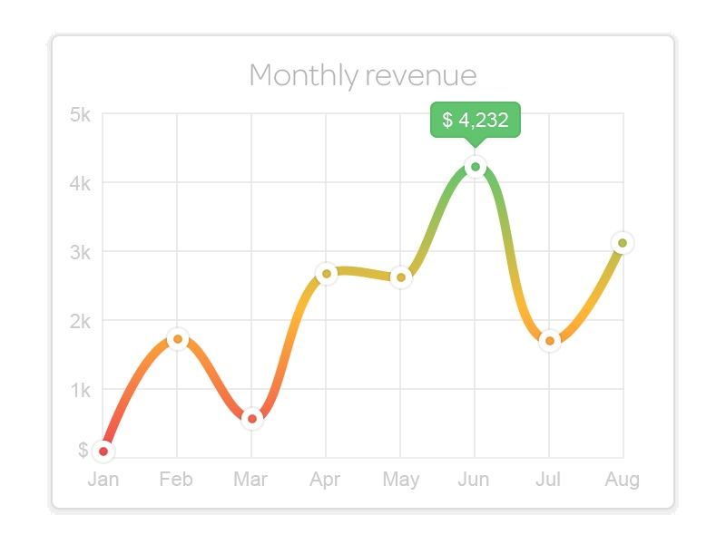
What is a time series?
A set of measurements arranged chronologically
Each representing measured statistic in a specific time unit
Examples:
Monthly revenues
Daily temperatures
Number of flu cases
Stock prices
…

Slide 5
Why is time series important?
Identify trends
Identify abnormal activity
Linear regression tools
Compare two time series
…

Slide 6
Agenda
Introduction to time series analysis
Euclidean distance
Dynamic time wrapping
Mini project TSA

Slide 7
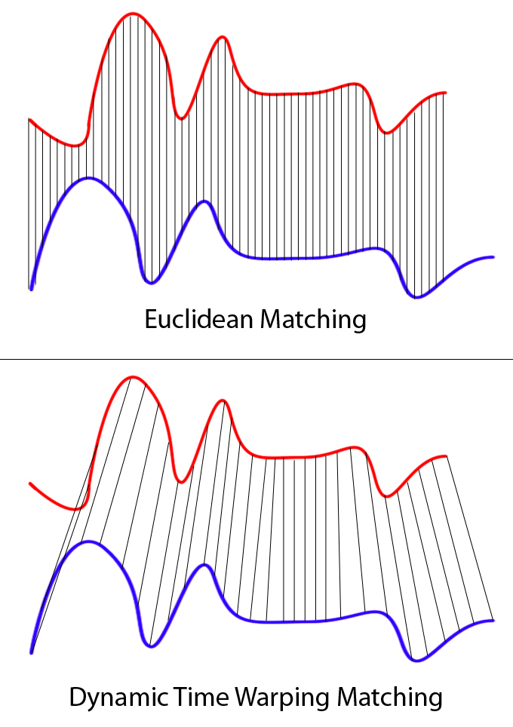
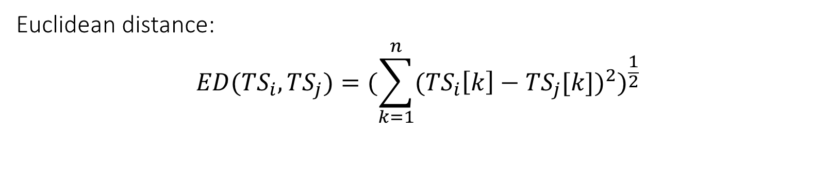
Euclidean distance
Euclidean distance:
$${ED({TS}_{i},{TS}_{j})=(\sum_{k=1}^{n}{{{(TS}_{i}\left[k\right]−{TS}_{j}[k])}^{2}})}^{\frac{1}{2}}$$
shifting

Slide 8

Euclidean distance - issues
Euclidean distance:
$${ED({TS}_{i},{TS}_{j})=(\sum_{k=1}^{n}{{{(TS}_{i}\left[k\right]−{TS}_{j}[k])}^{2}})}^{\frac{1}{2}}$$
shifting

Slide 9
Euclidean distance – possible solution
Bring center of mass to 0
shifting

Slide 10
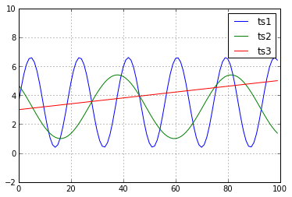

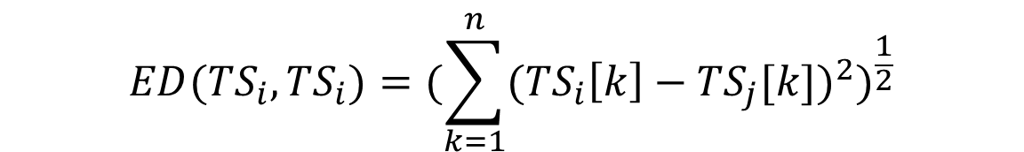
Euclidean distance - issues
$${ED({TS}_{i},{TS}_{i})=(\sum_{k=1}^{n}{{{(TS}_{i}\left[k\right]−{TS}_{j}[k])}^{2}})}^{\frac{1}{2}}$$

Slide 11
Euclidean distance - issues
We would like to enable
Shifting
Compression

Slide 12
Euclidean distance - issues
shifting

Slide 13
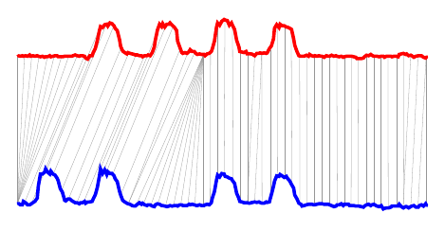
Euclidean distance - issues
compression

Slide 14
Agenda
Introduction to time series analysis
Euclidean distance
Dynamic time wrapping
Mini project TSA

Slide 15
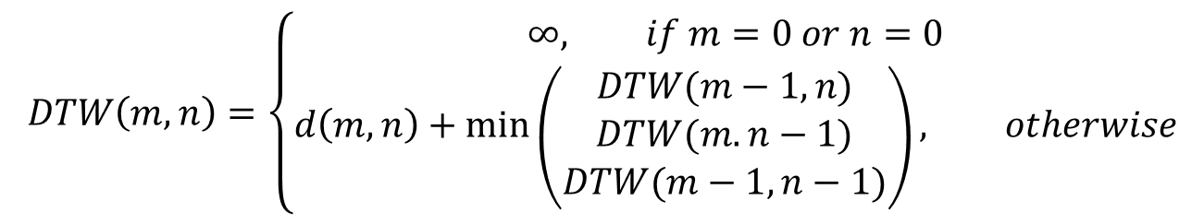
Dynamic Time Warping
Given two time series A and B of length n and m:
Notes:
1978 by Sakoe and Chiba for speech recognition
Sakoe, H., Chiba, S. (1978). Dynamic programming algorithm optimization for spoken word recognition. IEEE Trans. Acoustic Speech and Signal Processing, v26, pp. 43-49.

Slide 16
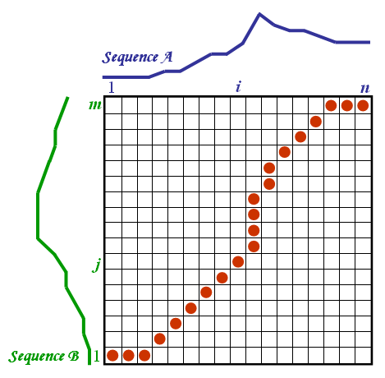
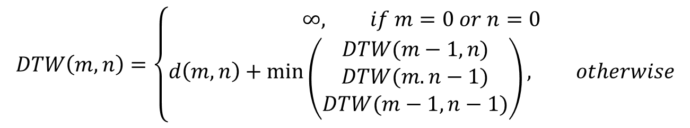
Dynamic Time Warping

Slide 17

DTW – time complexity
Computing DTW(m,n) takes ϴ(mn) time
Can be improved using several heuristics

Slide 18
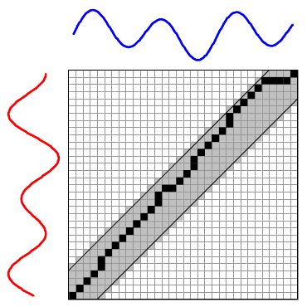
DTW heuristics – locality constraint
Often unlikely for a_{i} and b_{j} to be matched if |i-j|>w
Only compute w-width diagonal

Slide 19
Locality constraint – problematic scenario
shifting

Slide 20
Agenda
Introduction to time series analysis
Euclidean distance
Dynamic time wrapping
Mini project TSA

Slide 21
TSA mini projects
Build time series per file
Count machines? Number of download?
Window size - day? Week?
Step size – hour? Day?

Slide 22
TSA mini projects
Compute DTW distance to any two files
Can be expensive!
Maybe only distance from malicious/clean files?
Look at the nearest k files
Compute number of malwares among them
Compute the average/median/min/max
distance
k=10
k=5
k=1

