Slide 1
Text based features mini-project
Danny Hendler
hendlerd@post.bgu.ac.il
Amir Rubin
amirrub@post.bgu.ac.il

Slide 2
Agenda
Introduction to text analysis
Bag of words
N-gram
TF-IDF
Mini-project scenario

Slide 3
Agenda
Introduction to text analysis
Bag of words
N-gram
TF-IDF
Mini-project scenario

Slide 4
Why is text analysis important?
Sentiment analysis
Translation
Chat-bots
Text to speech
…

Slide 5
NLP vs code language processing
Scenario:
We have a big corpus of sentences.
Given a new sentence we want to “classify” it.
Vocabulary
Structure
Word2Vec

Slide 6
Agenda
Introduction to text analysis
Bag of words
N-gram
TF-IDF
Mini-project scenario

Slide 7
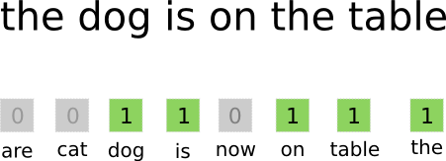
Bag of Words (BoW)
X:= number of words in the corpus
Represent each sentence by an x-long binary vector, each entry represents a word in the corpus.
There is no importance to the order in which the words appears

Slide 8
Bag of Words (BoW) – some issues
Upper/lower case?
Digits? (0-9)
What is the delimiter?
  www.Microsoft.com/home?user=jhon_999
  www.whatismyip.com
  www.bothhands.co.il
Dimensionality – in English there are ~171K words.
BUT – domains aren’t words ☹

Slide 9
Bag of Words (BoW) – “stop words”
Some words are “not important”:
  “a cat”
  “the cat”
  “any cat”
Removed to reduce dimensionality: “a”, “the”, “any” …

Slide 10
Agenda
Introduction to text analysis
Bag of words
N-gram
TF-IDF
Mini-project scenario

Slide 11
Character N-gram
X := number of n-length sub words in the corpus.
Represent each sentence with a X-long binary vector.
Each entry signals if the n-gram appears in the sentence.
Corpus: “hi”, “you” => [“hi”,”yo”,”ou”] (n=2, X=3)
“hi” => [1,0,0]
“you” => [0,1,1]
There is no importance to the order in which the n-gram appears (like BoW)

Slide 12
Character N-gram - example
“The quick brown fox jumps over the lazy dog“
1-gram: ‘t’ ‘h’ ‘e’ ‘ ‘ q’ ‘u’ ‘i’…
2-gram: ‘th’ ‘he’ ‘e ‘ q’ ‘qu’ ‘ui’ ‘ic’ …
…
Spaces?
Digits? (0-9)
Lower/upper case?

Slide 13

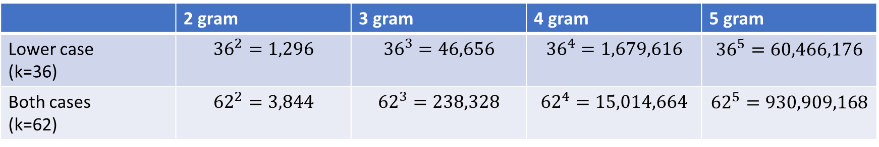
N-gram - dimensionally
Given an alphabet with k symbols, we have $k^{n}$ n-grams.
For English letters with digits:
Note- this is an upper-bound – not all n-gram are found in the corpus.
 | 2 gram | 3 gram | 4 gram | 5 gram
Lower case (k=36) | $${36}^{2}=1,296$$ | $${36}^{3}=46,656$$ | $${36}^{4}=1,679,616$$ | $${36}^{5}=60,466,176$$
Both cases (k=62) | $${62}^{2}=3,844$$ | $${62}^{3}=238,328$$ | $${62}^{4}=15,014,664$$ | $${62}^{5}=930,909,168$$

Slide 14
Agenda
Introduction to text analysis
Bag of words
N-gram
TF-IDF
Mini-project scenario

Slide 15
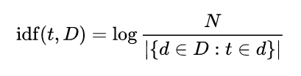
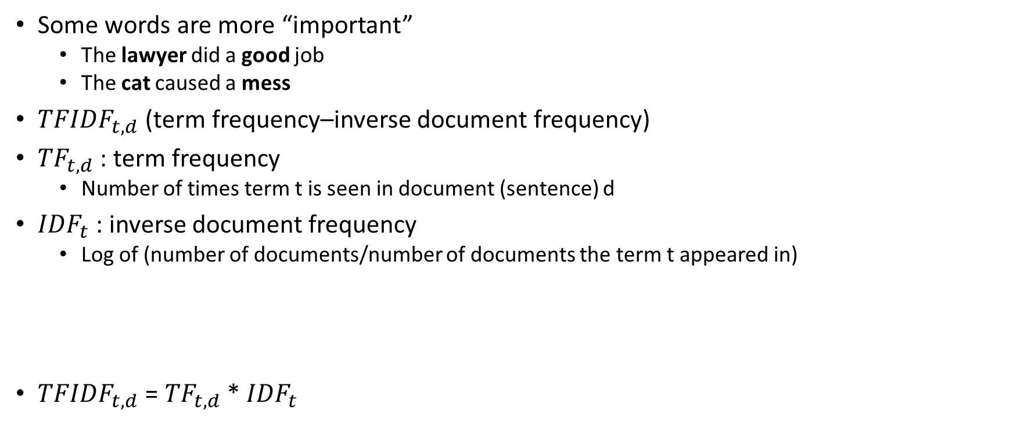
N-gram/BoW – TF-IDF
Some words are more “important”
  The lawyer did a good job
  The cat caused a mess
${TFIDF}_{t,d}$ (term frequency–inverse document frequency)
${TF}_{t,d}$ : term frequency
  Number of times term t is seen in document (sentence) d
${IDF}_{t}$ : inverse document frequency
  Log of (number of documents/number of documents the term t appeared in)
${TFIDF}_{t,d}$ = ${TF}_{t,d}$ * ${IDF}_{t}$
The less sentences the term t appears in, the higher the number!

Slide 16
N-gram/BoW – TF-IDF
  Corpus:
  S1: “I love my cat”
  S2: “This cat is lovely!”
  S3: “ The dog ate my lovely cat, but I still love that dog.”
  N =3
  Cat, dog, love

Slide 17
N-gram/BoW – TF-IDF
  Corpus:
  S1: “I love my cat”
  S2: “This cat is lovely!”
  S3: “ The dog ate my lovely cat, but I still love that dog.”
  N =3
  Cat, dog, love
  IDF(cat) = log(3/3)

Slide 18
N-gram/BoW – TF-IDF
  Corpus:
  S1: “I love my cat” tfidf(cat)=0
  S2: “This cat is lovely!” tfidf(cat)=0
  S3: “ The dog ate my lovely cat, but I still love that dog.” tfidf(cat)=0
  N =3
  Cat, dog, love
  IDF(cat) = log(3/3)

Slide 19
N-gram/BoW – TF-IDF
  Corpus:
  S1: “I love my cat”
  S2: “This cat is lovely!”
  S3: “ The dog ate my lovely cat, but I still love that dog.”
  N =3
  Cat, dog, love
  IDF(cat) = log(3/3) = 0
  IDF(dog) = log(3/1) = 0.47

Slide 20
N-gram/BoW – TF-IDF
  Corpus:
  S1: “I love my cat” tfidf(dog)=0
  S2: “This cat is lovely!” tfidf(dog)=0
  S3: “ The dog ate my lovely cat, but I still love that dog.” tfidf(dog)=2* 0.47=0.95
  N =3
  Cat, dog, love
  IDF(cat) = log(3/3) = 0
  IDF(dog) = log(3/1) = 0.47

Slide 21
N-gram/BoW – TF-IDF
  Corpus:
  S1: “I love my cat”
  S2: “This cat is lovely!”
  S3: “ The dog ate my lovely cat, but I still love that dog.”
  N =3
  Cat, dog, love
  IDF(cat) = log(3/3) = 0
  IDF(dog) = log(3/1) = 0.47
  IDF(love) = log(3/2) = 0.17

Slide 22
N-gram/BoW – TF-IDF
  Corpus:
  S1: “I love my cat” tfidf(love)=0.17
  S2: “This cat is lovely!” tfidf(love)=0
  S3: “ The dog ate my lovely cat, but I still love that dog.” tfidf(love)=0.17
  N =3
  Cat, dog, love
  IDF(cat) = log(3/3) = 0
  IDF(dog) = log(3/1) = 0.47
  IDF(love) = log(3/2) = 0.17

Slide 23
N-gram/BoW – TF-IDF
  Corpus:
  S1: “I love my cat”
  S2: “This cat is lovely!”
  S3: “ The dog ate my lovely cat, but I still love that dog.”
  N =3
  Cat, dog, love
  If we do the same for 4-gram (and not BoW):

Slide 24
N-gram/BoW – TF-IDF
  Corpus:
  S1: “I love my cat” tfidf(love)=0
  S2: “This cat is lovely!” tfidf(love)=0
  S3: “ The dog ate my lovely cat, but I still love that dog.” tfidf(love)=0
  N =3
  Cat, dog, love
  If we do the same for 4-gram (and not BoW):
  IDF(love) = log(3/3) = 0

Slide 25
Agenda
Introduction to text analysis
Bag of words
N-gram
TF-IDF
Mini-project scenario

Slide 26
Mini-Project – text analysis
What clear text features do we have? Domains/ file names
Extract features
n-gram
  Casing?
  Keep digits?
  Tf-idf?
  N=2,3,4,5?
BoW
  Casing?
  Keep digits?
  Tf-idf?
  Delimiters?

