Slide 1
Community detection mini-project
Danny Hendler
hendlerd@post.bgu.ac.il
Amir Rubin
amirrub@post.bgu.ac.il

Slide 2
Agenda
Introduction to community detection
Girvan-Newman algorithm
Dendogram and Modularity
Louvain algorithm
Mini projects usage

Slide 3
Agenda
Introduction to community detection
Girvan-Newman algorithm
Dendogram and Modularity
Louvain algorithm
Mini projects usage

Slide 4
What is a community?
What is a good community?
Out degree << in degree
What is a good partitioning to communities?
Overlapping communities?

Slide 5
Why is community-detection important?
A community ``summarizes” a group of actors and is relatively easy to visualize/understand
Partition to communities reveals high-level domain structure
May reveal important properties without compromising individuals' privacy

Slide 6
Community detection applications
Clustering customers with similar interests ➔ Recommendation systems [Reddy et al., DNIS 2002]
Clustering web clients with geographical proximity and similar access patterns ➔ cache servers positioning [Krishnamurty & Wang, SIGCOMM 2000]
Analysing structural positions ➔ Identifying central actors and inter-community mediators
Follow political trends
Detect malicious actors (e.g. spammers)
…

Slide 7
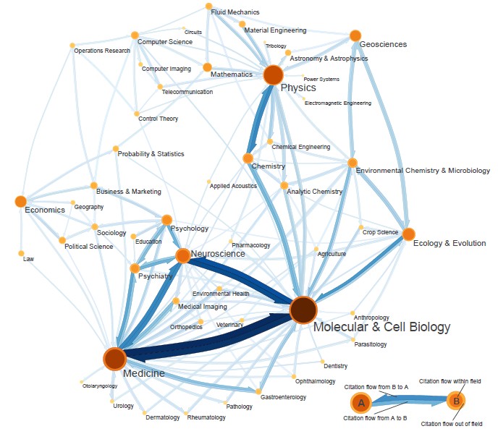
Notes:
כדי "לסבר את העין", הנה מפה של פעילות מדעית ואינטראקציות בין ובתוך קהילות מדעיות שונות שמבוססת על פרסומים מדעיים באלפי זורנלים...

Slide 8
Community detection algorithms
Cliques expansion
Label propagation
Random walks
Nodes embedding -> clustering
…
Girvan-Newman
Optimizing an objective function

Slide 9
Agenda
Introduction to community detection
Girvan-Newman algorithm
Dendogram and Modularity
Louvain algorithm
Mini projects usage

Slide 10
Girvan-Newman algorithm (2002)
A divisive method (as opposed to agglomerative methods)
Look for an edge that is most “between” pairs of nodes
Responsible for connecting many pairs
Remove edge and recalculate
Notes:
אוקי, אבל איך מזהים קהילות? יש הרבה מאד שיטות, ואני אציג עכשיו את אחד האלגוריתמים הקלאסיים – אלגוריתם של ניומן וגירוון משנת 2002
באופן כללי, יש שיטות זיהוי קהילות שמתחילות מהרשת המלאה ומוצאות את הקהילות באמצעות ניתוק קשתות שמהוות גשר בין קהילות. אלו נקראים divisive algorithms.
גישה אחרת מתחילה מהרשת ללא הקשתות ומוסיפה קשתות בין הצמתים ה"דומים" ביותר לפי קריטריונים כאלו ואחרים. אלו נקראים agglomerative algorithms.
האלגוריתם של ניומן וגירוון הוא מסוג divisive והרעיון שלו הוא לחפש קשתות בעלות רמת betweeness גבוהה, זאת אומרת, קשתות שמקשרות צמדים רבים של צמתים.

Slide 11
Girvan-Newman algorithm
Compute all-pairs shortest paths
For each edge, compute the number of such paths it belongs to
Remove a maximum-weight edge
Repeat until no edges
Notes:
האלגוריתם פשוט מאד ופועל באופן הבא: בכל שלב, מחושבים המסלולים הקצרים ביותר בגרף בין כל הצמדים
לכל קשת נותנים משקל על פי מספר המסלולים האלה העוברים דרכה
מסירים את הקשת בעלת המשקל המקסימלי, וחוזרים על החישוב
זהו אלגוריתם hierarchical clustering כי במהלך החישוב אנחנו מקבלים חלוקות רבות לקהילות וככל שהאלגוריתם מתקדם החלוקות הופכות ליותר ויותר עדינות. בואו נראה דוגמא לביצוע של האלגוריתם.

Slide 12
Shortest-path betweeness: an example
0
2
1
7
6
8
3
9
4
5

Slide 13
Shortest-path betweeness: an example
0
2
24
1
7
6
8
3
9
4
5
Notes:
The (2,6) edge is on the shortest path between every pair of nodes where one node is on the “left cluster” and the other is on the “right cluster”

Slide 14
Shortest-path betweeness: an example
0
2
1
7
6
8
3
9
4
5

Slide 15
Shortest-path betweeness: an example
0
2
1
7
9
6
8
3
9
4
5
Notes:
The (2,4) edge is on the shortest path between every pair of nodes where one node is on the “upper left cluster” and the other is on the “bottom left cluster”

Slide 16
Shortest-path betweeness: an example
0
2
1
3
7
6
8
3
9
4
5

Slide 17
Shortest-path betweeness: an example
0
1
2
1
7
6
8
3
9
4
5

Slide 18
Shortest-path betweeness: an example
0
1
2
1
7
6
8
3
9
4
5

Slide 19
Shortest-path betweeness: an example
0
2
1
1
7
6
8
3
9
4
5

Slide 20
Shortest-path betweeness: an example
0
2
1
7
6
8
3
1
9
4
5

Slide 21
Shortest-path betweeness: an example
0
2
1
7
6
8
3
9
1
4
5

Slide 22
Shortest-path betweeness: an example
0
2
1
7
6
8
3
9
4
5
1

Slide 23
Shortest-path betweeness: an example
0
2
1
7
1
6
8
3
9
4
5

Slide 24
Shortest-path betweeness: an example
0
2
1
7
6
1
8
3
9
4
5

Slide 25
Shortest-path betweeness: an example
0
2
1
7
6
8
3
9
1
4
5

Slide 26
Shortest-path betweeness: an example
0
2
1
7
6
8
3
9
4
5

Slide 27
Agenda
Introduction to community detection
Girvan-Newman algorithm
Dendogram and Modularity
Louvain algorithm
Mini projects usage

Slide 28
Dendrograms (hierarchical trees)
A dendrogram (hierarchical tree) illustrates the output of hierarchical clustering algorithms
Leaves represent graph nodes, top represents original graph
As we move down the tree, larger communities are partitioned to smaller ones
0
1
2
3
4
5
6
7
8
9

Slide 29
Shortest-path betweeness:
an example
0
2
24
1
7
6
8
3
9
4
5
0
1
2
3
4
5
6
7
8
9
Notes:
The (3,6) edge is on the shortest path between every pair of nodes where one node is on the “left cluster” and the other is on the “right cluster”

Slide 30
Shortest-path betweeness:
an example
0
2
1
7
9
6
8
3
9
4
5
0
1
2
3
4
5
6
7
8
9
Notes:
The (3,5) edge is on the shortest path between every pair of nodes where one node is on the “upper left cluster” and the other is on the “bottom left cluster”

Slide 31
Shortest-path betweeness:
an example
0
2
1
3
7
6
8
3
9
4
5
0
1
2
3
4
5
6
7
8
9

Slide 32
Shortest-path betweeness:
an example
0
1
2
1
7
6
8
3
9
4
5
0
1
2
3
4
5
6
7
8
9

Slide 33
Shortest-path betweeness:
an example
0
1
2
1
7
6
8
3
9
4
5
0
1
2
3
4
5
6
7
8
9

Slide 34
Shortest-path betweeness:
an example
0
2
1
1
7
6
8
3
9
4
5
0
1
2
3
4
5
6
7
8
9

Slide 35
Shortest-path betweeness:
an example
0
2
1
7
6
8
3
1
9
4
5
0
1
2
3
4
5
6
7
8
9

Slide 36
Shortest-path betweeness:
an example
0
2
1
7
6
8
3
9
1
4
5
0
1
2
3
4
5
6
7
8
9

Slide 37
Shortest-path betweeness:
an example
0
2
1
7
6
8
3
9
4
5
1
0
1
2
3
4
5
6
7
8
9

Slide 38
Shortest-path betweeness:
an example
0
2
1
7
1
6
8
3
9
4
5
0
1
2
3
4
5
6
7
8
9

Slide 39
Shortest-path betweeness:
an example
0
2
1
7
6
1
8
3
9
4
5
0
1
2
3
4
5
6
7
8
9

Slide 40
Shortest-path betweeness:
an example
0
2
1
7
6
8
3
9
1
4
5
0
1
2
3
4
5
6
7
8
9

Slide 41
Shortest-path betweeness:
an example
0
2
1
7
6
8
3
9
4
5
0
1
2
3
4
5
6
7
8
9

Slide 42
How to select the best level?
0
2
1
7
6
8
3
9
4
5
0
1
2
3
4
5
6
7
8
9
Notes:
The (2,6) edge is on the shortest path between every pair of nodes where one node is on the “left cluster” and the other is on the “right cluster”

Slide 43
Quality functions
Hierarchical clustering algorithms create numerous partitions
In general, we do not know how many communities we should seek. How will we know that our clustering is “good”?
We need a quality function
0
1
2
3
4
5
6
7
8
9

Slide 44
The modularity quality function
No communities in random graphs
Equal probabilities for all edges
Check how far intra-community and inter-community densities are from those you would expect in a random graph with identical nodes and same degree-distribution

Slide 45
Modularity - intuition
The goal: check the quality of a given partition
Compare the “density” in the clusters to a “random” graph
“Random”:
Keep the nodes degree as is
Edges are randomly placed

Slide 46
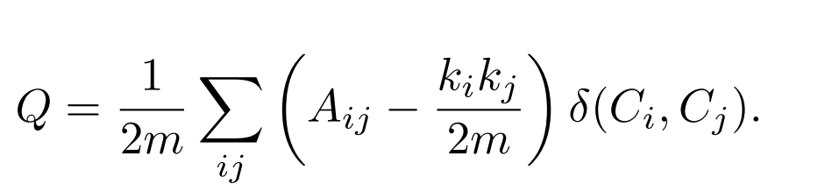
The modularity quality function
Degrees of nodes-pair
Modularity value
# edges
Probability of an edge if degrees are set and edges placed in random
In-same-cluster indicator variable
Graph adjacency matrix
Clauset, Newman and Moore. Finding community structure in very large networks, 2004

Slide 47
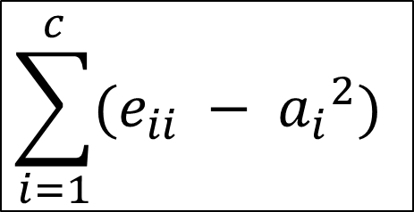
An alternative formulation for modularity
Fraction of edges with both endpoints in community i
$$\sum_{i=1}^{c}{(e_{ii} − {a_{i}}^{2})}$$
Fraction of ends of edges that are attached to vertices in community i
Notes:
בואי נדמיין שהצלעות נזרקות באקראי בגרף
כאשר מובטח לנו שדרגת הקודקודים נשמרת.
מה הוא הביטוי
A^2?
A
הוא מספר הקצוות של צלעות בתוך הקהילה(מתוך כל הקצוות שיש)
אז אם נכפיל אותו בעצמו נקבל את הסיכוי לצלע להופיע בתוך הקהילה(כי לצלע יש שתי קצוות, ואנחנו מכפילים,שזה שקול לשאלה – מה ההסברות ששני הקצוות בקהילה

Slide 48

Modularity-preparation
$e_{ij}=\sum_{v∈c_{i}, w∈c_{j}}{\frac{A_{v,w}}{2m}}$
$a_{i}=\sum_{j}{e_{ij}}$
C1
 | C1 | C2 | C3 | A
C1 | 10 | 1 | 1 | 12
C2 | 1 | 6 | 0 | 7
C3 | 1 | 0 | 4 | 5
C2
/2m
C3

Slide 49

Modularity-preparation
 | C1 | C2 | C3 | ai
C1 | 10 | 1 | 1 | 12
C2 | 1 | 6 | 0 | 7
C3 | 1 | 0 | 4 | 5
In a graph, for a given cluster $c_{i}$,
the chance that an edge is in $c_{i}$ is $e_{i,i}$.
In a “random” graph, this chance is
~ $a_{i}∗a_{i}$
So, the difference is: ${(e}_{i,i}−a_{i}^{2})$
C1
C2
C3

Slide 50
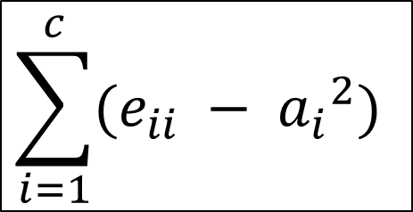
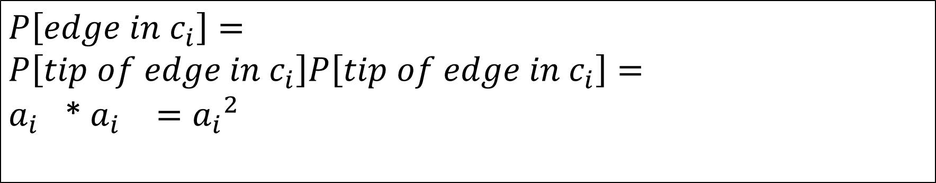
An alternative formulation for modularity
$$\sum_{i=1}^{c}{(e_{ii} − {a_{i}}^{2})}$$
$$P\left[edge in c_{i}\right]=$$
$$P\left[tip of edge in c_{i}\right]P\left[tip of edge in c_{i}\right]=$$
${a_{i}}^{}$* ${a_{i}}^{}={a_{i}}^{2}$
Notes:
בואי נדמיין שהצלעות נזרקות באקראי בגרף
כאשר מובטח לנו שדרגת הקודקודים נשמרת.
מה הוא הביטוי
A^2?
A
הוא מספר הקצוות של צלעות בתוך הקהילה(מתוך כל הקצוות שיש)
אז אם נכפיל אותו בעצמו נקבל את הסיכוי לצלע להופיע בתוך הקהילה(כי לצלע יש שתי קצוות, ואנחנו מכפילים,שזה שקול לשאלה – מה ההסברות ששני הקצוות בקהילה

Slide 51

Modularity
C is a partitioning of V
Q(C) = $\sum_{c=1}^{|C|}{\left(e_{ii}−a_{i}^{2}\right)}$
$e_{ii}=\sum_{v∈c_{i}, w∈c_{j}}{\frac{A_{v,w}}{2m}}$
$a_{i}=\sum_{j}{e_{ij}}$
C1
C2
C3

Slide 52

Modularity – edge cases
Fraction of edges with both endpoints in community i
C={{v} : v in V}
Q(C) = $\sum_{c=1}^{|C|}{\left(e_{ii}−a_{i}^{2}\right)}$
$e_{ii}$=0
$a_{i}^{2}={(\frac{k_{i}}{2m})}^{2}$
Q(C)= strong negative
Fraction of ends of edges that are attached to vertices in community i

Slide 53

Modularity – edge cases
Fraction of edges with both endpoints in community i
C=V
Q(C) = $\sum_{c=1}^{|C|}{\left(e_{ii}−a_{i}^{2}\right)}$
$e_{ii}=\frac{2m}{2m}$
$a_{i}^{2}={(\frac{2m}{2m})}^{2}$
Q(C)= 0
Fraction of ends of edges that are attached to vertices in community i

Slide 54
Agenda
Introduction to community detection
Girvan-Newman algorithm
Dendogram and Modularity
Louvain algorithm
Mini projects usage

Slide 55
Note: Modularity has a local delta value
C1
C1
C2
C2
C3
C3

Slide 56
Louvain – community detection algorithm (2008)
Optimizing Modularity
A node-centric approach
Notes:
So -community detection algorithms search for a good partitioning of the network.
many of these algorithms – such as
<CLICK>
Louvaiv, SCD, MOGA-net are guided by an objective function.
The objective functions assigns a score to a the partition, and the algorithm attempts to optimize this score.
Louvain from 2008 is a key example for such an algorithm
<CLICK>
Louvain takes a node centric approach - it selects, using the objective function, the “best” community to which the nodes should be added.
For example, the node here has 4 neighbors, each in a separate community.
Assume that the function gains 0.4 if the node joins the community on the right, 0.8 if it joins the bottom community, and 0.9 if it joins the one on the left.
It is now easy to decide to which *single* community it should be added, although it is less clear what we should do in the overlapping setting
SCD-
@inproceedings{prat2014high, title={High quality, scalable and parallel community detection for large real graphs}, author={Prat-P{\'e}rez, Arnau and Dominguez-Sal, David and Larriba-Pey, Josep-Lluis}, booktitle={Proceedings of the 23rd international conference on World wide web}, pages={225--236}, year={2014}, organization={ACM} }
MOGA-net –
Clara Pizzuti. A multiobjective genetic algorithm to nd communities
in complex networks. IEEE Transactions on Evolutionary Computation,
16(3):418{430, 2012.

Slide 57
Louvain – community detection algorithm (2008)
Init: C={{v}:v in V}, stableNodes=0
While stableNodes<n:
stableNodes=0
For v in V:
Extract v from all communities
For each c such that v has a neighbor in c:
Calc modularity improvement if we add v to c
Add v to the c with the largest improvement
If v returned to its original community: stableNodes++

Slide 58
Modularity

Slide 59
Modularity

Slide 60
Modularity

Slide 61
Modularity

Slide 62
Modularity

Slide 63
Modularity

Slide 64
Modularity

Slide 65
Modularity

Slide 66
Modularity
Stabled – no node prefers to move.

Slide 67
Agenda
Introduction to community detection
Girvan-Newman algorithm
Dendogram and Modularity
Louvain algorithm
Mini projects usage

Slide 68
Mini projects - Community Detection
Build networks
Example: Machine – Files
Weighted?
Extreme values?
Community detection
Machine learning
Features from communities
“Static” features (size, prevalence, etc..)

Slide 69
Build graphs
Files
Machines

Slide 70
Extract features
# files in cluster
# machines in cluster
# malicious files in cluster
…

