Slide 1
Big Data Analysis for Cyber Security mini-project
Big Data & Machine Learning Concepts
Presentation prepared by Yehonatan Cohen and Danny Hendler Some of the slides based on the online book “Social media mining”, R. Zafarani, M. A. Abbasi & H. Liu.

Slide 2
Talk outline
Data mining & machine learning concepts
Decision trees
Naïve Bayes classifier
Classification quality metrics

Slide 3
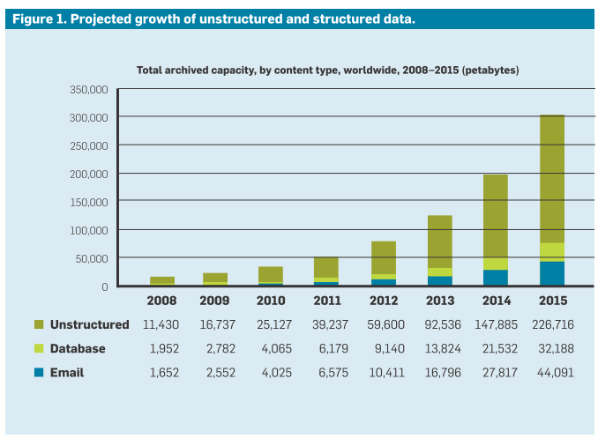
Big Data
Data production rate dramatically increased
Social media data, mobile phone data, healthcare data, purchase data…
Image taken from “data science and prediction”, CACM, December 2013
Notes:
Gigabyte
Terabyte
Petabyte

Slide 4
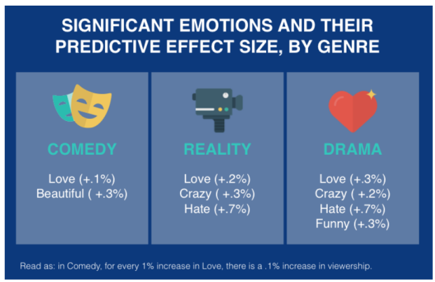
Data mining/ Knowledge Discovery in DB (KDD)
Infer actionable knowledge/insights from data
When men buy diapers on Fridays, they also buy beer (a myth…)
Email spamming accounts tend to cluster in communities
Both love & hate drive reality ratings
Notes:
Feelings of hate lead to bigger increase in viewership the following week for drama and reality shows (study base on Twitter data)

Slide 5
Data mining/ Knowledge Discovery in DB (KDD)
Infer actionable knowledge/insights from data
When men buy diapers on Fridays, they also buy beer
Email spamming accounts tend to cluster in communities
Both love & hate drive reality ratings
Involves several tasks
Anomaly detection
Association rule learning
Classification
Regression
Summarization
Clustering
Notes:
Feelings of hate lead to bigger increase in viewership the following week for drama and reality shows (study base on Twitter data)

Slide 6
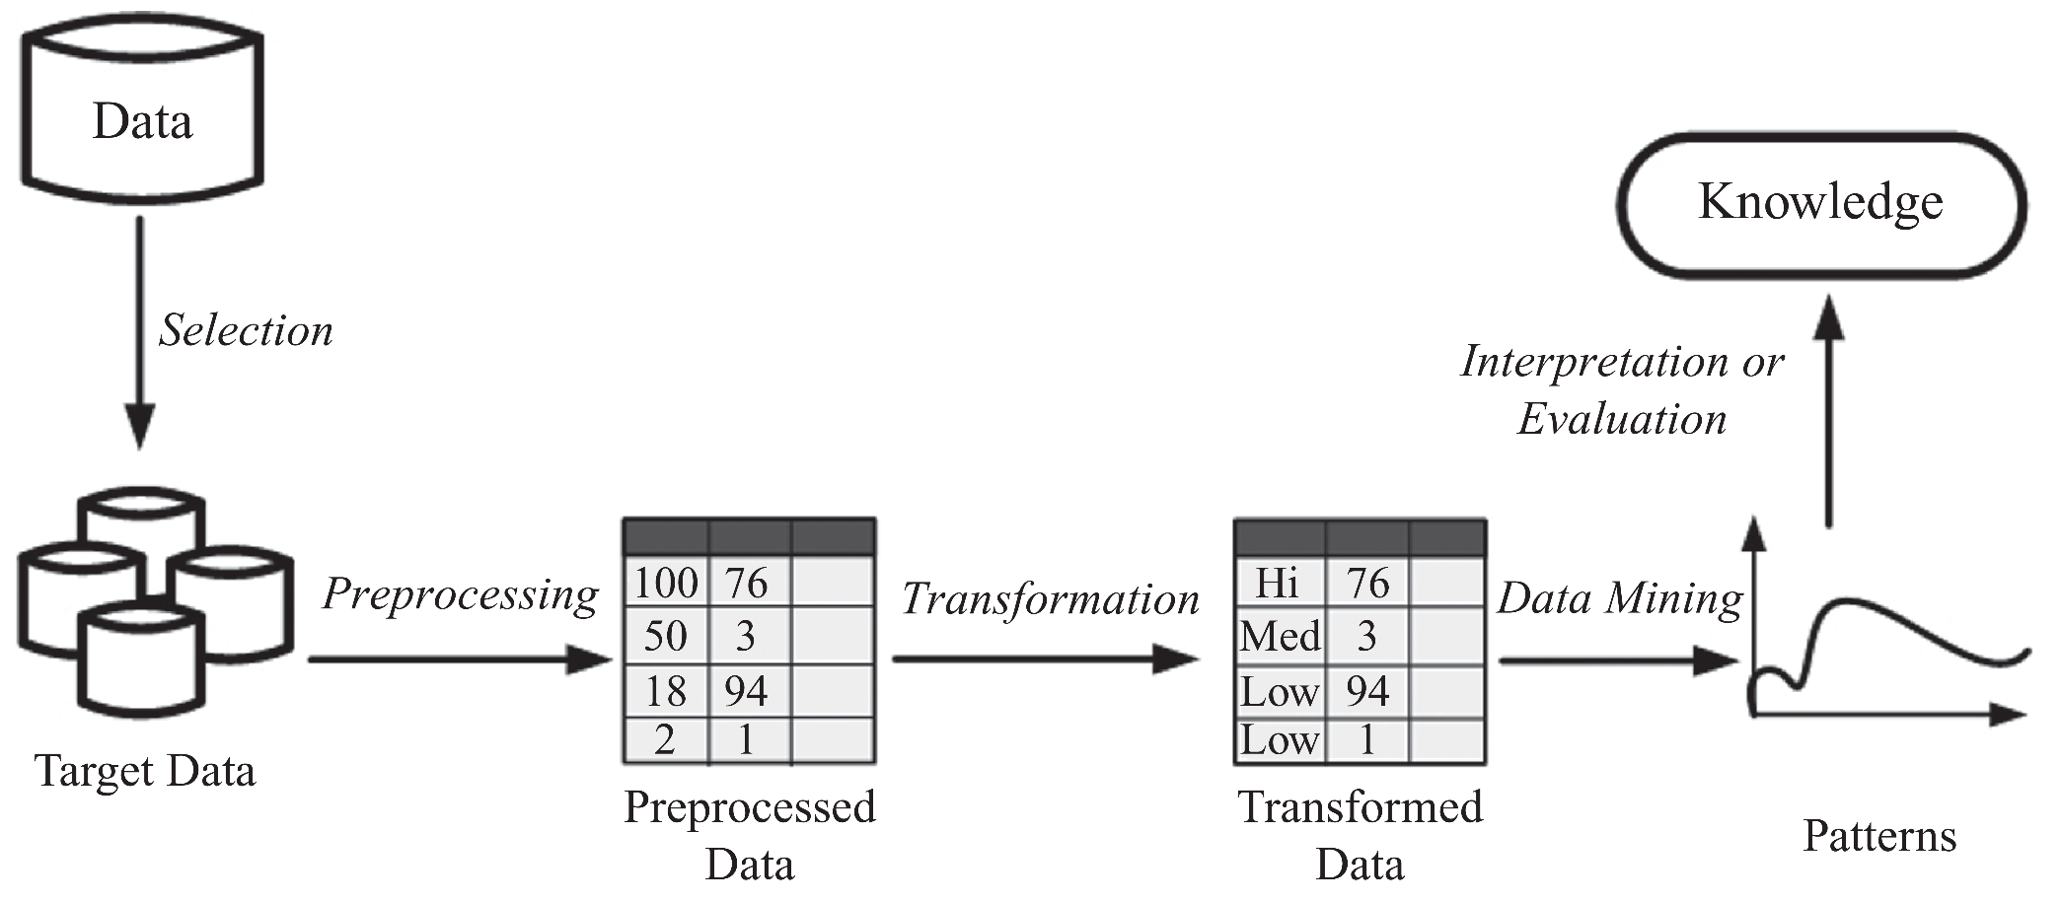
Data mining process
Notes:
Preprocessing deals with issues such as out-of-range values, impossible data combinations (Sex: male, pregnant: Yes), missing values, etc.
Transformation – data transformed into form appropriate for data mining, e.g. by removing noise, aggregating, etc.

Slide 7
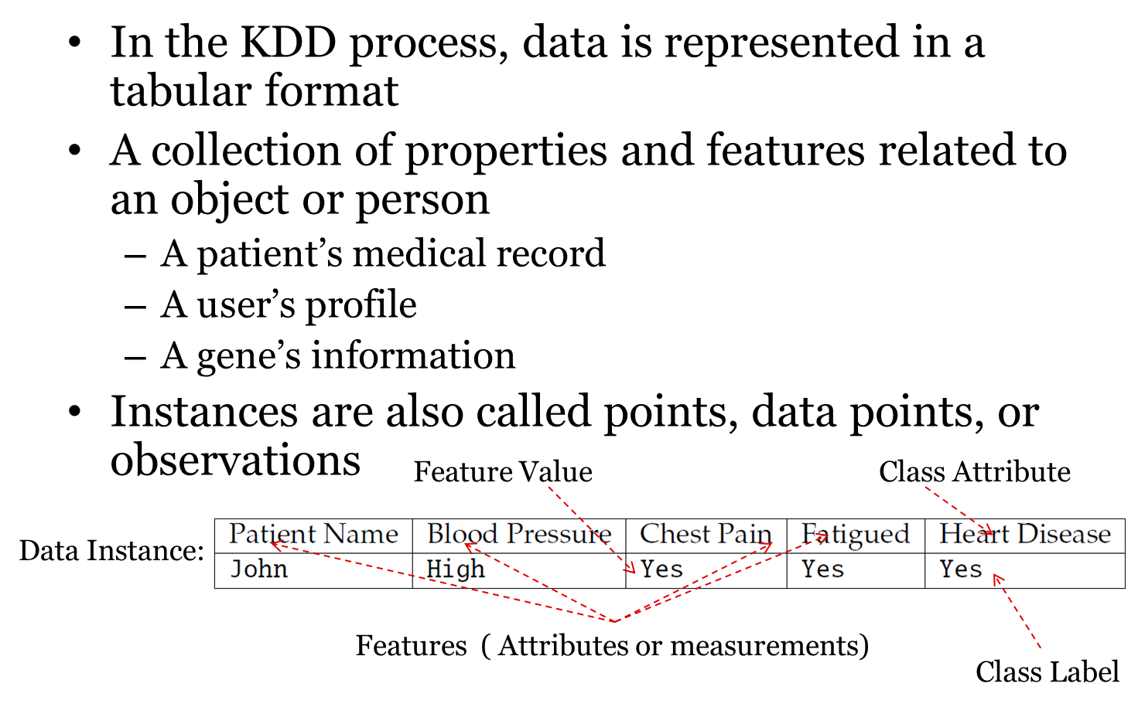
Data instances

Slide 8
Data instances (continued)
Unlabeled example
Labeled example
Predict whether an individual that visits an online book seller will buy a specific book

Slide 9
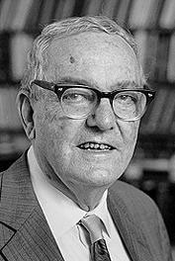
Machine Learning
Herbert Alexander Simon: “Learning is any process by which a system improves performance from experience.”
“Machine Learning is concerned with computer programs that automatically improve their performance through experience. “
Herbert Simon
Turing Award 1975
Nobel Prize in Economics 1978

Slide 10
Machine Learning
Learning = Improving with experience at some task
Improve over task, T
With respect to performance measure, P
Based on experience, E
Herbert Simon
Turing Award 1975
Nobel Prize in Economics 1978

Slide 11
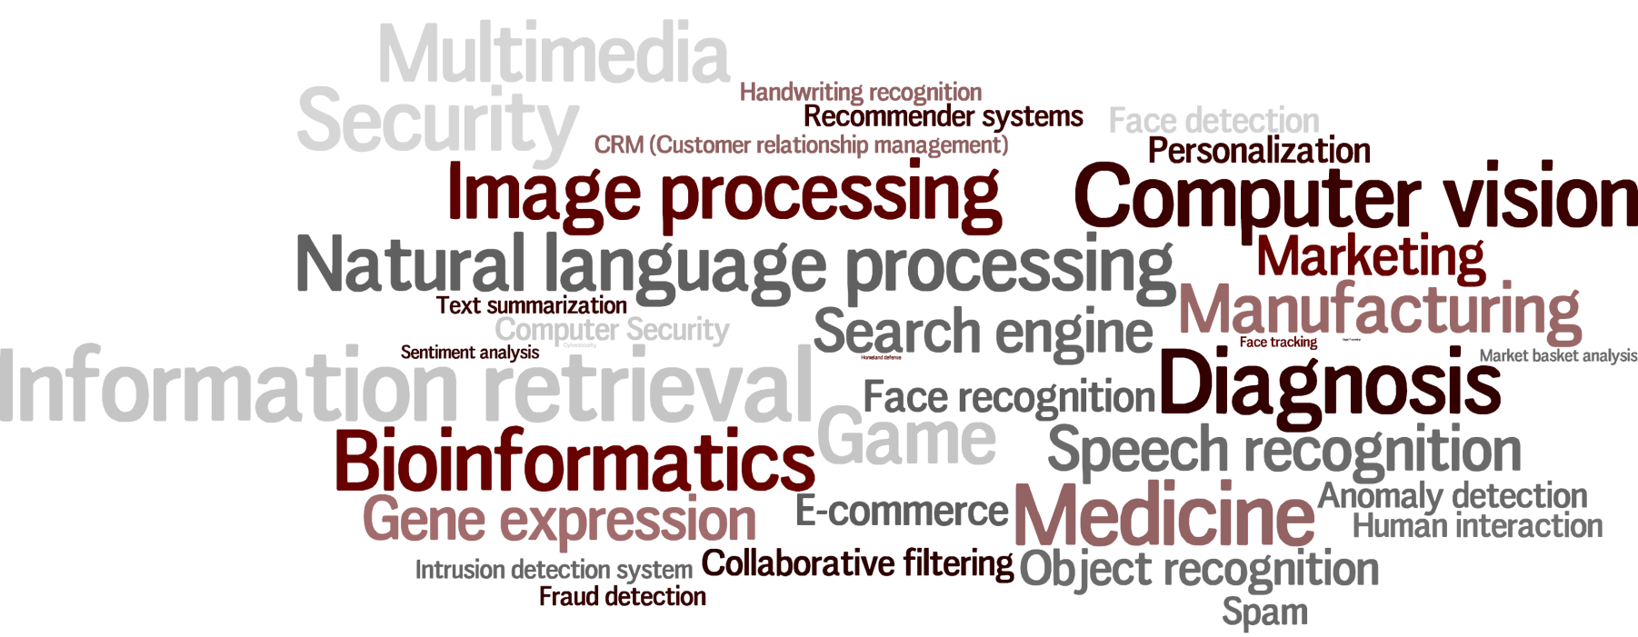
Machine Learning
Applications?

Slide 12
Categories of ML algorithms
Supervised Learning Algorithm
Classification (class attribute is discrete)
Assign data into predefined classes
Spam Detection, fraudulent credit card detection
Regression (class attribute takes real values)
Predict a real value for a given data instance
Predict the price for a given house
Unsupervised Learning Algorithm
Group similar items together into some clusters
Detect communities in a given social network

Slide 13
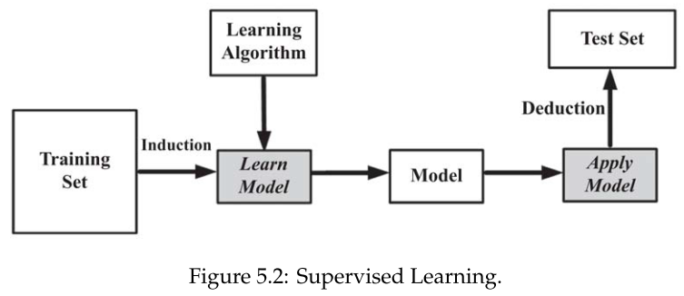
Supervised learning process
We are given a set of labeled examples
These examples are records/instances in the format (x, y) where x is a vector and y is the class attribute, commonly a scalar
The supervised learning task is to build a model that maps x to y (find a mapping m such that m(x) = y)
Given unlabeled instances (x’,?), we compute m(x’)
E.g., fraud/non-fraud prediction

Slide 14
Talk outline
Data mining & machine learning concepts
Decision trees
Naïve Bayes classifier
Classification quality metrics

Slide 15
Decision tree learning - an example
Splitting Attributes
categorical
categorical
Integer
class
Refund
Cheat | Taxable Income | Marital status | Refund | T id
No | 125K | Single | Yes | 1
No | 100K | Married | No | 2
No | 70K | Single | No | 3
No | 120K | Married | Yes | 4
Yes | 95K | Divorced | No | 5
No | 60K | Married | No | 6
No | 220K | Divorced | Yes | 7
Yes | 85K | Single | No | 8
No | 75K | Married | No | 9
Yes | 90K | Single | No | 10
Yes
No
No
MarSt
Single, Divorced
Married
TaxInc
No
< 80K
> 80K
No
Yes
Training Data
Class labels
Notes:
Tax fraud detection

Slide 16
Decision tree construction
Decision trees are constructed recursively from training data using a top-down greedy approach in which features are sequentially selected.
After selecting a feature for each node, based on its values, different branches are created.
The training set is then partitioned into subsets based on the feature values, each of which fall under the respective feature value branch; the process is continued for these subsets and other nodes
When selecting features, we prefer features that partition the set of instances into subsets that are more pure. A pure subset has instances that all have the same class attribute value.

Slide 17
Purity is measured by entropy
Features selected based on set purity
To measure purity we can use [minimize] entropy. Over a subset of training instances, T, with a binary class attribute (values in {+,-}), the entropy of T is defined as:
p₊ is the proportion of positive examples in D
p₋ is the proportion of negative examples in D

Slide 18
Entropy example
Assume there is a subset T, containing 10 instances. Seven instances have a positive class attribute value and three have a negative class attribute value [7+, 3-]. The entropy measure for subset T is
What is the range of entropy values?
[0 , 1]
Pure
Balanced

Slide 19
Information gain (IG)
We select the feature that is most useful in separating between classes to be learnt, based on IG
IG is the difference between the entropy of the parent node and the average entropy of the child nodes
We select the feature that maximizes IG

Slide 20
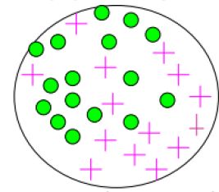
Information gain calculation example

Slide 21

Information gain calculation example

Slide 22
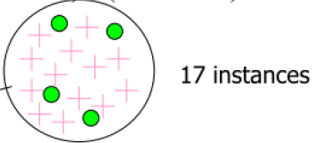
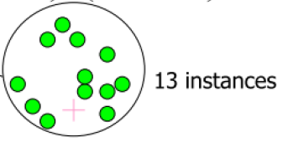
Information gain calculation example

Slide 23

Information gain calculation example

Slide 24

Information gain calculation example

Slide 25
Information gain calculation example

Slide 26
Information gain calculation example

Slide 27
Decision tree construction: example
categorical
categorical
Integer
class
Cheat | Taxable Income | Marital status | Refund | T id
No | 125K | Single | Yes | 1
No | 100K | Married | No | 2
No | 70K | Single | No | 3
No | 120K | Married | Yes | 4
Yes | 95K | Divorced | No | 5
No | 60K | Married | No | 6
No | 220K | Divorced | Yes | 7
Yes | 85K | Single | No | 8
No | 75K | Married | No | 9
Yes | 90K | Single | No | 10
Training Data

Slide 28
Decision tree construction: example
categorical
categorical
Integer
class
Splitting Attribute
Cheat | Taxable Income | Marital status | Refund | T id
No | 125K | Single | Yes | 1
No | 100K | Married | No | 2
No | 70K | Single | No | 3
No | 120K | Married | Yes | 4
Yes | 95K | Divorced | No | 5
No | 60K | Married | No | 6
No | 220K | Divorced | Yes | 7
Yes | 85K | Single | No | 8
No | 75K | Married | No | 9
Yes | 90K | Single | No | 10
Refund
Yes
Training Data
Model: Decision Tree

Slide 29
Decision tree construction: example
categorical
categorical
Integer
class
Splitting Attribute
Cheat | Taxable Income | Marital status | Refund | T id
No | 125K | Single | Yes | 1
No | 100K | Married | No | 2
No | 70K | Single | No | 3
No | 120K | Married | Yes | 4
Yes | 95K | Divorced | No | 5
No | 60K | Married | No | 6
No | 220K | Divorced | Yes | 7
Yes | 85K | Single | No | 8
No | 75K | Married | No | 9
Yes | 90K | Single | No | 10
Refund
Yes
Training Data
Model: Decision Tree

Slide 30
Decision tree construction: example
categorical
categorical
Integer
class
Splitting Attribute
Cheat | Taxable Income | Marital status | Refund | T id
No | 125K | Single | Yes | 1
No | 100K | Married | No | 2
No | 70K | Single | No | 3
No | 120K | Married | Yes | 4
Yes | 95K | Divorced | No | 5
No | 60K | Married | No | 6
No | 220K | Divorced | Yes | 7
Yes | 85K | Single | No | 8
No | 75K | Married | No | 9
Yes | 90K | Single | No | 10
Refund
Yes
NO
Training Data
Model: Decision Tree

Slide 31
Decision tree construction: example
categorical
categorical
Integer
class
Splitting Attribute
Cheat | Taxable Income | Marital status | Refund | T id
No | 125K | Single | Yes | 1
No | 100K | Married | No | 2
No | 70K | Single | No | 3
No | 120K | Married | Yes | 4
Yes | 95K | Divorced | No | 5
No | 60K | Married | No | 6
No | 220K | Divorced | Yes | 7
Yes | 85K | Single | No | 8
No | 75K | Married | No | 9
Yes | 90K | Single | No | 10
Refund
Yes
NO
Training Data
Model: Decision Tree

Slide 32
Decision tree construction: example
categorical
categorical
Integer
class
Splitting Attribute
Cheat | Taxable Income | Marital status | Refund | T id
No | 125K | Single | Yes | 1
No | 100K | Married | No | 2
No | 70K | Single | No | 3
No | 120K | Married | Yes | 4
Yes | 95K | Divorced | No | 5
No | 60K | Married | No | 6
No | 220K | Divorced | Yes | 7
Yes | 85K | Single | No | 8
No | 75K | Married | No | 9
Yes | 90K | Single | No | 10
Refund
Yes
No
NO
MarSt
Married
Training Data
Model: Decision Tree

Slide 33
Decision tree construction: example
categorical
categorical
Integer
class
Splitting Attribute
Cheat | Taxable Income | Marital status | Refund | T id
No | 125K | Single | Yes | 1
No | 100K | Married | No | 2
No | 70K | Single | No | 3
No | 120K | Married | Yes | 4
Yes | 95K | Divorced | No | 5
No | 60K | Married | No | 6
No | 220K | Divorced | Yes | 7
Yes | 85K | Single | No | 8
No | 75K | Married | No | 9
Yes | 90K | Single | No | 10
Refund
Yes
No
NO
MarSt
Married
Training Data
Model: Decision Tree

Slide 34
Decision tree construction: example
categorical
categorical
Integer
class
Splitting Attribute
Cheat | Taxable Income | Marital status | Refund | T id
No | 125K | Single | Yes | 1
No | 100K | Married | No | 2
No | 70K | Single | No | 3
No | 120K | Married | Yes | 4
Yes | 95K | Divorced | No | 5
No | 60K | Married | No | 6
No | 220K | Divorced | Yes | 7
Yes | 85K | Single | No | 8
No | 75K | Married | No | 9
Yes | 90K | Single | No | 10
Refund
Yes
No
NO
MarSt
Married
NO
Training Data
Model: Decision Tree

Slide 35
Decision tree construction: example
categorical
categorical
Integer
class
Splitting Attribute
Cheat | Taxable Income | Marital status | Refund | T id
No | 125K | Single | Yes | 1
No | 100K | Married | No | 2
No | 70K | Single | No | 3
No | 120K | Married | Yes | 4
Yes | 95K | Divorced | No | 5
No | 60K | Married | No | 6
No | 220K | Divorced | Yes | 7
Yes | 85K | Single | No | 8
No | 75K | Married | No | 9
Yes | 90K | Single | No | 10
Refund
Yes
No
NO
MarSt
Married
NO
Training Data
Model: Decision Tree

Slide 36
Decision tree construction: example
categorical
categorical
Integer
class
Splitting Attribute
Cheat | Taxable Income | Marital status | Refund | T id
No | 125K | Single | Yes | 1
No | 100K | Married | No | 2
No | 70K | Single | No | 3
No | 120K | Married | Yes | 4
Yes | 95K | Divorced | No | 5
No | 60K | Married | No | 6
No | 220K | Divorced | Yes | 7
Yes | 85K | Single | No | 8
No | 75K | Married | No | 9
Yes | 90K | Single | No | 10
Refund
Yes
No
NO
MarSt
Single, Divorced
Married
NO
Training Data
Model: Decision Tree

Slide 37
Decision tree construction: example
categorical
categorical
Integer
class
Splitting Attribute
Cheat | Taxable Income | Marital status | Refund | T id
No | 125K | Single | Yes | 1
No | 100K | Married | No | 2
No | 70K | Single | No | 3
No | 120K | Married | Yes | 4
Yes | 95K | Divorced | No | 5
No | 60K | Married | No | 6
No | 220K | Divorced | Yes | 7
Yes | 85K | Single | No | 8
No | 75K | Married | No | 9
Yes | 90K | Single | No | 10
Refund
Yes
No
NO
MarSt
Single, Divorced
Married
NO
Training Data
Model: Decision Tree

Slide 38
Decision tree construction: example
categorical
categorical
Integer
class
Splitting Attribute
Cheat | Taxable Income | Marital status | Refund | T id
No | 125K | Single | Yes | 1
No | 100K | Married | No | 2
No | 70K | Single | No | 3
No | 120K | Married | Yes | 4
Yes | 95K | Divorced | No | 5
No | 60K | Married | No | 6
No | 220K | Divorced | Yes | 7
Yes | 85K | Single | No | 8
No | 75K | Married | No | 9
Yes | 90K | Single | No | 10
Refund
Yes
No
NO
MarSt
Single, Divorced
Married
TaxInc
NO
> 80K
Training Data
Model: Decision Tree

Slide 39
Decision tree construction: example
categorical
categorical
Integer
class
Splitting Attribute
Cheat | Taxable Income | Marital status | Refund | T id
No | 125K | Single | Yes | 1
No | 100K | Married | No | 2
No | 70K | Single | No | 3
No | 120K | Married | Yes | 4
Yes | 95K | Divorced | No | 5
No | 60K | Married | No | 6
No | 220K | Divorced | Yes | 7
Yes | 85K | Single | No | 8
No | 75K | Married | No | 9
Yes | 90K | Single | No | 10
Refund
Yes
No
NO
MarSt
Single, Divorced
Married
TaxInc
NO
> 80K
Training Data
Model: Decision Tree

Slide 40
Decision tree construction: example
categorical
categorical
Integer
class
Splitting Attribute
Cheat | Taxable Income | Marital status | Refund | T id
No | 125K | Single | Yes | 1
No | 100K | Married | No | 2
No | 70K | Single | No | 3
No | 120K | Married | Yes | 4
Yes | 95K | Divorced | No | 5
No | 60K | Married | No | 6
No | 220K | Divorced | Yes | 7
Yes | 85K | Single | No | 8
No | 75K | Married | No | 9
Yes | 90K | Single | No | 10
Refund
Yes
No
NO
MarSt
Single, Divorced
Married
TaxInc
NO
> 80K
Yes
Training Data
Model: Decision Tree

Slide 41
Decision tree construction: example
categorical
categorical
Integer
class
Splitting Attribute
Cheat | Taxable Income | Marital status | Refund | T id
No | 125K | Single | Yes | 1
No | 100K | Married | No | 2
No | 70K | Single | No | 3
No | 120K | Married | Yes | 4
Yes | 95K | Divorced | No | 5
No | 60K | Married | No | 6
No | 220K | Divorced | Yes | 7
Yes | 85K | Single | No | 8
No | 75K | Married | No | 9
Yes | 90K | Single | No | 10
Refund
Yes
No
NO
MarSt
Single, Divorced
Married
TaxInc
NO
> 80K
Yes
Training Data
Model: Decision Tree

Slide 42
Decision tree construction: example
categorical
categorical
Integer
class
Splitting Attribute
Cheat | Taxable Income | Marital status | Refund | T id
No | 125K | Single | Yes | 1
No | 100K | Married | No | 2
No | 70K | Single | No | 3
No | 120K | Married | Yes | 4
Yes | 95K | Divorced | No | 5
No | 60K | Married | No | 6
No | 220K | Divorced | Yes | 7
Yes | 85K | Single | No | 8
No | 75K | Married | No | 9
Yes | 90K | Single | No | 10
Refund
Yes
No
NO
MarSt
Single, Divorced
Married
TaxInc
NO
< 80K
> 80K
Yes
Training Data
Model: Decision Tree

Slide 43
Decision tree construction: example
categorical
categorical
Integer
class
Splitting Attribute
Cheat | Taxable Income | Marital status | Refund | T id
No | 125K | Single | Yes | 1
No | 100K | Married | No | 2
No | 70K | Single | No | 3
No | 120K | Married | Yes | 4
Yes | 95K | Divorced | No | 5
No | 60K | Married | No | 6
No | 220K | Divorced | Yes | 7
Yes | 85K | Single | No | 8
No | 75K | Married | No | 9
Yes | 90K | Single | No | 10
Refund
Yes
No
NO
MarSt
Single, Divorced
Married
TaxInc
NO
< 80K
> 80K
Yes
Training Data
Model: Decision Tree

Slide 44
Decision tree construction: example
categorical
categorical
Integer
class
Splitting Attribute
Cheat | Taxable Income | Marital status | Refund | T id
No | 125K | Single | Yes | 1
No | 100K | Married | No | 2
No | 70K | Single | No | 3
No | 120K | Married | Yes | 4
Yes | 95K | Divorced | No | 5
No | 60K | Married | No | 6
No | 220K | Divorced | Yes | 7
Yes | 85K | Single | No | 8
No | 75K | Married | No | 9
Yes | 90K | Single | No | 10
Refund
Yes
No
NO
MarSt
Single, Divorced
Married
TaxInc
NO
< 80K
> 80K
NO
Yes
Training Data
Model: Decision Tree

Slide 45
Decision tree construction: example
categorical
categorical
Integer
class
Splitting Attribute
Cheat | Taxable Income | Marital status | Refund | T id
No | 125K | Single | Yes | 1
No | 100K | Married | No | 2
No | 70K | Single | No | 3
No | 120K | Married | Yes | 4
Yes | 95K | Divorced | No | 5
No | 60K | Married | No | 6
No | 220K | Divorced | Yes | 7
Yes | 85K | Single | No | 8
No | 75K | Married | No | 9
Yes | 90K | Single | No | 10
Refund
Yes
No
NO
MarSt
Single, Divorced
Married
TaxInc
NO
< 80K
> 80K
NO
Yes
Training Data
Model: Decision Tree

Slide 46
Talk outline
Data mining & machine learning concepts
Decision trees
Naïve Bayes classifier
Classification quality metrics

Slide 47
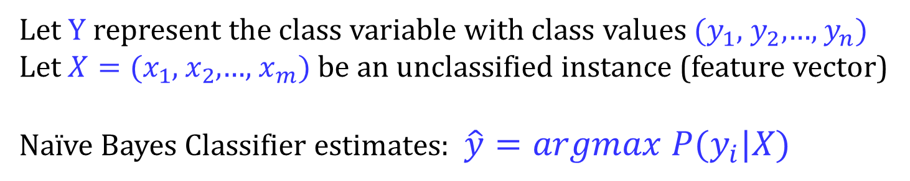

Naïve Bayes' Classifier
Let Y represent the class variable with class values $(y_{1}$, $y_{2}$,…, $y_{n})$ Let $X=(x_{1}$, $x_{2}$,…, $x_{m})$ be an unclassified instance (feature vector) Naïve Bayes Classifier estimates: $\hat{y}=argmax P(y_{i}|X)$
$$y_{i}$$
Notes:
בסיווג על פי עץ החלטה, בנינו עץ ובו בכל צומת אמצעי יש התפצלות בהתאם לערך של אחד מן ה features של X.
הסווג naïve Base לעומת זאת בוחר את אותו ערך של Y שההסתברות לראות אותו בהנתן X היא המקסימלית. עוד מעט נראה דוגמא שתבהיר לנו את הרעיון הזה.

Slide 48
Naïve Bayes' Classifier
Let Y represent the class variable with class values $(y_{1}$, $y_{2}$,…, $y_{n})$ Let $X=(x_{1}$, $x_{2}$,…, $x_{m})$ be an unclassified instance (feature vector) Naïve Bayes Classifier estimates: $\hat{y}=argmax P(y_{i}|X)$
$$y_{i}$$
From Bayes formula: $P{(y}_{i}|X)=\frac{P\left(X | y_{i}\right)P(y_{i})}{P(X)}$
Notes:
אבל איך נמצא את ההסתברות הזו? פה אפשר להשתמש בנוסחת בייס שנתונה פה.
שימו לב שאם נכפיל את שני האגפים ב P(x) נקבל בשני הצדדים את ההסתברות לחיתוך המאורעות, כלומר המאורע בו ערכי הfeatures הם X וערכו של Y הוא yi.

Slide 49

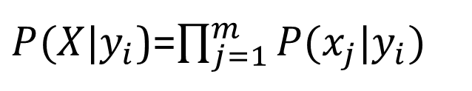
Naïve Bayes' Classifier
Let Y represent the class variable with class values $(y_{1}$, $y_{2}$,…, $y_{n})$ Let $X=(x_{1}$, $x_{2}$,…, $x_{m})$ be an unclassified instance (feature vector) Naïve Bayes Classifier estimates: $\hat{y}=argmax P(y_{i}|X)$
$$y_{i}$$
From Bayes formula: $P{(y}_{i}|X)=\frac{P\left(X | y_{i}\right)P(y_{i})}{P(X)}$
Assumption:
$P(X|y_{i}$)=$\prod_{j=1}^{m}{P(x_{j}|y_{i})}$
Notes:
כדי לחשב את הגורם P(X|yi) עושים הנחה מפשטת שלא נכונה באופן כללי מבחינה תאורטית אבל נותנת קירוב די טוב במקרים רבים.

Slide 50
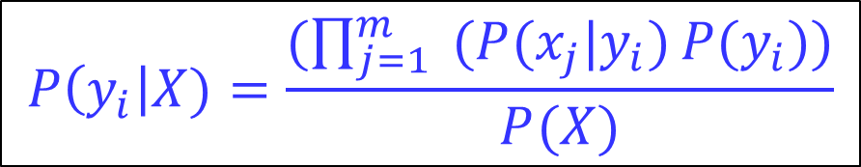
Naïve Bayes' Classifier
Let Y represent the class variable with class values $(y_{1}$, $y_{2}$,…, $y_{n})$ Let $X=(x_{1}$, $x_{2}$,…, $x_{m})$ be an unclassified instance (feature vector) Naïve Bayes Classifier estimates: $\hat{y}=argmax P(y_{i}|X)$
$$y_{i}$$
From Bayes formula: $P{(y}_{i}|X)=\frac{P\left(X | y_{i}\right)P(y_{i})}{P(X)}$
Assumption:
$P(X|y_{i}$)=$\prod_{j=1}^{m}{P(x_{j}|y_{i})}$
$$P\left(y_{i}\right|X)=\frac{(\prod_{j=1}^{m}{ (P(x_{j}|y_{i})}P(y_{i}))}{P(X)}$$
Notes:
ועכשיו, תחת הנחה זו, אנחנו יכולים לחשב כך את ההסתברות שהסווג הוא yi בהינתן שערכי הfeatures הם X.

Slide 51
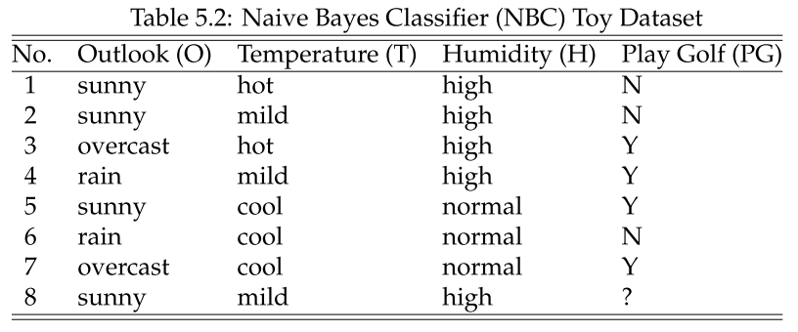
Naïve Bayes' Classifier: example
Notes:
עבור כל feature i מחשבים עבור כל ערך אפשרי שלו מהו ערך ה-y המסתבר ביותר.

Slide 52
Naïve Bayes' Classifier: example
X
Notes:
עבור כל feature i מחשבים עבור כל ערך אפשרי שלו מהו ערך ה-y המסתבר ביותר.

Slide 53

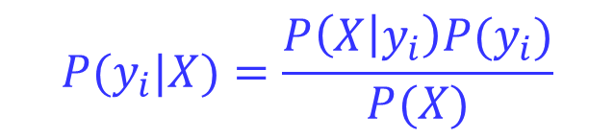
Naïve Bayes' Classifier: example
$$P{(y}_{i}|X)=\frac{P\left(X | y_{i}\right)P(y_{i})}{P(X)}$$
Notes:
עבור כל feature i מחשבים עבור כל ערך אפשרי שלו מהו ערך ה-y המסתבר ביותר.

Slide 54
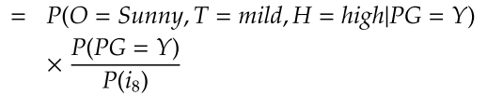
Naïve Bayes' Classifier: example
$$P{(y}_{i}|X)=\frac{P\left(X | y_{i}\right)P(y_{i})}{P(X)}$$
Notes:
עבור כל feature i מחשבים עבור כל ערך אפשרי שלו מהו ערך ה-y המסתבר ביותר.

Slide 55
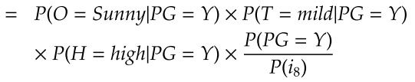
Naïve Bayes' Classifier: example
$$P{(y}_{i}|X)=\frac{P\left(X | y_{i}\right)P(y_{i})}{P(X)}$$
Notes:
עבור כל feature i מחשבים עבור כל ערך אפשרי שלו מהו ערך ה-y המסתבר ביותר.

Slide 56

Naïve Bayes' Classifier: example
$$P{(y}_{i}|X)=\frac{P\left(X | y_{i}\right)P(y_{i})}{P(X)}$$
Notes:
עבור כל feature i מחשבים עבור כל ערך אפשרי שלו מהו ערך ה-y המסתבר ביותר.

Slide 57

Naïve Bayes' Classifier: example
$$P{(y}_{i}|X)=\frac{P\left(X | y_{i}\right)P(y_{i})}{P(X)}$$

Slide 58
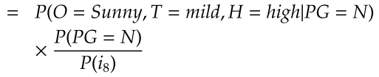
Naïve Bayes' Classifier: example
$$P{(y}_{i}|X)=\frac{P\left(X | y_{i}\right)P(y_{i})}{P(X)}$$

Slide 59
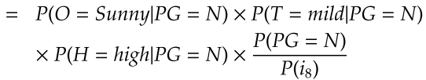
Naïve Bayes' Classifier: example
$$P{(y}_{i}|X)=\frac{P\left(X | y_{i}\right)P(y_{i})}{P(X)}$$

Slide 60

Naïve Bayes' Classifier: example
$$P{(y}_{i}|X)=\frac{P\left(X | y_{i}\right)P(y_{i})}{P(X)}$$

Slide 61

Naïve Bayes' Classifier: example
$$P{(y}_{i}|X)=\frac{P\left(X | y_{i}\right)P(y_{i})}{P(X)}$$
>

Slide 62
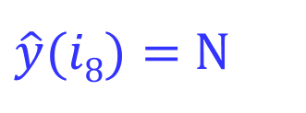
Naïve Bayes' Classifier: example
$$P{(y}_{i}|X)=\frac{P\left(X | y_{i}\right)P(y_{i})}{P(X)}$$
>
$\hat{y}(i8)=$ N

Slide 63
Talk outline
Data mining & machine learning concepts
Decision trees
Naïve Bayes classifier
Classification quality metrics

Slide 64
Classification quality metrics
Binary classification
(Instances, Class labels): (x₁, y₁), (x₂, y₂), ..., (x_{n}, y_{n})
y_{i} :{1,-1} - valued
Classifier: provides class prediction Ŷ for an instance
Outcomes for a prediction:
True class
 | 1 | -1
1 | True positive (TP) | False positive (FP)
-1 | False negative (FP) | True negative (TN)
Predicted class

Slide 65
Classification quality metrics (cont'd)
P(Ŷ = Y): accuracy (TP+TN)/ALL
P(Ŷ = 1 | Y = 1): true positive rate (TPR)/recall/sensitivity
P(Ŷ = 1 | Y = -1): false positive rate (FPR)
P(Y = 1 | Ŷ = 1): precision (TP/(TP+FP))
True class
 | 1 | -1
1 | True positive (TP) | False positive (FP)
-1 | False negative (FP) | True negative (TN)
Predicted class

Slide 66
Classification quality metrics: example
Consider diagnostic test for a disease
Test has 2 possible outcomes:
‘positive’ = suggesting presence of disease
‘negative’ = good news!
An individual can test either positive or negative for the disease

Slide 67
Classification quality metrics: example
Individuals without the disease
Individuals with disease
without the disease
Test Result
with the disease

Slide 68
Machine Learning: Classification
Call these patients “negative”
Call these patients “positive”
without the disease
Test Result
with the disease

Slide 69
Machine Learning: Classification
Call these patients “negative”
Call these patients “positive”
True Positives
without the disease
Test Result
with the disease

Slide 70
Machine Learning: Classification
Call these patients “negative”
Call these patients “positive”
without the disease
Test Result
False Positives
with the disease

Slide 71
Machine Learning: Classification
Call these patients “negative”
Call these patients “positive”
True negatives
without the disease
Test Result
with the disease

Slide 72
Machine Learning: Classification
Call these patients “negative”
Call these patients “positive”
False negatives
without the disease
Test Result
with the disease

Slide 73
Machine Learning: Cross-Validation
What if we don’t have enough data to set aside a test dataset?
Cross-Validation:
Each data point is used both as train and test data.
Basic idea:
Fit model on 90% of the data; test on other 10%.
Now do this on a different 90/10 split.
Cycle through all 10 cases.
10 “folds” a common rule of thumb.

Slide 74
Machine Learning: Cross-Validation
Divide data into 10 equal pieces P₁…P₁₀.
Fit 10 models, each on 90% of the data.
Each data point is treated as an out-of-sample data point by exactly one of the models.

