Slide 1
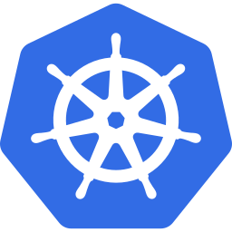
AGENDA
01 What is VPA? HPA vs VPA
Vertical Pod
02 VPA Architecture & Components
Autoscaler (VPA)
03 Demo Deployment YAML
Step-by-Step Implementation
04 Basic VPA Configuration
Enterprise Resource Optimization
for OpenShift Workloads
05 Advanced Resource Policy
06 Step-by-Step Demo Commands
OpenShift | Kubernetes | VPA
07 Monitoring & Best Practices
08 Enterprise Architecture & Q&A
Notes:
Welcome slide. Introduce yourself and the agenda. This deck covers VPA from concept to enterprise implementation. Estimated time: 45-60 minutes for a full workshop.

Slide 2


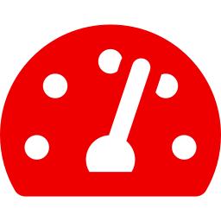

WHAT IS VPA?
02
Vertical Pod Autoscaler (VPA) automatically sets CPU and memory requests/limits for containers based on actual usage — eliminating manual resource guessing and over/under-provisioning.
HPA vs VPA – Key Differences
HPA – Horizontal Pod Autoscaler
VPA – Vertical Pod Autoscaler
Scales the number of pod replicas
Adjusts CPU/memory per container
Reacts to CPU/memory metrics
Analyzes historical usage patterns
Best for stateless, traffic-driven apps
Best for stateful, batch workloads
Does NOT change resource requests
Modifies resource requests/limits
Adds more pods horizontally
Optimizes resources vertically
Notes:
Explain the fundamental difference: HPA adds pods (scale out), VPA adjusts resources per pod (scale up/right). Both can coexist but need careful configuration to avoid conflicts, especially around CPU-based triggers.

Slide 3




VPA ARCHITECTURE
03
Metrics Server
VPA Recommender
VPA Updater
Admission Controller
Collects real-time
CPU & memory data
Analyzes historical
metrics & suggests
Evicts pods needing
resource adjustment
Mutates pod spec
on creation/restart
Metrics
Recommend
Evict
Mutate
cpu-app Deployment
DATA FLOW
Replicas: 2 CPU request: 50m → 500m
Recommendation flow
Image: ubi9/ubi Memory: 100Mi → 256Mi
Pod eviction trigger
⬆ VPA applies recommendations on pod restart
Spec mutation
Metrics collection
Notes:
Walk through the four VPA components: 1) Metrics Server gathers actual pod usage. 2) Recommender analyzes and suggests new resource values. 3) Updater evicts pods that need resource changes. 4) Admission Controller injects the new values when pods restart. This is why pods restart when VPA acts.

Slide 4
DEMO WORKLOAD – cpu-app DEPLOYMENT
04
cpu-app.yaml
🔴 CPU Stress Command
apiVersion: apps/v1
`dd if=/dev/zero of=/dev/null` generates maximal CPU load continuously. This simulates a real compute-intensive workload.
kind: Deployment
metadata:
name: cpu-app
spec:
replicas: 2
selector:
⚠️ Under-Provisioned
matchLabels:
app: cpu-app
CPU request of 50m is intentionally too low for a busy loop. Actual consumption will be 10–20× higher.
template:
spec:
containers:
- name: app
image: ubi9/ubi
command: ["/bin/bash","-c"]
✅ Ideal VPA Target
args:
Predictable high-CPU pattern is exactly what VPA Recommender is designed to detect and right-size automatically.
- "while true; do dd if=/dev/zero
of=/dev/null; done"
resources:
requests:
cpu: "50m" # ← intentionally low!
memory: "100Mi"
Notes:
This workload is deliberately extreme — an infinite loop reading from /dev/zero. The 50m CPU request will be completely overwhelmed. VPA will see near-100% CPU utilization vs. the requested 50m and recommend something like 500m-1000m within a few minutes.

Slide 5
BASIC VPA CONFIGURATION
05
cpu-app-vpa.yaml
RESOURCE TRANSFORMATION
apiVersion: autoscaling.k8s.io/v1
BEFORE
AFTER (VPA)
kind: VerticalPodAutoscaler
cpu: 50m
memory: 100Mi
cpu: 500m
memory: 256Mi
metadata:
name: cpu-app-vpa
spec:
targetRef:
apiVersion: apps/v1
oc describe vpa cpu-app-vpa [output]
kind: Deployment
Status:
name: cpu-app
Recommendation:
updatePolicy:
ContainerRecommendations:
updateMode: "Auto" # ← applies immediately
- ContainerName: app
LowerBound:
cpu: 200m memory: 128Mi
updateMode Options:
Target:
cpu: 500m memory: 256Mi
Auto
– Apply immediately, evict pods
UpperBound:
Recreate
– Apply on pod recreation only
Initial
– Only for new pods
cpu: 1000m memory: 512Mi
Off
– Recommend only, no changes
Notes:
The basic VPA with updateMode: Auto will automatically evict and restart pods with new resource values. Show how Target recommendation of 500m CPU is 10x the original 50m request. Emphasize that VPA only controls requests — not limits unless you set them explicitly.

Slide 6


ADVANCED RESOURCE POLICY
06
manual-vpa.yaml
minAllowed – Resource Floor
apiVersion: autoscaling.k8s.io/v1
kind: VerticalPodAutoscaler
Prevents VPA from setting resources too low. Ensures minimum viable performance even in off-peak hours. Critical for SLA compliance.
metadata:
name: manual-vpa
spec:
cpu: 200m | memory: 128Mi
targetRef:
apiVersion: apps/v1
maxAllowed – Resource Ceiling
kind: Deployment
name: cpu-app
Caps maximum allocation to prevent runaway usage. Protects node capacity and enforces cost budgets. Essential for multi-tenant clusters.
updatePolicy:
updateMode: "Auto"
cpu: 1000m | memory: 512Mi
resourcePolicy:
containerPolicies:
- containerName: app
Enterprise Governance
minAllowed: # ← floor
Combine min/max bounds with namespace LimitRanges and ResourceQuotas for full policy compliance across teams and environments.
cpu: "200m"
memory: "128Mi"
maxAllowed: # ← ceiling
LimitRange + ResourceQuota + VPA = Full Control
cpu: "1000m"
memory: "512Mi"
200m
← VPA safe zone →
1000m
Notes:
This is the enterprise-grade VPA configuration. minAllowed prevents VPA from under-provisioning below safe thresholds. maxAllowed stops runaway resource usage. For production workloads, always define these bounds. Also consider containerName: '*' to apply to all containers, or list each one explicitly for granular control.

Slide 7


STEP-BY-STEP DEMO
07
01
02
03
04
05
Deploy
Workload
Generate
Load
VPA
Recommends
Pod
Restart
Optimized
Resources
OpenShift CLI – oc commands
1
$ oc apply -f cpu-app.yaml
# Deploy the CPU-intensive workload (2 replicas)
2
$ oc apply -f cpu-app-vpa.yaml
# Apply the VPA object targeting cpu-app
3
$ oc top pod
# Watch actual CPU usage vs 50m request
4
$ oc describe vpa cpu-app-vpa
# View VPA recommendations and current status
5
$ oc get pods -w
# Watch pods restart with optimized resources
Verify: oc get vpa cpu-app-vpa -o yaml → check .status.recommendation.containerRecommendations
Notes:
Live demo sequence: 1) Deploy cpu-app and VPA. 2) Show oc top pod — CPU usage will be near 100% of one core vs 50m request. 3) Wait 3-5 minutes for Recommender to gather data. 4) oc describe vpa shows recommendations. 5) The Updater evicts pods, Admission Controller injects new values. 6) New pods have higher CPU requests.

Slide 8
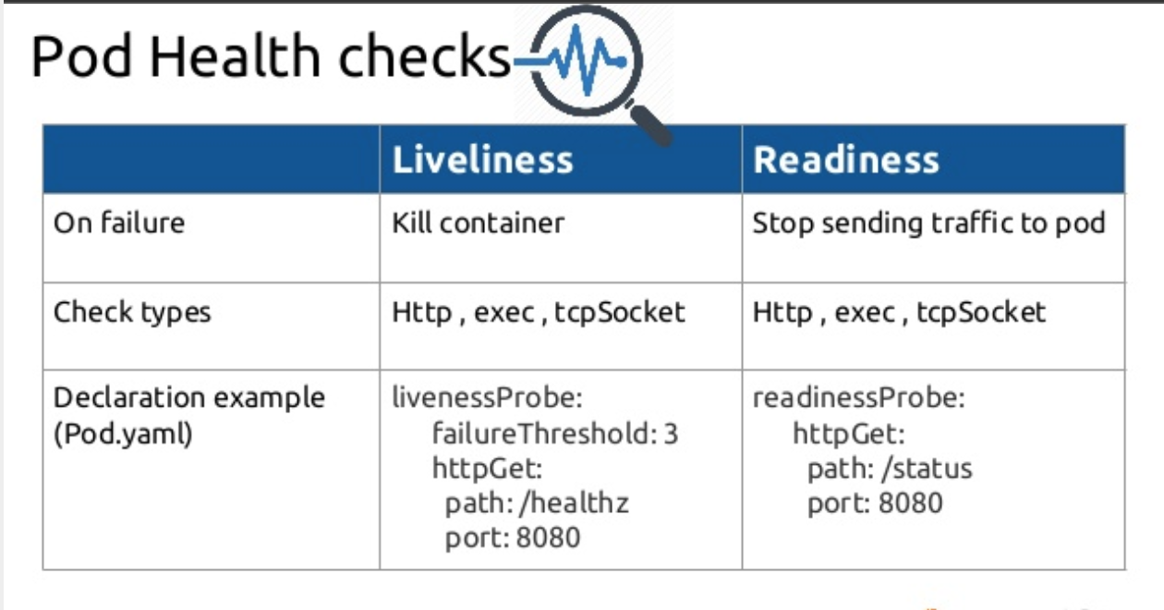
STEP-BY-STEP DEMO
ExecAction - executes a command inside the container.
TCPSocketAction - performs a TCP check against the container’s IP address on a specified port.
HTTPGetAction - performs an HTTP GET request on the container’s IP.
A handler can then return the following:
Success - the diagnostic passed on the container.
Fail - the container failed the diagnostic and will restart according to its restart policy.
Unknown - the diagnostic failed and no action will be taken.
Notes:
Live demo sequence: 1) Deploy cpu-app and VPA. 2) Show oc top pod — CPU usage will be near 100% of one core vs 50m request. 3) Wait 3-5 minutes for Recommender to gather data. 4) oc describe vpa shows recommendations. 5) The Updater evicts pods, Admission Controller injects new values. 6) New pods have higher CPU requests.

Slide 9
OpenShift VPA
Step-by-Step Implementation
RESOURCES
Q&A
docs.openshift.com/container-platform/vpa
kubernetes.io/docs/tasks/configure-pod-container/resize-container-resources
github.com/kubernetes/autoscaler/tree/master/vertical-pod-autoscaler
Questions & Discussion
access.redhat.com/documentation/openshift
Workshop Summary
Deployed cpu-app with intentionally low 50m CPU
Applied VPA and observed 500m recommendation
Explored minAllowed / maxAllowed governance
Wired Prometheus + Grafana for observability
Notes:
Thank the audience. Invite questions. Offer to share the deck and YAML files. Suggest next steps: 1) Try VPA in Off mode in their own cluster. 2) Set up Prometheus metrics for VPA. 3) Review Cluster Autoscaler integration. 4) Explore VPA with StatefulSets and DaemonSets.

