Slide 1
MapReduce vs. Apache Spark for Big Data Processing
Name : E.S.L Sudusinghe
Index No : 248280J
Assignment - Video presentation

Slide 2
MapReduce
MapReduce is a programming model and software framework introduced by Google in 2004 for processing large datasets in a distributed computing environment.
The MapReduce model consists of two key functions - Map and Reduce.
The Map function takes input data and converts it into key-value pairs.
The Reduce function aggregates the outputs of the Map function into the final result.

Slide 3
Apache Spark
Apache Spark is an open-source distributed computing system designed for big data processing and analysis.
Spark was first released in 2012 and has gained immense popularity in the industry due to its high performance and ease of use.
Like MapReduce, Spark can distribute data processing tasks across multiple computers.
Spark improves upon the MapReduce model with in-memory data sharing, allowing it to run workloads up to 100x faster than MapReduce in certain situations.

Slide 4

Demo
Let’s start the implementation and comparison.

Slide 5
Compare and contrast
Easy of use:
MapReduce is a simple and easy-to-use framework that is used for batch processing of large data sets. Apache Spark provides a higher-level programming model that makes it easier for developers to work with large data sets.
Fast Processing:
Apache Spark is generally faster than MapReduce due to its in-memory processing capabilities. MapReduce reads and writes data to disk for each MapReduce job, therefore it takes more time to execute the queries.

Slide 6
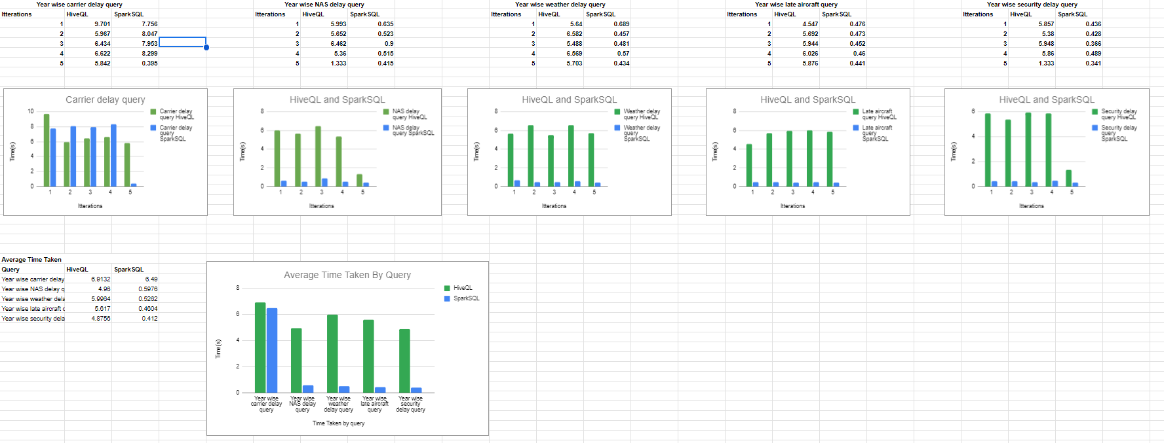
Time Comparisons

Slide 7
Conclusion
MapReduce and Apache Spark allows distributed processing of big data. The Spark is generally considered easier to use and faster than MapReduce framework. In-memory data processing engine of Spark allows to perform computations faster by minimizing disk reads and writes. Furthermore, Higher level APIs of Spark make it more developer friendly compared to MapReduce low level programming model. For most modern big data pipelines, Spark is the preferred distributed computing engine due to its speed and ease of use advantages over MapReduce.

Slide 8


Thanks!

