Slide 1


Lightning Talk:
No-Slot MIDI
or
Experiential lessons in persisting thru frustration
by Eric Rangell

Slide 2
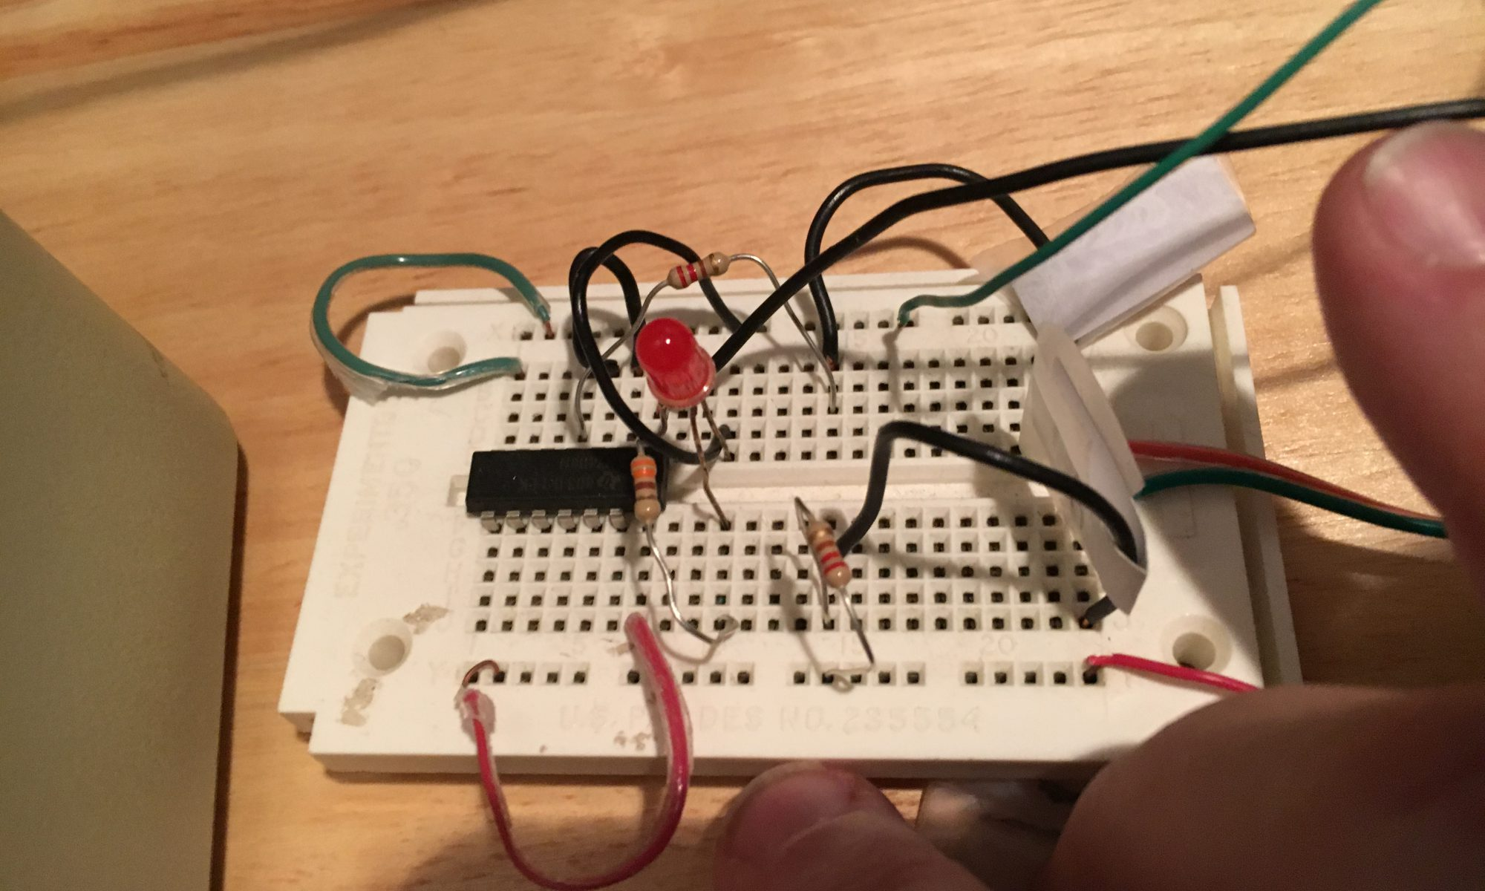
Breadboard with 3 wires to Game I/O Socket
Follow the MIDI wire
spec – search for a
tutorial.
Annunciator OUT
2 inverters
220 ohms
Pin 5
+5V
220 ohms
Pin 4
GND
Pin 2
Polarity matters: explain opto-isolation of MIDI IN: You are essentially driving an LED
that triggers a phototransistor.
+5V and GND can come from either Internal socket or External 9 pin cable
Any Annunciator
with caveats:
AN3 used for DHGR
AN2 goes high on reset.
If also using David Schmenk’s SDFAT Arduino circuit, use AN2 for MIDI
(AN3 on a 2GS)

Slide 3
Teach kids how to build the circuit:
Use electronics kits for intro to digital logic circuits (Inverter, Buffer)
Use logic probe to test annunciator outputs coming out of Apple
Test with LEDs and current limiting resistors first. Teach Ohm’s law.
Get each LED to turn on and off using Annunciator outputs:
C058 = AN0 off, C059 = AN0 on, etc. thru C05E/C05F for AN3.
Build a little, test it with logic probe, build some more and retest.
Several alternative TTL chips (Hex Inverter, Quad NAND, Quad NOR)
MIDI sockets available from SparkFun – Have kids figure out if they wired the pins opposite from the spec – encourage troubleshooting.

Slide 4
Test the interface, then have fun with it:
BLOAD the interface and run the test program to play a chord
Test playing the sample MIDI files included on the demo disk
Look at the Applesoft program to learn how to poke the MIDI data
Write programs to play simple songs – use keyboard or paddle buttons for timing.
Show students the variety of MIDI commands available.
Have each student program a project they are interested in.
Help students learn how to debug their own programs, and suggest best practices.

Slide 5
Independent Study for motivated students
Look at source code for MIDI playback program
Discuss timing anomalies due to use of Apple clock
Do research on internet about Interrupts to understand the theory
Use emulators to test Mockingboard interrupts – the Music Construction Set demos play music in the background
Write program that counts interrupts
Experiment with using the counter for note timing
Have the student do a final project to demonstrate their understanding of the expected learning outcomes.

Slide 6
Other projects I can show you – come see me: (will be added to https://github.com/erangell)
Dancing Notes – rendering of MIDI IN data from Passport interface
Apple ][ MIDI Player - Object-oriented machine language design
Mad Apple Forth – jazz stylings, drum machine, sequencing
Karaoke, Marquees – can have kids create their own scrolling messages
Arduino projects – MIDI file format 0 player, charlieplexing
Working on serial interfaces for //c and //c+
Hack my tie with MIDI – illustrates use of MIDI for lighting control
GS neural network to learn to play Atari “Touch Me” handheld game:
(game socket Annunciators control relays for buttons, CdS photocells to Game Controller pins detect which LEDs are being lit by the game)

Slide 7
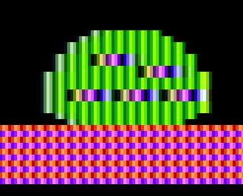






Thank you! May your teaching be fruitful!
Graphics remixed under fair use from Bouncing Kamungas!&trade;
by Tom Becklund &copy; 1983 Penguin Software

