Slide 1
Keydomet – making string lookups faster
Work in progress…

Slide 2
Target data structures
Sorted by a string key, lookups require O(log n) comparisons
Balanced trees
Skip list
Sorted array
Hash tables
Driving insight: lookup process meets very different keys
Most comparisons can be resolved by key prefixes

Slide 3
Key distribution in a sorted array
similar
similar
similar
similar
similar
similar
similar
1
2
3
4
5
6
7
8
very different
different
similar
Binary search pattern for key7
7

Slide 4
Given most comparisons involve very different keys, optimize that case
On other cases, resort to conventional comparison

Slide 5
Anatomy of a string
Different memory locations
size
pointer
H
E
L
L
O
\0
* YMMV – also stored sometimes: buffer size, SSO, hash, object header, encoding etc.; string size might be omitted etc.

Slide 6
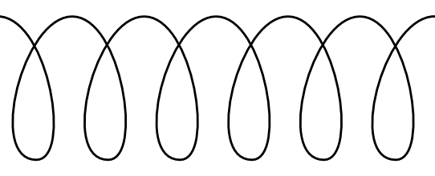
Baseline string comparison
Frequent cache misses
Low branch prediction rate
size
pointer
Pointer dereference
H
E
L
L
O
\0
size
pointer
G
‘
B
Y
E
\0
During key lookups, this happens A LOT

Slide 7
Keydomet
Cache key prefix as a number, preserving lexical order
Compare keydomets first; only if equal examine strings
0x4845
size
pointer
H
E
L
L
O
\0
Note: little endian requires byte flipping!

Slide 8
Keydomet-based comparison
int StrCmp(KdmtStr s1, KdmtStr s2) {
if (s1.kdmt != s2.kdmt)
return s1.kdmt – s2.kdmt;
return StrCmp(s1.chars, s2.chars);
}
No ptr dereference
No loop
No function call
 Extra condition
0x4845
size
pointer
H
E
L
L
O
\0

Slide 9
Optimizing C++ containers
set<string> vs. set<Keydomet<string>>
100
100
Keydomet use %
82
100
100
65
99
100
57
* Random 16 byte strings
** Sketchy measurement…
~2.4x speedup on average!

Slide 10
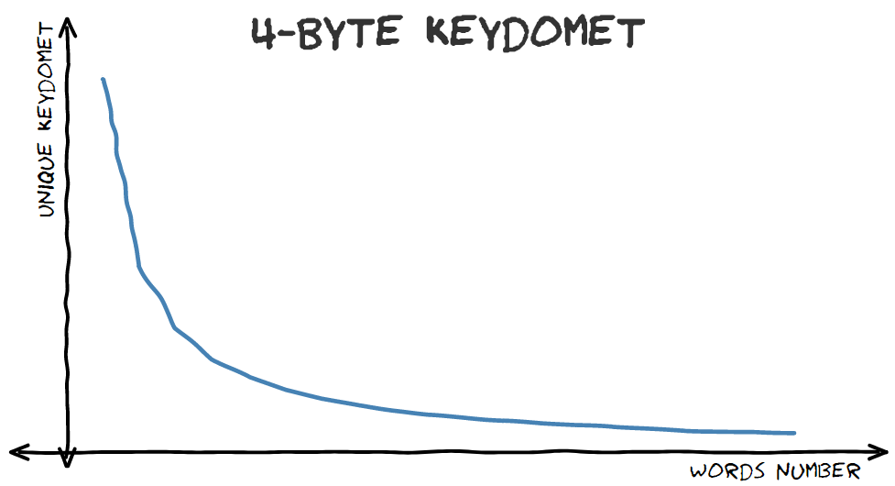
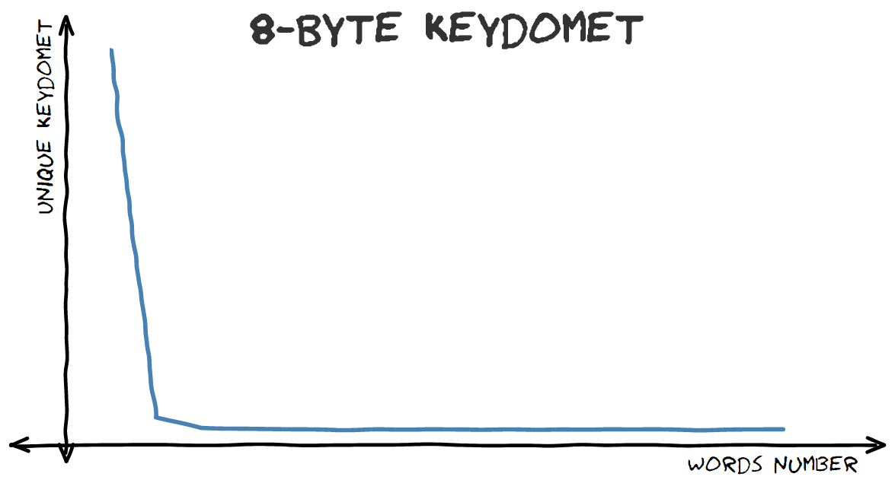
Real world applicability
Examined 500K Urban Dictionary terms
Natural language
Sketched “histograms” of different words per keydomet:
String comparison sometimes required for different words
Almost no different words mapped to the same keydomet

Slide 11
Optimized DB #1 - LMDB
Open source in-memory key-value store
Internal data structure: B+ tree
7 years old, >1000 commits, 19 contributers
Stav Namir and Aviad Rozenknof applied keydomet and measured lookup times:
~20% improvement for 4-byte keydomet!
~27% improvement for 8-byte keydomet!

Slide 12
Optimized DB #2 - LevelDB
Open source persistent key-value store
Increased memtable size to eliminate I/O aspect
Internal data structure: skip list
Extended a general-purpose type (Slice)
Ophir Katz and Mark Erlich applied keydomet and measured lookup times:
~22% improvement for 8-byte keydomet!

Slide 13
Additional measured results
Keydomet sufficient on vast majority of comparisons
Verified: use of keydomet correlates to lookup time
Performance counters indications:
Branch misprediction rate significantly reduced
L1 miss rate increased
Wait, what??

Slide 14
Gain limitations
No pointer deref.
0x4845
size
pointer
Short String Optimization (SSO)
H
E
L
L
O
\0
Memory overhead
Optimized strcmp:
repe cmpsb
SIMD

Slide 15
Intrusive keydomet application
Current approach: place keydomet in string wrapper and modify comparator
Alternative: place in node and modify algorithm
Avoid using keydomet where not much gain, e.g., lower B-tree:
Notes:
The graph shows LMDB keydomet usage percent, not absolute numbers. The increase at the ends is the results of not finding the desired key, which means many non-matching comparisons. However, the absolute number of lookups traversing the full 8 steps is small – when a match is found, a lookup can end much sooner. Also, any match necessarily includes at least one string comparison, whereas non-matching lookups might use keydomet comparisons all the way through.

Slide 16
Summary
Keydomet optimization seems like a low-hanging fruit
Probably exists in the wild, but I couldn’t find where
AFAIK, Similar ideas last described in papers from ‘89 and ’95
Evaluated only lookup workloads to get clean effect
Current projects will hopefully consider more aspects
Unexpected perf results indicate lack of understanding
But measured gain is clear!

