Slide 1
OpsSCHOOL Final PROJECT Winter 2020
By:
Eran Saban

Slide 2
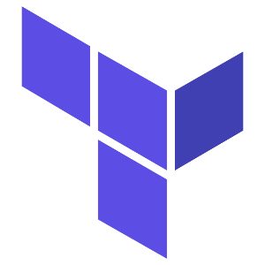

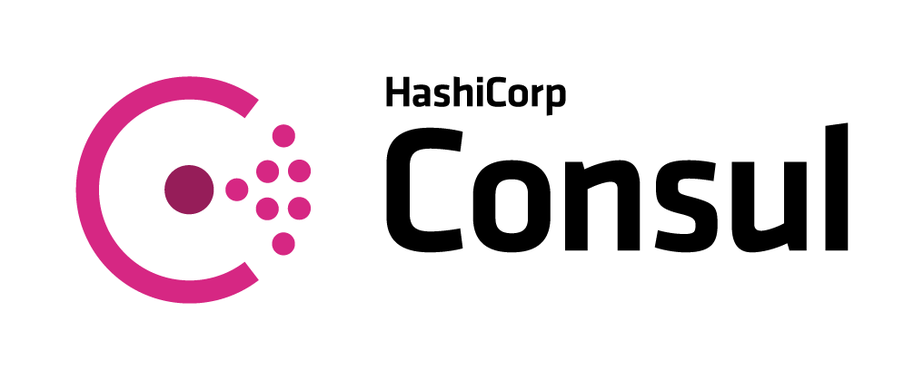

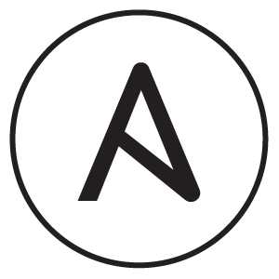



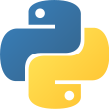
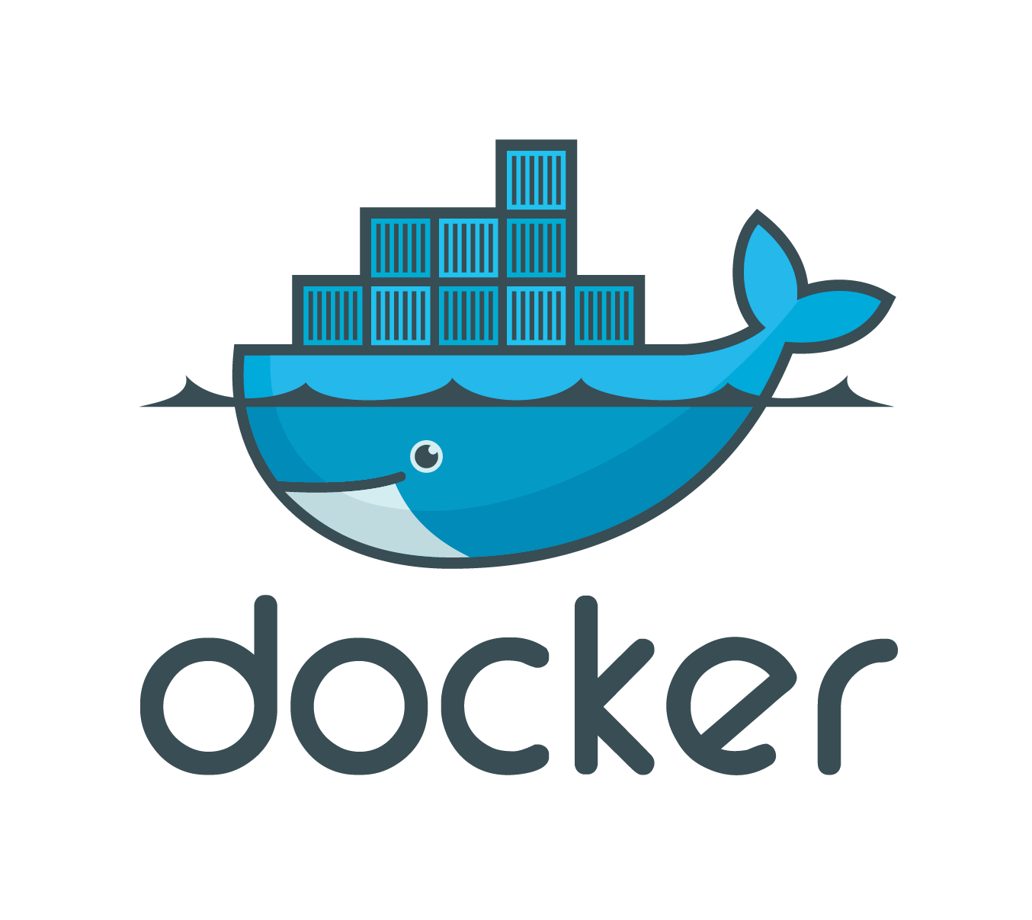

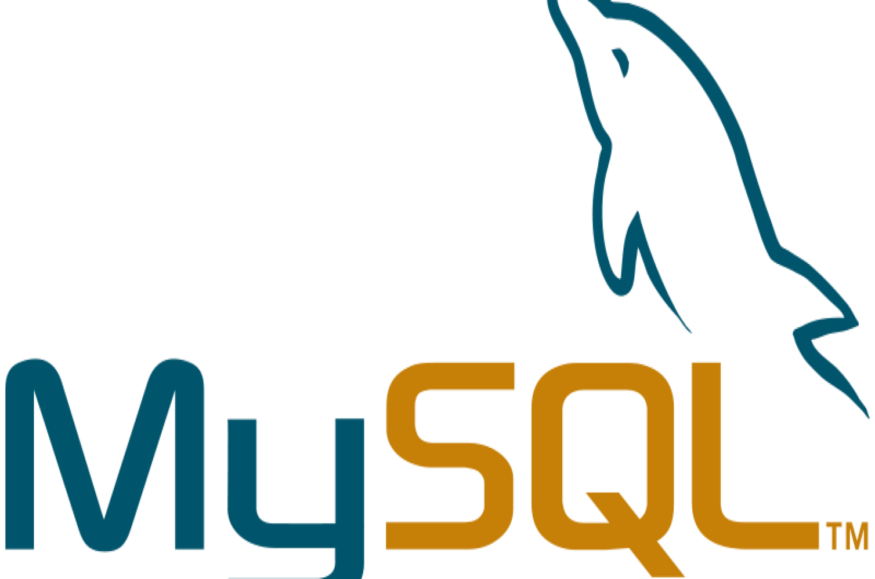
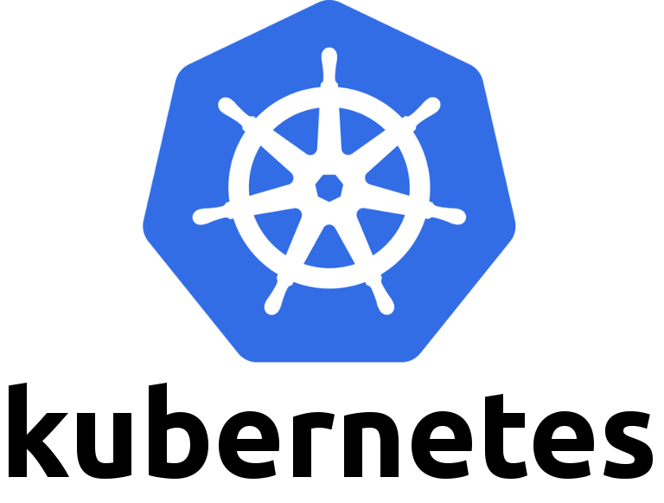
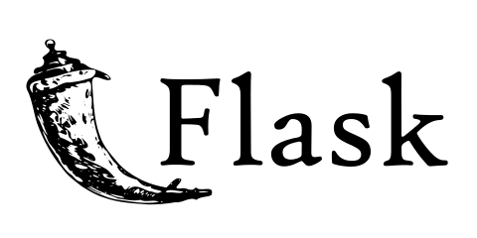
Project Goal:
The object of this project it’s to simulate a stable application deployment using the following tools and products

Slide 3
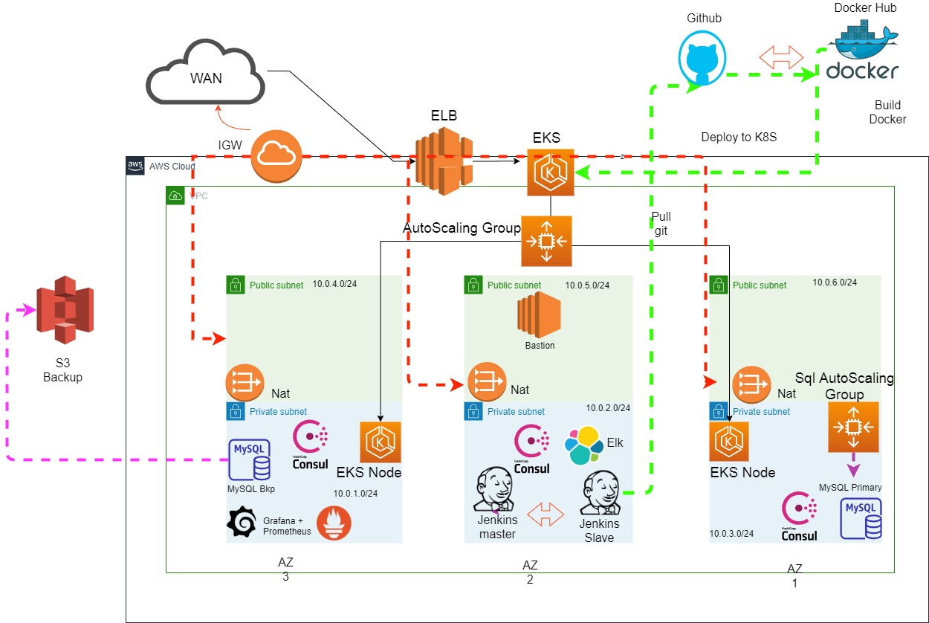
Topology

Slide 4
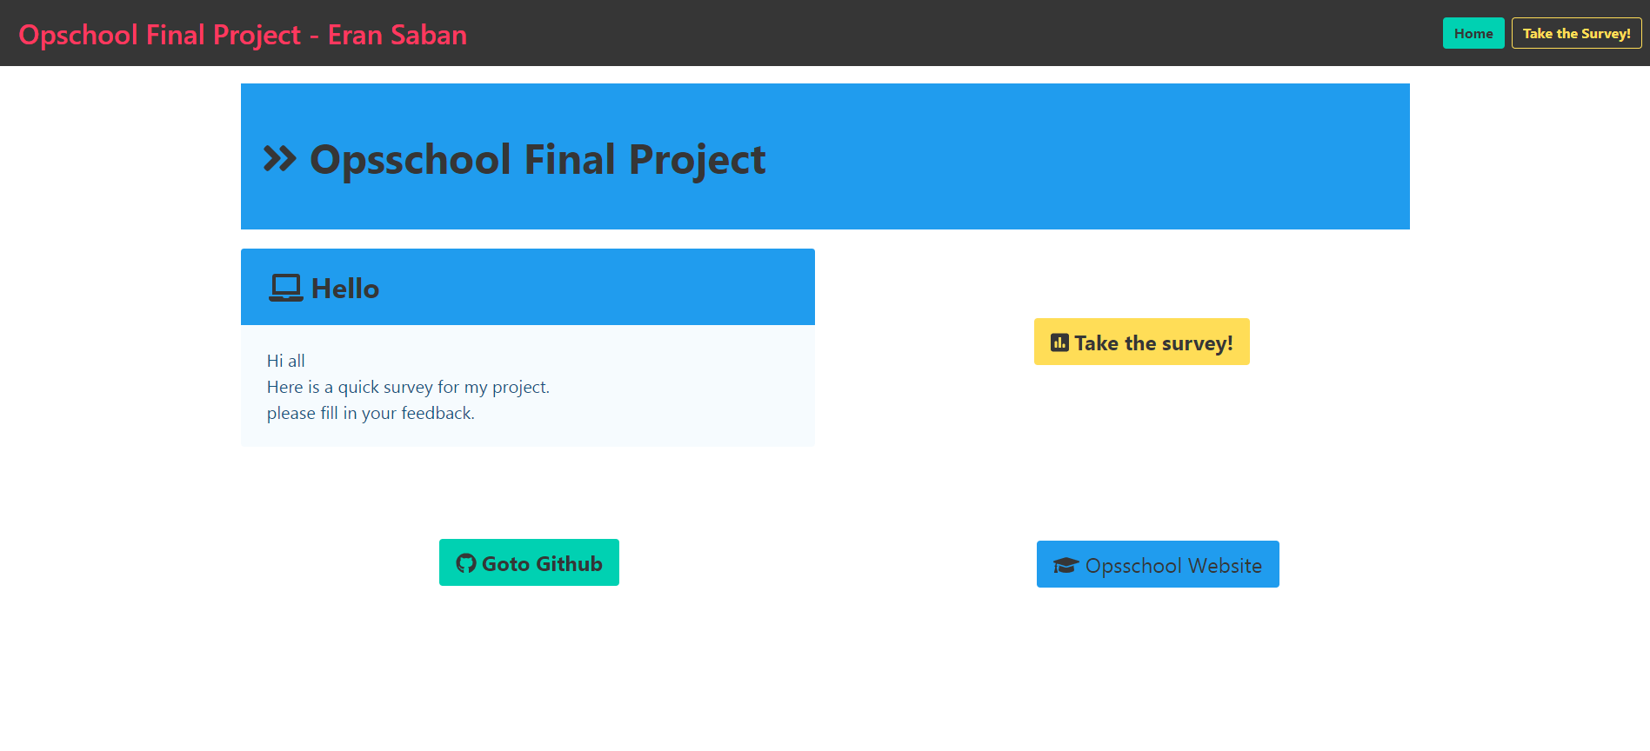
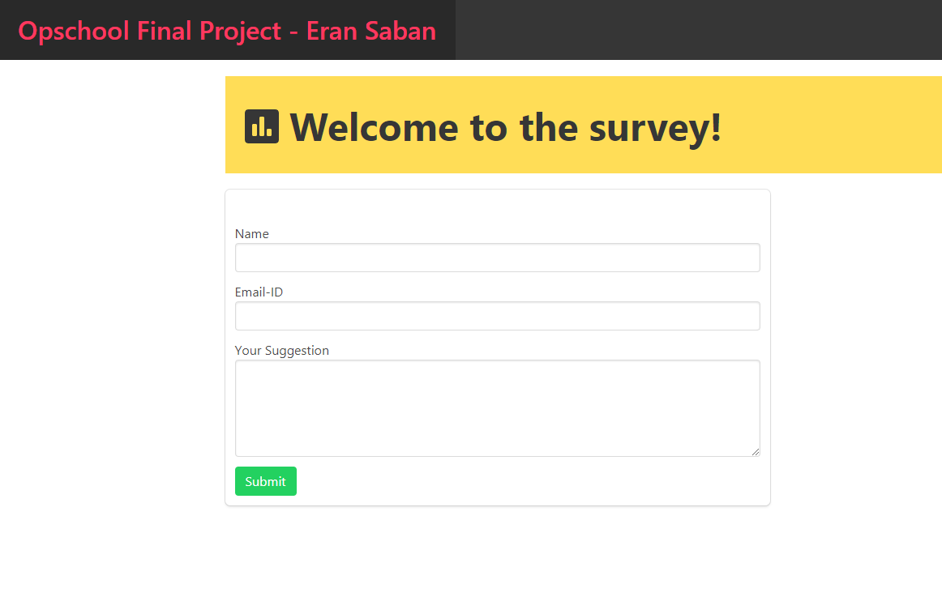
The App
The application I choose is a python flask program, with html templates
It’s a survey app, and users can write their name, email and what’s their feedback.
All the data that gathered through the app is saved in a database

Slide 5
ARCHITECTURE
The project is running in AWS, with 3 AZ (as recommended by the EKS module)
The network consist of:
Consul Cluster:
3 master servers each in another AZ.
All other nodes in the project contains a consul agent
Jenkins (CICD):
A Master and a Slave, hosted in the private subnets
MySQL:
Primary server for receiving posts from the application.
It’s launched through a scaling group, so if it will fail a new one will launch immediately
And a Backup server. With replica enabled from the primary server.
It also perform backup of the data to s3 bucket
Eks:
The app is deployed to EKS service running in a multizone environment for high availability
The eks nodes are running in private subnet and only accessible by AWS ELB and the VPC
The nodes are in an Auto Scaling group so if there’s any problem
A new node will launch right away to keep serving the application.

Slide 6
ARCHITECTURE
Part two
Monitoring:
Grafna and Prometheus:
The project has a server with Prometheus and Grafana
To monitor all the action and notify us when issues occur
Also there’s a Prometheus installed inside the EKS to monitor all the pods
And Grafana is reading all the data through a service eks publish
ELK Stack:
An ec2 node runs a docker based ELK Stack with 3 Dockers for elasticsearch, logstash and kibana
Bastion:
The only server in this project that is in the public network
And offer us a way into the main network, the private subnet
It has a consul template combined with NGINX and provide SSL reverse proxy
For all the services
And also it acts as jump server for a ssh tunnel into the rest of the servers

Slide 7


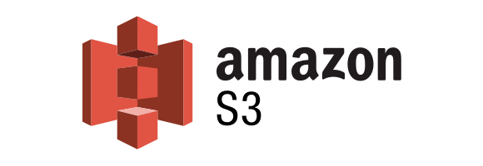


Deployment
Create ENV and nodes
7
8
Backup to S3
2
Deploy to Eks
Pull docker
6
Build and push to
docker hub
1
5
./projectbuild.sh
3
Configures the nodes
and start the app job
4 Pull code from
github
Because it’s a long process I’ve split the creation process into 3 terraform parts.
All this project is 100% automatically and everything is configured by automation and scripts.
We’ll start the automation process by running projectrun.sh script
The 1st step is deploying 2 S3 buckets
One to provide a Remote Backend for terraform state files
And the 2nd for data backups.
The 2nd step is deploying VPC & EKS using terraform.
After that ends the 3rd part will start.
It will deploy the rest of the servers including provisioning and configuration of all services

Slide 8
Deployment Process
After all main infrastructure has been built.
Terraform will create all the servers.
Each ec2 machine has a user data that deploys , consul agent, consul health and service checks,
Filebeat, and a Node Exporter, (specific machine also has related exporters,(Jenkins, mysql, blackbox)
Jenkins slave and master are docker based and after their creation, the slave immediately connects
to it’s master,
And ansible configure the master Jenkins with secrets and jobs
The slave has specific IAM role created for him so it will be able to deploy jobs to EKS
MySQL:
The db servers are created with mysql userdata, that includes mysql installation, consul, filebeat and
Exporters, and there’s a script inside that run all the preparation for a replication job including
Editing my.cnf file and exporting db, address and bin_log location and upload it to s3
The primary mysql is launched through a scaling group
After that when the mysql backup node start (there’s a tf “depend on master” delay) it pulls all the
Necessary data from s3 and configures replication on the host and also create a backup plan
With a cron job to sync all backups to s3 .
That way if another replica server will start, it will sync all the data from the primary again.
Each sql node contains an IAM role combined with s3 rights and ec2 describe Permissions (for cunsul)

Slide 9
Deployment Process
Monitoring:
The server containing the Prometheus and grafana services
Perform all installation from the userdata, and after that
Pull’s configurations files from github. That includes a predefined Prometheus scrape job
and grafana db, dashboard and slack alert provisioning So everything is set up automatically
The Elk node also install everything from user data
And pull’s a git with all the docker-compose file and data, and deploy it
Consul:
The cluster servers created at the private subnets and create a datacenter
All other nodes has a consul agent and their services registered to the cluster
So we can have full mesh and each node can contact the other with service discovery.
All nodes have IAM role with ec2 describe so they can search which node is a server by ec2 tags
Eks (kubernetes):
After the eks creation, a local exec on terraform start a configuration script on the local host
To deploy kubeconfig file, configure core dns service and a consul helm chart so each
pod on the eks node can contact services outside kuberenetes
App:
The app is deployed by Jenkins job that pull code from github, create a docker image, test it and
apply it on eks

Slide 10
Security
All secrets and passwords in this project are stored at 2 locations
And they are not synced anywhere and only known to the person running the job.
(should be listed in git ignore file)
The passwords and security codes can be found in
terraform.tfvars (Instances folder)
&
external_vars.yml (Instances folder) – for use with ansible playbooks and have dockerhub, slack, and app passwords
Aws keys are not transferred at all
All instance get an IAM role specific for their job and to enhance security and allow delegation only to the right server to finish it’s tasks
Jenkins slave has eks rights, mysql has s3 rights (for more enhanced security, sql need to be limited to write only and no
deletion rights)
All Nodes are in the private subnets of aws.
The only access to the network is by a bastion host with ssh
And it’s security group should be limited to private ip only (this demonstration allow connection to bastion from anywhere
for simplicty)
All inside traffic is limited to aws private network (10.0.0.0/16)
Bastion also configured with consul template and an nginx reverse proxy
To allow access to all the intra websites
All Website are encrypted with a TLS certificate so all traffic is encrypted to the websites

Slide 11
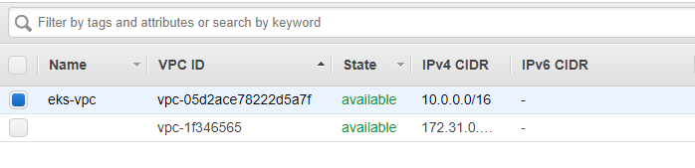
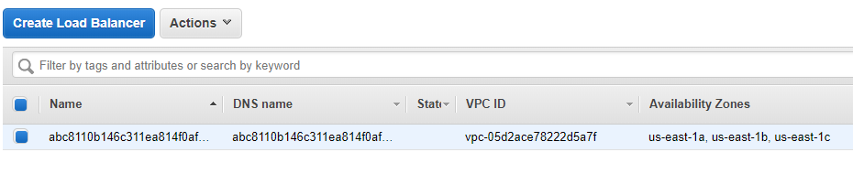
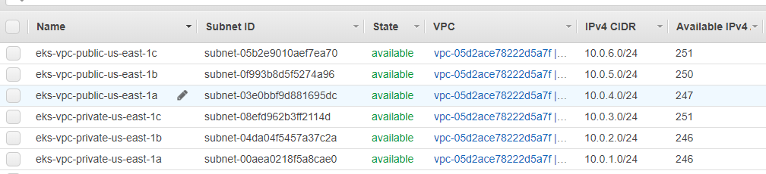
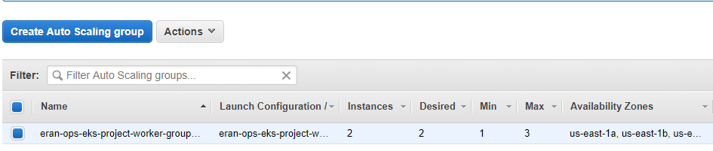
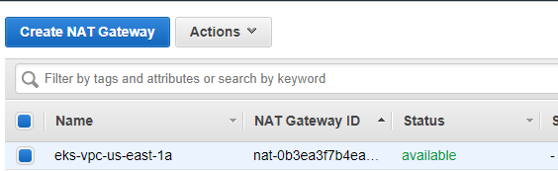
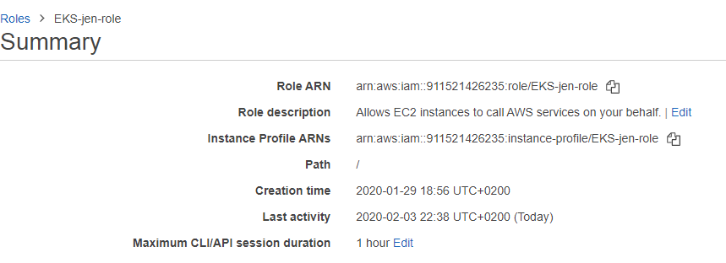
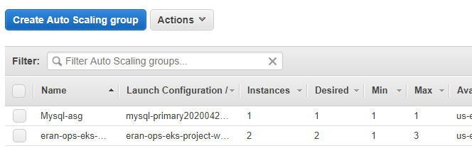
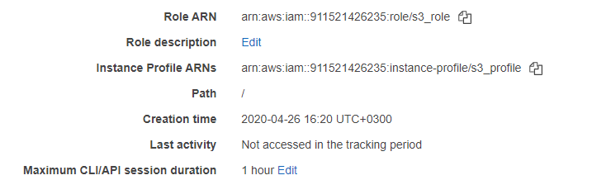

Slide 12
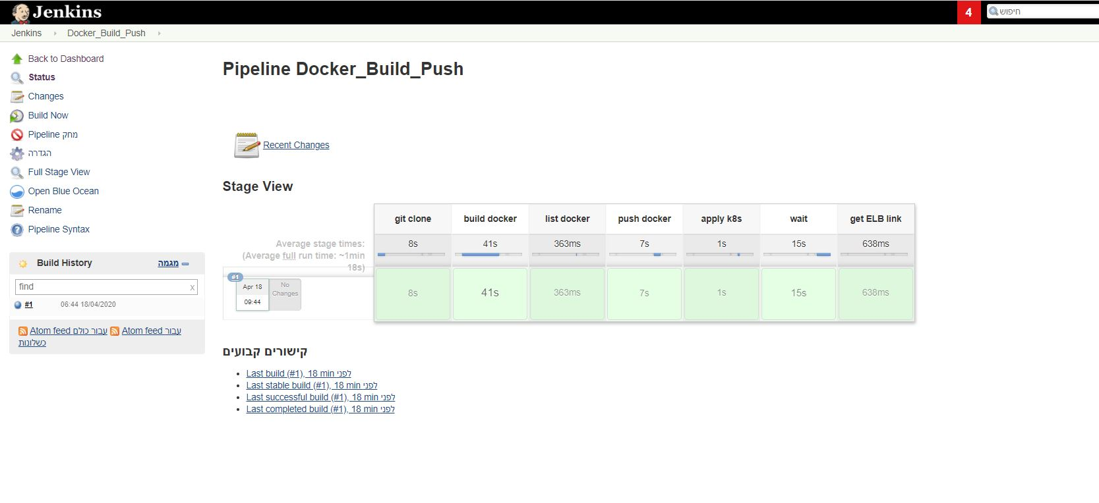
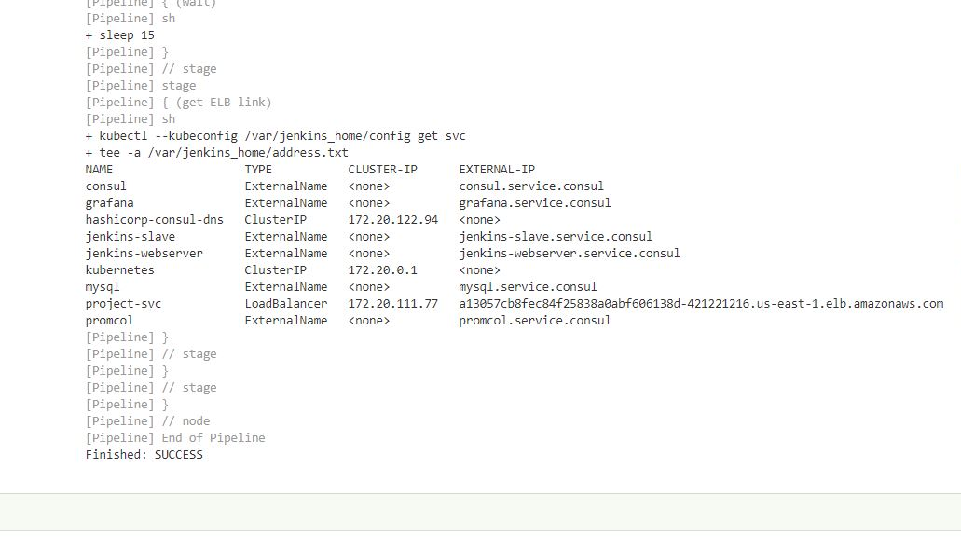
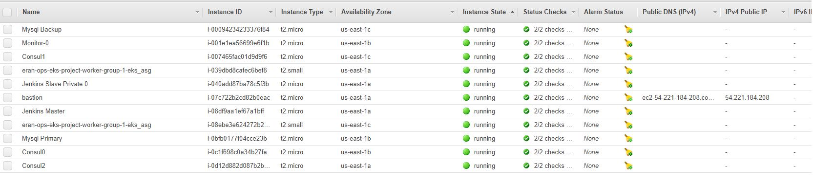

Slide 13
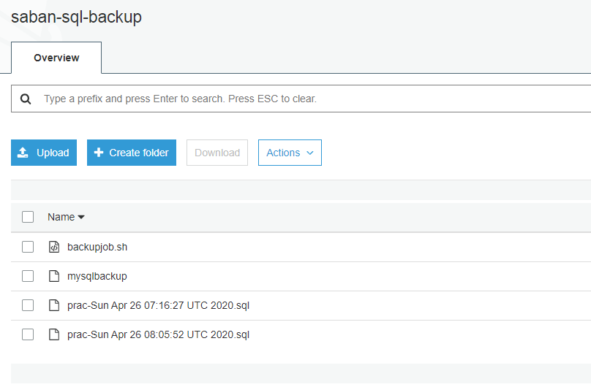
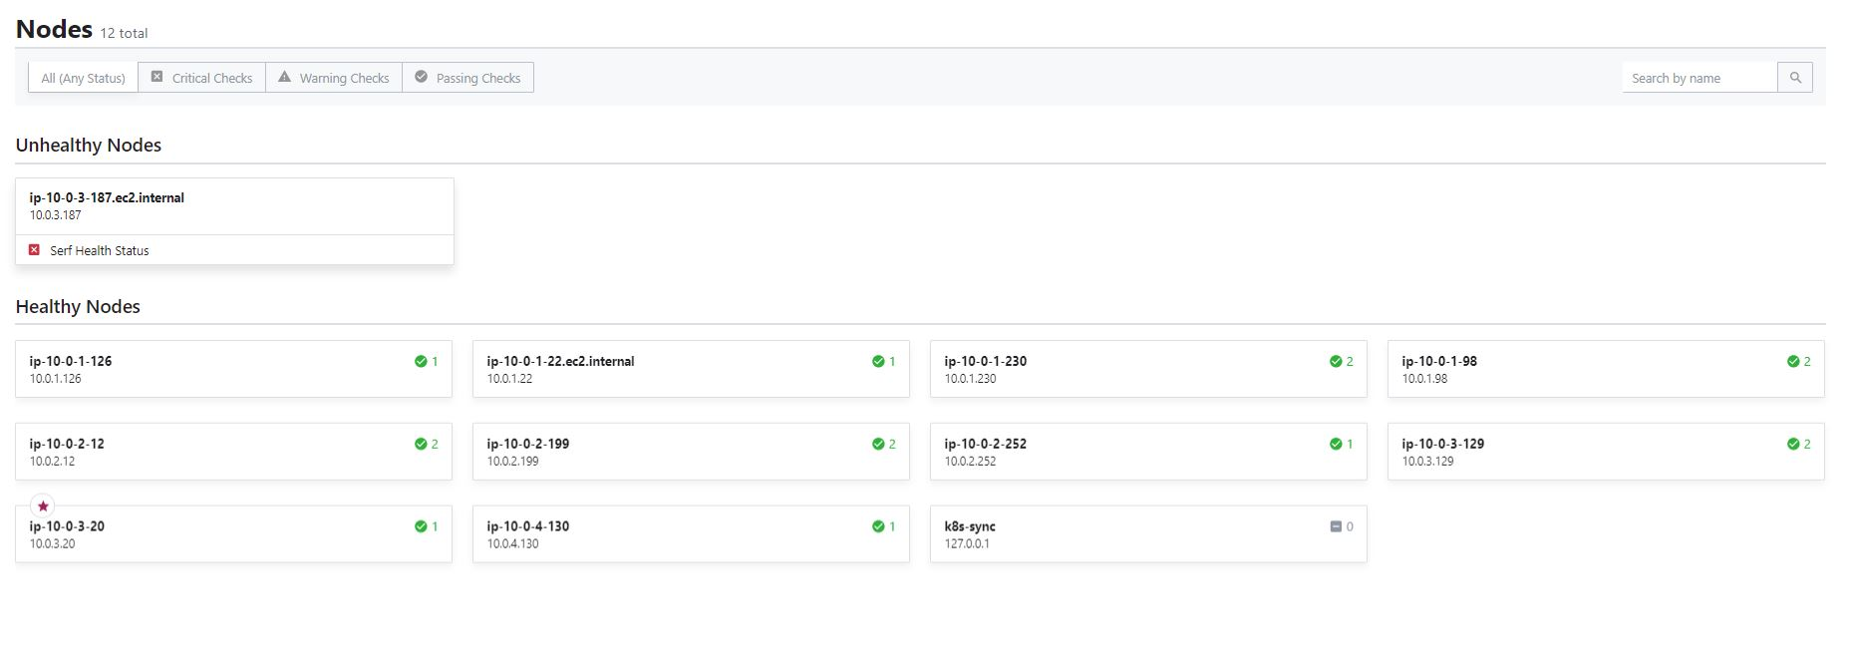
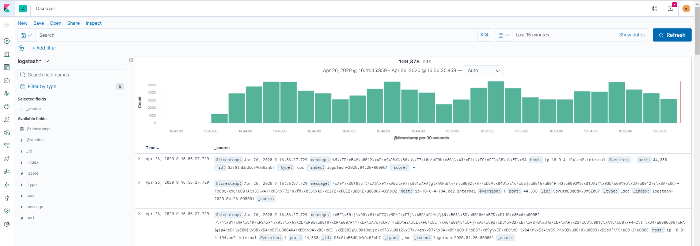

Slide 14
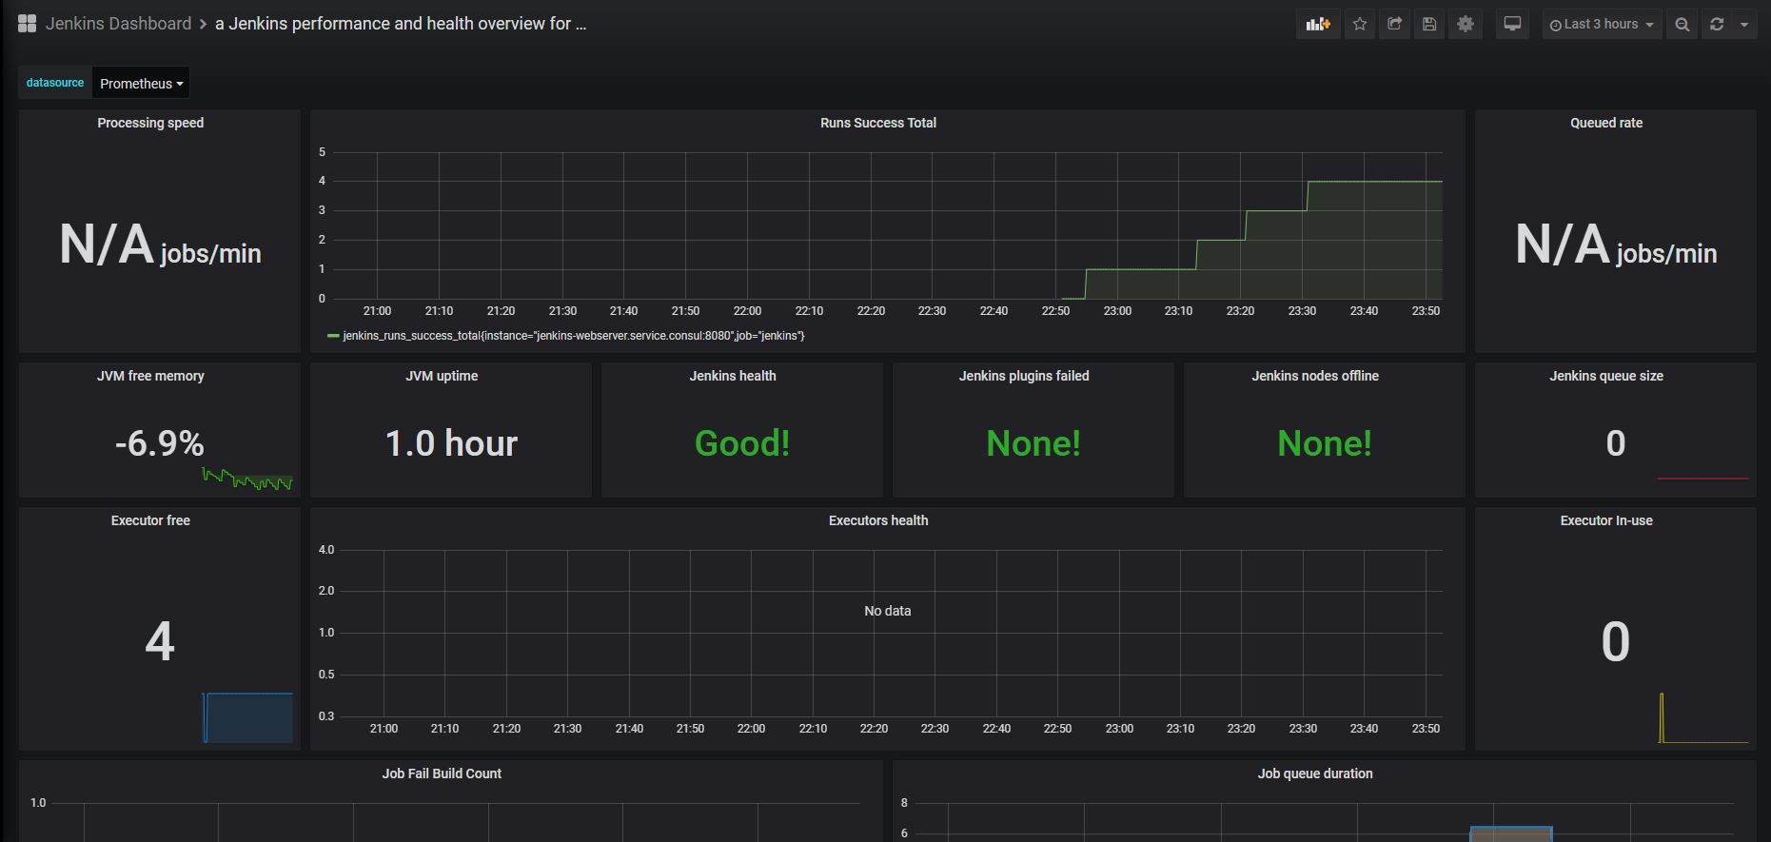
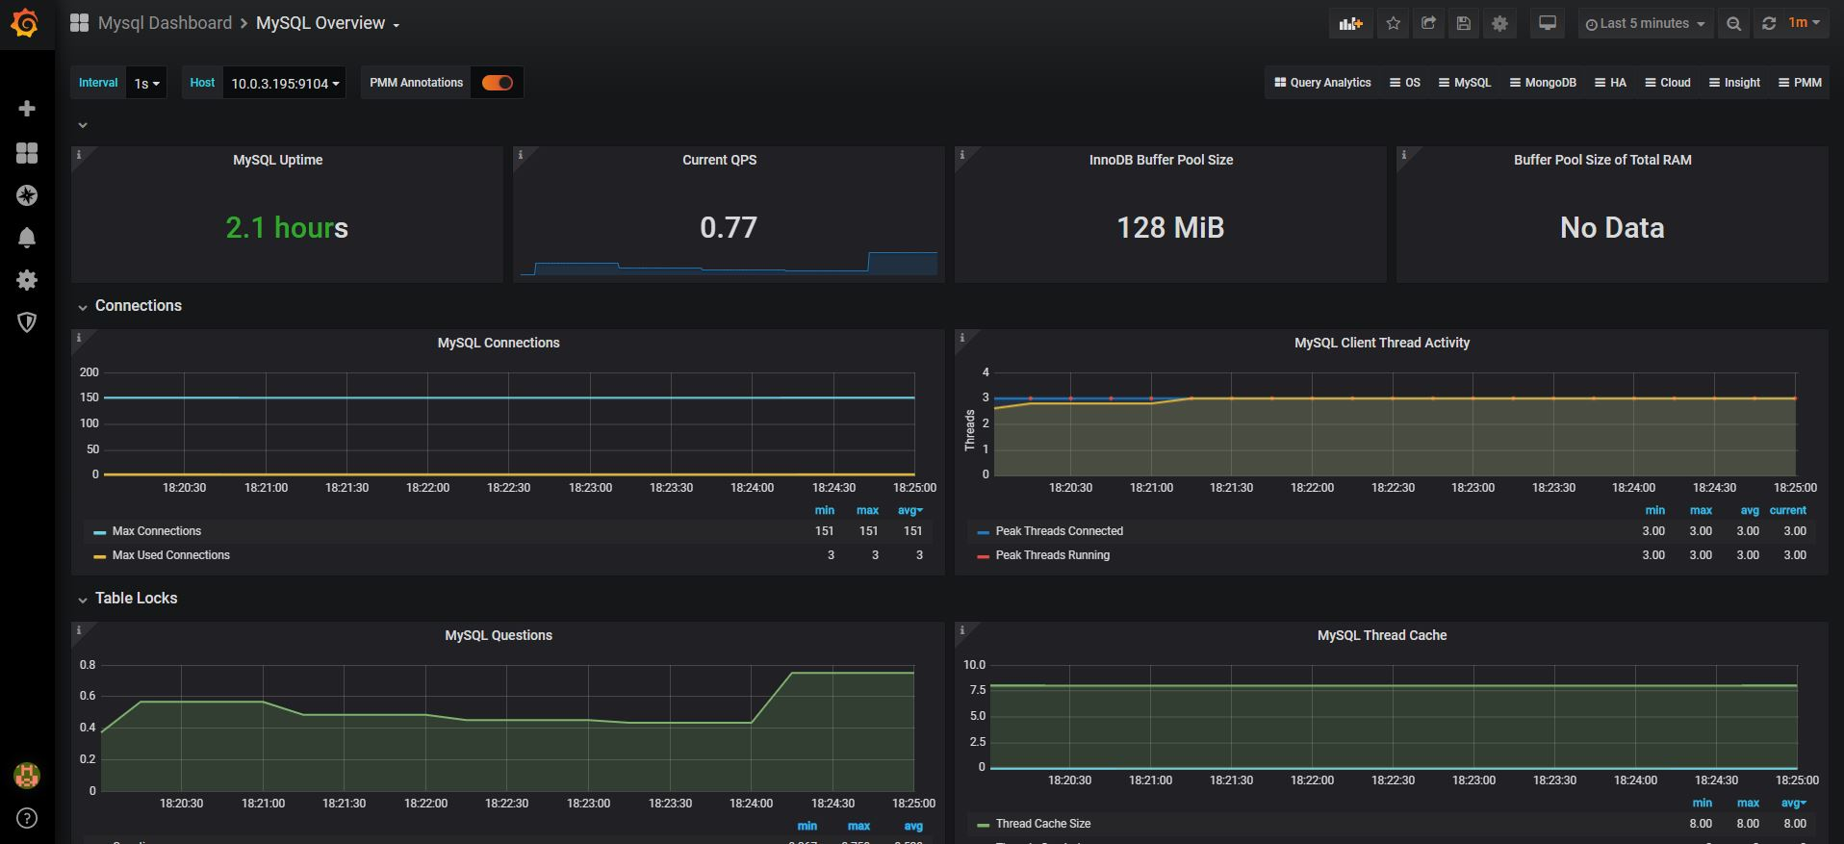
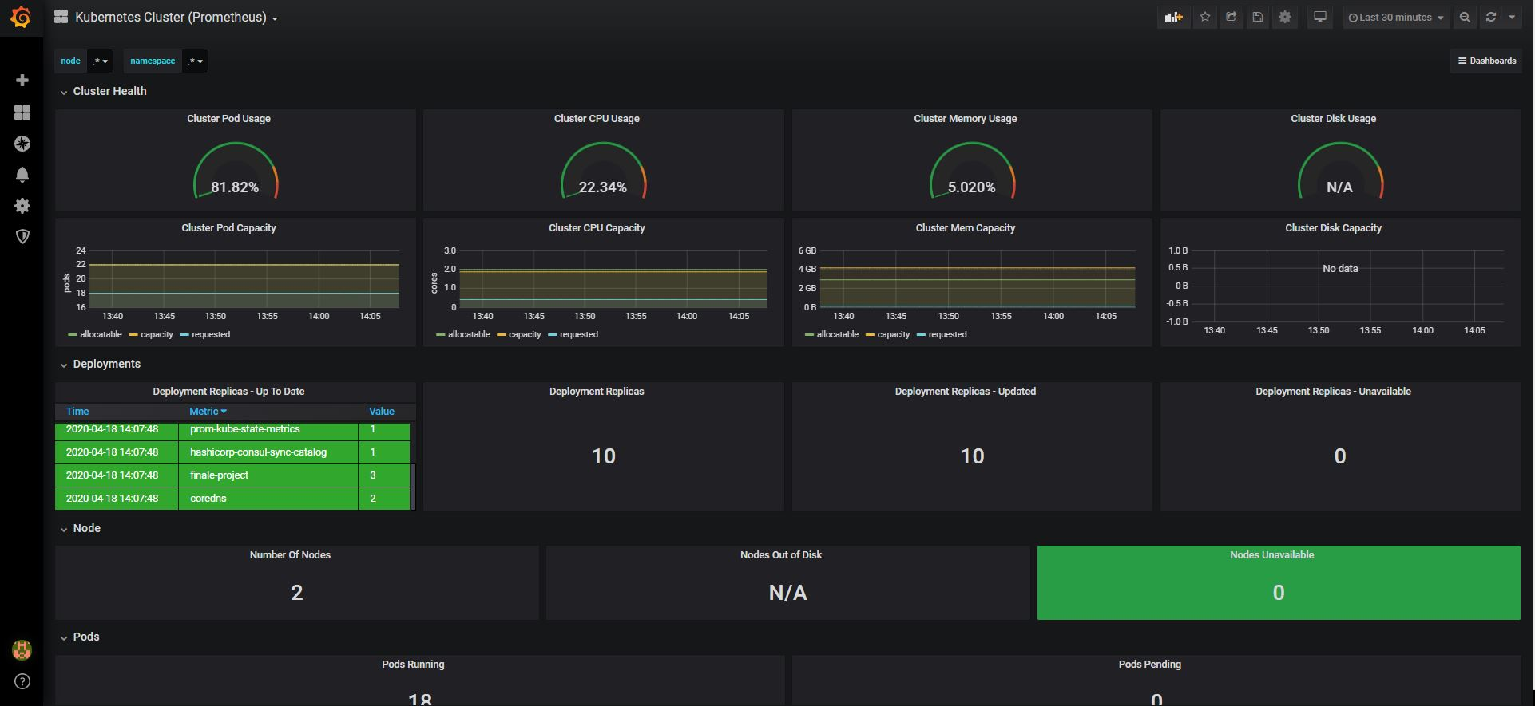
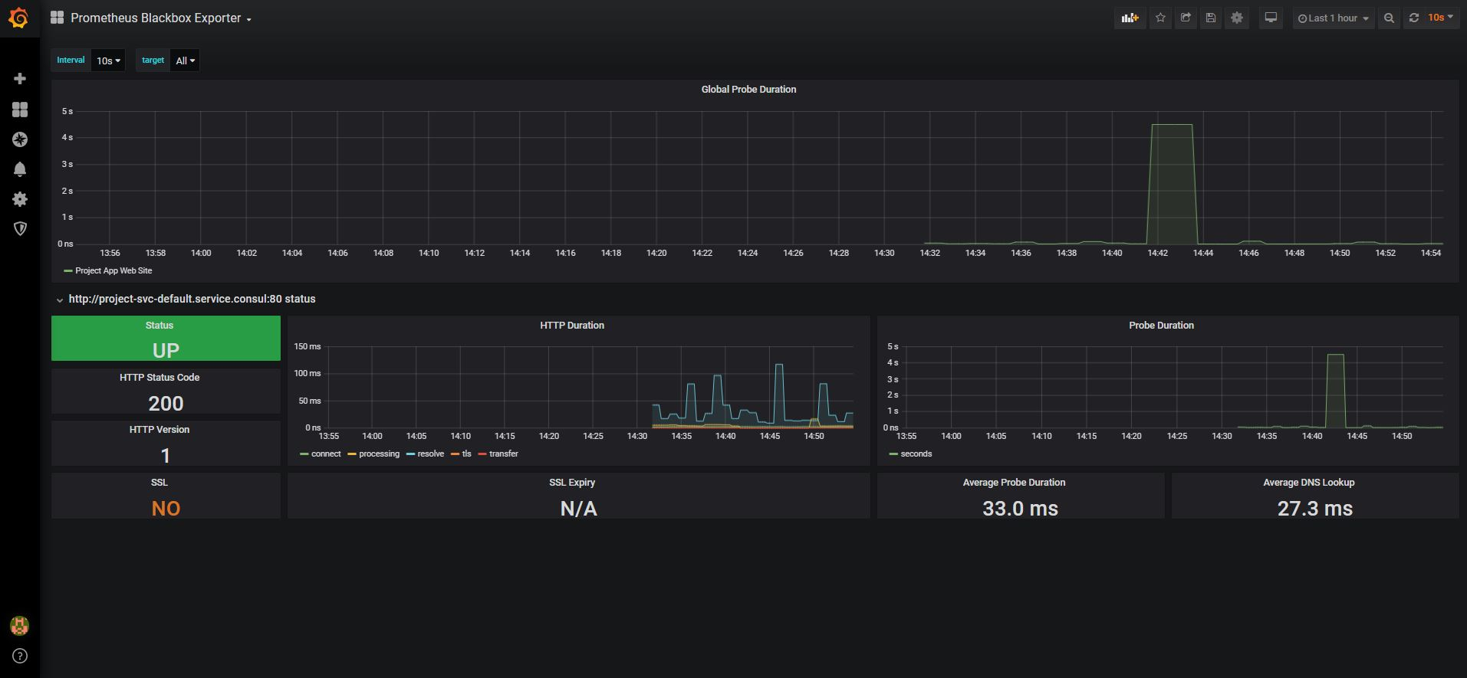

Slide 15
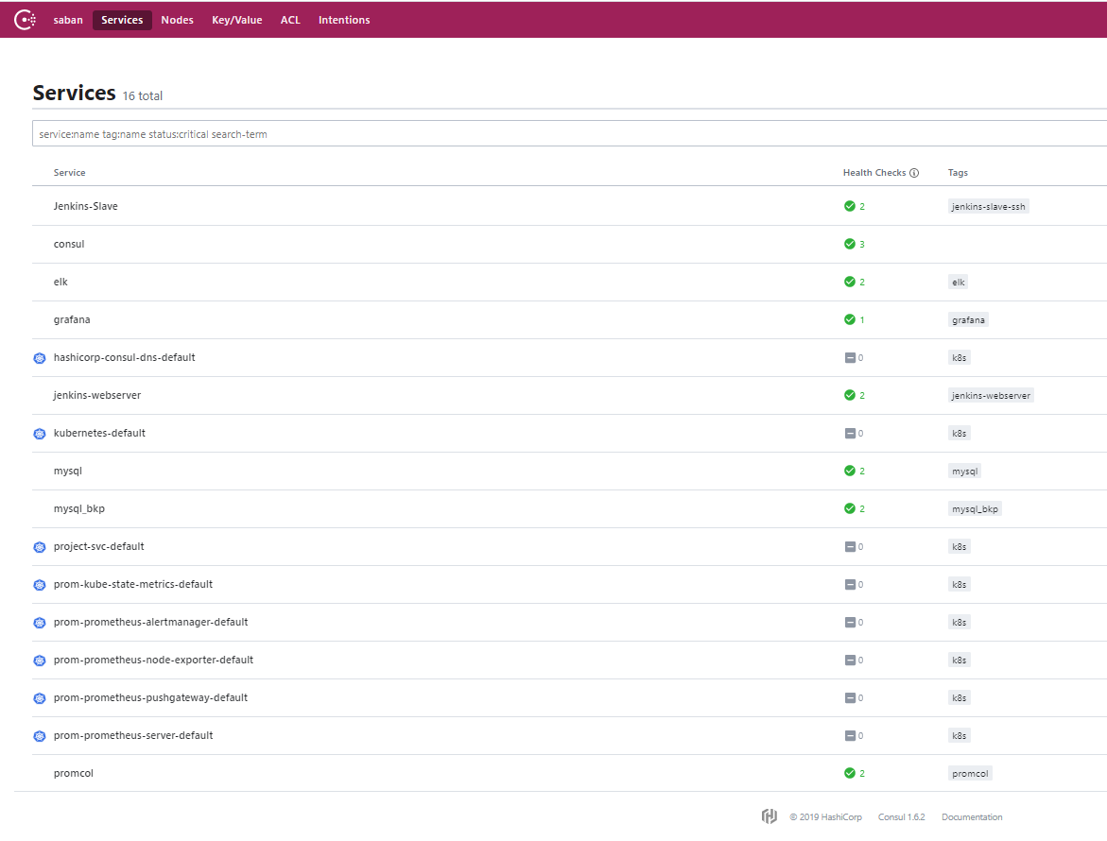
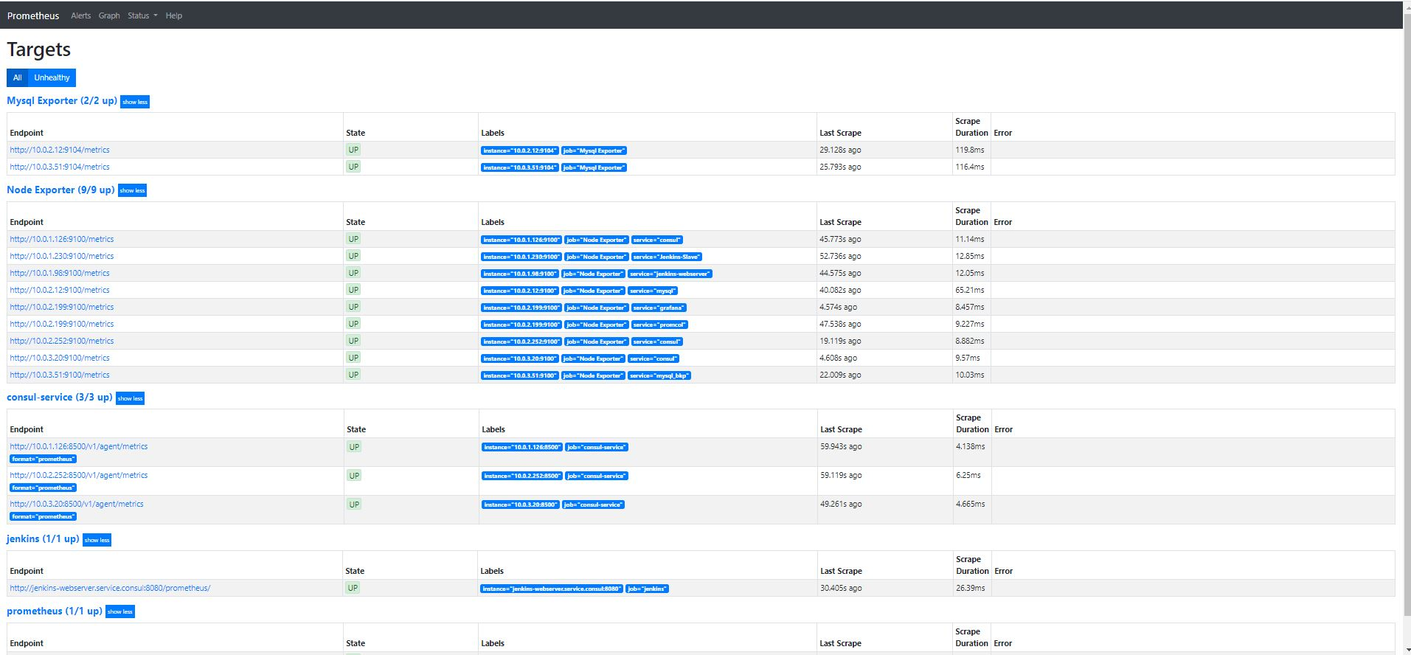

Slide 16
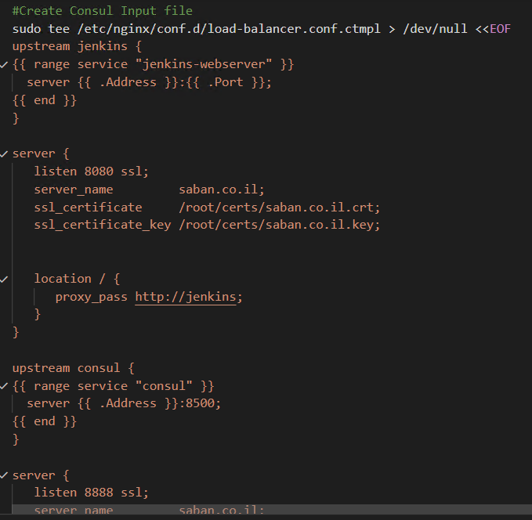
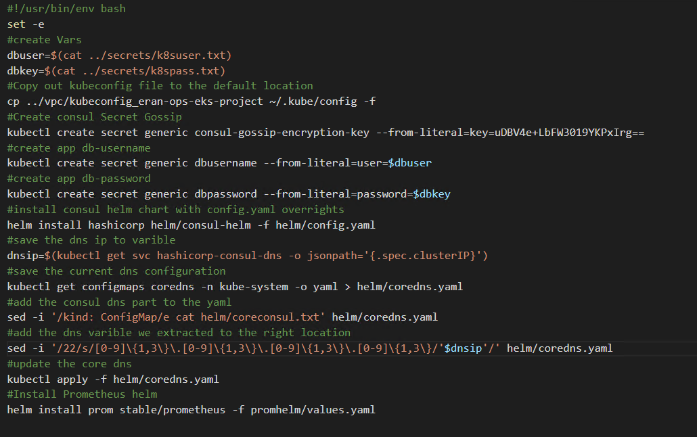
Code Snippets
Creating nginx reverse proxy with consul template with TLS certificate
Nice code samples to notice
Automating helm consul and configure coredns with
Export\import and sed
Generate self signed certificate during userdata mode

Slide 17
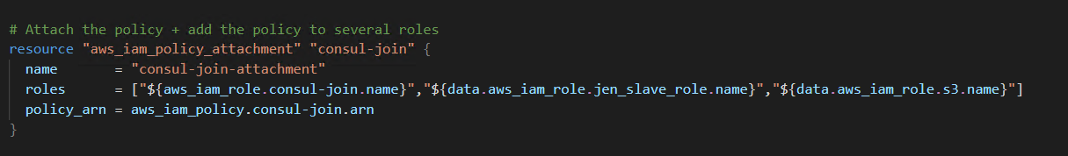
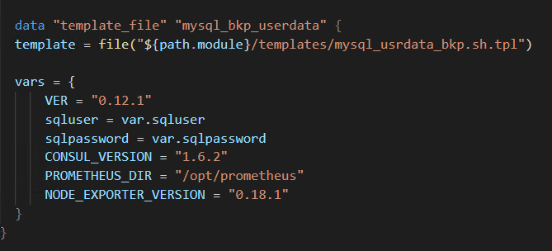
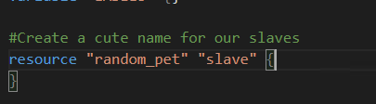
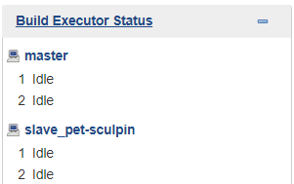
Code Snippets
Attaching consul permission to other profiles
Using Templates to create user data with variables
Creating a cute random name for the Jenkins slave

Slide 18
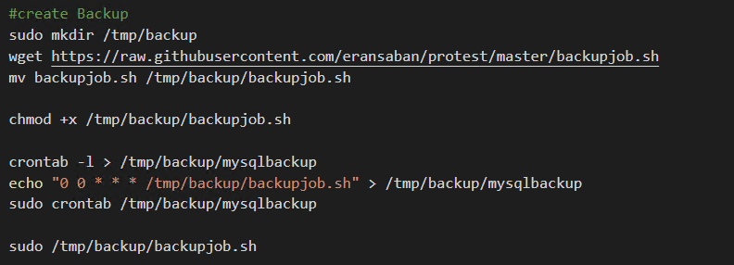
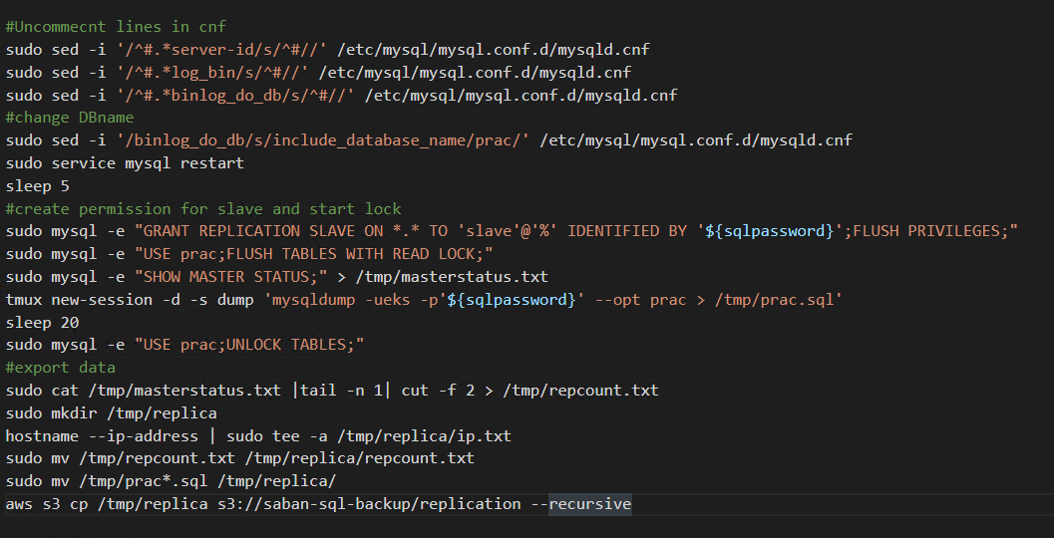
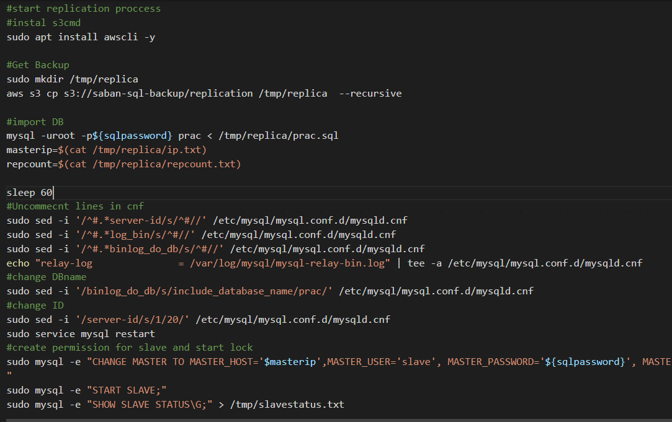
Code Snippets
Creating Backup script and cron to s3 with aws cli
Creating Complete automation of Mysql Replication
Master
Slave

