Slide 1
Control Plane
KUBERNETES
Data Plane
Architecture Reference
Object Model
Networking
Core Components · Object Model · Networking · Security · Operations
RBAC
Pod Security
Secrets Mgmt
Enterprise Security Architect Edition

Slide 2
What We'll Cover
10 topics · architecture-first approach
01
What is Kubernetes
06
Networking
Design principles, why it matters at enterprise scale
CNI, NetworkPolicy, zero-trust posture
AGENDA
02
Architecture Overview
07
Storage Architecture
Control Plane vs Data Plane, the two-plane model
PV/PVC, CSI driver, secrets management pattern
03
Control Plane Deep Dive
08
RBAC
API Server, etcd, Scheduler, Controller Managers
Roles, bindings, attack patterns, least privilege
04
Data Plane
09
Pod Security
kubelet, kube-proxy, container runtime (containerd)
Pod Security Standards, critical security controls
05
Object Model
10
Operations
Deployments, Services, RBAC objects, namespace isolation
Upgrades, multi-cluster, observability

Slide 3
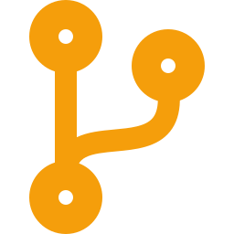
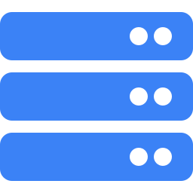


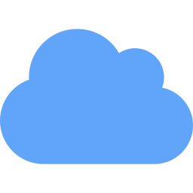
What Is Kubernetes?
Open-source container orchestration · CNCF · Originally designed by Google
Kubernetes automates the deployment, scaling, self-healing, and lifecycle management of containerized applications across clusters of machines. It is NOT a container runtime — it is the control system that decides where, when, and how containers run.
INTRODUCTION
Declarative State
API-Driven
Self-Healing
Extensible
Portable
Describe desired state.
K8s continuously reconciles
actual → desired via control loops.
Every operation goes through
kube-apiserver. No side channels.
Centralized audit and authz.
Failed pods restart. Unhealthy
nodes drained. Replacements
auto-scheduled.
Custom Resource Definitions
extend the API. Operators codify
domain-specific automation.
Same manifest on EKS, AKS,
GKE, or bare metal. Cloud
differences abstracted away.
K8s decouples workloads from infrastructure — enabling consistent deployment across on-prem, cloud, and hybrid environments with built-in availability, traffic management, and access control primitives.

Slide 4
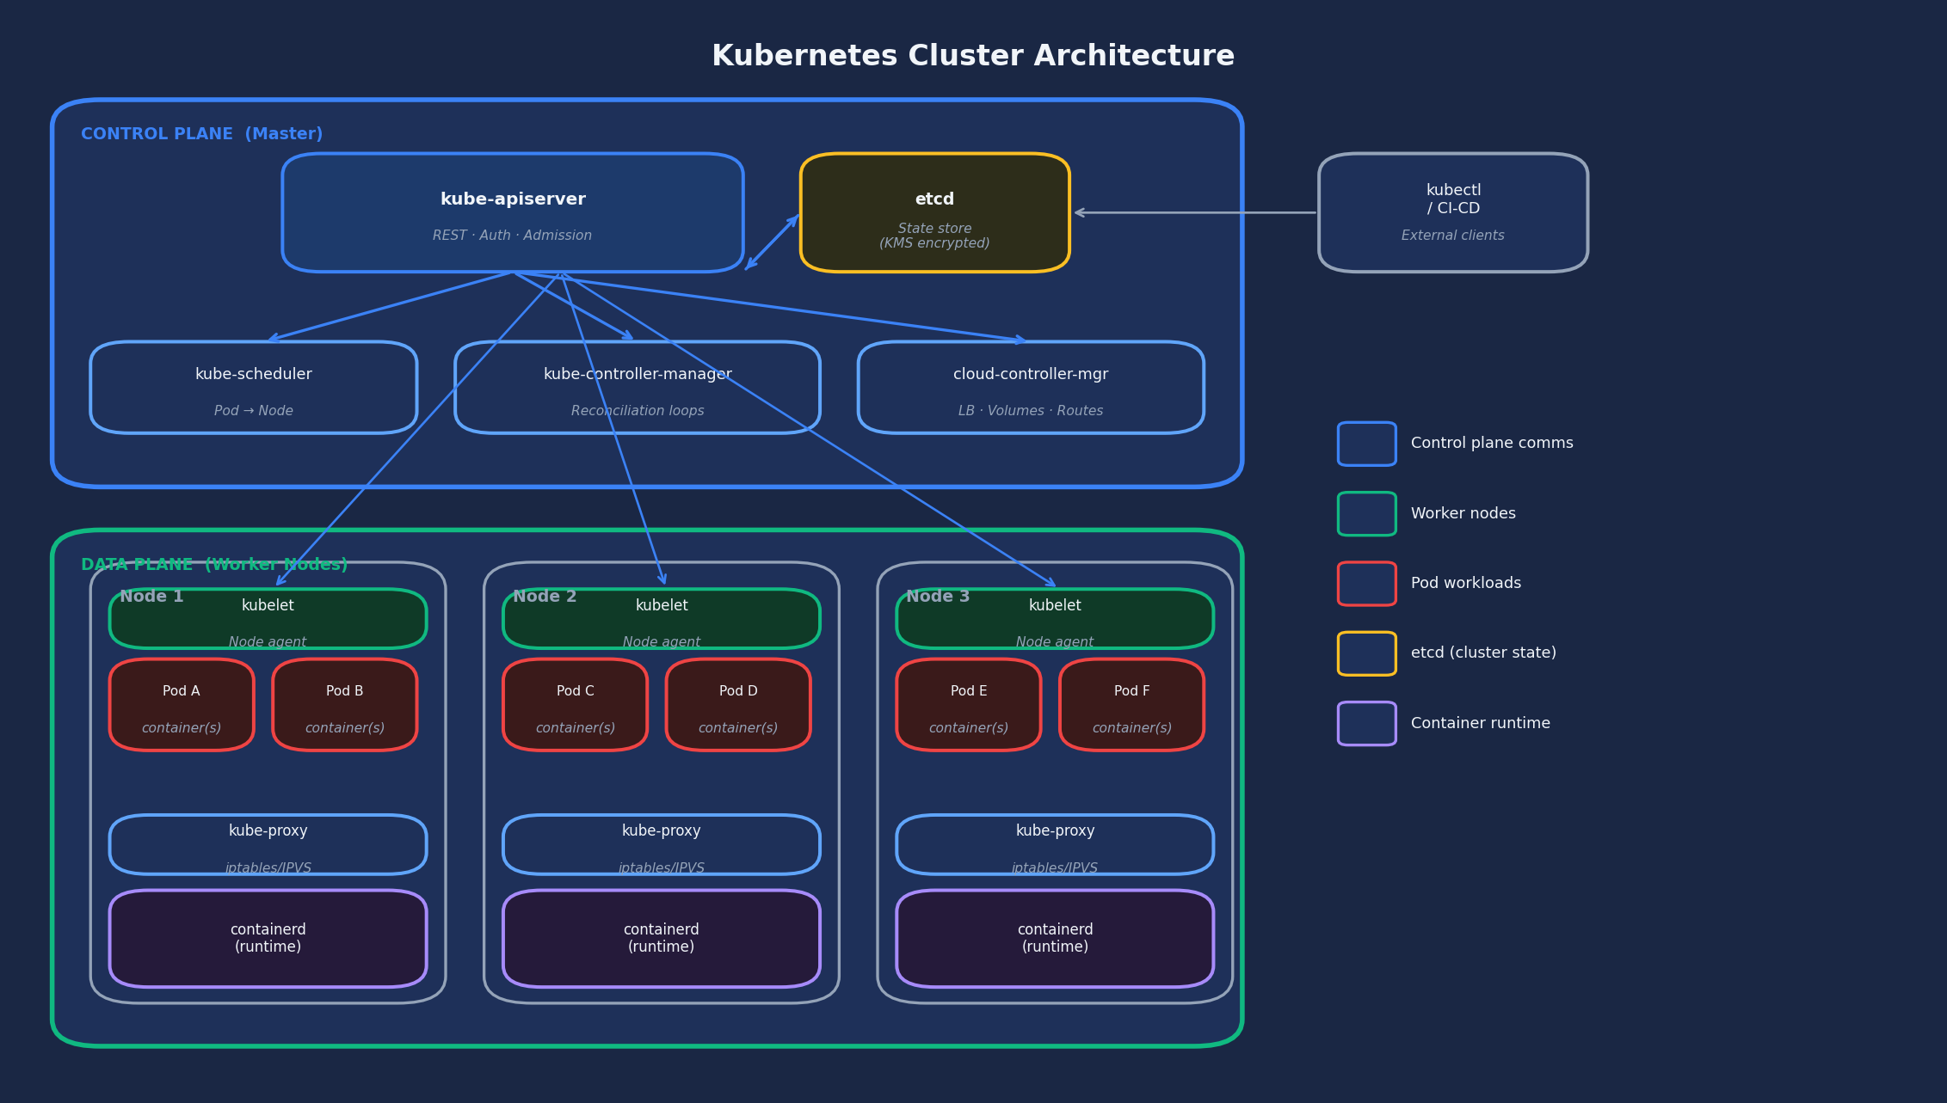
Cluster Architecture Overview
Control Plane manages state · Data Plane executes workloads · All comms via kube-apiserver
ARCHITECTURE

Slide 5
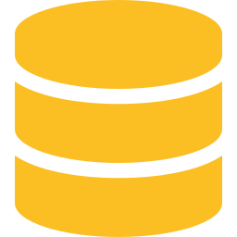
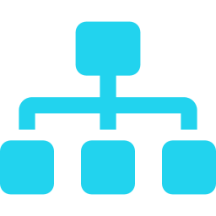

Control Plane Components
AWS/Azure/GCP manage this layer — you are responsible for configuration, not infrastructure
kube-apiserver
etcd
CONTROL PLANE
Single entry point for ALL cluster operations. Handles authentication (who?), authorization (allowed?), and admission control (should we accept this object?). The only component that writes to etcd. The highest-value attack target in any cluster.
Distributed key-value store. Complete cluster state. If compromised = game over. Secrets base64-only by default — envelope encryption via KMS is mandatory in production. Direct etcd network access must be blocked. Backup snapshots are your disaster recovery plan.
kube-scheduler
kube-controller-manager
cloud-controller-manager
Assigns pending pods to nodes. Two phases: Filter (removes nodes that can't satisfy requirements) then Score (ranks feasible nodes). Respects resource requests, node affinity, taints/tolerations, topology spread constraints.
Multiple reconciliation loops in one binary. Node controller (health monitoring), Deployment controller (rolling updates), ReplicaSet controller (replica count), ServiceAccount controller, Endpoints controller.
Interfaces with cloud provider APIs. Provisions load balancers when type: LoadBalancer services are created. Provisions storage when PVCs are bound. Updates routing tables when nodes are added/removed.
SECURITY: API server audit logging is your forensic record. Enable it. Ship logs to immutable external storage. etcd direct access = instant cluster admin. Never expose etcd to any network outside the control plane.

Slide 6
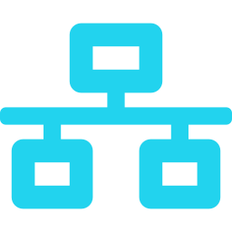
Data Plane – Worker Nodes
kubelet · kube-proxy · Container Runtime (containerd) | Your responsibility to harden
kubelet
WORKER NODE ANATOMY
kubelet
Primary node agent. Runs on every worker node. Receives PodSpecs from API server. Communicates with container runtime via CRI (Container Runtime Interface). Manages container lifecycle. Reports node and pod health. Mounts secrets, configmaps, volumes into pods.
Security: kubelet API must not be publicly accessible. Disable anonymous access. kubelet --read-only-port 0.
DATA PLANE
kube-proxy
Pod Pod Pod
kube-proxy
Runs on every node. Implements the Service abstraction. Programs network rules so Service ClusterIP traffic is load-balanced to pod IPs.
Backend modes: nftables (recommended, v1.31+), iptables (legacy), IPVS (deprecated in v1.35 — do not use for new deployments).
Note: In eBPF-based clusters (Cilium, GKE Dataplane V2), kube-proxy is replaced entirely — better performance and intranode visibility.
containerd (CRI)
OS Kernel (Linux namespaces · cgroups)
Container Runtime (containerd)
Hypervisor / Bare Metal
Pulls images, manages image layers, creates container processes via Linux namespaces and cgroups. containerd is the standard. Docker runtime was deprecated in K8s v1.20, removed v1.24.
cgroup v2 required: cgroup v1 is disabled by default in v1.35 and will be removed in v1.36. All production nodes must run cgroup v2. containerd 2.x required for v1.36+; upgrade from 1.x before then.
Security: Use gVisor (GKE), Bottlerocket (EKS), or COS (GKE) to limit node attack surface.

Slide 7
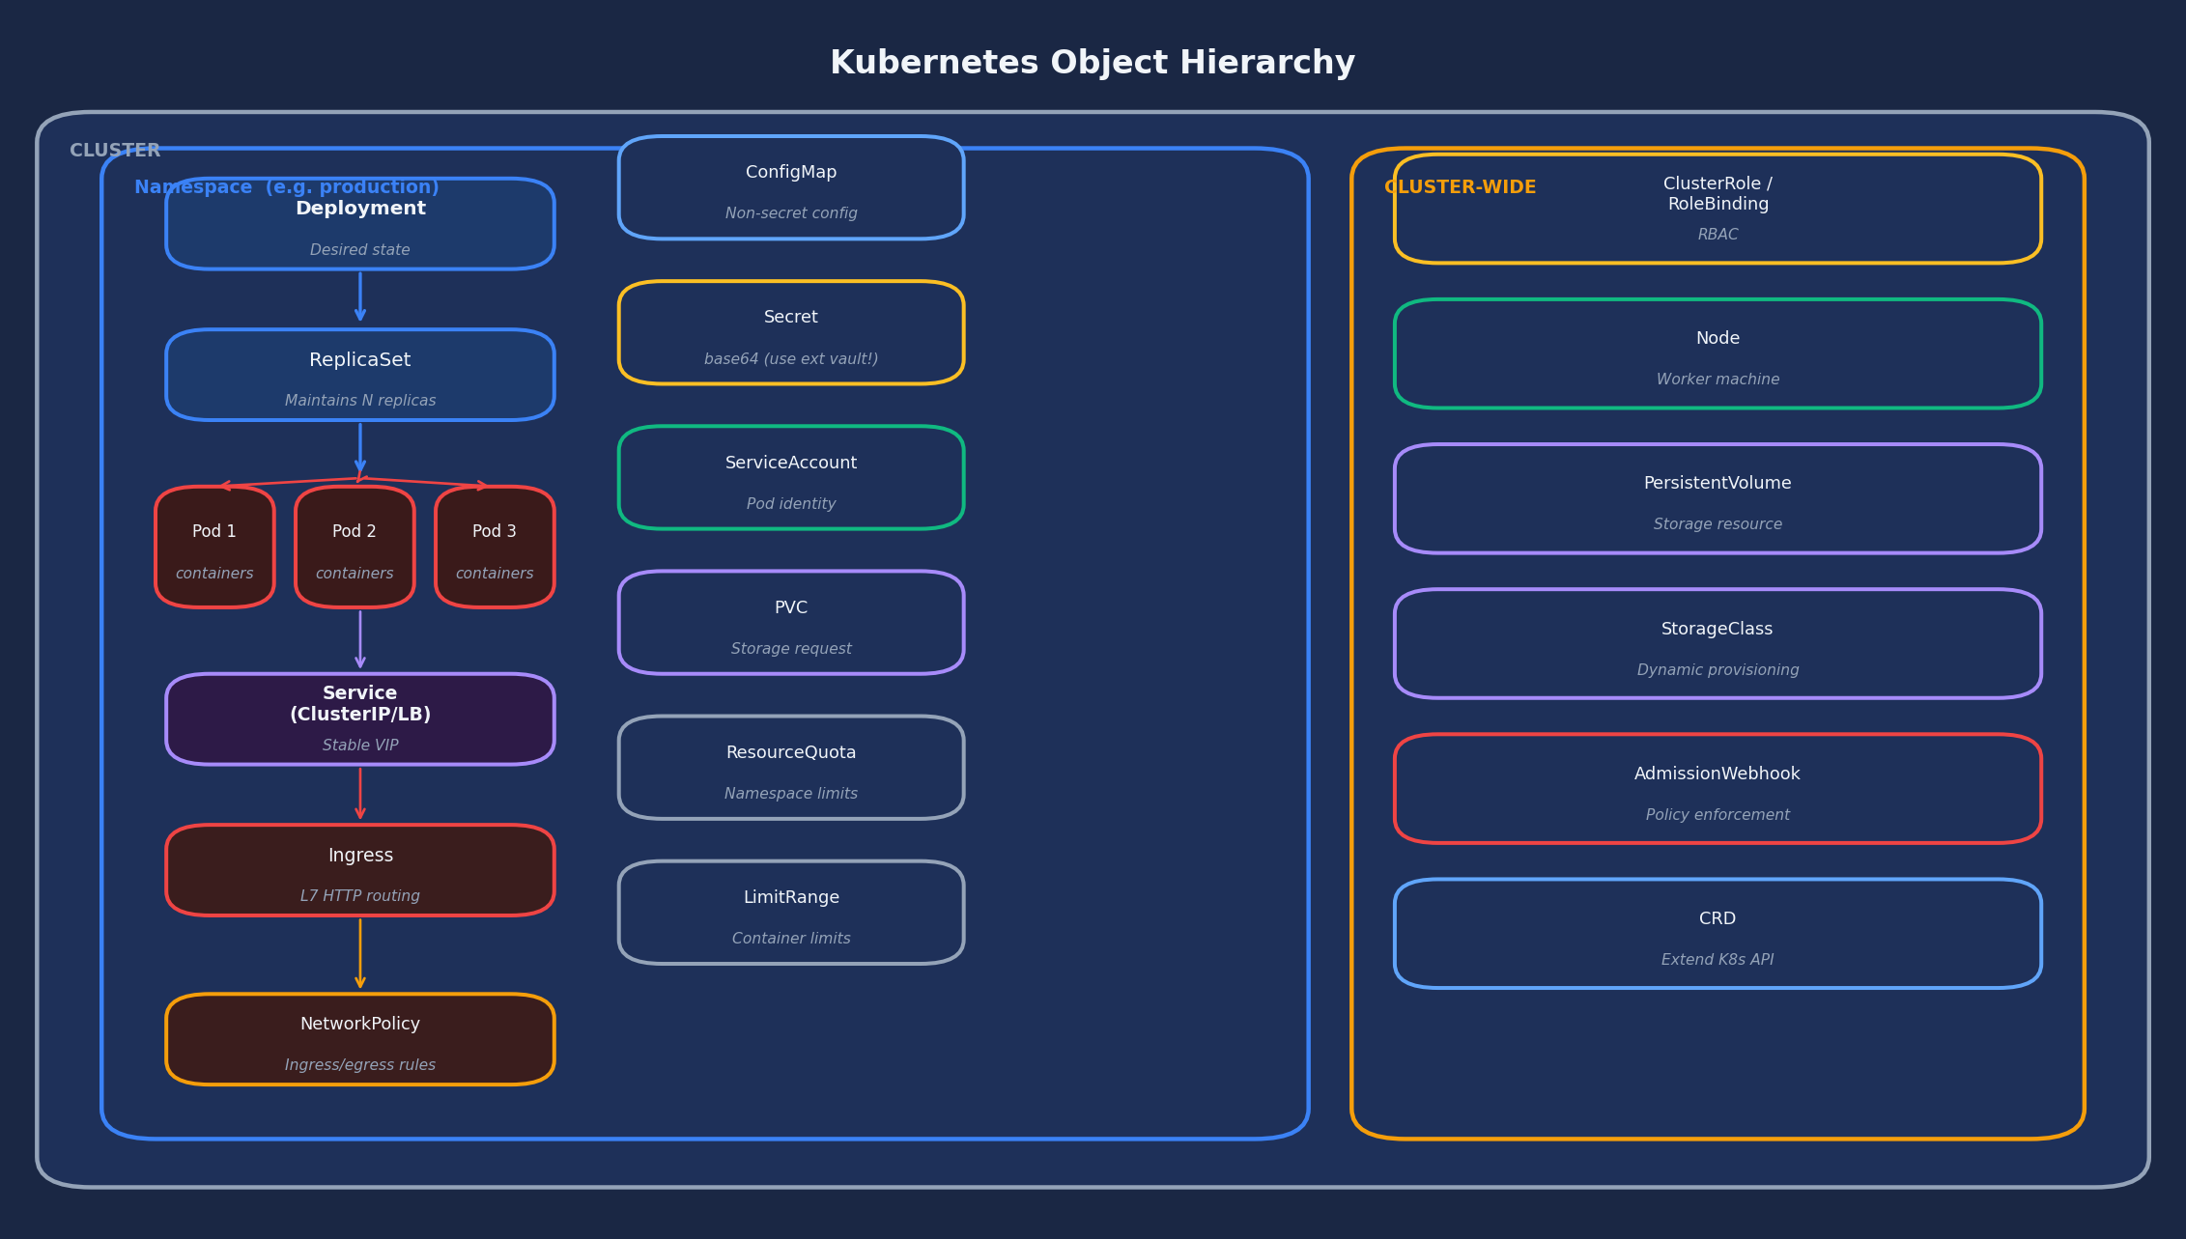
Kubernetes Object Hierarchy
Every resource is an API object stored in etcd · Namespaces scope most objects
OBJECT MODEL

Slide 8
Key Object Types Explained
Know these cold — every K8s operation involves one of these objects
Workload
Workload
Workload
Networking
Deployment
StatefulSet
DaemonSet
Service
OBJECT MODEL
Declarative update for stateless apps. Manages a ReplicaSet. Rolling updates, rollbacks. Never deploy bare pods in production.
Like Deployment but for stateful apps. Stable network identities, ordered scaling, persistent storage per replica.
One pod per node. Used for logging agents, monitoring (Falco), CNI plugins, security tooling.
Stable virtual IP and DNS name for a set of pods. Types: ClusterIP / NodePort / LoadBalancer / ExternalName.
Networking
Networking
Config
Config
Ingress
NetworkPolicy
ConfigMap
Secret
L7 HTTP/HTTPS routing. Routes external traffic based on hostname and path. Requires an Ingress Controller.
Defines allowed ingress/egress traffic. Only enforced by the CNI plugin (Cilium/Calico). Default: allow all.
Non-secret configuration. Injected as env vars or volume mounts. Use for feature flags, config files.
base64 only — NOT encrypted. NEVER use for prod secrets. Mount from external vault via CSI driver instead.
Identity
RBAC
Storage
Isolation
ServiceAccount
Role/Binding
PVC/PV
Namespace
Pod identity. The mechanism for IRSA, Workload Identity, SPIFFE/SPIRE. One SA per workload, not shared.
Defines permissions (verbs on resources) and binds them to subjects. Namespace-scoped. Never use cluster-admin.
PersistentVolumeClaim requests storage; PV provides it. StorageClass enables dynamic provisioning.
Logical isolation boundary. Scopes RBAC, NetworkPolicy, ResourceQuota. NOT a security sandbox by itself.

Slide 9
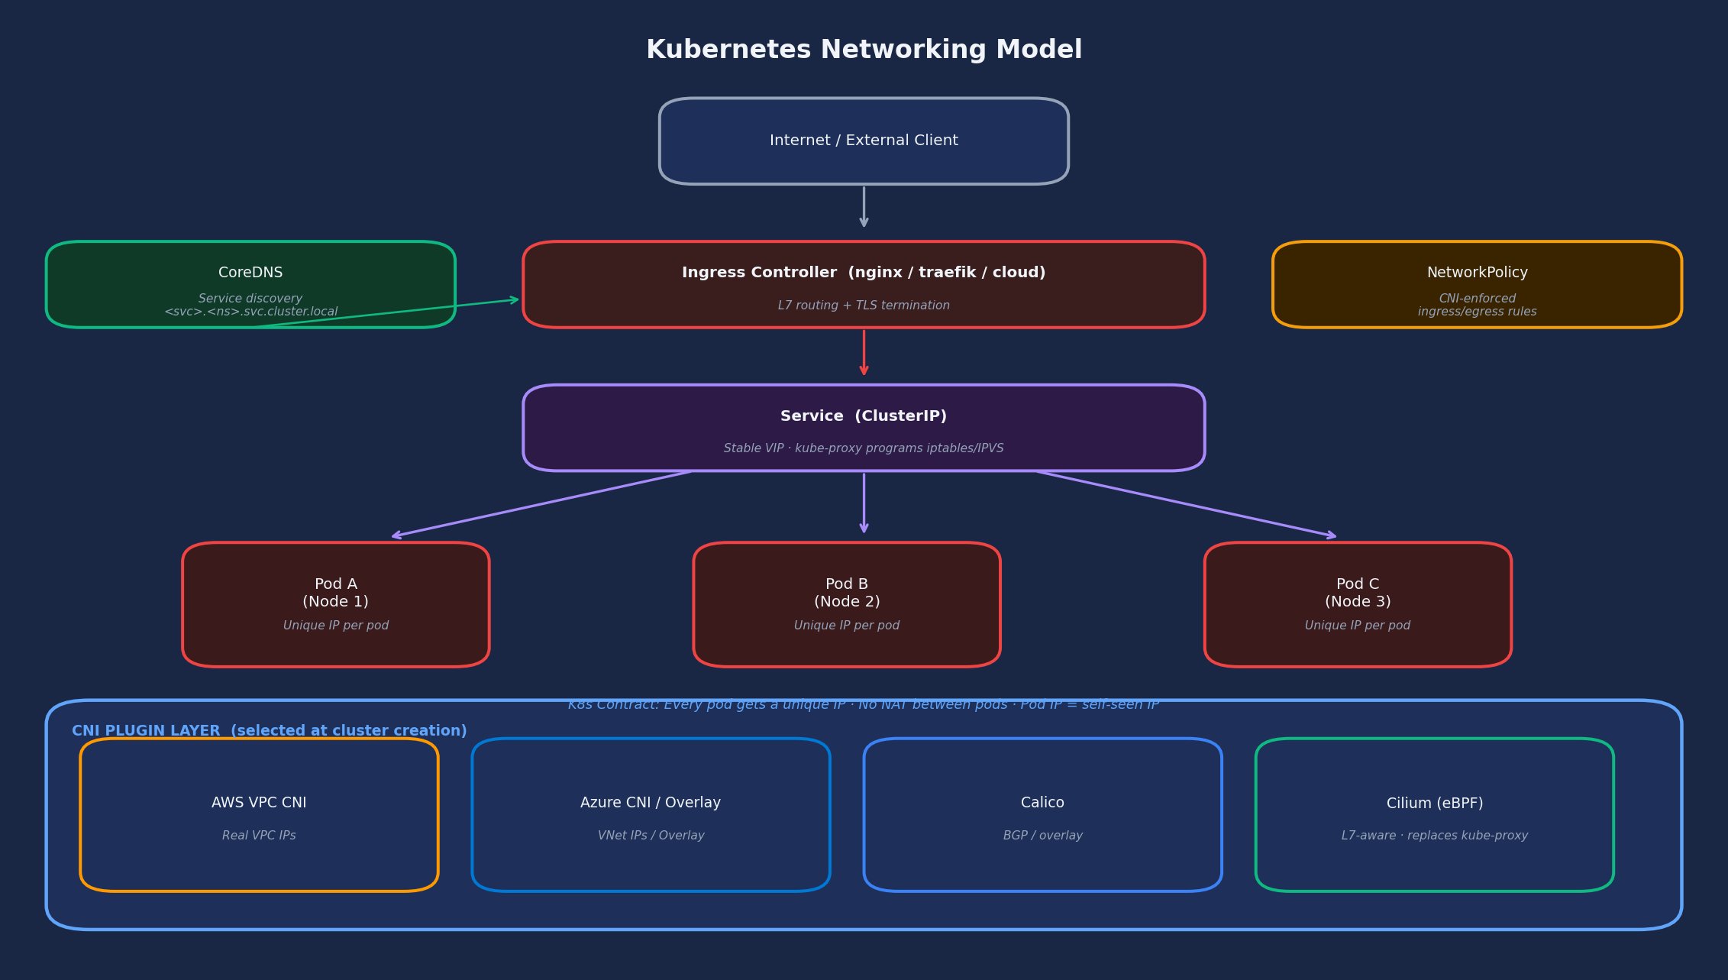
Kubernetes Networking Model
Every pod gets a unique IP · No NAT between pods · CNI plugin enforces NetworkPolicy
NETWORKING

Slide 10
Zero Trust Network Posture in Kubernetes
Default K8s = allow all. Zero trust requires explicit configuration.
DEFAULT STATE: All pods can communicate with all other pods across all namespaces. This is the opposite of zero trust.
NETWORKING
1
Default-Deny Policies
2
Explicit Allowlist Policies
3
Egress Controls
4
CNI with L7 Enforcement
Apply a deny-all ingress AND deny-all egress NetworkPolicy to every namespace.
Without this, any pod can reach any other pod across all namespaces. Even after adding allowlist policies, the default-deny is your safety net.
Define NetworkPolicies that allow only the specific communication paths your application requires.
Document every allowed path. If you can't justify a communication path, block it.
Restrict pod egress to known internal services and explicitly approved external endpoints.
Block unrestricted internet egress from all pods. A pod that can reach the internet is a data exfiltration risk.
Use Cilium or Calico. kubenet does NOT enforce NetworkPolicy.
Cilium (eBPF) provides L7-aware policy (HTTP methods, paths), replaces kube-proxy, and delivers detailed network observability including intranode traffic.
For ingress routing, prefer Gateway API (GA since v1.28) over Ingress for new deployments. Ingress NGINX has announced retirement.

Slide 11
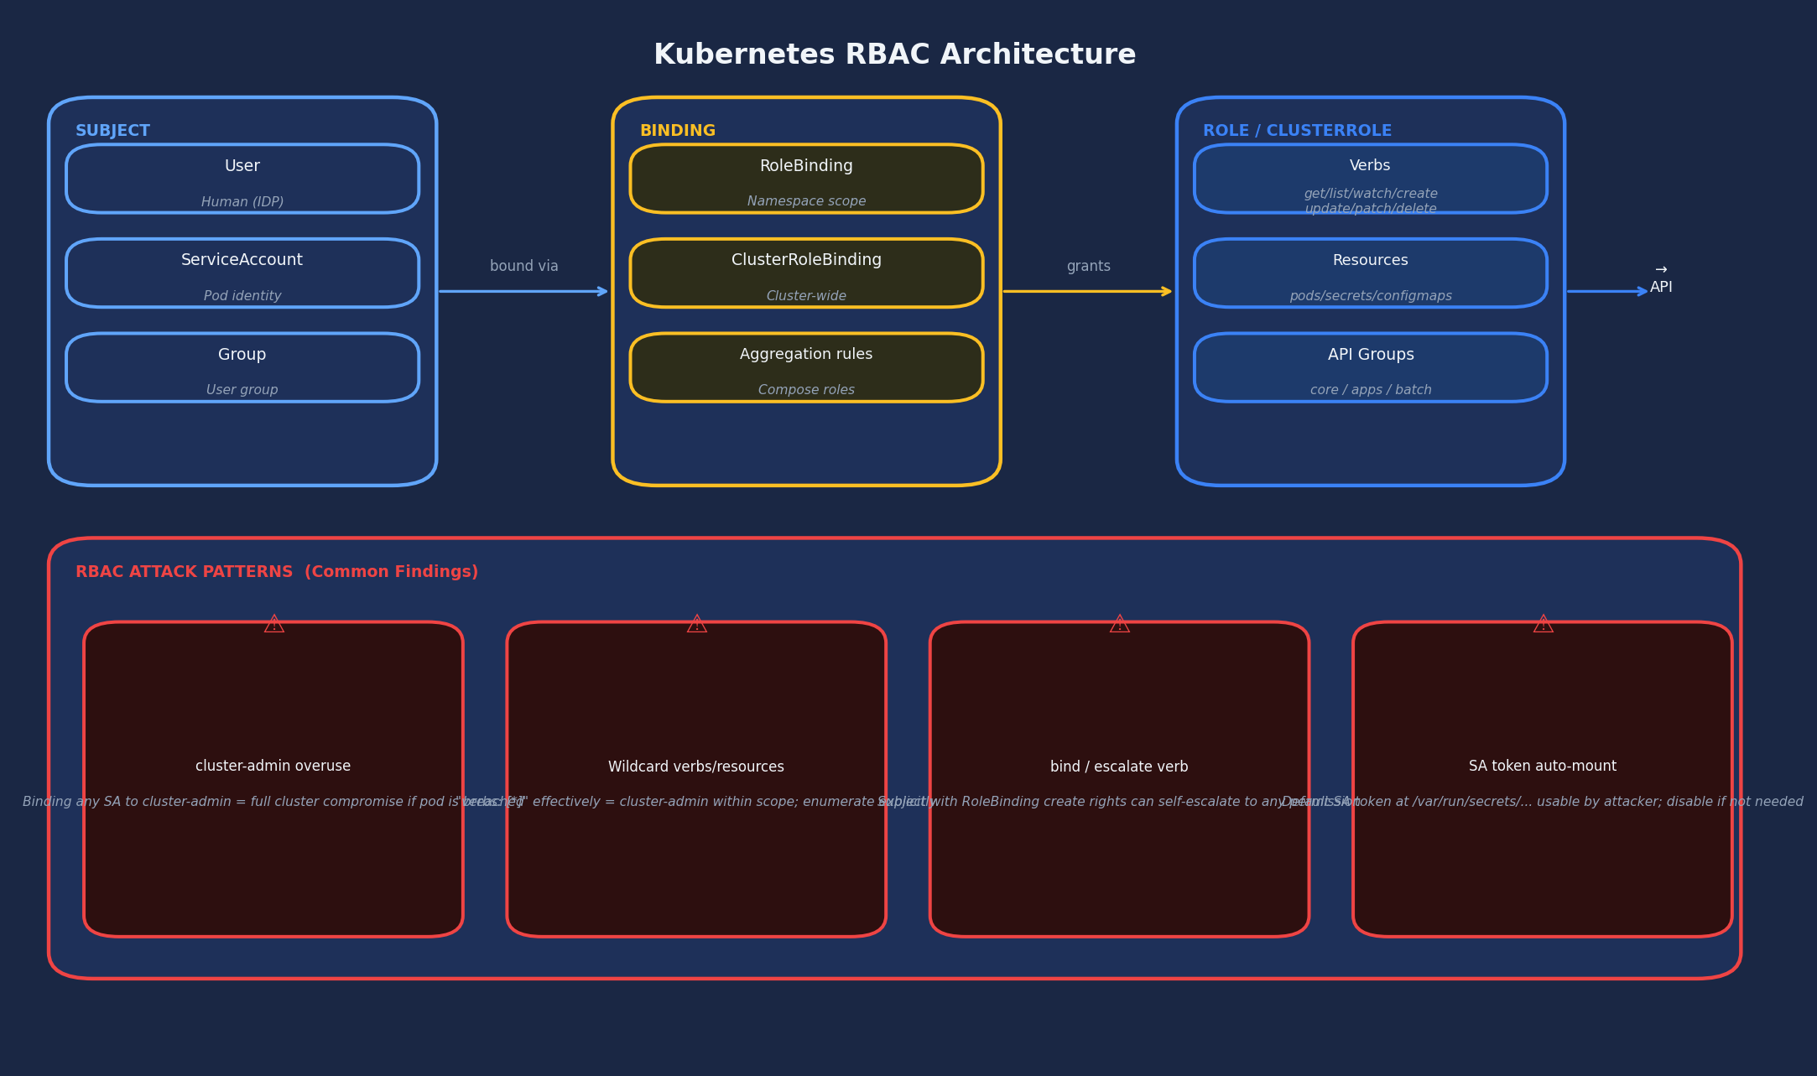
Role-Based Access Control (RBAC)
Subjects + Bindings + Roles = Permissions · RBAC is additive — no deny rules
RBAC

Slide 12
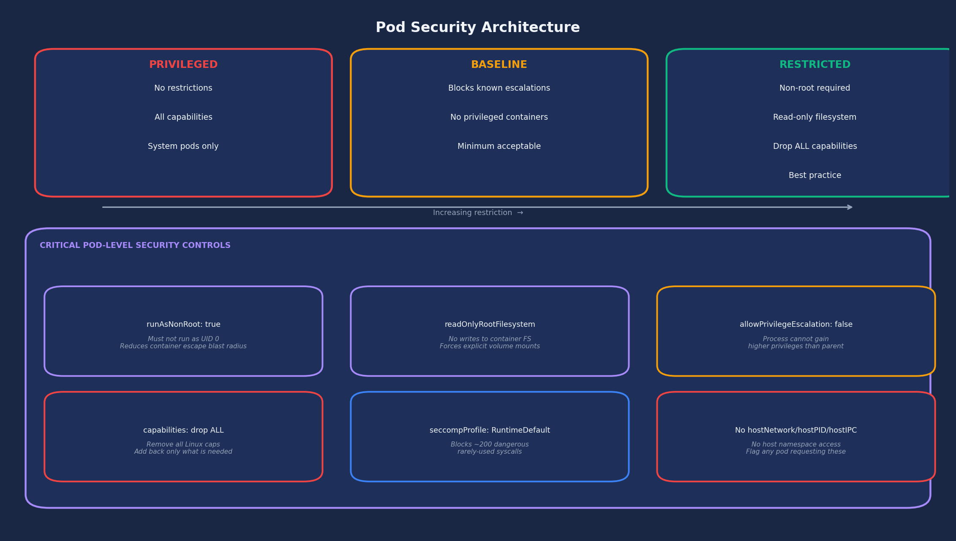
Pod Security Architecture
Pod Security Standards + critical spec controls — enforced via admission webhook (OPA/Kyverno)
POD SECURITY

Slide 13
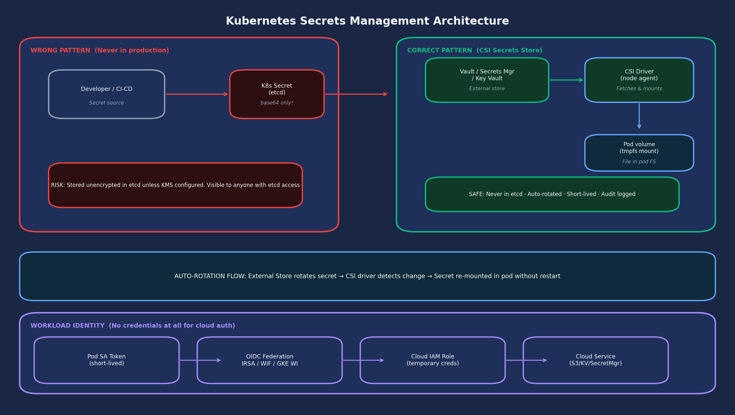
Secrets Management Architecture
Kubernetes Secrets = base64 only. The correct architecture never stores secrets in etcd.
SECRETS MGMT

Slide 14
Storage Architecture & CSI
PersistentVolumes · StorageClasses · CSI Secrets Store driver
VOLUME TYPES
CSI SECRETS STORE DRIVER PATTERN
emptyDir
1
External Secrets Manager
STORAGE
Ephemeral scratch space. Deleted with the pod. Shared between containers in same pod.
Vault / AWS Secrets Manager
Azure Key Vault / GCP Secret Manager
hostPath
2
CSI Driver (node agent)
AVOID IN PRODUCTION. Mounts node filesystem into pod. Can expose /etc, /var, sensitive host files to container.
Fetches secrets on pod start.
Holds in tmpfs. Short TTL.
PVC
3
Volume mount in pod
App reads from file path.
No env var, no K8s Secret.
Correct pattern for persistent storage. Decouples storage lifecycle from pod lifecycle. Backed by cloud block storage.
4
Auto-rotation
CSI
Store rotates → driver detects
→ remounts without pod restart.
Plugin-based storage. Enables external secrets stores (Vault, Secrets Manager, Key Vault) to mount directly into pods.
RESULT: etcd contains zero sensitive credentials · All secrets short-lived and audited

Slide 15
Observability & Operations
Metrics · Logs · Traces · Audit Logging · Upgrade Strategy · Multi-Cluster
THE THREE OBSERVABILITY PILLARS
Metrics
Logs
Traces
OPERATIONS
Prometheus (or cloud-native equiv) is the standard. Node Exporter for OS metrics, kube-state-metrics for K8s object state, /metrics endpoints on pods. Metrics Server for kubectl top and HPA.
No native log aggregation. DaemonSet-based agents (Fluent Bit, Filebeat) collect container stdout/stderr and ship to Elasticsearch, CloudWatch, Azure Monitor, Cloud Logging, or Splunk.
Requires instrumentation (OpenTelemetry) or service mesh sidecar injection. Not automatic. Jaeger or Zipkin as backends. Essential for debugging latency in microservice architectures.
Audit Logging (Security Critical)
Upgrade Strategy
Records every request to kube-apiserver. NOT enabled by default in managed services.
Must capture: metadata for all requests · request body for writes to Secrets, RBAC, ConfigMaps · responses for sensitive reads.
Ship to immutable storage outside cluster. Retain 90 days minimum (financial services: 1 year+).
Alert on: cluster-admin binding creation · anonymous access · exec into pods · secrets reads in bulk.
New minor version ~3x per year (every 15 weeks) · 14-month support window · Current: v1.35 (Dec 2025) · Pattern: cordon → drain (respects PDBs) → upgrade → uncordon. PodDisruptionBudgets are mandatory. Ensure cgroup v2 on all nodes before upgrading to v1.35+.
Multi-Cluster Patterns
Separate cluster per environment (dev/staging/prod) · Per compliance domain (PCI vs non-PCI) · Multi-region active-active for DR · Hub-spoke with GitOps fleet management (Flux, ArgoCD, GKE Fleet, AWS EKS Anywhere).

Slide 16
KEY TAKEAWAYS
Kubernetes Architecture Reference
01
Everything goes through the API server
02
etcd is the crown jewel
03
Default posture is insecure
Centralizes auth, authz, and audit. The API server is your highest-value target and your single control point.
Holds complete cluster state including Secrets. Requires envelope encryption (KMS) and must never be network-accessible outside the control plane.
No default-deny network policy. No Secrets encryption. No pod security restrictions. Every production cluster requires explicit hardening.
04
Workload identity beats credentials
05
Secrets belong in external stores
06
CNI choice is a security decision
IRSA / Workload Identity / GKE WI eliminate static credentials entirely. Any pod with static cloud credentials is an architectural defect.
Kubernetes Secrets = base64. Use CSI Secrets Store driver with Vault / cloud KMS. Zero secrets in etcd in any production deployment.
Not all CNIs enforce NetworkPolicy. Cilium (eBPF) is most capable: L7-aware policy, replaces kube-proxy, intranode visibility. cgroup v1 removed in v1.35; containerd 2.x required for v1.36+.
Kubernetes Architecture Reference · Enterprise Security Architect Edition · Based on Kubernetes v1.35 (December 2025)

