Slide 1
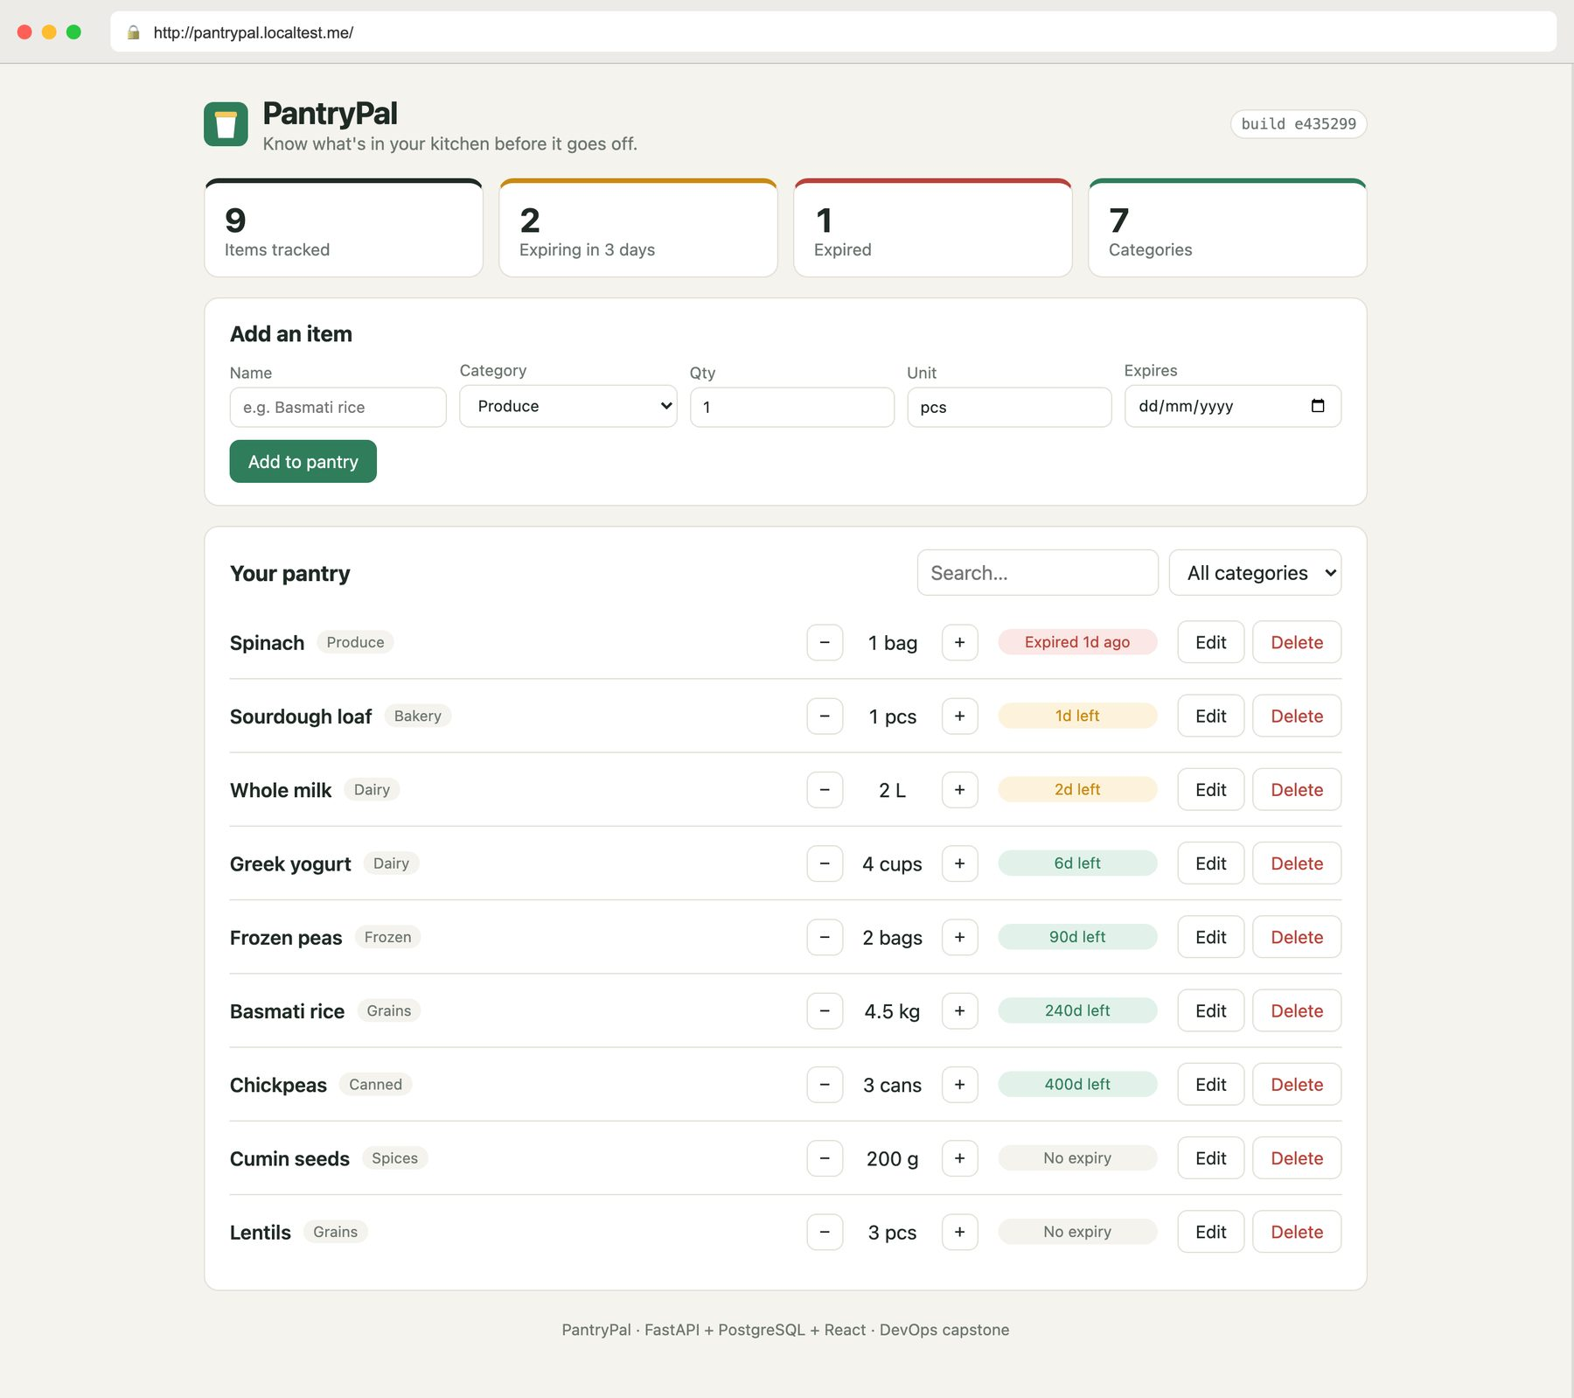
PantryPal
From commit to cluster: a complete DevOps pipeline for a home pantry tracker
DevOps & Cloud capstone · erantianantha · October 2026
Notes:
PantryPal is a pantry inventory tracker I built as the application for this capstone. The real subject is everything around it: tests, containers, CI/CD with a security gate, Terraform, Kubernetes with Helm, and monitoring. The screenshot is the app running in Kubernetes behind an Ingress.

Slide 2
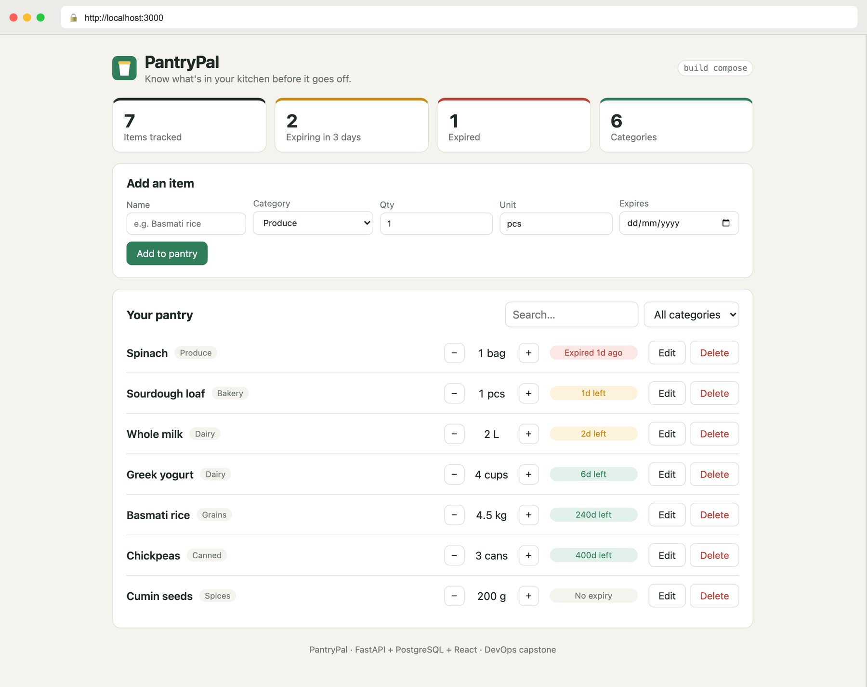



The problem PantryPal solves
Track what you have
Name, category, quantity and unit for every item in the kitchen
See what expires first
Items sorted by expiry date; red, amber and green badges flag what to use now
Know at a glance
Totals, items expiring within 3 days, expired items and categories
Notes:
Food gets forgotten at the back of the cupboard and thrown away. PantryPal keeps a list of what you have and puts whatever expires soonest at the top. It's a real three-tier app: React talks to a FastAPI backend, which stores data in PostgreSQL.

Slide 3










What I built: 10 modules, one pipeline
M1
M2
M3
M4
M5
App
Testing
Git
Docker
CI/CD
React + FastAPI + PostgreSQL
19 pytest tests, ruff lint
Small, descriptive commits
Multi-stage, non-root, Compose
Test → build → push → deploy
M6
M7
M8
M9
M10
Security
Terraform
Kubernetes
Monitoring
Docs
Trivy blocks HIGH/CRITICAL CVEs
VPC + EKS as code
Helm chart, Ingress, 2 replicas
Prometheus + Grafana dashboard
README with every screenshot
Notes:
Each course module maps to one part of the project, and they chain together: code is tested, containerised, scanned, published, deployed by Helm into Kubernetes and monitored. Terraform describes the AWS network and EKS cluster it would run on.

Slide 4
How the pieces fit together
Developer
git push main
Kubernetes cluster (kind locally · EKS on AWS)
Ingress (Traefik)
Users (browser)
/
/api
GitHub Actions
test · build · Trivy · push · deploy
Frontend ×2
React + nginx
Backend ×2
FastAPI
PostgreSQL
StatefulSet + PVC
Terraform
infrastructure as code
helm upgrade
scrape /metrics
AWS
VPC · 2 public + 2 private subnets · NAT · IAM · EKS + node group
GHCR
images tagged :commit-sha
pull
Prometheus
+ Grafana
run against mock AWS (moto)
Notes:
Left: the delivery path. A push triggers GitHub Actions, which publishes images to GHCR tagged with the commit SHA and deploys them with Helm. Middle: inside the cluster, one Ingress sends / to the React frontend and /api to the FastAPI backend, which talks to PostgreSQL. Prometheus scrapes the backend's metrics and Grafana shows them. Right: Terraform describes the AWS VPC and EKS cluster.

Slide 5
Tech stack, and why I chose it
Area | Chosen | Alternatives considered | Why
Backend | FastAPI (Python) | Flask, Django | Typed models, async, free Swagger docs
Frontend | React + Vite | Plain HTML, Angular | Small bundle, component UI, fast builds
Database | PostgreSQL + Alembic | MySQL, MongoDB | Relational data, versioned migrations
CI/CD | GitHub Actions | Jenkins, GitLab CI | Lives next to the code, no server to run
Registry | GHCR | Docker Hub | Same login as the repo, linked packages
Security | Trivy | Snyk, Grype | Free, fast, scans OS and Python packages
IaC | Terraform | CloudFormation, Pulumi | Declarative, plan before apply
Orchestration | Kubernetes + Helm | Docker Swarm, ECS | Self-healing, rolling updates, portable
Monitoring | Prometheus + Grafana | CloudWatch, Datadog | Open source, pull-based, rich dashboards
Notes:
For every layer I picked the tool the course used, but I also looked at the alternatives. Kubernetes over Docker Swarm or ECS because it's portable: the same Helm chart runs on my laptop with kind and on AWS EKS. GHCR over Docker Hub because the images live next to the code with no extra account.

Slide 6
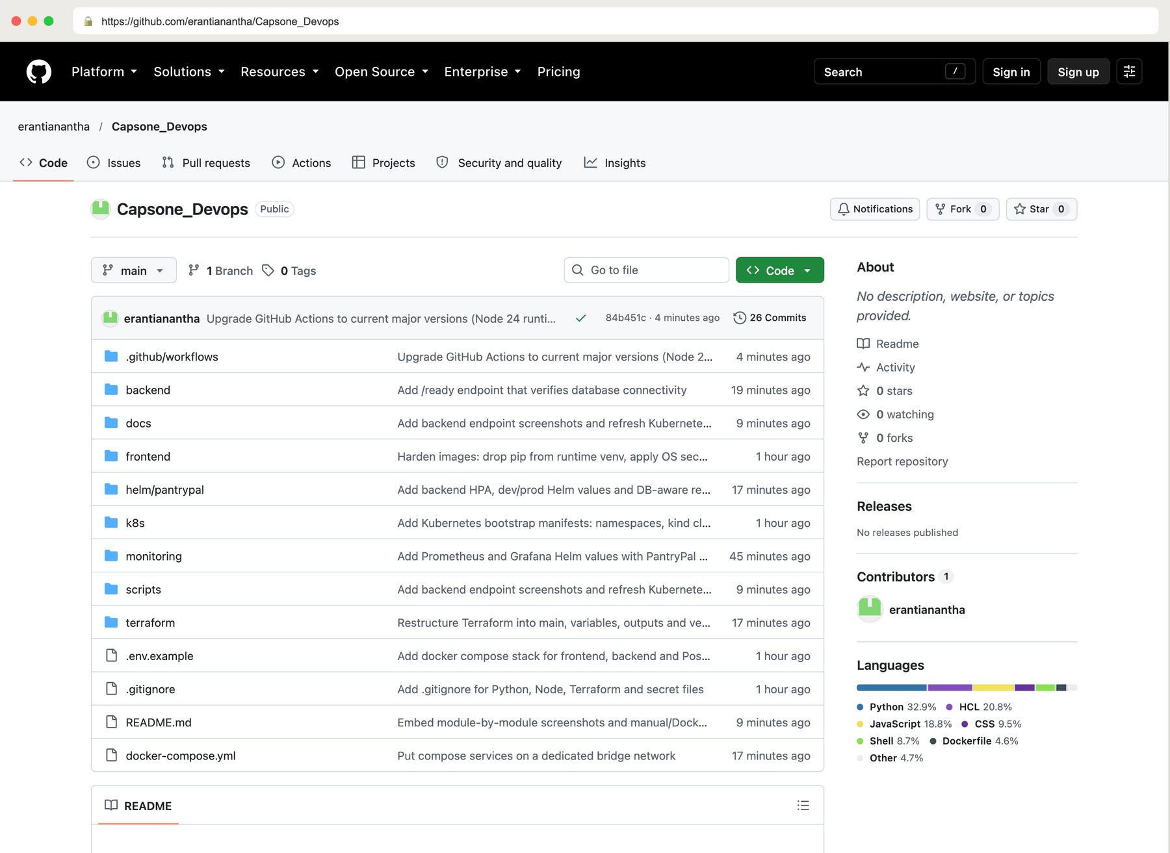
The codebase on GitHub
25+
focused commits with descriptive messages
backend/ FastAPI app, Alembic, tests
frontend/ React app and nginx
terraform/ · helm/ · k8s/ infrastructure
monitoring/ Prometheus and Grafana
.gitignore keeps .env, venvs, node_modules and Terraform state out
Notes:
Everything is in one public repository: github.com/erantianantha/Capsone_Devops. Each folder maps to a module. No secrets are committed: passwords live in Kubernetes Secrets or git-ignored files, and a Trivy secret scan of the repo is clean.

Slide 7
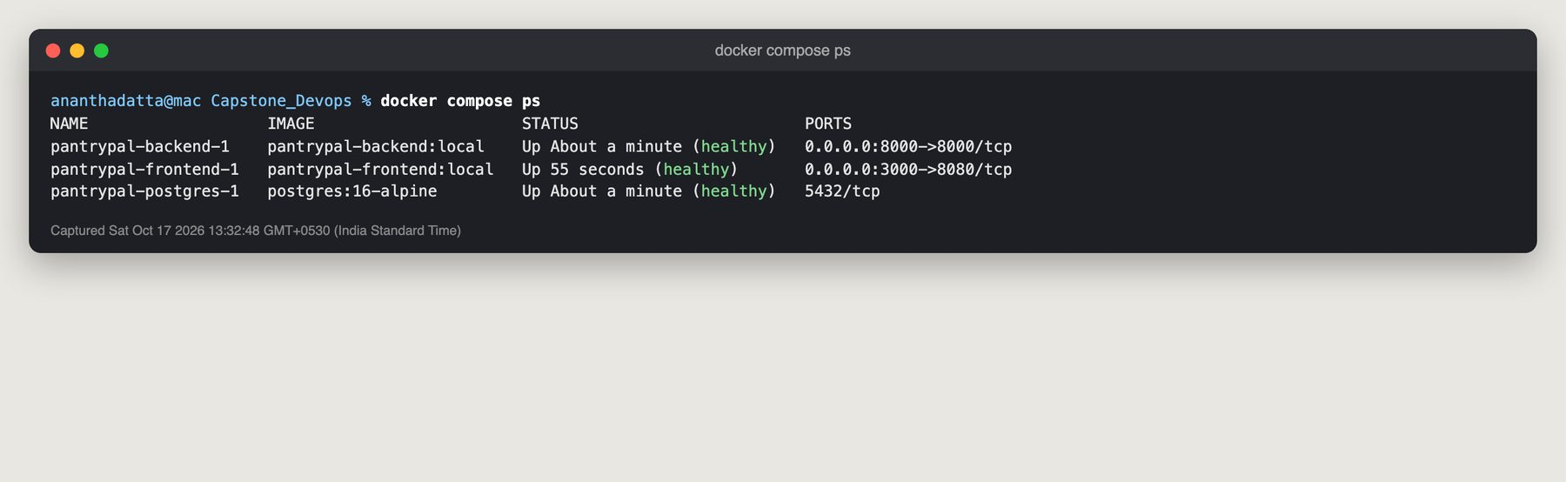
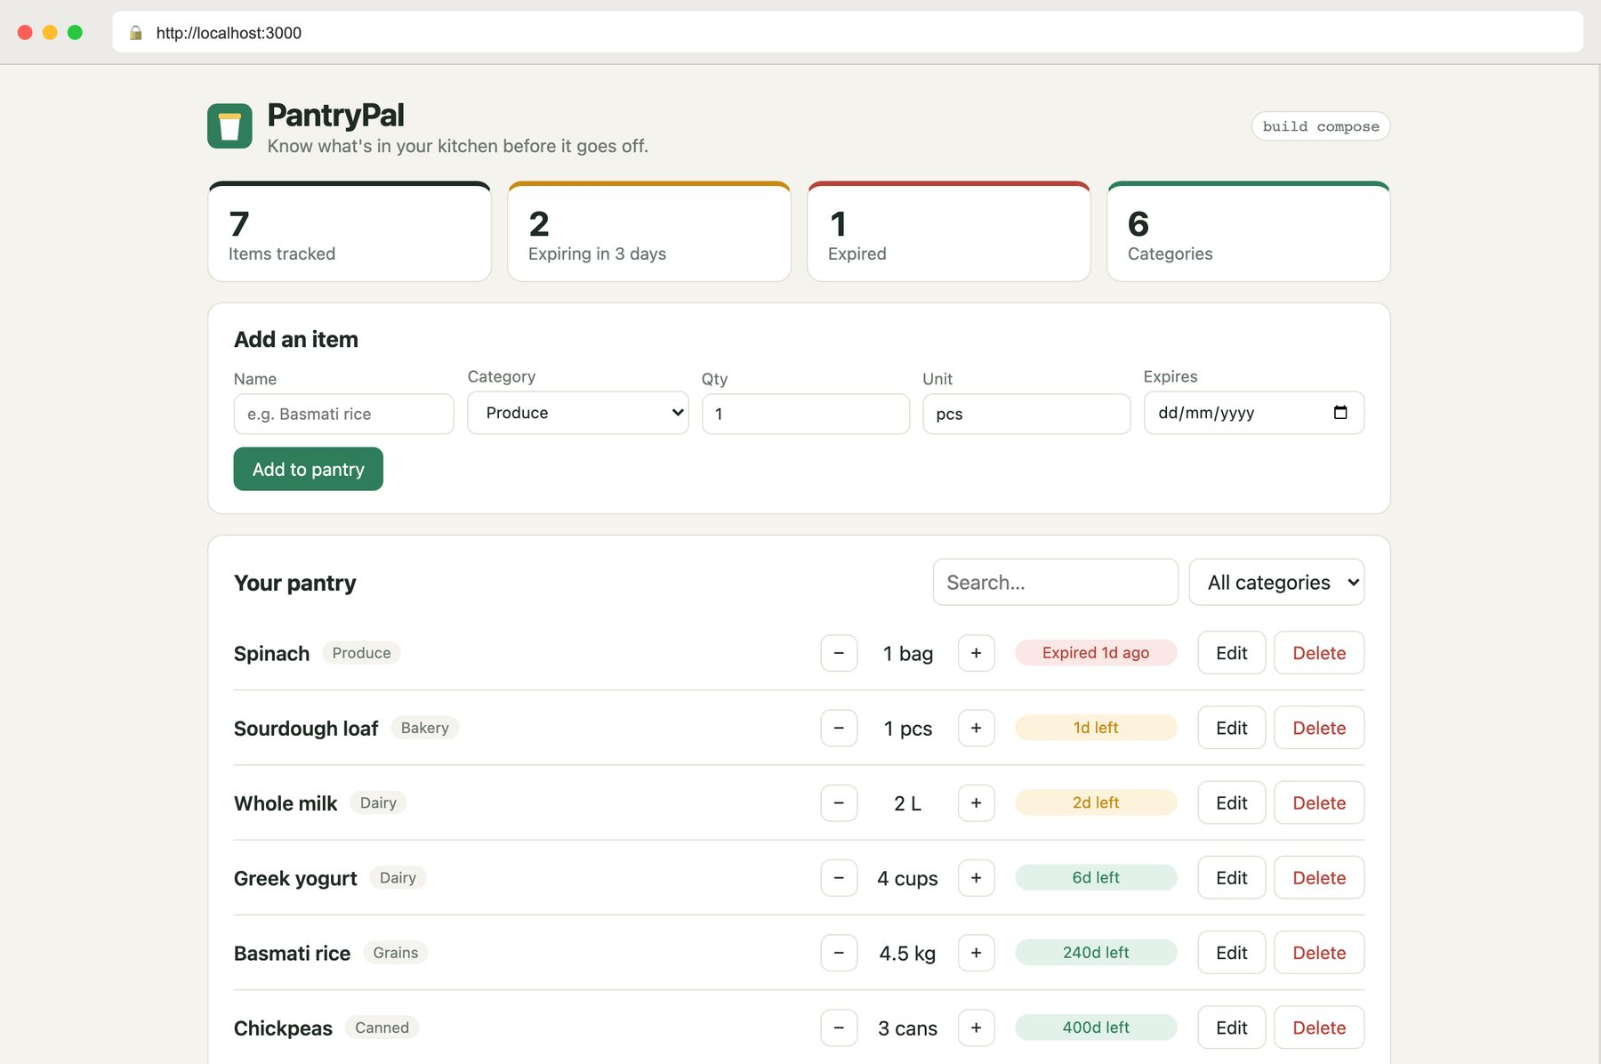
One command runs the whole stack
docker compose up --build
3 services: frontend :3000, backend :8000, PostgreSQL
Multi-stage builds: Node builds the UI, nginx serves it
Non-root: backend uid 10001, frontend uid 101
Healthchecks + depends_on: services start in the right order
Volume + bridge network: data survives restarts
Notes:
Each part of the app is its own container. One Compose command builds and starts all three, and they come up in order once each is healthy. Both images run as non-root users, so a compromised container has fewer privileges. Below: the app running from Compose at localhost:3000.

Slide 8
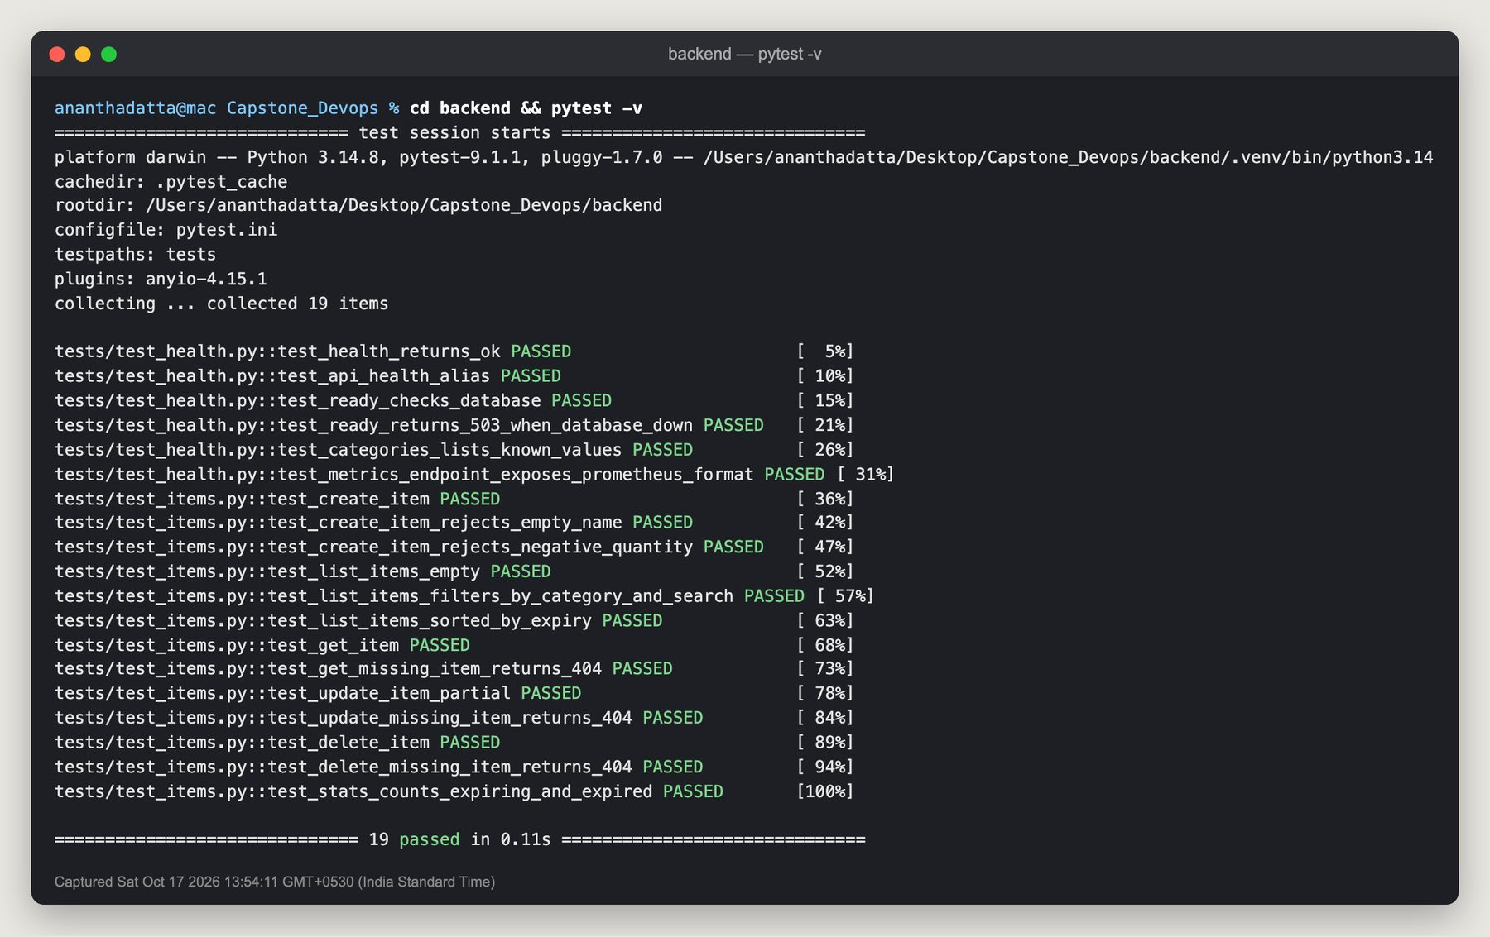
Tests run before anything is built
19
pytest tests, all passing
8
API endpoints covered
0
real databases touched: tests use an in-memory SQLite DB
Notes:
Tests cover health and readiness (including a simulated database outage), validation errors, 404s, filtering, expiry sorting and stats. They run against a throwaway in-memory database, so they're fast and never touch real data. In the pipeline, a single failing test stops the build.

Slide 9
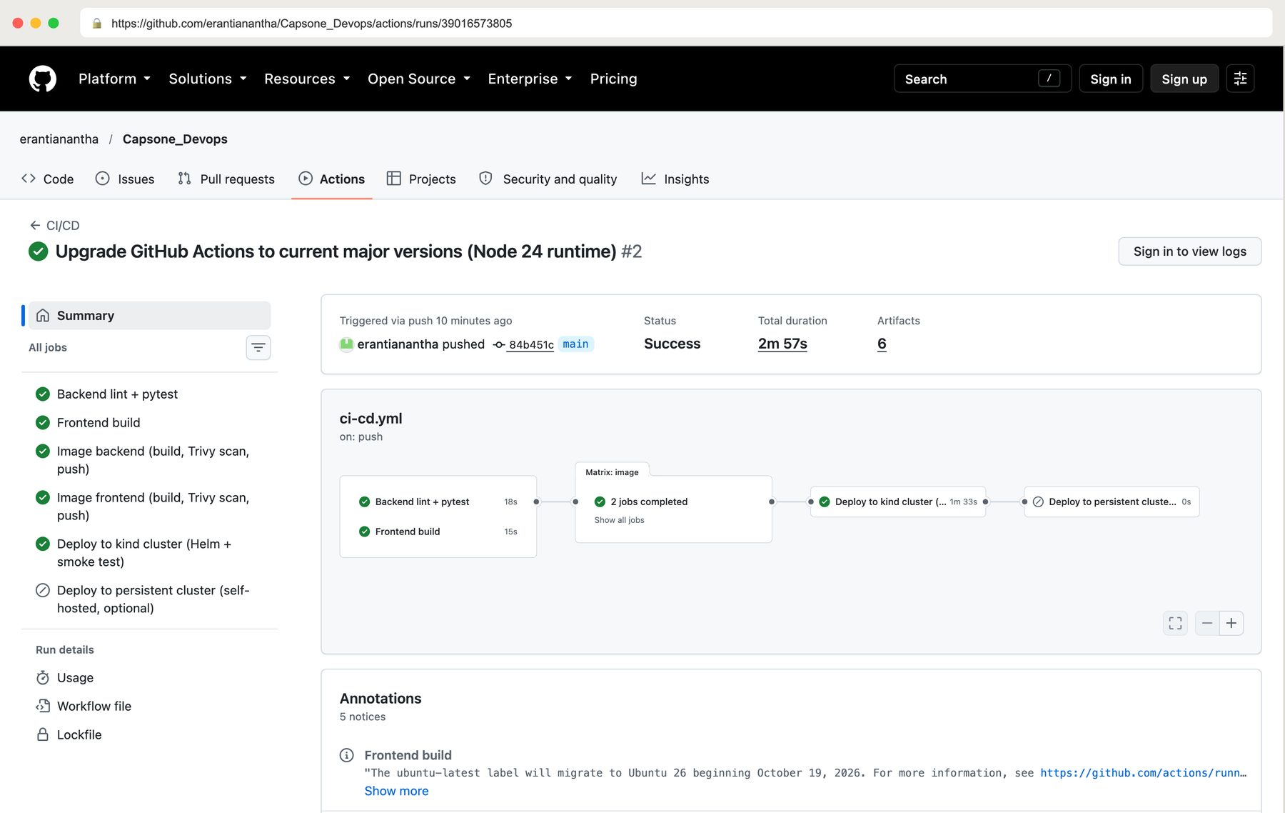
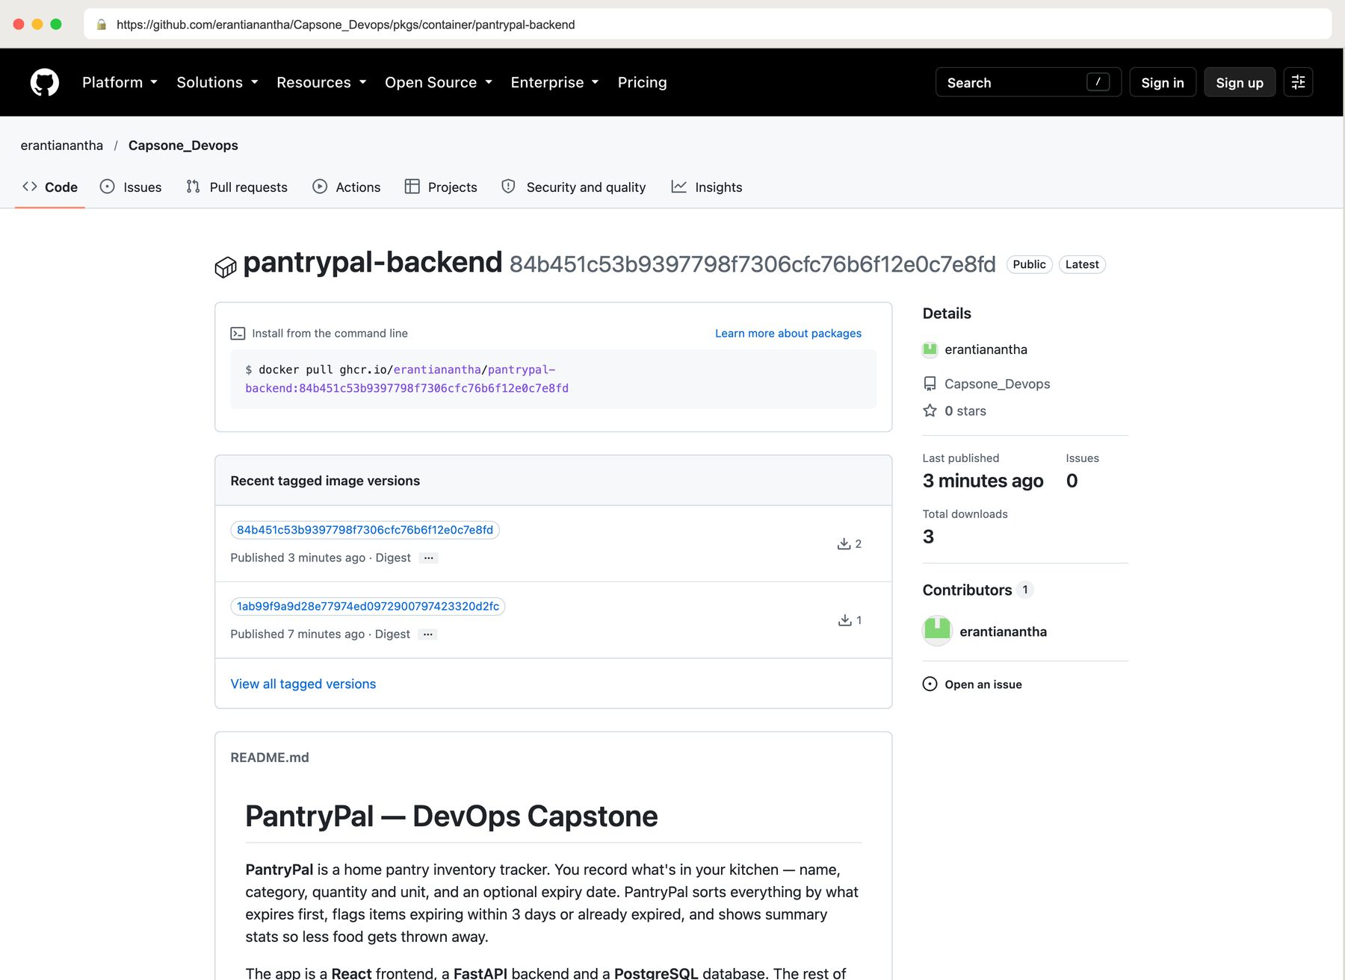
CI/CD: from push to deployment
Test
Build
Trivy scan
Push to GHCR
Deploy (kind)
Notes:
Every push to main runs this pipeline. Tests and the frontend build run first. Then each image is built, scanned by Trivy and pushed to GHCR, tagged with the commit SHA instead of 'latest', so every running version traces back to an exact commit. Finally the pipeline creates a temporary Kubernetes cluster, deploys that exact version with Helm, and checks it works through the Ingress. Right: the published image, public, tagged with the commit SHA.

Slide 10
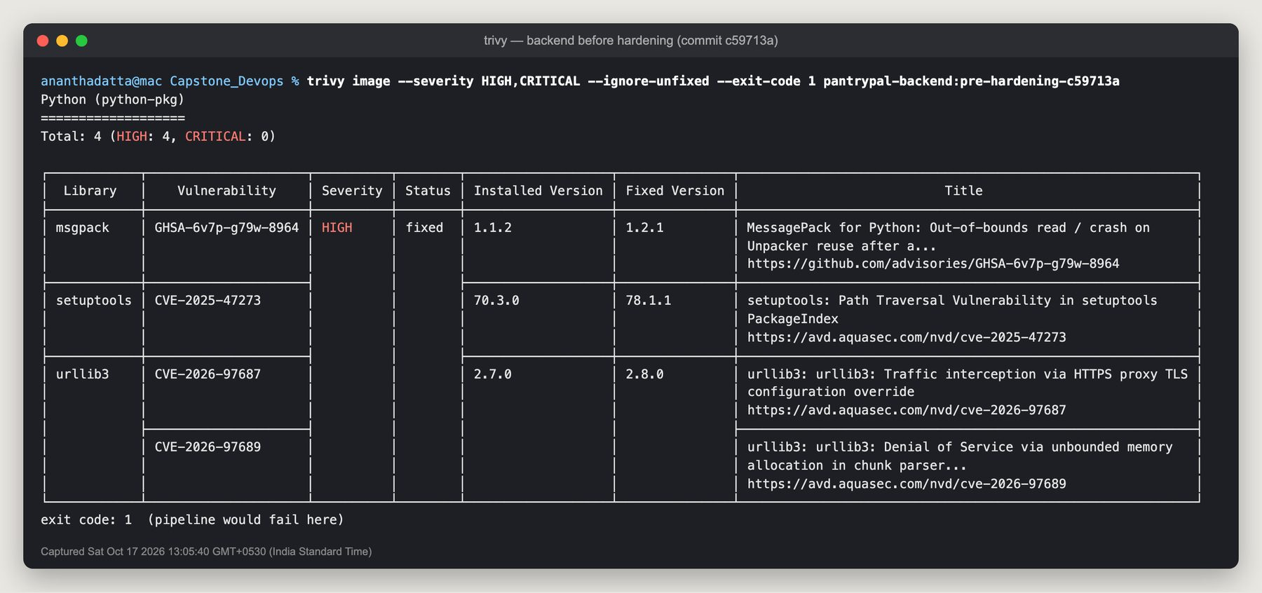
A security gate before every push
Example: CVE-2025-47273
A path-traversal bug in setuptools 70.3.0 that lets a crafted package URL write files outside its folder. The app never needed setuptools at runtime, so I removed pip and setuptools from the final image.
4 HIGH
CVEs in the first backend image, so the pipeline failed
0
fixable HIGH/CRITICAL CVEs in either image today
Notes:
Trivy checks every image for known vulnerabilities before it's pushed. If it finds a HIGH or CRITICAL one with a fix available, the pipeline stops. The first build failed this gate, which is the point: I fixed the image instead of shipping it. Now both images scan clean.

Slide 11
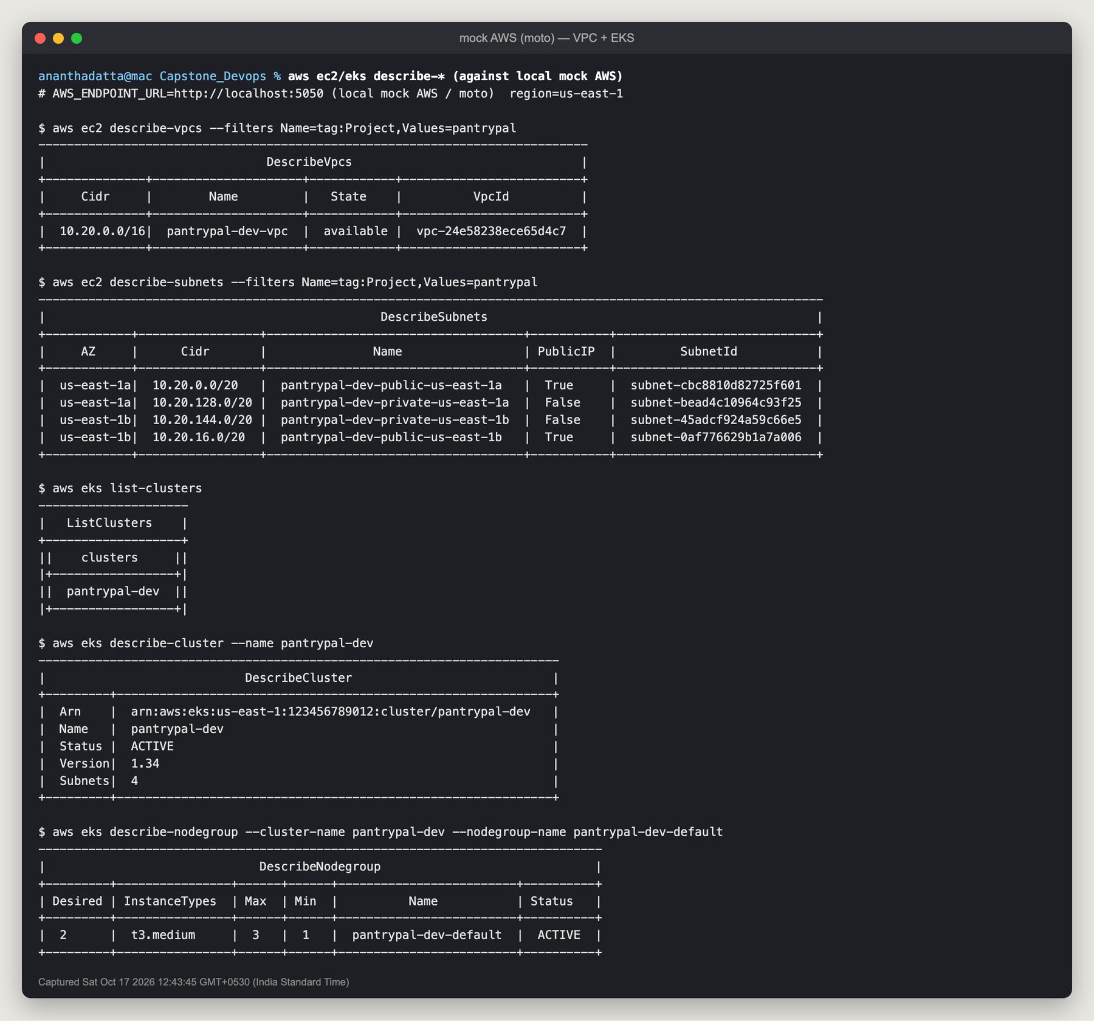
Infrastructure as code with Terraform
25
AWS resources defined in code
VPC with 2 public + 2 private subnets in 2 zones
Internet Gateway, NAT Gateway, route tables
IAM roles for the cluster and its nodes
EKS cluster + managed node group (2 × t3.medium)
init → plan → apply → destroy all ran cleanly
Run against a local mock of the AWS API (moto), so no cloud bill. The same code targets real AWS by changing one variable.
Notes:
Instead of clicking through the AWS console, the whole network and Kubernetes cluster are written as code, so they can be reviewed, versioned and recreated. Without an AWS account I ran Terraform against moto, a local AWS emulator: plan showed 25 resources, apply created them, and destroy removed them all.

Slide 12
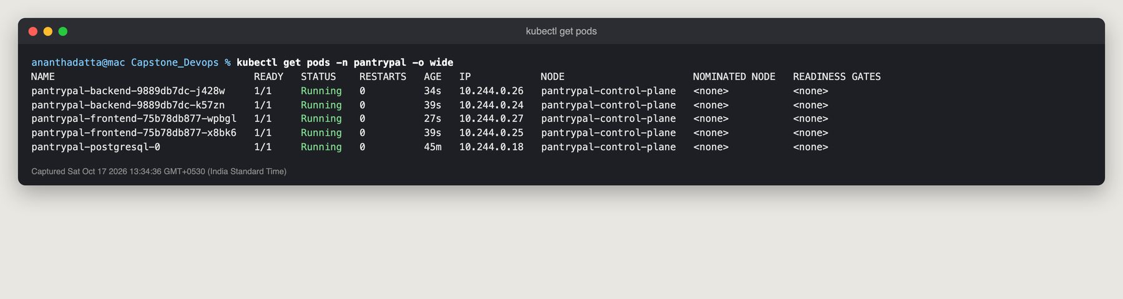
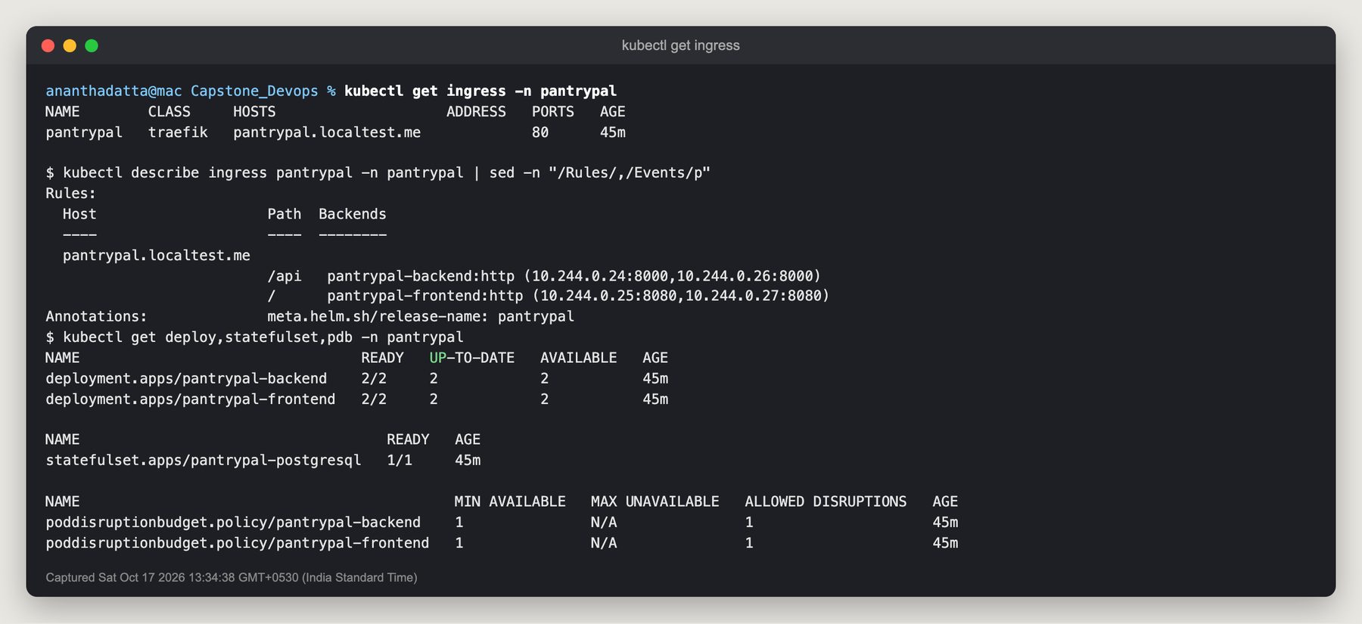
Kubernetes and Helm
One Helm chart deploys the frontend, backend, PostgreSQL and Ingress
2 replicas each, rolling updates with zero downtime
Ingress: / goes to the frontend, /api to the backend
Health probes restart or isolate broken pods automatically
Same chart runs on kind locally and EKS on AWS
Notes:
Kubernetes keeps two copies of the frontend and backend running and replaces any that fail. Helm packages all the Kubernetes objects into one chart, so deploying a new version is a single command that sets the image tag to the new commit SHA. The Ingress is the single front door for users.

Slide 13
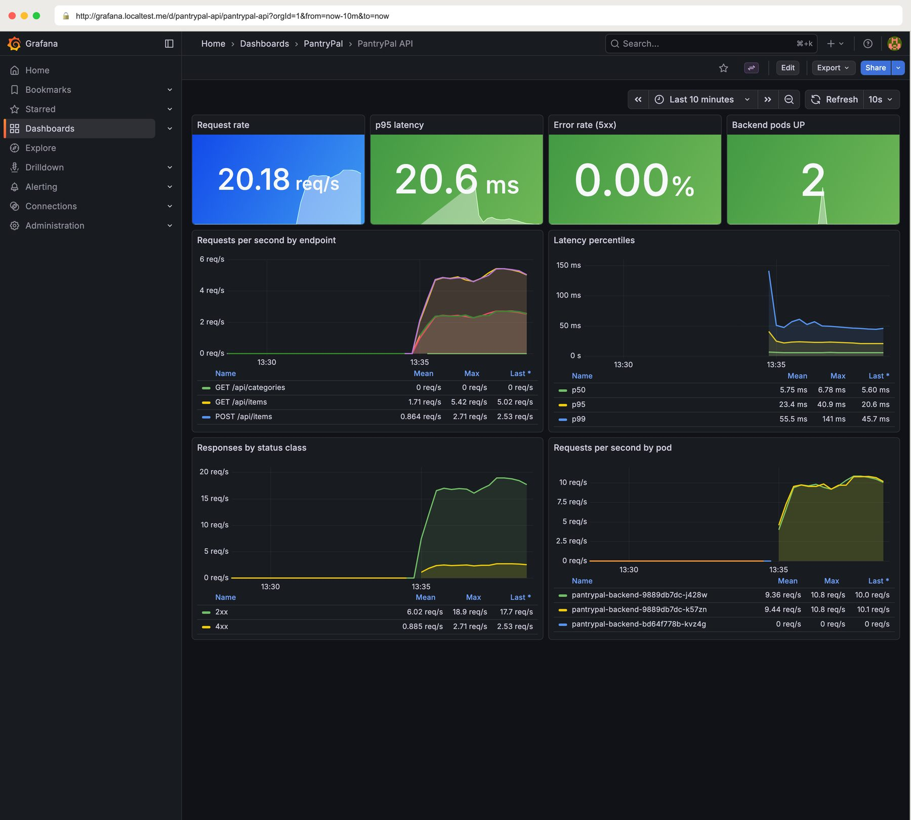
Observability with Prometheus + Grafana
~20 req/s
live traffic during the test
~21 ms
p95 response time
0.00%
server errors (5xx)
Notes:
The backend exposes a /metrics endpoint. Prometheus collects it from both backend pods every 15 seconds, and Grafana turns it into a dashboard: request rate, response-time percentiles, error rate and traffic per pod. These numbers are from a real load test against the cluster.

Slide 14
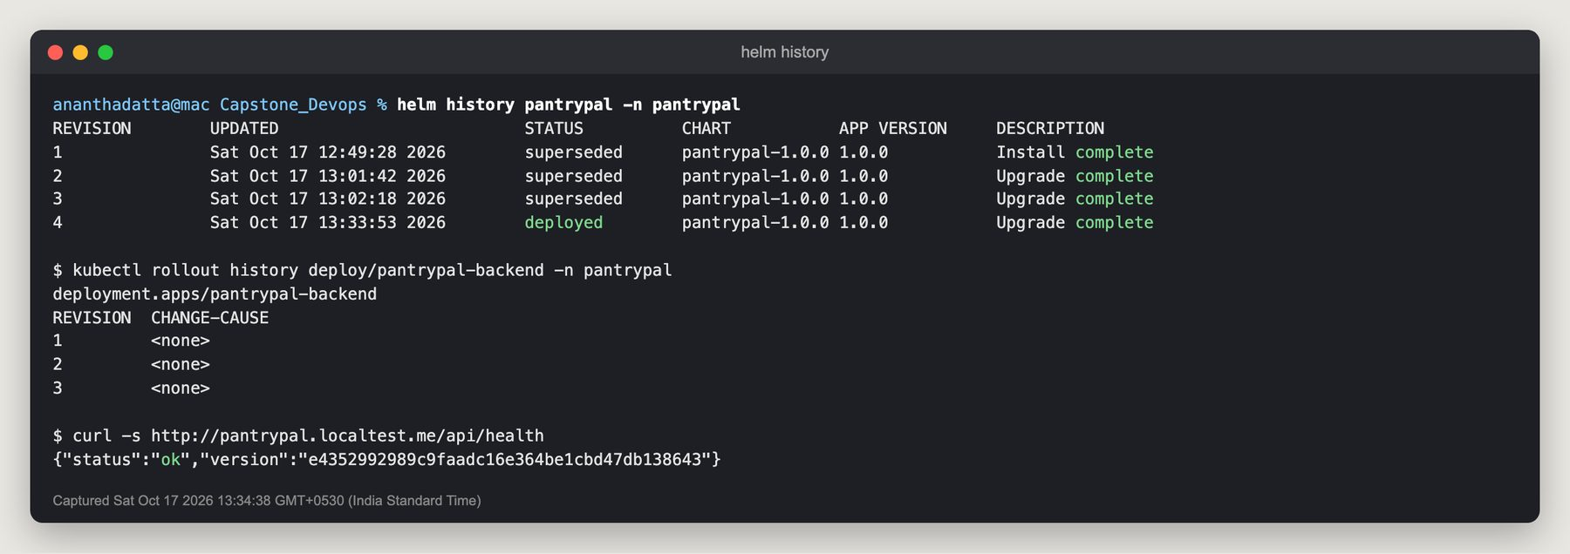
Live demo: commit → pipeline → rollout
1
2
3
4
5
Change
Push
Verify
Deploy
See it
Edit the app's tagline and commit
git push origin main triggers the pipeline
Tests, build and Trivy scan pass; images pushed with the new SHA
Helm rolls new pods out while the old ones keep serving
Refresh the app: new tagline, build badge shows the new SHA
Notes:
In the live demo I change one line of the UI, commit and push. The audience watches GitHub Actions test, scan and publish the images and deploy them. Then I refresh the app: the new text appears and the build badge shows the new commit SHA. helm history shows each rollout as a new revision.

Slide 15
Problems I hit and how I solved them
Vulnerable base images
Backend crash-looping
Metrics counted twice
Trivy failed the first build. Removed unused pip/setuptools and patched OS packages.
Pods started before PostgreSQL was ready. Added an init container that waits for the DB.
Two Prometheus jobs scraped the same pods. Switched to one label-based job.
No AWS account
Port 5000 taken
Safe migrations
Ran Terraform against moto, a local AWS emulator, and enabled its managed IAM policies.
macOS AirPlay uses port 5000. Moved the mock AWS server to port 5050.
Two replicas could migrate at once. A Postgres advisory lock serialises them.
Notes:
Most of the learning came from things that went wrong. Each of these was a real failure during the build, found by a test, a scan, a crash or a dashboard, and fixed at the root rather than worked around.

Slide 16
Thank you
Questions?
Code: github.com/erantianantha/Capsone_Devops
Docs: README.md · docs/submission.md · docs/demo.md
Notes:
Thank you. Everything shown is in the public repository, and the README has step-by-step instructions and a screenshot for every module.

