Slide 1
Pacman
In Town
Artificial Intelligence and Machine Learning for Interactive Products and Media Artificial Intelligence and Machine Learning for Interactive Products and Media Artificial Intelligence and Machine Learning for Interactive Products and Media Artificial Intelligence and Machine Learning for Interactive Products and Media Artificial Intelligence and Machine Learning for Interactive Products and Media Artificial Intelligence and Machine Learning for Interactive Products and Media Artificial Intelligence and Machine Learning for Interactive Products and Media Artificial Intelligence and Machine Learning for Interactive Products and Media Artificial Intelligence and Machine Learning for Interactive Products and Media Artificial Intelligence and Machine Learning for Interactive Products and Media Artificial Intelligence and Machine Learning for Interactive Products and Media Artificial Intelligence and Machine Learning for Interactive Products and Media Artificial Intelligence and Machine Learning for Interactive Products and Media Artificial Intelligence and Machine Learning for Interactive Products and Media Artificial Intelligence and Machine Learning for Interactive Products and Media Artificial Intelligence and Machine Learning for Interactive Products and Media Artificial Intelligence and Machine Learning for Interactive Products and Media Artificial Intelligence and Machine Learning for Interactive Products and Media Artificial Intelligence and Machine Learning for Interactive Products and Media Artificial Intelligence and Machine Learning for Interactive Products and Media Artificial Intelligence and Machine Learning for Interactive Products and Media Artificial Intelligence and Machine Learning for Interactive Products and Media Artificial Intelligence and Machine Learning for Interactive Products and Media Artificial Intelligence and Machine Learning for Interactive Products and Media Artificial Intelligence and Machine Learning for Interactive Products and Media Artificial Intelligence and Machine Learning for Interactive Products and Media Artificial Intelligence and Machine Learning for Interactive Products and Media Artificial Intelligence and Machine Learning for Interactive Products and Media Artificial Intelligence and Machine Learning for Interactive Products and Media Artificial Intelligence and Machine Learning for Interactive Products and Media Artificial Intelligence and Machine Learning for Interactive Products and Media Artificial Intelligence and Machine Learning for Interactive Products and Media Artificial Intelligence and Machine Learning for Interactive Products and Media Artificial Intelligence and Machine Learning for Interactive Products and Media Artificial Intelligence and Machine Learning for Interactive Products and Media Artificial Intelligence and Machine Learning for Interactive Products and Media Artificial Intelligence and Machine Learning for Interactive Products and Media Artificial Intelligence and Machine Learning for Interactive Products and Media Artificial Intelligence and Machine Learning for Interactive Products and Media Artificial Intelligence and Machine Learning for Interactive Products and Media Artificial Intelligence and Machine Learning for Interactive Products and Media Artificial Intelligence and Machine Learning for Interactive Products and Media Artificial Intelligence and Machine Learning for Interactive Products and Media Artificial Intelligence and Machine Learning for Interactive Products and Media Artificial Intelligence and Machine Learning for Interactive Products and Media Artificial Intelligence and Machine Learning for Interactive Products and Media Artificial Intelligence and Machine Learning for Interactive Products and Media Artificial Intelligence and Machine Learning for Interactive Products and Media Artificial Intelligence and Machine Learning for Interactive Products and Media Artificial Intelligence and Machine Learning for Interactive Products and Media Artificial Intelligence and Machine Learning for Interactive Products and Media Artificial Intelligence and Machine Learning for Interactive Products and Media Artificial Intelligence and Machine Learning for Interactive Products and Media Artificial Intelligence and Machine Learning for Interactive Products and Media Artificial Intelligence and Machine Learning for Interactive Products and Media Artificial Intelligence and Machine Learning for Interactive Products and Media Artificial Intelligence and Machine Learning for Interactive Products and Media Artificial Intelligence and Machine Learning for Interactive Products and Media Artificial Intelligence and Machine Learning for Interactive Products and Media Artificial Intelligence and Machine Learning for Interactive Products and Media Artificial Intelligence and Machine Learning for Interactive Products and Media Artificial Intelligence and Machine Learning for Interactive Products and Media Artificial Intelligence and Machine Learning for Interactive Products and Media Artificial Intelligence and Machine Learning for Interactive Products and Media Artificial Intelligence and Machine Learning for Interactive Products and Media Artificial Intelligence and Machine Learning for Interactive Products and Media Artificial Intelligence and Machine Learning for Interactive Products and Media Artificial Intelligence and Machine Learning for Interactive Products and Media Artificial Intelligence and Machine Learning for Interactive Products and Media Artificial Intelligence and Machine Learning for Interactive Products and Media Artificial Intelligence and Machine Learning for Interactive Products and Media Artificial Intelligence and Machine Learning for Interactive Products and Media Artificial Intelligence and Machine Learning for Interactive Products and Media Artificial Intelligence and Machine Learning for Interactive Products and Media Artificial Intelligence and Machine Learning for Interactive Products and Media Artificial Intelligence and Machine Learning for Interactive Products and Media Artificial Intelligence and Machine Learning for Interactive Products and Media Artificial Intelligence and Machine Learning for Interactive Products and Media Artificial Intelligence and Machine Learning for Interactive Products and Media Artificial Intelligence and Machine Learning for Interactive Products and Media Artificial Intelligence and Machine Learning for Interactive Products and Media Artificial Intelligence and Machine Learning for Interactive Products and Media Artificial Intelligence and Machine Learning for Interactive Products and Media Artificial Intelligence and Machine Learning for Interactive Products and Media Artificial Intelligence and Machine Learning for Interactive Products and Media Artificial Intelligence and Machine Learning for Interactive Products and Media Artificial Intelligence and Machine Learning for Interactive Products and Media Artificial Intelligence and Machine Learning for Interactive Products and Media Artificial Intelligence and Machine Learning for Interactive Products and Media Artificial Intelligence and Machine Learning for Interactive Products and Media Artificial Intelligence and Machine Learning for Interactive Products and Media Artificial Intelligence and Machine Learning for Interactive Products and Media Artificial Intelligence and Machine Learning for Interactive Products and Media Artificial Intelligence and Machine Learning for Interactive Products and Media Artificial Intelligence and Machine Learning for Interactive Products and Media Artificial Intelligence and Machine Learning for Interactive Products and Media Artificial Intelligence and Machine Learning for Interactive Products and Media Artificial Intelligence and Machine Learning for Interactive Products and Media Artificial Intelligence and Machine Learning for Interactive Products and Media Artificial Intelligence and Machine Learning for Interactive Products and Media Artificial Intelligence and Machine Learning for Interactive Products and Media Artificial Intelligence and Machine Learning for Interactive Products and Media Artificial Intelligence and Machine Learning for Interactive Products and Media Artificial Intelligence and Machine Learning for Interactive Products and Media Artificial Intelligence and Machine Learning for Interactive Products and Media Artificial Intelligence and Machine Learning for Interactive Products and Media Artificial Intelligence and Machine Learning for Interactive Products and Media Artificial Intelligence and Machine Learning for Interactive Products and Media Artificial Intelligence and Machine Learning for Interactive Products and Media Artificial Intelligence and Machine Learning for Interactive Products and Media Artificial Intelligence and Machine Learning for Interactive Products and Media Artificial Intelligence and Machine Learning for Interactive Products and Media Artificial Intelligence and Machine Learning for Interactive Products and Media Artificial Intelligence and Machine Learning for Interactive Products and Media Artificial Intelligence and Machine Learning for Interactive Products and Media Artificial Intelligence and Machine Learning for Interactive Products and Media Artificial Intelligence and Machine Learning for Interactive Products and Media Artificial Intelligence and Machine Learning for Interactive Products and Media Artificial Intelligence and Machine Learning for Interactive Products and Media Artificial Intelligence and Machine Learning for Interactive Products and Media Artificial Intelligence and Machine Learning for Interactive Products and Media Artificial Intelligence and Machine Learning for Interactive Products and Media Artificial Intelligence and Machine Learning for Interactive Products and Media Artificial Intelligence and Machine Learning for Interactive Products and Media Artificial Intelligence and Machine Learning for Interactive Products and Media Artificial Intelligence and Machine Learning for Interactive Products and Media Artificial Intelligence and Machine Learning for Interactive Products and Media Artificial Intelligence and Machine Learning for Interactive Products and Media Artificial Intelligence and Machine Learning for Interactive Products and Media Artificial Intelligence and Machine Learning for Interactive Products and Media Artificial Intelligence and Machine Learning for Interactive Products and Media Artificial Intelligence and Machine Learning for Interactive Products and Media Artificial Intelligence and Machine Learning for Interactive Products and Media Artificial Intelligence and Machine Learning for Interactive Products and Media Artificial Intelligence and Machine Learning for Interactive Products and Media Artificial Intelligence and Machine Learning for Interactive Products and Media Artificial Intelligence and Machine Learning for Interactive Products and Media Artificial Intelligence and Machine Learning for Interactive Products and Media Artificial Intelligence and Machine Learning for Interactive Products and Media Artificial Intelligence and Machine Learning for Interactive Products and Media Artificial Intelligence and Machine Learning for Interactive Products and Media Artificial Intelligence and Machine Learning for Interactive Products and Media Artificial Intelligence and Machine Learning for Interactive Products and Media Artificial Intelligence and Machine Learning for Interactive Products and Media Artificial Intelligence and Machine Learning for Interactive Products and Media Artificial Intelligence and Machine Learning for Interactive Products and Media Artificial Intelligence and Machine Learning for Interactive Products and Media Artificial Intelligence and Machine Learning for Interactive Products and Media Artificial Intelligence and Machine Learning for Interactive Products and Media
A project suggestion for a course in
A.I.M.L.I.P.M
(Artificial Intelligence and Machine Learning for Interactive Products and Media)

Slide 3
Abstract / Concept
An interactive game
Finding interesting places
Navigating through them
Jogging Aid (running away from the ghosts)
More cool features…

Slide 4
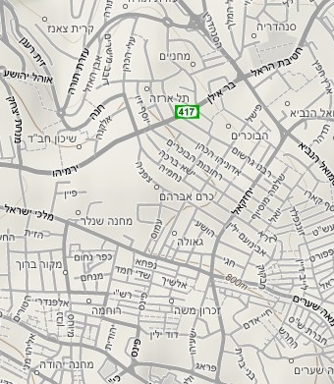
What do you see?
You are here
There’s some nice buildings two streets from you
Where will you go
?

Slide 5
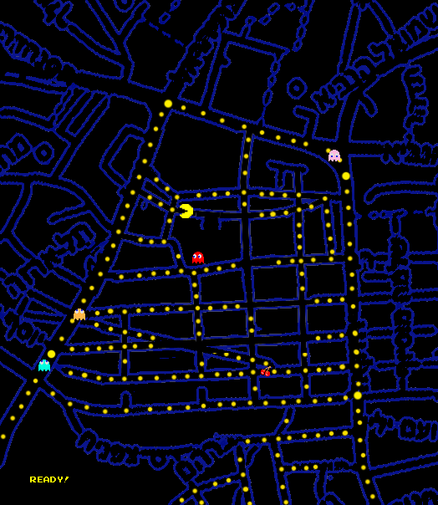
How it works?
Grab the big points
Once you got into the destination – you can run after the ghosts (Human\AI)

Slide 6
Where’s the AI?
Ghosts behavior (expectiMiniMax)
http://en.wikipedia.org/wiki/Expectiminimax_tree
Hmmm….

