Slide 1

WikiWars
Visualization of Controversy
J. Abramson
E. Weissenstern

Slide 2
Task motivation
Wikipedia is one of the biggest source of knowledge.
  As of today, there are 3,356,098 articles in English
…and it’s constantly changing
  Over millions of edits per month
We would like to know in one glance which articles were edited a lot recently, or “hot”.

Slide 3
Data set
From Wikipedia:
  Article names
  The links between the articles
  Number of edits
All of those are Acquired using SQL queries,
from a local dump file

Slide 4
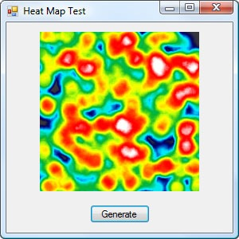
Justification
  Related articles should be closer on map
  Color indicates number of edits, so it easy to see war zones.
Hot
Cold
משט
עגבניות
Israel
Turkey
שלי יחימוביץ'
הון
שלטון

Slide 5
Adjacency Matrix
Zero shot: tried to take the whole graph – too big!
First shot: We tried taking the first n pages and building the adjacency matrix based on the links between them. Result matrix was too sparse too get useful data from links.
Second shot: BFS on the link-graph, starting from a random page. better, but because the database is huge, the result was star like.

Slide 6
Adjacency Matrix (Cont’d)
Third shot: We used BFS but restricted the introduction of new vertices. The result was more like a clique.
Fourth: We chose different pages (15 countries) and built a graph with clique for each page.

Slide 7
Lessons learned and future plans
View the edits and war zones in each page
See changes in real time
Render video to see changes over time
Extend to other databases with revisions:
  Google code, Linux kernel, etc.

