Slide 1


LOGO
PDAS
creative
2025
IN SOLANA

Slide 2
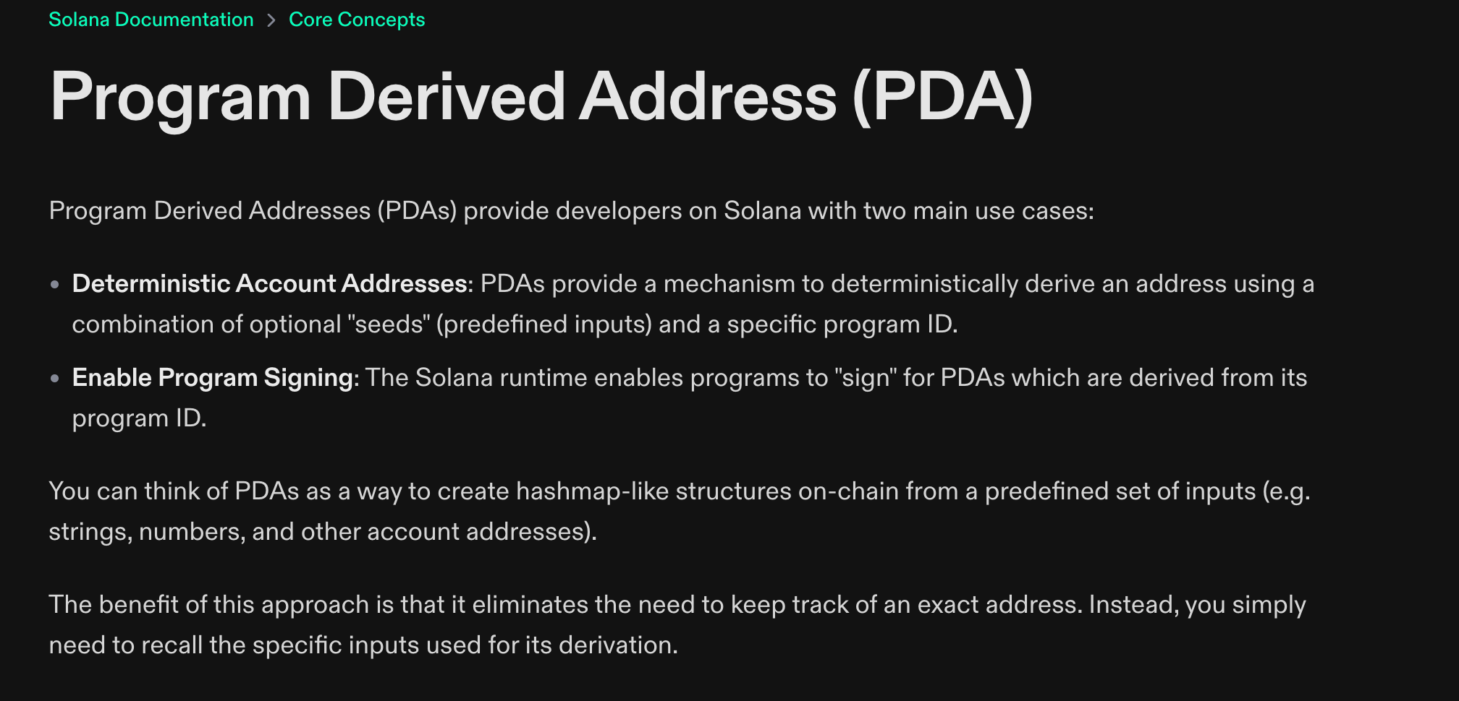
2025
HTTPS://SOLANA.COM/DOCS/CORE/PDA

Slide 3
2025
HTTPS://SOLANA.COM/DOCS/CORE/PDA

Slide 4
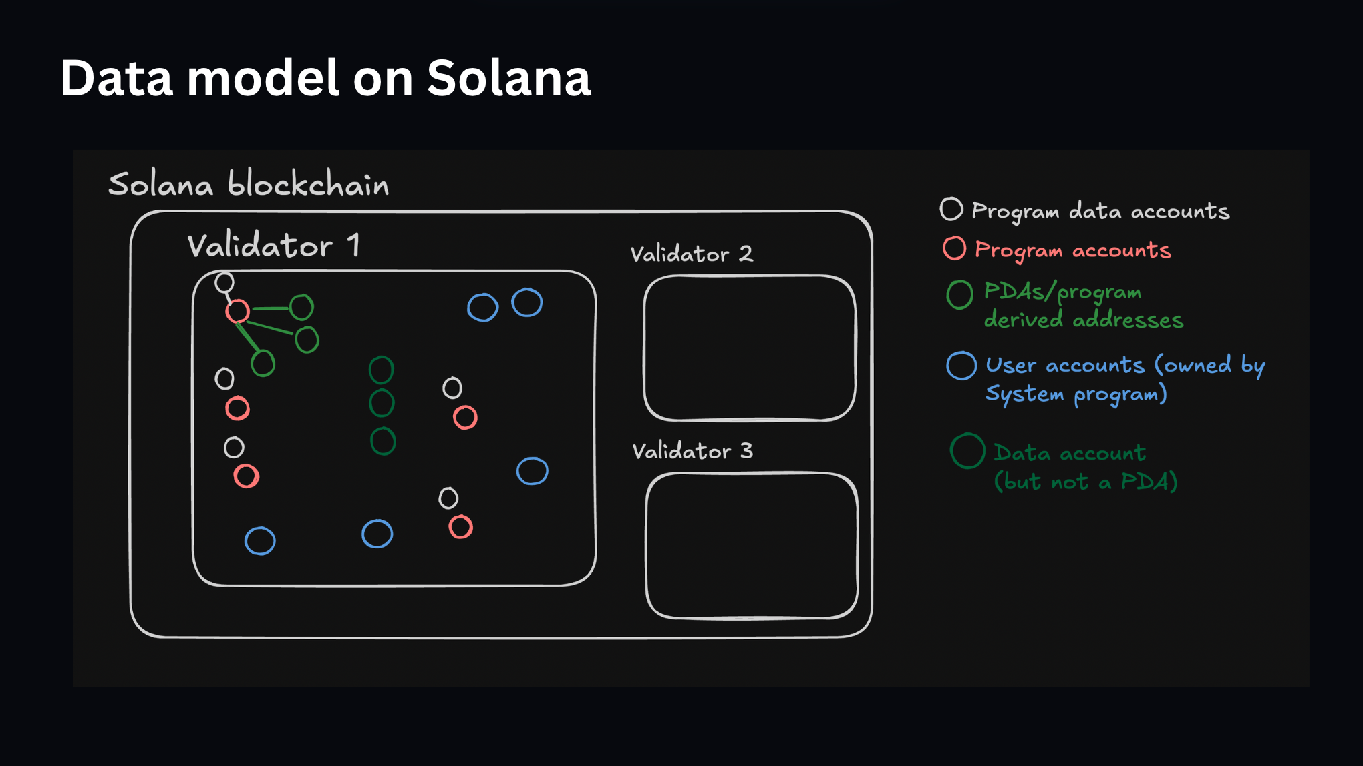

Slide 5
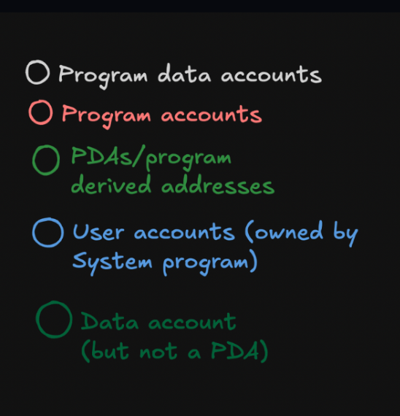
https://github.com/100xdevs-cohort-3/sol-name-contract

Slide 6
https://github.com/100xdevs-cohort-3/sol-name-contract

Slide 7
https://github.com/100xdevs-cohort-3/sol-name-contract

Slide 8
https://github.com/100xdevs-cohort-3/sol-name-contract

Slide 9
??????

Slide 10
PDAS
Program
Derived
Addresses

Slide 11
WEB2

Slide 12
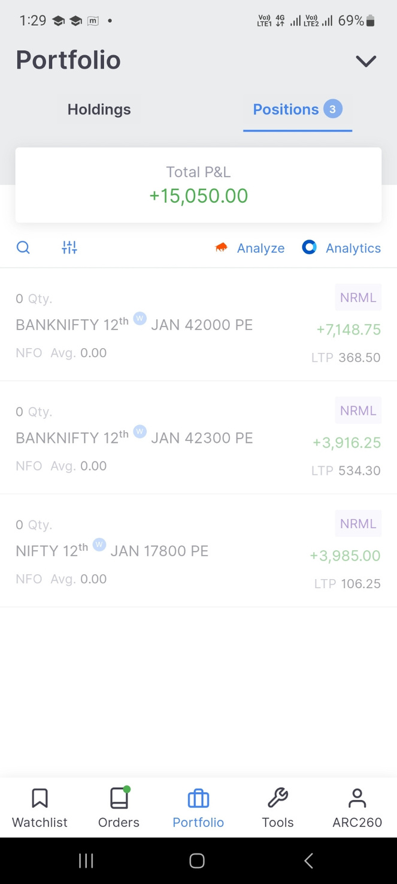
Zerodha app
DB Schema
userId | INR Balance | Reliance Stock Balance
1 | 10000 | 20
2 | 200000 | 300
3 | 500000 | 100

Slide 13
Zerodha app
DB Schema
userId | INR Balance | Reliance Stock Balance
1 | 10000 | 20
2 | 200000 | 300
3 | 500000 | 100
HTTP Server
DB

Slide 14
WEB3

Slide 15
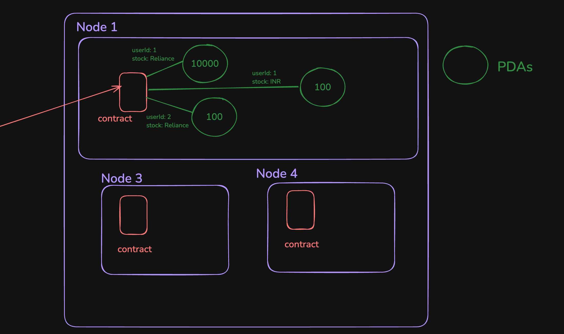
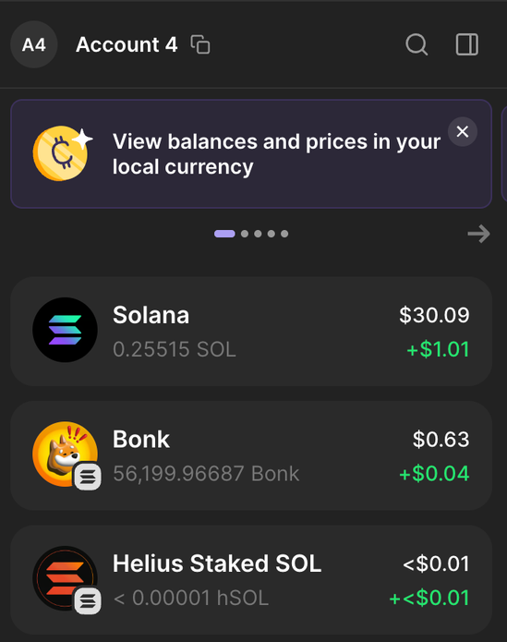

Slide 16
Associated token account (pda)

Slide 17
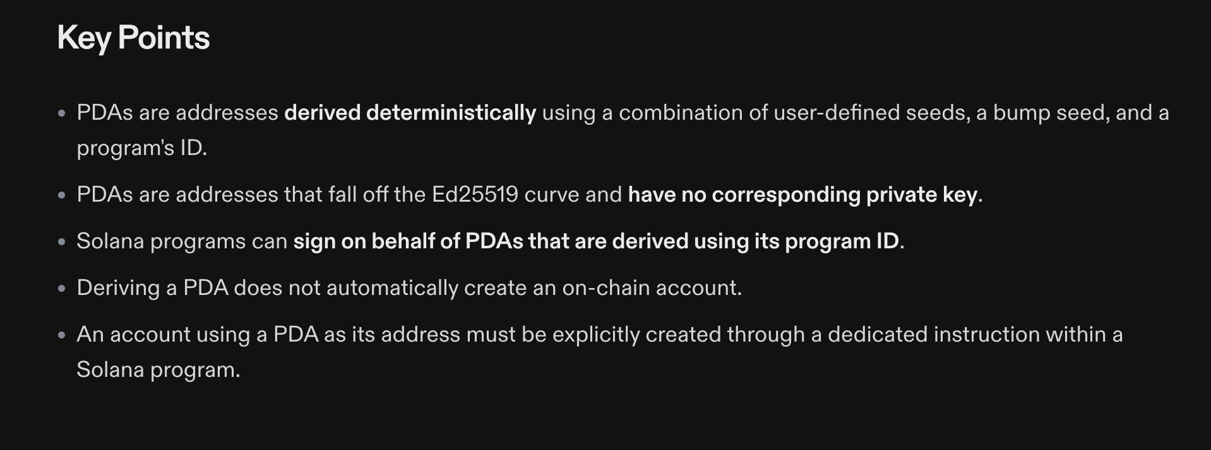
PDAS

Slide 18
PDAS
Trick question

Slide 19
SYSTEM PROGRAM

Slide 20
PDAS
A PDA is a special type of address on Solana that:
Is derived deterministically using seeds and a program ID.
Cannot be owned by a private key — it’s only controlled by a specific on-chain program.
Is used by programs to store data

Slide 21
PDAS
A PDA is a special type of address on Solana that:
Is derived deterministically using seeds and a program ID.
Cannot be owned by a private key — it’s only controlled by a specific on-chain program.
Is used by programs to store data

Slide 22
Zerodha app
DB Schema
userId | INR Balance | Reliance Stock Balance
1 | 10000 | 20
2 | 200000 | 300
3 | 500000 | 100
HTTP Server
SELECT INR FROM Balances
WHERE userId=1
DB

Slide 24
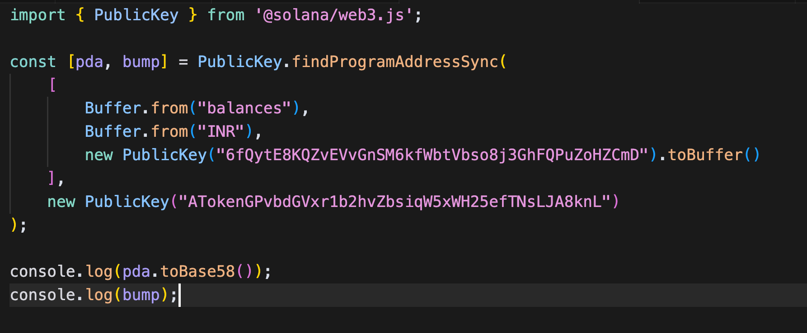
Seeds
ProgramId

Slide 25
SELECT INR
FROM Balances
WHERE userId=1

Slide 26
SELECT INR
FROM Balances
WHERE userId=1

Slide 27
SELECT INR
FROM Balances
WHERE userId=1

Slide 28
100
10000
Harkirats BONK balance
Harkirats USDC balance
Associated
Token contract
100
20
Ramans USDC Balance
Ramans PEPE balance
100
Ramans TRUMP Balance

Slide 29
Project
Create a zerodha like app where -
Users can come and sign up
Users can onramp xyz of a token name
Users can transfer x amount of a token
to someone else

Slide 30
Our
TOKEN
Contract
User

Slide 31
Our
TOKEN
Contract
User
Signup

Slide 32
harkirat
user public key
+
“name”
Our
TOKEN
Contract
User
Signup

Slide 33
harkirat
Our
TOKEN
Contract
User

Slide 34
harkirat
what is my name
on this project/contract
Our
TOKEN
Contract
User

Slide 35
harkirat
onramp
INR
1000
Our
TOKEN
Contract
User

Slide 36
harkirat
user public key
+
“balance”
+
“INR”
onramp
INR
1000
Our
TOKEN
Contract
User
1000

Slide 37
harkirat
Our
TOKEN
Contract
User
1000

Slide 38
harkirat
Our
TOKEN
Contract
User
1000
What is my INR balance?

Slide 39
harkirat
Our
TOKEN
Contract
User
1000
User 2

Slide 40
harkirat
Transfer
500 INR
to user 2
Our
TOKEN
Contract
User
1000
User 2

Slide 41
harkirat
user public key
+
“balance”
+
“INR”
Transfer
500 INR
to user 2
Our
TOKEN
Contract
User
500
User 2
user2 public key
+
“balance”
+
“INR”
500

Slide 42
harkirat
Our
TOKEN
Contract
User
500
User 2
500

Slide 43
Users
harkirat
userId | name
1 | harkirat
2 | raman
500
Balance
userId | Balance
1 | 500
2 | 500
500

Slide 44
Every row of a SQL table
is a PDA on solana
Benefits -
Users can pay rent for their own data
Deterministically arrive at their data

Slide 45
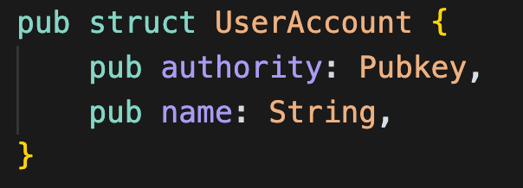
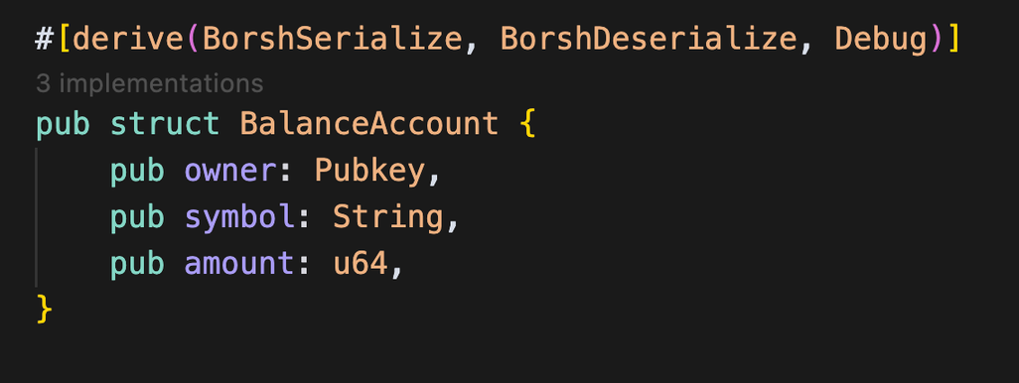
harkirat
Our
TOKEN
Contract
User
500
User 2
500

