Slide 1
Build Your Own Router
Computer Networks
Project 2

Slide 2
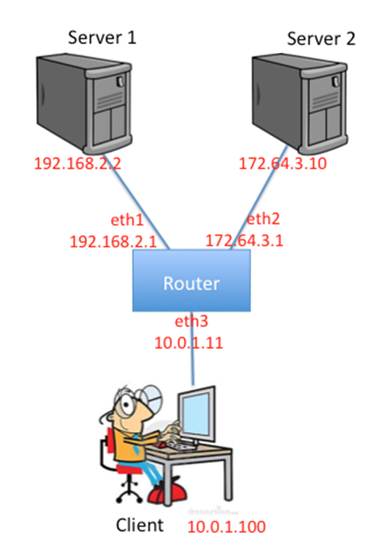
Project Overview
Implement a simple router in a single router topology with static routing table (forwarding table).
Your router will receive raw Ethernet frames, and handle/forward packets in correct logic.

Slide 3
Lessons to learn

Slide 4
What is a Router?
Forwarding: move packets from router’s input to appropriate router output
Routing: determine route taken by packets from source to dest.

Slide 5
What about Our Router?
Forwarding: move packets from router’s input to appropriate router output
Load predefined routing table
Look up matching entry in routing table
Handle ICMP
Handle ARP request / reply
Routing: determine route taken by packets from source to dest.

Slide 6
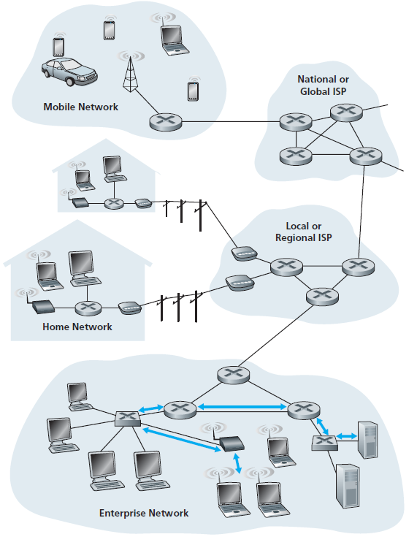
Link Layer
Transfer internet layer datagram from node to adjacent node over a link
Encapsulate internet layer datagram into frame, add header & trailer
Use “MAC” address in frame headers for source, dest

Slide 7
MAC address v.s. IP address
32-bit IP address:
network-layer address
used to get datagram from src to dest IP subnet
48-bit MAC (Ethernet) address:
link-layer address for network interfaces
get frame from one interface to another physically-connected interface (same subnet)
Broadcast address: “FF:FF:FF:FF:FF:FF”

Slide 8
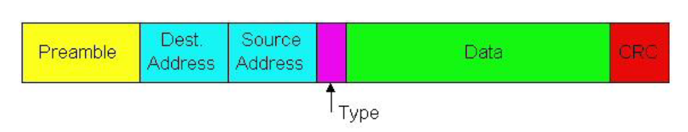
Ethernet Frame
56 bit
48 bit
48 bit
16 bit
32 bit
Need in this project
Encapsulates IP datagram (or other network layer protocol packet) in Ethernet frame
preamble and crc are handled transparently in this project

Slide 9
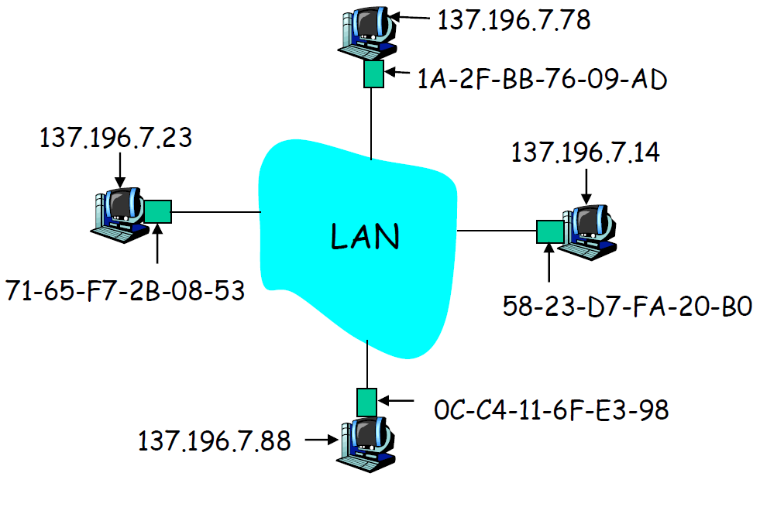
ARP: Address Resolution Protocol
Question: How to get MAC address of B from B’s IP address
ARP request: request IP-MAC mapping of next hop interface (send to broadcast address)
ARP reply: send IP-MAC of current interface
ARP cache: IP – MAC mapping for nodes (timeout after a 30s)

Slide 10
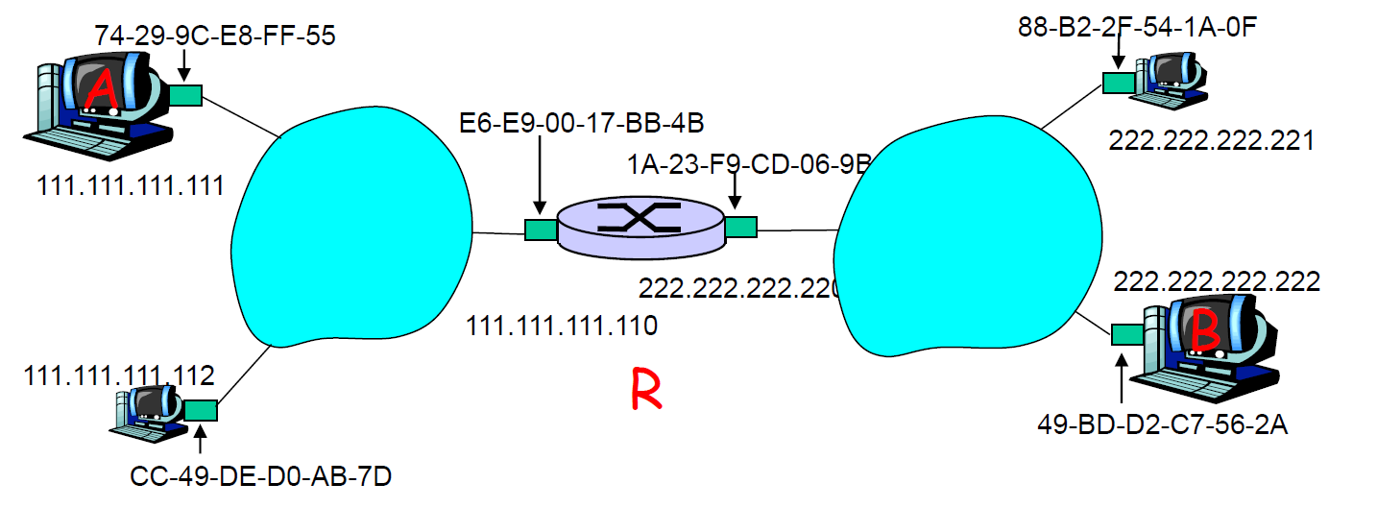
ARP: Address Resolution Protocol
Volunteer?
Walkthrough: send datagram from A to B through R.

Slide 11
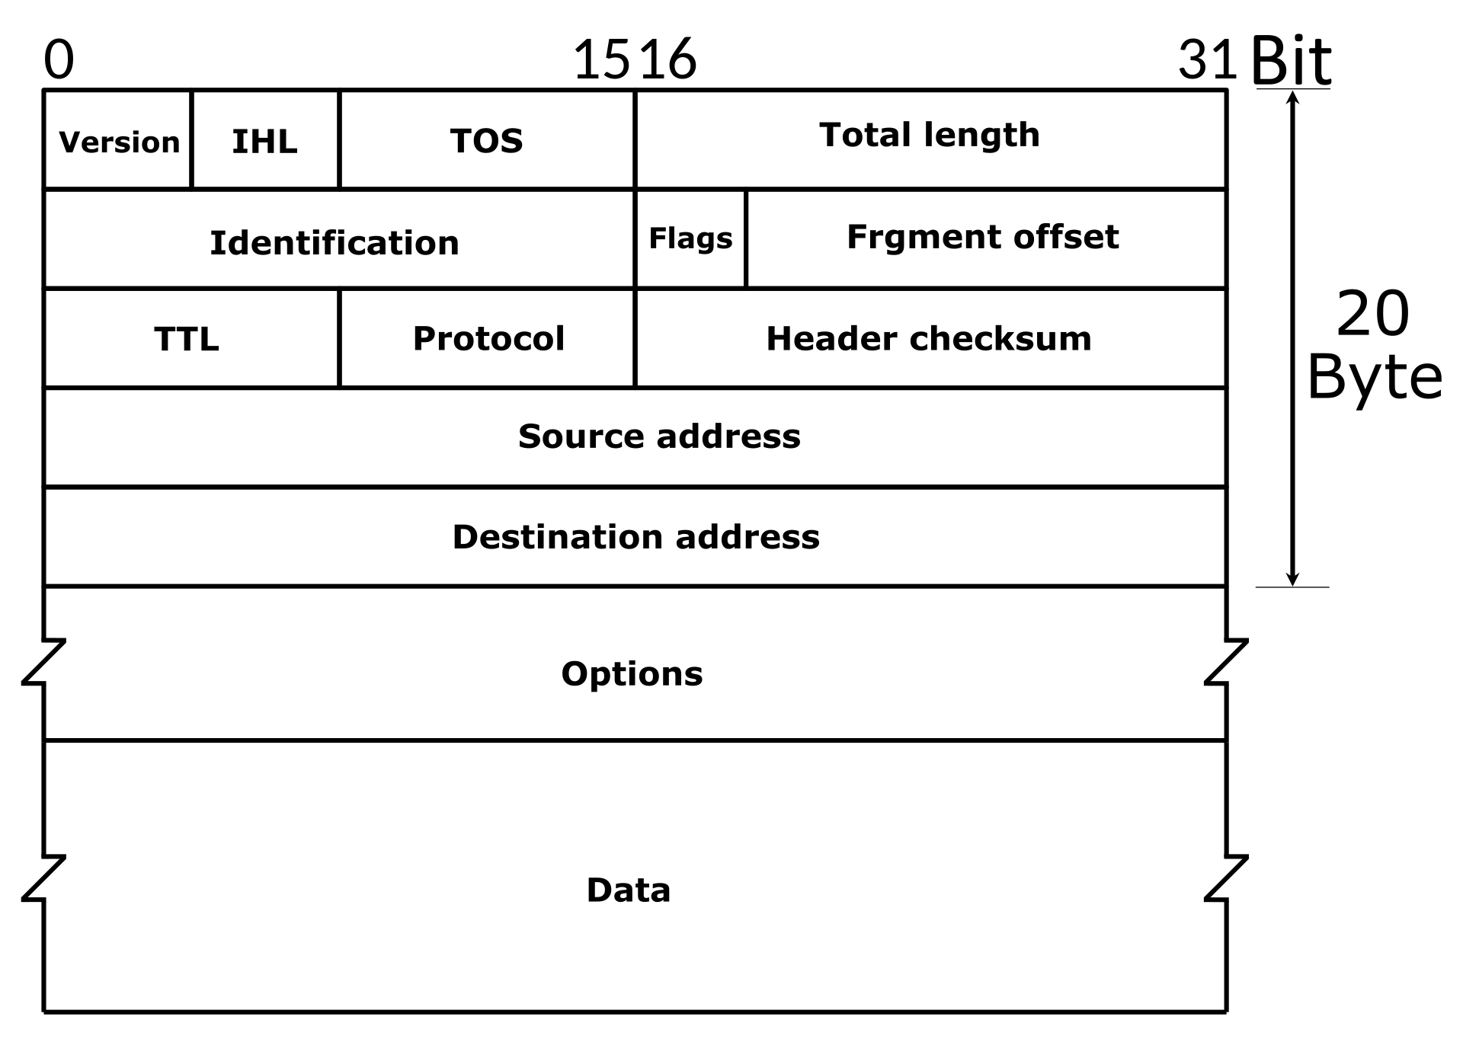
Internet Protocol (IPv4)
Delivering packets from src to dest based on IP address
Header checksum
Decrement TTL

Slide 12
Routing Table
Destination & Netmask: subnet network ID
Gateway: next hop IP address to destination
Interface: name of network interface card connected to gateway
Metric: routing metric of path to destination (omitted in this project)

Slide 13
Longest Prefix Match
Destination | Netmask | Gateway | Interface
0.0.0.0 | 0.0.0.0 | 10.0.1.100 | eth3
192.168.2.2 | 255.255.255.0 | * | eth1
172.64.3.10 | 255.255.0.0 | * | eth2
Where should packet dest at “192.168.1.1” go?

Slide 14
Longest Prefix Match
Destination | Netmask | Gateway | Interface
0.0.0.0 | 0.0.0.0 | 10.0.1.100 | eth3
192.168.2.2 | 255.255.255.0 | * | eth1
172.64.3.10 | 255.255.0.0 | * | eth2
Where should packet dest at “192.168.2.1” go?

Slide 15
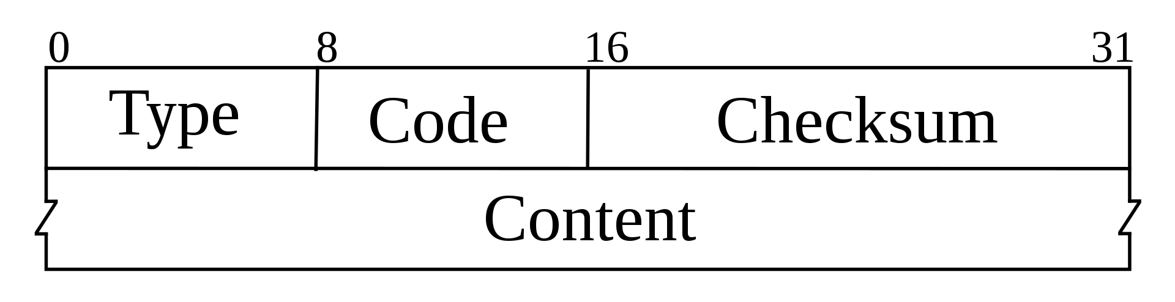
ICMP: Internet Control Message Protocol
Used by hosts & routers to communicate network-level information
error reporting (unreachable host, network, port, protocol)
echo request/reply
Sent as IPv4 payload
Content: Internet header + 8 bytes of original datagram

Slide 16
Ping & Traceroute
Ping: ICMP echo request/reply
reply with TTL = 64

Slide 17
Ping & Traceroute
Ping: ICMP echo request/reply
reply with TTL = 64
Traceroute: displaying possible routes and RTT in IP network.
sends UDP segments with TTL = 1,2,3, … with unlikely port number
when nodes receive datagram with TTL=0, return ICMP “Time Exceeded”
destination returns ICMP “Port Unreachable”

Slide 18
Useful Materials
IPv4:
RFC 791: https://tools.ietf.org/html/rfc791
Text Book: section 4.4.1, 4.4.2
ICMP:
RFC 792: https://tools.ietf.org/html/rfc792
Text Book: section 4.4.3
ARP:
RFC 826: https://tools.ietf.org/html/rfc826
Text Book: section 5.4.1

Slide 19
results to show

Slide 20
Expected Behaviors
ping from client to any server & router interfaces
traceroute from client to any server & router interfaces
wget files from server
Update ARP cache table

Slide 21
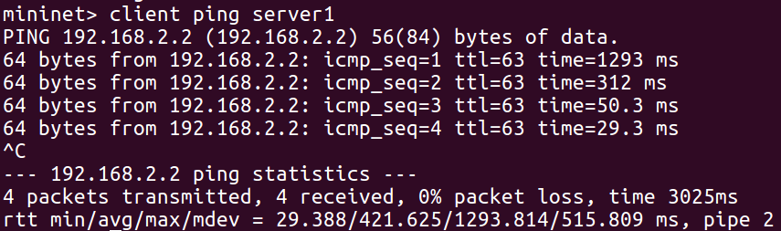
Ping
ping from client to any http servers

Slide 22
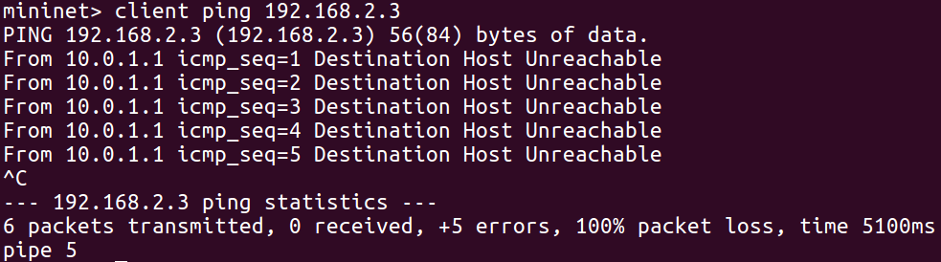
Ping
ping wrong IP address

Slide 23
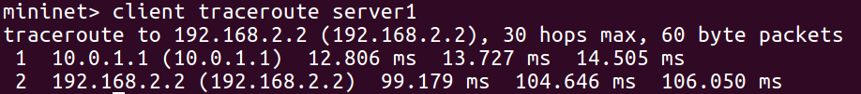
Traceroute
traceroute to any http server
traceroute to router interfaces

Slide 24
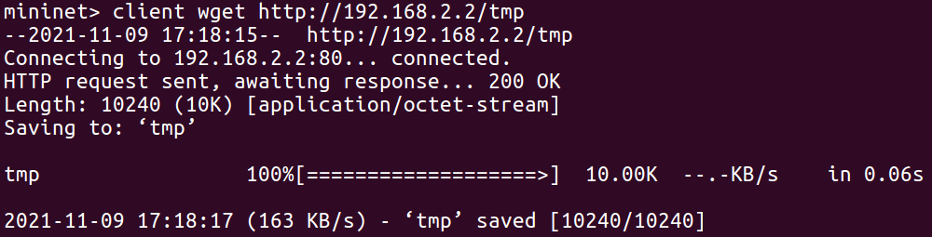
File Downloading
wget from any of servers

Slide 25
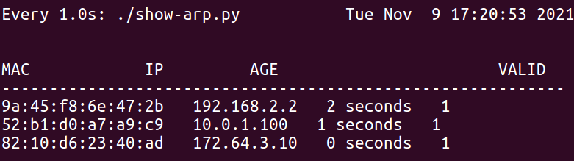
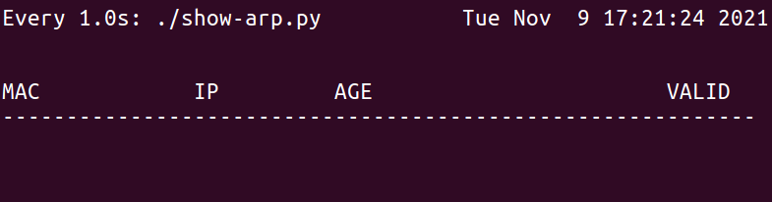
ARP Cache table
“pingall”
30 seconds later

Slide 26
code to implement

Slide 27
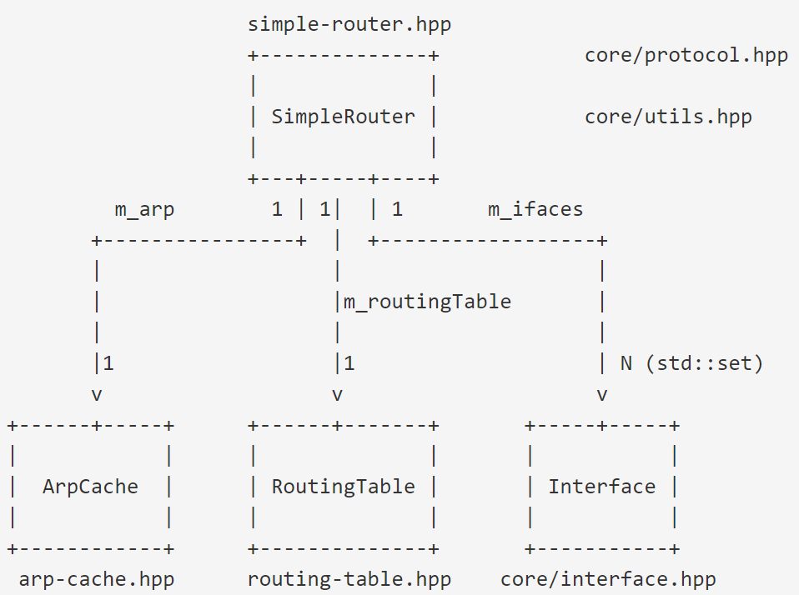
Code Structure

Slide 28
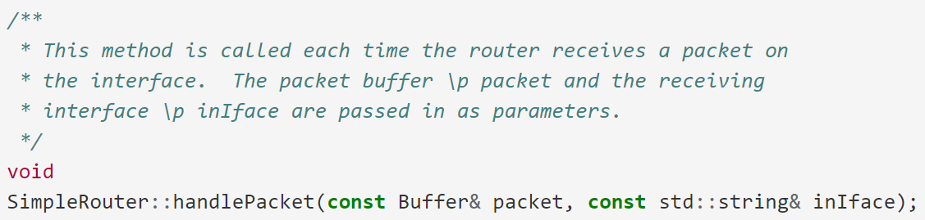
Key Methods
NEED TO IMPLEMENT
Method that receives a raw Ethernet frame (simple-router.hpp|cpp):

Slide 29
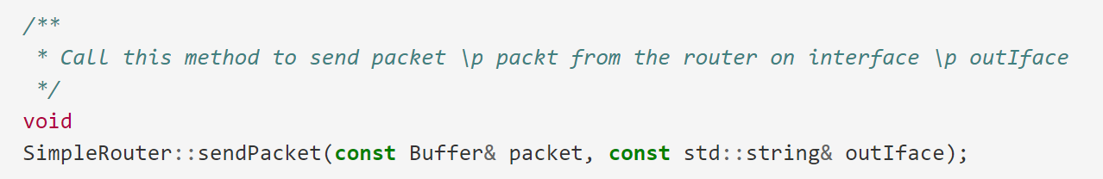
Key Methods
IMPLEMENTED
Method to send raw Ethernet frames (simple-router.hpp|cpp):

Slide 30
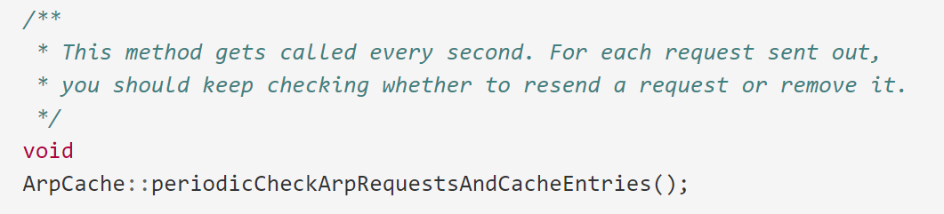
Key Methods
NEED TO IMPLEMENT
Method to handle ARP cache events (arp-cache.hpp|cpp):

Slide 31
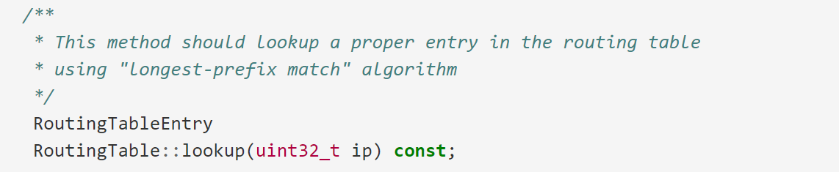
Key Methods
NEED TO IMPLEMENT
Method to lookup entry in the routing table (routing-table.hpp|cpp):

Slide 32
issues to notice

Slide 33
Some Important Issues
Grading (up to 105%)
Router Implementation (85%=45%public + 40%private)
Ping tests (50%)
Traceroute tests (20%)
File Downloading tests (15%)
Project Report + Code Quality (20%)
Individual work

Slide 34
Some Important Issues
Submission
Source code (“make tarball”)
Do not modify existing data structures
Report: no longer than THREE pages
Evaluation
ping, traceroute, file downloading, details in project spec
Code quality
Project report

Slide 35
Some Important Issues
Start up: today, after class
Deadline: 12.5, 23:59 (3 weeks and a half)
Late Submission: 12.6 ~ 12.12, 23:59
-20pts punishment
No more submissions after 12.12

Slide 36
Problems Emerged
Improper TTL handling in traceroute / ping
when to do TTL--?
when to send ICMP time exceeded?
Fail to maintain ARP cache entries / send ARP requests
Imperfect longest prefix match
Compilation & project structure problem
check before submission

Slide 37
Get to work as soon as possible, not like FTP!

Slide 38
Q&A
Good luck

Slide 39
Acknowledgement
This project is based on the CS118 class project by Alexander Afanasyev, UCLA.

