Slide 1
Projects Options for CESC 510 and/or Senior Design Classes
Jianhua Liu
8/26/26

Slide 2
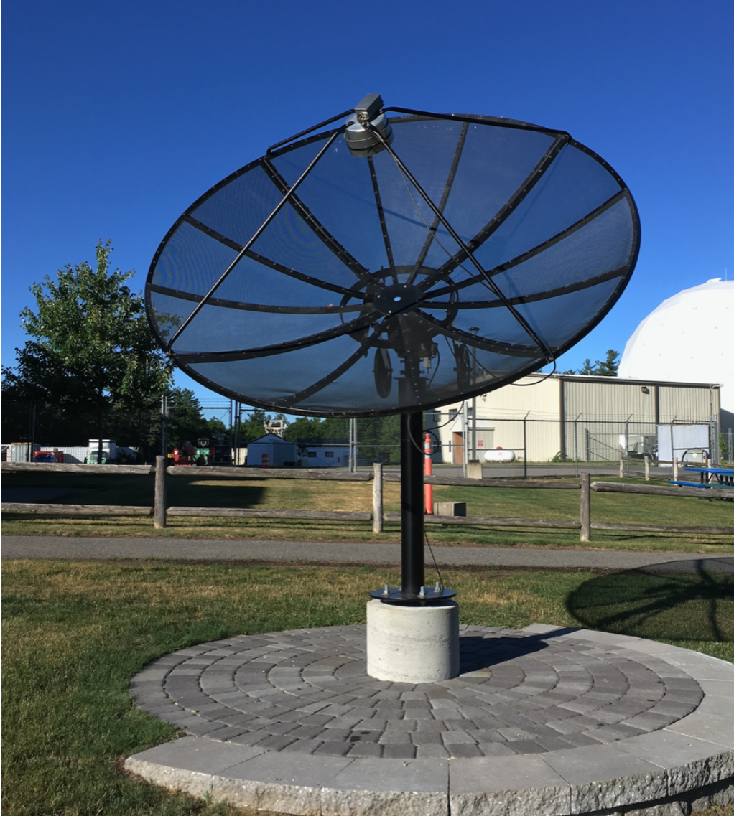
Project 1: Small Radio Telescope (SRT) Based on Software Defined Radio (SDR)
Background info
Hardware and software were developed by the MIT Haystack Observatory.
Home page: https://www.haystack.mit.edu/haystack-public-outreach/srt-the-small-radio-telescope-for-education/
GitHub repo for the software: https://github.com/MITHaystack/srt-py
Installed at Burns Sci Tech at Edge Water.
Need to upgrade software

Slide 3
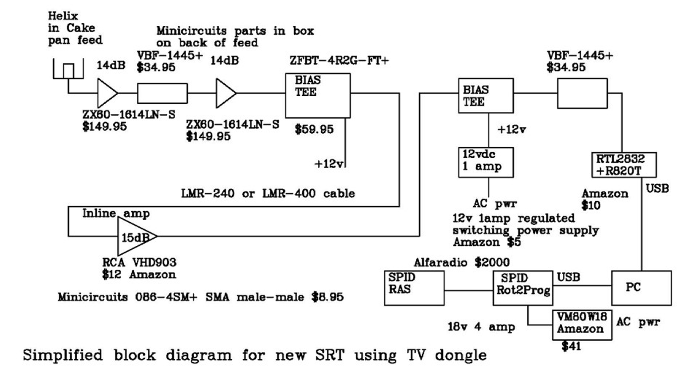
Hardware Diagram and Components
Background info
Minicircuits
LPF
1420.4058 MHz
Will upgrade to
RTL SDR 1 PPM TCXO
Works via serial
port using VCP
diagram_and_comp/Diagram_and_list_of_components.docx

Slide 4
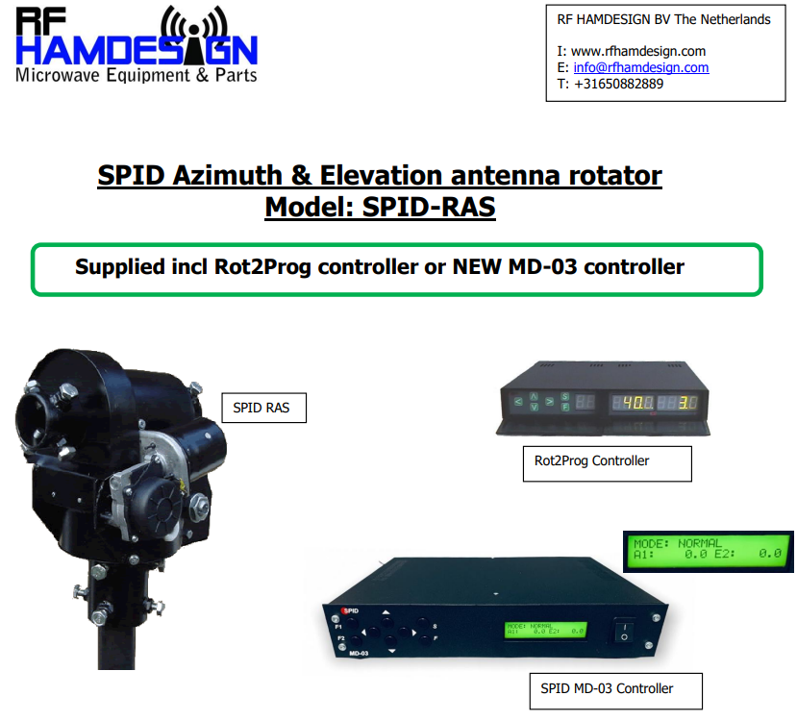
Background info
All above hardware works well
We will get a new SDR receiver with better frequency stability.

Slide 5
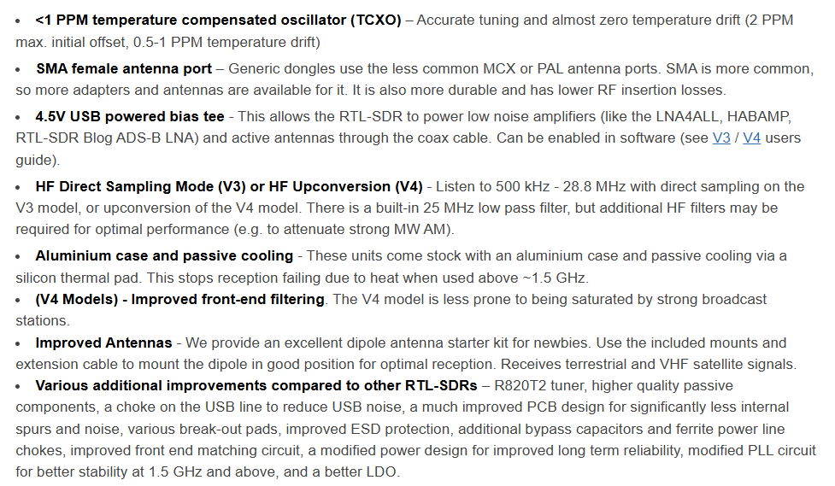
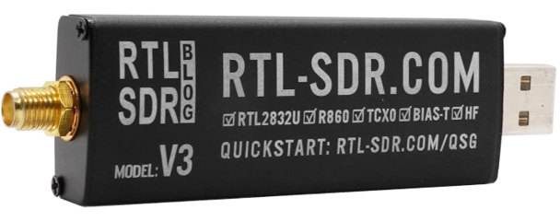
RTL 2832 Dongle
Background info

Slide 6
Software Versions of the SRT
Background info
There are many versions of SRT software.
Long time ago, it was written with Java. See the “Legacy SRT software” section at https://www.haystack.mit.edu/haystack-public-outreach/srt-the-small-radio-telescope-for-education/#current.
Jeanette Barott and Charlie Husbands were able to make these version work. This was the time when the SRT was installed at the Museum of Art, Science, and History.
Then, the programming language is changed to C. See the “Previous SRT software” section at https://www.haystack.mit.edu/haystack-public-outreach/srt-the-small-radio-telescope-for-education/#current.
The current version is written with Python.
We will switch to a totally different software package, which works well with the current hardware and the new SDR receiver.

Slide 7
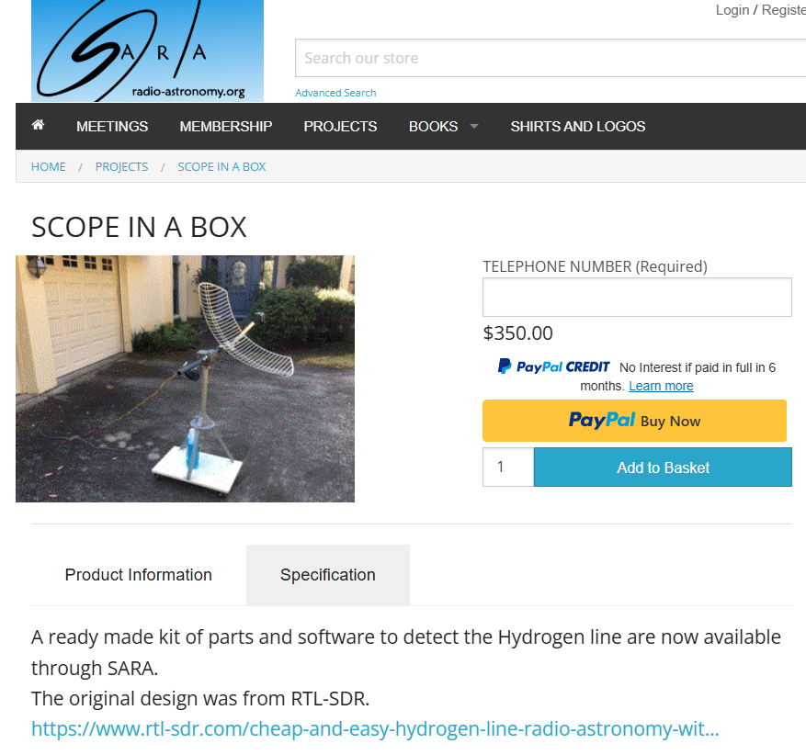
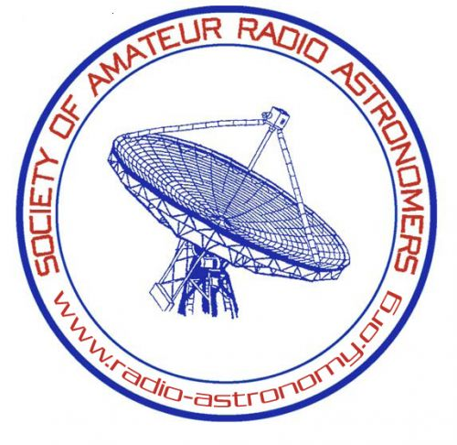
Components of the new Software Package
Work to Do
Processing signals from the receiver.
Tracking celestial bodies.
Controlling antenna
Search for amateur radio astronomy software packages

Slide 8
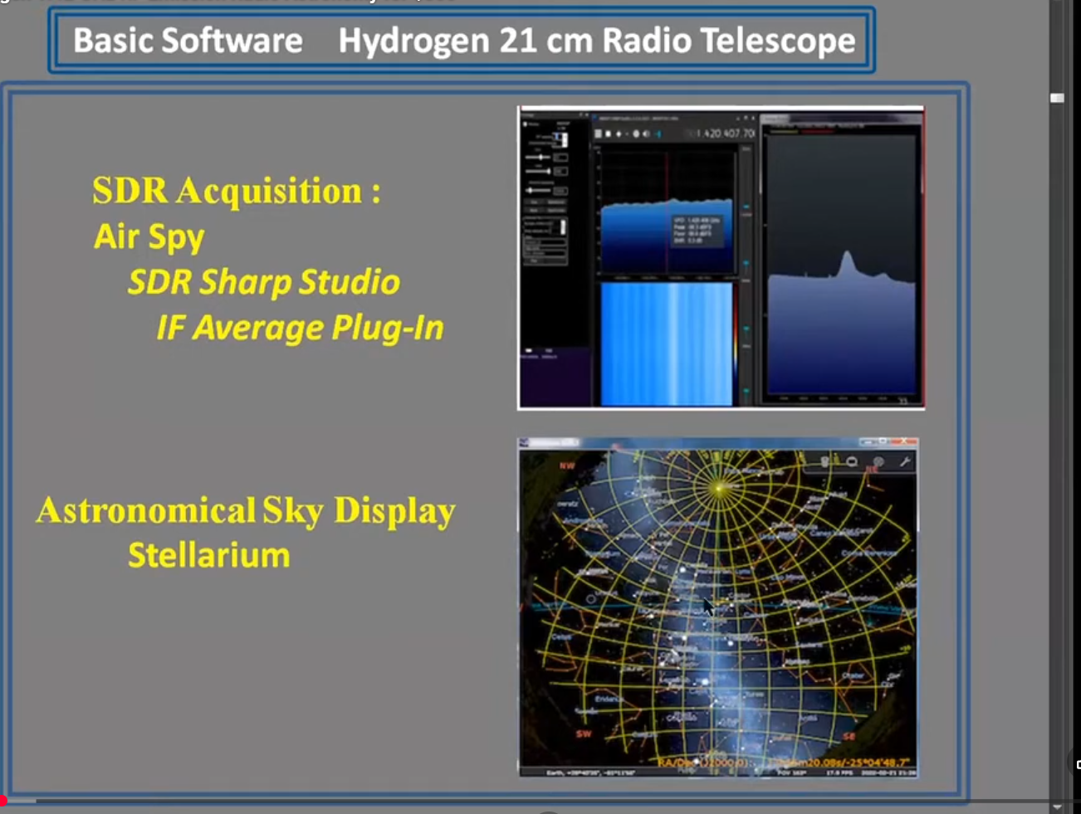
Processing Signals from Receiver

Slide 9
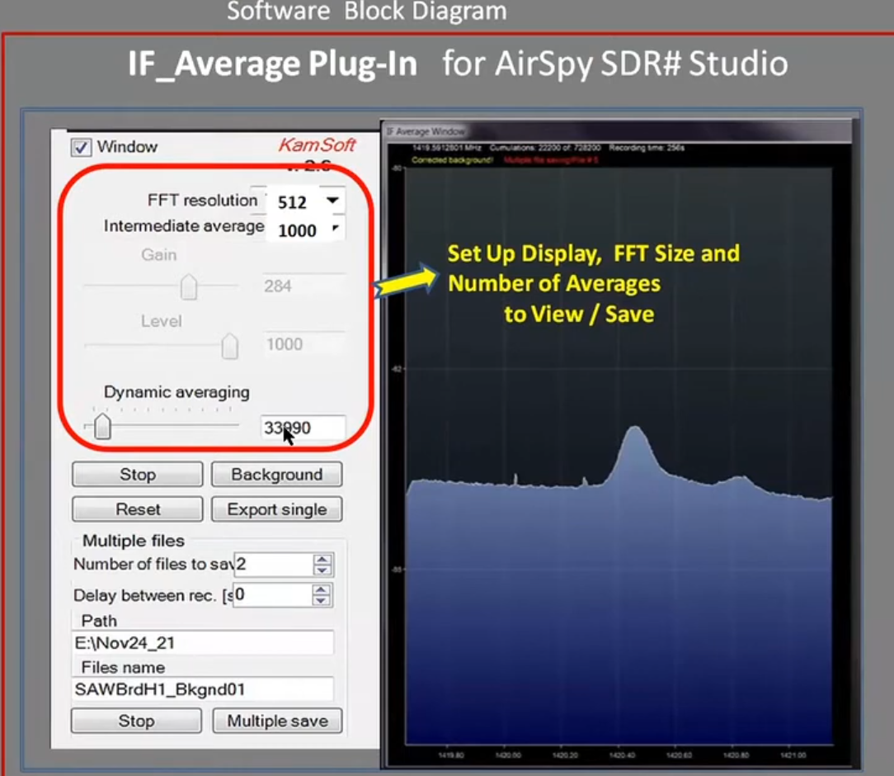
Processing Signals from Receiver

Slide 10
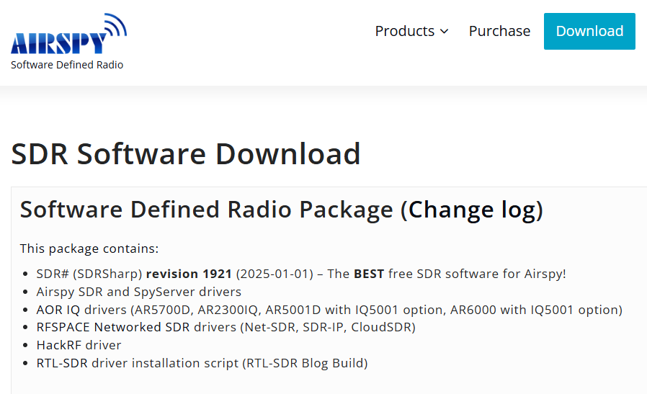
Processing Signals from Receiver

Slide 11
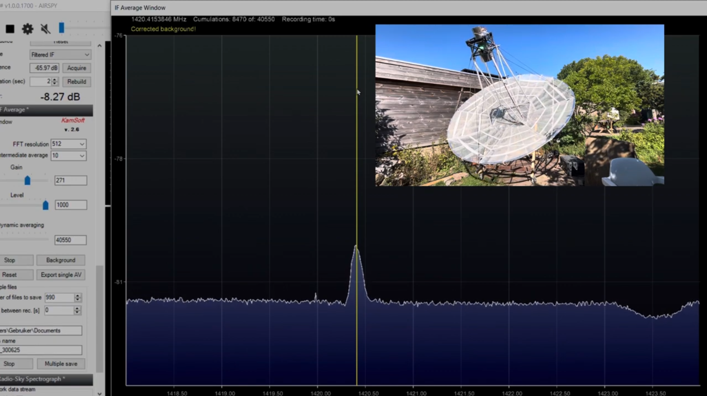
Processing Signals from Receiver

Slide 12
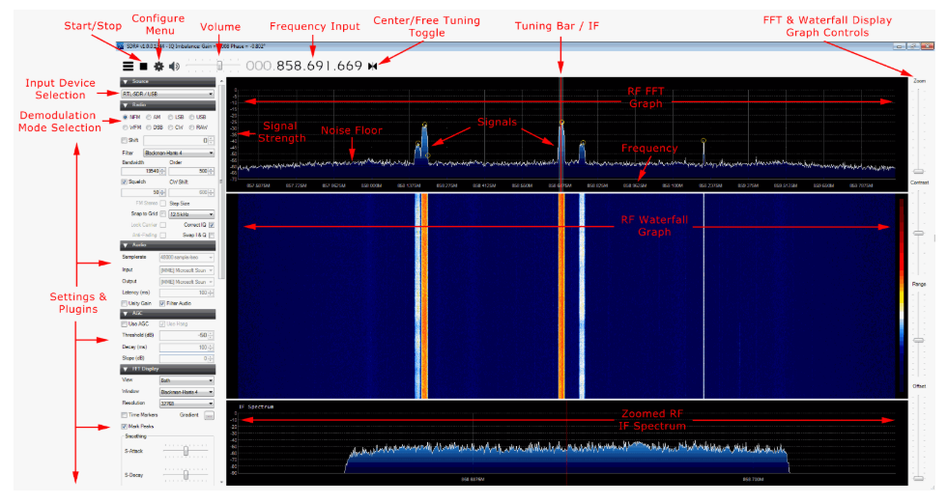
Processing Signals from Receiver
SDR# (SDR Sharp)

Slide 13
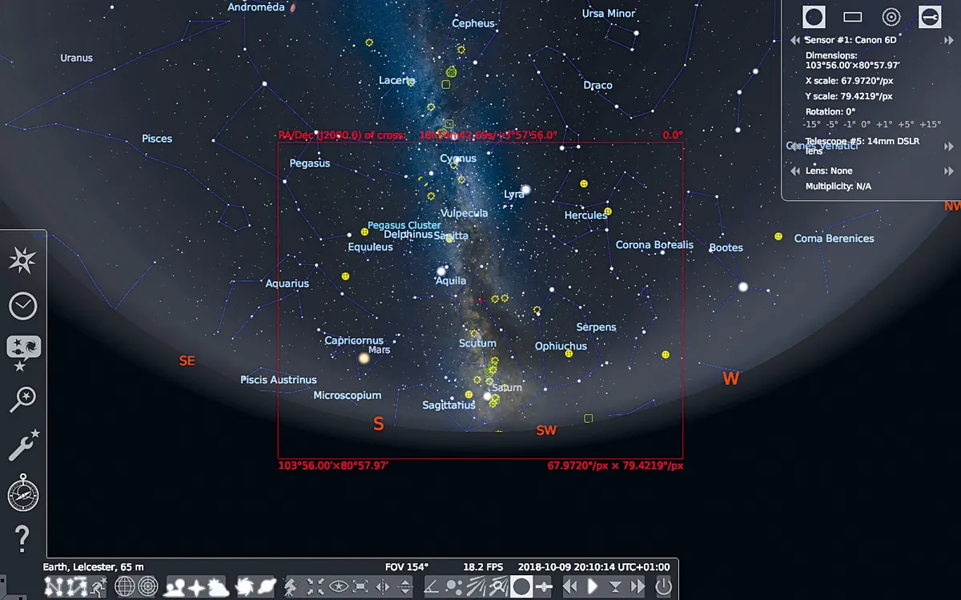
Tracking celestial bodies
Stellarium

Slide 14
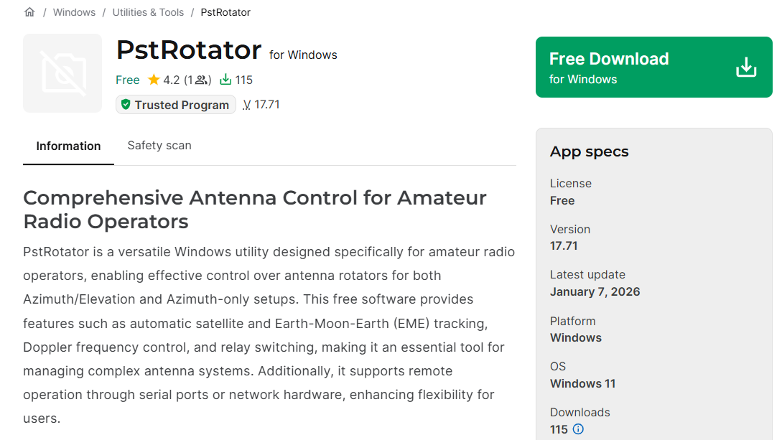
Controlling Antenna
Software for
AZ/EL rotators

Slide 15
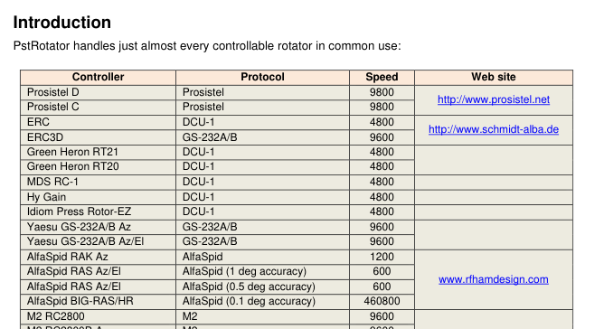
Controlling Antenna

Slide 16
Goal for Project 1
Replace the existing software which is not updated regularly.
The new software package should be updated by the community regularly.
Known issues should be addressed relatively quickly.
Assemble a relatively easy to use software package for middle school students for science projects.
Software package should be very stable so users don’t have to face constant operation issues.
Appropriate logging is needed

Slide 17
Requirements and Suggestions for Project 1
For CESC 510:
Research what software packages the amateur radio astronomers commonly use which are compatible to our hardware.
Install the chosen software package on your computer which runs a SDR for signal receiving and experiment with the basic operations.
Do a field test at Burns to make sure the package works.
For Senior Design:
All the above.
Create an antenna simulator that can simulate the rotation of the antenna and modulate the strength of received signals.
Create a wrapper app so that different pieces of software in the package can be started and operated with the wrapper to reduce the operational overhead and cognitive load.

Slide 18
Project 2: ATC Communication Quality Research Using SDR
Background info
ATC communications between ATC controller and pilots still are based on classic VHF AM technology.
Voice quality of ATC communication can vary.
We want to figure what are the factors that affects the quality of VHF AM communications.
Result of quality research can be used in two ways:
Improve audio quality of the receiver output so that an ASR (automatic speech recognition) system can work better.
Generate realistic voice signals that can be used for ASR model finetuning.

Slide 19
Getting ATC Voice Data
Requesting ATC voice data from LiveATC and other sources, such as FOIA.
Recording ATC voice data using our own hardware and software:
We use the same SDR as Project 1 to create VHF AM receivers.
There are many different choices for software to get the audio signal out:
Use existing SDR software packages with AM demodulation, such as AirSpy.
Create our own AM receiver based on tools like GNU Radio.

Slide 20
Goal/Requirements of Project 2
For CESC 510: Can select one of TWO flavors:
Flavor 1: Voice quality research
Analyze requested voice data to document the variation of voice quality for different location, ATC positions, frequencies, and time.
Associate the spectrum of the audio signal and the audio quality and investigate root cause for reduced audio quality.
Record data by experimenting on slightly changing the receiver frequency and tweaking filter shapes to mimic different voice qualities.
Simulate the creation of reduced quality audio signals.

Slide 21
Goal/Requirements of Project 2
For CESC 510: Can select one of TWO flavors:
Flavor 2: Noice characteristic research
Analyze noise patterns in the requested voice data.
Patterns may include time domain distributions of noise signal strength and well as frequency domain spectrum pattern.
Associate the pattern and strength of noise to distance between transmitter and receiver if possible. The distance can be calculated by using ADS-B data.
Associate the spectrum of the voice signal and the adjacent noise signal to see the effect of receiver filters.
Experiment the creation of noise that have similar noise patterns as that from requested data.

Slide 22
Goal/Requirements of Project 2
For Senior Design Classes:
The union of the above two flavors.
Additional requirements may be added later.

