Slide 1
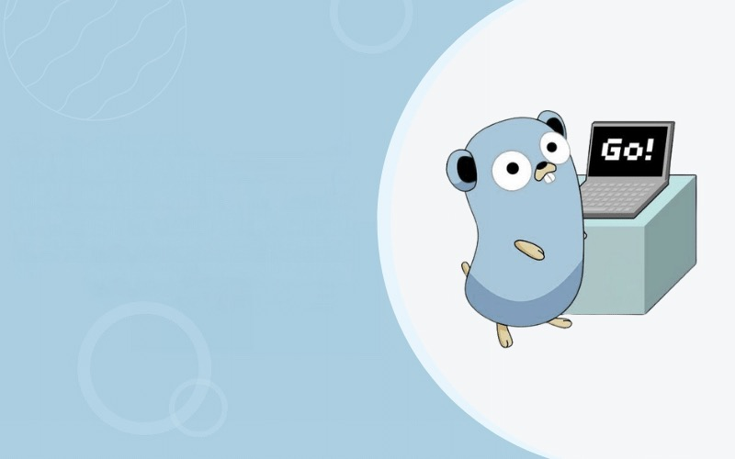
GO
Concepts of Programming Languages
Ahmet Eray Karadağ – B201202021
Tunahan Akça – B201202056
Ahmet Alkan – B211202378
Abdulhady Sabbagh – B211202555

Slide 2

Overview
Where Go came from and where it is now... ……………………3
Why learn Go?..........................................................................................4
Companies using Go……………………………………………...5
Where Go language works best & Go language limitations……...6
Bitly – Why we write everything in Go…………………………...7
Syntax of Golang with codes…………………………………….11

Slide 3

Where Go came from and where it is now
The GO was born because Google’s codebase has been getting more and more complex in time.
It was designed by Robert Griesemer, Rob Pike, and Ken Thompson.
Go was announced to the public in 2009, and it was made open source in 2012 when its first version, 1.0, was released.
Go language is a statically typed language. Meaning that the variable types are known and verified at compile time. Unlike dynamically typed languages where the variable types are checked at runtime.
Go quickly rose in popularity and became many developers' first choice due to its simplicity, readability, efficiency, and concurrent nature.
Go is used for server-side (backend) programming, game development, cloud-based programming, and even Data Science.
As of December 21st, 2022, Go is one of the Top 10 most popular programming languages.

Slide 4

Why learn Go?
Go language is small and simple
Go is meant to be simple to learn, straightforward to work with, and easy to read by other developers. Go is reminiscent of C in its syntax, making it relatively easy for longtime C developers to learn.
Go is fast
Go performance is as good as C for the vast majority of work, and generally much faster than other languages known for speed of development (e.g., JavaScript, Python, and Ruby).
Mascot of Go programing language is a Gopher

Slide 5









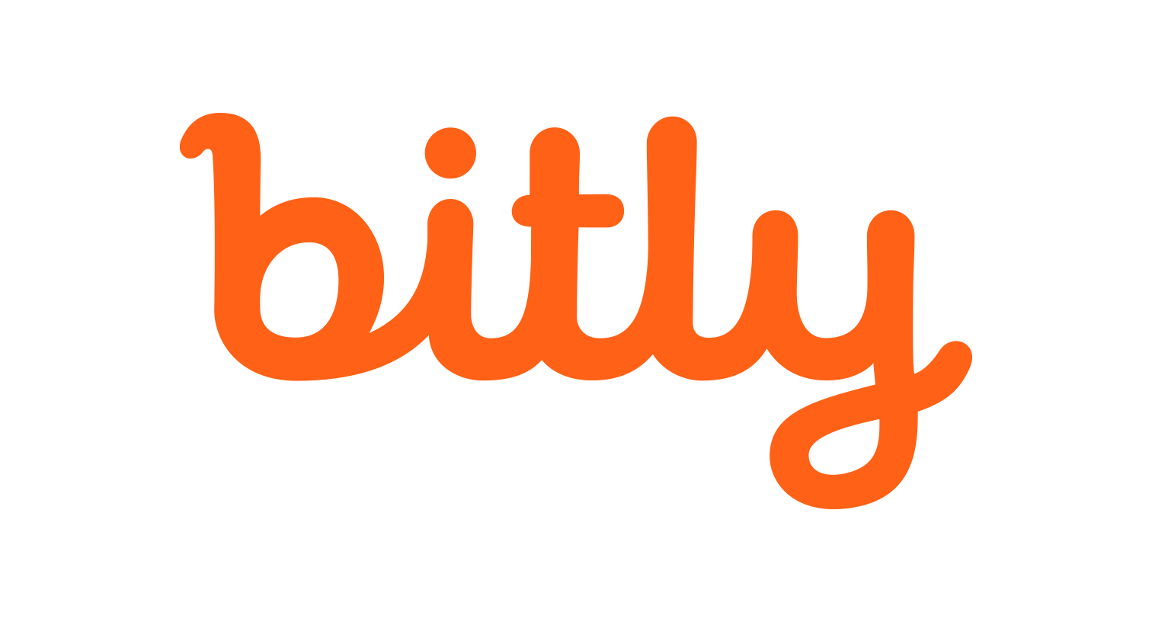




Companies using Go
Many famous companies in the world use GO language in certain areas like Web Development, Cloud & Network Services, etc. In a few examples:
American Express uses GO for payment & rewards.
Paypal taps GO to modernize and scale.
Riot Games - leveraging Golang for game development and operations.
Salesforce - from Python/C to GO
Uber - GPU-power analytics engine in GO.
Twitch - GO's march to low-latency GC.
Monzo - Building a bank with Golang, microservices and containers.

Slide 6

Where Go language works best
Go language limitations
Go’s opinionated set of features has drawn both praise and criticism. Go is designed small and easy to understand, with certain features deliberately omitted. The result is that some features that are commonplace in other languages simply aren’t available in Go—on purpose.
Another potential downside to Go is the size of the generated binaries. Go binaries are statically compiled by default, meaning that everything needed at runtime is included in the binary image. This approach simplifies the build and deployment process, but at the cost of a simple “Hello, world!” weighing in at around 1.5MB on 64-bit Windows.
No language is suited to every job, but some languages are suited to more jobs than others. Go shines brightest for developing the following application types:
Cloud-native development
Distributed network services
Utilities and stand-alone tools

Slide 7
Bitly - Why we write everything in Go
At Bitly, we’ve been all in on Go as our preferred back-end language since about 2015. Why? We like tools that are efficient and powerful. We like to avoid the unnecessarily complex. We like repeatable patterns, open source, clear standards and high performance. We like easy-to-read code because we like easy-to-maintain code. This is why we like Go.
Once Upon a Time…
There once was a time when we wrote most backend services in Python, and when we wanted serious performance, we dropped into C.
We used Python because it was easy to write, reasonably performant, and there was a nice web server framework called Tornado that scaled pretty well with its effective use of non-blocking network I/O. We used C because, well, it was C and you can’t beat its performance. You can, however, beat its maintainability.

Slide 8
Enter Go
In 2014, we wrote a little open source project called NSQ (nsq.io) and put a promising new language called Go through its paces. We liked what we saw so much that we started writing everything new in Go, and soon thereafter we began porting all legacy services to Go as well.
One of the most compelling findings from that early experience was that we could run the same workload in Go on fewer servers than the Python version and the response times were typically twice as fast.
Performance: Go vs. Python
Serving a simple request
In this example, there is one path served up by a web app. This is simply the serving of a site association file for iOS deep linking for a given custom domain. (If you don’t know what that means, suffice it to say, iOS calls it and it’s a simple json response.)
This example is written in Go and Python versions. The two pieces of code are basically doing the same thing:
Call our internal API to get the site association data for a given custom domain
Return some json

Slide 9
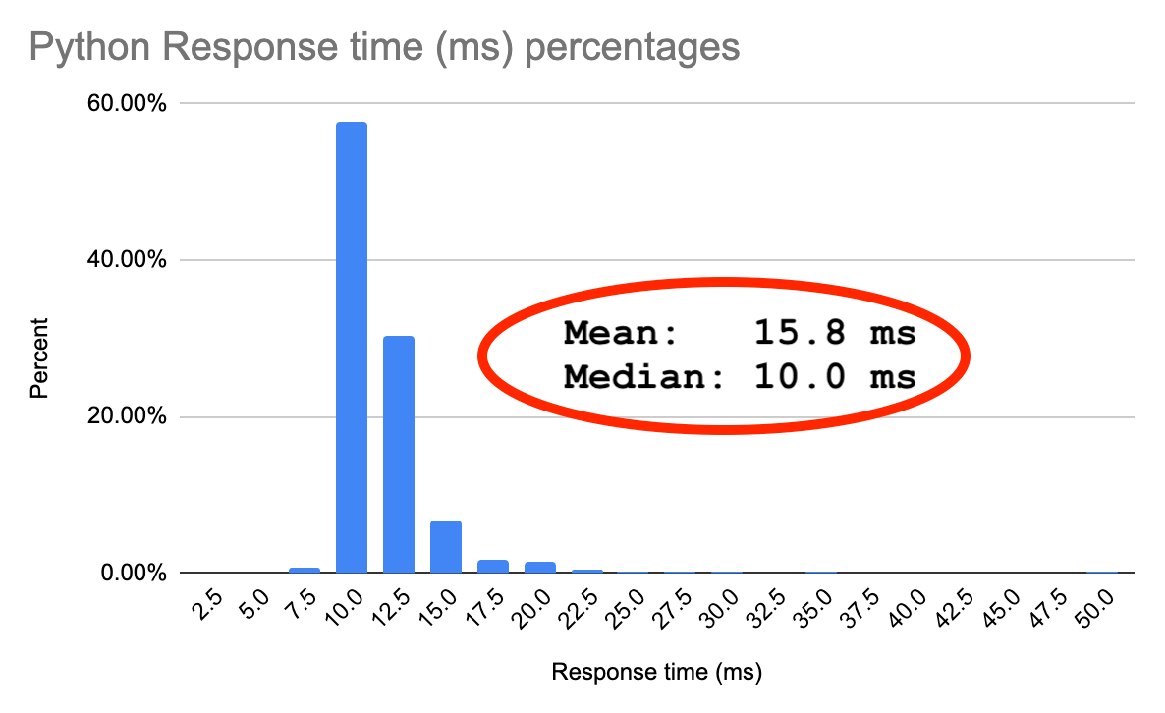
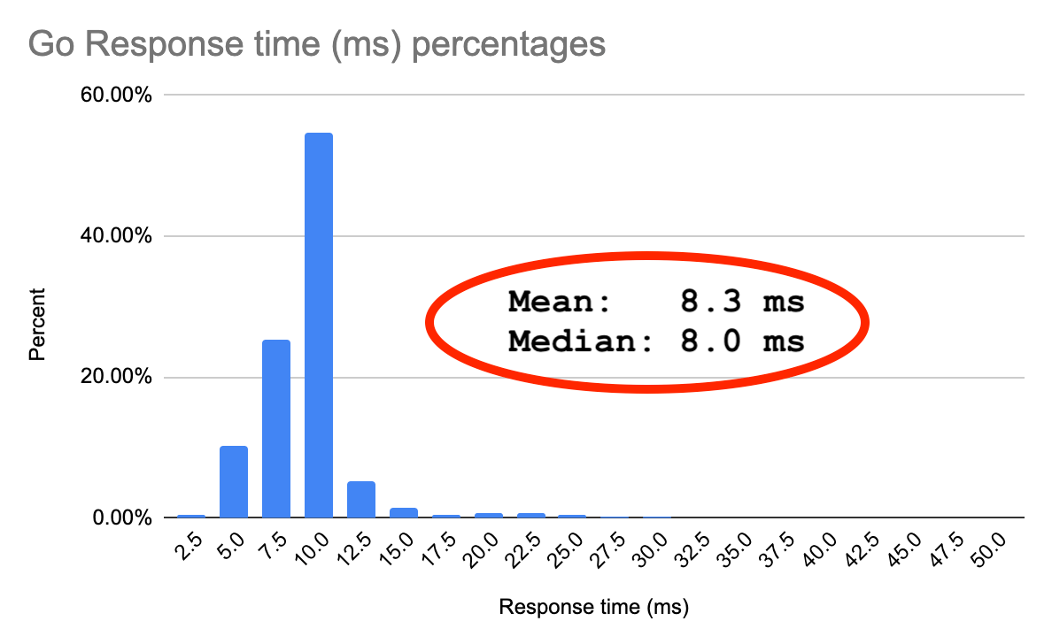
Now look at the difference in performance.
Fig 1. Python – Response times in milliseconds. Sample size: 67,179 requests.
Fig 2. Go – Response times in milliseconds. Sample size: 50,192 requests.
That’s almost half the average response time!
A handful of milliseconds improvement may seem like no big deal, but this code does almost nothing. It makes a single API call and marshals some data to return. A 50% improvement in response time at this level increases exponentially as the complexity of the code increases. More complex code is made up of simple building blocks like this.

Slide 10
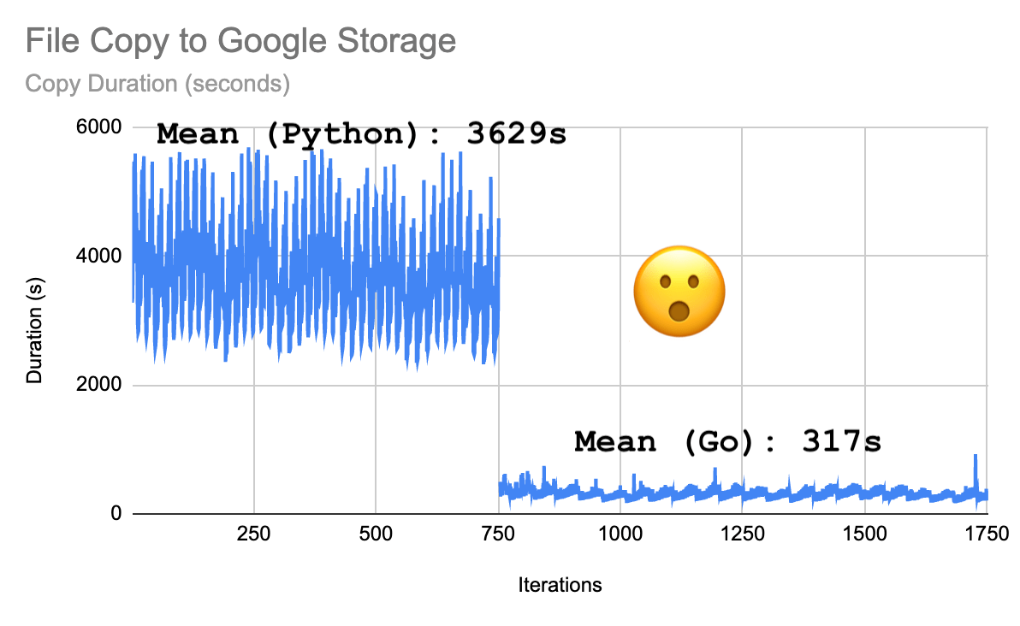
gsutil (Python) to gscopy (Go)
Maybe you use gsutil, like we used to, to copy files to Google Storage. Mundane task, right?
gsutil is a Python-based utility provided by Google (https://cloud.google.com/storage/docs/gsutil). We rewrote the parts of it that we needed in Go and here’s what we found.
The graph below shows the duration of a cron job that runs every 30 minutes. It copies 7,000 to 11,000 files per run. Average file size is 100Mb. (Those of you crunching the numbers will see that the Python version of that cron job didn’t really run every 30 minutes. That version took close to an hour to run.)
Fig 3. Time to copy 7,000 to 11,000 files to Google Storage, Python vs. Go

Slide 11
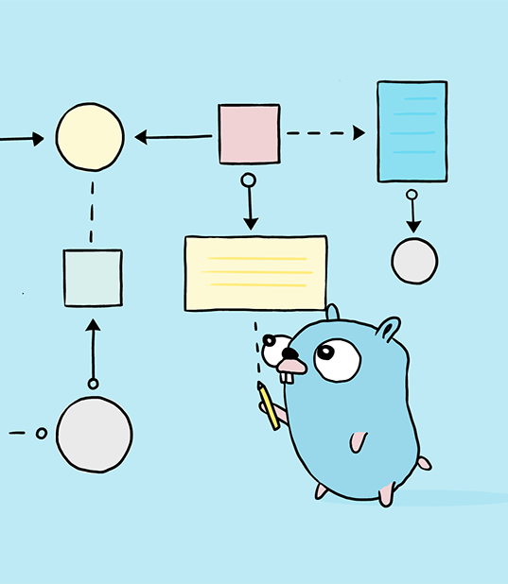
Syntax of Golang with codes

Slide 12
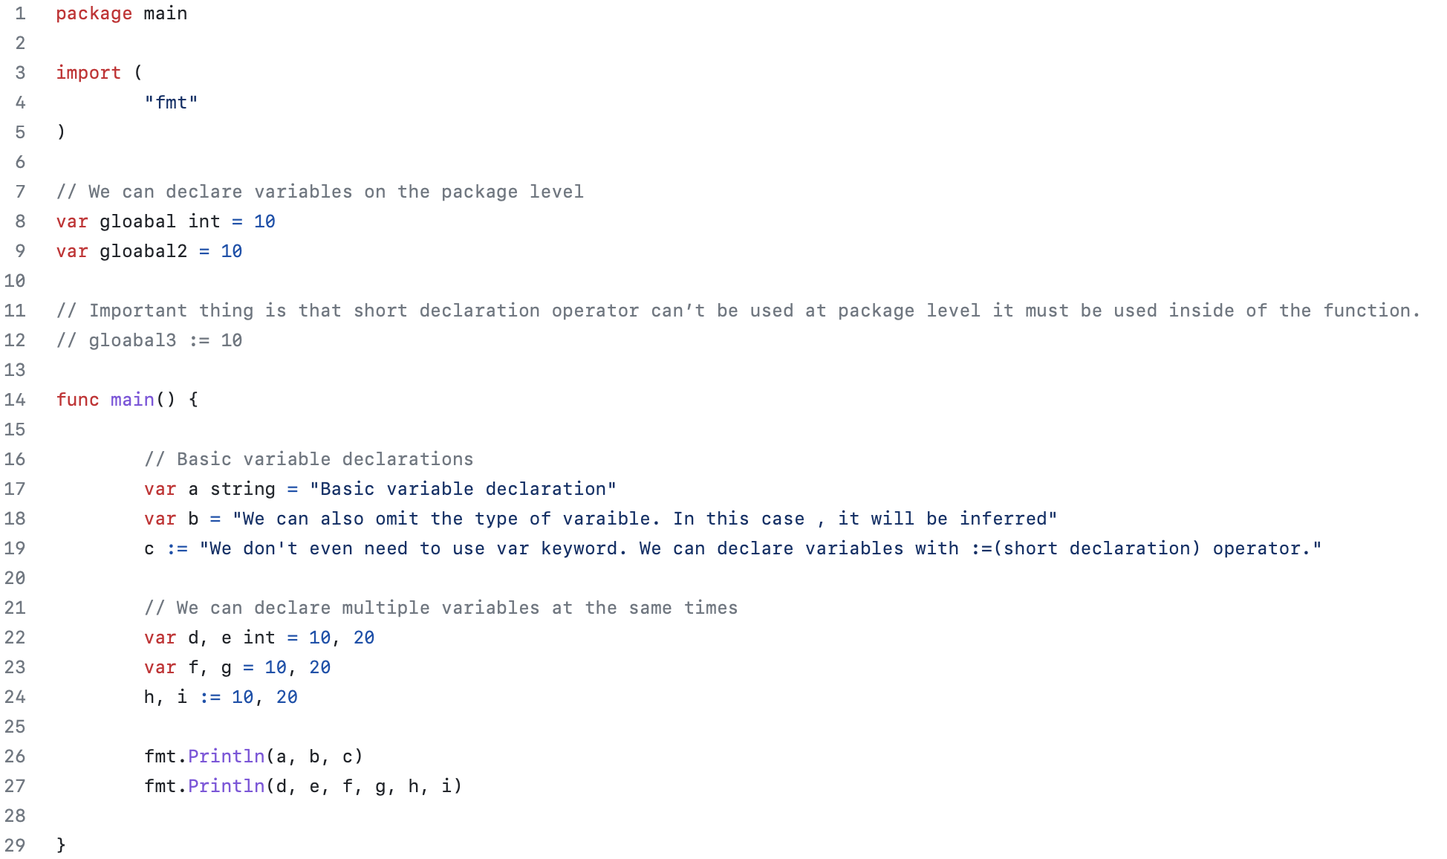
Variables

Slide 13
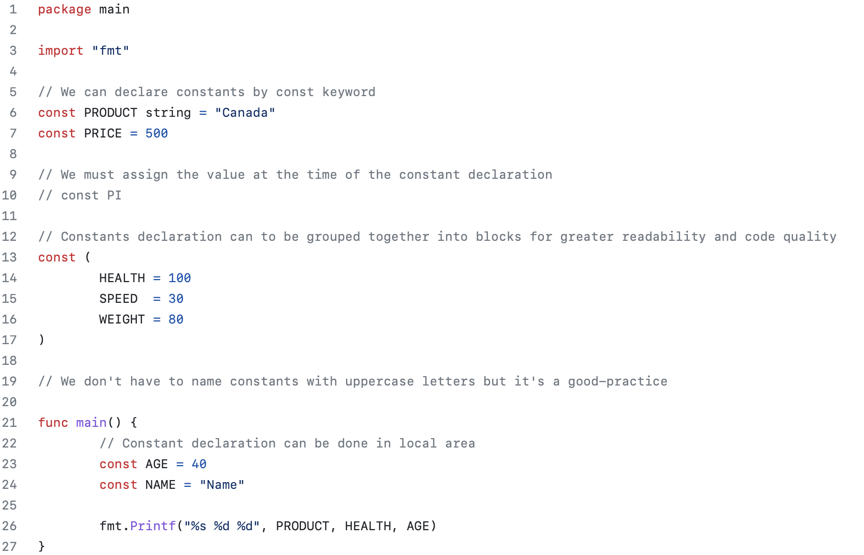
Constants

Slide 14

Functions
Naming Conventions for Golang Functions
A name must begin with a letter and can have any number of additional letters and numbers.
A function name cannot start with a number.
A function name cannot contain spaces.
If the functions with names that start with an uppercase letter will be exported to other packages. If the function name starts with a lowercase letter, it won’t be exported to other packages, but you can call this function within the same package.
If a name consists of multiple words, each word after the first should be capitalized like this: empName, EmpAddress, etc.
Function names are case-sensitive (car, Car and CAR are three different variables)

Slide 15
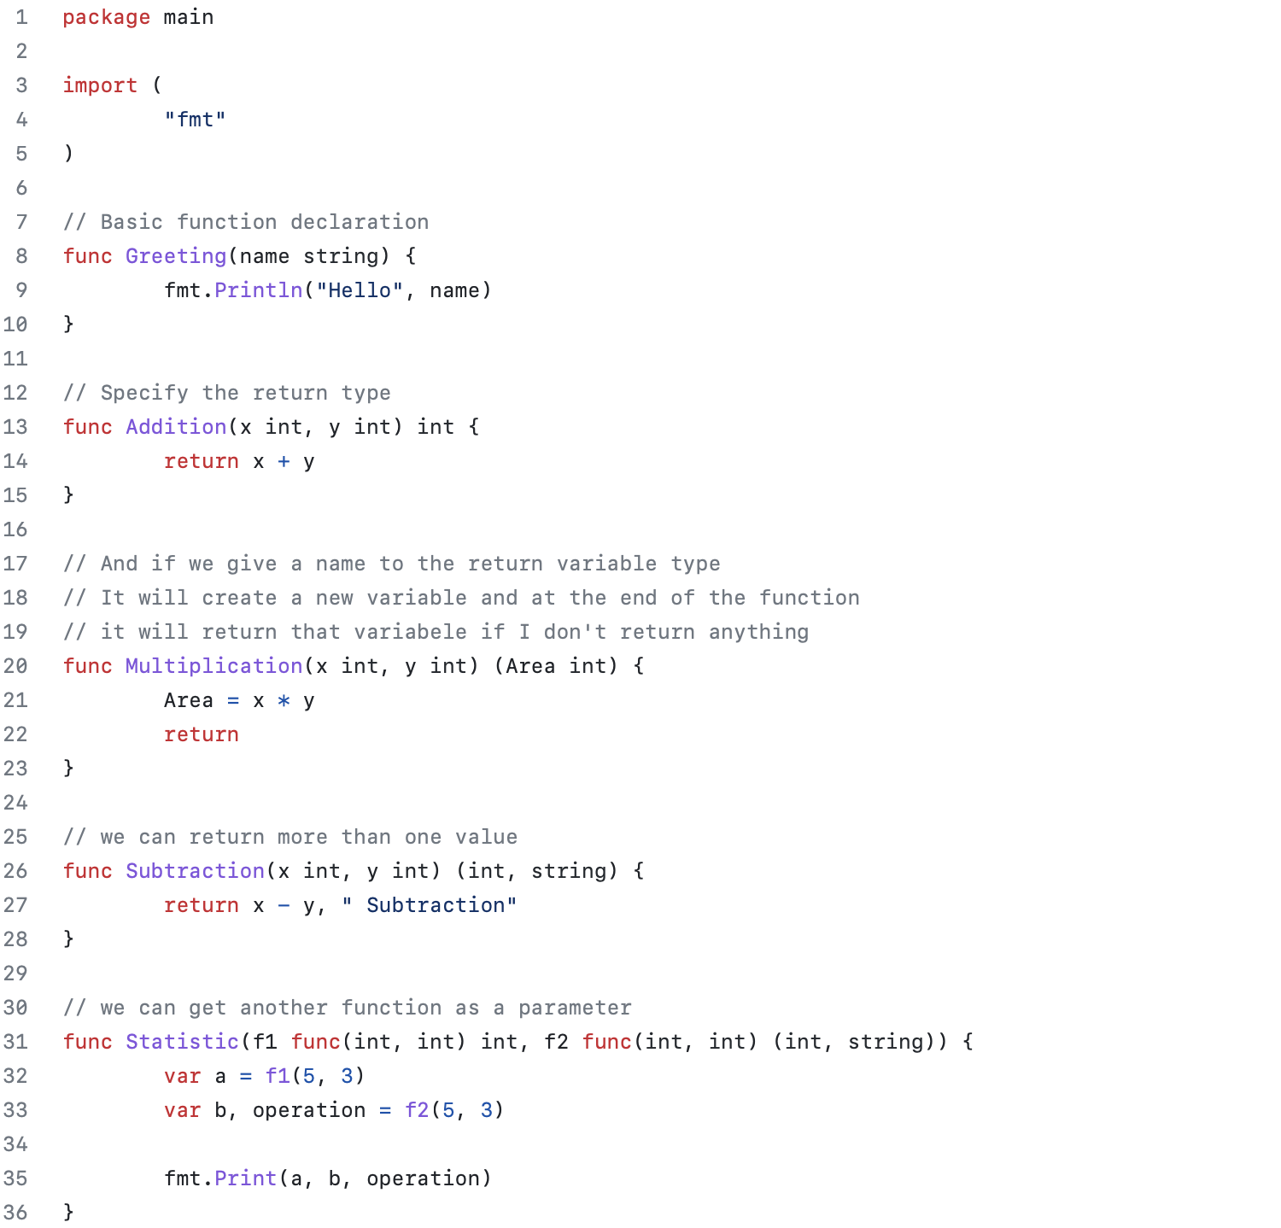

Slide 16
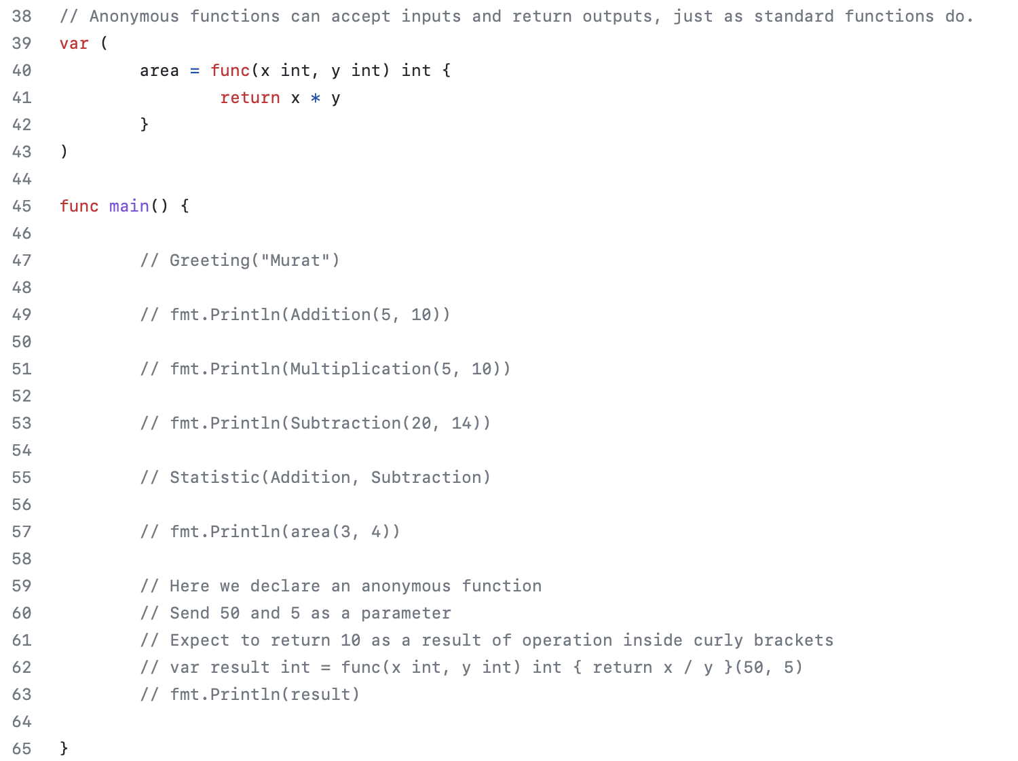

Slide 17
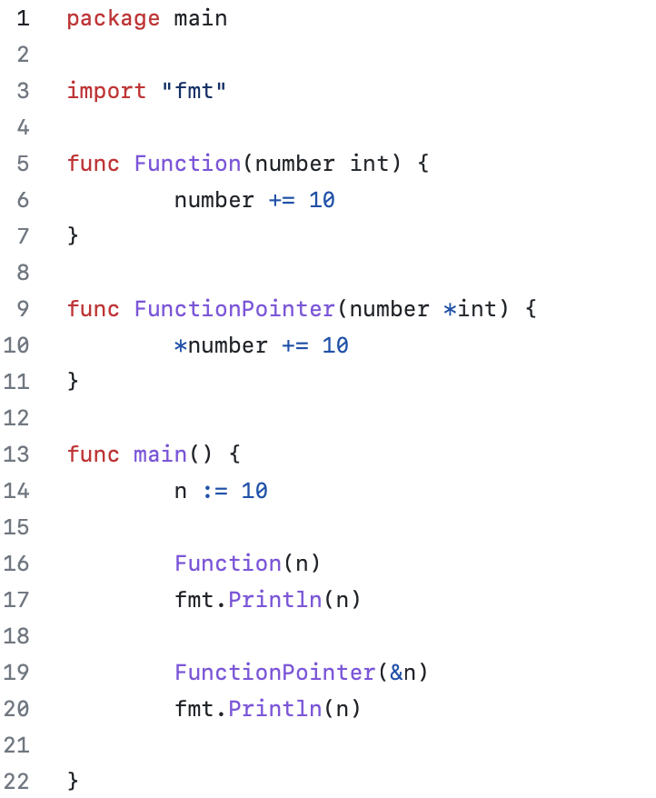
Function Parameters

Slide 18
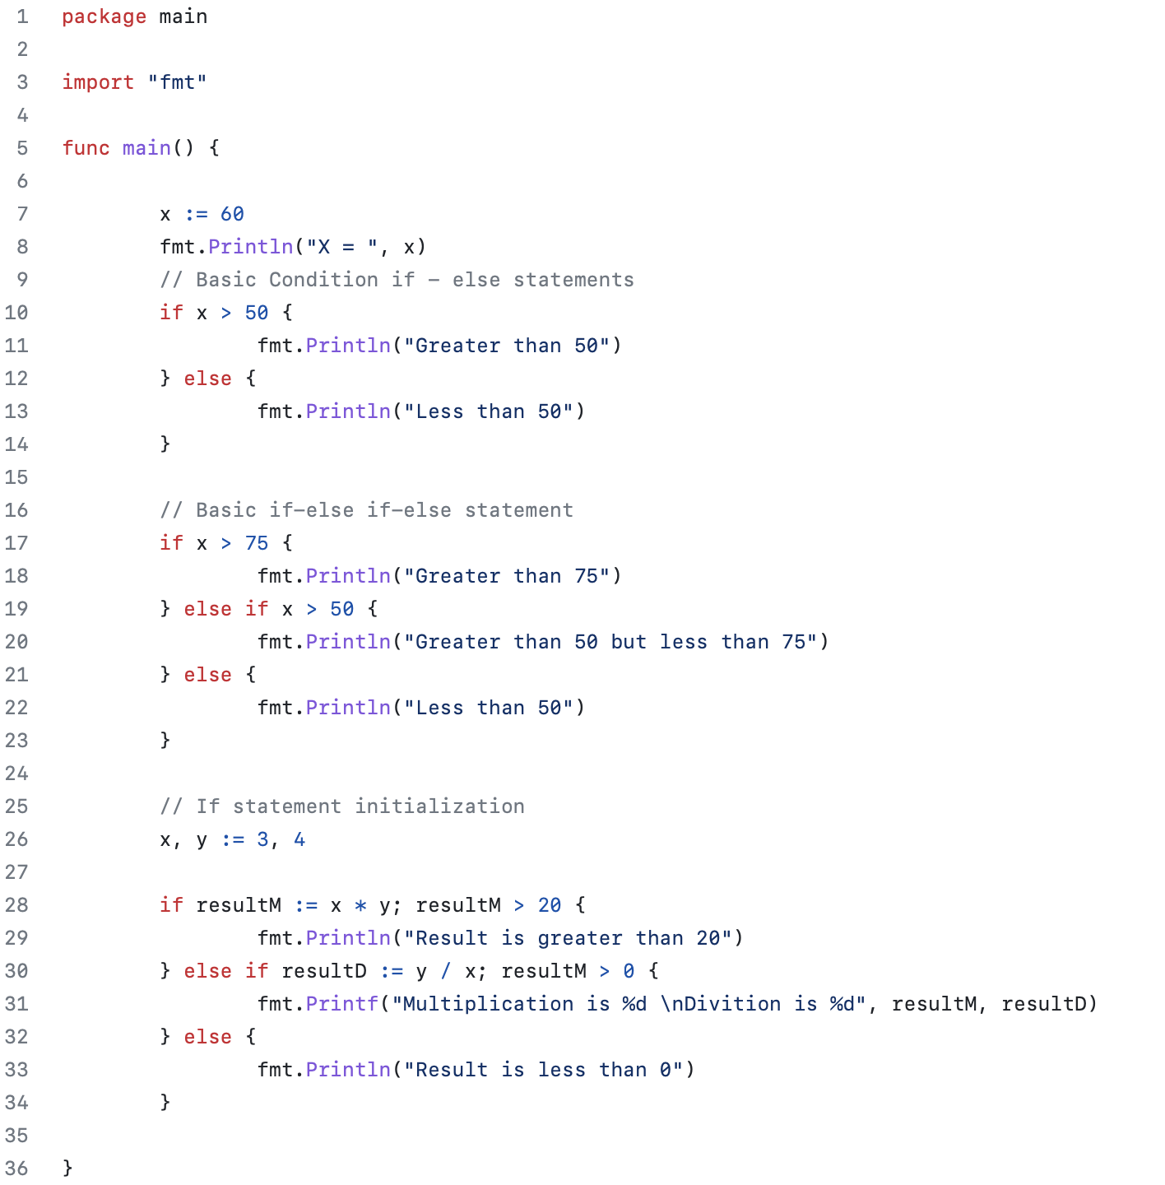
Conditions

Slide 19
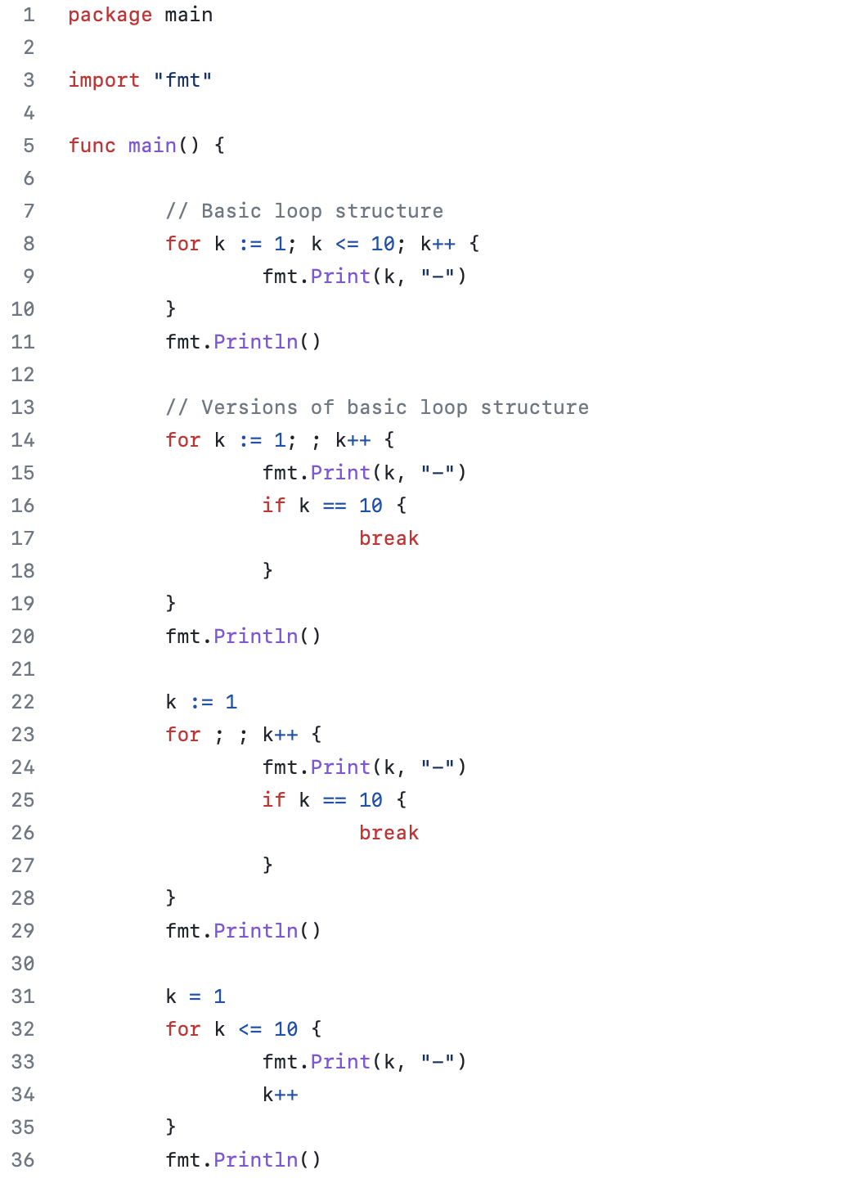
Loops

Slide 20
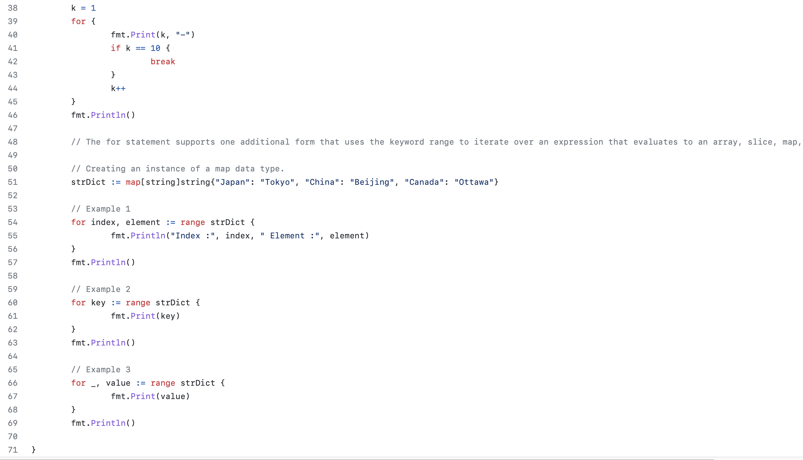

Slide 21
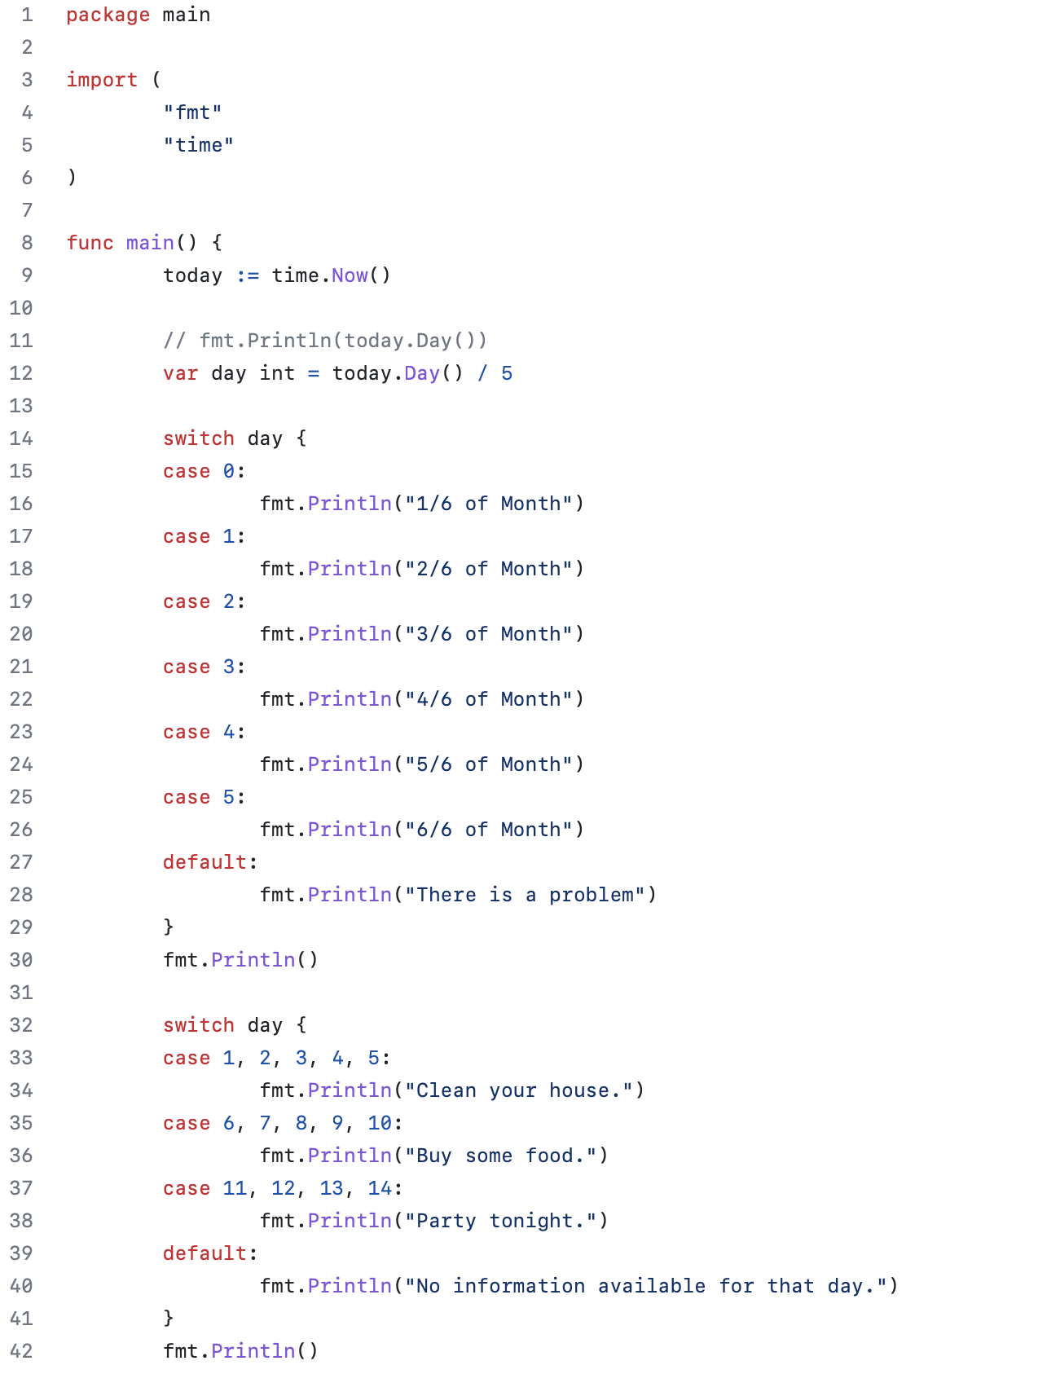
Switch Statement

Slide 22
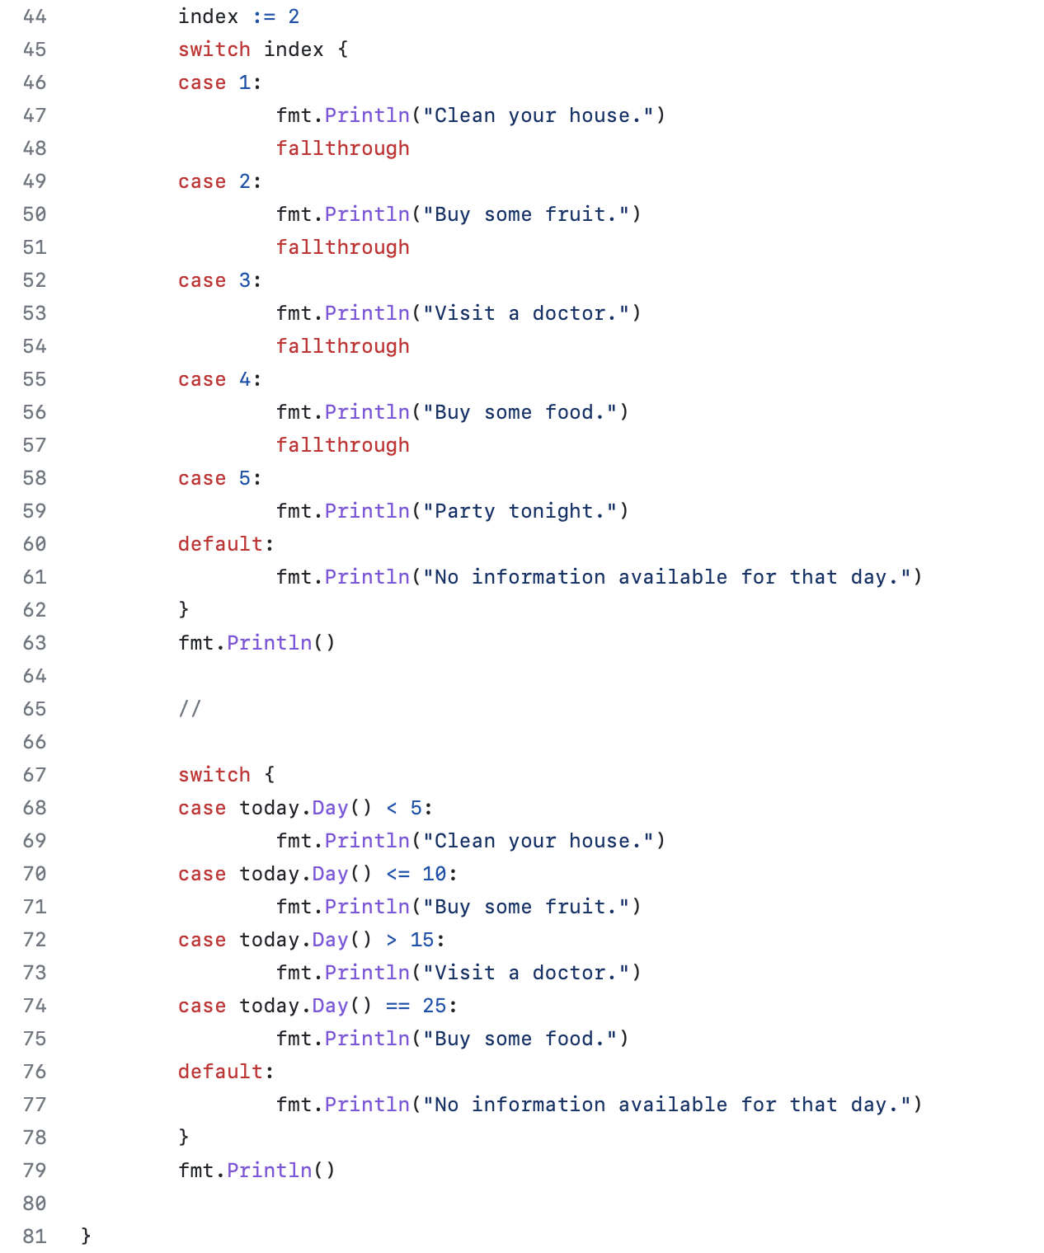

Slide 23

References
https://go.dev
https://www.freecodecamp.org/news/what-is-go-programming-language/
https://nexttechnology.io/the-most-popular-programming-languages-in-2023/
https://www.infoworld.com/article/3198928/whats-the-go-programming-language-really-good-for.html
https://www.youtube.com/watch?v=etSN4X_fCnM&list=PL4cUxeGkcC9gC88BEo9czgyS72A3doDeM
https://www.golangprograms.com/go-language/functions.html

