Slide 1

Contamination-Aware Network Experimentation
Mine Su Erturk
Joint work with Eray Turkel

Slide 2
Experiments on Networks
Multiple experimenters
No coordination/decentralized
Can contaminate other experiments
Examples
Facebook during performance review cycles
Airbnb promoting minorities while subsidizing some neighborhoods
Notes:
Network interference & spillovers in treatment effects.
Multiple experimenters – no coordination
Not enough days to schedule each experiment
How to run experiments while taking into account the potential contamination that can be caused on other experiments
10k thousand experiments every day not enough subgraphs – all partitions will have some overlap or not enough power
Contamination unavoidable – so control it as best as you can

Slide 3
Related Literature
Treatment effect spillovers: Aronow et al. (2017), Aronow and Samii (2013), Wager and Xu (2019), Ugander et al. (2013), Athey et al. (2018), Eckles et al. (2017)
Optimal policy learning with observational data: Athey and Wager (2020), Nie et al. (2020)
Online learning: Russo and Van Roy (2014), Russo and Van Roy (2016), Rusmevichientong and Tsitsiklis (2010)
Network Seeding: Akbarpour et al. (2018), Banerjee et al. (2019)
Notes:
Focus in this area is to come up with clever (cluster) randomization schemes that allows an experimenter to estimate direct and indirect treatment effects

Slide 4
Model

Slide 5


Experiment Setup
N units, {1, …, N}, connected on an undirected, unweighted graph G
Treatment assignment vector at period $t∈\{1, …, T\}$:

Slide 6

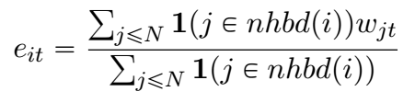
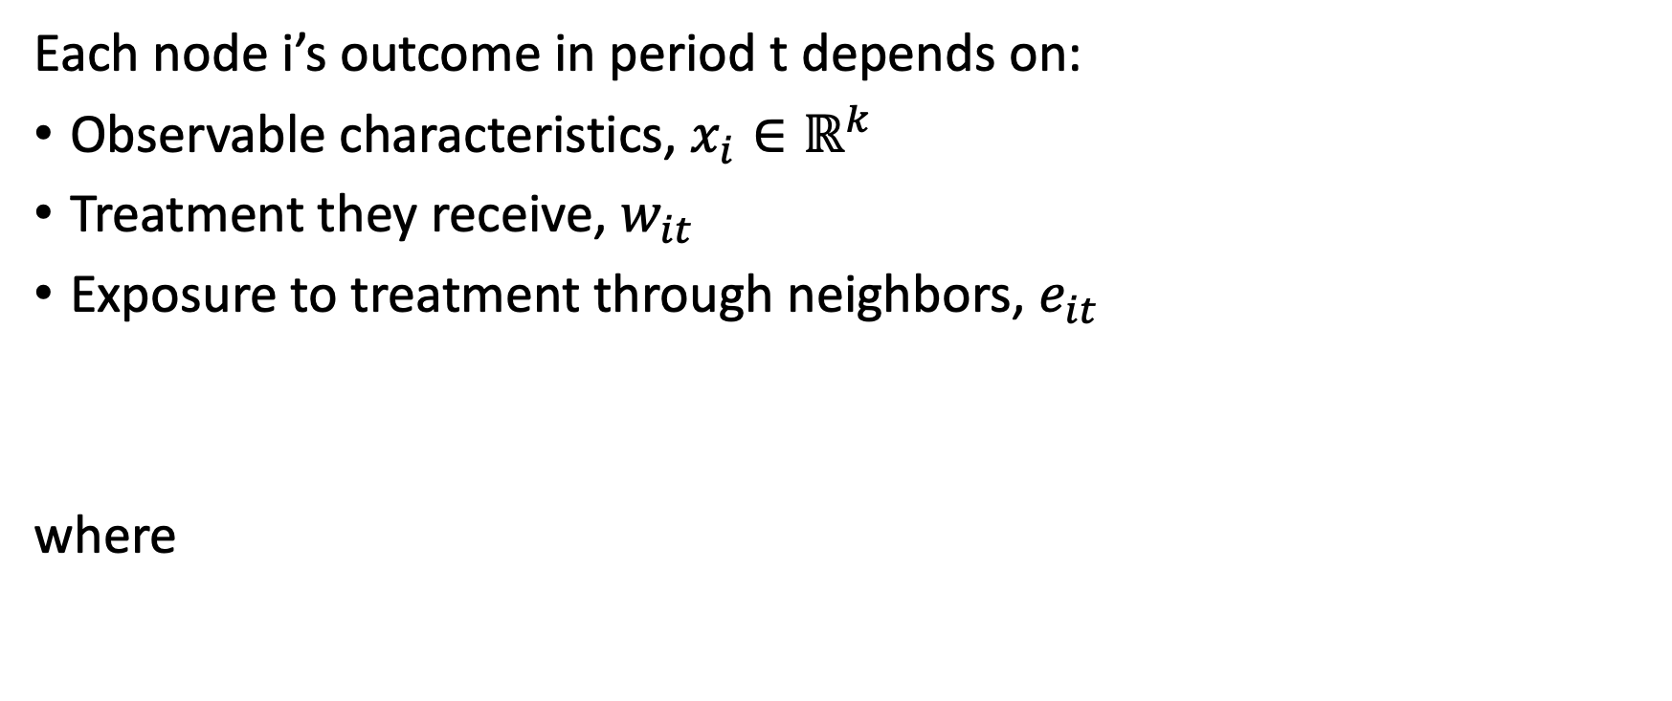
Experiment Setup
Each node i’s outcome in period t depends on:
Observable characteristics, $x_{i}∈ℝ^{k}$
Treatment they receive, $w_{it}$
Exposure to treatment through neighbors, $e_{it}$
where

Slide 7
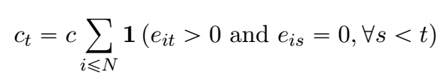
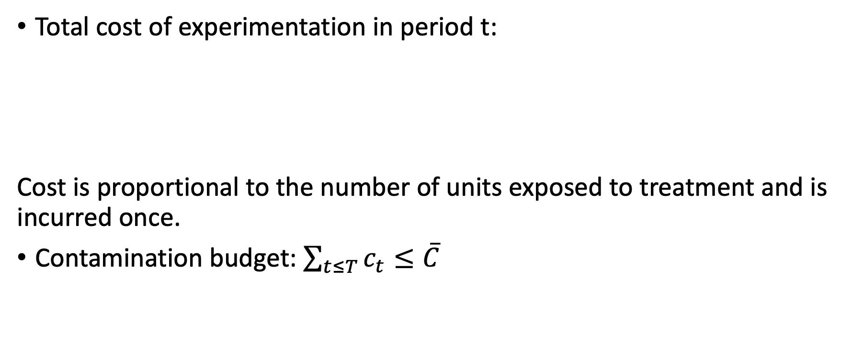
Contamination as a cost
Total cost of experimentation in period t:
Cost is proportional to the number of units exposed to treatment and is incurred once.
Contamination budget: $\sum_{t≤T}{c_{t}}≤\overline{C}$
Notes:
At every period $t$, the DM's experimentation creates a cost, because the experiment interacts with a previous experimenter's treatment allocation, contaminating their results. We assume that the cost is proportional to the number of units exposed to the treatment, and once a unit is exposed, future exposures of that unit do not increase the cost any further.

Slide 8
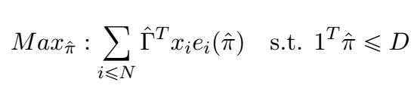
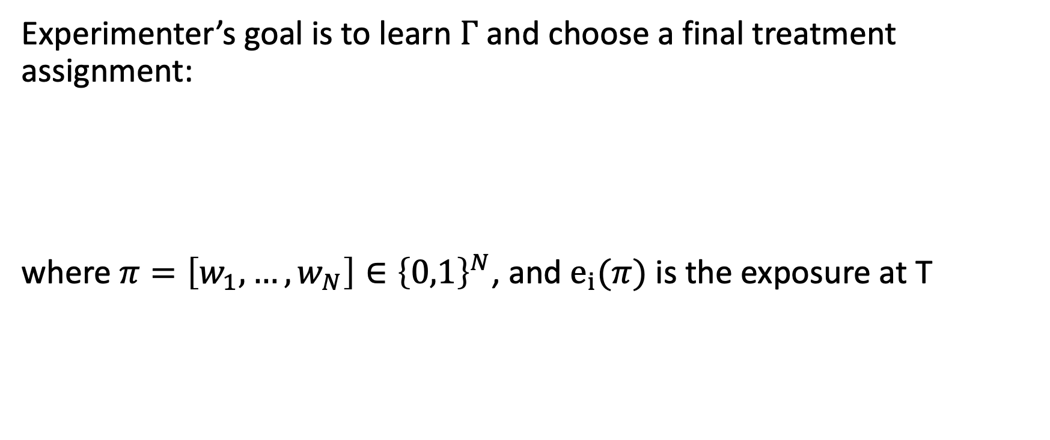
Final Deployment
Experimenter’s goal is to learn $Γ$ and choose a final treatment assignment:
where $π=\left[w_{1},…,w_{N}\right]∈{\left\{0,1\right\}}^{N}$, and $e_{i}(π)$ is the exposure at T
Notes:
Distance to oracle outcome’I minimize etmeye equivalent bu max problem
How contamination and performance here interact
How does network topology play a role

Slide 9
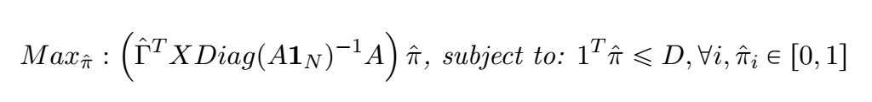

Final Deployment
Experimenter’s goal is to learn $Γ$ and choose a final treatment assignment:
where $π=\left[w_{1},…,w_{N}\right]∈{\left\{0,1\right\}}^{N}$

Slide 10
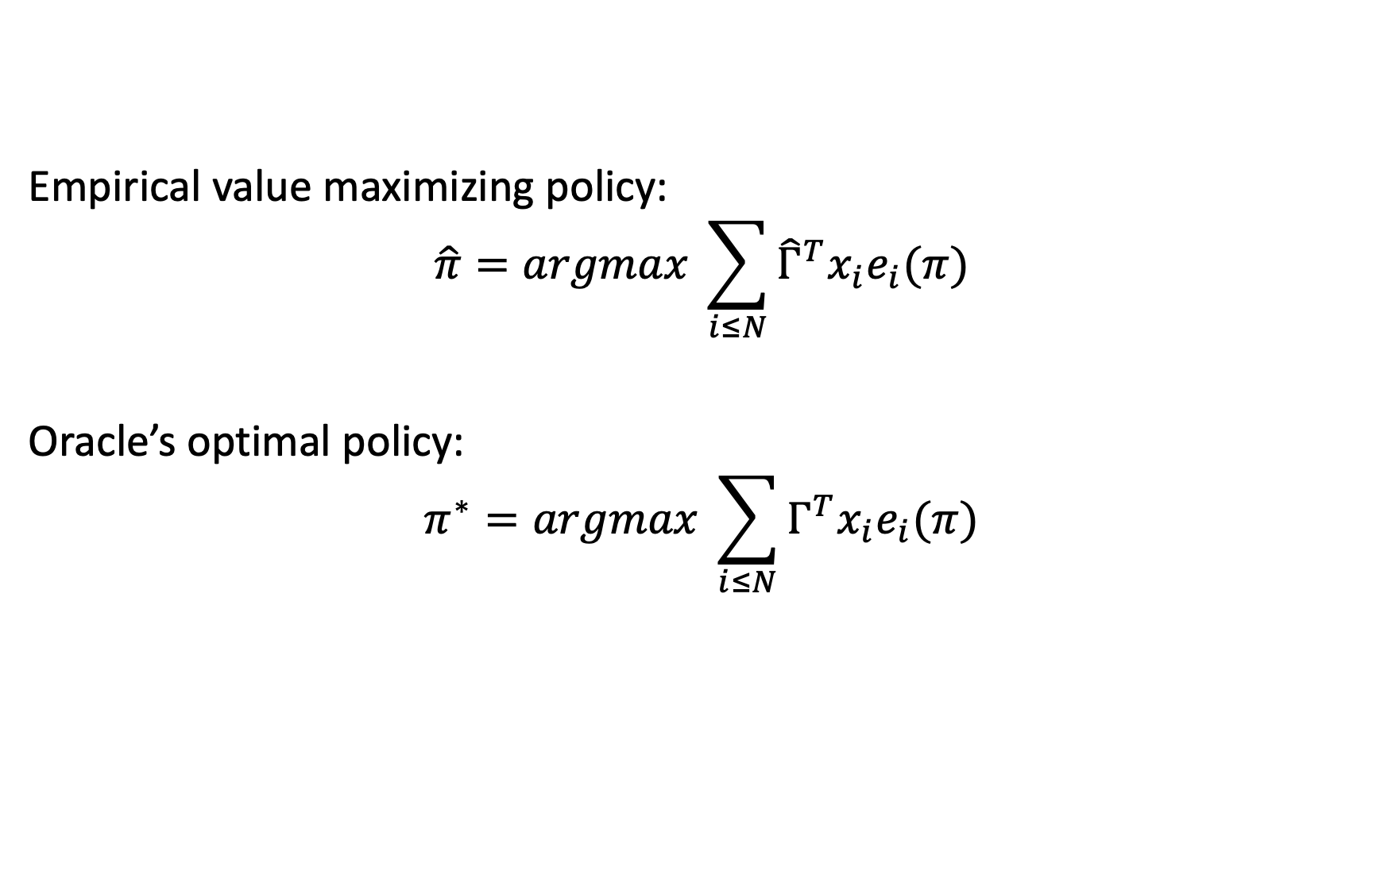
Regret Analysis
Empirical value maximizing policy:
$$\hat{π}=argmax \sum_{i≤N}{{\hat{Γ}}^{T}x_{i}e_{i}(π)}$$
Oracle’s optimal policy:
$$π^{∗}=argmax \sum_{i≤N}{Γ^{T}x_{i}e_{i}(π)}$$

Slide 11
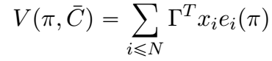


Regret Analysis
Value of policy $π$:
Regret of the empirical value maximizing policy$\hat{π}$:

Slide 12

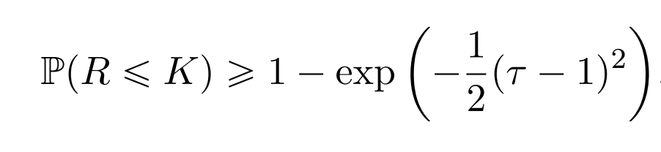
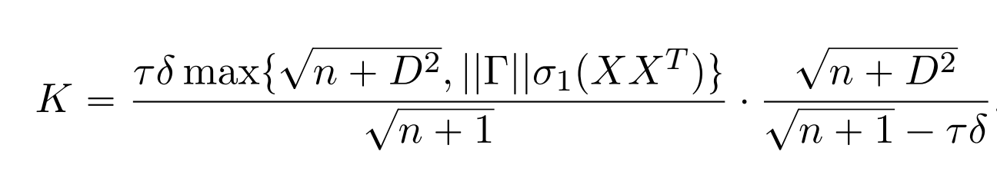
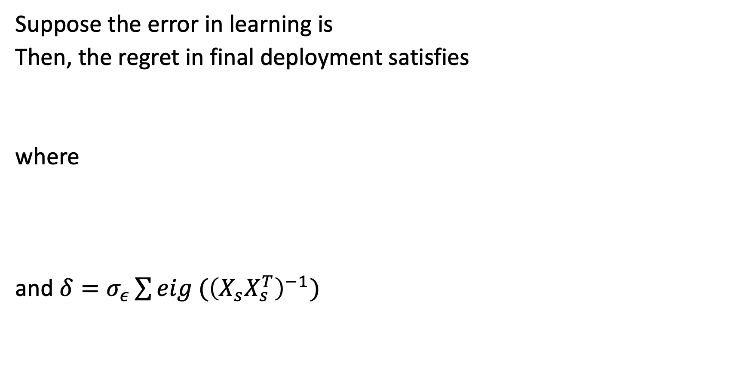
Regret Analysis
Suppose the error in learning is
Then, the regret in final deployment satisfies
where
and $δ=σ_{ε}\sum{eig ({\left(X_{s}X_{s}^{T}\right)}^{−1})}$
Notes:
Upper bound on regret decreases with contamination budget (as this increases, we learn better so sum of eigenvalues decreases. And K decreases
Regret increases with the complexity of the problem, meaning the first principla component of data plus the size of the treatment response covariate (norm of gamma)
D large = there is more to lose
Important to note that experimentation (and the policy there) can only impact delta
And in the regime where the graph is large, the upper bound depends only on delta
Analysis based on perturbation analysis of lp

Slide 13
Proposed Algorithm
Knapsack-based heuristic
In each period t, choose the node with highest value/cost ratio
Value = information gain from experimenting
Cost = number of newly contaminated nodes
Repeat until contamination budget is consumed.
Notes:
Information directed sampling idea

Slide 14
Simulations

Slide 15
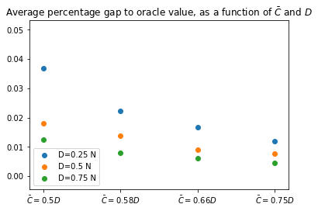
Notes:
Fix graph with 1000 vertices ER. 10 covariates for every node.
Very large graph
Even when 1/8 of graph can be contaminated, the gap is 4 % of oracle (96 vs 100)
As c increases and d increases it gets better

Slide 16
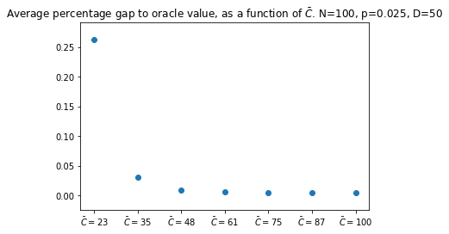
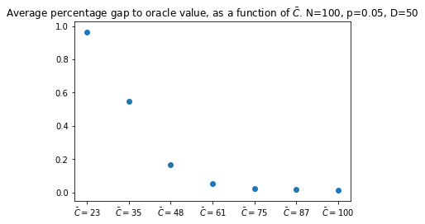
Notes:
Every dot is average of 1000 simulations. Graph and covariates changing.
Topology: sparse vs dense
Sparse is easier to learn on
Because paying less but still able to explore different areas of covariate space
Homophily in covariates could have changed the results

