Slide 1
A Weakly Supervised Graph-based System for Customer Review Categorization
Eray Yıldız
TERM PROJECT
for ITU BLG 614E - WEB MINING COURSE

Slide 2
MOTIVATION
Assigning aspect categories to customer reviews is an important problem
The providers want to monitor the opinion of their costumers with respect to a set of aspects such as price, service and quality
Supervised learning methods are mostly used for aspect categorization
Although supervised systems obtain good results for the domain they are trained on, they are almost useless when the domain or language has changed.
Annotating data for all domains and languages is not applicable.
The goal is to develop a semi-supervised system
which is able to automatically categorize customer reviews into aspect categories defined by the users.
which requires only a small amount of labeled reviews
Can Personalized PageRank Algorithm help?

Slide 3
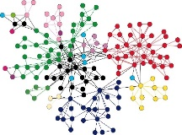
Proposed Method
Preprocess all reviews (e.g., tokenization and stemming)
Represent each review with a dense vector using doc2vec
Construct similarity graph using cosine similarity of review vectors
Apply Personalized PageRank (labeled reviews as starting nodes of random walks)
Unlabeled Review Corpus
Word Embeddings
Preprocessing
(Tokenization, stemming, etc.)
Represent reviews with dense vectors
Similarity Graph Generator
Review Similarity Graph
A few labeled reviews
Personilized PageRank
Labeled Review Corpus

Slide 4
Dataset used for evaluation
Turkish restaurant reviews dataset
Published in SemEval 2016 Task 5 [1]
Total number of reviews: 1228
Each review has multiple labels (multi-label classificaion task)
[1] Pontiki, Maria, et al. "SemEval-2016 task 5: Aspect based sentiment analysis." Proceedings of the 10th international workshop on semantic evaluation (SemEval-2016). 2016.

Slide 5
Dataset used for evaluation
Example reviews and labels from dataset
Review | Aspect categories
fiyatlar normal, servis cok yavaş, tuvaletler ise pis. | AMBIENCE/GENERAL SERVICE/GENERAL RESTAURANT/PRICES
bu servise bu fiyatlar ise cok fazla. | RESTAURANT/PRICES
1 kere denedigim fiyatlarinin yüksek yemeklerinin lezzetsiz oldugu bir mekan önermiyorum | RESTAURANT/PRICES FOOD/QUALITY
Duyduğum kadarıyla suda değil sütte bekletiyorlarmış | FOOD#STYLE OPTIONS
Sevmediğimden yiyemedim kenarlarını, ama ortası pek lezizdi | FOOD/QUALITY FOOD/STYLE OPTIONS

Slide 6
Preprocessing steps:
Tokenization
Lowercase all characters
Stop word removal
Non-word removal (punctuations and numbers)
Stemming
Asciification
fiyatlar normal, servis cok yavaş, tuvaletler ise pis.
fiyat normal servis yavas tuvalet pis

Slide 7
Learning vector representation of reviews
Distributed Representations of Documents (Doc2Vec) is used to obtain vector representation of reviews
Similar to word2vec except it also generates vector representations of documents in addition to word vectors
Doc2Vec model is trained on a large customer review dataset
1.2 million reviews are obtained by crawling sources such as eksisozluk, hepsiburada and sikayetvar
Restaurant reviews are also added into the dataset
Distributed Representations of Documents[1]
(a.k.a Doc2Vec)
Classifier
yavas
Concatanate
Dense
vectors
R
W
W
W
review id
fiyat
normal
servis
fiyat normal servis yavas
[2] Le, Quoc, and Tomas Mikolov. "Distributed representations of sentences and documents." International Conference on Machine Learning. 2014.

Slide 8
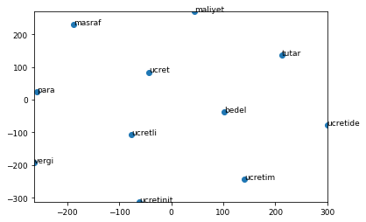
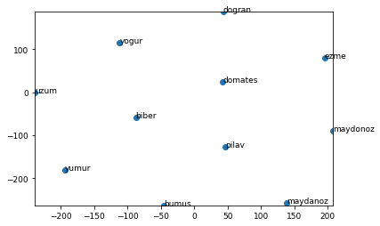
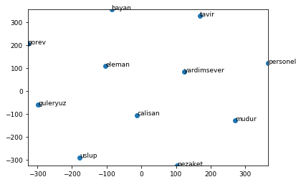
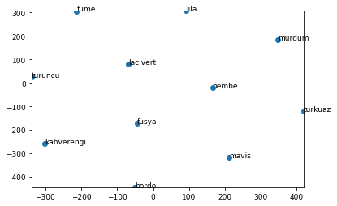
Learning vector representation of reviews
Some Word Vectors in two dimensional space
(dimension reduction is performed by TSNE algorithm)
ücret
maydanoz
personel
turkuaz

Slide 9
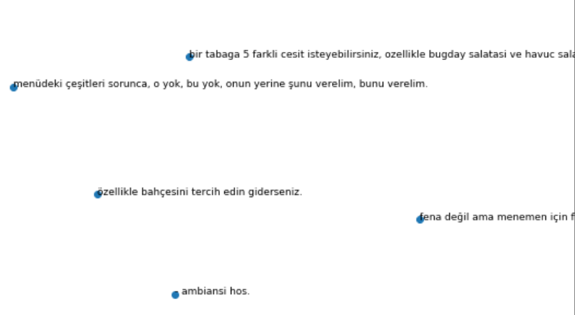
Learning vector representation of reviews
Some review vectors in two dimensional space
(dimension reduction is performed by TSNE algorithm)

Slide 10
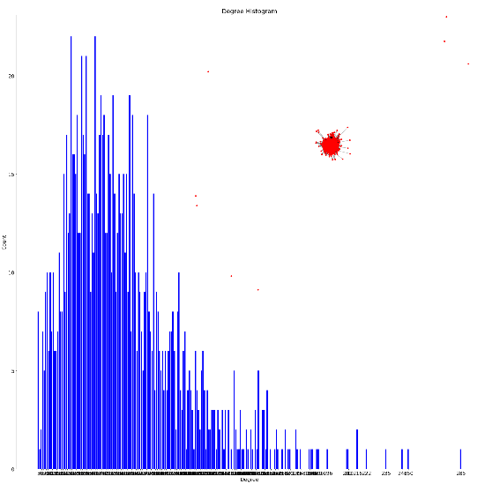
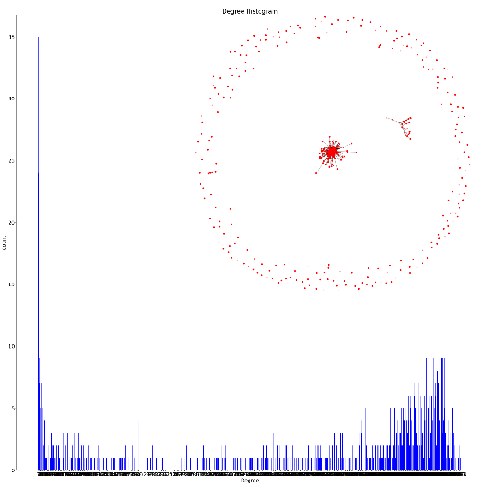
Construction of Similarity Graphs
Calculate cosine simalarity between each review pair using vector representations
Both for Doc2Vec and TF-IDF vectors
Degree distribution of TF-IDF similartiy graph
Threshold: 0.1
Average degree count = 59
Nodes without connection = 8
Degree distribution of DOC2VEC similartiy graph
Threshold: 0.7
Average degree count = 498
Nodes without connection = 226

Slide 11
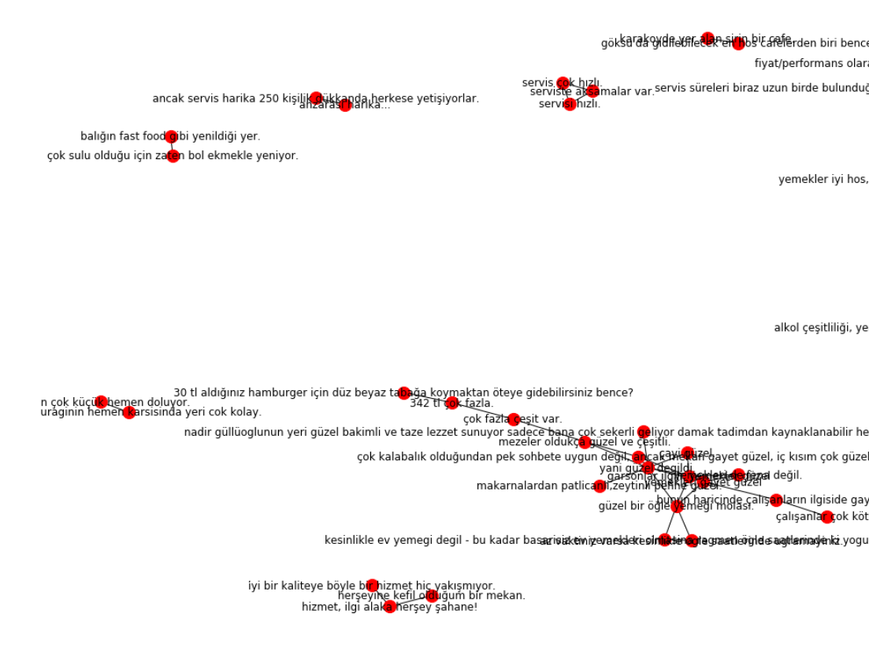
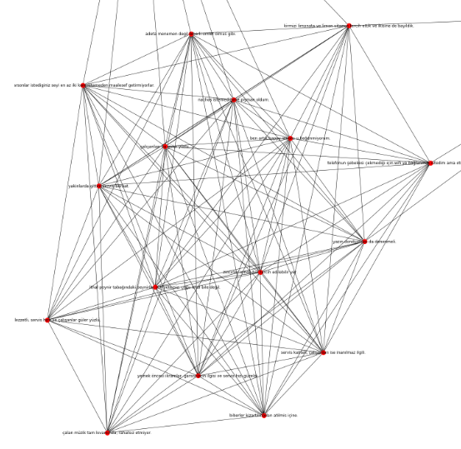
Construction of Similarity Graphs
A subgraph of TF-IDF similarity graph
A subgraph of Doc2Vec similarity graph

Slide 12
Personalized PageRank for Multi-label Categorization
Personalized PageRank (PPR) is modified version of PageRank
Except jumps are back to one of a given set of starting vertices.
with probability α, follow a random edge
with probability 1- α restart at a seed
Idea: (PPR for multi-label categorization)
For each label in the dataset:
Use labeled reviews as seeds for PPR
Apply a threshold to PPR scores of the nodes

Slide 13
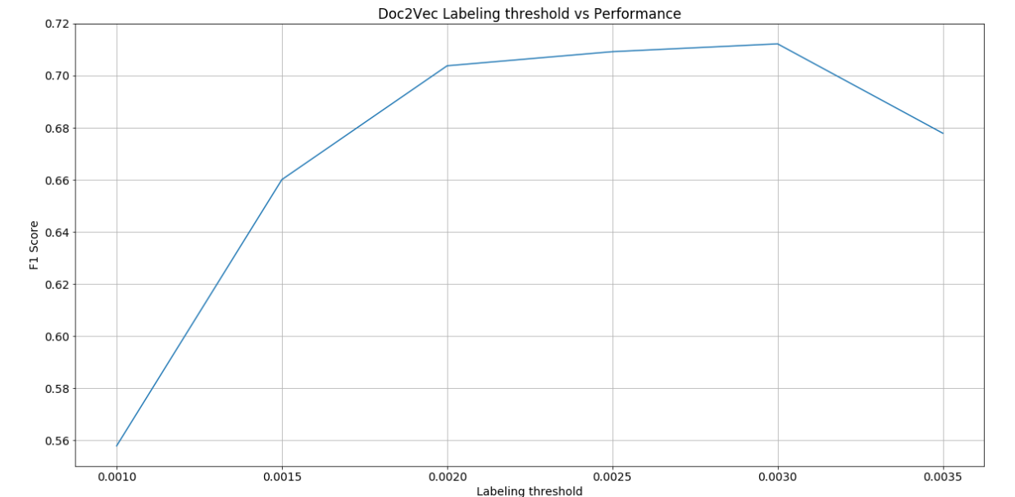
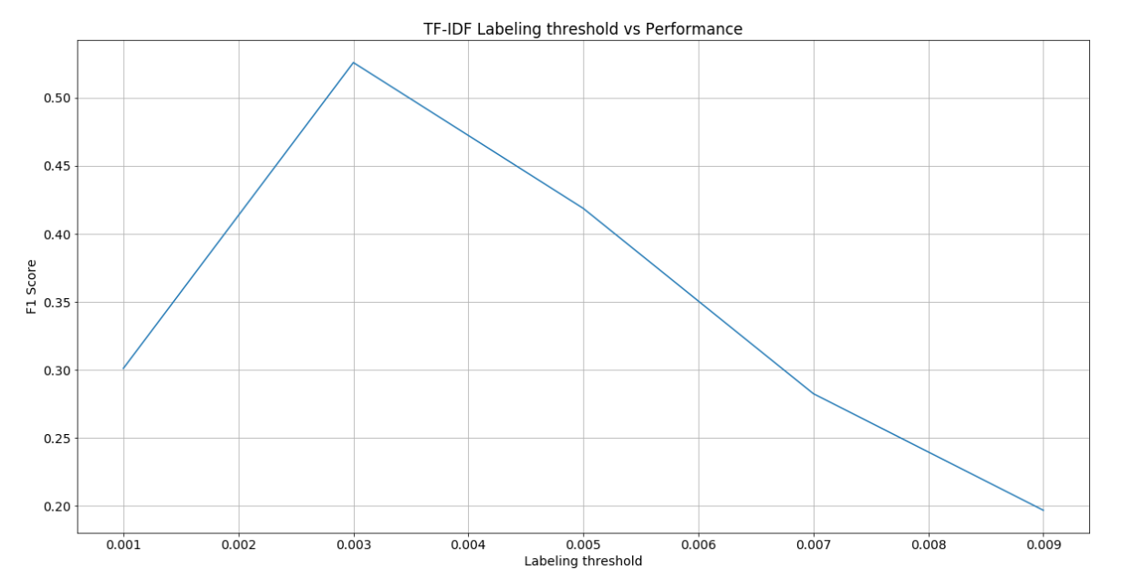
PPR for Multi-label Categorization Threshold optimization
The experiments are performed on Turkish restaurant reviews dataset.
50 labeled reviews are used as seeds for PPR for each label
Totally 600,
50% of the dataset
According to the results: Best threshold for both TF-IDF and Doc2VEc is 0.003

Slide 14
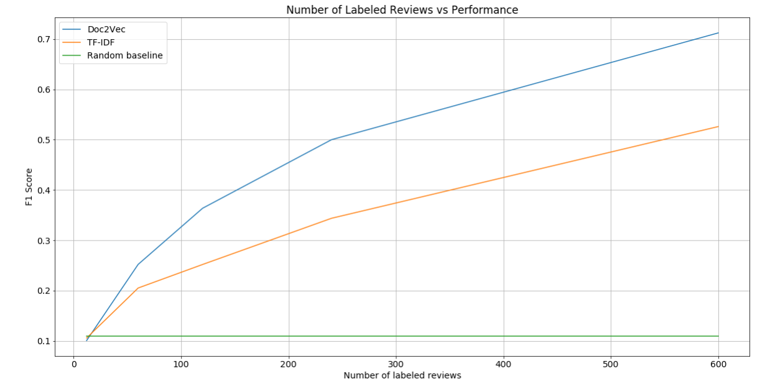
Experimental Results

Slide 15
Experimental Results
Method | # of labeled reviews | Average F1 Score
Random baseline | 0 | 0.11
LSTM + Logistic Regression[3] | 1.1K (90%) | 0.61
TF-IDF + PPR | 12 (1%) | 0.1
 | 60 (5%) | 0.2
 | 240 (20%) | 0.34
 | 600 (50%) | 0.52
Doc2Vec + PPR | 12 (1%) | 0.1
 | 120 (10%) | 0.25
 | 240 (20%) | 0.5
 | 600 (50%) | 0.71
[3] Tamchyna, Aleš, and Kateřina Veselovská. "Ufal at semeval-2016 task 5: recurrent neural networks for sentence classification." Proceedings of the 10th International Workshop on Semantic Evaluation (SemEval-2016). 201

Slide 16
Conclusion
With proposed method (Doc2Vec similarity graph + PPR)
High accuracies are possible wtih smaller number of labeled reviews
Nodes without connection decreases the performance:
226 unconnected nodes in Doc2Vec similarity graph leads to low recall values
Average Precision: 0.98,
Average Recall:0.64,
AverageF1: 0.71
The proposed system is easily extendible. Experiments should be performed on other languages and domains

Slide 17
References
[1] Pontiki, Maria, et al. "SemEval-2016 task 5: Aspect based sentiment analysis." Proceedings of the 10th international workshop on semantic evaluation (SemEval-2016). 2016.
[2] Le, Quoc, and Tomas Mikolov. "Distributed representations of sentences and documents." International Conference on Machine Learning. 2014.
[3] Tamchyna, Aleš, and Kateřina Veselovská. "Ufal at semeval-2016 task 5: recurrent neural networks for sentence classification." Proceedings of the 10th International Workshop on Semantic Evaluation (SemEval-2016). 201
[4] Shayan A Tabrizi, Azadeh Shakery, Masoud Asadpour, Maziar Abbasi, and Mohammad Ali Tavallaie. Personalized pagerank clustering: A graph clustering algorithm based on random walks. Physica A: Statistical Mechanics and its Applications, 392(22):5772–5785, 2013.

