Slide 1
GPU Instancing & Draw Call Optimization in Unity
CMPE 485 Term Project
Option A (Single Challenge)
Eray Yüklü
Measuring how draw-call batching strategies hold up as object count and mesh complexity grow on Apple Silicon Metal.

Slide 2

Why Batching Matters
Every draw call is a CPU cost. Modern scenes can issue thousands per frame.
CPU-bound rendering caps frame rate long before the GPU is saturated.
Unity exposes two main remedies: GPU Instancing and Static Batching.
Each carries different cost, memory, and flexibility trade-offs.
This project quantifies those trade-offs on a real Unity build.
Foundational reference: Pranckevičius, A. (2015). “Rendering Optimisation in Unity.”
ERAY YÜKLÜ

Slide 3
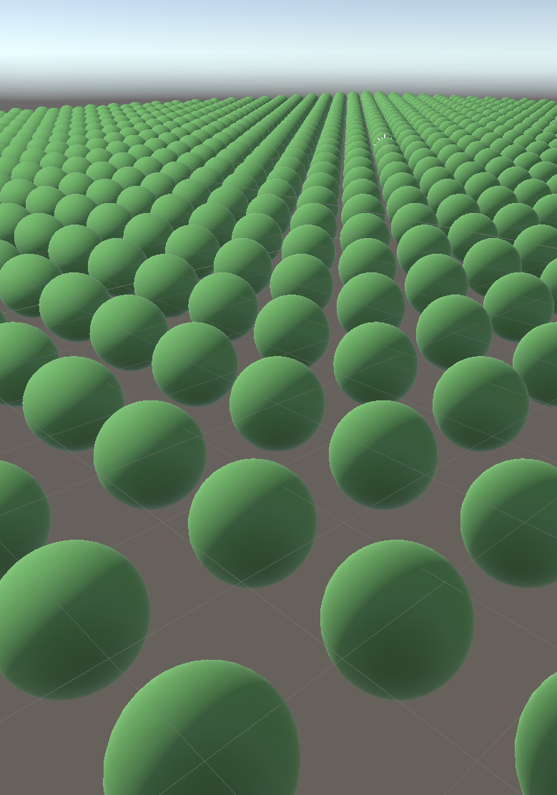
Experiment Design
A controlled 3 × 3 × 5 sweep, repeated 3×
Rendering mode: Baseline | GPU Instancing | Static Batching
Mesh complexity: Low-poly (112 tris) | Mid-poly (1,740) | High-poly (19,800)
Object count N: 100, 500, 1 000, 5 000, 10 000
Per cell: 3 repeats with mean ± 1σ reporting → 135 configurations
Recorded: FPS, wall-clock + GPU frame time, draw call batches, reserved memory
ERAY YÜKLÜ

Slide 4
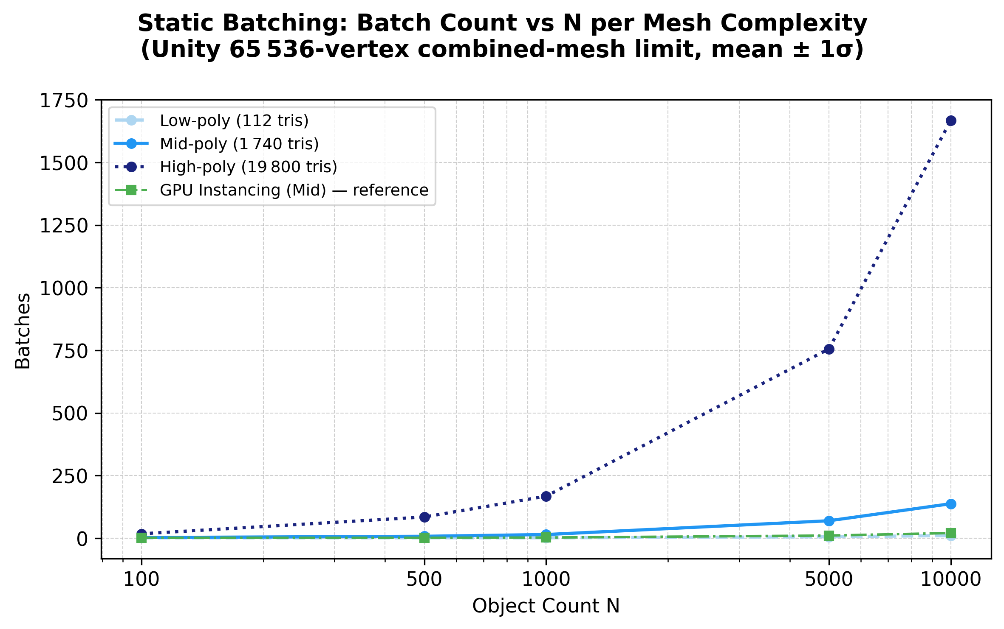
CPU Draw-Call Submission → GPU Vertex Throughput
Static Batching breaks down
Unity caps each combined mesh at 65,536 vertices
High-poly (19,800 tris ≈ 10,000 verts): only ~6 objects fit per batch
Result: batch count grows linearly with N at high-poly
N=10,000 → 1,668 batches (vs. 21 with GPU Instancing)
Combined mesh also balloons reserved memory to 6.2 GB
GPU Instancing has no such cap — stays at ~21 batches regardless of mesh complexity
Static-batch count vs N — note vertex-cap cliff
ERAY YÜKLÜ

Slide 5
Methodology & Metrics
ERAY YÜKLÜ
Variables
- Object count N ∈ {100, 500, 1000, 5000, 10000}
- Mesh complexity: Low (112), Mid (1 740), High (19 800 tris)
- Mode: Baseline, GPU Instancing, Static Batching (3×5×3 = 45 cells × 3 repeats)
Metrics Captured
- FPS & frame time : wall-clock vs. GPU (FrameTimingManager)
Draw-call batches : Unity ProfilerRecorder (Batches Count); theoretical formula substituted when Metal returns 0
- Total reserved memory: Profiler.GetTotalReservedMemoryLong()
- Per cell: 3 s warm-up discarded, then 30 s measurement window (×3 repeats = 135 windows)
Cross-validated against Unity Editor Profiler — harness agrees within 0.5 ms across CPU- and GPU-bound regimes.

Slide 6
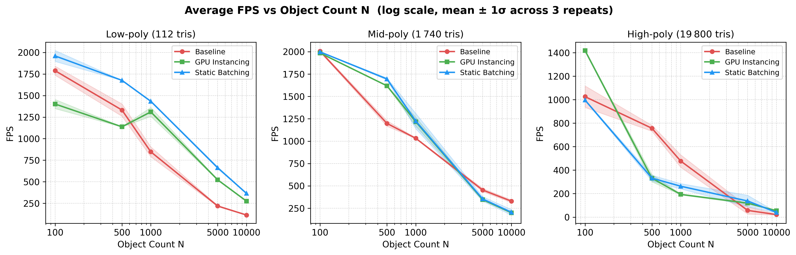
Result: GPU Instancing Wins at Scale
At N=10000 high-poly: Baseline 21 FPS → GPU Instancing 55 FPS (2.6×). Static Batching: 40 FPS (1.9×).
ERAY YÜKLÜ

Slide 7
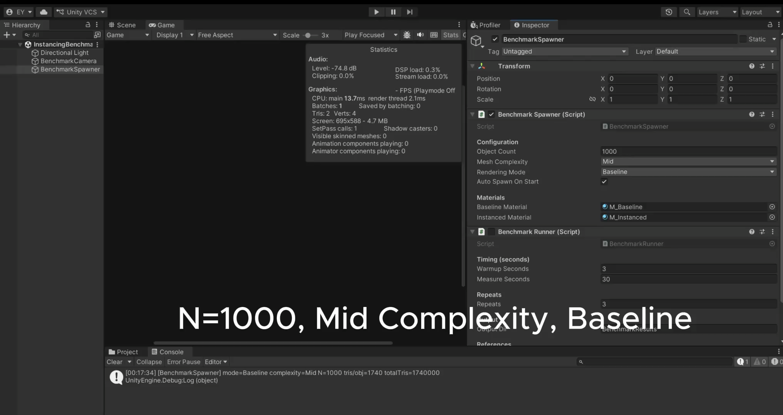
Demo VIDEO: GPU Instancing in Action
Video Link: https://drive.google.com/file/d/1BxELsNZe8aG59iXXfvFj2ZmJgLVN-Sej/view?usp=sharing
ERAY YÜKLÜ

Slide 8

Conclusions & Takeaways
GPU Instancing scales best. Constant batch count (≤21) regardless of N; 2.6× FPS gain at N=10,000 high-poly.
Static Batching has hidden costs. 6.2 GB memory at high-poly; vertex cap forces re-batching as mesh size grows.
Bottleneck shifts with mesh complexity. Low/Mid-poly: CPU-bound (batching wins). High-poly: GPU-bound (batching gains plateau).
Recommendation: Default to GPU Instancing for repeated meshes; reserve Static Batching for small, light scenes.
Future work. Extend to URP / HDRP + SRP Batcher; add frustum-culling exercise; cross-platform comparison (D3D11, Vulkan).
ERAY YÜKLÜ

