Slide 1
Female Labor Force Participation Rate vs GDP
Eric Boyda

Slide 2
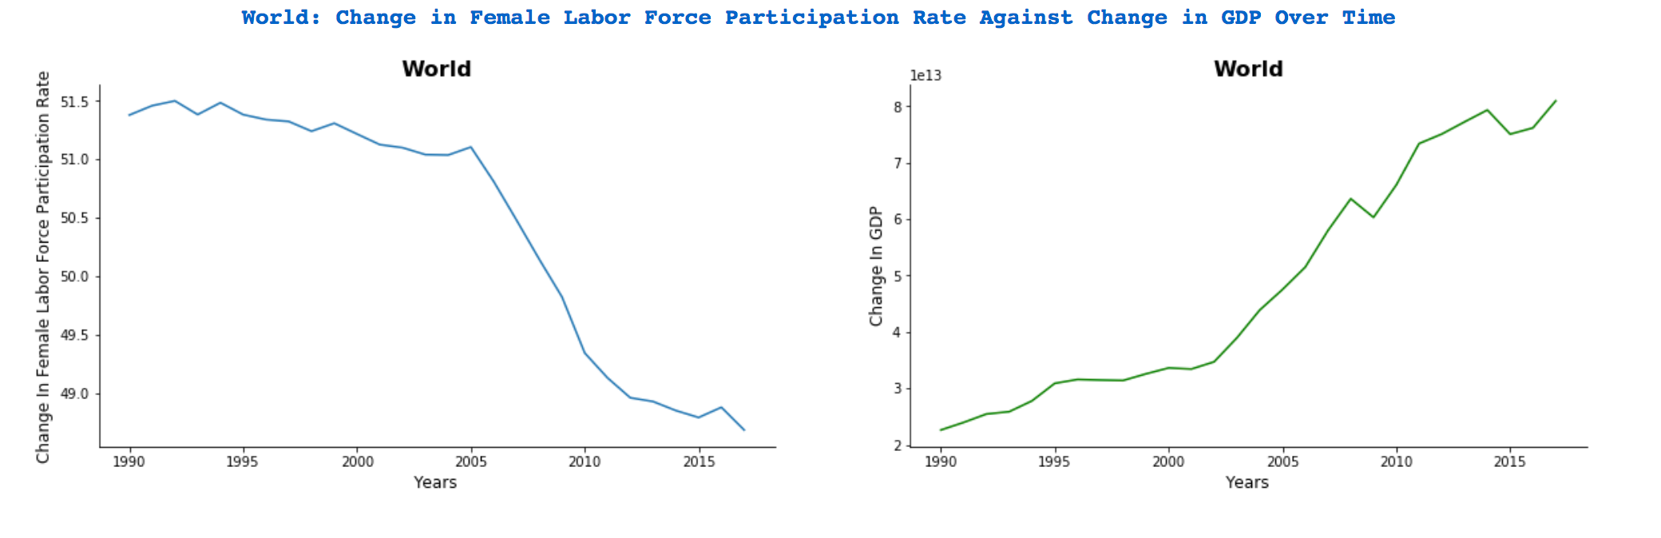
World Figures

Slide 3
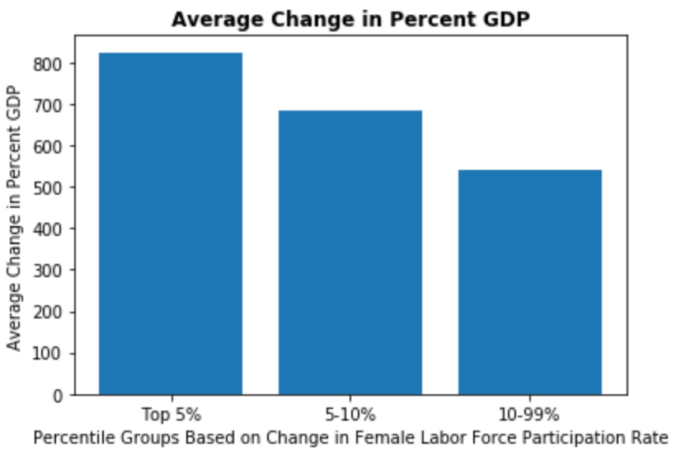
Association exists
Countries with the highest rate of increase in FLFPR experienced the highest rate of % GDP increase

Slide 4
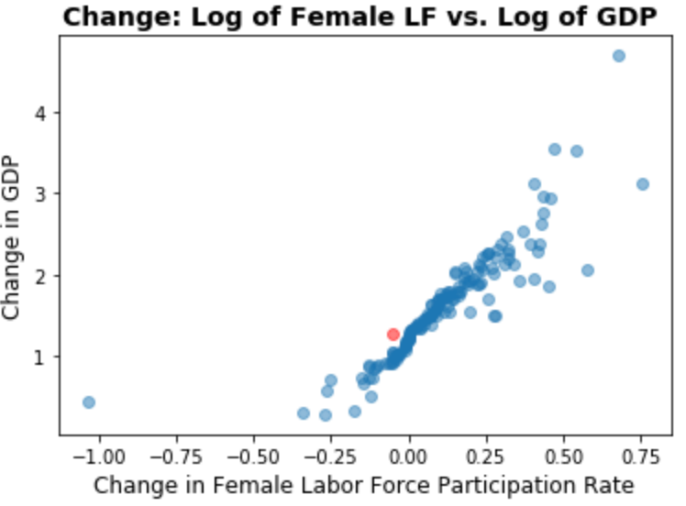
Association: Proven

Slide 5
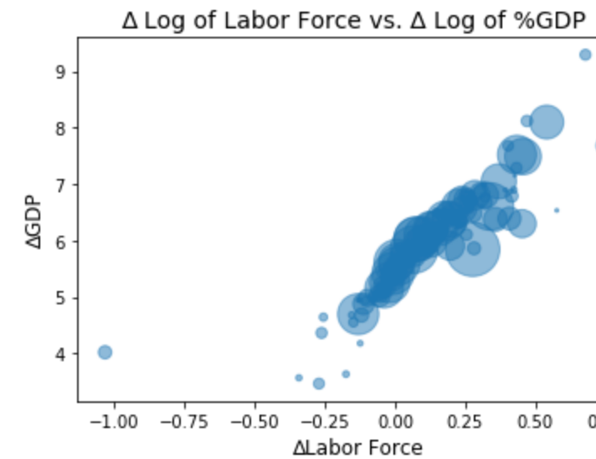
Association: Proven

