Slide 1



PhotoShareShare
Photo-Sharing Paradise for all Photo-taking Lovers

Slide 2
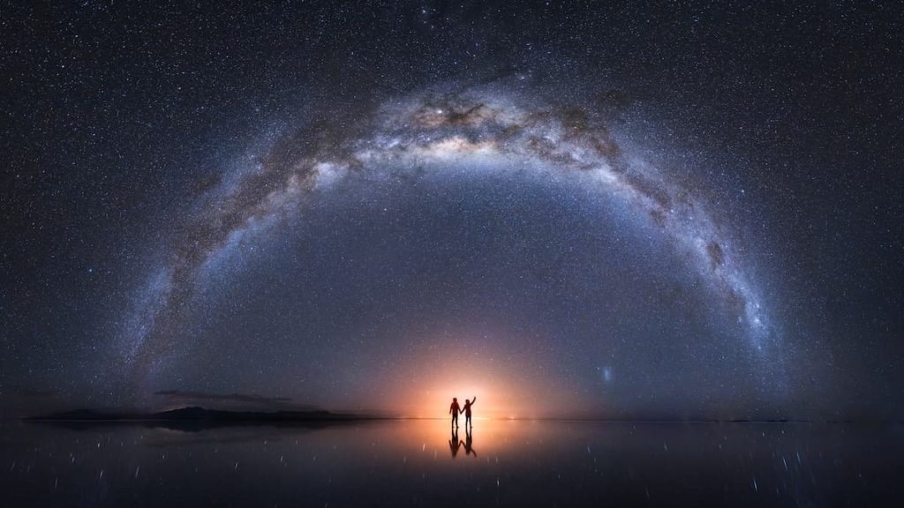
Introduction
Many astonishing photos are not taken in single shot. RHS is taken by famous photographer in Hong Kong – Kelvin Yuen. Per his description, it is composed from 18 pictures
Not easy for others to know how to take it, except having look of those raw photos
Our site provides an all-in-one interface to show both raw and final photo in one screen
Copyright @ Kelvin Yuen

Slide 3
System Overview
Characteristic of PhotoShareShare: -
Easy-to-use
Zero administration
Run on open source platform – Free of charge
Suitable for small group photo-sharing use

Slide 4
System Overview
Login / Sign-up
User Profile Management
Album Maintenance
Photo Viewing
Photo Owner
Photo Viewer
Like Photo Response

Slide 5
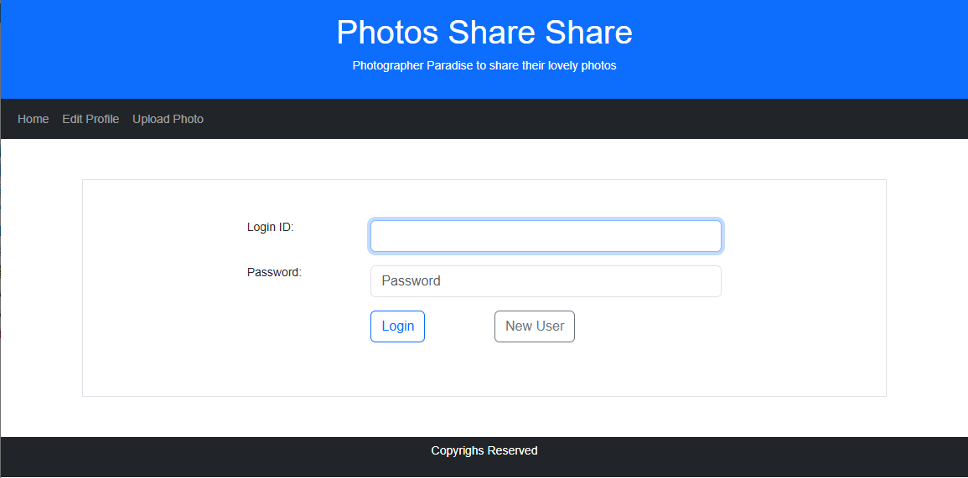
System Log-in

Slide 6
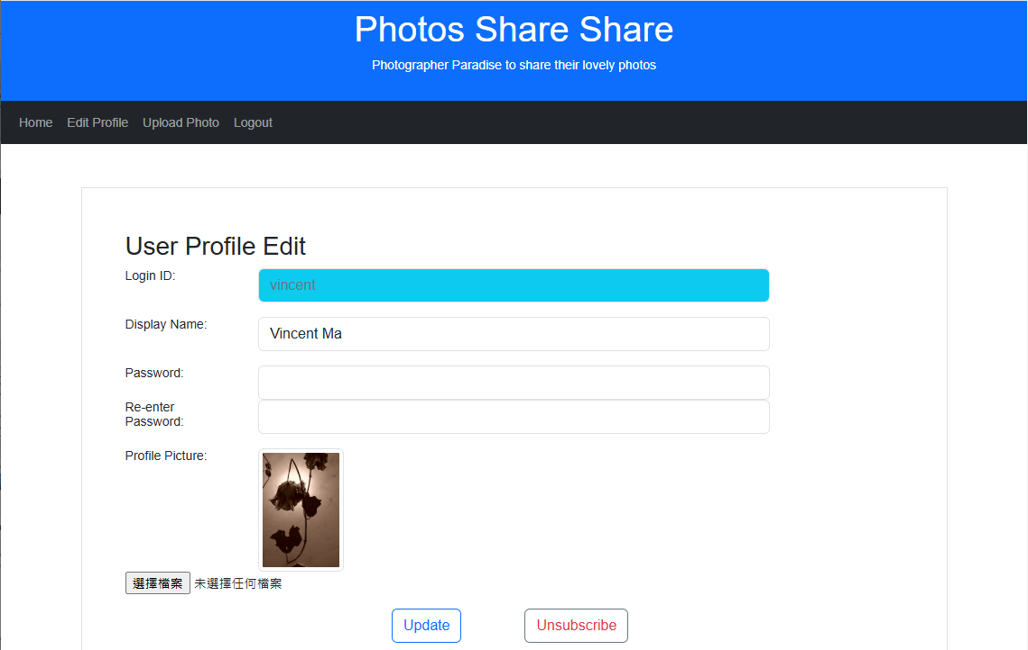
User Profile Edit

