Slide 1
Two phase commit

Slide 2
Failures in a distributed system
Consistency requires agreement among multiple servers
  Is transaction X committed?
  Have all servers applied update X to a replica?
Achieving agreement w/ failures is hard
  Impossible to distinguish host vs. network failures
This class:
  all-or-nothing atomicity in distributed systems

Slide 3
Example
Transfer $1000
  From A:$3000
  To B:$2000
client
Bank A
Bank B
Clients want all-or-nothing transactions
  Transfer either happens or not at all

Slide 4
Strawman solution
Transfer $1000
  From A:$3000
  To B:$2000
Transaction
coordinator
client
Bank A
Bank B

Slide 5
Strawman solution
client
transaction
coordinator
bank A
bank B
start
A=A-1000
done
B=B+1000
What can go wrong?
  A does not have enough money
  B’s account no longer exists
  B has crashed
  Coordinator crashes

Slide 6
Reasoning about correctness
TC, A, B each has a notion of committing
Correctness:
  If one commits, no one aborts
  If one aborts, no one commits
Performance:
  If no failures, A and B can commit, then commit
  If failures happen, find out outcome soon

Slide 7
Correctness first
client
transaction
coordinator
bank A
bank B
start
prepare
prepare
rA
rB
outcome
result
outcome
If rA==yes && rB==yes
outcome = “commit”
else
outcome = “abort”
B commits upon
receiving “commit”

Slide 8
Performance Issues
What about timeouts?
  TC times out waiting for A’s response
  A times out waiting for TC’s outcome message
What about reboots?
  How does a participant clean up?

Slide 9
Handling timeout on A/B
TC times out waiting for A (or B)’s “yes/no” response
Can TC unilaterally decide to commit?
Can TC unilaterally decide to abort?

Slide 10
Handling timeout on TC
If B responded with “no” …
  Can it unilaterally abort?
If B responded with “yes” …
  Can it unilaterally abort?
  Can it unilaterally commit?

Slide 11
Possible termination protocol
Execute termination protocol if B times out on TC and has voted “yes”
B sends “status” message to A
  If A has received “commit”/”abort” from TC …
  If A has not responded to TC, …
  If A has responded with “no”, …
  If A has responded with “yes”, …
Resolves most failure cases except
sometimes when TC fails

Slide 12
Handling crash and reboot
Nodes cannot back out if commit is decided
TC crashes just after deciding “commit”
  Cannot forget about its decision after reboot
A/B crashes after sending “yes”
  Cannot forget about their response after reboot

Slide 13
Handling crash and reboot
All nodes must log protocol progress
What and when does TC log to disk?
What and when does A/B log to disk?

Slide 14
Recovery upon reboot
If TC finds no “commit” on disk, abort
If TC finds “commit”, commit
If A/B finds no “yes” on disk, abort
If A/B finds “yes”, run termination protocol to decide

Slide 15
Summary: two-phase commit
All nodes that decide reach the same decision
No commit unless everyone says "yes".
No failures and all "yes", then commit.
If failures, then repair, wait long enough for recovery, then some decision.

Slide 16
A Case study of 2P commit in real systems
Sinfonia (SOSP’07)

Slide 17
What problem is Sinfonia addressing?
Targeted uses
  systems or infrastructural apps within a data center
Sinfonia: a shared data service
  Span multiple nodes
  Replicated with consistency guarantees
Goal: reduce development efforts for system programmers

Slide 18
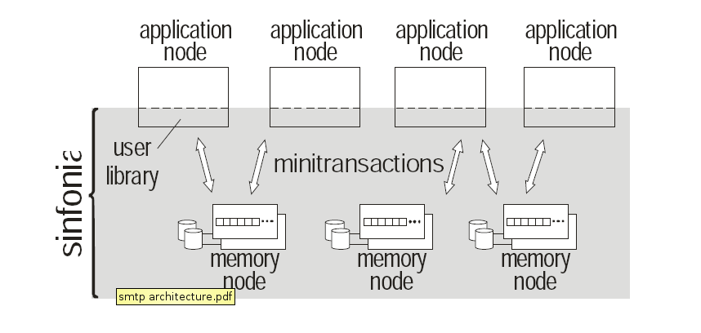
Sinfonia architecture
Each memory node provides a shared
address space with name (node-id, address)

Slide 19
Sinfonia mini-transactions
Provide all-or-nothing atomic operations
  as well as before-after atomicity (using locks)
Trade off expressiveness for efficiency
  fewer network roundtrips to execute
  Less flexible, general-purpose than traditional transactions
Result
  a lightweight, short-lived type of transaction
  over unstructured data

Slide 20
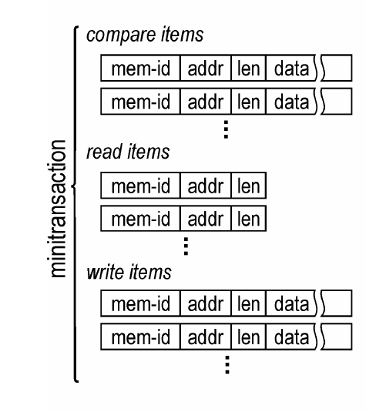
Mini-transaction details
Mini-transaction
  Check compare items
  If match, retrieve data in read items, modify data in write items
Example:
t = new Minitransaction()
t->cmp(node-X:0x000, 4, 3000)
t->cmp(node-Y:0x100, 4, 2000
t->write(node-X:0x000, 4, 2000)
t->write(node-Y:0x100, 4, 3000)
Status = t->exec_and_commit()

Slide 21
Sinfonia uses 2P commit
Traditional transactions:
general but expensive
BEGIN tx
If (a > 0 && b== 0)
b = a * a
for (i = 0; i < a; i++)
b += i
END tx
coordinator
coordinator
action1
action2
actions…
Mini-transaction:
less general but efficient
BEGIN tx
If (a == 3000 && b==2000)
{
a=2000
b=3000
}
END tx
Prepare & exec
prepare
commit
commit
Traditional
transactions
Mini-
transactions

Slide 22
Potential uses of mini-transactions
1. atomic swap operation
2. atomic read of many data
3. try to acquire a lease
4. try to acquire multiple leases atomically
5. change data if lease is held
6. validate cache then change data

Slide 23
Sinfonia’s 2P protocol
Transaction coordinator is at application node instead of memory node
  Saves one RTT
Problems: crashed TC blocks transaction progress
  App nodes are less reliable than memory nodes

Slide 24
Sinfonia’s 2P protocol
TC keeps no log
A transaction is committed iff all participants have “yes” in their logs
Recovery coordinator cleans up
  Ask all participants for existing vote (or vote “no” if not voted yet)
  Commit iff all vote “yes”
Transaction blocks if a memory node crashes
  Must wait for memory node to recovery from disk

Slide 25
Sinfonia applications
SinfoniaFS
  hosts share the same set of files, files stored in Sinfonia
  scalable: performance improves with more memory nodes
  fault tolerant
SinfoniaFS exports a NFS interface
  Each NFS op corresponds to 1 mini-transaction

Slide 26
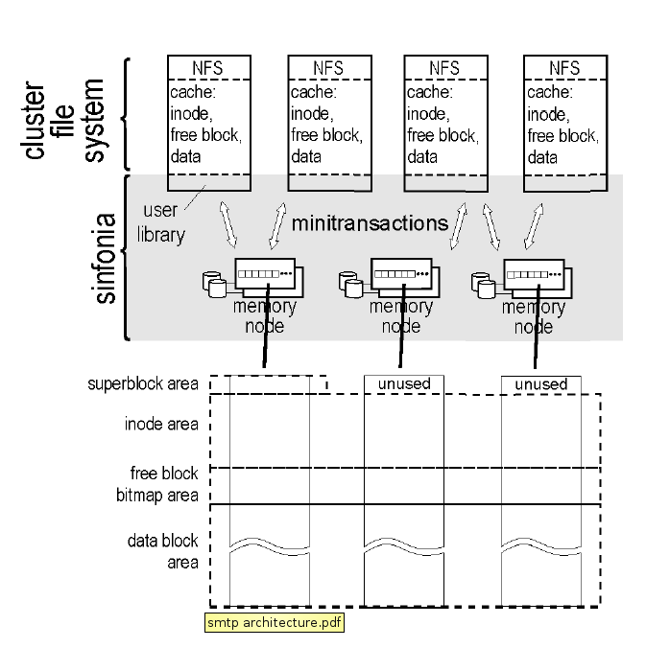
SinfoniaFS architecture

Slide 27
Example use of mini-transaction
setattr(ino_t inum, sattr_t newattr) {
do {
addr = address of inode
curr_version = inode->version
t = new Minitransaction;
t->cmp(addr, 4, curr_version)
t->write(addr, 4, curr_version+1)
t->write(addr, 20, newattr);
}while (status == fail);
}

Slide 28
General use of mini-transaction in SinfoniaFS
If local cache is empty, load it
Make modifications to local cache
Issue a mini-transaction to check the validity of cache, apply modification
If mini-transaction fails, reload cached item and try again

Slide 29
More examples: append to file
Find a free block in cached freemap
Issue mini-transaction with
  Compare items: cached inode, free status of the block
  Write items: inode, append new block, freemap, new block
If mini-transaction fails, reload cache

Slide 30
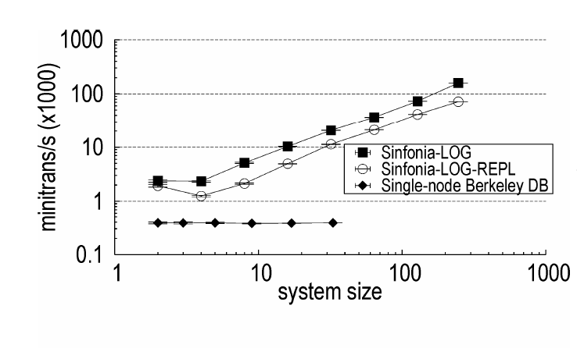
Sinfonia’s mini-transaction is fast

