Slide 1
CSM IEEE Robotics Team Grant Request
Kristin Farris
Daichi Jameson
Colin Young

Slide 2
Agenda
Competition overview
Goals analysis
Design discussion
Schedule and Deliverables
Budget and Request

Slide 3
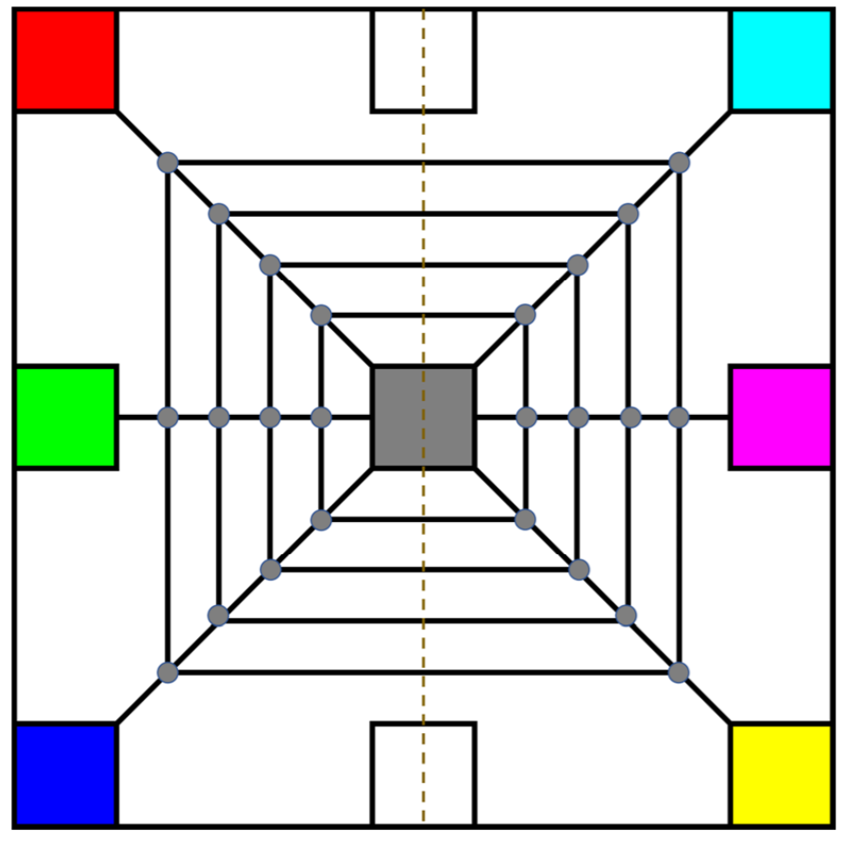
IEEE R5 2018 Competition
April 7, 2018
Austin, Texas
Autonomous navigation
Extraction of embedded tokens
Color identification

Slide 4
Goals for Improvement
Simplicity and Accessibility
Iterative Design Process
Improved Planning
Better Research

Slide 5
Goals for Learning and Success
Autonomous Tracking
Color Identification
Effective Circuit Development
Robust Chassis Design
Modern Techniques and Software

Slide 6
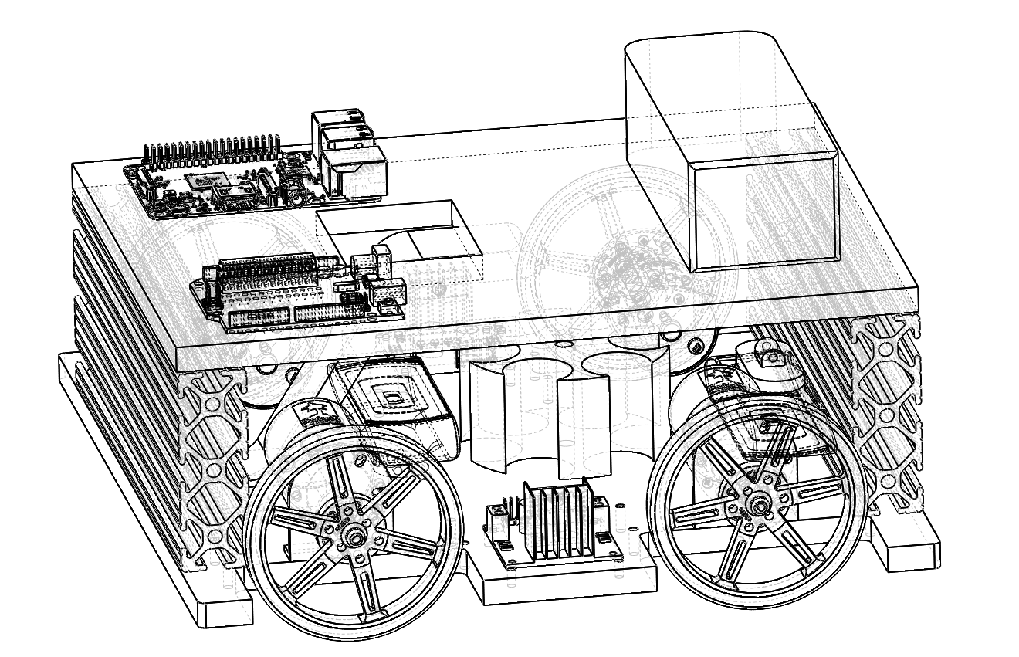
Our Design

Slide 7
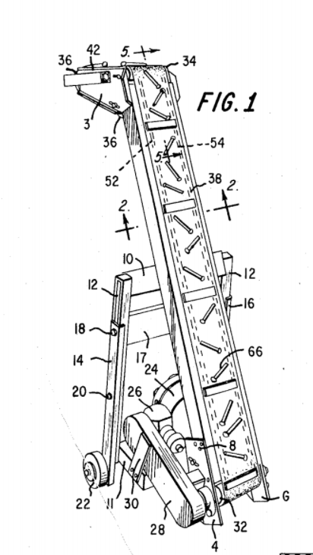
Mechanical Subsystem
Chassis
4-Wheel
Aluminum
Custom Brackets
Token Retrieval
Magnetic Conveyor System
Revolver Storage Mechanism

Slide 8
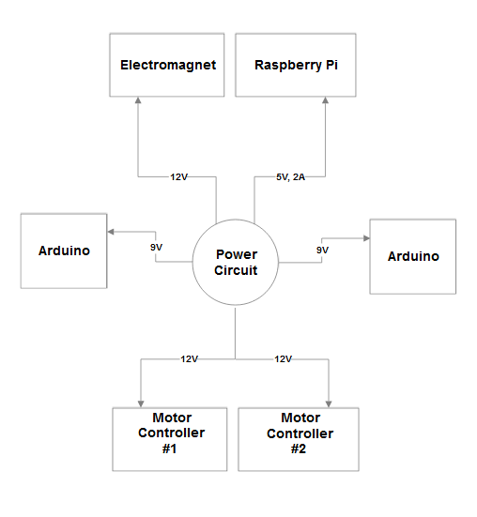
Electrical Subsystem
Power Circuit
Switching Voltage Regulators
12V, 9V, 5V Outputs

Slide 9
Software Subsystem
Autonomous Navigation
Spatial Localization
PID Controller
Color Identification
Computer Vision

Slide 10
Schedule
December 1, 2017 | Power Circuit
December 10, 2017 | Drivable Chassis
January 10, 2018 | Autonomous Movement
February 15, 2018 | Pickup Mechanism
February 15, 2018 | Sorting Mechanism
February 15, 2018 | Color Detection
March 25, 2018 | Documentation
March 25, 2018 | System Tests Complete

Slide 11
Planned Budget
Item | Purpose | Amount
Raw Aluminum | Chassis Construction | $140.00
80-20 with Hardware | Framing for Chassis | $30.00
Collection Hardware | Used for building collection mechanism | $200.00
Motor Controllers | Used for power distribution and control of motors | $16.00
DC Motors with Encoders | Movement and Navigation | $160
Wheels and Mounting Hardware | Attach to motors | $40
Raspberry Pi | Main brain controller | $45
Arduino | Main PWM controller | $40
Various Circuit Components | Used to correctly step down battery voltage, connect sensors | $80
Battery | Energy Storage | $36
Cameras | Utilization of computer vision | $26
Miscellaneaous | Part Replacement/broken components | $187
TOTAL CONSTRUCTION |  | $1,000.00
Travel Expenses | Estimated gas usage | $400
Hotel Expenses |  | $750
TOTAL PRICE |  | $2,150.00

Slide 12
Grant Request
Initial Request: $1,000
Materials
Development
Secondary request following progress report: $1,150
Travel
Lodging

Slide 13
Thank You/Questions
REFERENCES
A. Kornylak, "Magnetic Conveyor", 3642118, 1972.

