Slide 1
Raccourcis
Menu des tags:
PC: CTRL+e
Mac: apple+e
Align text toward the right: “Select text” + TAB, then align as you wish.
Align text toward the left: “Select text” + SHIFT+ TAB, then align as you wish.
Comment <!– blabla --> : CTRL+SHIFT+’ OR click droit.

Slide 2
Space/Espace
Meaningful, when between two characters.
Quantity (of space) is never meaningful in XML.
1, 2, 3 or more space = 1 space.
Adding a space at the end of a line is not meaningful.
So when you want to deal with complex space, you need some Markup.
See EG 8.1

Slide 3
Encoding Tamil Texts
NB, in encoding:
(1) tta ALWAYS means தத understood as த்த, i.e. implicit puḷḷi
(2) t·ta means த்த, i.e. explicit puḷḷi
(3) t=ta means a conjunct akṣara/eḻuttu

Slide 4
Puḷḷi
If the puḷḷi is used, it has to be encoded at the level of transliteration.
Use · (U+00B7 Middle Dot) after the letter bearing the puḷḷi
E.g.: m·

Slide 5
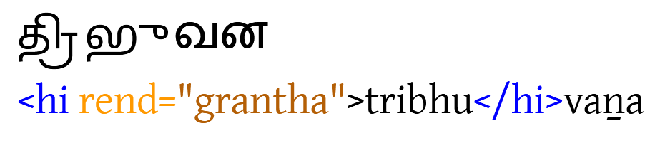
Grantha Syllables
Grantha syllables are to be tagged as follows

Slide 6
Grantha Syllables
What if the Grantha script is also ornate?
<hi rend="grantha ornate">tribhu</hi>vaṉa
See EG 7.5

Slide 7
Tamil Conjunct Letters
E.g. tt, kk, kku, nt, …
Treated in transliteration, thus
t=t, k=k, k=ku, n=t

Slide 8
Tamil Conjunct Letters
What if the conjunct is at the boundary between two words or two elements of a compound word?
k= ka
k=-ka (or k-=ka? TBC)
Probably automatically replaced by
<seg type="aksara">k ka</seg>
<seg type="aksara">k-ka</seg>

Slide 9
Basic Markup
<lb n="1" /> for physical line on the artefact.
<lb n="2" break="no"/> when the line breaks a word between line 1 and 2.

Slide 10
Basic Markup
<p></p> for prose inscriptions
Use several <p></p> to break your text into semantic paragraphs.
<ab></ab> for short prose inscriptions not constituting a § (see guidelines: name on sealing, label, etc.).
<lg></lg> for verse/stanza and <l></l> for metrical foot + special rules for enjambment.

Slide 11
<milestone/> (EG 3.6)
Empty tag. For so-called fragments, i.e. transition from one stone to another
<milestone unit="block" n="a"/>
for inscriptions on physically separate building blocks
<milestone unit="surface" n="a"/>
for inscriptions on multiple surfaces of a single object

Slide 12
<persName></persName>
<placeName></placeName>
<roleName></roleName>
Use them, but do not add attributes yet.
Test in progress with Valérie’s corpus.

Slide 13
Table (EGv01, p. 55)
Confidence in reading/ restoration | Status of text
 | lost | illegible | dubitable
absolute | <supplied reason="lost"> | <unclear> | no markup
reasonable |  |  | <unclear>
tentative | <supplied reason="lost" cert="low"> | <unclear cert="low"> | <unclear cert="low">
nil | <gap reason="lost"> | <gap reason="illegible"> | NA

Slide 14
Editorial Correction Scribal Omission
koppakecari instead of
kopparakecari
kōppa <supplied reason="omitted">ra</supplied> kēcari

Slide 15
NB
<supplied reason="omitted”>
= no space/letters on artefact
<supplied reason="lost">
= it was on the stone, but not legible anymore

Slide 16
Lacunae
<gap reason="lost" quantity="1" unit="character"></gap>
<gap reason="lost" quantity="1" unit="line"></gap>
When no guess about quantity of loss:
<gap reason="lost" extent="unknown" unit="character"></gap>

Slide 17
Editorial Correction Scribal Error
kapparakecari instead of
kopparakecari
k <choice><sic>a</sic><corr>ō</corr></choice> pparakēcari

Slide 18
Editorial Correction Editorial Deletion
koppararakecari instead
of kopparakecari
kōppara <surplus>ra</surplus> kēcari

Slide 19
Normalisation / Regularisation / Standardisation
pirāntakaṉ, vaicca instead of
instead of
parāntakaṉ, vaitta
p <choice><orig>i</orig><reg>a</reg></choice> rāntakaṉ

Slide 20
Correction OR Standardisation?
BUT correct with
<choice><sic>a</sic><corr>ō</corr></choice>
only the obvious mistakes.
E.g. maha instead of mahā.
When it is not clear whether we deal with an incorrect form or a non-standard form, use <orig> (see EG).

Slide 21
Where to place <orig></orig> ?
Ex. nikki inscribed for expected nīkki.
At the level of word? <orig>nikki</orig> At the level of letter? n<orig>i</orig>kki
TBC
+ possibility that we will use <reg> in some instances, e.g. dha<reg>r</reg>mma TBC
(dhamma inscribed for expected dharmma; but so often met with that might not be considered a mistake)

Slide 22
Examples of tagging only with <orig></orig>
nikki for nīkki
bhumi for bhūmi
muṉṟu for mūṉṟu
vaicca, vaiycca, vaiytta for vaitta
Irregular sandhi:
Irupattaiyṅ-kaḻañcu for Irupattaiṅ-kaḻañcu

Slide 23
Symbols (EG 4.2)
Numeral symbols. Require tagging.
<g type="numeral">100</g> <g type="numeral">20</g> 3
NB: no tag for 3 = decimal system, so treated only at transliteration level.
Number expressed in words (iraṇṭu) should not be tagged.
Generic symbols. Empty tag with type and descriptive subtype.
<g type="symbol" subtype="trefoil"/> (symbole en forme de trèfle)

Slide 24
Symbols (EG 4.2)
Punctuation marks
A few (daṇḍa) treated at the level of transliteration without tagging (see EG Appendix E).
The rest to be treated as generic symbols.
<g type="symbol" subtype="…"/>
Space filler
Treated at the level of transliteration (transliterated as "§" ) and tagged.
<g type="filler">§</g>

Slide 25
Verse
<lg> [line group] instead of <ab>
Inside <lg>: <l> for verse line.
<lg n="1" met="āciriyappā"> <l n="1"> <l n="2"> <l n="…"> <l n="26"> </lg>

Slide 26
Sandhi Split
makaṟ in sandhi >> << makaḷ in pausa
Markup possible but cumbersome!
We keep the form as on the artefact (makaṟ).
NB: at a later stage, markup could be added on separate copies of the files (e.g. for a chrestomathy for pedagogical purposes).

Slide 27
Word-Split
Authority = MTL
E.g.: இருமாவரை iru-mā-v-arai , n. < id. +. The fraction ⅛ being a sum of இருமா (⅒) and அரைமா (¹⁄₄₀); அரைக்கால்.
Thus irumāvarai OR iru-mā-v-arai
Convention to be followed constantly so as to be machine-actionable.

Slide 28
Adjectives
Two options:
As discrete words, except if lexicalised
As “prefix”, thus part of the word it qualifies.
Option (2) is preferred as dispenses to check MTL about lexicalisation or not.
THUS peruṅkōyil OR peruṅ-kōyil NOT peruṅ kōyil
Idem for numerals: iru-… (adjectival) vs. irāṇṭu (predicative)

Slide 29
Numerals: iru vs. iraṇṭu
See Wilden’s Grammar, p. 52, where distinction is made between adjectival (iru) and predicative (iraṇṭu).
Not many real adjectives in Tamil, but normally treated as element of a compound:
peru-nilam
peruṅ-kōyil
THUS iru-kalam and kalam iraṇṭu
That is, we treat all adjectives as “prefix”.

Slide 30
Forms derived from āku-tal
āka, adverbial suffix
kāṇiyāka OR kāṇi-y-āka NOT ḵāṇi-y āka
āṉa, adjectival suffix
…varmar-āṉa NOT varmar āṉa
ākavum (āka), predicate of infinitive proposition = discrete word.
Iṟai-y-āvat’ ākavum NOT Iṟai-y-āvat-ākavum
ākki, absolutive = discrete word.

Slide 31
Examples of word-split
…-uḷḷa
3āvatu, 3vatu, 3-vatu
itu-v-ē, koḷḷ-ō
tiru- (noun, treated as an adjective).
THUS
tiruvālaṅtuṟai OR tiru-v-ālaṅ-tuṟai NOT tiru-v ālan-tuṟai
tirunallam OR tiru-nallam NOT tiru nallam.

Slide 32
Examples of word-split
incaintōmarutūr (> icaintōm marutūr)
yāṇṭ’ ēḻāvatu
eṉ eḻuttu NOT eṉ-eluttu

Slide 33
Examples of word-split
eṉṟ’ aruḷi NOT eṉṟ-aruḷi
karuppūr-uṭaiya vēṅkaṭavaṉ NOT karuppūr uṭaiya vēṅkaṭavaṉ
karuppūr-uṭaiyaṉ NOT karuppūr uṭaiyaṉ
But uṭaiyār if used alone without determinant preceding, is to be treated as a discrete word,
Treat kiḻar, kiḻavaṉ like uṭaiyaṉ.

Slide 34
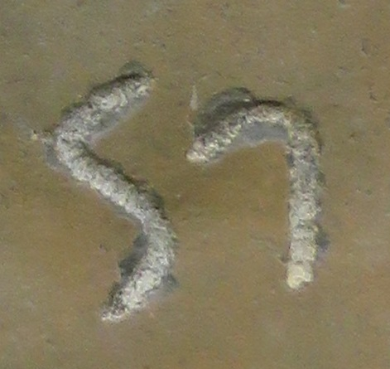
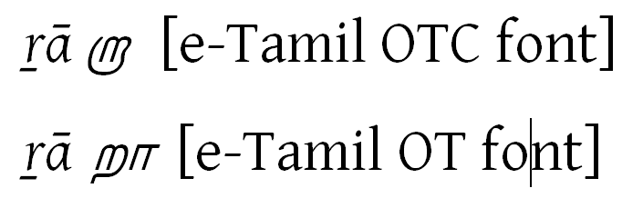
Allographs
Too much granularity. No Markup needed.
Dealt with in TEI header.
<handDesc>
<handNote>description of letters</handNote>
</handDesc>

Slide 35
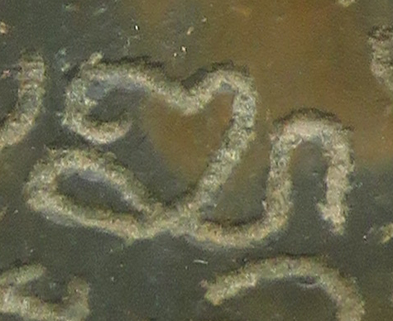
Particular Form of Letters
லூ or ளூ?
lū or ḷū?
<unclear reason="form">ḷū</unclear>

Slide 36
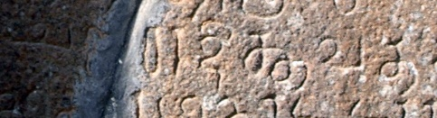

Candirādittavat (tta = Tamil script NOT Grantha) NOT candirādittavat

Slide 38
Punctuation (old policy)
Standard type: daṇḍa
<g type="punctuation">|</g>
Automatically converted to
<pc><g type="punctuation">|</g></pc>
Non-standard type
<g type="punctuation">||||—</g><note>4 parallel vertical strokes and 1 horizontal stroke</note>

Slide 39
Syllable split between two lines
At the level of transliteration (convertible to Markup, if needed).
Symbols for “prescript vowel” and “postscript vowel” in display, e.g. ⌈ and ⌉ TBC
க|ா kā⌉<lb/>
ெ|க <lb/>⌈ke
ெக|ா ko⌉<lb/>
ெ|கா <lb/>⌈ko

Slide 40
Syllable Split between Lines
கொ
ெக|ா (“|” = line-break)
ெ|கா
rddh|ā
<seg type="aksara" part="I">rddh</seg><lb n="2"><seg type="aksara" part="F">ā</seg>
rddh|e (-e | rddh, in fact in the original Indian alphabet:)
<seg type="aksara" part="F">e</seg><lb n="2"><seg type="aksara" part="I">rddh</seg>

Slide 41
The kāl issue
The kāl in ancient script is ambiguous as it represents medial ā (-ā, ா), r (ர்) and ra (ர).
க ka
கா in ancient inscriptions = kā OR kar OR kara
Modern script
கா = kā கர் = kar கர = kara

Slide 42
Scenario A: simple interrupted akṣaras
க<lb/>ா kā⌉<>
ெ<lb/>க <>⌈ke
கெ<lb/>ா ko⌉<>
ெ<lb/>கா <>⌈ko
(NB: <lb/> may instead be <space/>)

Slide 43
Scenario B: simple ambiguous kāl
Context doesn't clearly tell how a kāl should be understood.
கா would be
k<choice><unclear>ā</unclear><unclear>ara</unclear><unclear>ar</unclear><unclear>ra</unclear></choice>
கொ would be
k<choice><unclear>o</unclear><unclear>era</unclear><unclear>er</unclear></choice>

Slide 44
I expect there will be very few cases where all of the alternatives are indeed possible,
In most cases, it will probably be acceptable (and much simpler) to encode these as:
k<unclear>ā</unclear> and k<unclear>o</unclear> OR ka<unclear>ra</unclear> and ke<unclear>ra</unclear> (whichever seems more likely); readers who care will I assume be able to figure out the alternatives.
Attribute “reason= “kāl” necessary?

Slide 45
Scenario C: interrupted akṣara with ambiguous kāl
Combine the above approaches.
THUS:
க<lb/>ா would be k<choice><unclear>ā</unclear><unclear>ara</unclear><unclear>ar</unclear><unclear>ra</unclear></choice><lb/>⌉
கெ<lb/>ா would be k<choice><unclear>o</unclear><unclear>era</unclear><unclear>er</unclear><unclear>re</unclear></choice><lb/>⌉
and ெ<lb/>கா would be ⌈<lb/>k<choice><unclear>o</unclear><unclear>era</unclear><unclear>er</unclear><unclear>re</unclear></choice>

Slide 46
Scenario D: interrupted akṣara followed by a lacuna with supplied kāl
Again, combine the above approaches. If for example you have க or கெ at the end of the line and the beginning of the next line is lost, but you know from the context that the correct reading must be kā or ko, then mark up
k<supplied reason="lost">ā</supplied><lb/>⌉
and k<unclear>o</unclear><lb/>⌉

Slide 47
Scenario E interrupted akṣara followed by a lacuna with possibly lost kāl
I don't think anything needs to be done in the markup to indicate a "possibly lost kāl" in a lacuna where you can't make a restoration from context. Thus, if you have க or கெ followed by a lacuna (directly or after an intervening line break or binding hole), then I guess you would simply transliterate ka/ke followed by <gap/> (possibly adding <unclear> to the vowel in those transliterations), and again leave it to readers to know that a ka or ke before a lacuna may actually be a partially preserved kā or ko, even if the lacuna comes after an interruption.

