Slide 1
Introduction CS 111 Spring 2019 Operating System Principles Harry Xu

Slide 2
Outline
Administrative materials
Introduction to the course
Why study operating systems?
Basics of operating systems

Slide 3
Administrative Issues
Instructor and TAs
Load and prerequisites
Web site, syllabus, reading, and lectures
Exams, homework, projects
Grading
Academic honesty

Slide 4
Instructor: Harry Xu
Associate Professor at UCLA Computer Science Department
Long history of research in software systems
Email: harryxu@cs.ucla.edu
Office: 496A Engineering VI
Office hours: W 2:40-4pm

Slide 5
TAs
Claudia Seidel
cseidel2@ucla.edu
Alexandre Tiard
tiard@cs.ucla.edu
Zhaoxing Bu
zbu@ucla.edu
Office hours to be announced

Slide 6
Instructor/TA Division of Responsibilities
Instructor handles all lectures, readings, and tests
Ask me about issues related to these
TAs handle projects
Ask them about issues related to these
Generally, instructor won’t be involved with project issues
So direct those questions to the TAs

Slide 7
Web Site
http://web.cs.ucla.edu/~harryxu/courses/111/spring19
https://piazza.com/class/jsxs5mq464501
What’s there:
Schedules for reading, lectures, exams, projects
Project materials
And uploads of completed projects
Copies of lecture slides (Powerpoint and PDF)
Announcements
Sample midterm and final problems

Slide 8
Prerequisite Subject Knowledge
CS 32 programming
Objects, data structures, queues, stacks, tables, trees
CS 33 systems programming
Assembly language, registers, memory
Linkage conventions, stack frames, register saving
CS 35L Software Construction Laboratory
Useful software tools for systems programming
If you haven’t taken these classes, expect to have a hard time in 111

Slide 9
Course Format
Two weekly reading assignments
Mostly from the primary text
Some supplementary materials available on web
Two weekly lectures
Four (10-25 hour) individual projects
Exploring and exploiting OS features
Plus one warm-up project
A midterm and a final exam

Slide 10
Course Load
Reputation: THE hardest undergrad CS class
Fast pace through much non-trivial material
Expectations you should have
lectures 4-6 hours/week
reading 3-6 hours/week
projects 3-20 hours/week
exam study 5-15 hours (twice)
Keeping up (week by week) is critical
Catching up is extremely difficult

Slide 11
Primary Text for Course
Remzi and Andrea Arpaci-Dusseau: Operating Systems: Three Easy Pieces
Freely available on line at http://pages.cs.wisc.edu/~remzi/OSTEP/
Supplemented with web-based materials

Slide 12
Course Grading
Basis for grading:
Class evaluation 1%
1 midterm exam 24%
Final exam 30%
Lab 0 5%
Other labs 10% each
I do look at distribution for final grades
But don’t use a formal curve
All scores available on MyUCLA
Please check them for accuracy

Slide 13
Midterm Examination
When: 5th week (in class section, Wednesday, May 1)
Scope: All material up to the exam date
Approximately 60% lecture, 40% text
No questions on purely project materials
Format:
Closed book
10-15 essay questions with short answers
Goals:
Test understanding of key concepts
Test ability to apply principles to practical problems

Slide 14
Final Exam
When: Monday, June 12, 3-6 PM
Scope: Entire course
Format:
Similar to the midterm
Covering entire scope of class
Again, no questions purely from projects
Goals:
Determining if you have mastered the full range of material presented in the class

Slide 15
Lab Projects
Format:
1 warm-up project
4 regular projects
Done individually (except project 3)
Goals:
Develop ability to exploit OS features
Develop programming/problem solving ability
Practice software project skills

Slide 16
Late Assignments & Make-ups
Labs
Due on each Friday
TAs also sets policy on late assignments
The TAs will handle all issues related to labs
Ask them, not me
Don’t expect me to overrule their decisions
Exams
Alternate times or make-ups only possible with prior consent of the instructor
If you miss a test, too bad

Slide 17
Academic Honesty
It is OK to study with friends
Discussing problems helps you to understand them
It is OK to do independent research on a subject
There are many excellent treatments out there
But all work you submit must be your own
Do not write your lab answers with a friend
Do not copy another student's work
Do not turn in solutions from off the web
If you do research on a problem, cite your sources
I decide when two assignments are too similar
And I forward them immediately to the Dean
If you need help, ask the instructor

Slide 18
Academic Honesty – Projects
Do your own projects
If you need additional help, ask the TA
You must design and write all your own code
Do not ask others how they solved the problem
Do not copy solutions from the web, files or listings
Cite any research sources you use
Exception: project 3 allows two-person teams
Protect yourself
Do not show other people your solutions
Be careful with old listings

Slide 19
Academic Honesty and the Internet
You might be able to find existing answers to some of the assignments on line
Remember, if you can find it, so can we
And we have, before
It IS NOT OK to copy the answers from other people’s old assignments
People who tried that have been caught and referred to the Office of the Dean of Students
ANYTHING you get off the Internet must be treated as reference material
If you use it, quote it and reference it

Slide 20
Introduction to the Course
Purpose of course and relationships to other courses
Why study operating systems?
What is an operating system?

Slide 21
What Will CS 111 Do?
Build on concepts from other courses
Data structures, programming languages, assembly language programming, computer architectures, ...
Prepare you for advanced courses
Data bases, data mining, and distributed computing
Security, fault-tolerance, high availability
Network protocols, computer system modelling
Provide you with foundation concepts
Processes, threads, virtual address space, files
Capabilities, synchronization, leases, deadlock

Slide 22
Why Study Operating Systems?
Why do we have them, in the first place?
Why are they important?
What do they do for us?

Slide 23
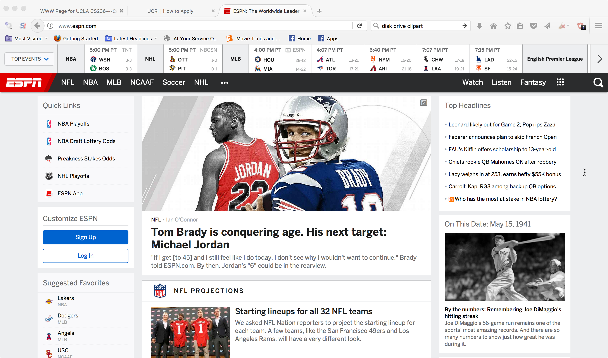
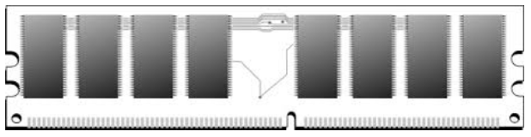
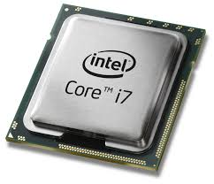
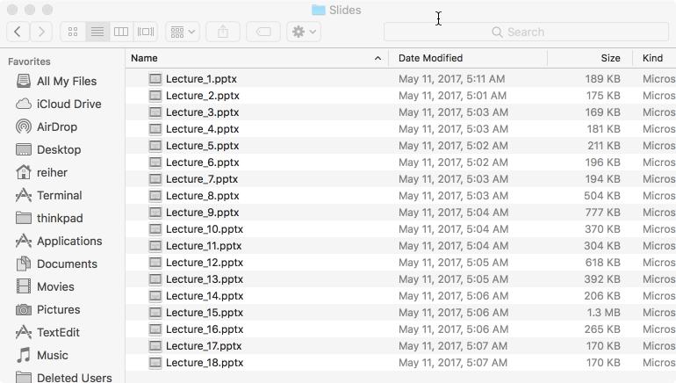
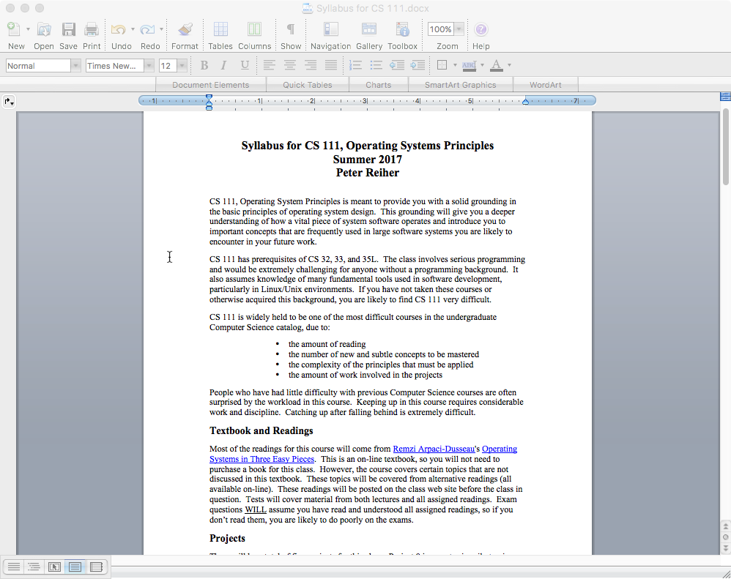
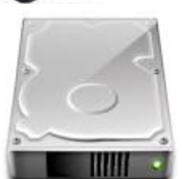
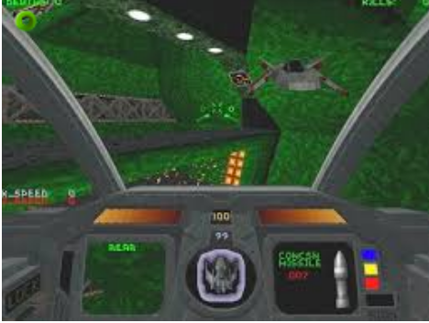
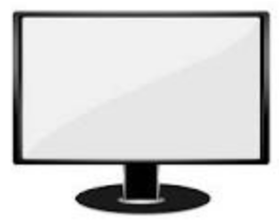

Starting From the Bottom
Here’s what you’ve got
Here’s what you want

Slide 24
What Can You Do With What You’ve Got?
Read or write some binary words
Report X and Y movements
MOV
ADD
JMP
SQRTPD
Write to groups of pixels
READ
REQUEST SENSE
Read or write a block of data

Slide 25

And You Want This?

Slide 26
You’re Going to Need Some Help
And that’s what the operating system is about
Helping you perform complex operations
Using various hardware
And probably various bits of software
While hiding the complexity
And making sure nothing gets in the way of anything else

Slide 27
What Is An Operating System, Anyway?
System software intended to provide support for higher level applications
Some higher level system software applications
But primarily for user processes
The software that sits between the hardware and everything else
The software that hides nasty details
Of hardware, software, and common tasks
On a good day, the OS is your best computing friend

Slide 28
But Why Are You Studying Them?
High probability none of you will ever write an operating system
Or even fix an operating system bug
Not very many different operating systems are in use
So the number of developers for them is small
So why should you care about them?

Slide 29
Everybody Has One
Practically all computing devices you will ever use has an operating system
Servers, laptops, desktop machines, tablets, smart phones, game consoles, set-top boxes
Many things you don’t think of as computers have CPUs inside
Usually with an operating system
Internet of Things devices
So you will work with operating systems

Slide 30
How Do You Work With OSes?
You configure them
You use their features when you write programs
You rely on services that they offer
Memory management
Persistent storage
Scheduling and synchronization
Interprocess communications
Security

Slide 31
Another Good Reason
Many hard problems have been tackled in the context of operating systems
How to coordinate separate computations
How to manage shared resources
How to virtualize hardware and software
How to organize communications
How to protect your computing resources
The operating system solutions are often applicable to programs and systems you write

Slide 32
Some OS Wisdom
View services as objects and operations
Behind every object there is a data structure
Interface vs. implementation
An implementation is not a specification
Many compliant implementations are possible
Inappropriate dependencies cause problems
An interface specification is a contract
Specifies responsibilities of producers & consumers
Basis for product/release interoperability

Slide 33
More OS Wisdom
Modularity and functional encapsulation
Complexity hiding and appropriate abstraction
Separate policy from mechanism
Policy determines what can/should be done
Mechanism implements basic operations to do it
Mechanisms shouldn’t dictate or limit policies
Policies must be changeable without changing mechanisms
Parallelism and asynchrony are powerful and vital
But dangerous when used carelessly
Performance and correctness are often at odds
Correctness doesn’t always win . . .

Slide 34
What Is An Operating System?
Many possible definitions
One is:
It is low level software . . .
That provides better, more usable abstractions of the hardware below it
To allow easy, safe, fair use and sharing of those resources

Slide 35
What Does an OS Do?
It manages hardware for programs
Allocates hardware and manages its use
Enforces controlled sharing (and privacy)
Oversees execution and handles problems
It abstracts the hardware
Makes it easier to use and improves SW portability
Optimizes performance
It provides new abstractions for applications
Powerful features beyond the bare hardware

Slide 36
What Does An OS Look Like?
A set of management & abstraction services
Invisible, they happen behind the scenes
Applications see objects and their services
CPU supports data-types and operations
bytes, shorts, longs, floats, pointers, ...
add, subtract, copy, compare, indirection, ...
So does an operating system, but at a higher level
files, processes, threads, devices, ports, ...
create, destroy, read, write, signal, ...
An OS extends a computer
Creating a much richer virtual computing platform
Supporting richer objects, more powerful operations

Slide 37
Where Does the OS Fit In?
Applications Software
(e.g. word processor, compiler, VOIP program, ...)
Application Binary Interface
System Services/Libraries
(e.g. string, random #s, encryption, graphics ...)
System Call Interface
Operating System
Privileged instruction set
Standard instruction set
Hardware
(arithmetic, logical, copy, test, flow-control operations, ...)

Slide 38
What’s Special About the OS?
It is always in control of the hardware
Automatically loaded when the machine boots
First software to have access to hardware
Continues running while apps come & go
It alone has complete access to hardware
Privileged instruction set, all of memory & I/O
It mediates applications’ access to hardware
Block, permit, or modify application requests
It is trusted
To store and manage critical data
To always act in good faith
If the OS crashes, it takes everything else with it
So it better not crash . . .

Slide 39
Instruction Set Architectures (ISAs)
The set of instructions supported by a computer
Which bit patterns correspond to what operations
There are many different ISAs (all incompatible)
Different word/bus widths (8, 16, 32, 64 bit)
Different features (low power, DSPs, floating point)
Different design philosophies (RISC vs. CISC)
Competitive reasons (68000, x86, PowerPC)
They usually come in families
Newer models add features (e.g., Pentium vs. 386)
But remain upwards-compatible with older models
A program written for an ISA will run on any compliant CPU

Slide 40
Privileged vs. General Instructions
Most modern ISAs divide the instruction set into privileged vs. general
Any code running on the machine can execute general instructions
Processor must be put into a special mode to execute privileged instructions
Usually only in that mode when the OS is running
Privileged instructions do things that are “dangerous”

Slide 41
Platforms
ISA doesn’t completely define a computer
Functionality beyond user mode instructions
Interrupt controllers, DMA controllers
Memory management unit, I/O busses
BIOS, configuration, diagnostic features
Multi-processor & interconnect support
I/O devices
Display, disk, network, serial device controllers
These variations are called “platforms”
The platform on which the OS must run

Slide 42
Portability to Multiple ISAs
A successful OS will run on many ISAs
Some customers cannot choose their ISA
If you don’t support it, you can’t sell to them
Which implies that the OS will abstract the ISA
Minimal assumptions about specific HW
General frameworks are HW independent
File systems, protocols, processes, etc.
HW assumptions isolated to specific modules
Context switching, I/O, memory management
Careful use of types
Word length, sign extension, byte order, alignment
How can an OS manufacturer distribute to all these different ISAs and platforms?

Slide 43
Binary Distribution Model
Binary is the derivative of source
The OS is written in source
But a source distribution must be compiled
A binary distribution is ready to run
OSes usually distributed in binary
One binary distribution per ISA
Binary model for platform support
Device drivers can be added, after-market
Can be written and distributed by 3rd parties
Same driver works with many versions of OS

Slide 44
Binary Configuration Model
Good to eliminate manual/static configuration
Enable one distribution to serve all users
Improve both ease of use and performance
Automatic hardware discovery
Self-identifying busses
PCI, USB, PCMCIA, EISA, etc.
Automatically find and load required drivers
Automatic resource allocation
Eliminate fixed sized resource pools
Dynamically (re)allocate resources on demand

Slide 45
Interface Stability
People want new releases of an OS
New features, bug fixes, enhancements
People also fear new releases of an OS
OS changes can break old applications
How can we prevent such problems?
Define well specified Application Interfaces
Application programming interfaces (APIs)
Application binary interfaces (ABIs)
Applications only use committed interfaces
OS vendors preserve upwards-compatibility

Slide 46
What Functionality Is In the OS?
As much as necessary, as little as possible
OS code is very expensive to develop and maintain
Functionality must be in the OS if it ...
Requires the use of privileged instructions
Requires the manipulation of OS data structures
Must maintain security, trust, or resource integrity
Functions should be in libraries if they ...
Are a service commonly needed by applications
Do not actually have to be implemented inside OS
But there is also the performance excuse
Some things may be faster if done in the OS

Slide 47
The OS and Abstraction
One major function of an OS is to offer abstract versions of resources
As opposed to actual physical resources
Essentially, the OS implements the abstract resources using the physical resources
E.g., processes (an abstraction) are implemented using the CPU and RAM (physical resources)
And files (an abstraction) are implemented using disks (a physical resource)

Slide 48
Why Abstract Resources?
The abstractions are typically simpler and better suited for programmers and users
Easier to use than the original resources
E.g., don’t need to worry about keeping track of disk interrupts
Compartmentalize/encapsulate complexity
E.g., need not be concerned about what other executing code is doing and how to stay out of its way
Eliminate behavior that is irrelevant to user
E.g., hide the slow erase cycle of flash memory
Create more convenient behavior
E.g., make it look like you have the network interface entirely for your own use

Slide 49
Generalizing Abstractions
Lots of variations in machines’ HW and SW
So make many different types appear to be same
So applications can deal with single common class
Usually involves a common unifying model
E.g., portable document format (pdf) for printers
Or SCSI standard for disks, CDs and tapes
Usually involves a federation framework
Per sub-type implementations of standard functions
For example:
Printer drivers make different printers look the same
Browser plug-ins to handle multi-media data

Slide 50
Common Types of OS Resources
Serially reusable resources
Partitionable resources
Sharable resources

Slide 51
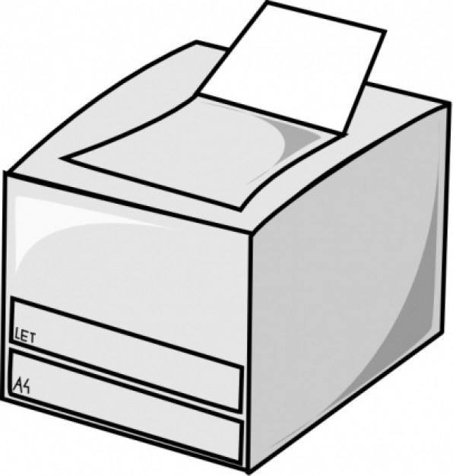
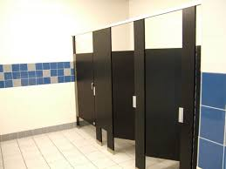
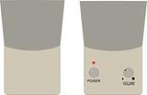
Serially Reusable Resources
Used by multiple clients, but only one at a time
Time multiplexing
Require access control to ensure exclusive use
Require graceful transitions from one user to the next
Examples:

Slide 52
What Is A Graceful Transition?
A switch that totally hides the fact that the resource used to belong to someone else
Don’t allow the second user to access the resource until the first user is finished with it
No incomplete operations that finish after the transition
Ensure that each subsequent user finds the resource in “like new” condition
No traces of data or state left over from the first user

Slide 53
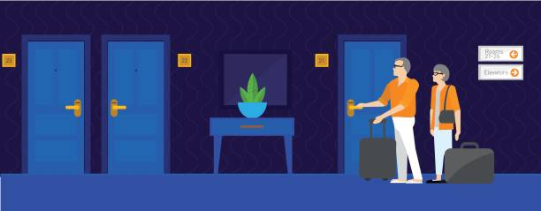
Partitionable Resources
Divided into disjoint pieces for multiple clients
Spatial multiplexing
Needs access control to ensure:
Containment: you cannot access resources outside of your partition
Privacy: nobody else can access resources in your partition
Examples:

Slide 54
Do We Still Need Graceful Transitions?
Yes
Most partitionable resources aren’t permanently allocated
The piece of RAM you’re using now will belong to another process later
As long as it’s “yours,” no transition required
But sooner or later it’s likely to become someone else’s

Slide 55
Shareable Resources
Usable by multiple concurrent clients
Clients don’t “wait” for access to resource
Clients don’t “own” a particular subset of the resource
May involve (effectively) limitless resources
Air in a room, shared by occupants
Copy of the operating system, shared by processes

Slide 56
Do We Still Need Graceful Transitions?
Typically not
The shareable resource usually doesn’t change state
Or isn’t “reused”
We never have to clean up what doesn’t get dirty
Like an execute-only copy of the OS
Shareable resources are great!
When you can have them . . .
Tip: Design your system to maximize sharable resources.

Slide 57
General OS Trends
They have grown larger and more sophisticated
Their role has fundamentally changed
From shepherding the use of the hardware
To shielding the applications from the hardware
To providing powerful application computing platform
To becoming a sophisticated “traffic cop”
They still sit between applications and hardware
Best understood through services they provide
Capabilities they add
Applications they enable
Problems they eliminate

Slide 58
Why?
Ultimately because it’s what users want
The OS must provide core services to applications
Applications have become more complex
More complex internal behavior
More complex interfaces
More interactions with other software
The OS needs to help with all that complexity

Slide 59
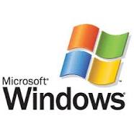
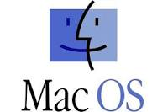

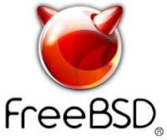


OS Convergence
There are a handful of widely used OSes
1985
1984
1991
And a few special purpose ones (e.g., real time and embedded system OSes)
OSes in the same family are used for vastly different purposes
Challenging for the OS designer
Most OSes are based on pretty old models

Slide 60
Why Have OSes Converged?
They’re expensive to build and maintain
So it’s a hard business to get into and stay in
They only succeed if users choose them over other OS options
Which can’t happen unless you support all the apps the users want
Which requires other parties to do a lot of work
You need to have some clear advantage over present acceptable alternatives

Slide 61
Conclusion
Understanding operating systems is critical to understanding how computers work
Operating systems interact directly with the hardware
Operating systems provide services via abstractions
Operating systems are constrained by many non-technical factors

