Slide 1
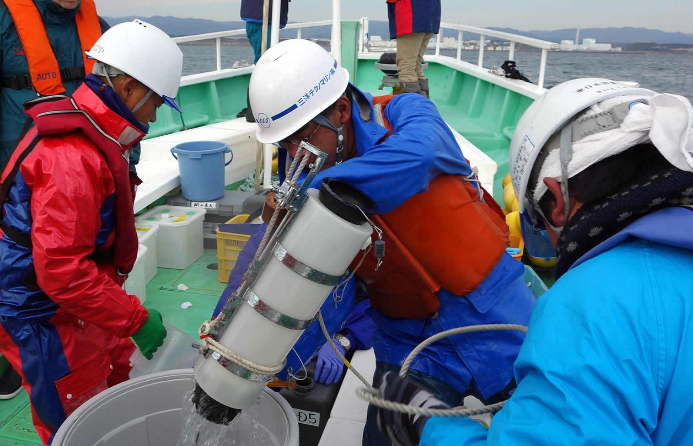
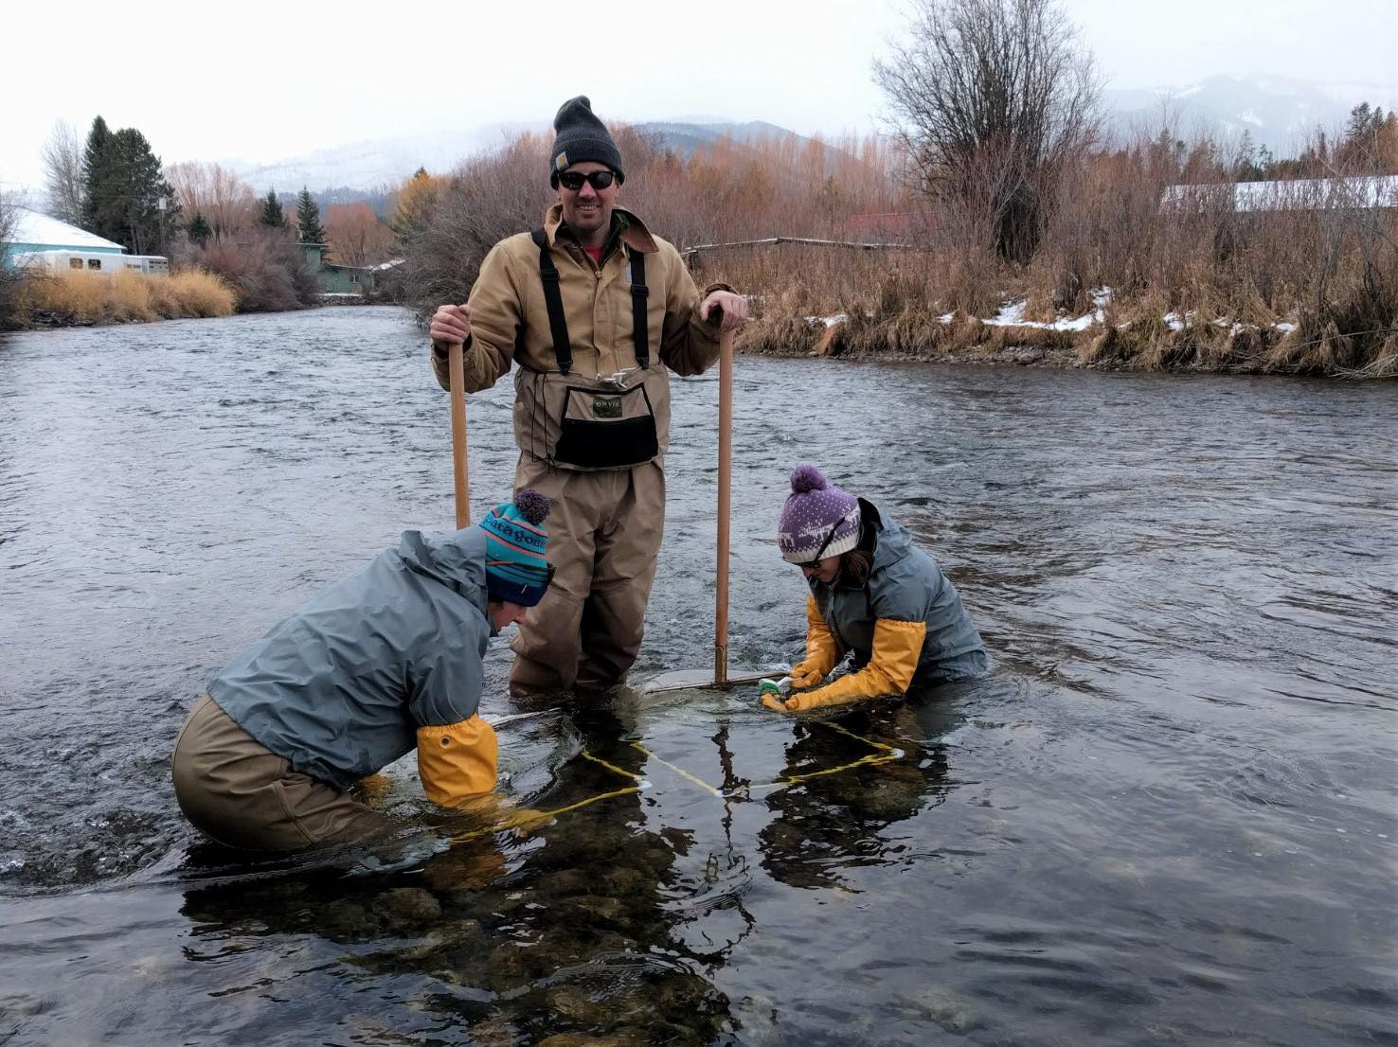
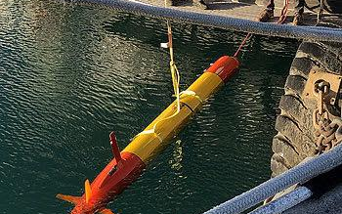
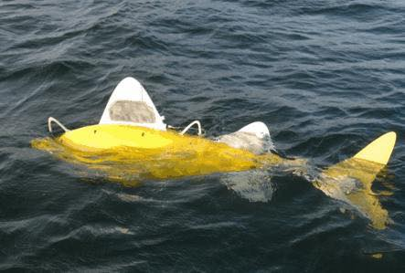
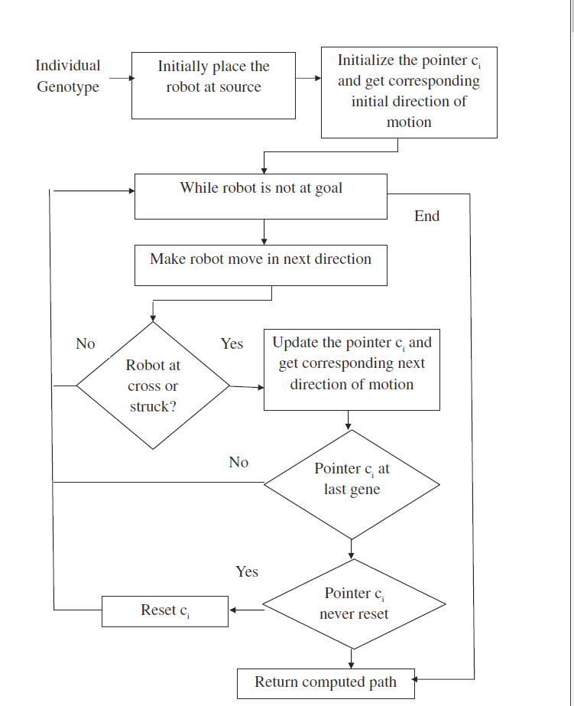
Robotic Fish for Water Sampling
Zhina Majd, Yuebo Yao, Farrandi Hernando
INTRODUCTION
Hardware
CONCLUSION
For the past 36 years, over 2000 people got affected by mercury poisoning by eating fish in Minamata, Japan, and 50% of them died.
Design
The robotic fish is made out of 3 parts: streamlined head, body and tail
Tail contains all control units (batteries, wireless communication module)
Body made of multiple jointed segments. Include fins to ensure stability
Tail which oscillates and provides motor power
Why we need it for water sampling
Cost and time efficient
Doesn’t require a group of researches to sail to the sea
Conclusion (explain leader fish and followers)
A group of fish will venture to the ocean to a specified location and take water samples at different depths
Each fish is assigned to a different depth (pre-programmed)
There will be a leader where all the other fish will follow
The Leader fish is given the genetic algorithm code to reach its destination
Limitations
The follower fishes are dependent on the leader robot
The ability of the fish to maneuver around obstacles is limited to the precision/ sensitivity of the sensors
Advantages
No need to program every single robot
With less cost, we are able to get more water samples from different locations
Robot fishes have “spatial awareness” meaning they will not crash onto each other
How to improve
Possibly program another fish to be a “leader” if the leader fish actually is not functioning
To prevent this, the collecting and processing of marine water samples is crucial for the analyzing water quality. The current method for water sampling takes 3-5 days and is arduous, requiring a group of researchers to venture deep into the ocean and collect water samples. This costs roughly around $5000 dollars per operation.
Alternatively, we found a solution that is more time efficient and inexpensive as compared to the traditional method.
Path Planning and Movement
Robotic fish are made out of 3D folded plastics (fiberglass)
This is suitable as it is inexpensive, abundant, fast production and remains stable in water
Definition of Genetic Programming
Genetic Algorithm allows path planning with generated waypoints using a grid map. Each grid cell is considered a gene. Genetic Algorithm makes use of knowledge from genetic evolution for selecting the right path (“survival of the fittest”)
Normal Situation
Use Genetic Algorithm to reach destination:
1. First download the map (from satellite data)
2. Convert the search environment to a grid graph
3. Specify the start and end point
Program is coded to one “leader” robot
which other “following” robots will follow
Information from sensors will be inputted
to the map and the fish will find the path
Whenever robots go somewhere, the “master” robot will record the history of the path so that other robots can use it late
Extreme Situation
Whenever there is an obstacle
detected by the sensor, the robot
is programmed to rotate to
another direction
When the robot’s sensor detects
a potential collision with another
robot, it will stop itself until
another robot goes far away
Depth Control
Buoyancy – to dive deeper,
water is pumped into the fish
(vice versa for going up)
Contains built in buoyancy tank full of compressed air which allows it to adjust its depth
Mimics shape and movement of real marine animals
SUB HEADING
Energy Source
The robotic fish will be equipped with a lithium ion battery.
It will have to swim deep into the water to collect water samples at different depths and sunlight might not penetrate deep into these depths.
A solution is that the fish will be programmed to go up to the water surface when its battery is below 20%.
The fish uses solar panels which allows photons of light to knock electrons from atoms which would generate a current. This electrical energy would then be converted into chemical potential energy in the battery for the robotic fish to use.
The fish will continuously dive down collect water and go up to charge then repeat.
REFERENCES
Kala, R. (2012). Multi-robot path planning using co-evolutionary genetic programming. Expert Systems with Applications, 39(3), 3817-3831. doi:10.1016/j.eswa.2011.09.090
N. E. Leonard, D. A. Paley, F. Lekien, R. Sepulchre, D. M. Fratantoni and R. E. Davis, "Collective Motion, Sensor Networks, and Ocean Sampling," in Proceedings of the IEEE, vol. 95, no. 1, pp. 48-74, Jan. 2007. doi: 10.1109/JPROC.2006.887295
Mohanan, M., & Salgoankar, A. (2018). A survey of robotic motion planning in dynamic environments. Robotics and Autonomous Systems, 100, 171-185. doi:10.1016/j.robot.2017.10.011

