Slide 1

Welcome!
Software Carpentry Bootcamp at Cornell University
Special thanks for financial support from the Department of Molecular Biology and Genetics

Slide 2
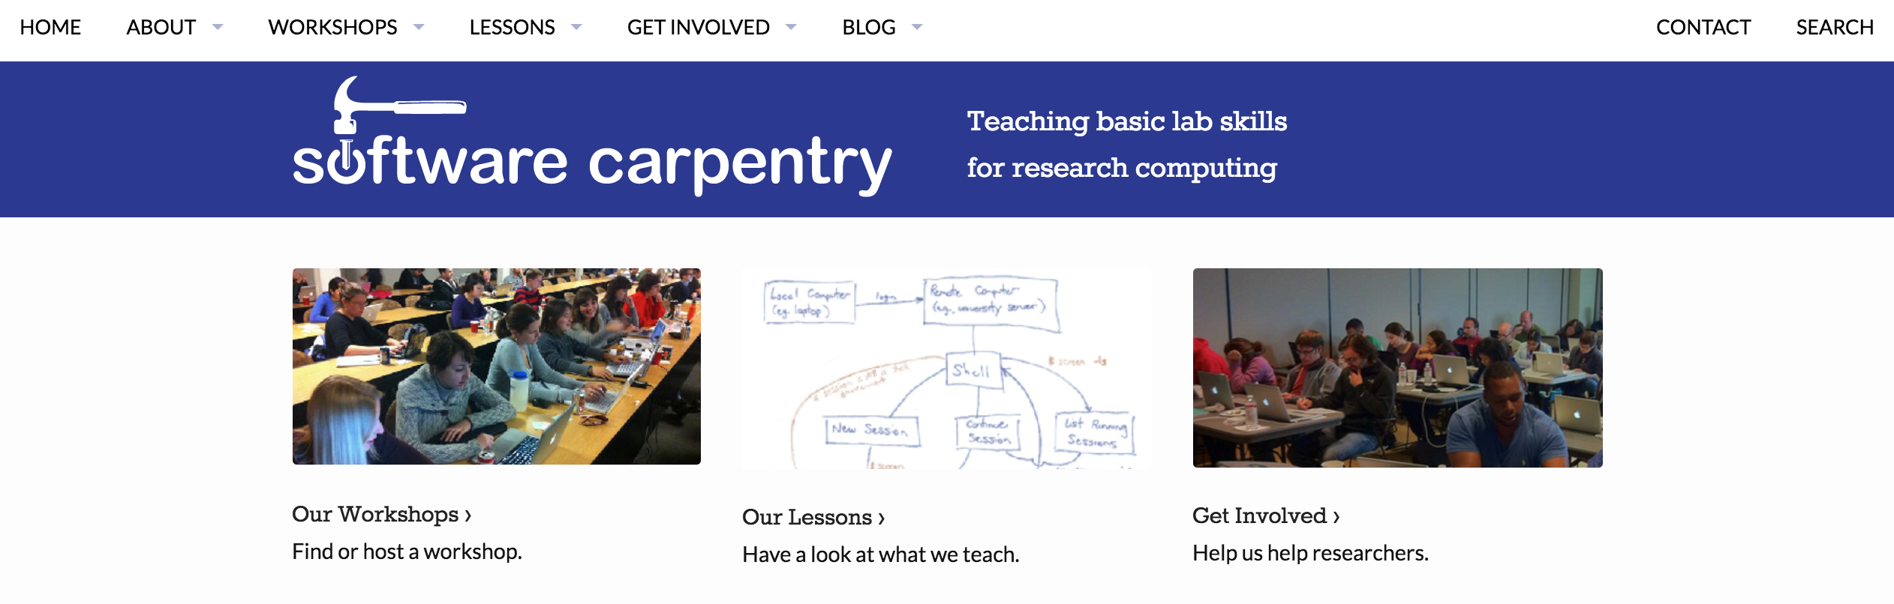
What is Software Carpentry?

Slide 3
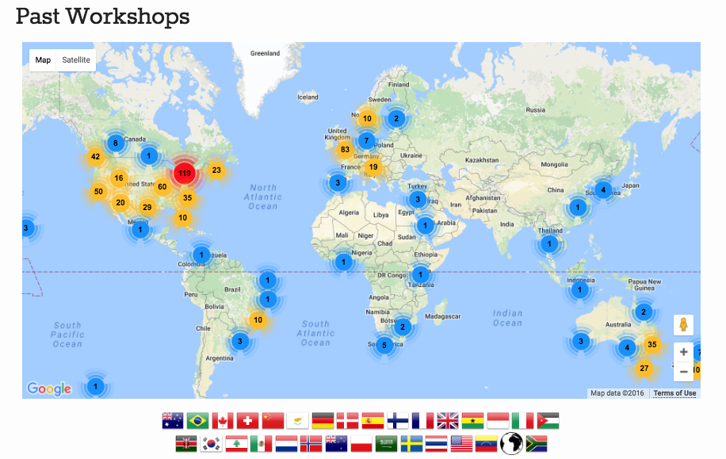
What is Software Carpentry?

Slide 4
Why SWC?

Slide 5
What are we covering?
1. Unix Shell
2. R
3. Version Control

Slide 6
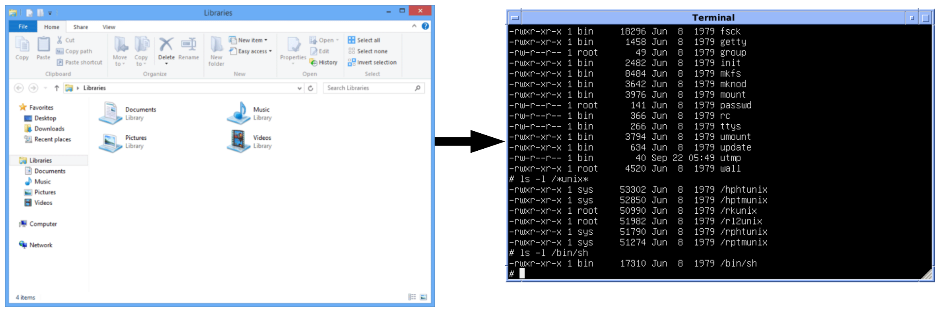
What are we covering?
1. Unix Shell
2. R
3. Version Control
Why Unix shell?
Automation of tasks
Reproducibility
Recordable
High performance clusters

Slide 7
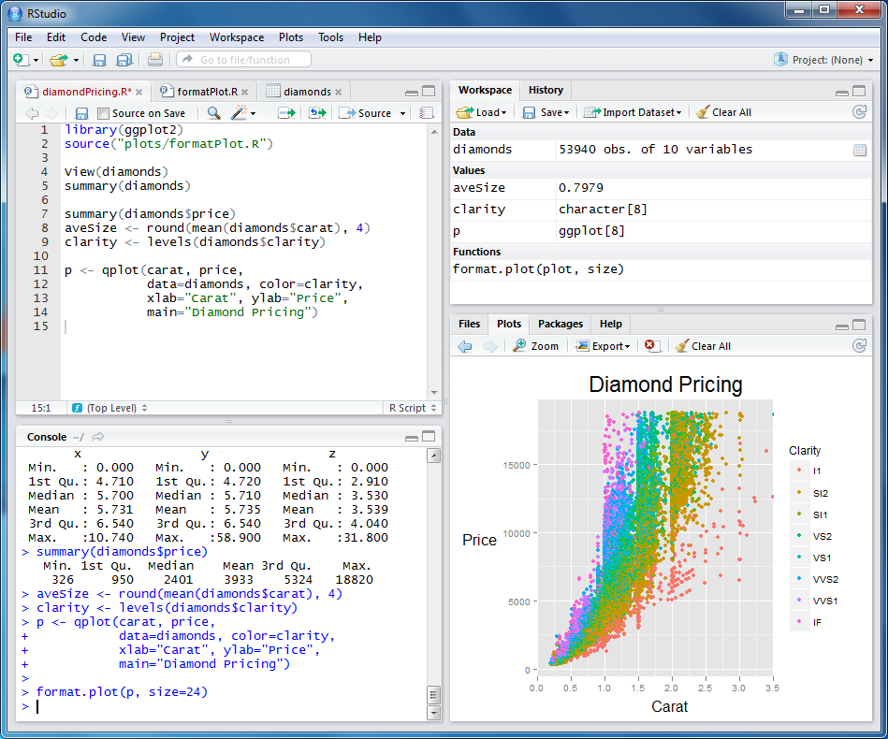
What are we covering?
1. Unix Shell
2. R
3. Version Control
Why R?
Free, open source stats software
Visualization abilities
Can be scripted

Slide 8
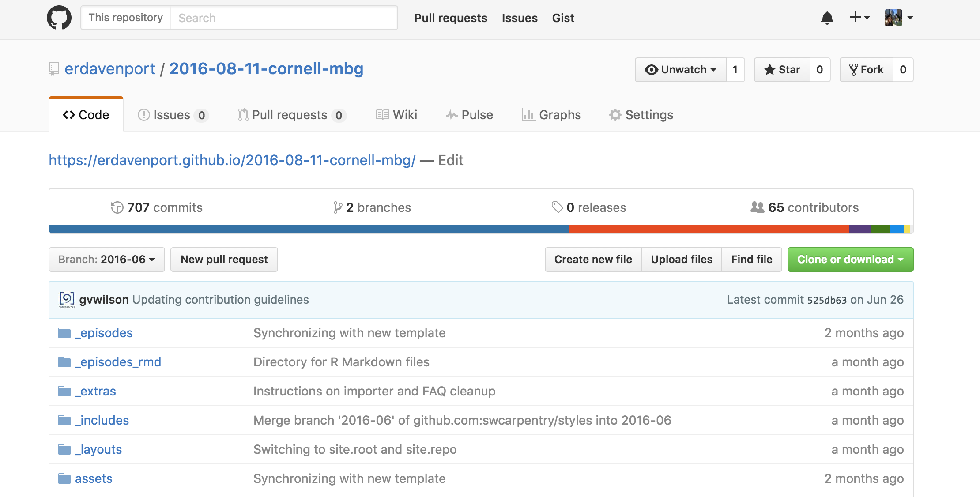
What are we covering?
1. Unix Shell
2. R
3. Version Control
Why Git?
Store different versions of your code
Collaborate and share code
Back up code

