Slide 1
CS6140 Final Project: Airplane Passenger Satisfaction Investigation
Christopher Daly, Edgar David and Jacqueline Girouard

Slide 2

Introduction
The Motivation:
As the world slowly emerges from the Covid-19 pandemic, travel is reentering the lives of millions of Americans. How can airline companies capitalize on this return to travel and make the experience as positive as possible so industry can quickly recover?
The Research Question:
Through various kernels Support Vector Machines, we can identify a reasonable decision boundaries?
Can we infer insights about the feature rich data and their impact on one-another?

Slide 3

Data
The Data Set:
“Airline Passenger Satisfaction” dataset from Kaggle.
25 possible features and with over 1500 data entries.
Strive to predict the binary “satisfaction” feature.
Data Treatment
Missing or Null values were replaced with median or "most common" class values.
Data came with pre-split with train and test sets. Addition k-fold validation was used to ensure model result accuracy

Slide 4
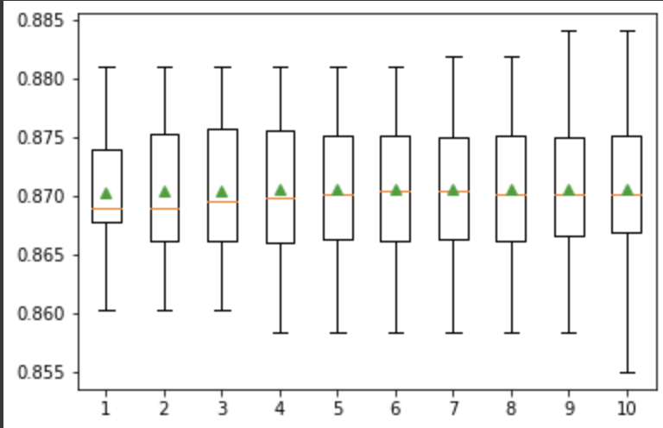
IMPLEMENTATION: Baseline Results
Naïve Bayes and Logistic Regression Models were both used to calculate baseline results as they are relatively simple models compared to SVM's.
Baseline results provide context into the effectiveness of future SVM models
Model | Accuracy | Recall | Precision | F1
Naïve Bayes | 88.6 | 89.36 | 89.69 | 89.52
Logistic Regression | 87.04 | 83.41 | 86.58 | 84.97
Logistic Regression 10-Fold Cross Validation

Slide 5
IMPLEMENTATION: SVM Kernels
Using scikit-learn SVM models, we implement various kernels one by one with increasing complexity to analyze the results as the decision boundary grew in complexity and dimensionality
We explored the following Kernels:
1) Linear
2) Polynomial
3) Radial Bases Functions
How many Features:
Explore results with 3 and all Features.
Best 3 Features discovered via Grid Search and Random Forest Trees

Slide 6
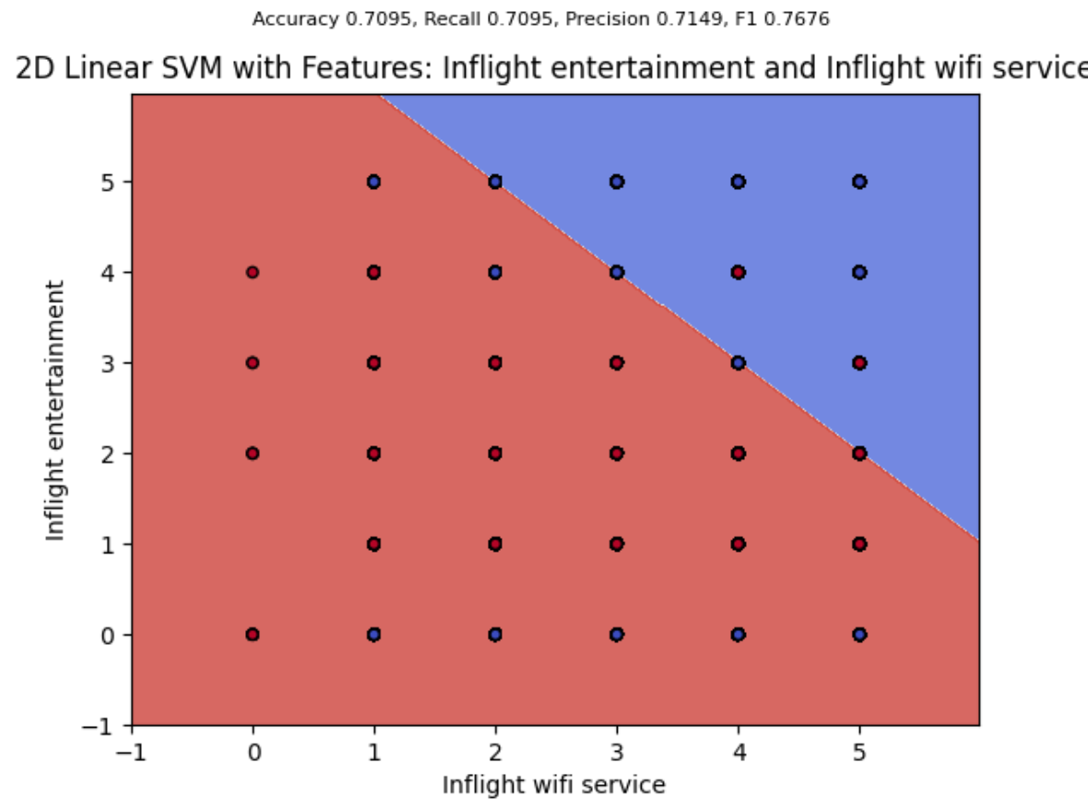
Results: SVM Linear Kernels
The Linear Boundary for SVM Kernel performed under the baseline.
It's is likely that for poor performance simply is due to the true decision boundary being too complex for linear description
Model Summary
2 Feature Sample Visualization
Features | Accuracy | Recall | Precision | F1
2 | 80.04 | 80.04 | 80.14 | 83.04
3 | 84.20 | 77.40 | 85.24 | 84
All | 87.26 | 82.38 | 87.85 | 87

Slide 7
Results: Linear SVM, Investigating the Slack Variable
The different slack values in linear SVM does not provide improvements or impact in the customer satisfaction
On the other hand, from the results it showed that linear decision boundary and the SVM constraints are not significant factors in determining customer satisfaction

Slide 8
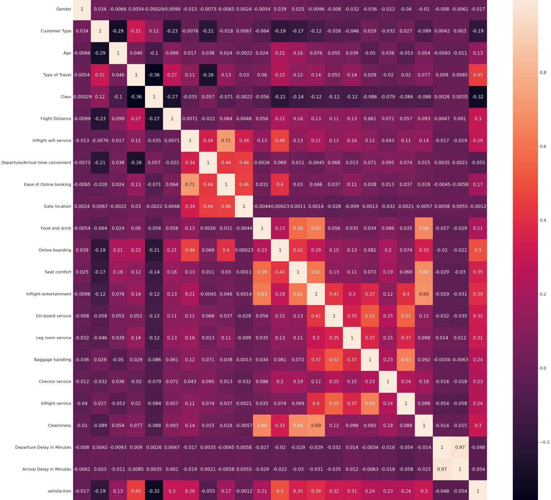
Correlation Heat Map
While some features, such as late departure and late arrival times were highly correlated, correlation overall was relatively low.
The few features found to be found to be highly correlated where "themed" (for example Late Arrival and Late Departure time) and are, to an extent, dependent
The majority of factors were "inside" the airlines control. It would be interesting if features outside their control, such as weather, were recorded so relationships could be identified. For example, When travelling to a cold place, it is most important to have good leg room.

Slide 9
Results: SVM Polynomial and RBF Kernels
RBF Kernel outperformed baseline when given all features!
High Performance of RBF model on all feature confirm suspicion that linear kernel most likely was not a descriptive enough.
Model Summary
Kernel | Features | Accuracy | Recall | Precision
Poly | 3 | 87.75 | 88.76 | 84.20
Poly | All | 92.90 | 89.99 | 93.37
RBF | 3 | 88.75 | 87.99 | 86.59
RBF | All | 94.71 | 92.71 | 95.10

Slide 10

Conclusion
Radial Basis Kernels proved to be the most successful model, beating our baseline by over an impressive 5%.
Despite experimenting with the slack variable C, the linear kernel was not sufficient to beat the baseline.

Slide 11
Future Work
Potentially expand dataset to include conditional variables such as but not limited to dissatisfaction due to bad weather, annoyed with a seatmate or even turbulence that leads to a negative experience
Future analysis can involve different airline companies. Any significant difference for each airline carrier can be appealing to investigate
Involve other factors such as airport, country, pilot experience and others that might have an impact
Given more time, we would like to investigate the why the slack variable had low impact on our linear results

Slide 12

Acknowledgements
Thank you to Professor Ahmad for a great summer semester!

Slide 13
REFERENCES
Klein, TJ. Airline Passenger Satisfaction, Retrieved July 2022 from https://www.kaggle.com/datasets/teejmahal20/airline-passenger-satisfaction.
Scikit-learn: Machine Learning in Python, Pedregosa et al., JMLR 12, pp. 2825-2830, 2011.
Course Notes:
Ahmed, Bilal, "The Naïve Bayes Model", CS6140 Machine Learning Course Notes, Jan. 26, 2015.
Ahmed, Bilal, "Logistic Regression", CS6140 Machine Learning Course Notes
Ahmed, Bilal, "Support Vector Machines III", CS6140 Machine Learning Course Notes, Jan. 26, 2015.
Pavlu, Virgil, "Kernels", CS6140 Machine Learning Course Notes, Nov. 30, 2014

