Slide 1
Which Football player are you? in Roblox
By EMINEM

Slide 2
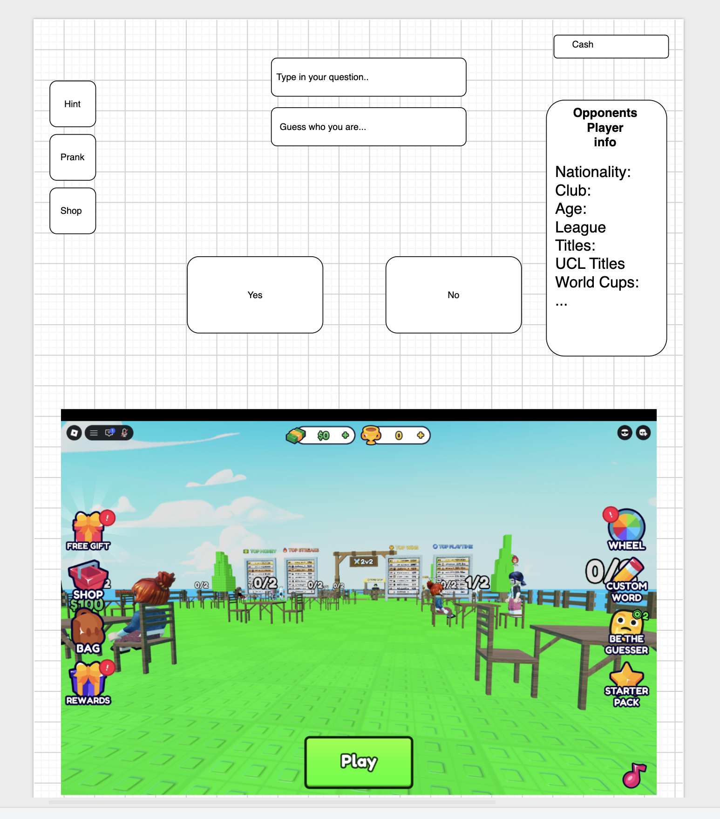
Mockup

