Slide 1
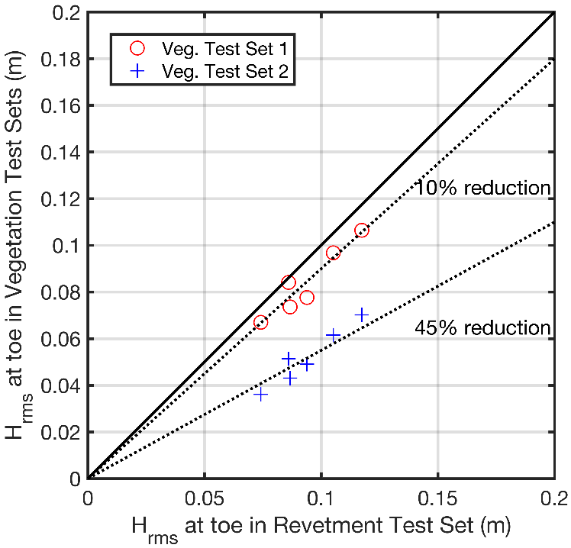
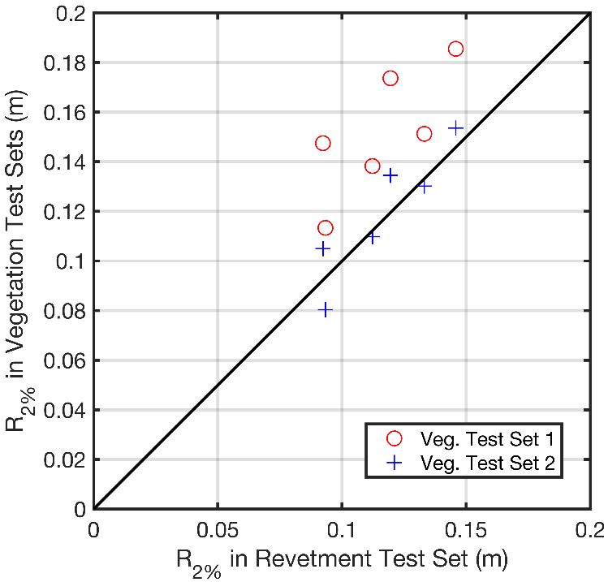

CSHORE Results
Q: Why does smaller $H_{rms}$ at the toe lead to larger $R_{2\%}$?

Slide 2
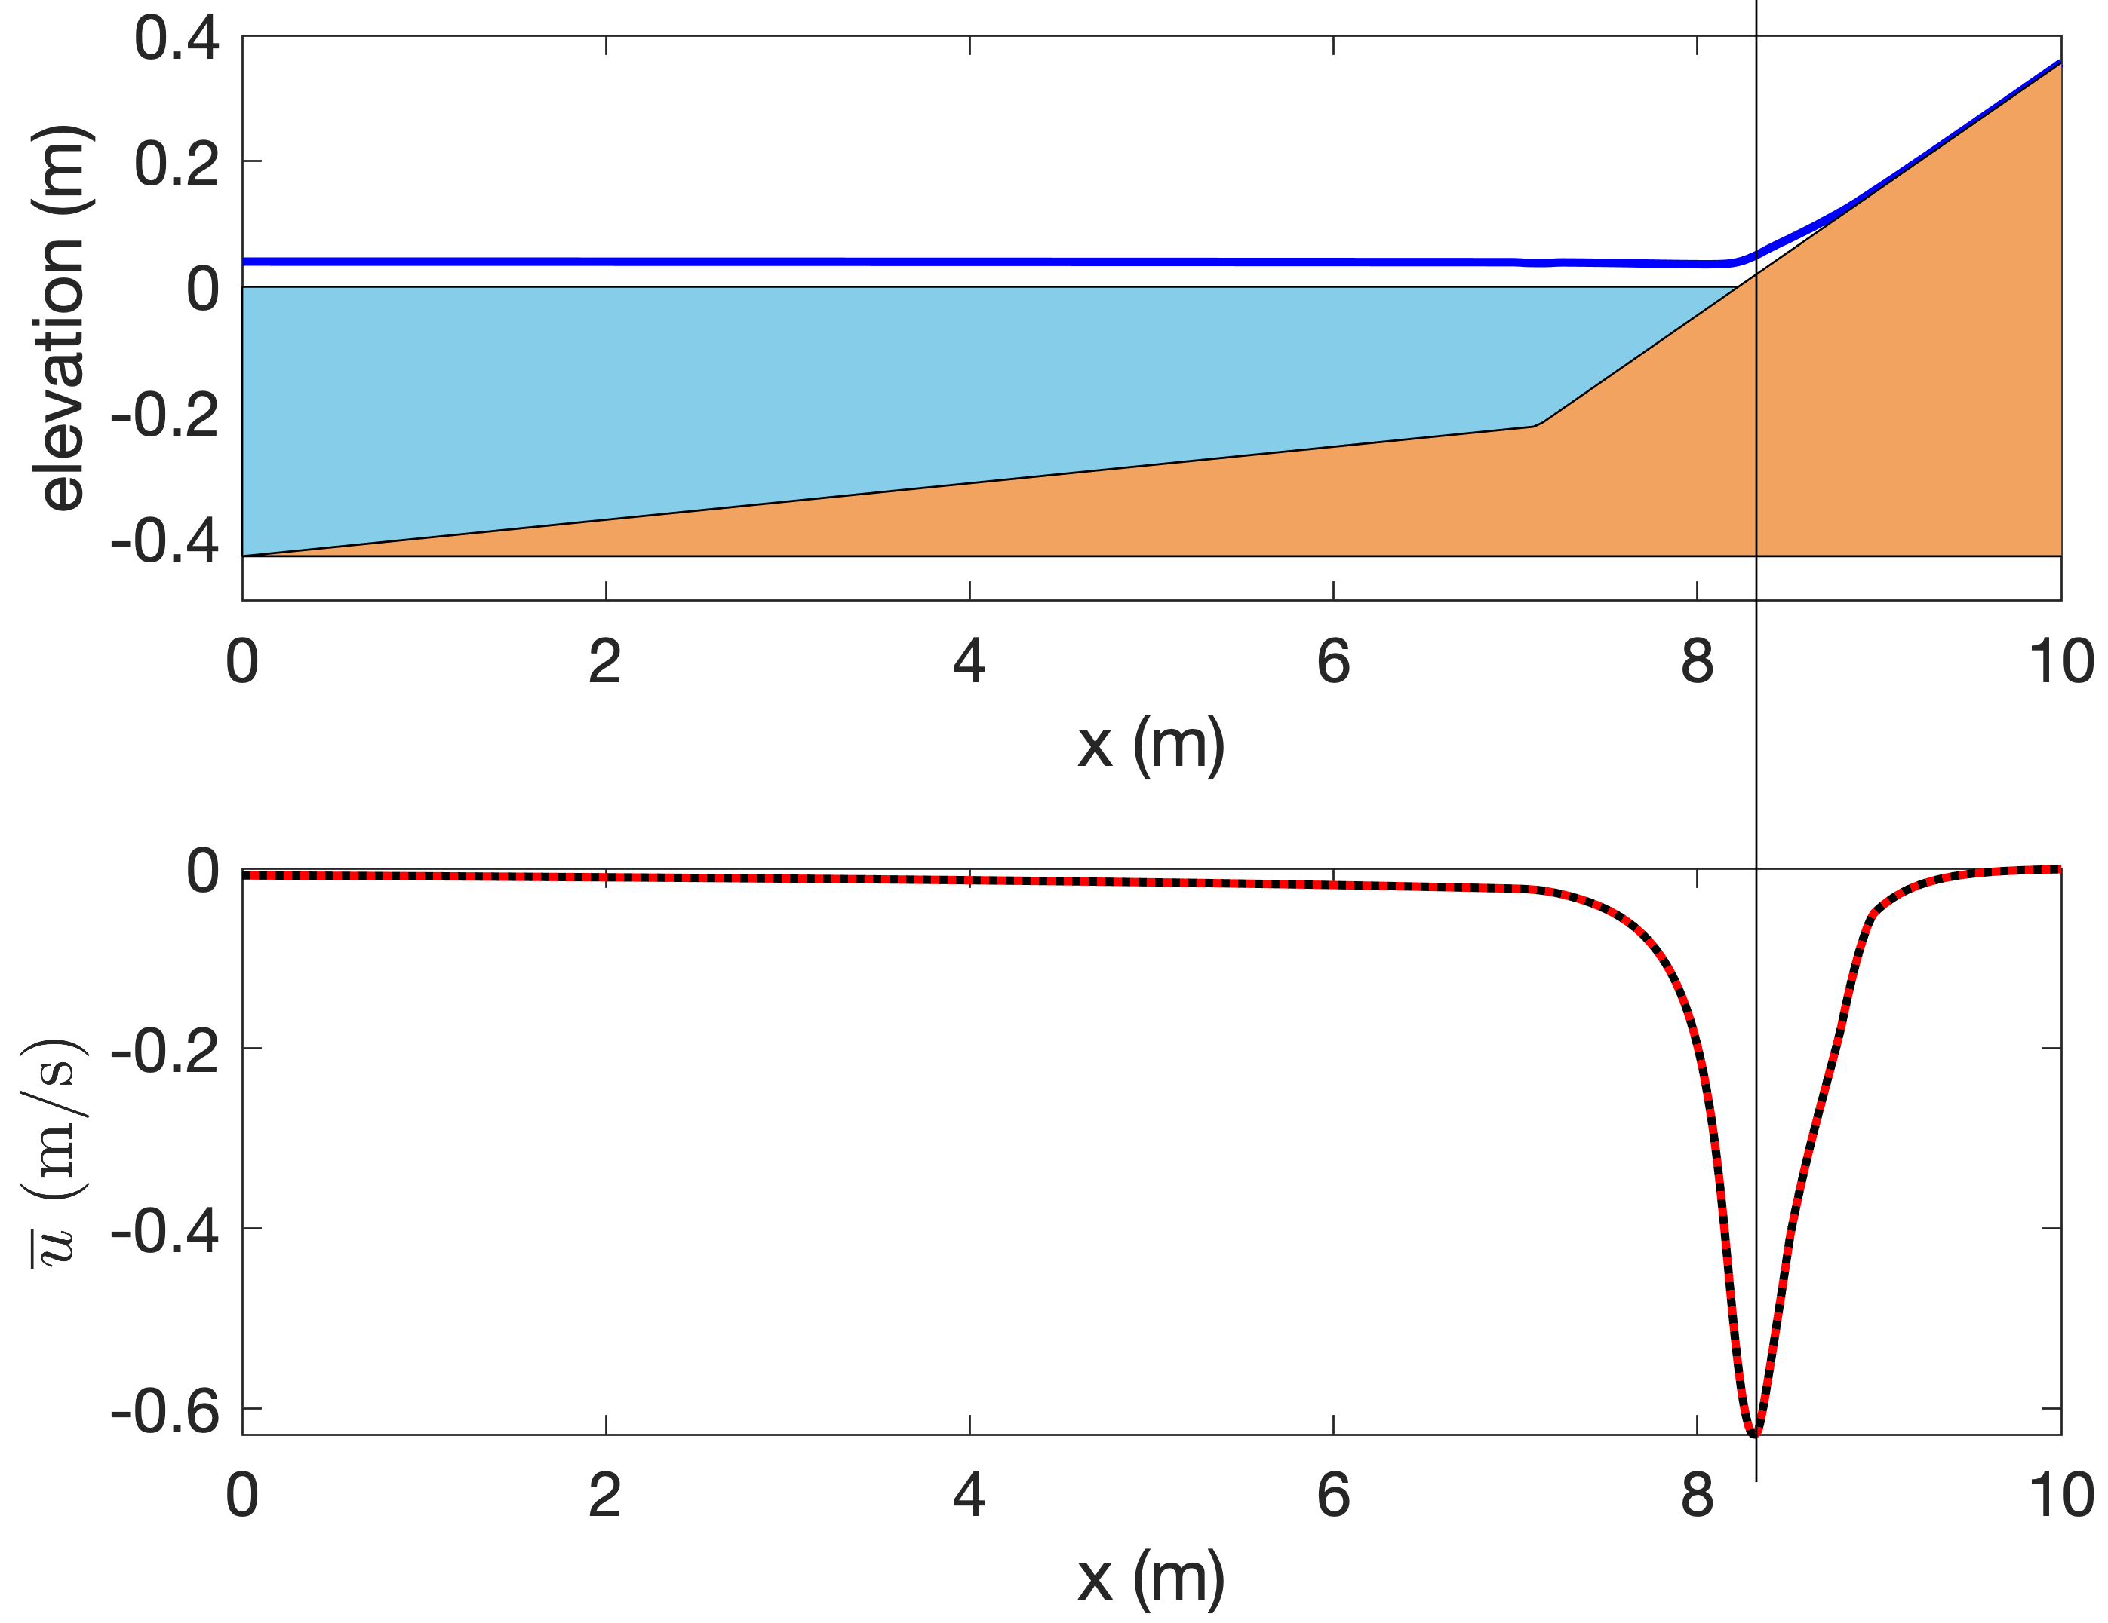
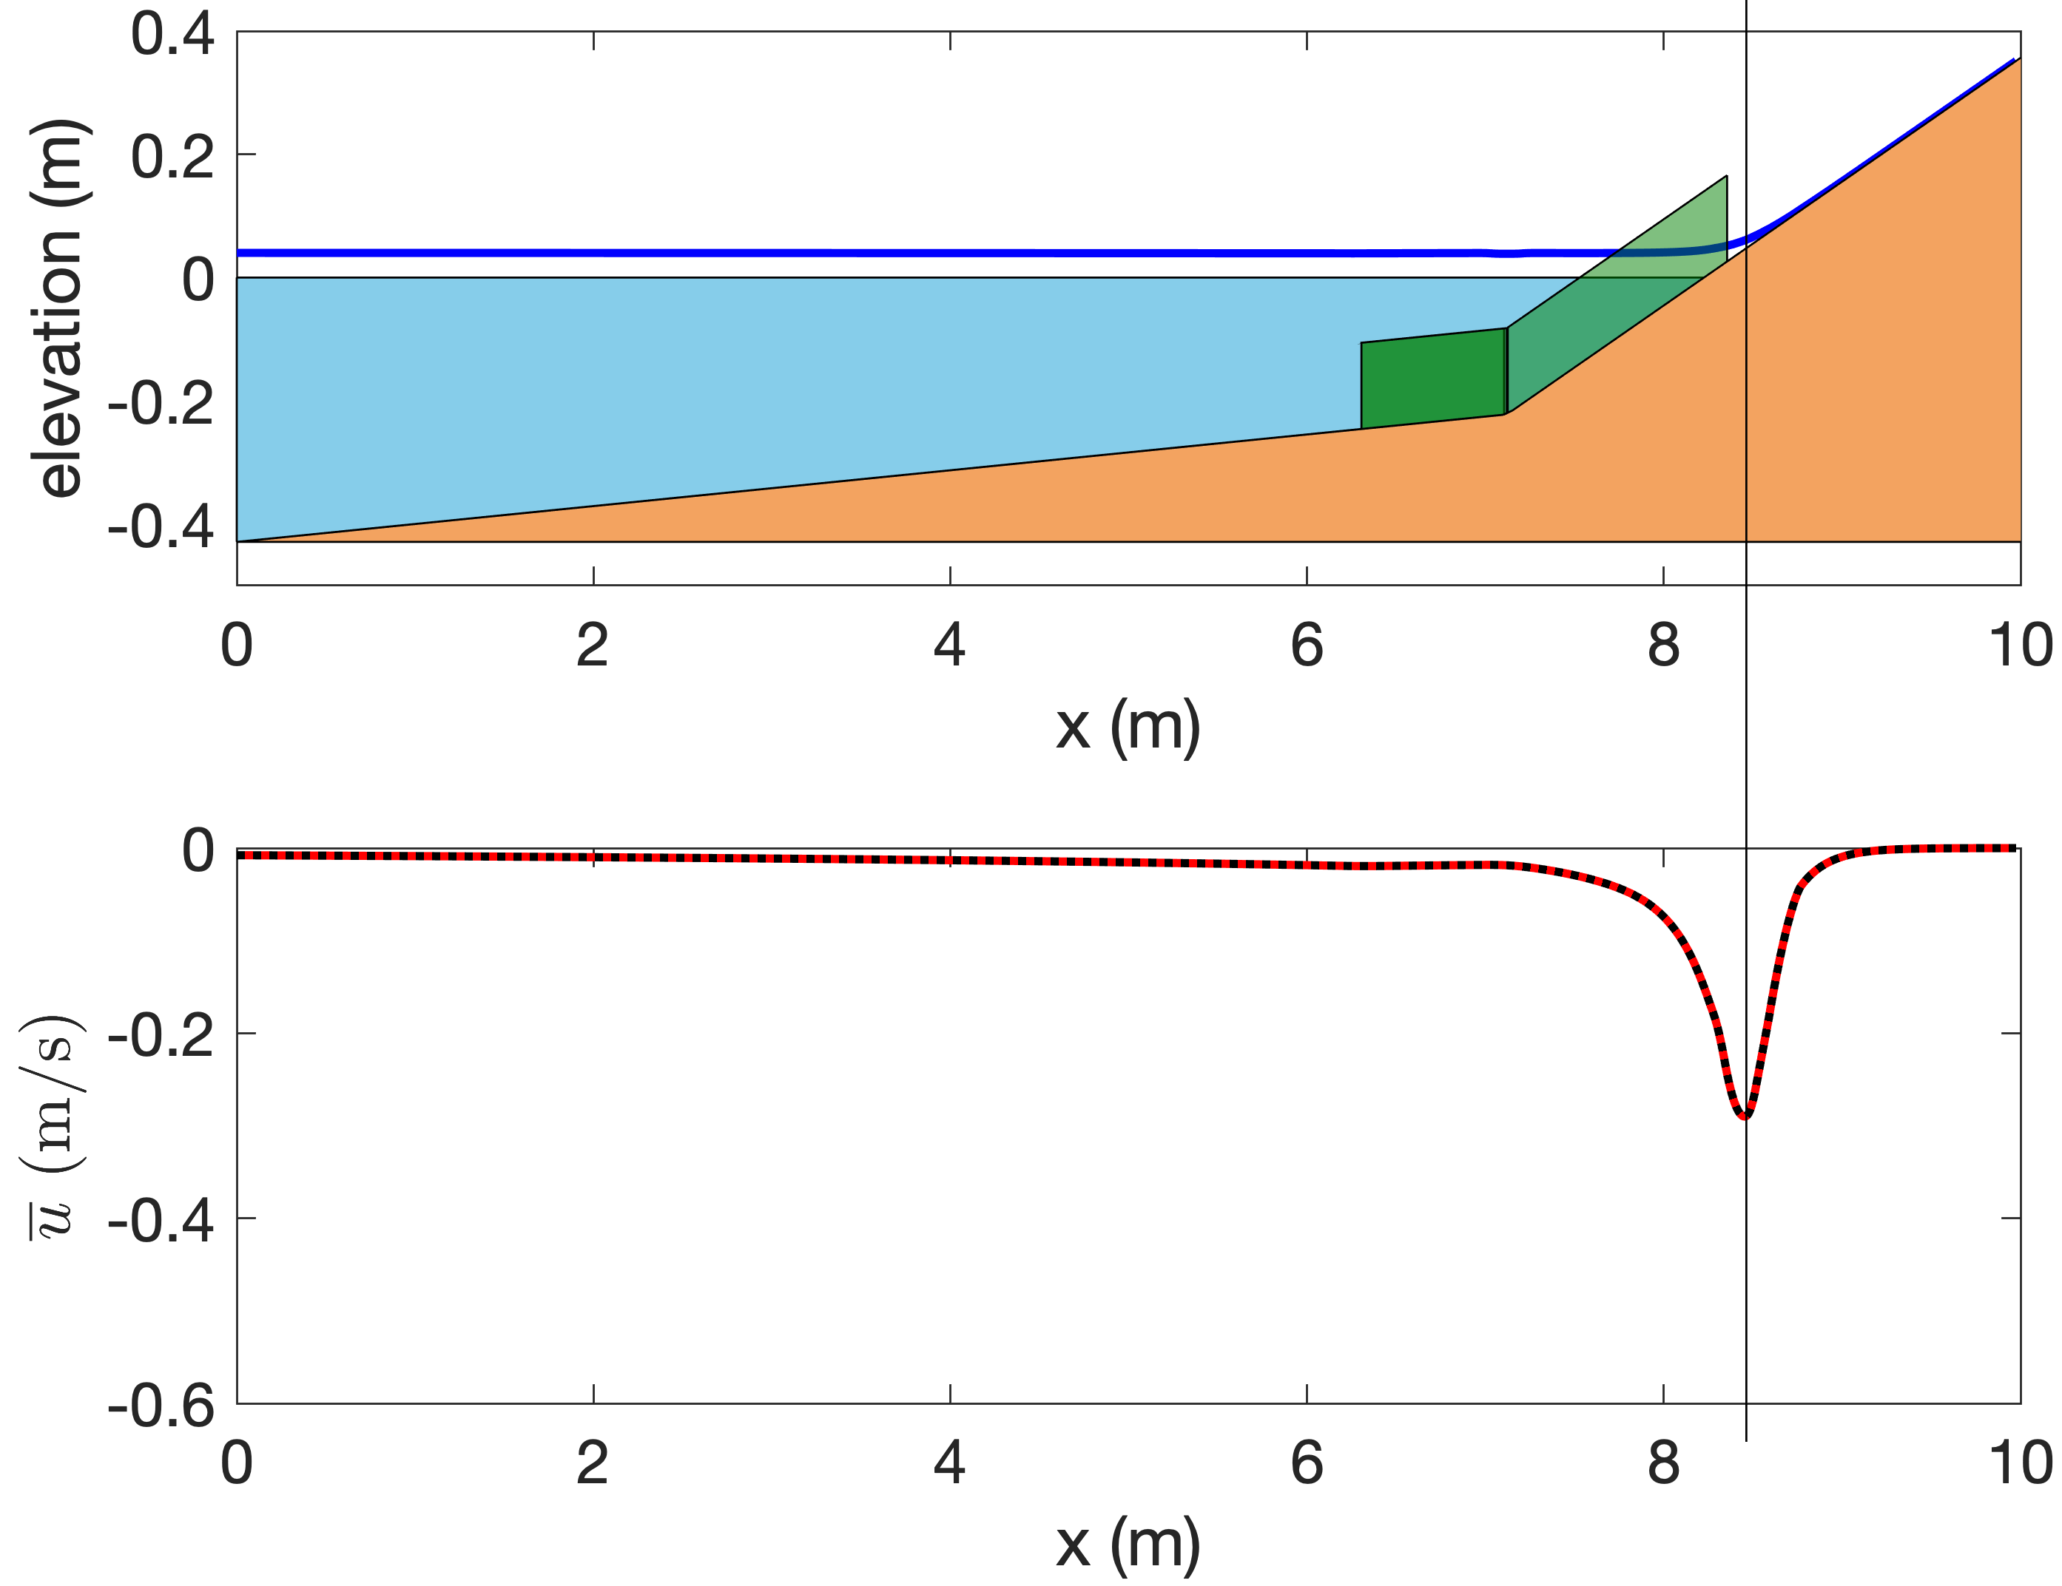
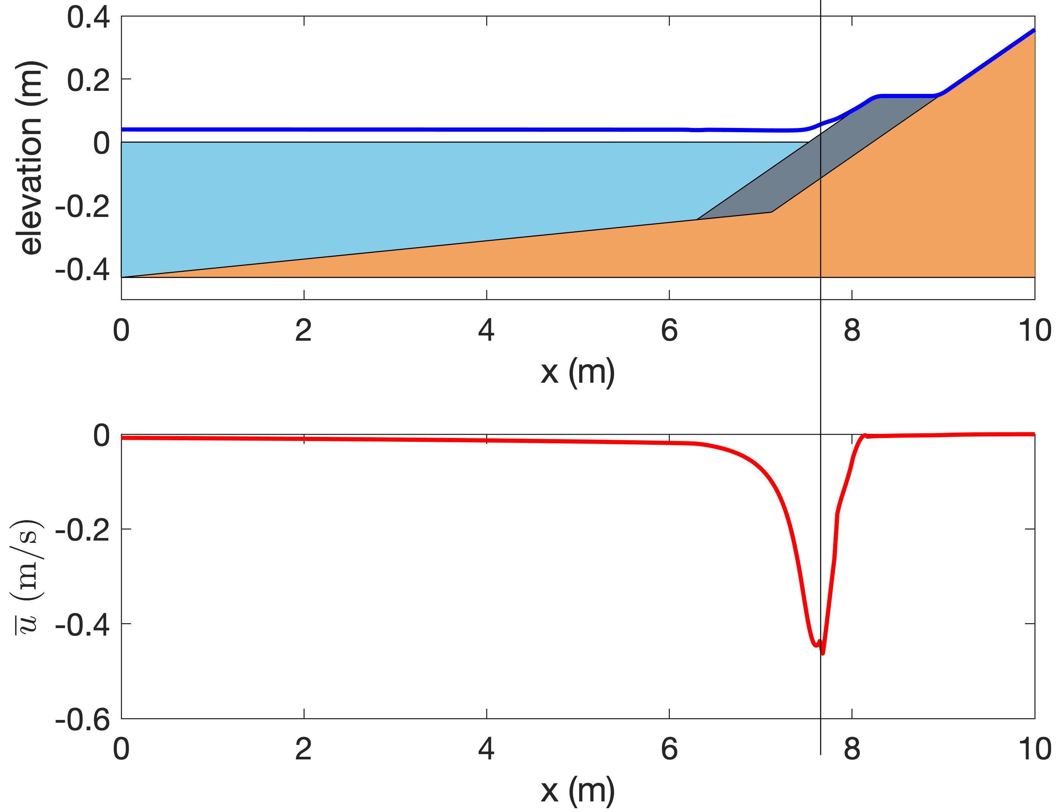
Understand CSHORE Results
toe
toe
toe

Slide 3
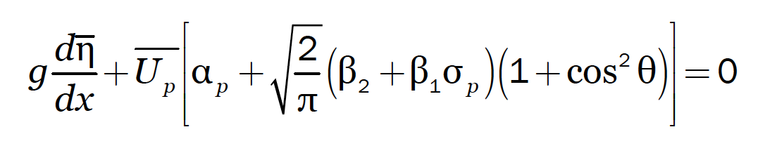
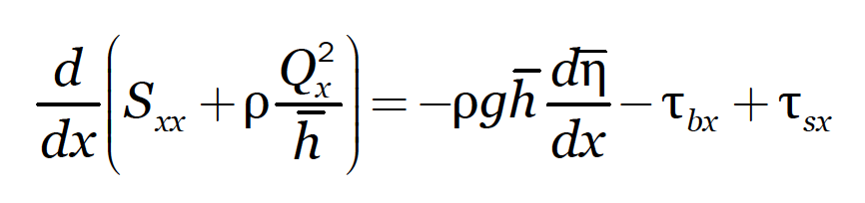
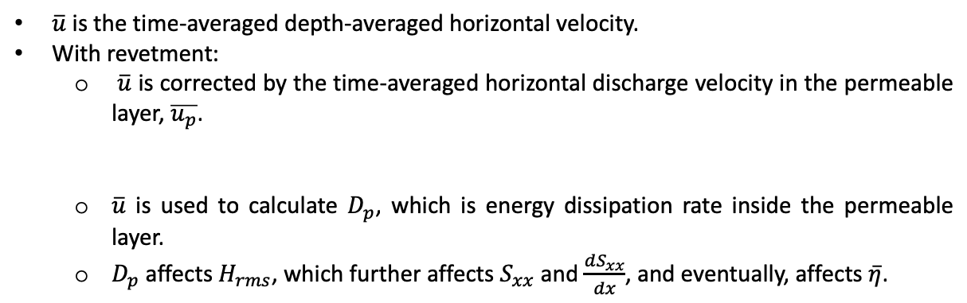
Understand CSHORE Results
toe
toe
toe
$\overline{u}$ is the time-averaged depth-averaged horizontal velocity.
With revetment:
$\overline{u}$ is corrected by the time-averaged horizontal discharge velocity in the permeable layer, $\overline{u_{p}}$.
$\overline{u}$ is used to calculate $D_{p}$, which is energy dissipation rate inside the permeable layer.
$D_{p}$ affects $H_{rms}$, which further affects $S_{xx}$ and $\frac{dS_{xx}}{dx}$, and eventually, affects $\overline{η}$.

Slide 4
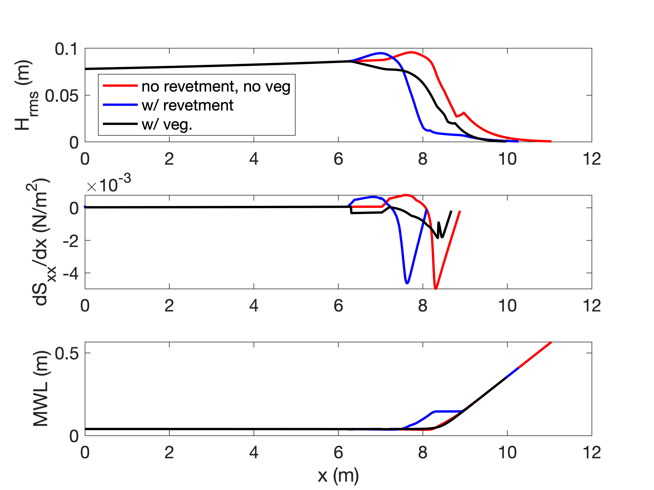
Understand CSHORE Results
toe
toe
toe
$\overline{u}$ is the time-averaged depth-averaged horizontal velocity.
With revetment:
$\overline{u}$ is corrected by the time-averaged horizontal discharge velocity in the permeable layer, $\overline{u_{p}}$.
$\overline{u}$ is used to calculate $D_{p}$, which is energy dissipation rate inside the permeable layer.
$D_{p}$ affects $H_{rms}$, which further affects $S_{xx}$ and $\frac{dS_{xx}}{dx}$, and eventually, affects $\overline{η}$.

Slide 5
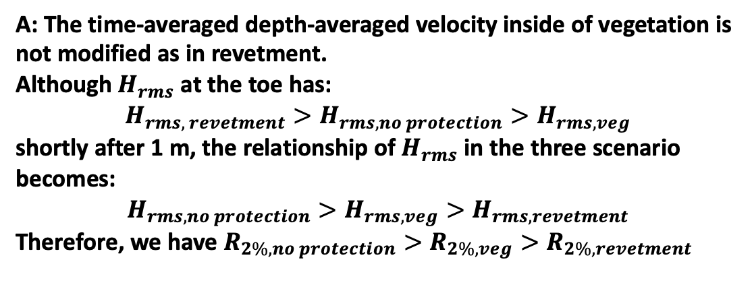
Understand CSHORE Results
toe
toe
toe
A: The time-averaged depth-averaged velocity inside of vegetation is not modified as in revetment.
Although $H_{rms}$ at the toe has:
$$H_{rms, revetment}>H_{rms, no protection}>H_{rms, veg}$$
shortly after 1 m, the relationship of $H_{rms}$ in the three scenario becomes:
$$H_{rms, no protection}>H_{rms, veg}>H_{rms,revetment}$$
Therefore, we have $R_{2\%, no protection}>R_{2\%, veg}>R_{2\%,revetment}$

