Slide 1

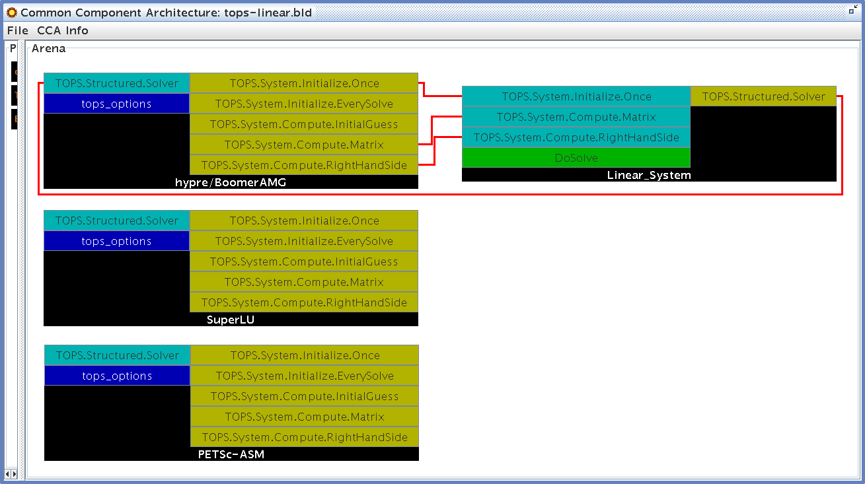

Advanced Scientific Computing Research
Mathematics and Computer Science
TOPS Solver Components
The SciDAC Terascale Optimal PDE Simulations (TOPS) project and the Center for Component Technology for Terascale Simulation Software have developed language-independent software components for the scalable solution of large linear and nonlinear algebraic systems arising from either structured or unstructured meshes. These components, compliant with the Common Component Architecture (CCA) and written using the Scientific Interface Definition Language (SIDL) and Babel software, can interface to underlying solvers provided by a large variety of libraries developed at various institutions, including hypre (LLNL), SuperLU (LBNL), and PETSc (ANL).
The complexity and scale of today’s high-fidelity, multidisciplinary scientific simulations create ever more challenging demands for high-performance numerical solvers that are flexible, extensible, and interoperable. Component-based design can help to manage such complexity by combining object-oriented design with the powerful features of well-defined abstract interfaces, programming language interoperability, and dynamic composability.
Linear Solver Components. TOPS components enable applications scientists to experiment easily with vast numbers of linear solvers without needing to make premature choices about data structures and algorithms. The Ccaffeine framework wiring diagram, below, depicts use of TOPS solver components to solve a linear system arising from a structured mesh problem. The application provides ports for initializing the system and computing the coefficient matrix and right-hand side vector. The BoomerAMG solver within hypre is selected in this case.
Direct Krylov Accelerators Iterative
Sparse Biconjugate gradient BoomerAMG (hypre)
SuperLU Bi-cg-stab ML (Trilinos)
Spooles Chebychev Euclid (hypre)
MUMPS Conjugate gradient Pilut (hypre)
UMFPACK Conjugate residual Prometheus
DSCPACK Flexible GMRES Parasails (hypre)
Dense GMRES SPAI
PLAPACK LSQR PETSc
Minres Multigrid
SYMMLQ
Transpose-free QMR
CCA
Common Component Architecture

Slide 2
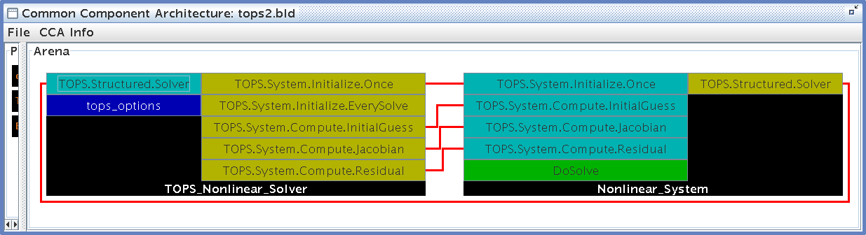
CCA
Common Component Architecture
Nonlinear Solver Components. The TOPS component design helps to make the transition from linear to nonlinear problems straightforward for applications scientists. Also, scientists can easily update solution strategies as more advanced algorithms are formulated and encapsulated within toolkits. The wiring diagram depicted below uses the nonlinear solvers within PETSc. The application provides ports for computing an initial guess as well as computing the residual vector and its associated Jacobian matrix.
TOPS Software Installer. The TOPS software installer can install a large variety of solver packages (listed in the diagram on the reverse side) on most Unix systems, as well as several under Microsoft Windows. This tool helps to ease the difficulties of manually installing the various underlying toolkits to which the TOPS components interface and ensures that the toolkits are all built with the same compilers and compiler options.
TOPS Component Generator. The TOPS component generator can be used to generate the SIDL for application problems, as well as all the boilerplate code needed to use the application code as a Common Component Architecture (CCA) component. Essentially all an application must provide is the source code for the methods that define a given algebraic linear or nonlinear problem.
Future Work. We will incorporate the TOPS components in parallel applications such as fusion and accelerator modeling. Furthermore, using prototype CCA infrastructure for computational quality of service, we will explore the adaptivity of TOPS solver parameters and algorithms in response to changing conditions during long-running simulations.
The complete source code for TOPS solver components, along with the TOPS software installer, is available via http://www.mcs.anl.gov/scidac-tops/solver-components/tops.html .
For further information on this subject contact:
Barry Smith
Argonne National Laboratory
Argonne, IL 60439-4844
E-mail: bsmith@mcs.anl.gov

