Slide 1

TOPS Solver Components
Language-independent software components for the scalable solution of large linear and nonlinear algebraic systems arising from either structured or unstructured meshes
  Solve Ax=b
  Solve f(u)=0, where f:R R
Compliant with the Common Component Architecture (CCA)
  Interfaces use SIDL (Scientific Interface Definition Language) and the Babel (LLNL) language interoperability tool
  Common interfaces to facilitate easy experimentation with different solvers developed by different institutions
Developed by the TOPS and CCTTSS (CCA) SciDAC projects
n n
CCA
Common Component Architecture

Slide 2
Using TOPS Solver Components
The application developer constructs a CCA component that implements the TOPS.System interfaces. This component defines the algebraic system to be solved. (See Appendix.)
The solver and the TOPS.System component can be combined using one of:
  a traditional programming language
  a component scripting language
  a component GUI such as provided by the Ccaffeine framework (SNL) … see examples in following slides
The solver and TOPS.System component then collaborate to solve one or more algebraic problems. Complex applications will likely also couple several additional CCA components.

Slide 3
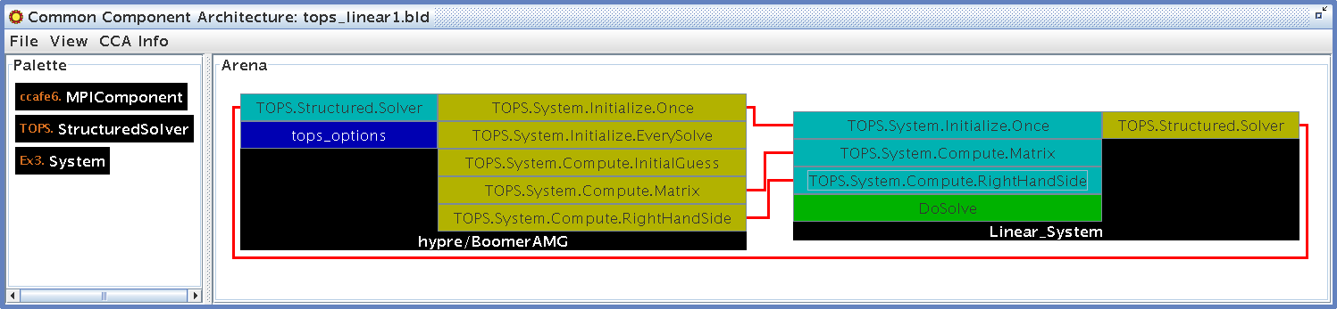
TOPS Linear Solver Components
The application provides ports for
  Initializing the linear system
  Computing the coefficient matrix, A
  Computing the right-hand-side vector, b
The application uses a TOPS solver port
This wiring diagram using the GUI within the Ccaffeine framework (SNL) depicts solving a linear system arising from a structured mesh problem. The BoomerAMG solver within hypre (LLNL) is employed. The large black boxes represent components. The small light blue boxes denote provides ports (functionality provided for use by another component); the small gold boxes denote uses ports (functionality needed from another component);

Slide 4
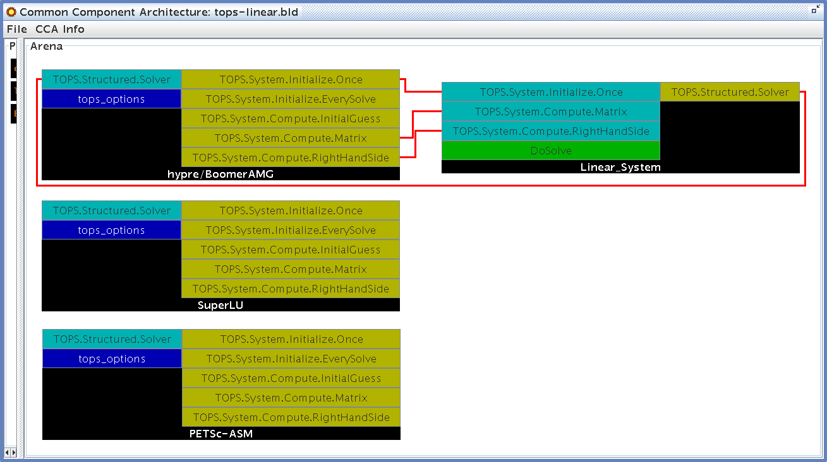
Facilitating Experimentation
TOPS solvers enable applications scientists to easily experiment with vast numbers of linear solvers without needing to make premature choices about data structures and algorithms.
Direct Krylov Accelerators Iterative
Sparse Biconjugate gradient BoomerAMG (hypre)
SuperLU Bi-cg-stab ML (Trilinos)
Spooles Chebychev Euclid (hypre)
MUMPS Conjugate gradient Pilut (hypre)
UMFPACK Conjugate residual Prometheus
DSCPACK Flexible GMRES Parasails (hypre)
Dense GMRES SPAI
PLAPACK LSQR PETSc
Minres Multigrid
SYMMLQ
Transpose-free QMR
[Link to on-line demo]

Slide 5
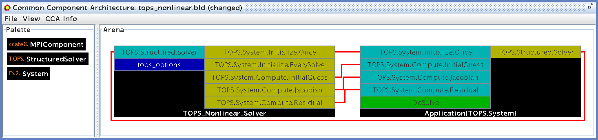
TOPS Nonlinear Solver Components
The TOPS design makes the transition from linear to nonlinear problems straightforward.
The application provides ports for
  Initializing the nonlinear system
  Computing the residual vector, f(u)
  Computing the associated Jacobian matrix, f’(u) (optional)
The application uses a TOPS solver port
This wiring diagram depicts solving a nonlinear system arising from a structured mesh problem using a Newton-based nonlinear solver in PETSc (ANL).

Slide 6
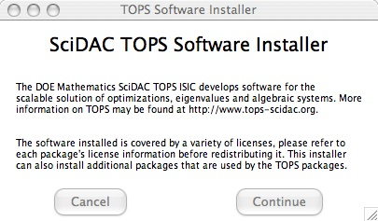
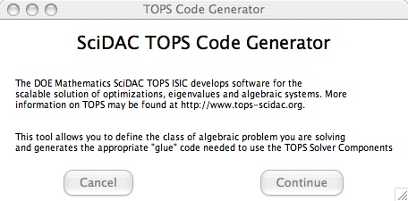
Auxiliary TOPS Tools
TOPS Software Installer: Can download and install a large variety of solver packages.
  Eases the difficulties of manual installation of the various underlying toolkits
  Ensures that the toolkits are all built with the same compilers and compiler options
TOPS Component Generator: Can generate the SIDL for your problem and all the boilerplate code needed to use it as a CCA component
  Essentially, applications simply need to provide source code for the methods that define an algebraic linear or nonlinear problem.
(See Appendix for more details.)

Slide 7
Example Code
See several linear and nonlinear examples at:
  http://www.mcs.anl.gov/scidac-tops/solver-components/tops.html
Classic Bratu (solid fuel ignition) problem discretized with finite differences on a regular mesh in two dimensions
  Solve: – Laplacian(u) – lambda*exp(u) = 0, 0 < x,y < 1
  where u=0 for x=0,x=1, y=0, y=1
The application code consists of:
  SIDL definition of the System component (in file Ex1.sidl)
  package Ex1 version 0.0.0 {
  class System implements-all TOPS.System.Compute.Residual,
  gov.cca.Component,
  gov.cca.ports.GoPort {}
  }
  Code that defines the nonlinear equation
    In file Ex1_System_Impl.cc … (See next slide)

Slide 8
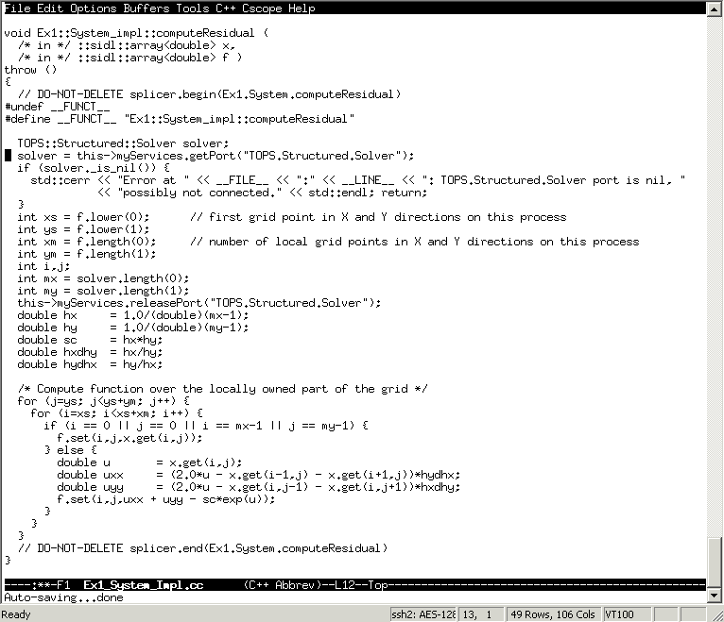
Example Code (cont.)
File: Ex1_System_Impl.cc
Get TOPS solver port
Release TOPS solver port

Slide 9
Current Status and Future Plans
The complete source code for TOPS components, along with the TOPS Software Installer, are available:
  http://www.mcs.anl.gov/scidac-tops/solver-components/tops.html
Future work includes
  Incorporating TOPS components into scientific simulations
  Using CCA infrastructure for computational quality of service to explore the adaptivity of TOPS solver parameters and algorithms in response to changing conditions during long-running simulations

Slide 10
Appendix
TOPS.System
TOPS Component Generator
TOPS Software Installer
Additional CCA Overview Slides

Slide 11
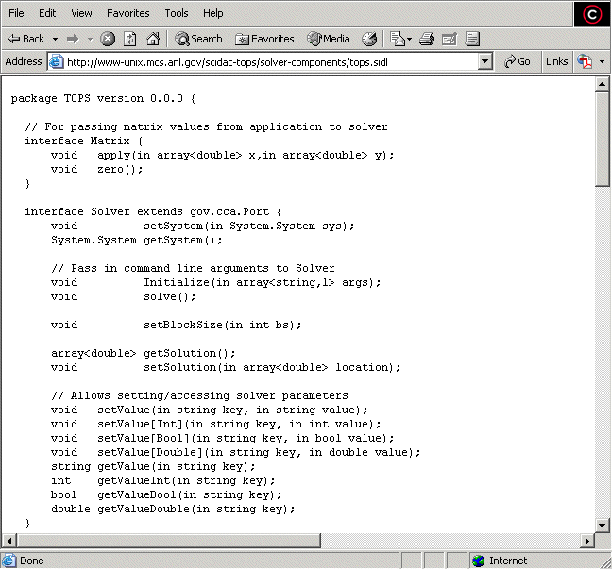
TOPS.System (1)
(continued)

Slide 12
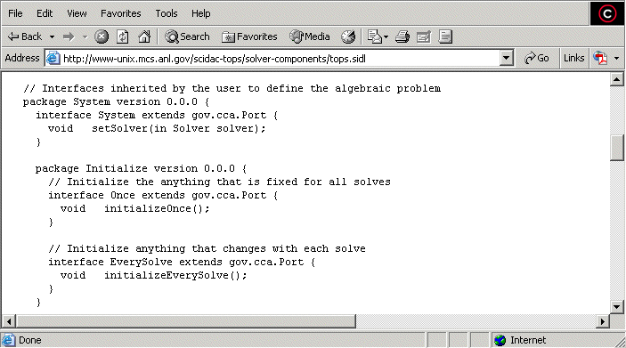
TOPS.System (2)
(continued)

Slide 13
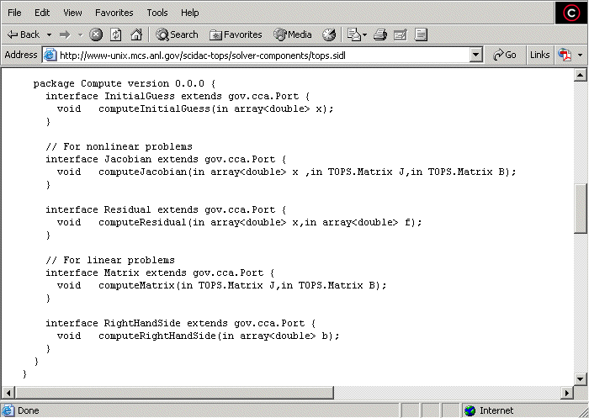
TOPS.System (3)
(continued)

Slide 14
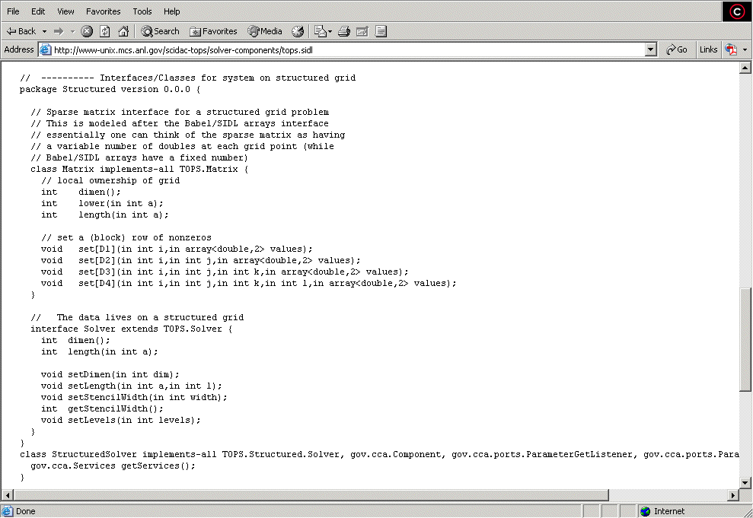
TOPS.System (4)
(continued)

Slide 15
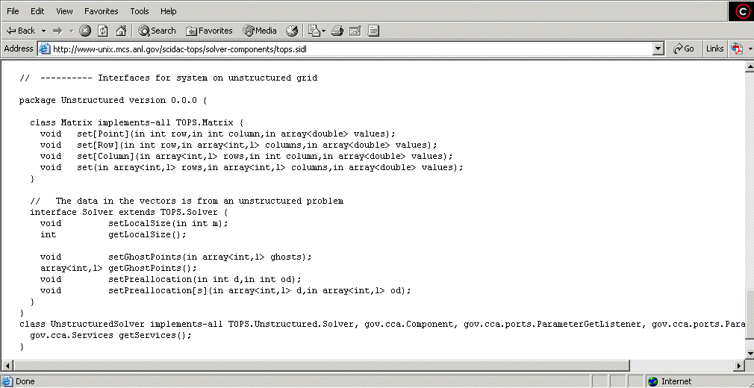
TOPS.System (5)

Slide 16
TOPS Software Installer (1)
Download TOPSInstaller.py and run:
python TOPSInstaller.py (on Apple Mac OS X pythonw may be needed)
Written using the EasyGui.py python module
Follow the questions as below:

Slide 17
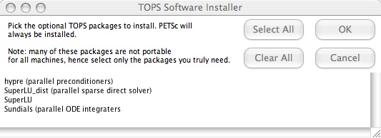
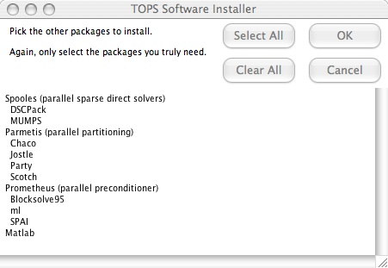
TOPS Software Installer (2)

Slide 18
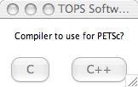
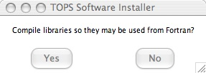
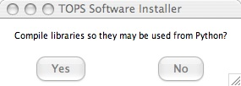
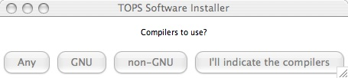
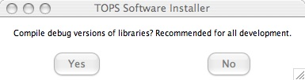
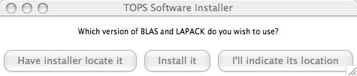
TOPS Software Installer (3)

Slide 19
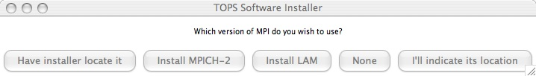
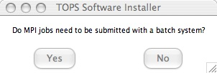
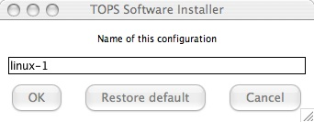
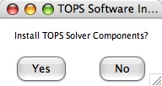
TOPS Software Installer (4)

Slide 20
TOPS Component Generator (1)
Generates
  the SIDL
  the Babel boilerplate server code
  all the CCA port registration code that must be added to the Babel generated code
  a makefile that builds the component
Essentially, applications simply need provide source code for the methods that define an algebraic linear or nonlinear problem.
Run:
  python TOPSGenerator.py (on Apple Mac OS X you may need pythonw)
The particular set of images below generated the second TOPS solver component example
  Multicomponent nonlinear PDE using a structured mesh (driven cavity model)
  See examples/c++/Ex2

Slide 21
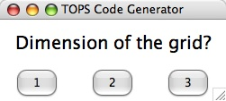
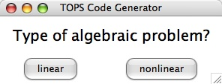
TOPS Component Generator (2)

Slide 22
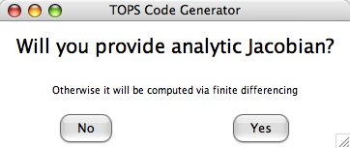
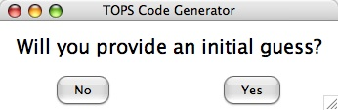
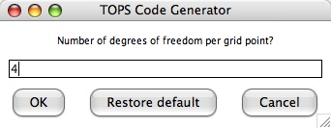
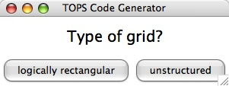
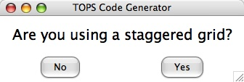
TOPS Component Generator (3)

Slide 23
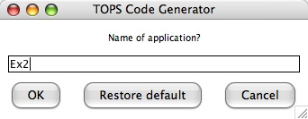
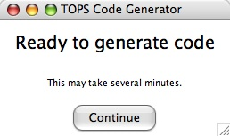
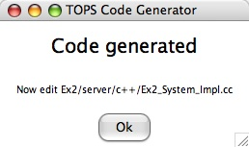
TOPS Component Generator (4)

Slide 24
Additional Overview CCA Slides
The following 4 slides provide an overview of how the CCA is enabling new approaches to scientific discovery. Just FYI. Use (or not) as you see fit. The 4th slide (CCA Overview) is intended primarily as background information.

Slide 25
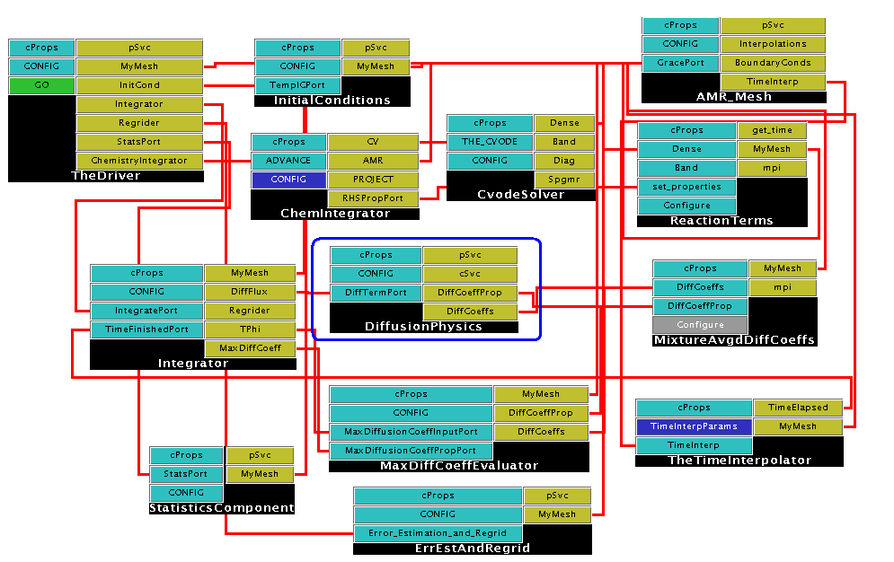
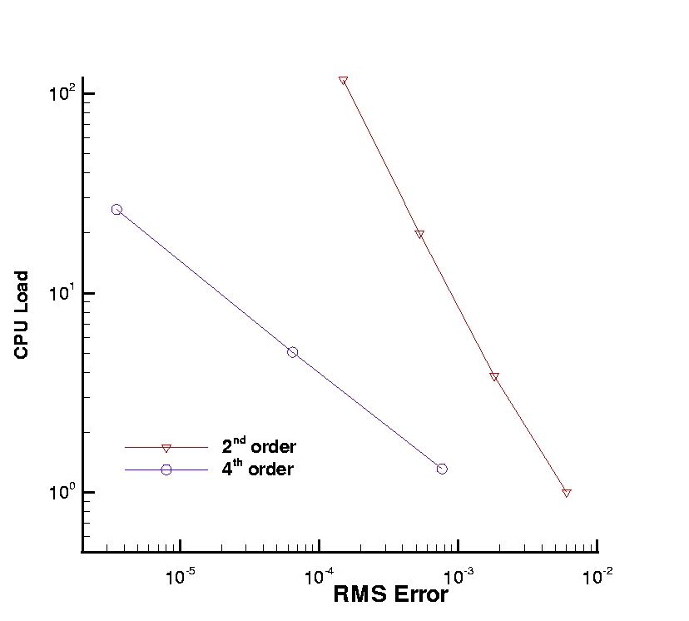
The CCA provides component technology for high-performance computing
The Common Component Architecture (CCA) has enabled the SciDAC Computational Facility for Reacting Flow Science (CFRFS) to create a plug-and-play toolkit for AMR-based simulations of combustion. Recently, high-order discretizations were incorporated to drastically reduce resolution requirements and computation time.
Changes confined to one component!
CPU load as a function of error for old (red) and new (blue) algorithms
Habib Najm (CFRFS PI): “The CCA has provided us with a great framework for developing and maintaining reacting flow codes. By providing well-defined interfaces and encouraging a code structure based on a hierarchy of interchangeable, lightweight components, the CCA-based CFRFS toolkit has resolved significant challenges with handling reacting flow code complexity.”
Ref: S. Lefantzi, et al. A Component-Based Toolkit for Reacting Flows with High Order Spatial Discretizations on Structured Adaptively Refined Meshes. Progress in Computational Fluid Dynamics, to appear.

Slide 26
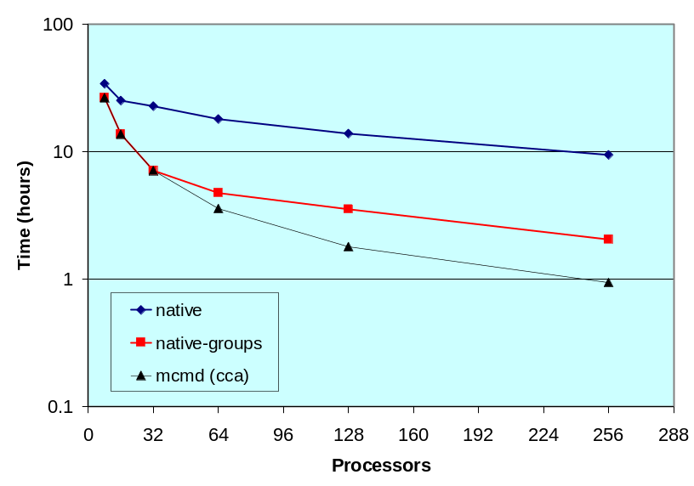
The CCA enables new approaches to scientific discovery
For quantum chemists at PNNL (NWChem package) and SNL (MPQC package), the CCA provides new capabilities.
The team achieved cost reductions of up to 43% for molecular structure determinations via CCA-based access to optimization components from ANL’s Toolkit for Advanced Optimization (TAO) and parallel data management components from PNNL’s Global Arrays
In other calculations, use of CCA-provided infrastructure has resulted in 10-fold speed-ups by facilitating implementation of a hybrid parallel algorithm.
NWChem leader Theresa Windus: “The hybrid algorithm would have been impractical to implement in a reasonable time without using the CCA; we see CCA-based technology as the foundation of future software development in chemistry.”
Refs: J. P. Kenny, et al., Component-Based Integration of Chemistry and Optimization Software, J. Computat. Chem. 24, 1717 (2004); M. Krishnan, et al., Multilevel Parallelism in Computational Chemistry using Common Component Architecture and Global Arrays, Proceedings of SC2005, to appear.

Slide 27
CCA has seen widespread adoption in SciDAC and HPC in general
Application areas participating in the CCA:
astronomy, astrophysics, biological and medical simulations, chemically reacting flow, climate and weather modeling, combustion, computational chemistry, data management, fusion and plasma physics modeling, linear algebra, materials science, molecular electronics, nanoscience, nuclear power plant simulations, structured adaptive meshes, unstructured meshes, and visualization
Research agencies sponsoring software development using the CCA:
DOE (SciDAC, Office of Science, NNSA/ASC), NASA, NIH, NSF, DoD, European Union

Slide 28
CCA Overview
Component environments
  Combine object-oriented design with the powerful features of
    Well-defined interfaces
    Programming language interoperability
    Dynamic composability
  Popular in commercial computing but do not adequately serve HPC needs
The Common Component Architecture (CCA) is specially designed to meet the needs of high-performance scientific computing
  Support for legacy software
    Minimal change required for component environment
  Performance is important
    Negligible overhead for typical scientific applications (usually <1%)
  Both parallel and distributed computing are important
  Support for languages, data types, and platforms
    Including Fortran
    Including complex numbers and multi-dimensional arrays (as first-class objects)
    Portable to diverse parallel computing environments
CCA specification and tools are developed by the CCA Forum
  An open group that was established in 1998 as a grass-roots outgrowth of the DOE2000 initiative
  The Center for Component Technology for Terascale Simulation Software
    Subset of the CCA Forum
    Members receive partial support from the SciDAC initiative

