Slide 1
The Problem with Granular Media
John F. Peters
US Army ERDC,
Geotechnical and Structures Laboratory
Notes:
1

Slide 2
Synopsis
Sand can be viewed as either a collection of objects or as a continuum. When viewed as a continuum, sand becomes an enigma.
A Navier-Stokes equation for sand?
Sand as a solid and the problem of friction.
What is the way forward?

Slide 3





An Experiment

Slide 4

Rate-Independent Viscosity
τ
v
x
τ
γ

Slide 5
Frictional solids
Analytical versus experimental aspects of stability
  Violation of “stability” condition an experimental fact
  Local continuum formulation is ill-posed
  Comments on discrete structure and non-local theory
Findings from micromechanical observations
  Diffusion plays a major role in constitutive response
  Diffusion implies “viscosity” in granular media
Closing Remarks
  A suitable model for granular media will be nonlocal
  Should not view problem as “regularization”

Slide 6
Instability and Frictional Materials
τ
Stable Materials
dσ_{ij} dε_{ij}>0 (Hill) dσ_{ij} dε_{ij}^{p}>0 (Drucker)
  Convexity of yield surface
  Normality of plastic strain rate
  Existence, uniqueness, and stability of solution
  Material stability (Drucker)
Frictional materials violate both Hill and Drucker condition yet appear to be stable
γ

Slide 7
Mandel’s Stability Experiment
N,dv
T_{f} = μN
T,du
T_{f}
>
dN dv + dT du 0
=
>

Slide 8
Lade’s Wedge Experiment
dε^{p}
q
yield surface
dw<0
p’

Slide 9
Reflection on Mandel and Lade
Violation of dσ_{ij} dε_{ij}>0 (and dσ_{ij} dε_{ij}^{p}>0) is directly observed.
Definition of yield surface, or even its existence, is not an issue.
Non-symmetric tangent stiffness can be inferred from experiments.
Violation of dσ_{ij} dε_{ij}>0 is necessary for modeling important
engineering behavior (e.g. liquefaction and shear banding).
Relationship of dσ_{ij} dε_{ij}>0 to physical stability is unclear.
Ostensibly stable system but with dσ_{ij} dε_{ij}>0 becomes unstable
when a constraint is applied.

Slide 10
Unstable Effect of Constraint
N,dv=0
T,du

Slide 11
Question of Well Posed Solution
Question left open by Hill/Drucker approach for frictional materials
Uniqueness, existence and stability determined from algebraic
properties of acoustic tensor (Hadamard, Mandel, Hill, and Schaeffer).
Analysis is closely tied to that for shear banding (Mandel, Thomas,
Hill, and Rudnicki and Rice).
Comprehensive analysis by Valanis and Peters (1996) specifically
identified that properties of the eigenvalues to the acoustic tensor
determined properties of the solution.

Slide 12
Properties of Acoustic Tensor Q
Given Q_{ij} = C_{ijkl} n_{j} n_{l} with eigenvalues λ_{r}:
Finite, real, and positive λ_{r} is necessary and sufficient for well-
posed Initial-Boundary Value Problem.
For non-symmetric Q, positive-definite property Q_{ij}x_{i}x_{j}>0 does
not imply λ_{r} is finite, real, and positive and vice versa.
1. Therefore, in frictional materials the Hill/Drucker conditions are neither necessary nor sufficient for existence, stability, and uniqueness of solutions!
2. Local continuum theory is not sufficient because models that predict experiment cannot lead to well-posed mathematical problems in general.

Slide 13
Convergence of Discrete Approximations
Map solution from a numerical grid to a truncated Fourier
representation.
U (x,y)=ΣΣ A_{NM} cos(N π x/L) cos(M π y/H)
V(x,y)=ΣΣ B_{NM} cos(N π x/L) cos(M π y/H)
Characteristic polynomial in terms of rational N/M rather than n_{x}/n_{y}. Therefore, λ_{r}=0 can be only approximated for any (N,M).
1. Conditions for loss of hyperbolicity more closely met as resolution
is increased (sensitivity to grid size).
2. λ_{r}=0 is possible for some orientation of “grid” (sensitivity to grid orientation).
n_{i}
N M
N M

Slide 14
Nonlocal Theory
Eringen’s nonlocal elastic media for
lattice dynamics (1D version).
t,_{k} + ρ (f - v,_{t} ) = 0 (EQoM)
α(|x-x’|)
(1)
-a
a
x-x’
α’(|x-x’|)
(2)
a
-a
x-x’
Equations (1) and (2) combine to give
α’’(|x-x’|)
-a
a
x-x’

Slide 15
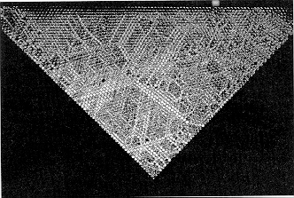
Structures in Granular Media
“Stress” chains in assembladge of photoelastic discs (Behringer and Baxter, 1994)

Slide 16

Nearly Rigid Particles
Stability of the stool:the iso-static state
Force chains are the result of a “rigid” instability.
Number of Legs
1-2 too few
4 too many
3 just right

Slide 17
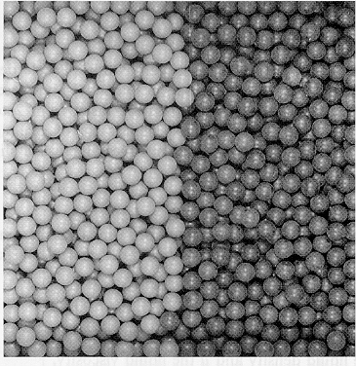
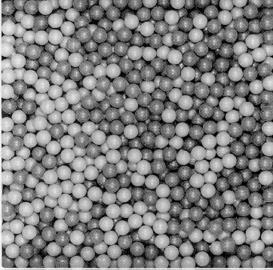
Diffusion in Granular Media
Before Shear
After Shear
Mixing of particles caused by cyclic simple shear (Bridgewater, 1994)

Slide 18
Implications of Diffusion Law
Nature of particle movements imply that diffusion should
have spatial component
  Configuration entropy-temperature of Valanis et. al.
  Should include endochronic “viscosity”
Diffusion a source of energy “dissipation”
  internal friction
  boundary effects
Diffusion might not be entirely rate independent
  Should consider “micro-inertia” at rapid shear rates
  (e.g. Experiments of Skempton et. al.)
Complete theory will be “non-local”

Slide 19
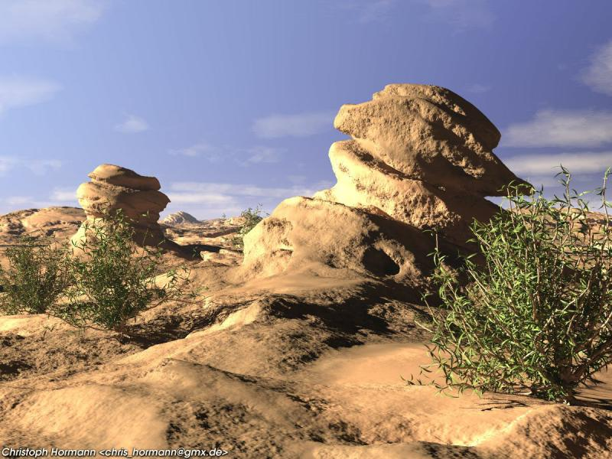
Thank You

