Slide 1

Dynamic
Speculators
Ahmed Zeer

Slide 2
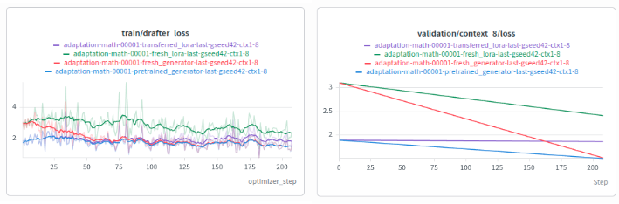
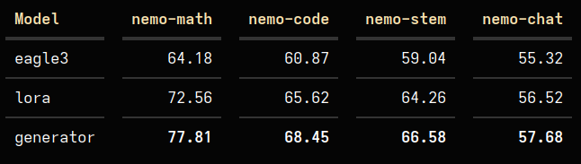
LoRA Bank VS. Direct
Generator achieves better loss than oracle LoRA.
Pretraining on a LoRA bank isn’t effective.
Ahmed Zeer

Slide 3
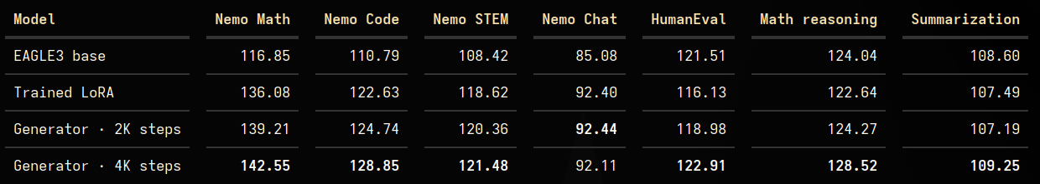
Direct
Train the generator on 24K data (5K from each category + val).
Train LoRA on the same amount of data.
4K Steps -> 3 Epochs
The more we train the generator the better it gets.
The results match our expectation of ~1.5x speedup
Ahmed Zeer

Slide 4
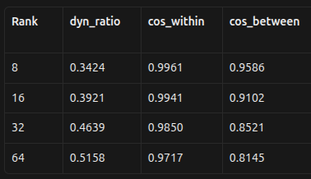
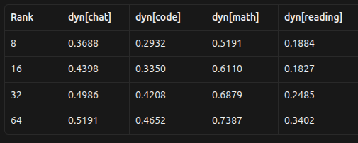
Dynamism
We have 4 categories: math, code, stem and chat
We should measure the change in lora cross-category and in-category.
The higher the rank gets, the more “dynamic” the generator is.
Ahmed Zeer

Slide 5
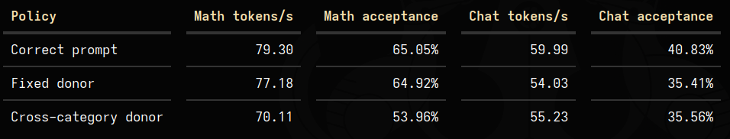
Dynamism
Let’s think about two distinct categories: math and chat
What happens if we swap loras between categories? (cross-categ donor)
What happens if we use the same lora in a category? (fixed donor)
As expected, swapping categories causes decrement in performance and using a single lora for each category also reduces throughput.
Ahmed Zeer

Slide 6
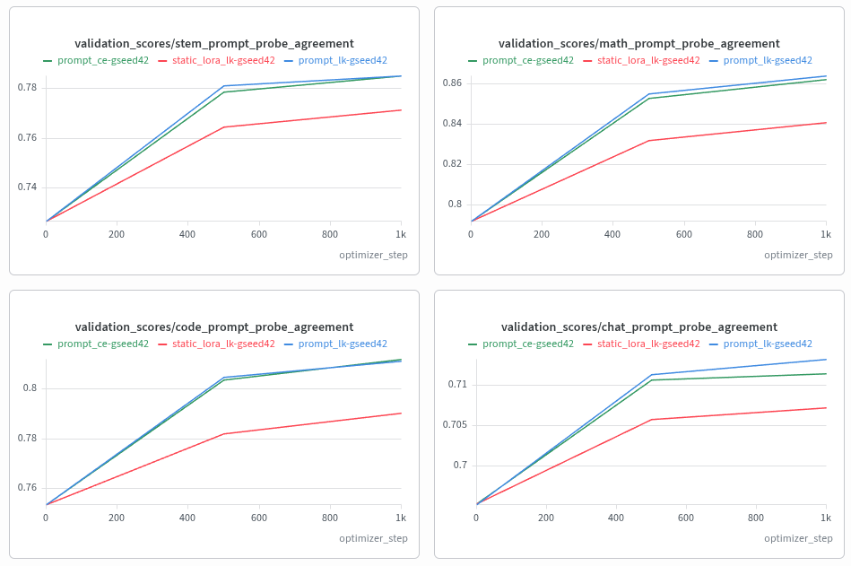
Loss
What happens if we train using CE instead of LK loss?
No difference.
Ahmed Zeer

Slide 7
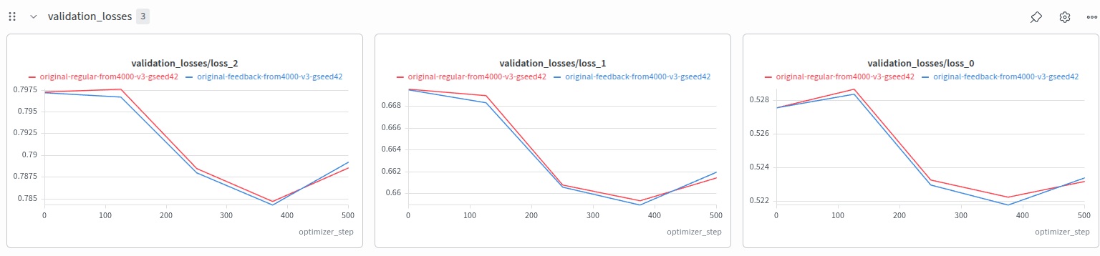
Feedback
What happens if we continue training on the feedback signal ?
No extra benefit from regular training.
It is a promising idea, but needs more investigation later.
Ahmed Zeer

Slide 8
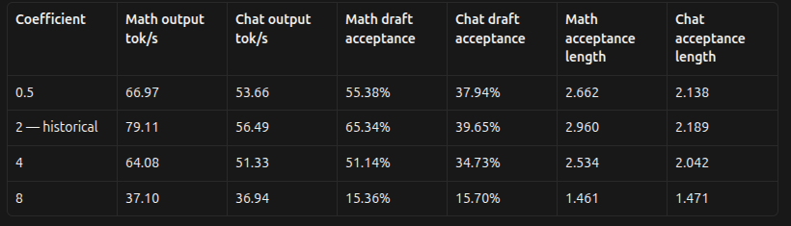
LoRA Coefficient
What happens if we change the LoRA coefficient at test-time ?
A coefficient of 2, which is the baseline, turns out to be the best.
Whether learning to change this coefficient is beneficial remains a question.
Ahmed Zeer

Slide 9
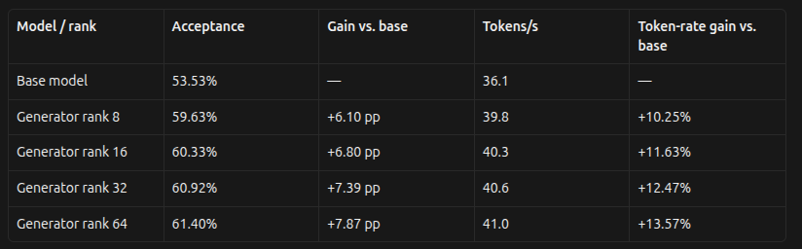
Rank Effect
What happens when we increase the output rank?
Throughput might not increase because it takes more time to generate a bigger lora.
The acceptance rate increases.
The throughput increases, which is critical.
Ahmed Zeer

Slide 10
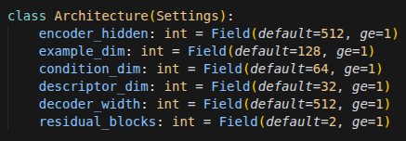
Architecture Ablation
We need an architecture with low latency, that’s why we are only using FFNs.
Still, we might ablate on the dimension of each FFN, w.r.t to its job.
Decoder width={ 256, 512, 1024 }
Condition dim={ 32, 64, 128 }
Residual blocks={ 1, 2, 4}
Encoder hidden={ 256, 512, 1024 }
Target Attention Modules = { all_attn, all_ffn, all }
Ahmed Zeer

Slide 11
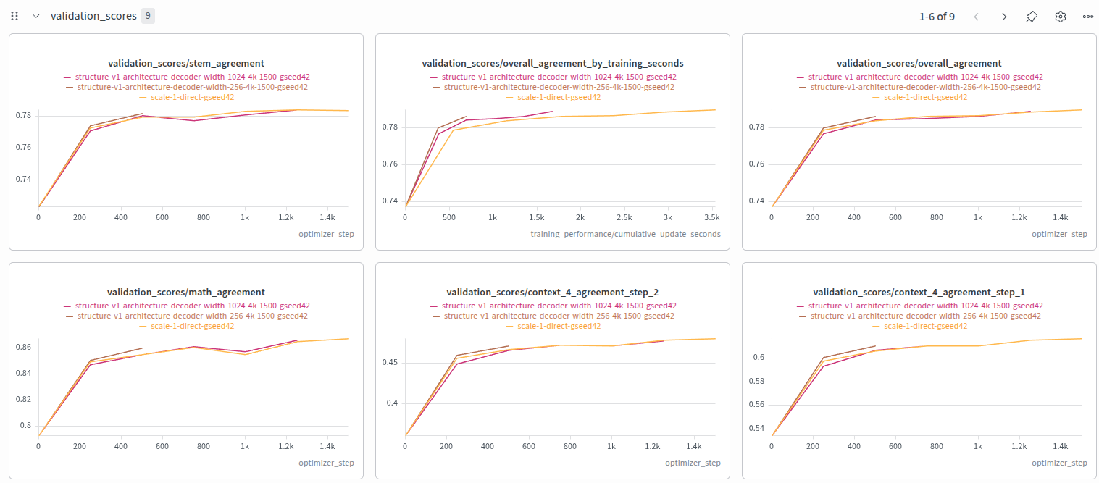
Decoder Width
No change.
Ahmed Zeer

Slide 12
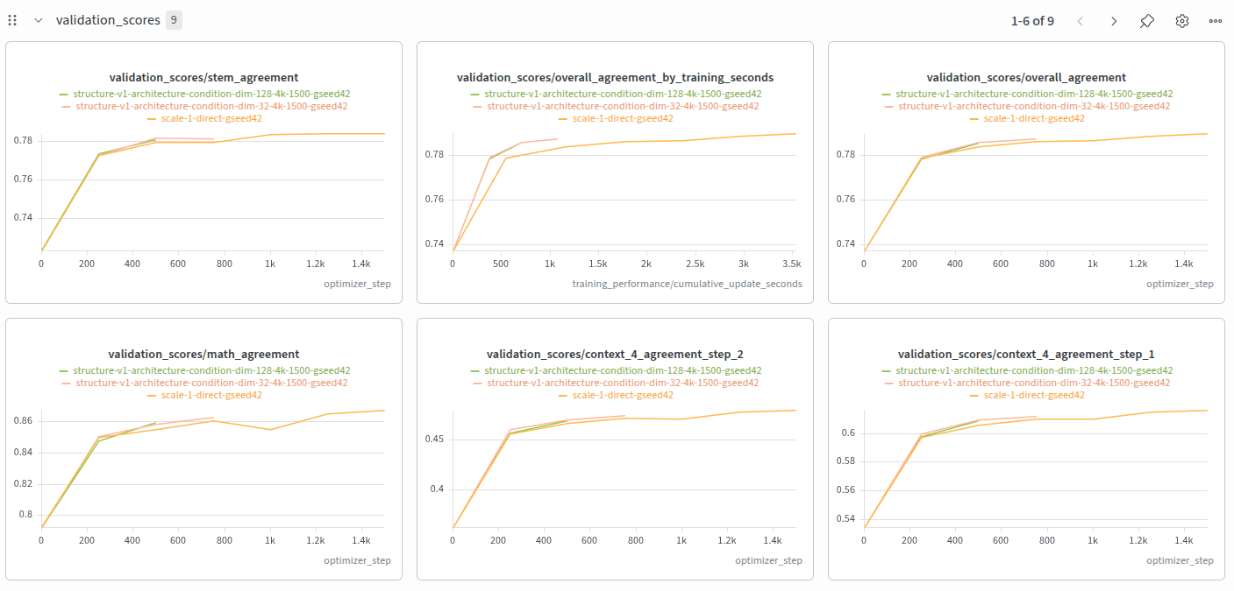
Condition Dim
No change.
Ahmed Zeer

Slide 13
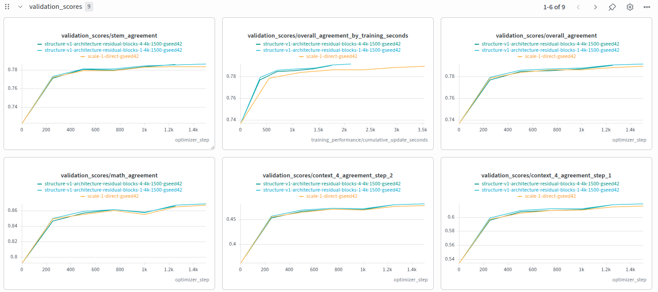
Residual Blocks
No change.
Ahmed Zeer

Slide 14
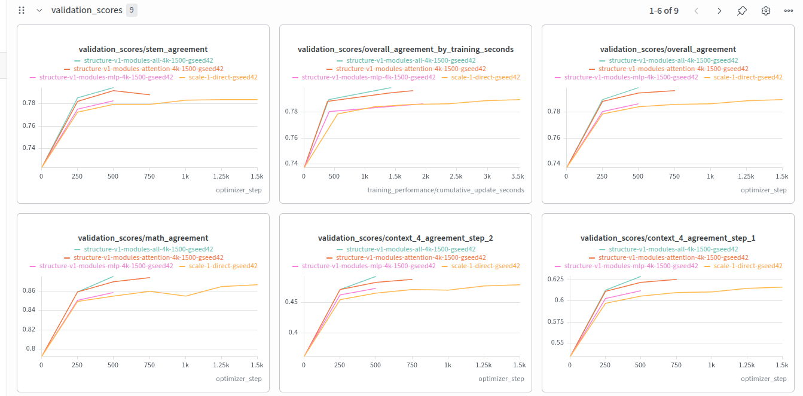
Target Modules
All > Attn Only > FFN Only.
Ahmed Zeer

Slide 15
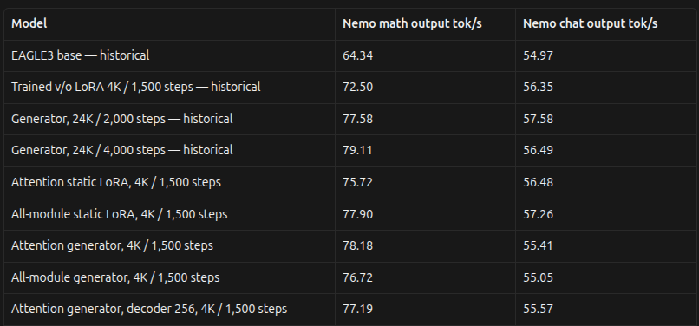
Architecture
LoRA
Gen.
Attn Generator > All Generator, because it is faster
All LoRA > All Generator, because it is faster
Attn Generator > All LoRA, because it is more accurate
512 decoder > 256 decoder, higher capacity
Ahmed Zeer

Slide 16
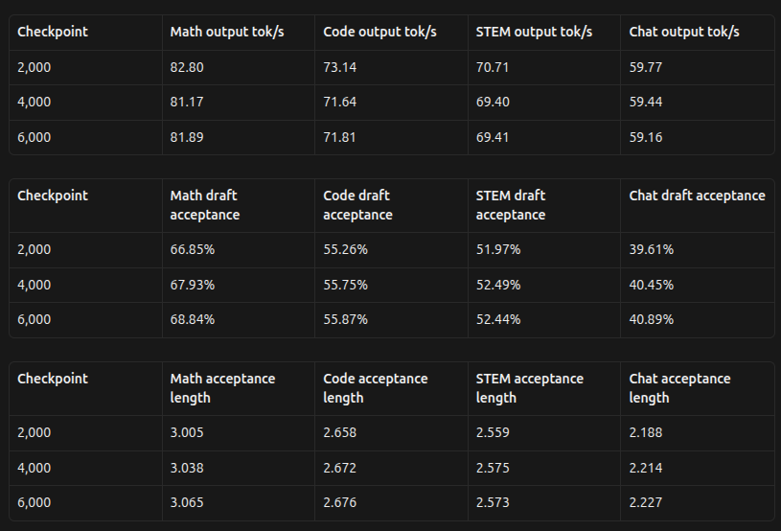
Scale Attention Generator
Lets train the attention generator now on 24K and compare it with the baseline.
With more training the acceptance rate increases, even though it might not directly be reflected on the throughput.
Still, 3 epochs seems to be enough to not “overfit”.
Ahmed Zeer

Slide 17
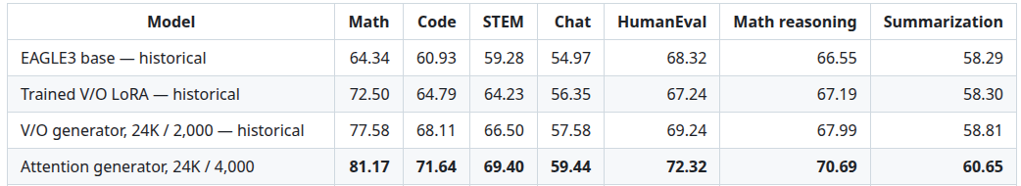
Scale Attention Generator
It outperforms what we used to have.
Ahmed Zeer

Slide 18
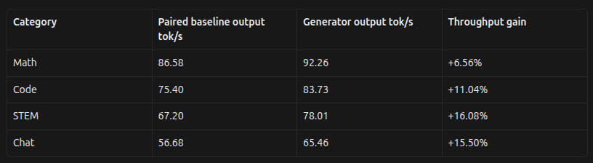
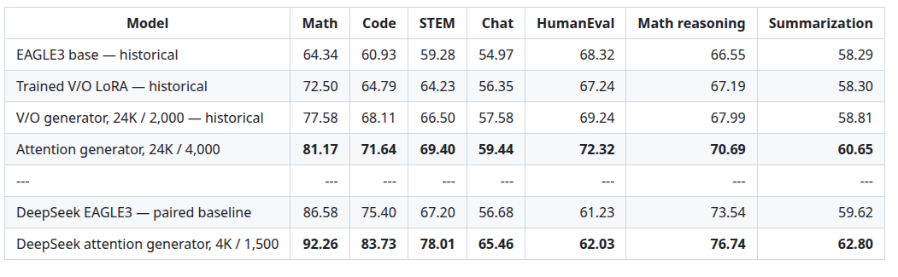
DeepSeek EAGLE-3 Drafter
Even though DeepSeek’s drafter model is already so good, we are able to make it even better with little training.
Ahmed Zeer

Slide 19
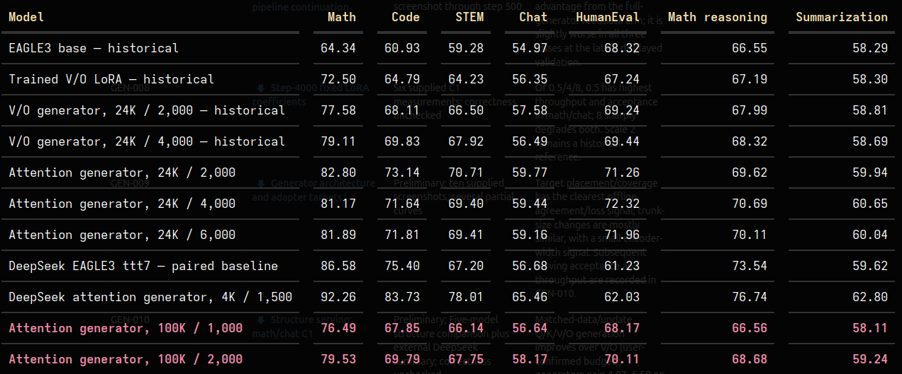
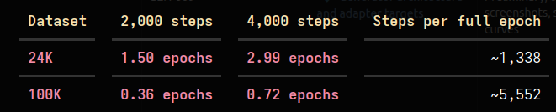
Scale Attention Generator - 100k
We couldn’t outperform the 24K version because we didn’t train on more data.
Ahmed Zeer

