Slide 1


Slide 2

EE464 HARDWARE PROJECT PRESENTATION
By Emine BOOSTancı
Canberk Kaçan
Erdem Canaz
Erkin Atay Toka
24.04.2024

Slide 3
Table of Contents
Design Criteria
Topology & Design Selection
Magnetic Design
Simulation Results
Component Selection
Future Work

Slide 4
1. Design Criteria
Minimum Input Voltage: 20 V
Maximum Input Voltage: 40 V
Output Voltage: 12 V
Output Power: 60 W
Output Voltage Peak-to-Peak Ripple: 3%
Line Regulation: 3%
Load Regulation: 3%
Isolated Converter
Close Loop Feedback

Slide 5
2. Topology & Design Selection
Flyback Converter: low power applications
(up to 100 Watts)
Forward Converter: 50 Watts to a couple of hundred watts
Push Pull Converter: medium power levels (100 Watts to a few kilowatts)
Half and Full Bridge Converter: medium to high power ranges (100 Watts to over 500 Watts)
Push Pull, Half and Full Bridge Convertes are overdesign.

Slide 6
2. Topology & Design Selection
Flyback Converter
Forward Converter
No restriction on D
Less components (only transformer)
No resetting the core’s flux
Easiest to design
Leakage inductance
Less efficiency
More ripple and worse regulation
Restriction on D
More components (transformer & inductor)
Resetting the core’s flux
Harder to design
Magnetizing inductance
Higher efficiency
Less ripple and better regulation

Slide 7
2. Topology & Design Selection
Single Switch Flyback Converter
Two Switch Flyback Converter
No restriction on D
Simplicity
Snubber Design
Less efficiency
D < 0.5 for CCM
Complexity (high side switch)
High input capacitance
Higher efficiency
Target Efficiency = %80

Slide 8
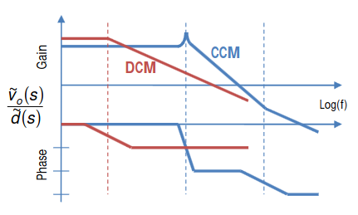
2. Topology & Design Selection
CCM or DCM: CCM. Less ripple but worse core utilization. Analytically easy but nonlineer Bode plot.
Switching Frequency: 90 kHz.
Turns Ratio and Duty Cycle Range: 0.23<D<0.375 N=1

Slide 9
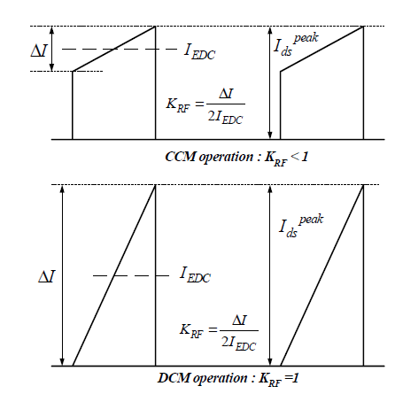
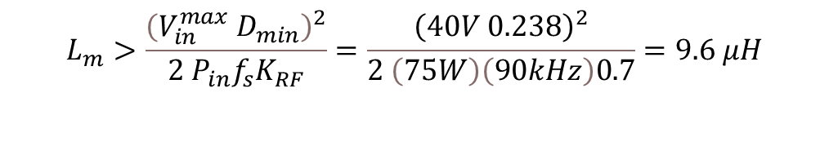

3. Magnetic Design
Lm Determination:
$$L_{m}>\frac{{\left(V_{in}^{max} D_{min}\right)}^{2}}{2 P_{in}f_{s}K_{RF}}=\frac{{\left(40V 0.238\right)}^{2}}{2 \left(75W\right)\left(90kHz\right)0.7}=9.6 μH$$
$L_{m}$=20 $μH$

Slide 10
3. Magnetic Design
Core Selection:
Aim: Operate around 100mT to minimize losses.
Disadvantage: Volume increase. Losses might increase.
Choose ferrite core → less leakage. Fringing fields problem
Higher window area → fill factor auxilary winding
0R45530EC

Slide 11

3. Magnetic Design
Core Selection: $N_{1}∅=L_{m}I_{max,pri}$

Slide 12

3. Magnetic Design
$$L_{m}=\frac{N_{1}^{2}}{R_{gap}}$$
Core Selection:
N1=N2=7 turns
lgap=0.7 mm
Bmax=96 mT

Slide 13
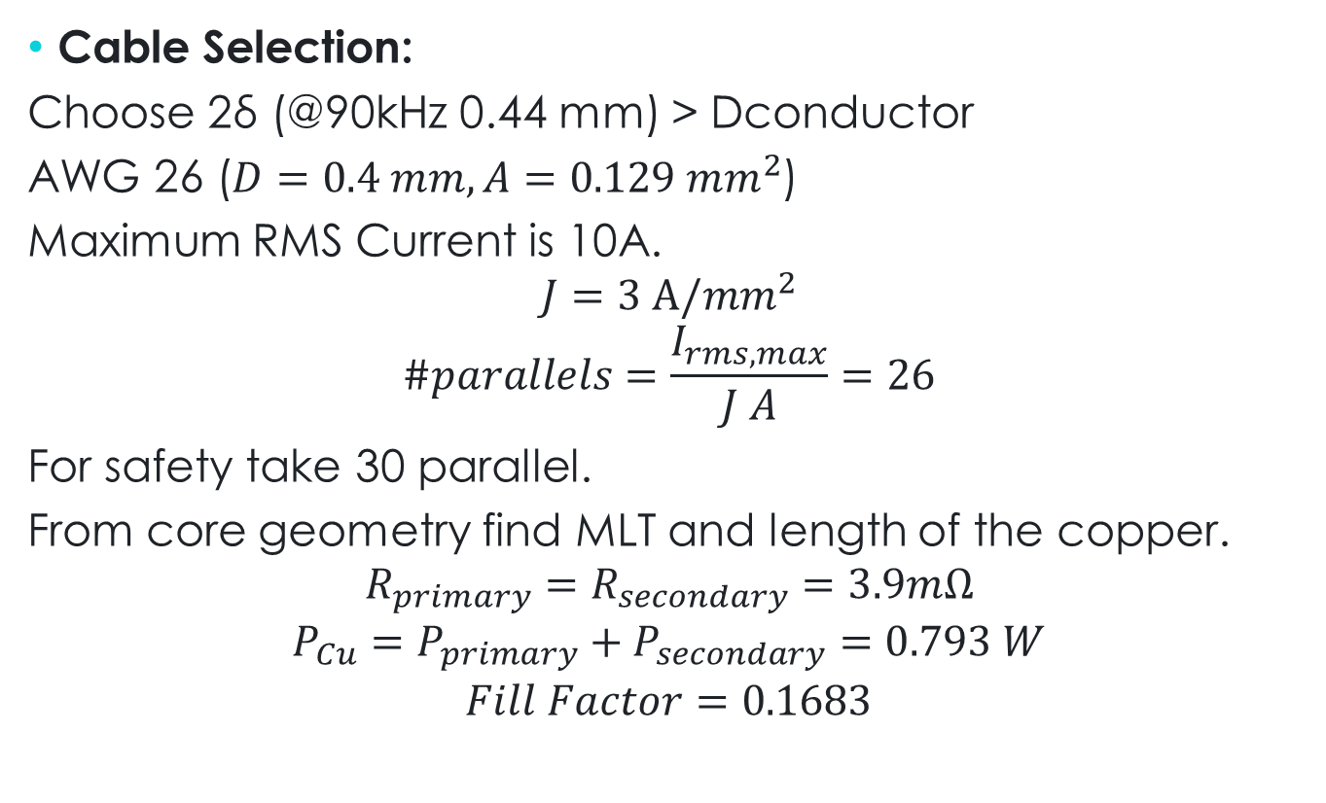
3. Magnetic Design
Cable Selection:
Choose 2δ (@90kHz 0.44 mm) > Dconductor
AWG 26 ($D=0.4 mm, A=0.129 {mm}^{2}$)
Maximum RMS Current is 10A.
$$J=3 A/{mm}^{2}$$
$$\#parallels=\frac{I_{rms,max}}{J A}=26$$
For safety take 30 parallel.
From core geometry find MLT and length of the copper.
$$R_{primary}=R_{secondary}=3.9mΩ$$
$${P_{Cu}=P}_{primary}+P_{secondary}=0.793 W$$
$$Fill Factor=0.1683$$
[1]

Slide 14
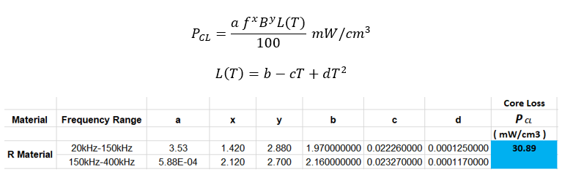

3. Magnetic Design
Core Losses:
Steinmetz Coefficients
$$P_{core}=2VP_{CL}=3.21 W$$
[2]

Slide 15
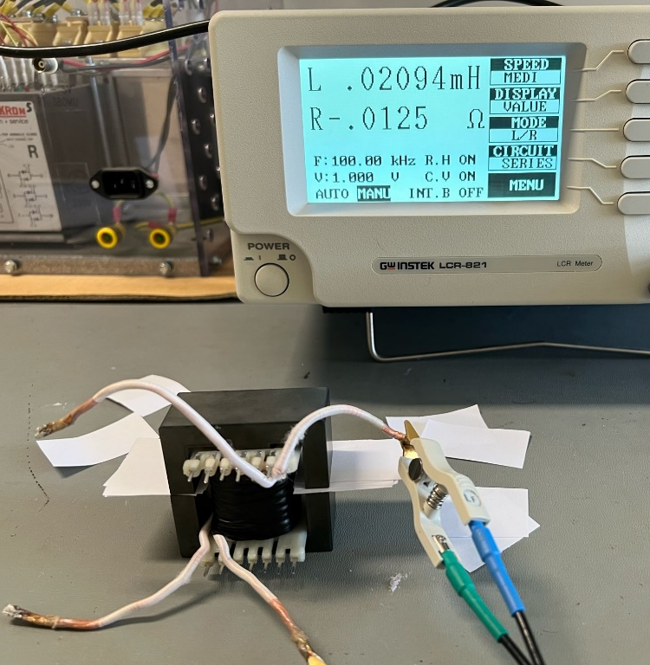
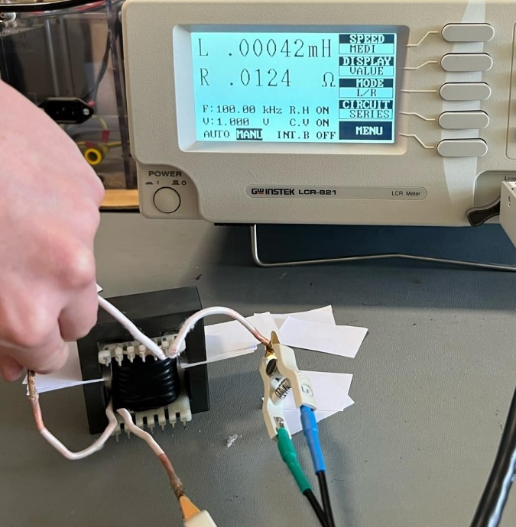
3. Magnetic Design
Experimental Results:
$$L_{m}=20.94 μH L_{leak}=0.21μH R_{Cu}=4.6 mΩ$$

Slide 16
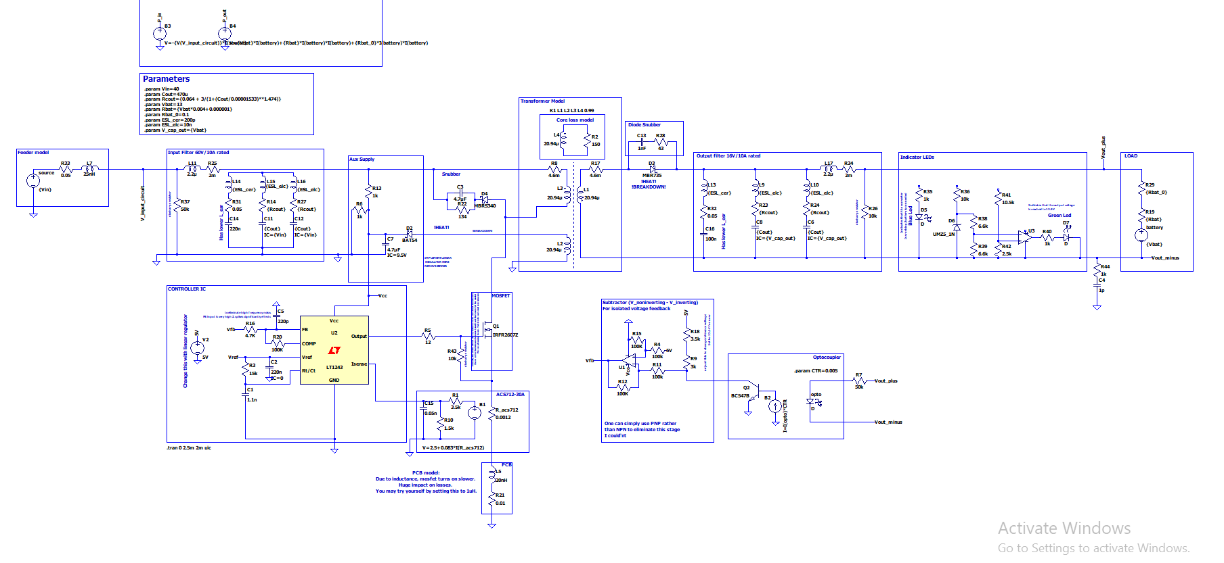
4. Simulation Results:Block diagram

Slide 17
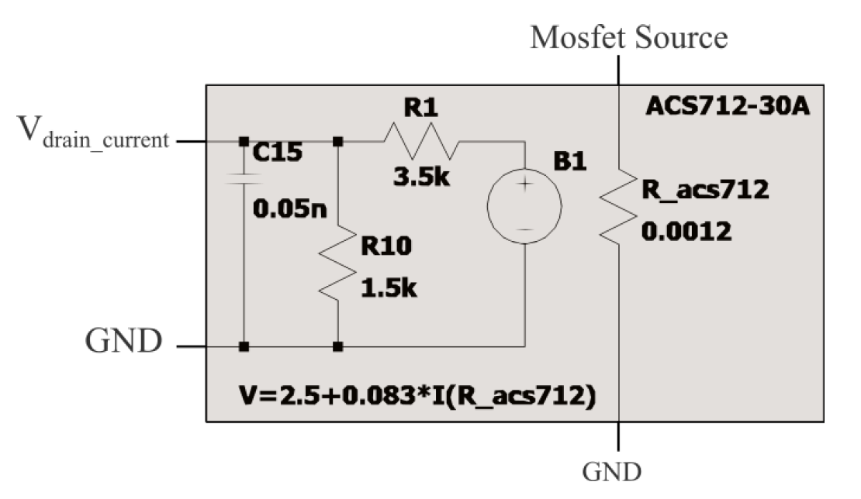
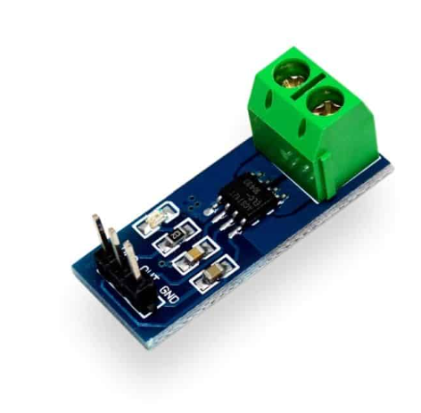
4. Simulation models: Current Feedback

Slide 18
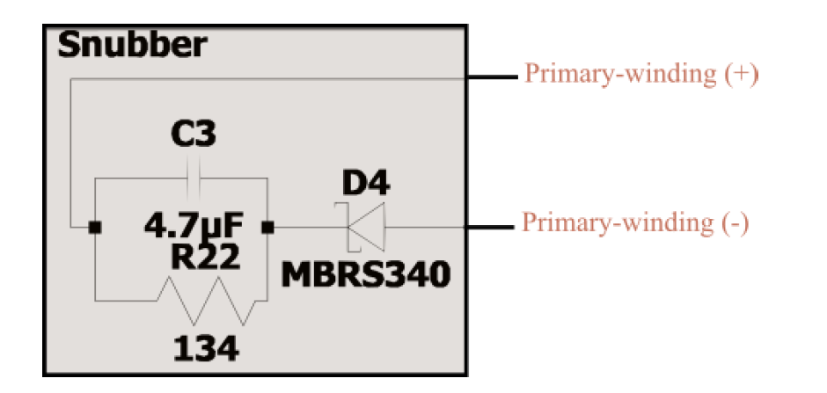
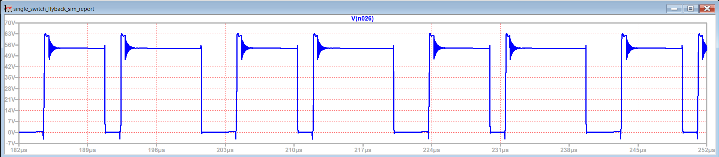
4. Simulation Results:
20v
3.2w
60v

Slide 19
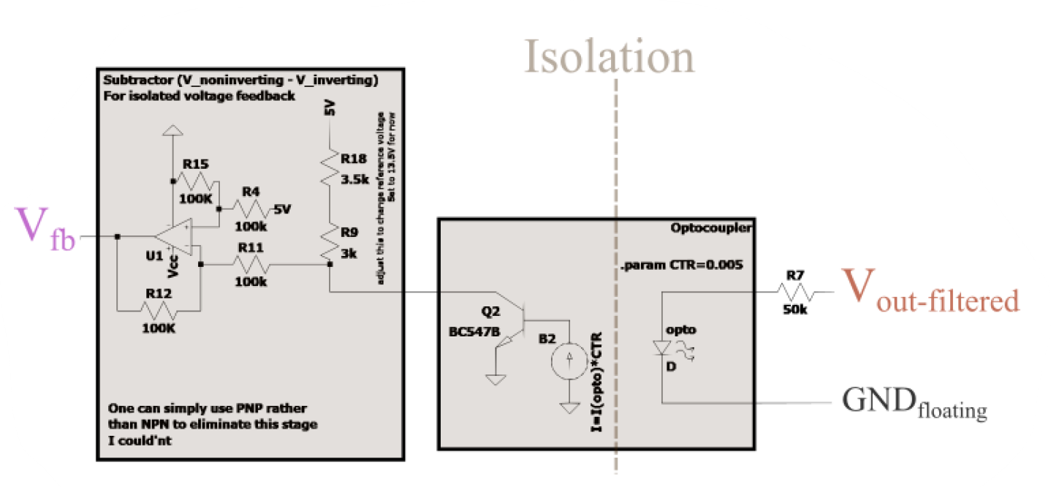
4. Simulation Results: Voltage feedback

Slide 20
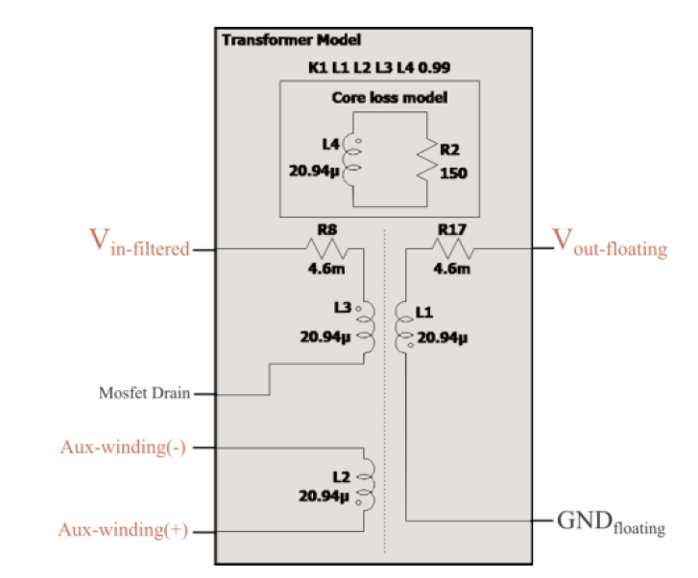
4. Simulation Results: Voltage feedback

Slide 21
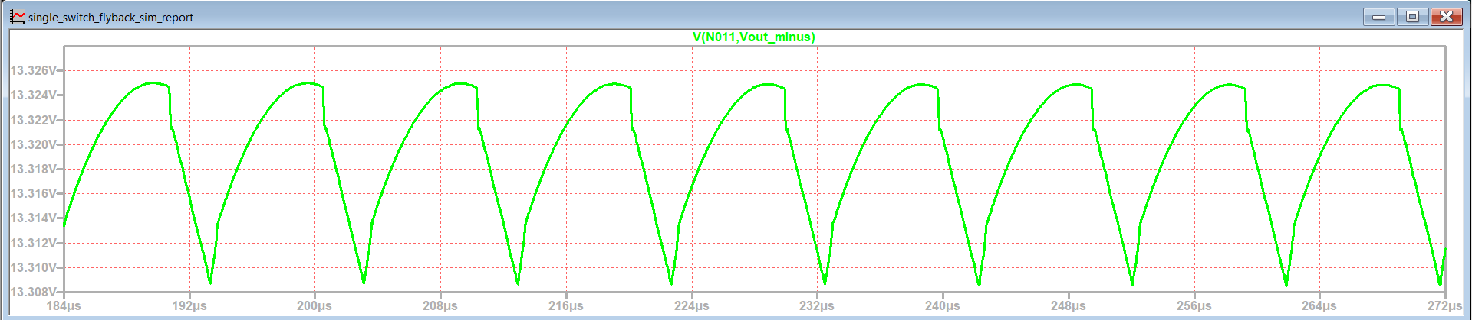
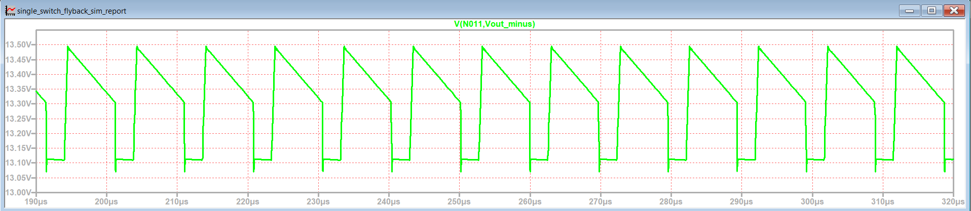
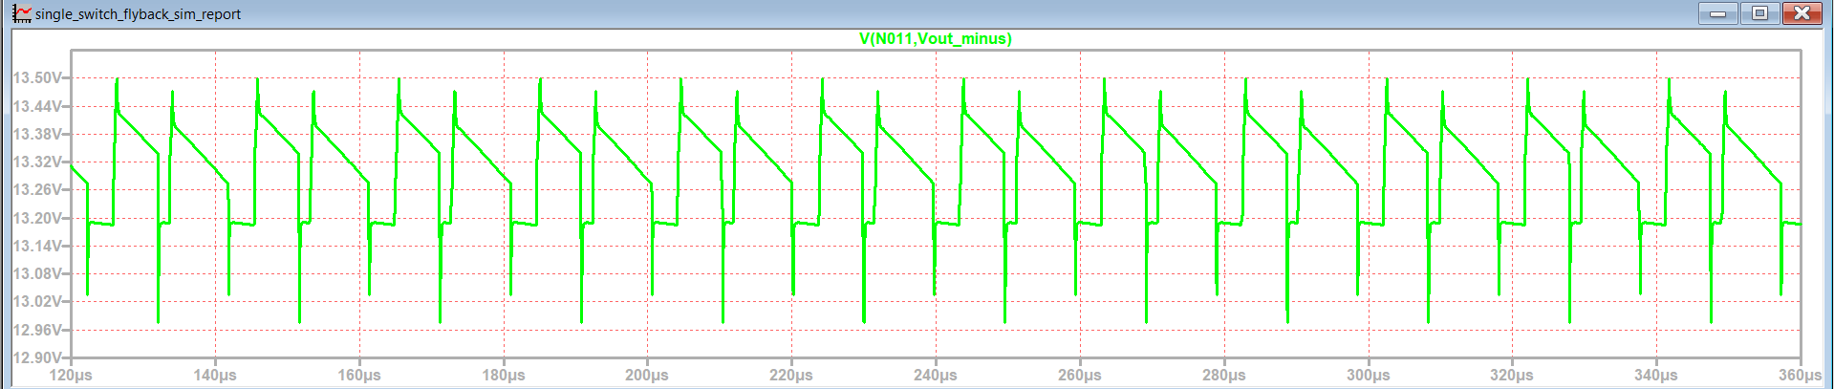
4. Simulation Results: Output Filter

Slide 22
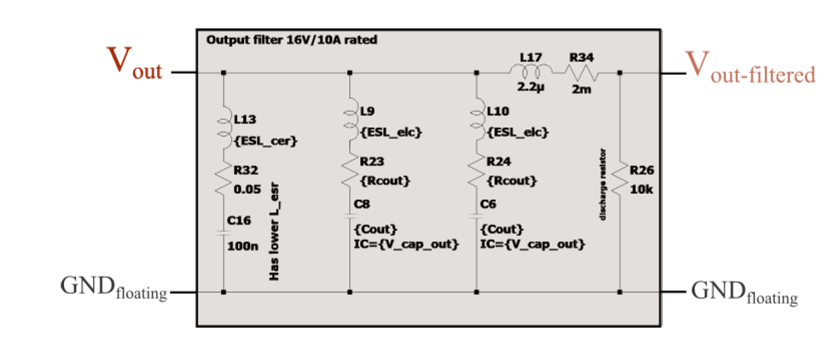
4. Simulation Results: Output Filter

Slide 23
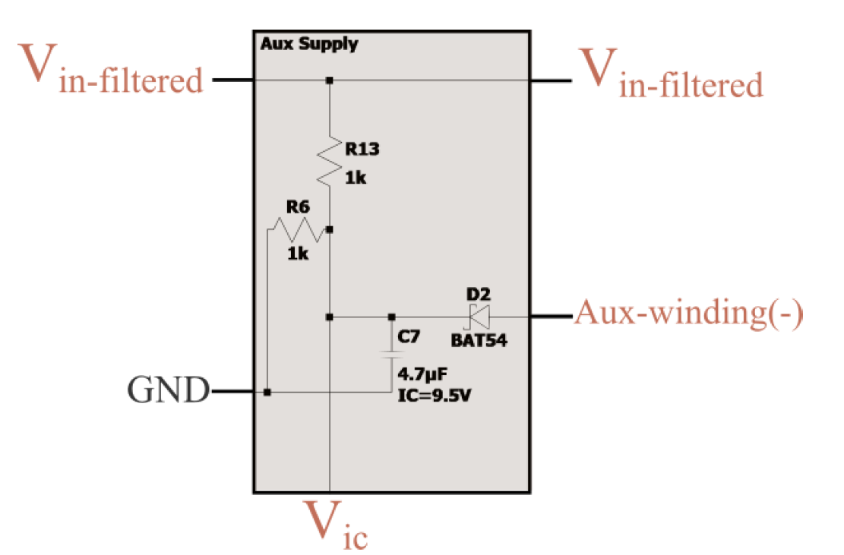
4. Simulation Results: Auxiliary Supply

Slide 24
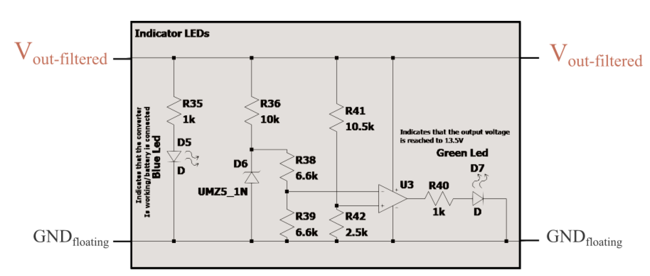
4. Simulation Results: Indicator LEDs

Slide 25
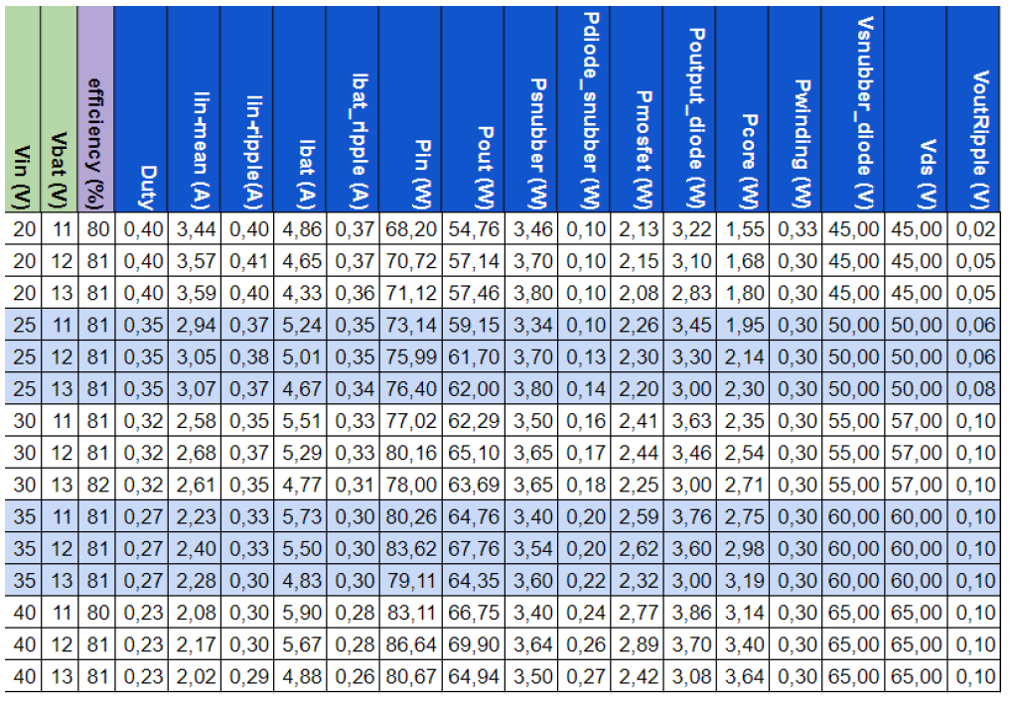
4. Simulation Results: Detailed results

Slide 26
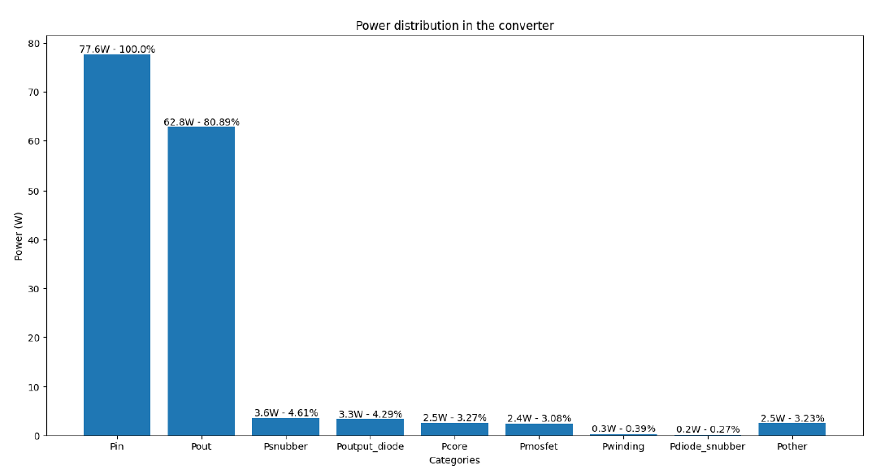
4. Simulation Results: Summary
Vin = {20, 25, 30, 35, 40}V
Vbat = {11, 12, 13}V

Slide 27
4. Simulation Results: Summary
About %75-80 efficiency is expected
The snubber works properly
Output voltage regulation is satisfied

Slide 28
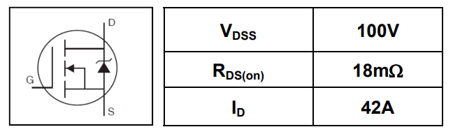
5. Component Selection
MOSFET: IRFU3710ZPbF
I_{D,max} ≈ 10A
V_{DS,max} ≈ 65V
 | Parameter | Max. | Units
I_{D} @ TC = 25°C | Continuous Drain Current VGS @ 10V | 56 | A
I_{D} @ TC = 100°C | Continuous Drain Current, VGS @ 10V | 39 | A
V_{GS} | Gate-to-Source Voltage | ± 20 | V
R_{DS(on)} | Drain-to-Source On-Resistance | 18 | mΩ
V_{GS(th)} | Gate Threshold Voltage | 4.0 | V
t_{r} | Rise Time | 43 | ns
t_{f} | Fall Time | 42 | ns
[3]

Slide 29
5. Component Selection
Diode: DSA30C100PB (Both for the snubber and the secondary side)
Schottky diode is chosen due to its speed.
Snubber
I_{F,max} ≈ 8A
V_{max} ≈ 65V
Secondary Side
I_{F,max} ≈ 9.5A
V_{max} ≈ 62V
 | Parameter | Max. | Units
V_{RRM}(T_{VJ} = 25°C) | max. repetitive reverse blocking voltage | 100 | V
V_{F} (I_{F} = 15A, T_{VJ} = 25°C) | forward voltage drop | 0.91 | V
V_{F} (I_{F} = 15A, T_{VJ} = 125°C) | forward voltage drop | 0.73 | V
I_{FAV} (T_{VJ} = 125°C) | average forward current | 15 | A
C_{J} | junction capacitance | 146 | pF
I_{R} | reverse current, drain current | 250 | µA
[4]

Slide 30
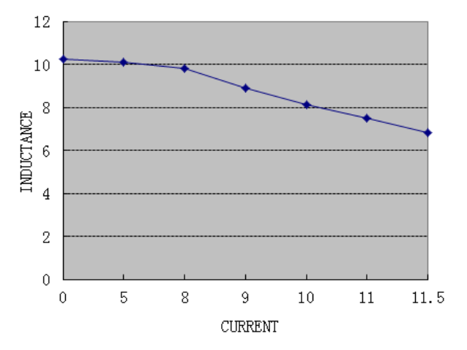
5. Component Selection
Output Filter Inductance: SRI1209-100M
Parameter | Max. | Units
L | 10 ± 20% | µH
R_{DC} | 0.03 | Ω
I_{DC} | 10 | A
Test Conditions:
1KHZ / 0.25V
Output
Current
[5]

Slide 31
5. Component Selection
Input Capacitor:
4xPKLH-063V471
63V 470µF
Output Capacitor:
4xPKLH-016V471
16V 470µF
Control IC:
UC3845AN
Due to duty cycle limiting behaviour
Current Sensor IC:
ACS712-30A
And various resistors
[6-9]

Slide 32
6. Future Work
Optocoupler Design Finalization
Design Implementation on Stripboard
Thermal Analysis
PCB Design (Bonus)
Case Design (Bonus)

Slide 33
6. References
[1] W. (n.d.). Round Wire ac Resistance Calculator. https://chemandy.com/calculators/round-wireac-resistance-calculator.htm
[2]“Magnetics - Ferrite Core Loss Calculator.” https://www.mag-inc.com/Design/DesignTools/Ferrite-Core-Loss-Calculator
[3] https://cdn.ozdisan.com/ETicaret_Dosya/652386_243124.pdf [4]https://cdn.ozdisan.com/ETicaret_Dosya/483083_5853486.pdf
[5] https://pdf.direnc.net/upload/10uh-12x12-datasheet.pdf
[6] https://cdn.ozdisan.com/ETicaret_Dosya/465839_6115297.pdf
[7] https://cdn.ozdisan.com/ETicaret_Dosya/342170_703953.pdf
[8] https://pdf.direnc.net/upload/acs712-datasheet.pdf
[9] https://cdn.ozdisan.com/ETicaret_Dosya/501245_5372110.pdf

Slide 34
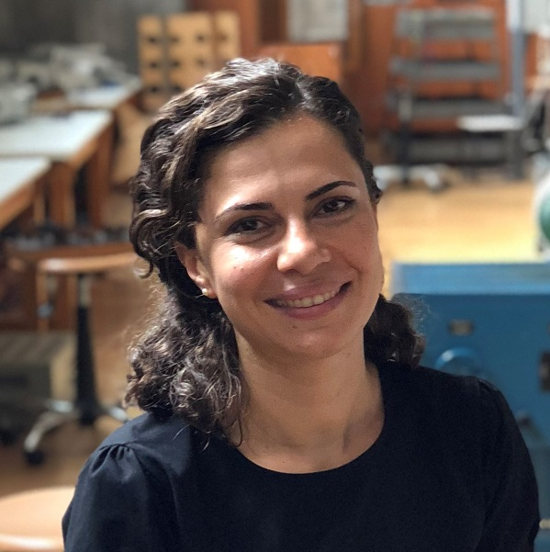
In memory of …

