Slide 1


Slide 2

EE464 HARDWARE PROJECT PRESENTATION
By Emine BOOSTancı
Canberk Kaçan
Erdem Canaz
Erkin Atay Toka
24.04.2024

Slide 3
Table of Contents
Design Criteria
Topology & Design Selection
Magnetic Design
Simulation Results
Component Selection
Future Work

Slide 4
1. Design Criteria
Minimum Input Voltage: 20 V
Maximum Input Voltage: 40 V
Output Voltage: 12 V
Output Power: 60 W
Output Voltage Peak-to-Peak Ripple: 3%
Line Regulation: 3%
Load Regulation: 3%
Isolated Converter
Close Loop Feedback

Slide 5
2. Topology & Design Selection
Flyback Converter: low power applications
(up to 100 Watts)
Forward Converter: 50 Watts to a couple of hundred watts
Push Pull Converter: medium power levels (100 Watts to a few kilowatts)
Half and Full Bridge Converter: medium to high power ranges (100 Watts to over 500 Watts)
Push Pull, Half and Full Bridge Convertes are overdesign.

Slide 6
2. Topology & Design Selection
Flyback Converter
Forward Converter
No restriction on D
Less components (only transformer)
No resetting the core’s flux
Easiest to design
Leakage inductance
Less efficiency
More ripple and worse regulation
Restriction on D
More components (transformer & inductor)
Resetting the core’s flux
Harder to design
Magnetizing inductance
Higher efficiency
Less ripple and better regulation

Slide 7
2. Topology & Design Selection
Single Switch Flyback Converter
Two Switch Flyback Converter
No restriction on D
Simplicity
Snubber Design
Less efficiency
D < 0.5 for CCM
Complexity (high side switch)
High input capacitance
Higher efficiency
Target Efficiency = %80

Slide 8
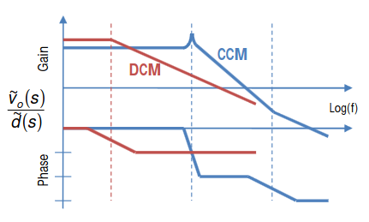
2. Topology & Design Selection
CCM or DCM: CCM. Less ripple but worse core utilization. Analytically easy but nonlineer Bode plot.
Switching Frequency: 90 kHz.
Turns Ratio and Duty Cycle Range: 0.23<D<0.375 N=1

Slide 9
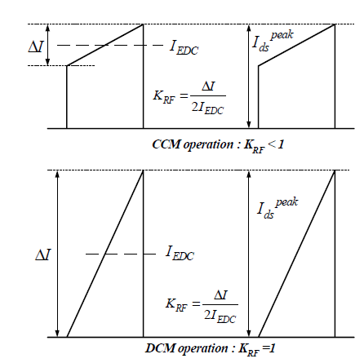
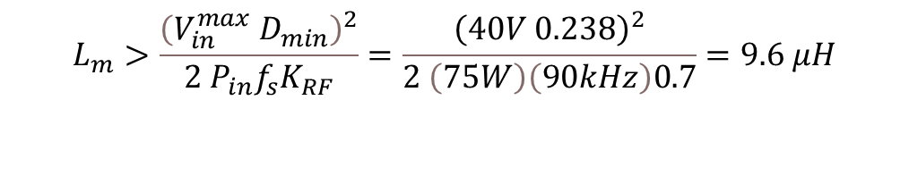

3. Magnetic Design
Lm Determination:
$$L_{m}>\frac{{\left(V_{in}^{max} D_{min}\right)}^{2}}{2 P_{in}f_{s}K_{RF}}=\frac{{\left(40V 0.238\right)}^{2}}{2 \left(75W\right)\left(90kHz\right)0.7}=9.6 μH$$
$L_{m}$=20 $μH$

Slide 10
3. Magnetic Design
Core Selection:
Aim: Operate around 100mT to minimize losses.
Disadvantage: Volume increase. Losses might increase.
Choose ferrite core → less leakage. Fringing fields problem
Higher window area → fill factor auxilary winding
0R45530EC

Slide 11

3. Magnetic Design
Core Selection: $N_{1}∅=L_{m}I_{max,pri}$

Slide 12

3. Magnetic Design
$$L_{m}=\frac{N_{1}^{2}}{R_{gap}}$$
Core Selection:
N1=N2=7 turns
lgap=0.7 mm
Bmax=96 mT

Slide 13
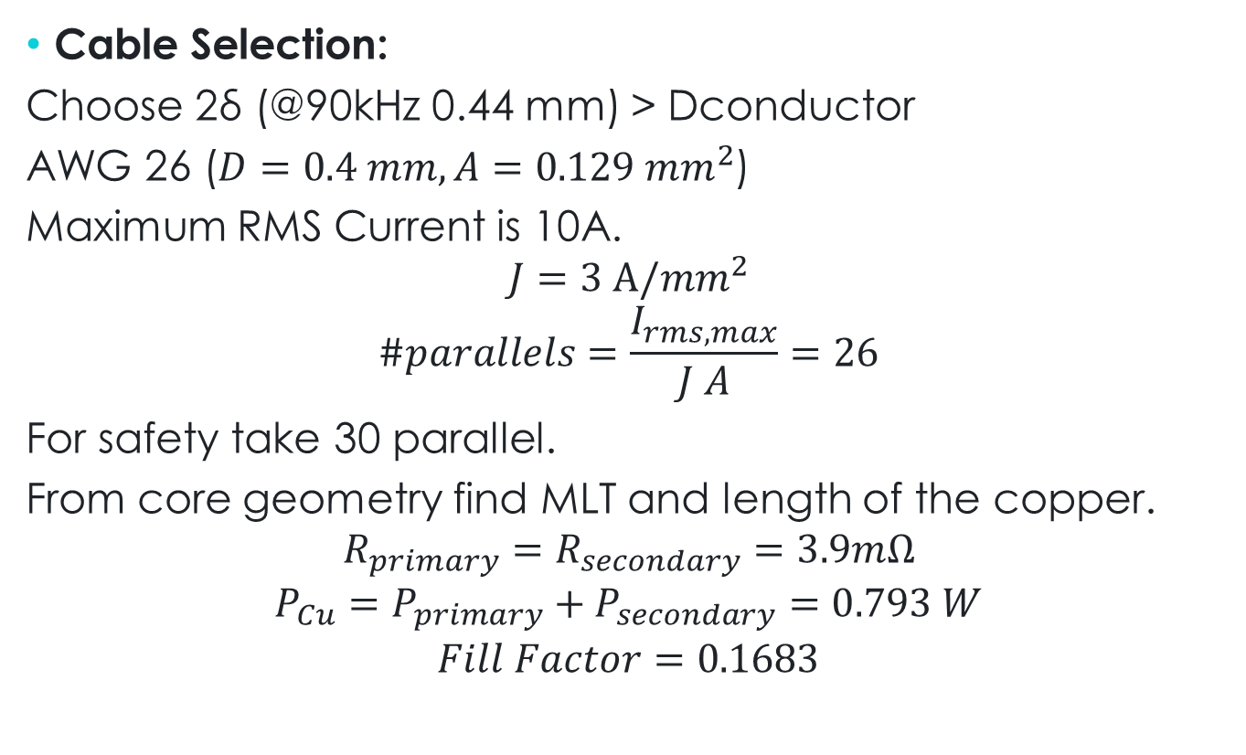
3. Magnetic Design
Cable Selection:
Choose 2δ (@90kHz 0.44 mm) > Dconductor
AWG 26 ($D=0.4 mm, A=0.129 {mm}^{2}$)
Maximum RMS Current is 10A.
$$J=3 A/{mm}^{2}$$
$$\#parallels=\frac{I_{rms,max}}{J A}=26$$
For safety take 30 parallel.
From core geometry find MLT and length of the copper.
$$R_{primary}=R_{secondary}=3.9mΩ$$
$${P_{Cu}=P}_{primary}+P_{secondary}=0.793 W$$
$$Fill Factor=0.1683$$
[1]

Slide 14
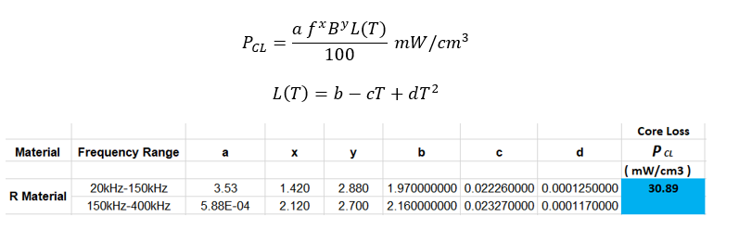

3. Magnetic Design
Core Losses:
Steinmetz Coefficients
$$P_{core}=2VP_{CL}=3.21 W$$
[2]

Slide 15
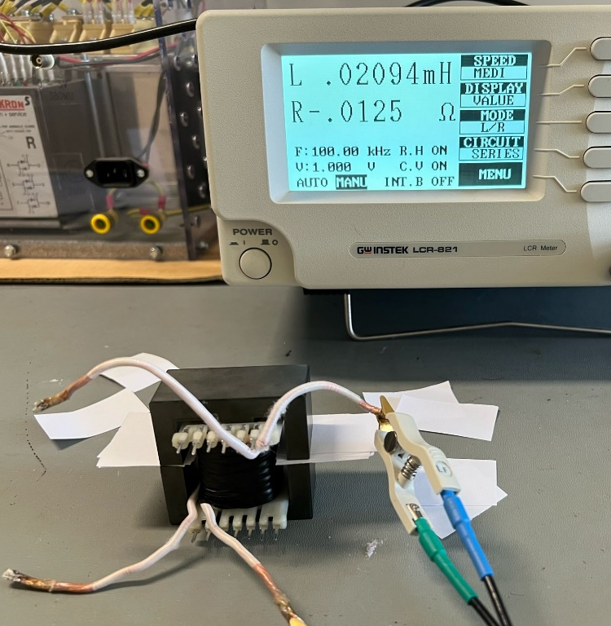
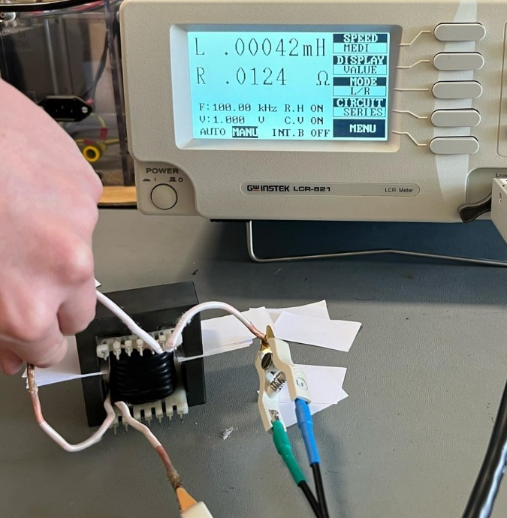
3. Magnetic Design
Experimental Results:
$$L_{m}=20.94 μH L_{leak}=0.21μH R_{Cu}=4.6 mΩ$$

Slide 16
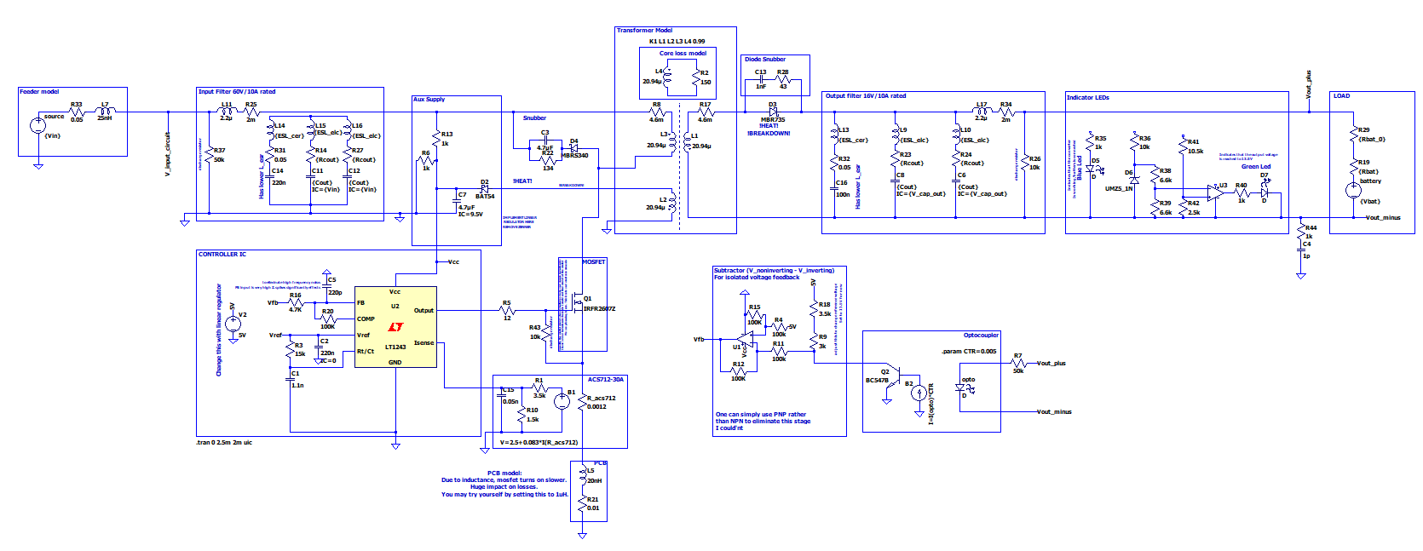
4. Simulation Results:Block diagram
Transformer
Diode Snub.
Source model
Input Fil.
Aux. Sup.
Output Fil.
Indicators
Bat. Model
Snub.
MOSFET
Current
feedback
Controller IC
Voltage
feedback
PCB model

Slide 17
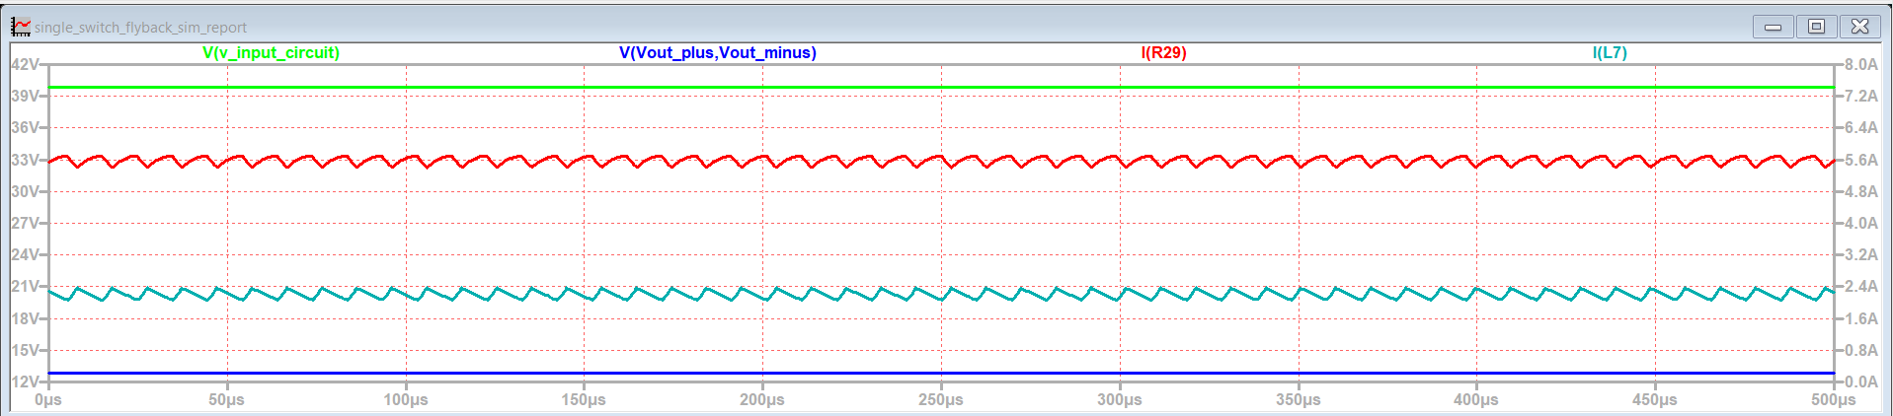
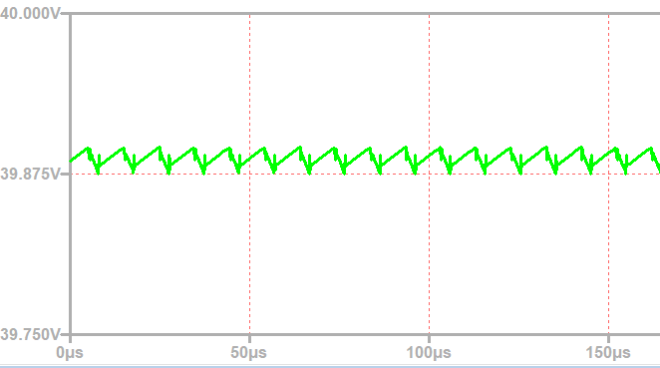
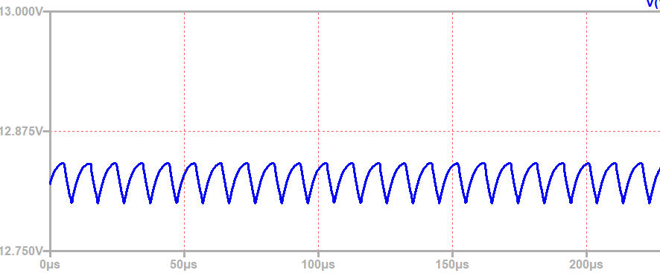
4. Simulation Results:Block diagram
Single run for Vin = 40V, Vbat = 12V
Vin
Iout
Iin
Vout
Vin
Vout

Slide 18
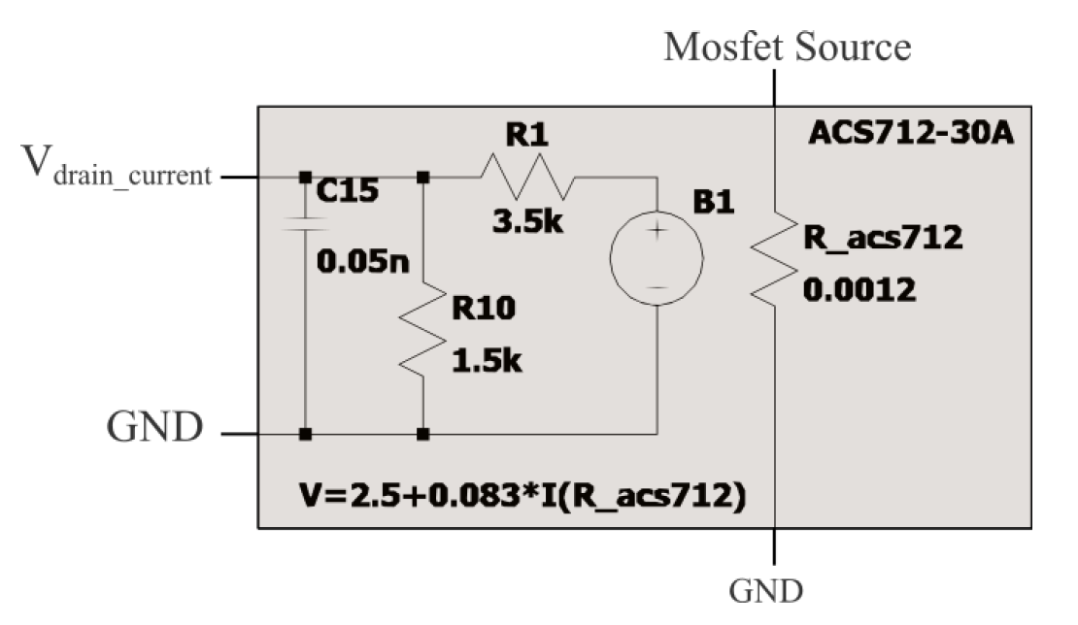
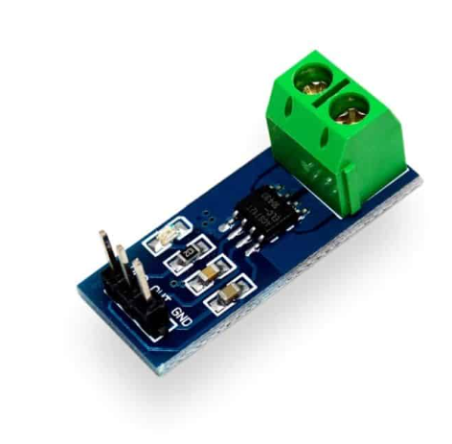
4. Simulation models: Current Feedback

Slide 19
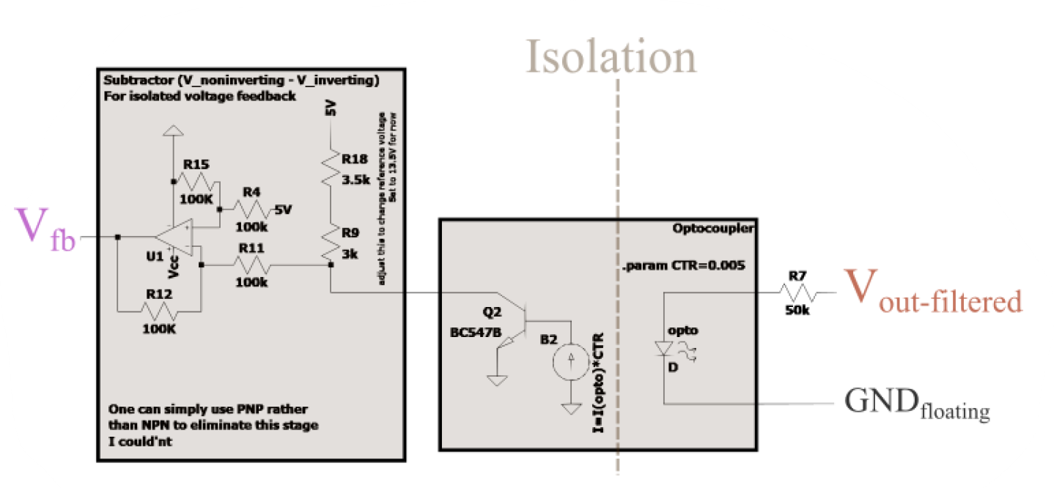
4. Simulation Results: Voltage Feedback

Slide 20
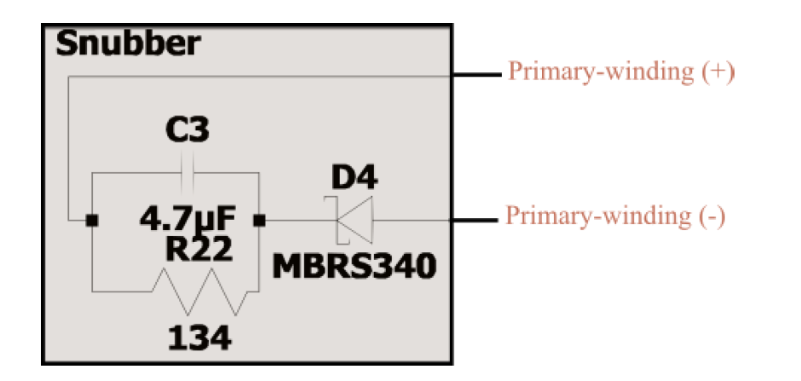
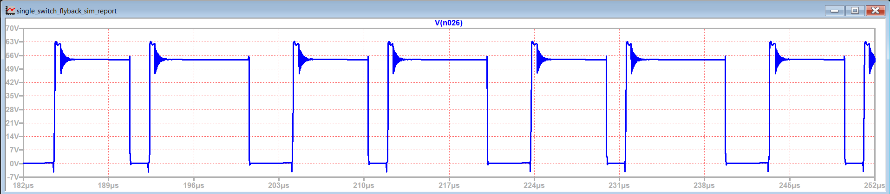
4. Simulation Results: Snubber (40V Vin)
20v
3.2w
60v
Drain-to-Source Voltage of MOSFET

Slide 21
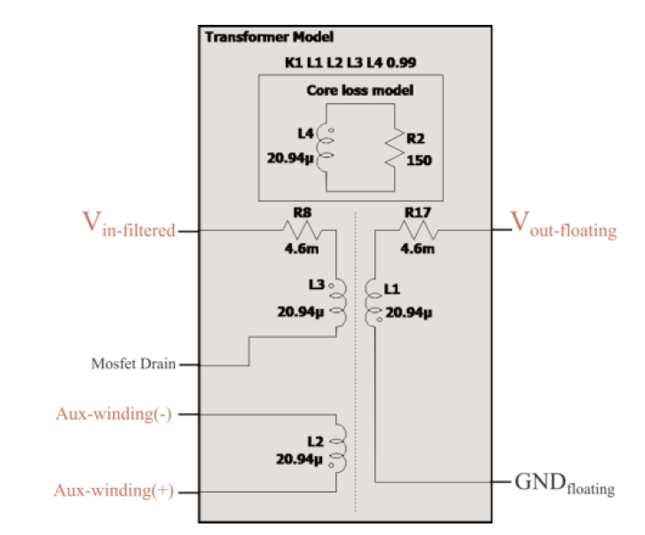
4. Simulation Results: Transformer Model
Coupling Factor
%1

Slide 22
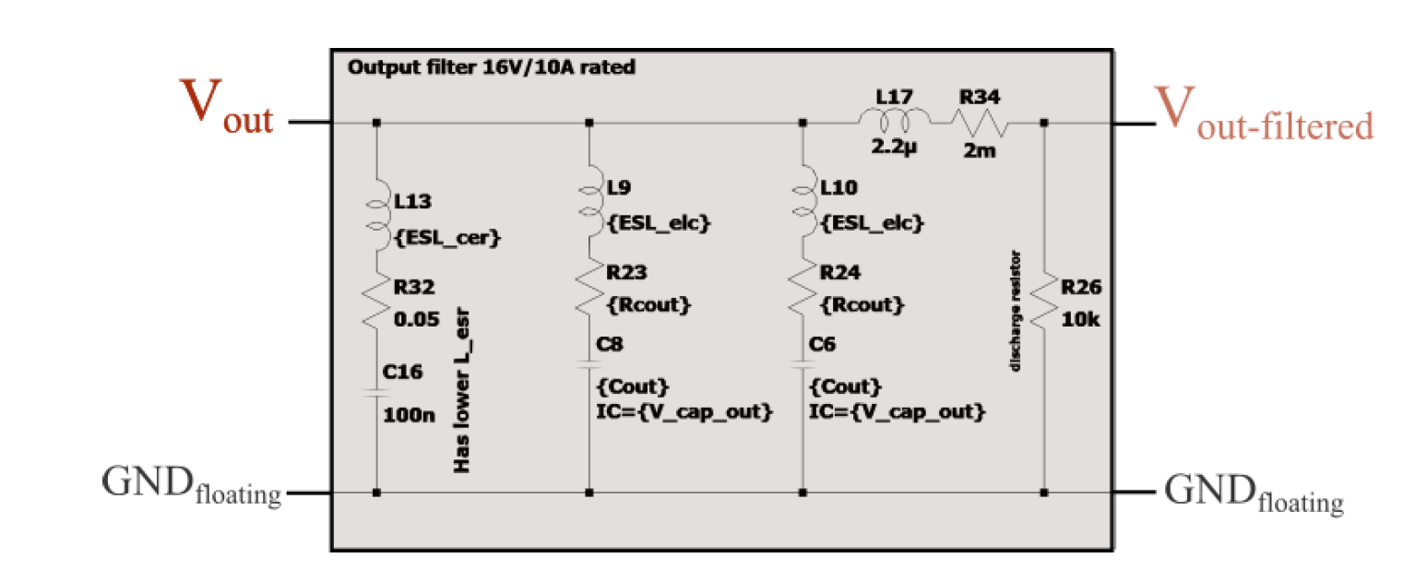
4. Simulation Results: Output Filter Model

Slide 23
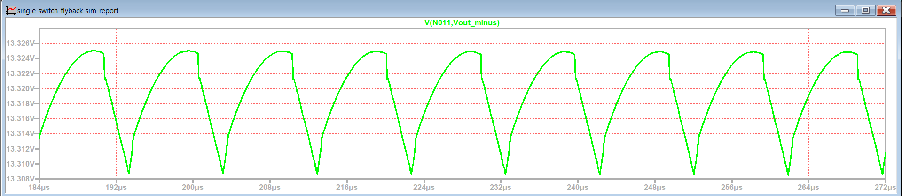
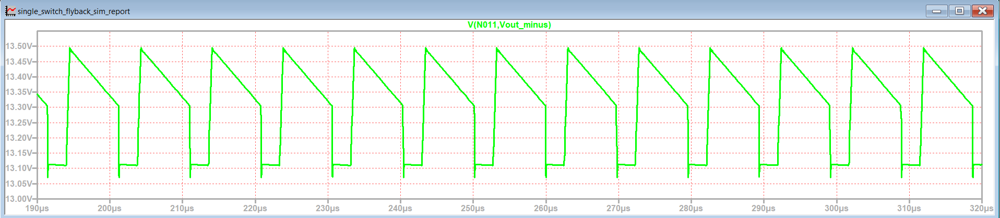

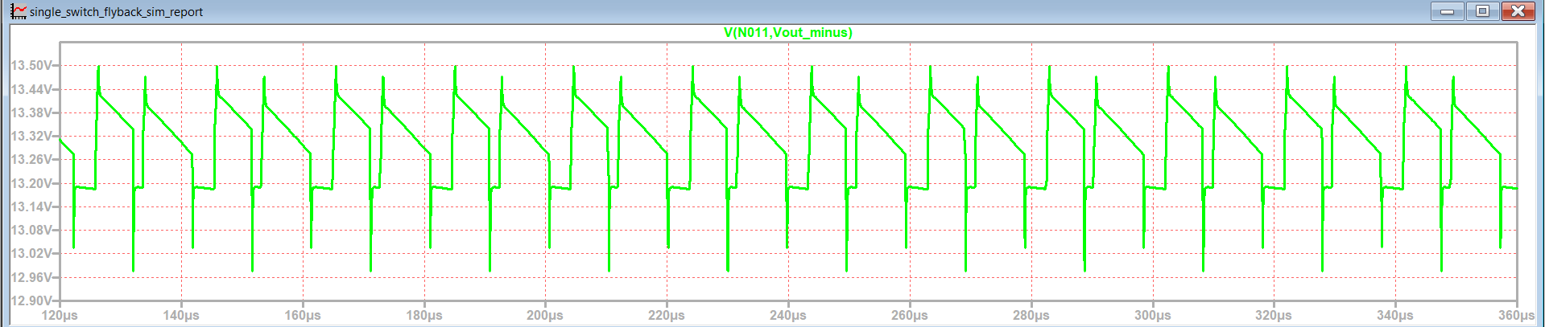
4. Simulation Results: Capacitor Model
C
C-R
C-R-L
Output voltages seen at secondary terminals

Slide 24
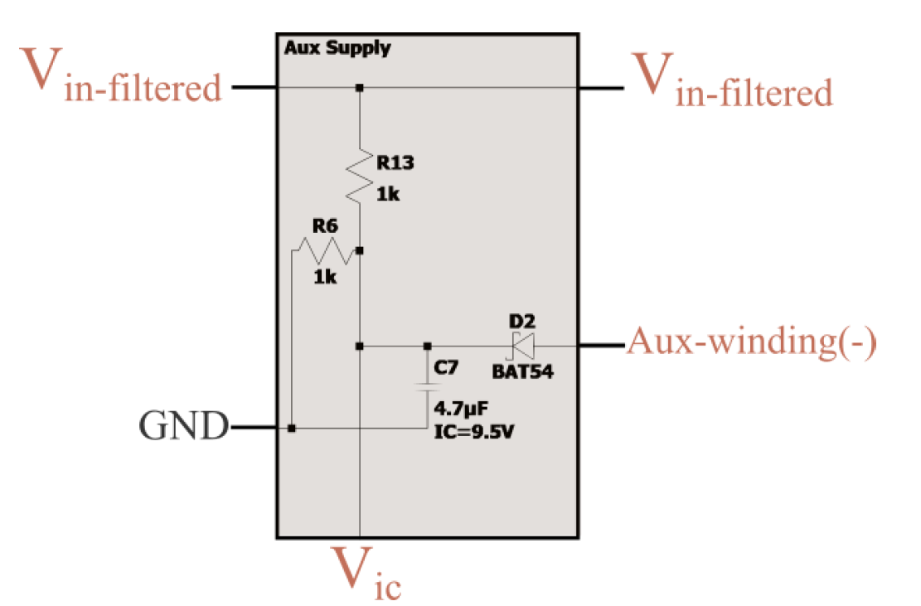
4. Simulation Results: Auxiliary Supply Model

Slide 25
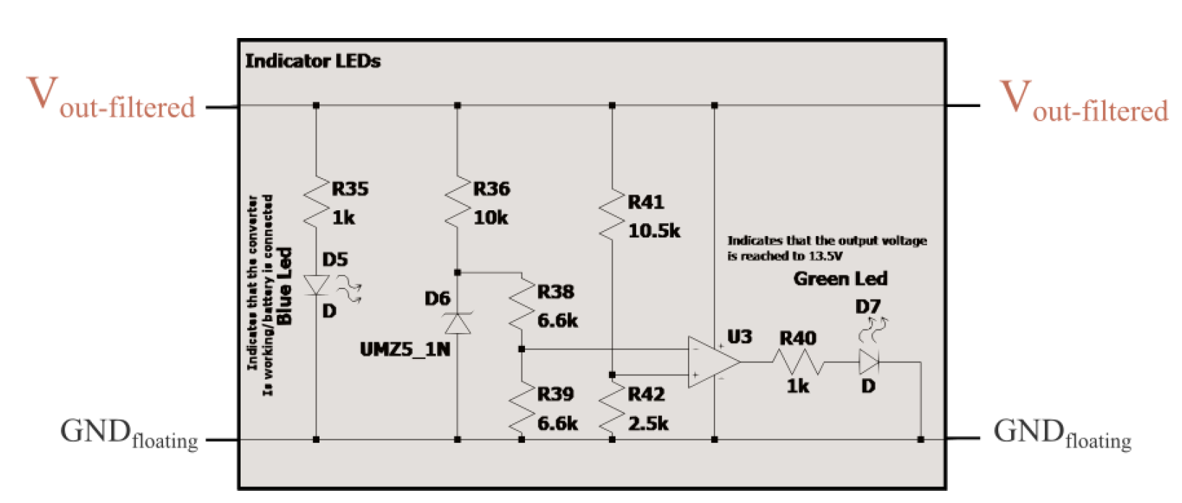
4. Simulation Results: Indicator LEDs

Slide 26
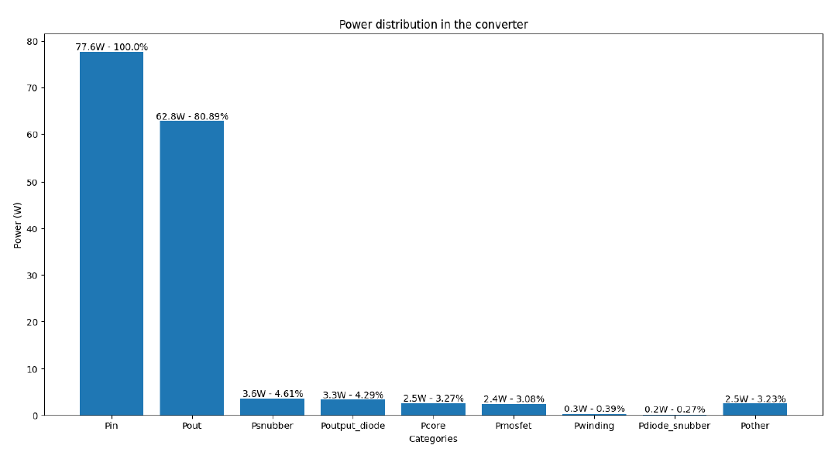
4. Simulation Results: Summary
Vin = {20, 25, 30, 35, 40}V
Vbat = {11, 12, 13}V

Slide 27
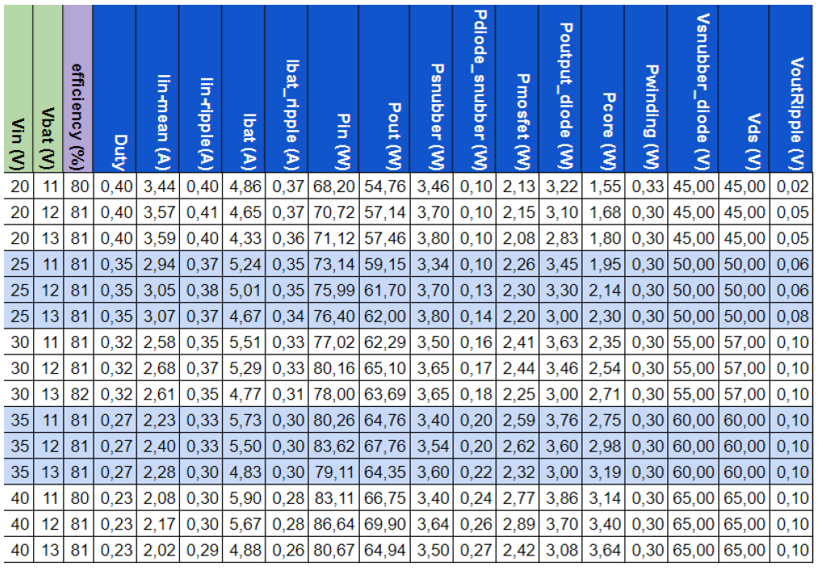
4. Simulation Results: Detailed results

Slide 28
4. Simulation Results: Summary
About %75-80 efficiency is expected
Ratings are acceptable
The snubber works properly
Voltage regulations are satisfied

Slide 29
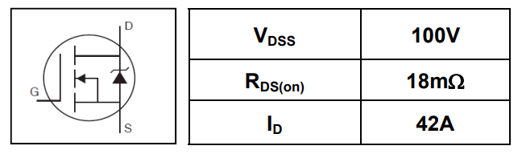
5. Component Selection
MOSFET: IRFU3710ZPbF
I_{D,max} ≈ 10A
V_{DS,max} ≈ 65V
 | Parameter | Max. | Units
I_{D} @ TC = 25°C | Continuous Drain Current VGS @ 10V | 56 | A
I_{D} @ TC = 100°C | Continuous Drain Current, VGS @ 10V | 39 | A
V_{GS} | Gate-to-Source Voltage | ± 20 | V
R_{DS(on)} | Drain-to-Source On-Resistance | 18 | mΩ
V_{GS(th)} | Gate Threshold Voltage | 4.0 | V
t_{r} | Rise Time | 43 | ns
t_{f} | Fall Time | 42 | ns
[3]

Slide 30
5. Component Selection
Diode: DSA30C100PB (Both for the snubber and the secondary side)
Schottky diode is chosen due to its speed.
Snubber
I_{F,max} ≈ 8A
V_{max} ≈ 65V
Secondary Side
I_{F,max} ≈ 9.5A
V_{max} ≈ 62V
 | Parameter | Max. | Units
V_{RRM}(T_{VJ} = 25°C) | max. repetitive reverse blocking voltage | 100 | V
V_{F} (I_{F} = 15A, T_{VJ} = 25°C) | forward voltage drop | 0.91 | V
V_{F} (I_{F} = 15A, T_{VJ} = 125°C) | forward voltage drop | 0.73 | V
I_{FAV} (T_{VJ} = 125°C) | average forward current | 15 | A
C_{J} | junction capacitance | 146 | pF
I_{R} | reverse current, drain current | 250 | µA
[4]

Slide 31
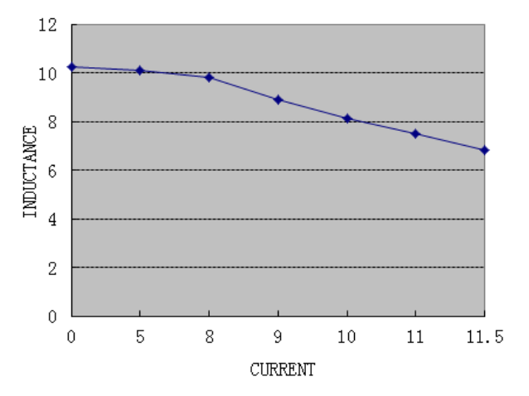
5. Component Selection
Output Filter Inductance: SRI1209-100M
Parameter | Max. | Units
L | 10 ± 20% | µH
R_{DC} | 0.03 | Ω
I_{DC} | 10 | A
Test Conditions:
1KHZ / 0.25V
Output
Current
[5]

Slide 32
5. Component Selection
Input Capacitor:
4xPKLH-063V471
63V 470µF
Output Capacitor:
4xPKLH-016V471
16V 470µF
Control IC:
UC3845AN
Due to duty cycle limiting behaviour
Current Sensor IC:
ACS712-30A
And various resistors
[6-9]

Slide 33
6. Future Work
Optocoupler Design Finalization
Design Implementation on Stripboard
Thermal Analysis
PCB Design (Bonus)
Case Design (Bonus)

Slide 34
6. References
[1] W. (n.d.). Round Wire ac Resistance Calculator. https://chemandy.com/calculators/round-wireac-resistance-calculator.htm
[2]“Magnetics - Ferrite Core Loss Calculator.” https://www.mag-inc.com/Design/DesignTools/Ferrite-Core-Loss-Calculator
[3] https://cdn.ozdisan.com/ETicaret_Dosya/652386_243124.pdf [4]https://cdn.ozdisan.com/ETicaret_Dosya/483083_5853486.pdf
[5] https://pdf.direnc.net/upload/10uh-12x12-datasheet.pdf
[6] https://cdn.ozdisan.com/ETicaret_Dosya/465839_6115297.pdf
[7] https://cdn.ozdisan.com/ETicaret_Dosya/342170_703953.pdf
[8] https://pdf.direnc.net/upload/acs712-datasheet.pdf
[9] https://cdn.ozdisan.com/ETicaret_Dosya/501245_5372110.pdf

Slide 35

In memory of …

