Slide 1

Spotify Song Popularity Prediction
Erdem Dağdeviren
Ist DataScienceAcademy

Slide 2
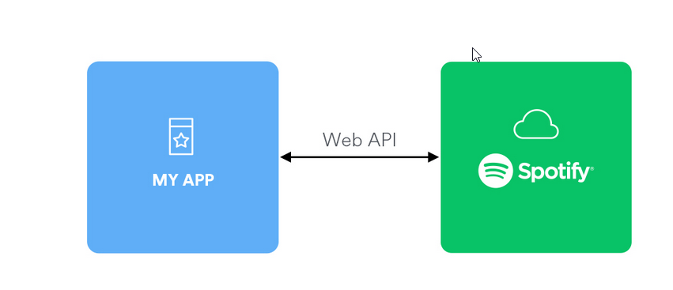
Collecting Data From the Spotify Web API Using Spotipy
Goal of the First Step:
The goal is to show how to collect audio features data for tracks from the official Spotify Web API in order to use it for analysis, prediction and machine learning.
Spotify offers a number of API endpoints to access the Spotify data
Spotipy is a lightweight Python library for the Spotify Web API. With Spotipy you get full access to all of the music data provided by the Spotify platform.

Slide 3
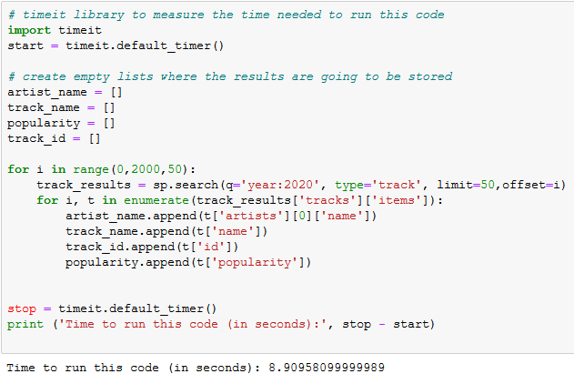
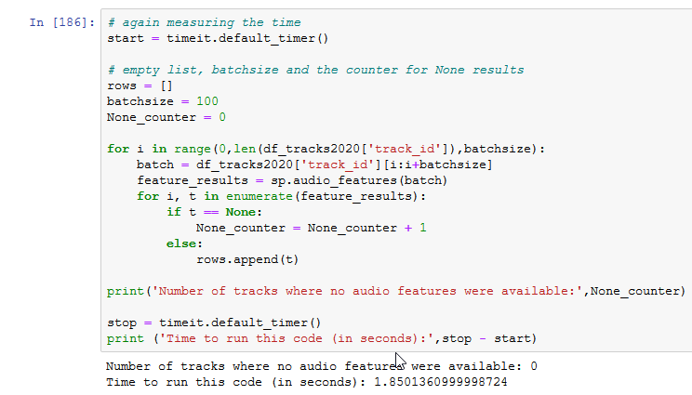
Using the Spotify Web API
The data collection is divided into 2 parts:
21.000 track IDs are collected from the Spotify API.
Grouping the entries by atrist name and track name is used to check for duplicates and then they are deleted.
1
The Track IDs
2
The Audio Features

Slide 4
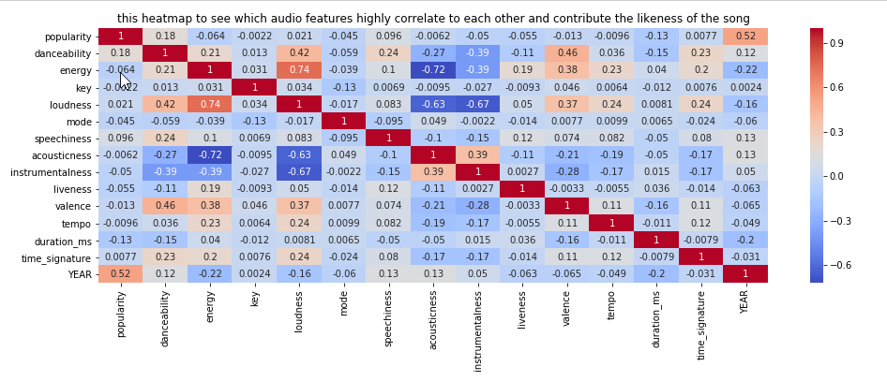
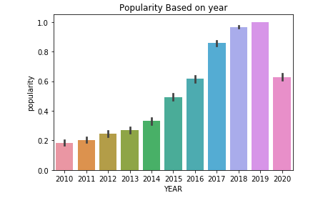
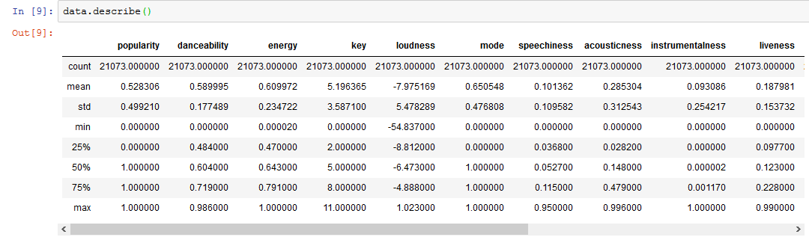
EDA & Data Preparation
The effects of audio data on itself and its effect on popularity
No need to clean the data as obtained duplicate data were removed in the previous step

Slide 5
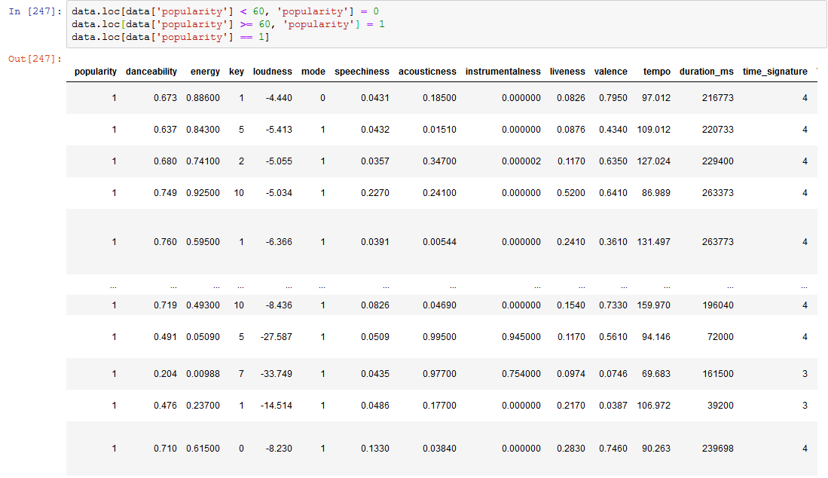
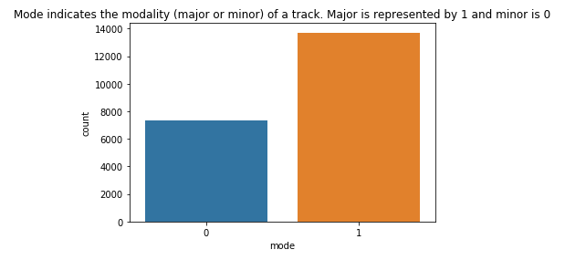
Feature Engineering
The popularity column consisted of data varying between 0 – 100.
They were replaced with 1 and 0 depending on average popularity
The mode column; 1 is replaced with major , 0 is replaced with minor.

Slide 6
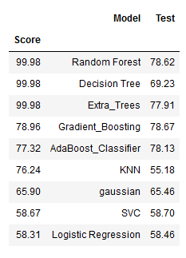
Basic Model Fitting and Predicting
01
The dataset is loaded into machine learning with the base parameters of 9 models.
02
The model that gave the best score is started to be worked on.

Slide 7
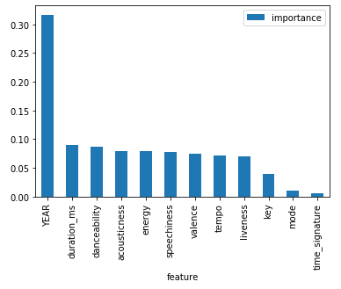
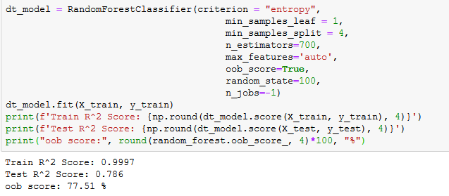
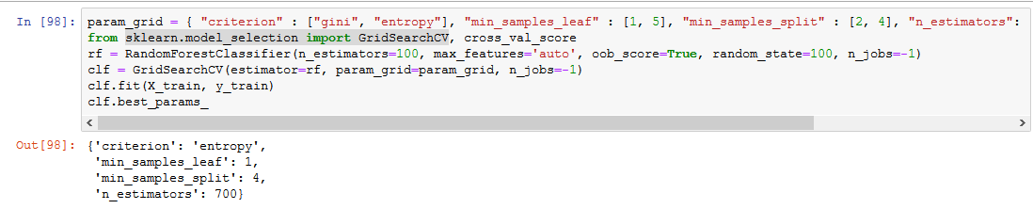
Details of Machine Learning
The sklearn GridSearchCV model is used to find the best paremets for the RandomForestClassifier model
The features that loaded to machine learning are evaluated in order of importance and removed the trivial ones
The values ​​of accuracy, precision and recall are calculated by cross validation
RandomForestClassifier model has the highest accuracy score according to the result of Grimacy

Slide 8
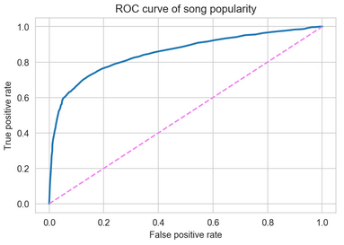
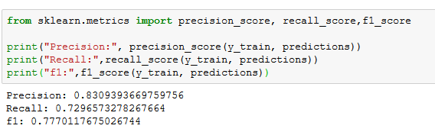
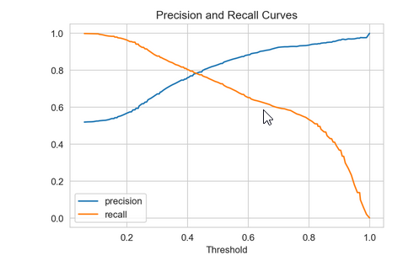
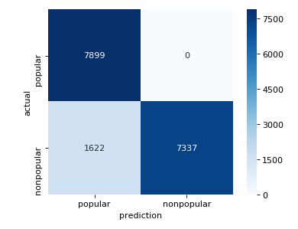
ROC Curve - F1 - Precision – Recall - Confusion Matrix

Slide 9
Conclusion and Future Work
Using a dataset of 21000 Spotify Tracks, I was able to predict popularity using audio-based metrics such as key, mode, energy, acousticness, danceability and year
The Random Forest Classifier was the best performing algorithm with 99.0% accuracy and 85.4% AUC
For increasing the accuracy, I analysed each parameter and removed mode and time_signature
I will enlarge my Spotify dataset by using the Spotify API by collecting my own data. Then, I will work on different predictions by changing the point of view with more comprehensive dataset. For ex: Genre classification or trend prediction

Slide 10


Thank You!

Slide 11
Collecting Data from the Spotify Web API Using Spotipy
Spotipy is a lightweight Python library for the Spotify Web API. With Spotipy you get full access to all of the music data provided by the Spotify platform.
About using the Spotify Web API:
Spotify offers a number of API endpoints to access the Spotify data. In this notebook, I used the following:
search endpoint to get the track IDs
audio features endpoint to get the corresponding audio features.
The data was collected on several days during the months of April, May and August 2018.
Goal of this First Step:
The goal is to show how to collect audio features data for tracks from the official Spotify Web API in order to use it for further analysis/ machine learning which will be part of another notebook.
For this short project, I will be predicting the popularity of songs based purely on song metrics such as key, dancibility, and acousticness. Year, artist, era, and genre will not be included.

Slide 12
Using the Spotify Web API
The data collection is divided into 2 parts: the track IDs and the audio features. In this step, I'm going to collect 20.000 track IDs from the Spotify API.
Sometimes, the same track is returned under different track IDs. So i can use group the entries by artist_name and track_name and check for duplicates and also delete it.

Slide 13
EDA & DATA PREPARATION
In EDA section, you can see the effects of auido data on itself and its effect on popularity, as I have cleared double data to obtain audio data in response to track data I received from spotify.

Slide 14
Basic Model Fitting and Predicting
First, I put the dataset into machine learning with the base parameters of 9 models. Afterwards, I started to work on the model that gave the best score.

Slide 15
Collecting Data from the Spotify Web API using Spotipy
Spotipy is a lightweight Python library for the Spotify Web API. With Spotipy you get full access to all of the music data provided by the Spotify platform.
About using the Spotify Web API:
Spotify offers a number of API endpoints to access the Spotify data. In this notebook, I used the following:
search endpoint to get the track IDs
audio features endpoint to get the corresponding audio features.
The data was collected on several days during the months of April, May and August 2018.
Goal of this First Step:
The goal is to show how to collect audio features data for tracks from the official Spotify Web API in order to use it for further analysis/ machine learning which will be part of another notebook.

