Slide 1

MOVIE DATA ANALYSIS
Aysu Erdemir
May 12, 2022

Slide 2
Business Problem
What type of movies should Microsoft create?
Find a way to assess movie “profitability”.
Explore characteristics of past movies in relation to profitability.
Make specific suggestions.

Slide 3

Business Problem
What genres of movies to make?
Which directors to work with?
When to release the movie?
Which movie length to focus on?

Slide 4


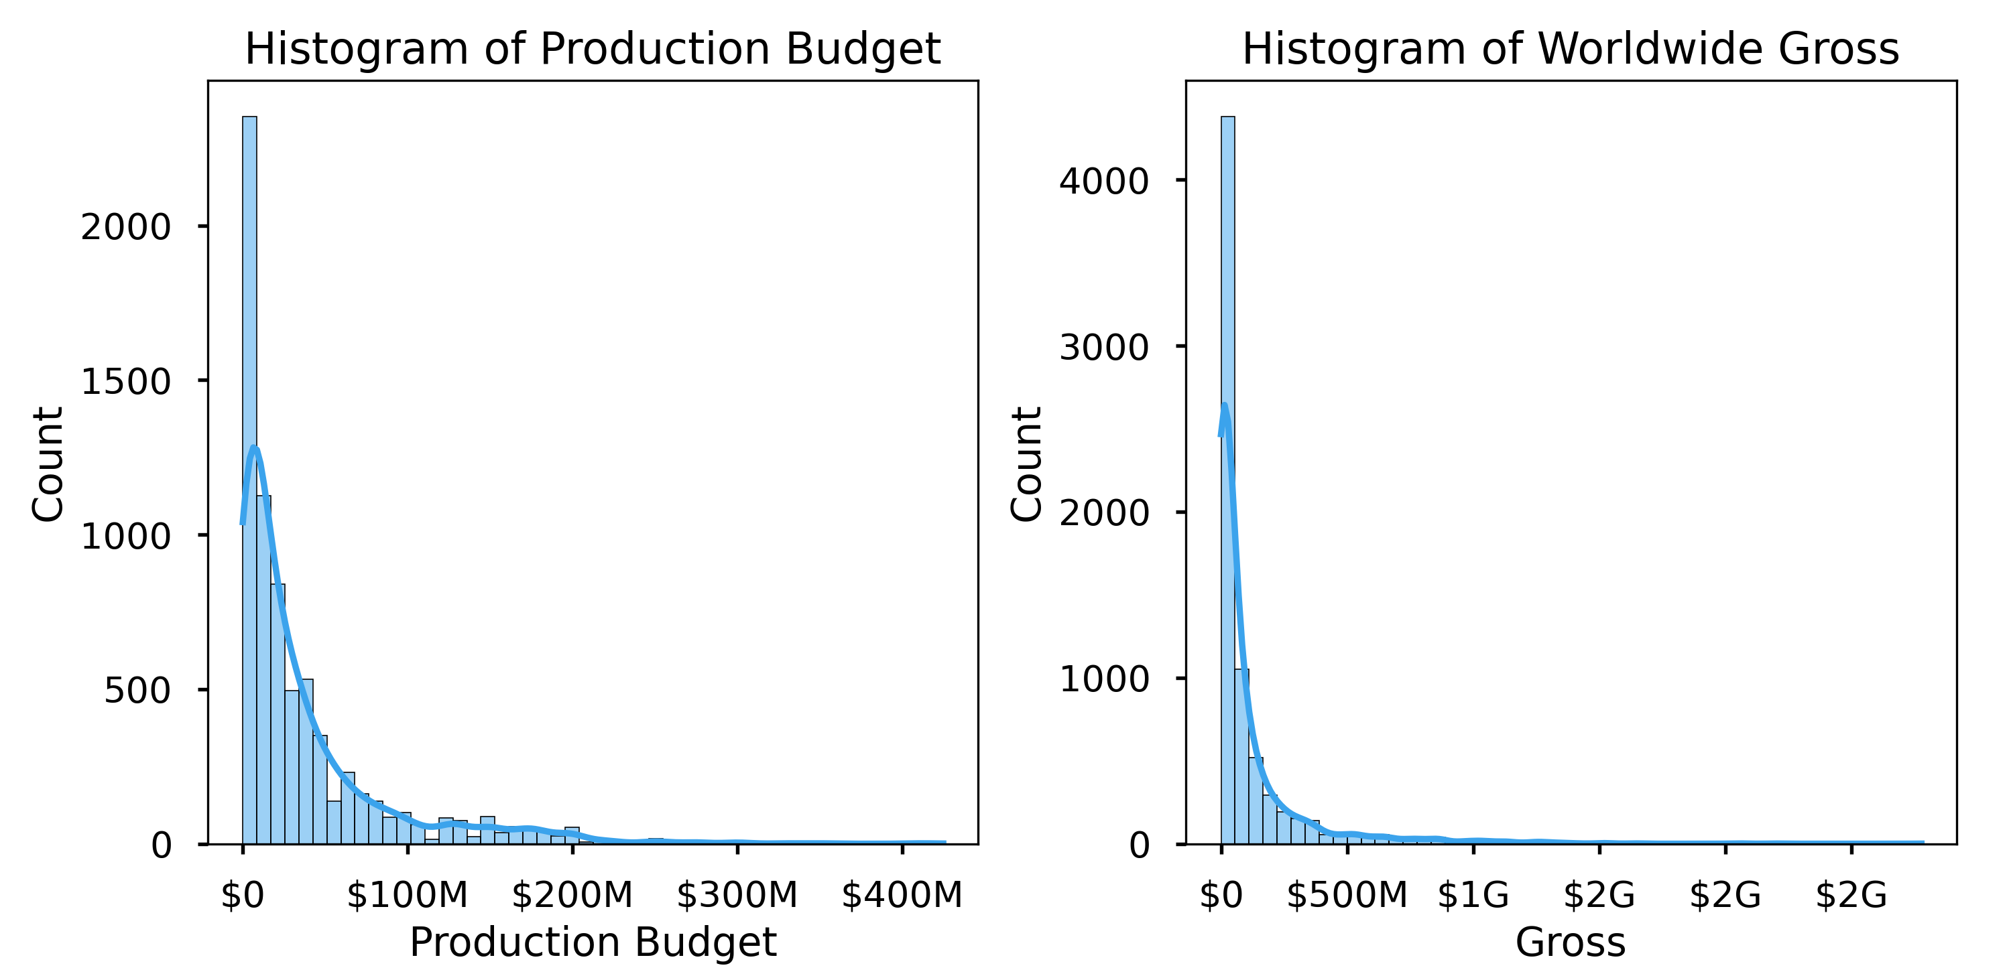
Data
IMDb dataset:
140416 movies
includes genre, release date, runtime, director and rating.
The Numbers dataset:
5698 movies
includes budget and gross
derived profit and return on investment

Slide 5
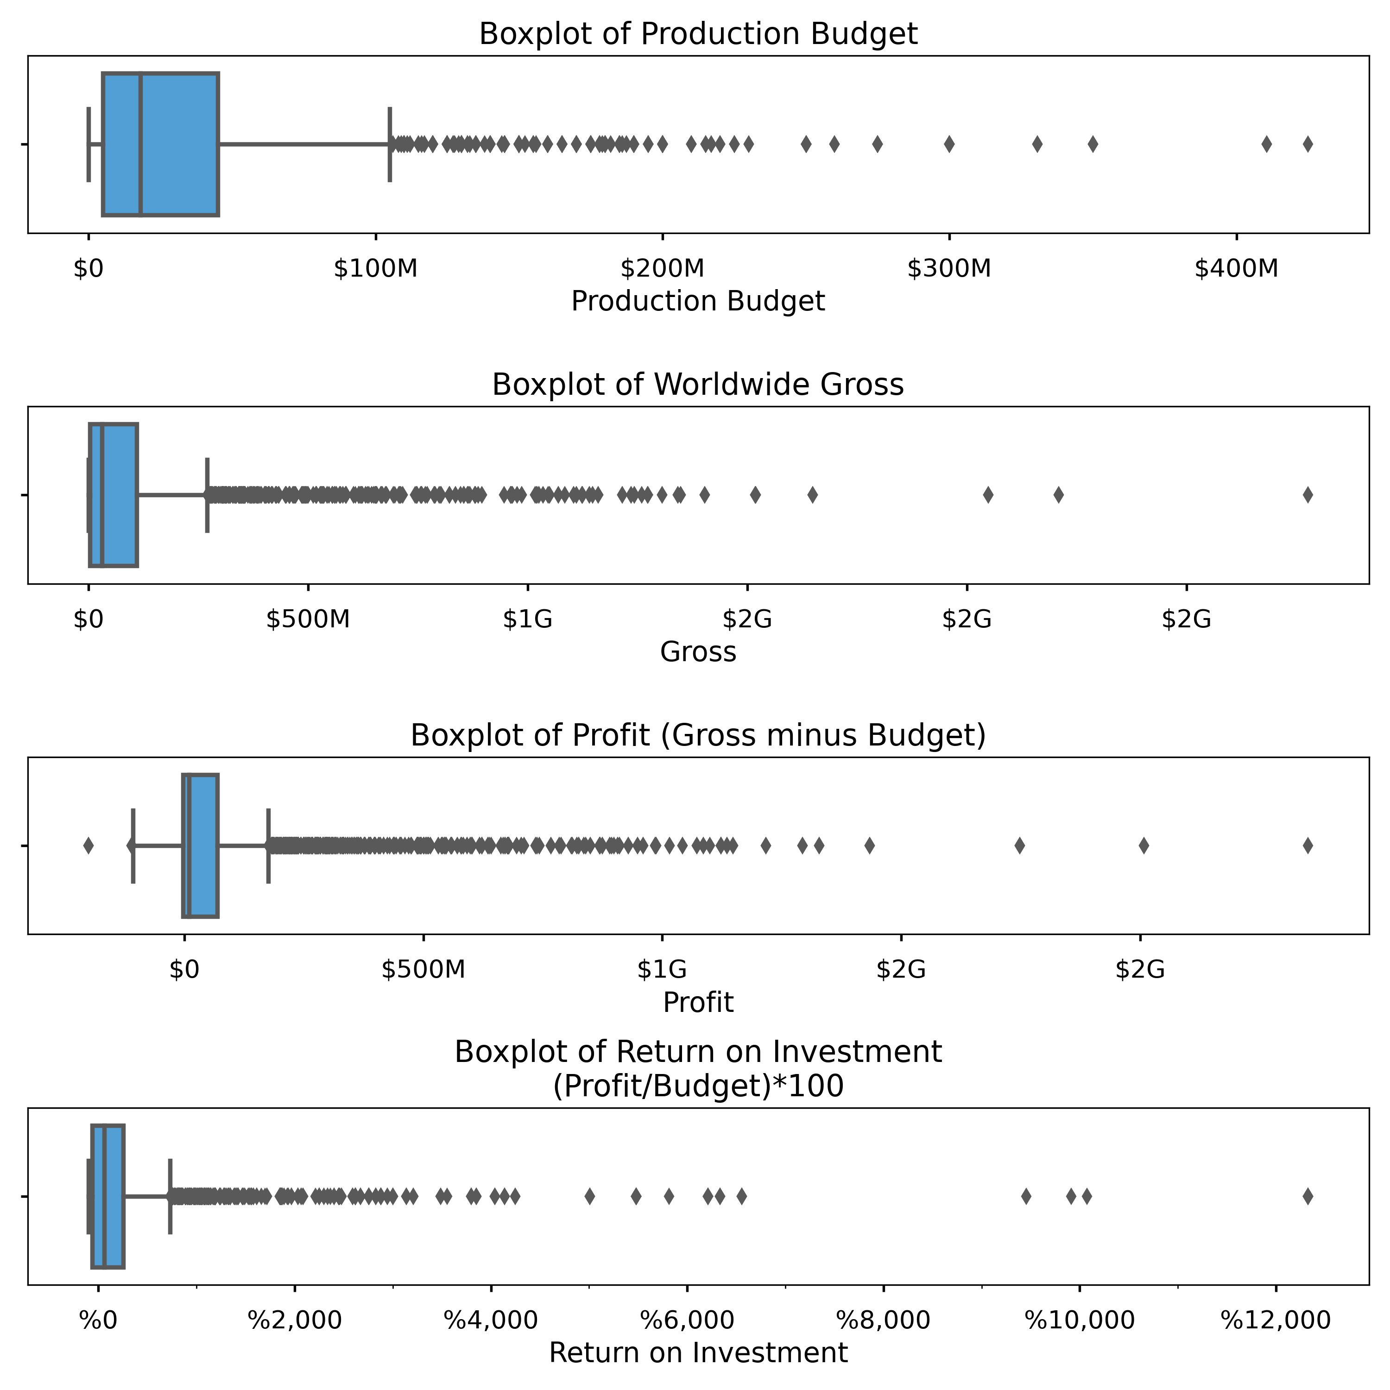
Methods
Use Profit and Roi as means to assess Profitability.
Use MEDIAN as a measure of central tendency due to:
The large number of unsuccessful movies accumulated on the lower end
Lots of high success outlier movies with extremely high budget or gross.

Slide 6
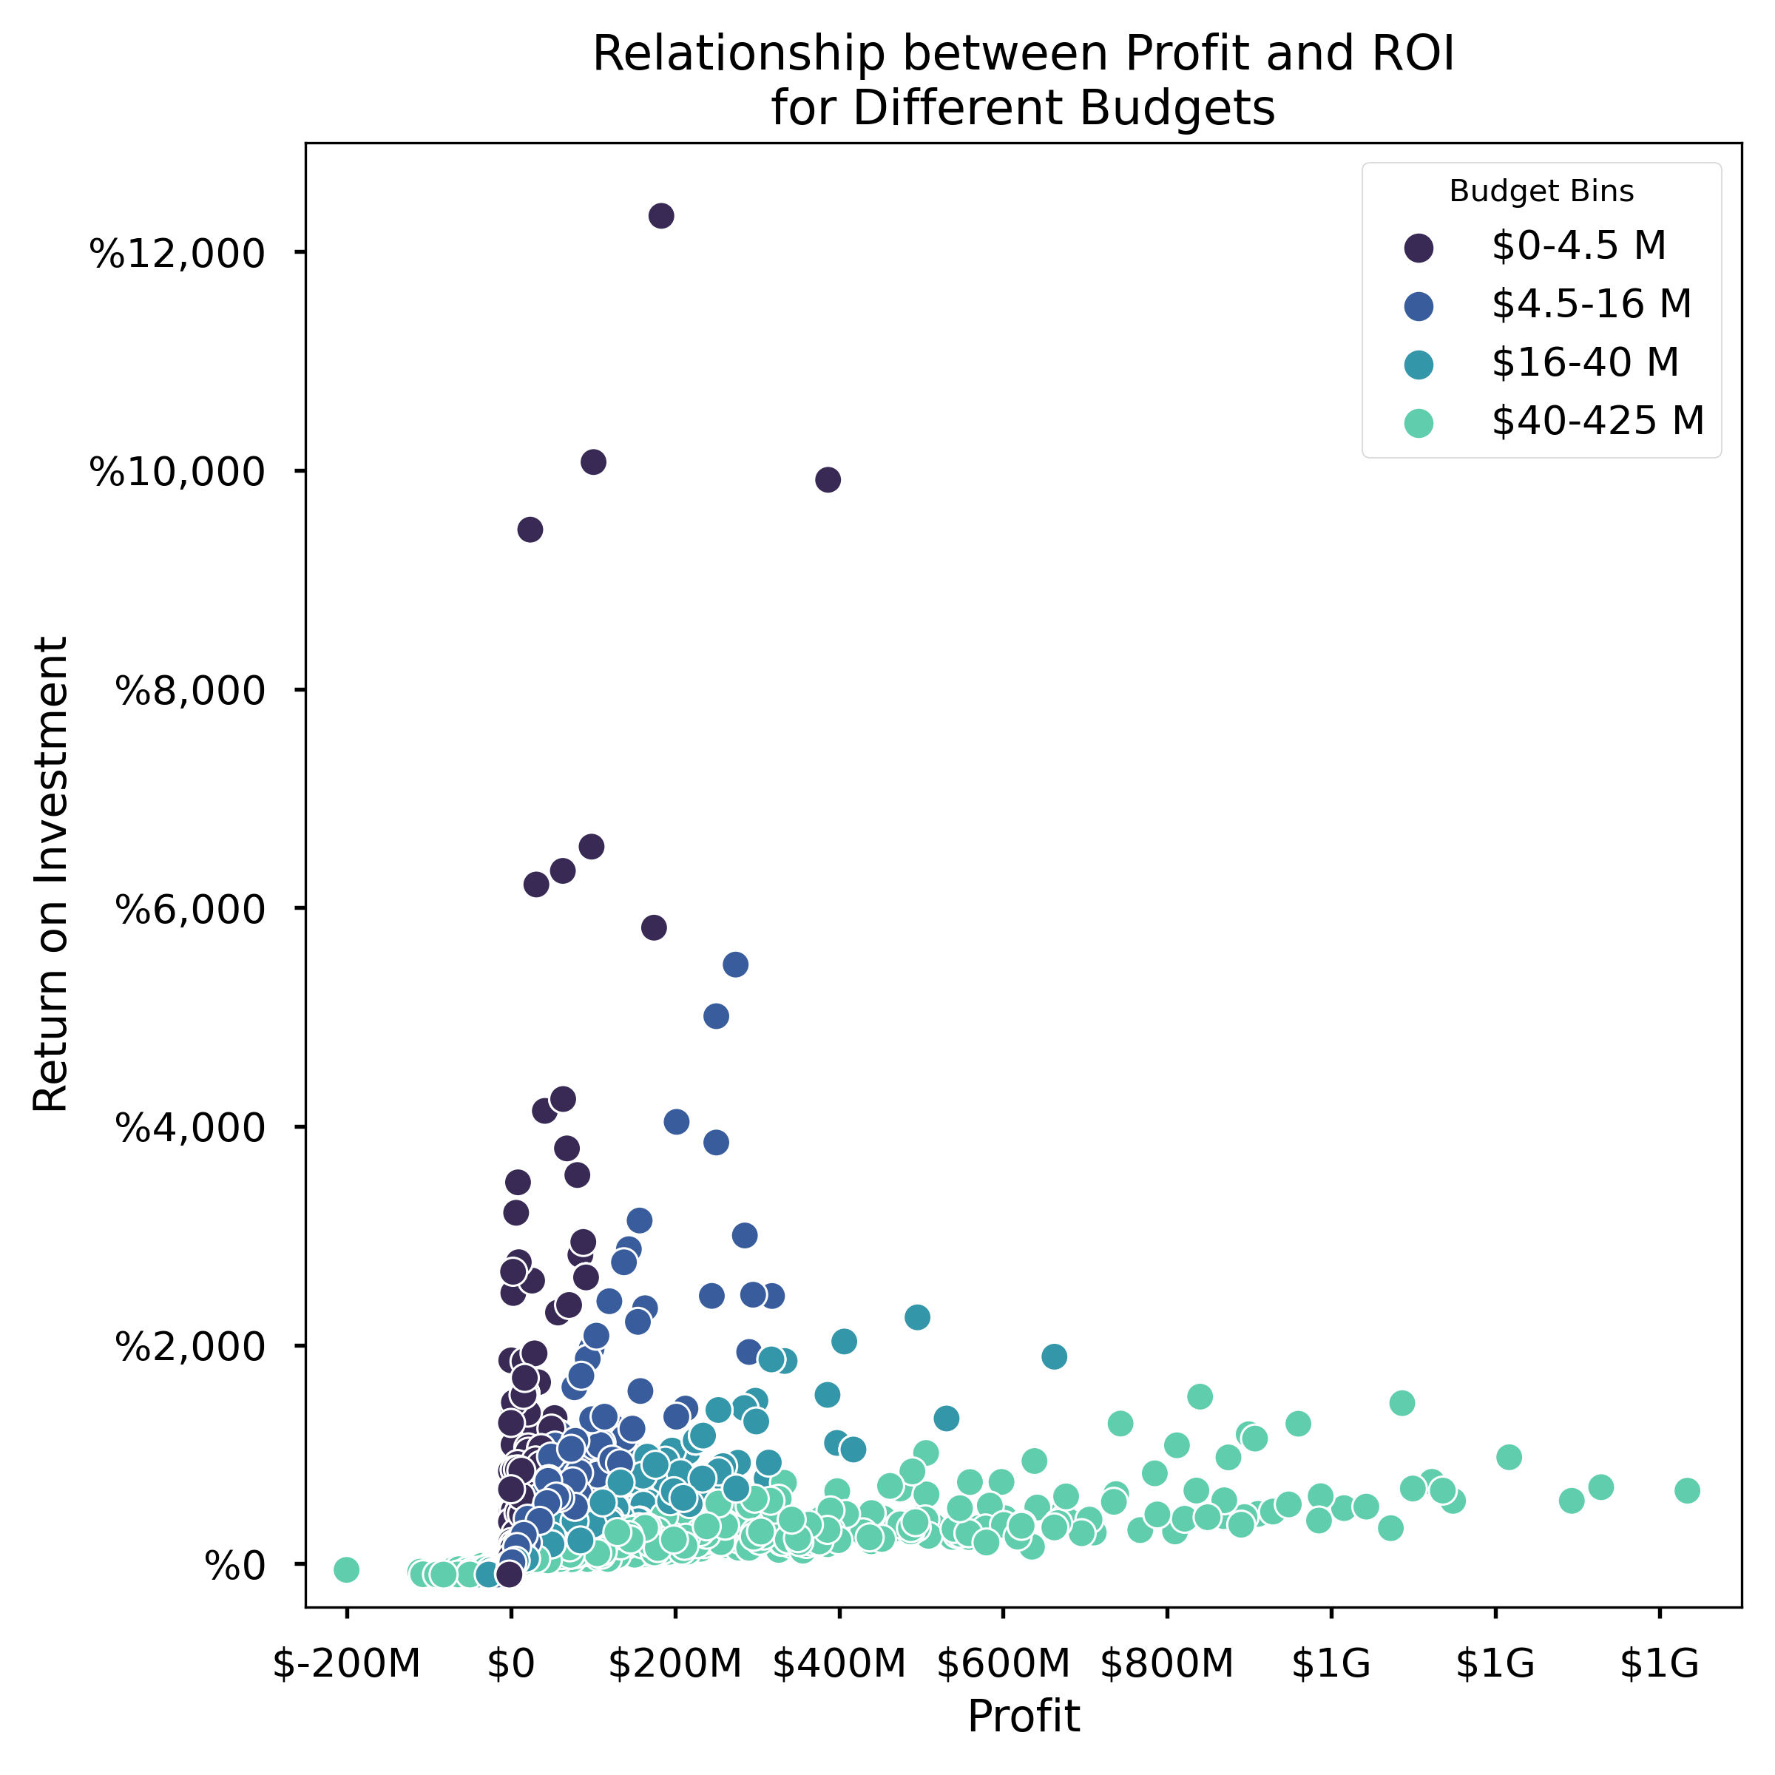
Methods
>$4.5M Budget : Low profit due to low budget, high ROI potential.
$4.5-16M Budget: Slightly higher profit, moderate ROI potential.
$16-40M Budget: Slightly higher profit, moderate ROI potential.
>$40M Budget: High profit due to high budget, low ROI potential.
When assessing profitability:
ROI for lower budget movies?
Profit for higher budget movies?

Slide 7
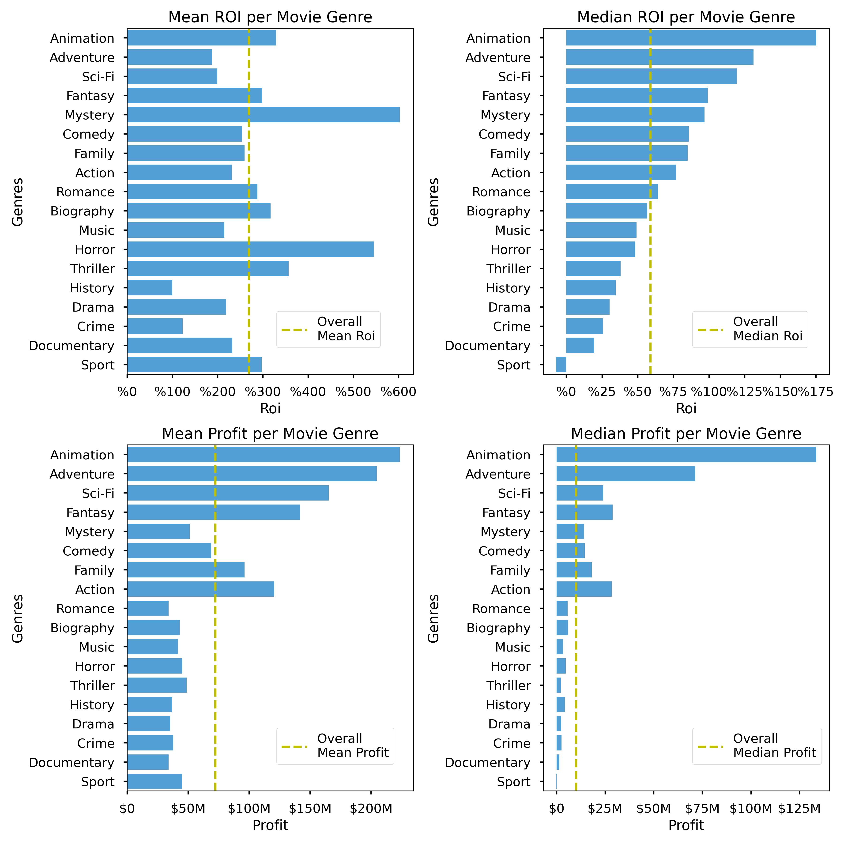
What genres of movies to make?
The genres that bring the most ROI are:
Animation
Adventure
Sci-Fi
Fantasy
Mystery
The genres that bring the most profit:
Animation
Adventure
Fantasy
Action
Fantasy

Slide 8
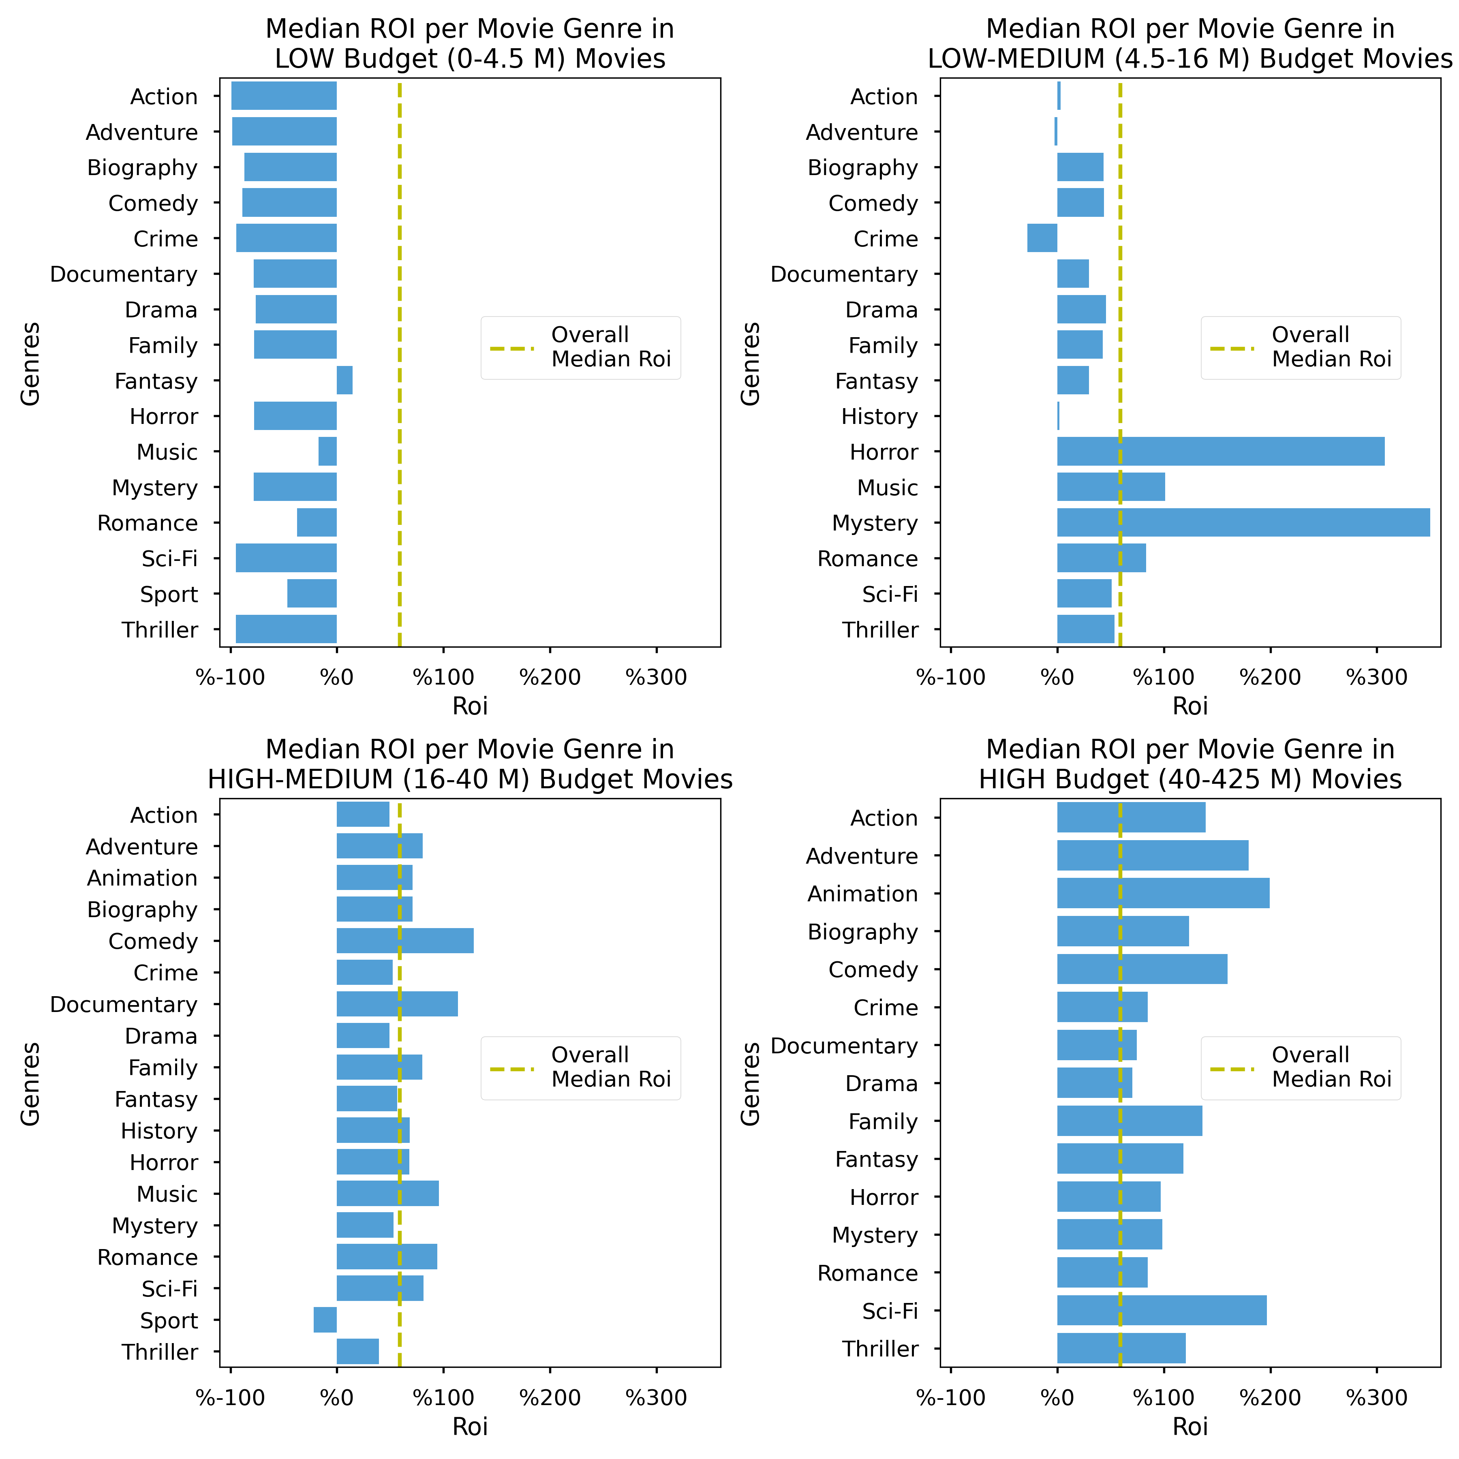
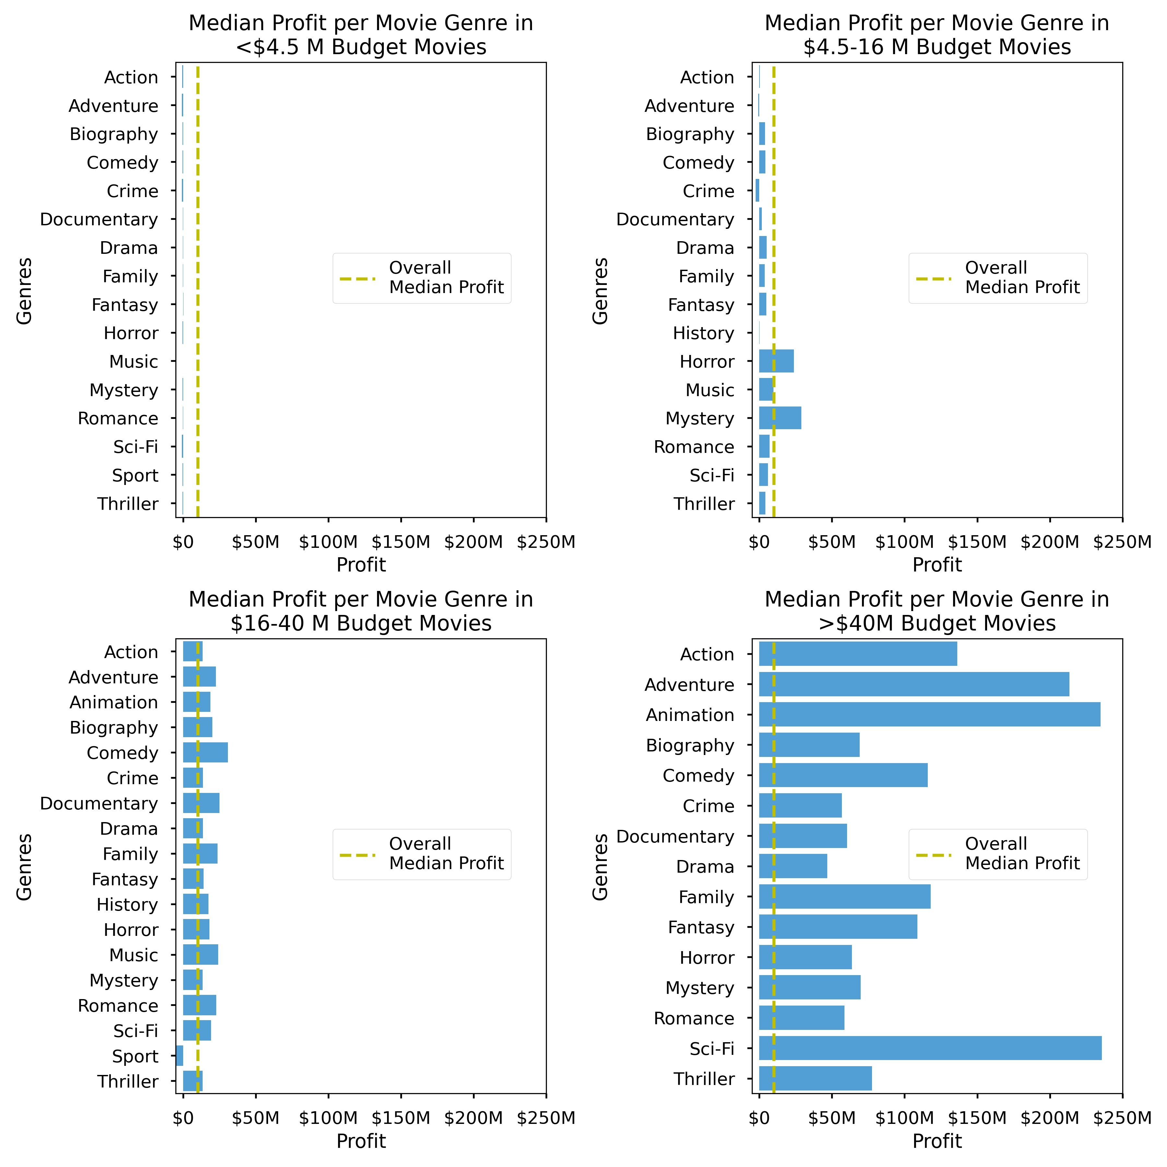
What genres of movies to make based on budget?
With low-medium budget ($4.5-16M), make movies of:
Mystery
Horror
They bring close to 300% ROI but about 20-25M $ in profit.
With high budget (>$40M), make movies of:
Animation
Adventure
Sci-Fi
They bring close to 200% ROI but about 200-250 M $ in profit.

Slide 9
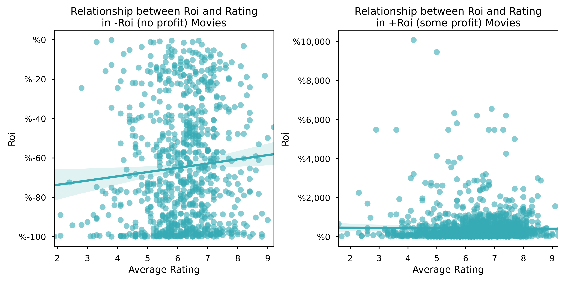
Ratings could be misleading for assessing movie success
Do NOT rely on ratings when assessing a movie’s success especially if the movie makes a profit.

Slide 10
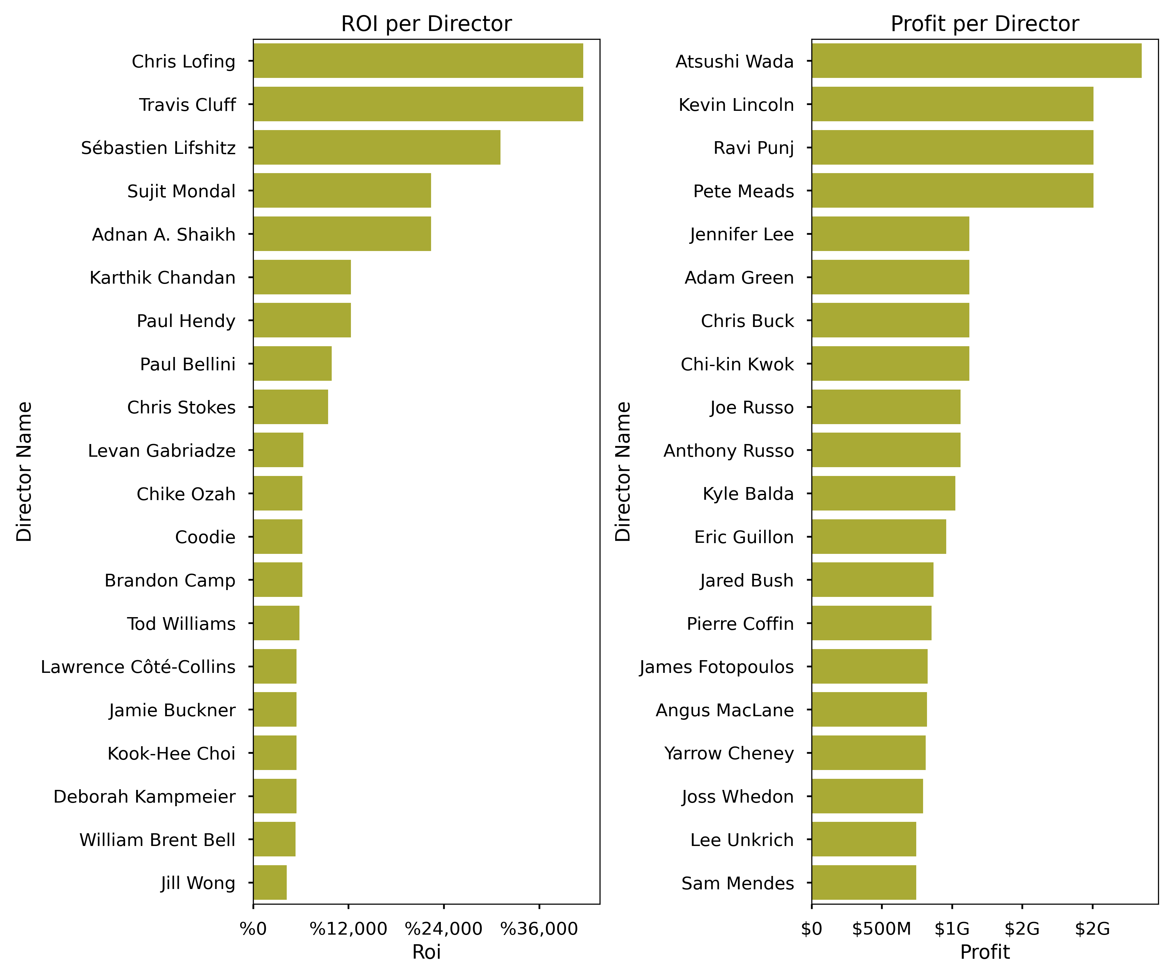
Which directors to work with?
For smaller budget movies where we care more about ROI invest on:
Chris Lofing
Travis Cluff
Sébastien Lifshitz
Sujit Mondal
Adnan A. Shaikh
For bigger budget movies where we care more about PROFIT invest on:
Atsushi Wada
Kevin Lincoln
Ravi Punj
Pete Meads

Slide 11
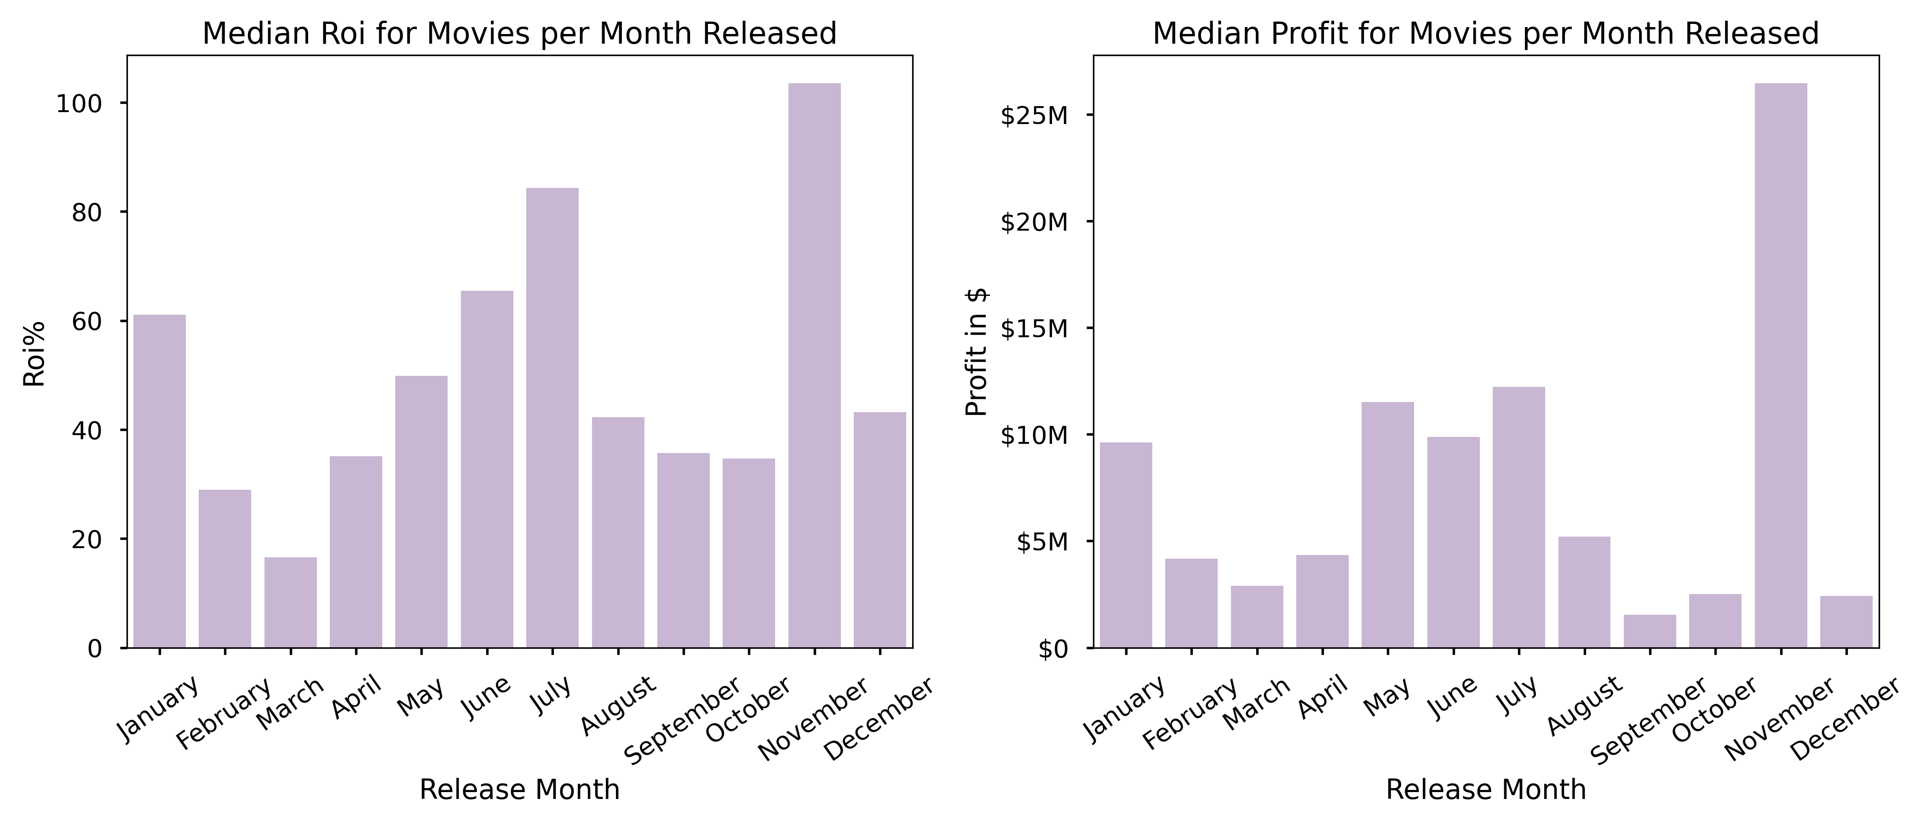
When to release the movie?
For high ROI and Profit release the movie in late fall, especially in November.
If you miss November, do NOT release in December, wait for January.
Summer months of June and July are also good months to release.

Slide 12
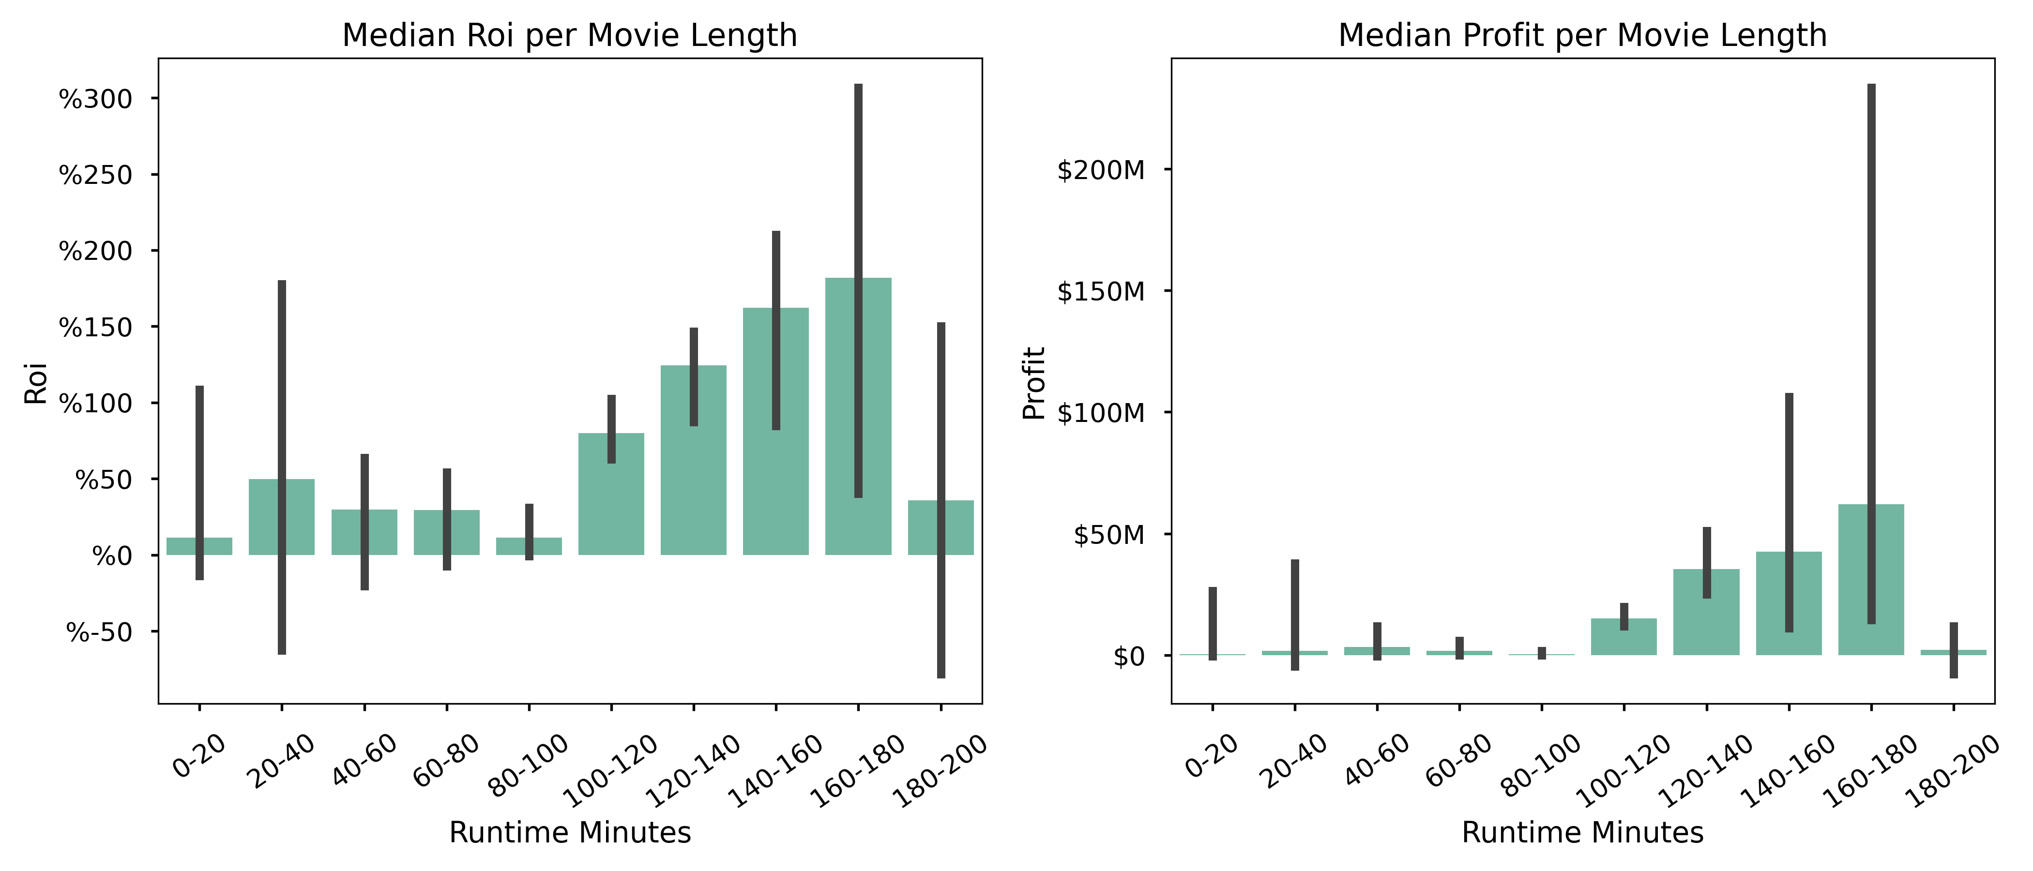
Which movie length to focus on?
For the highest Roi and Profit target 120-140 min length for the least risk. This is a little over 2 hours.

Slide 13
Conclusions
Focus on Animation, Sci-Fi and Action for high budget movies and Thriller and Mystery for lower budget movies.
Hire Chris Lofing and Travis Cluff as the director for lower budget movies, and Atsushi Wada and Kevin Lincoln for higher budget movies.
Release the movie in late fall right before the holiday season or in the summer.
Make movies slightly longer than 2 hours.

Slide 14

Limitations and Improvement Ideas
Small sample size - due to lack of budget and gross information. API calls or wed scraping ?
Challenging merging: Movie names not coded the same way in different dataset.
Lots of outlier movies making the statistical analyses more challenging.
Need more information about Microsoft’s allocated budget?
Notes:
Sample size was reduced due to lack of budget and gross information on many movies.
Movie names were not coded the same way in different datasets which made the merging process challenging and insufficient.

Slide 15

Email: erdemiraysu@gmail.com
GitHub: @erdemiraysu
LinkedIn: linkedin.com/in/aysuerdemir/
THANK YOU!

