Slide 1
Machine learning in python vs. …
Erdem Ultanir
QuantMinds International May 2019

Slide 2
Outline
Machine learning is not just an “optimization” problem, real world is different than “Kaggle”
90% of the time is spend on data, visualization, and explanation of results
A data scientist needs significant knowledge in these areas
What are the latest toolsets capturing the full cycle of machine learning?

Slide 3
What is hot now??
Amazing Machine Learning Open Source of the Year (v.2019)
Top 49 Tools & Projects. Average Github
Computer Vision
Reinforcement Learning
NLP
Generative adversarial network (GAN)
Neural Network
Toolkits
https://medium.mybridge.co/amazing-machine-learning-open-source-tools-projects-of-the-year-v-2019-95d772e4e985
Almost all in python! A few in javascript, clear python domination
Notes:
GANs are primarily for image generation

Slide 4


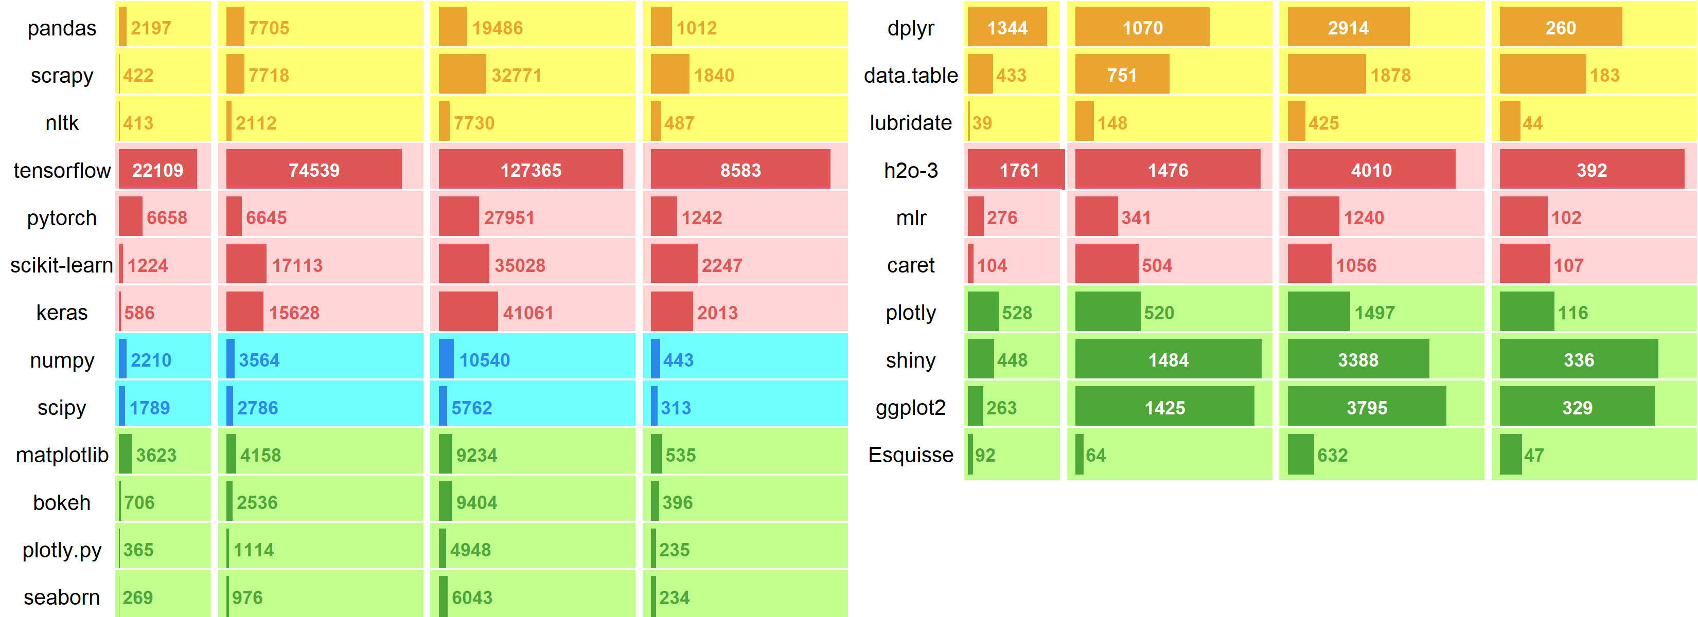
Github stats
Measure developers interest in major data science libraries
Commits; # of commits in last year
Forks: # of other repos copied
Stars: # of bookmarkers
Watchers: # of people in change message list
Clear domination of python, with emphasize in NN.
This list is not an true indicator of usages, installation lists ; pypi load counts => vanity, cran downloads counts => cranlogs. Installation is not a true indicator of usage though; ex venv…
commits forks stars watchers
commits forks stars watchers
data manipulation machine learning mathematics visualizations

Slide 5
Data: Python pandas
Good: Having an R-style dataframe (csv like table with column names) can help a lot in keeping track of your data.
Bad: hidden memory killers in the project, like the way that we use Python objects (like strings) for many internal details, so it's not unusual to see a dataset that is 5GB on disk take up 20GB or more in memory. It's an overall bad situation for large datasets.” Pandas rule of thumb: Wes Mckinney "have 5 to 10 times as much RAM as the size of your dataset“
an array of strings is an array of PyObject pointers, and the actual string data lives inside PyBytes or PyUnicode structs that live all over the process heap. As developers, we are hamstrung by the bloated, memory-bound nature of processing these objects. In Python, the simple string 'wes' occupies 52 bytes of memory. '' occupies 49 bytes.
pandas is the requirement that data must be loaded completely into RAM to be processed. No memory mapping
missing data (NULL) storage is not explicit
In pandas, all memory is owned either by NumPy or the Python interpreter, anything missing in Numpy ex pandas.Categorical is supported separately outside Numpy
Pandas query planning is series of temporary tables df[df.c < 0].d.sum(), pandas creates a temporary DataFrame df[df.c < 0], not efficient…

Slide 6
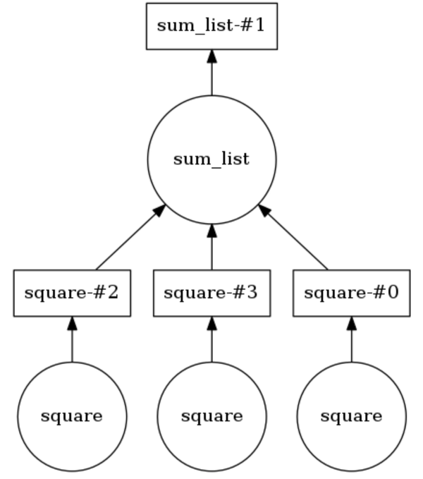
Data: Python Dask
Improving the speed through parallelization in python
minimal code changes you can run the code in parallel taking advantage of the processing power
@delayed def square(num): print("square fn:", num) print() return num * num @delayed def sum_list(args): print("sum_list fn:", args) return sum(args) items = [1, 2, 3]
computation_graph = sum_list([square(i) for i in items])

Slide 7
Data :R data.table
It is widely used for fast aggregation of large datasets, low latency add/update/remove of columns, quicker ordered joins, and a fast file reader
fast primary ordered indexing and its automatic secondary indexing
a memory efficient combined join and group by.
in addition to standard sql joins (right, left, inner, full outer), allows rolling joins, non-equivalent joins
Syntax : DT[where, select|update|do, by] For example: >
DT[,sum(v),by=x] x V 1: A 192213.2 2: B 192183.3 3: C 192601.7 DT[X, on=.(y<=foo)] Joins X to DT (right join X to DT) DT[X, on=.(x, y<=foo)] Joins X to DT (right join X to DT) on column x and DT.y <= X.foo

Slide 8
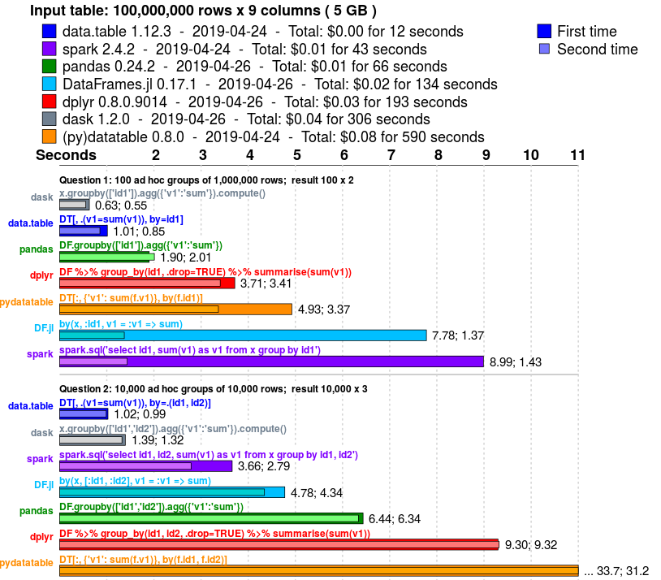
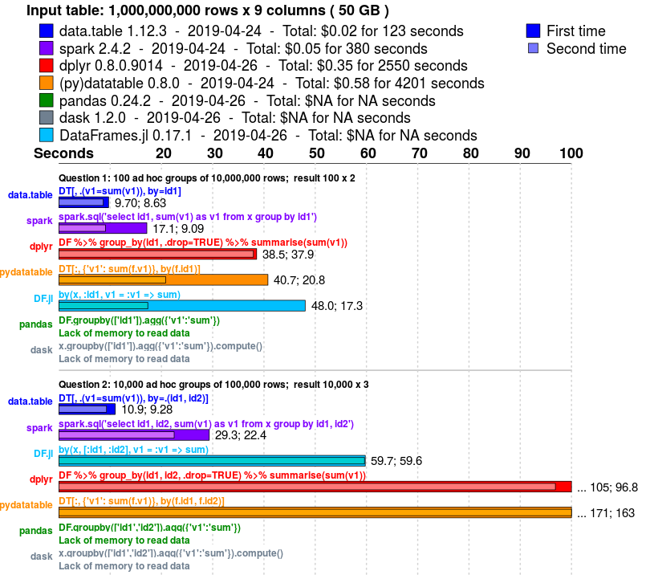
Data: R data.table
https://h2oai.github.io/db-benchmark/
groupby task benchmark for various data sizes and various data characteristis (cardinality, percentage of missing values, pre-sorted input). There are 10 different questions run for each input data, questions are categorized into two groups
data.table performs significantly faster than other alternatives, has the most efficient use of memory

Slide 9
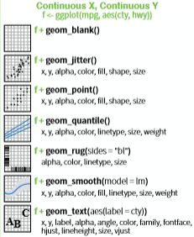
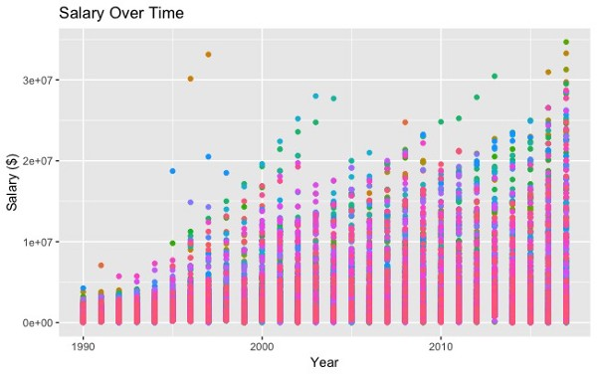

Visualization: ggplot2 R (and Python)
ggplot2 is based on the grammar of graphics
the idea that you can build every graph from the same few components: a data set, a set of geoms—visual marks that represent data points, and a coordinate system.

Slide 10
Visualization: ggplot2 R (and Python)
Sometimes ggplot2 can be a bit difficult
Use ggplot2 builder (Esquisse) like Tableau to create your charts, and export the codes Tableau to R

Slide 11
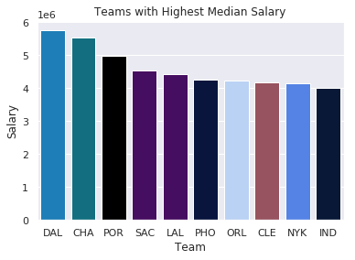
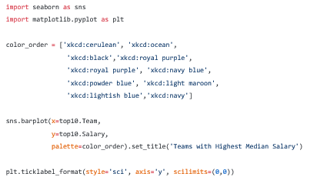
Visualization: Matplotlib, Seaborn, and Pandas (Python)
Matplotlib base library for python plot supports
Seaborn and Pandas plotting were built on top of Matplotlib — when you use Seaborn or df.plot() in Pandas, you are actually utilizing code that people have written using Matplotlib

Slide 12
Visualisation-Interactive: plotly
Interactive visualisation package written in javascript, but available for both R and Python
Brings Matlab like plots to other environments

Slide 13
Learning Algorithms: scikit-learn vs caret (or mlr)
R has more data analysis built-in (summary function, dataframe), Python relies on packages (Statsmodels, pandas). For statistical tasks R is more straightforward, this resonates well with not only with regression
Scikit-learn compares well Caret in R. -Both of these provide data partition routines for test and train samples -Both provides access around series of machine learning routines; including random forests, decision trees, svms, regressions, and neural nets -Model summaries is a bit better in R as usual, but both libraries are comparable

Slide 14
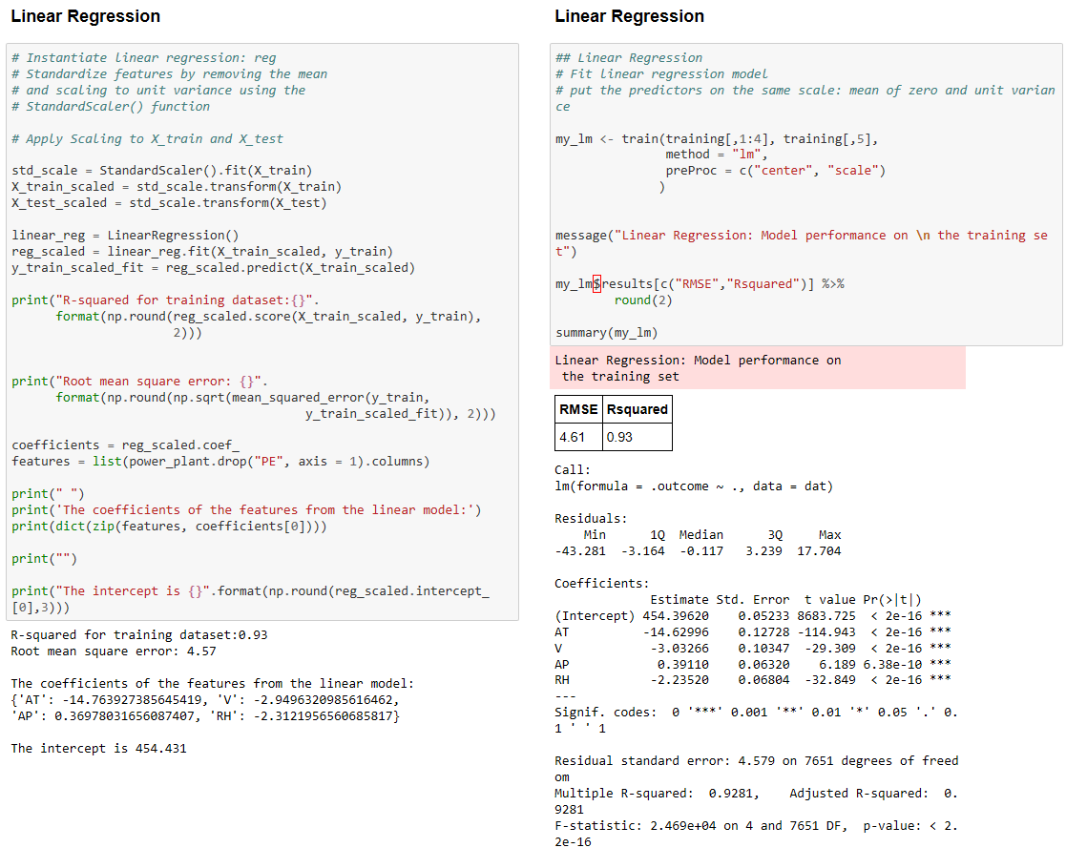
Learning Algorithms: scikitlearn vs caret
functional
Object
oriented
Requires more code to get the performance
Rich stats
through
summary
https://datascience-enthusiast.com/R/ML_python_R_part1.html

Slide 15
NN: Tensorflow
Ignited massive interest in NN through support by Google. TensorFlow no doubt is better marketed compared to the other deep learning frameworks
symbolic math library, and is also used for machine learning applications such as neural networks. It is not really a ready set of machine learning algorithms. Primarily a gradient descent optimization tool
deployment of computation across a variety of platforms (CPUs, GPUs, TPUs)
stable Python (for version 3.7 across all platforms and C APIs and without API backwards compatibility guarantee: C++, Go, Java] JavaScript and Swift. Third-party packages are available for C#, Haskell, Julia, R, Scala, Rust, Ocaml, and Crystal.
If you are not building some completely new NN, tensorflow might be an overkill

Slide 16
NN: Keras
Keras on the otherhand, ss a user friendly way to access since you can build neural nets one layer at a time. You don’t need to spend several lines of codes of tensorflow to create a layer. The process with Keras:
Define your model. Create a sequence and add layers.
Compile your model. Specify loss functions and optimizers.
Fit your model. Execute the model using data.
Make predictions. Use the model to generate predictions on new data.

Slide 17
Distributed learning: H20
H20 is java based (available through R and Python) the primary purpose of H2O is as a distributed (many machines), parallel (many CPUs), in memory (several hundred GBs) processing engine.
Key Features:
Access from both R and Python
Access from web-based interface named Flow. By means of Flow, data scientists are able to import, explore, and modify datasets, play with models, verify models performances, and much more.
AutoML : automatic training and tuning of many models within a user-specified time-limit.
Distributed, In-memory processing : In-memory processing with fast serialization between nodes and clusters to support massive datasets.
Simple Deployment : Easy to deploy POJOs/MOJOs (java model object files) to deploy models for fast and accurate scoring in any environment, including with very large models. -makes it possible for a data scientist to interrupt training and deploy a model before it is fully optimized if time and performance considerations make this desirable.

Slide 18
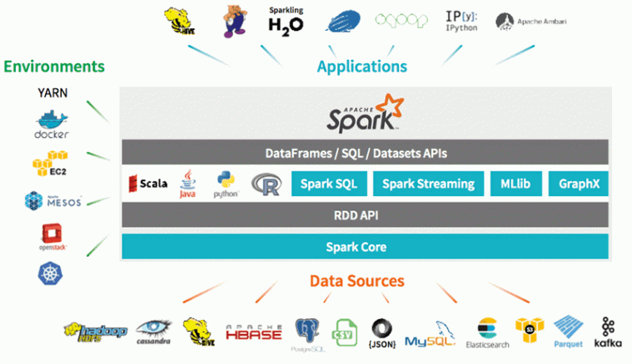
Big Data: Apache Spark
Spark is a unified, one-stop-shop for working with Big Data — “Spark is designed to support a wide range of data analytics tasks, ranging from simple data loading and SQL queries to machine learning and streaming computation, over the same computing engine and with a consistent set of APIs.
Spark executes much faster by caching data in memory across multiple parallel operations, whereas MapReduce involves more reading and writing from disk.
A Spark application runs as independent processes, coordinated by the SparkSession object in the driver program.
Spark SQL, Spark Streaming, Mlib, Graphx
Notes:
Apache Spark is a unified computing engine and a set of libraries for parallel data processing on computer clusters Spark is a unified, one-stop-shop for working with Big Data — “Spark is designed to support a wide range of data analytics tasks, ranging from simple data loading and SQL queries to machine learning and streaming computation, over the same computing engine and with a consistent set of APIs. Spark optimizes its core engine for computational efficiency — “by this, we mean that Spark only handles loading data from storage systems and performing computation on it, not permanent storage as the end itself. Spark can be used with a wide variety of persistent storage systems, including cloud storage systems such as Azure Storage and Amazon S3 https://towardsdatascience.com/a-beginners-guide-to-apache-spark-ff301cb4cd92 Spark executes much faster by caching data in memory across multiple parallel operations, whereas MapReduce involves more reading and writing from disk. Spark runs multi-threaded tasks inside of JVM processes, whereas MapReduce runs as heavier weight JVM processes. This gives Spark faster startup, better parallelism, and better CPU utilization. Spark provides a richer functional programming model than MapReduce. Spark is especially useful for parallel processing of distributed data with iterative algorithm A Spark application runs as independent processes, coordinated by the SparkSession object in the driver program. The resource or cluster manager assigns tasks to workers, one task per partition. A task applies its unit of work to the dataset in its partition and outputs a new partition dataset. Because iterative algorithms apply operations repeatedly to data, they benefit from caching datasets across iterations. Spark SQL is Apache Spark’s module for working with structured data. It provides JDBC and ODBC connectivity for querying Spark datasets with SQL like queries using traditional analytics, data discovery, BI and visualization tools. Spark SQL also lets users being in data from different formats such as JSON, Parquet or a relational database, transform it, and expose it via Spark for ad-hoc querying.
Spark Streaming can be used for processing the real-time streaming data. This is based on micro batch style of computing and processing.
Spark MLlib is a scalable machine learning library consisting of common learning algorithms and utilities, including classification, regression, clustering, collaborative filtering, dimensionality reduction, as well as underlying optimization primitives.
Spark GraphX is an API for graphs and graph-parallel computation. It includes a collection of graph algorithms and builders to simplify graph analytics tasks.

Slide 19
Another language: Scala
Scala is another programming language!
Uses Java Virtual Machine (JVM) during runtime which gives is some speed over Python in most cases. Python is dynamically typed and this reduces the speed
In case of Python, Spark libraries are called which require a lot of code processing and hence slower performance. In this scenario Scala works well for limited cores
Scala learning curve is a bit more difficult versus python as there is so much out there for python
Scala allows writing of code with multiple concurrency primitives, whereas Python does support heavyweight process forking. Here, only one thread is active at a time. So whenever a new code is deployed, more processes must be restarted which increases the memory overhead.
Scala does not have great support for ML libraries example NLP, Python is preferred. Visualization Python is better
Refactoring: Scala is a statically typed language which allows us to find compile time errors. whereas Python is a dynamically typed language. Python language is highly prone to bugs every time you make changes to the existing code. Hence refactoring the code for Scala is easier than refactoring for Python.
Conclusion
Scala might be beneficial to get more speed, and dealing with Apache Spark directly

Slide 20
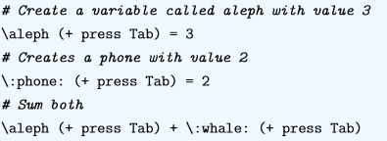
Another Language: Julia
Compiled not interpreted.
Dynamically typed (similar to python)
Faster compared to unoptimized python
Uses mathematical syntax
Julia is still young, less community
Julia tries to not only replace R, Python, but the underlying C and C++ development in package development (for fast R/python packages).
Julia is not object oriented, but this feature of python is not mostly utilized for data science
Summary: At the current stage, python is significantly more useful than Julia, and investing time in learning Julia might be considered a hobby
Notes:
Julia is categorized as a just-in-time (JIT) and is compiled by the LLVM framework. Since it is not interpreted, Julia is a fast programming language

Slide 21
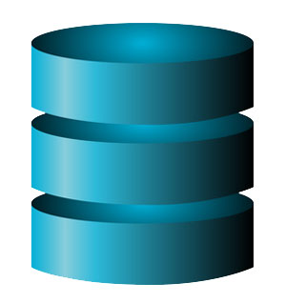
Finally: Continuous Integration
Regardless of what toolset you use create repeatability!
Create consistent development environments in test and development machines
Merge all developer code to shared repository, automate build and make build self-testing. Capture not only modelling code changes but also data
Modelling process involves several repetitions of data merges, filtering, transformations
Repetitive fitting guarantees stable access to data, and impact of each data changes are monitored
Jenkins or Teamcity
R testthat, Python jenkinsapi/teamcity-messages
Database 1
Database 2
CI server
Map/Merge
Filter
Fit
Transform
Deploy model & run tests

Slide 22
Conclusion
Python and R are generally doing the same things, though Python got an edge with new NN packages. It is useful to know both at this stage, and common packages make them interchangeable.
R might be more user friendly and efficient for small data problems
Julia or Scala are far behind in terms of available packages for machine learning, visualization and data manipulations.

