Slide 1
Finance
WK5

Slide 2
作业4
1
开放作业 project
应用Random Forest 方法编写一个 house price predictor
数据参见
data.zip
# target: ﻿SalePrice
# Features: **
要求：
不需要全部feature，仅用float, int 训练就可以了
如果有兴趣，可以尝试清理object features
参考答案
https://www.kaggle.com/marsggbo/kaggle

Slide 3
Stock Market
What are stock exchanges
NYSE (US$22.9 trillion (2019))
NASDAQ (US$ 12.95 Trillion (2019))
SSE ( US$5.01 trillion (May 2019))
SZSE (US$3.51 trillion (March 2019)
Oversee agency
SEC
证监会

Slide 4
Index
What are Index
S&P 500
Dow Jones Industrial Average (DJIA)
Russell 3000
Shanghai Composite
SZSE Component
https://www.investing.com/indices/major-indices

Slide 5
Stocks
IPO
Public traded company
OTC
https://www.investing.com/indices/major-indices

Slide 6
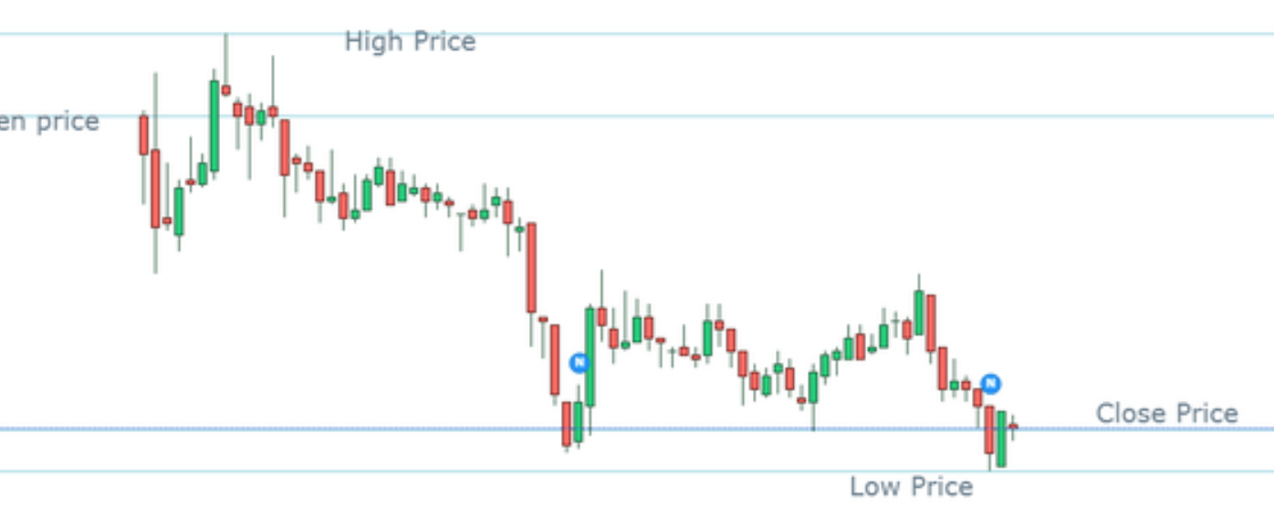
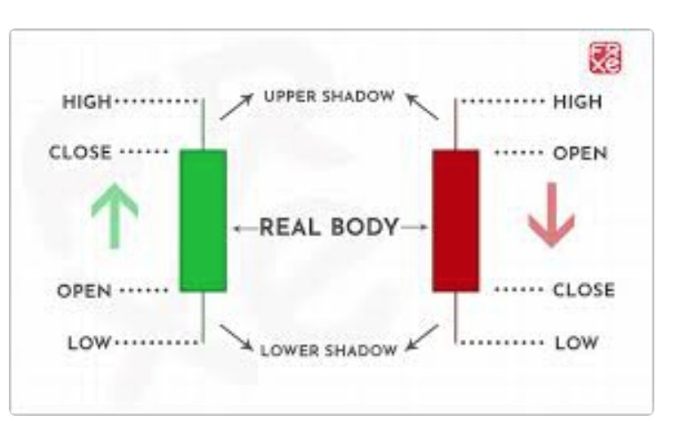
Stocks Price
https://en.wikipedia.org/wiki/Open-high-low-close_chart
https://www.mit.edu/~mbarker/formula1/f1help/11-ch-10.htm#:~:text=Types%20of%20Stock%20Charts,a%20particular%20period%20of%20time.&text=Open%2DHigh%2DLow%2DClose,stock%20for%20the%20same%20period.

Slide 7
Other Financial Assets
Mutual Fund
ETF
Bonds
Derivatives

Slide 8
Bull or bear

Slide 9
Option

Slide 10
Option

Slide 11
Random Walk

Slide 12
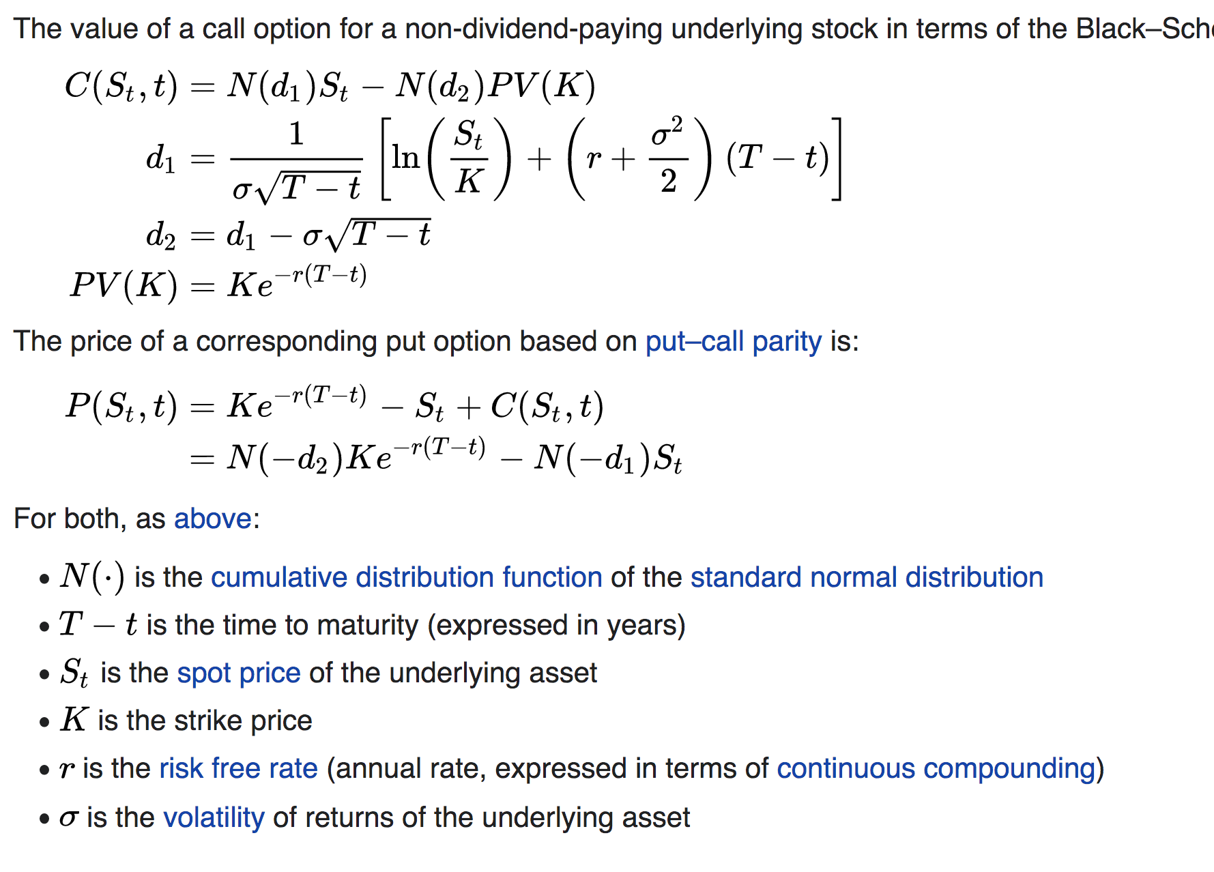
Black-Schole Equ
https://en.wikipedia.org/wiki/Black%E2%80%93Scholes_model

Slide 13
What is a stock market crash?
A stock market crash is different than a market “correction,” which is defined as a 10%+ decline in market prices from a recent high.
Another common term is a “bear market,” which is defined as a 20%+ decline in market prices over a two-month period.

Slide 14
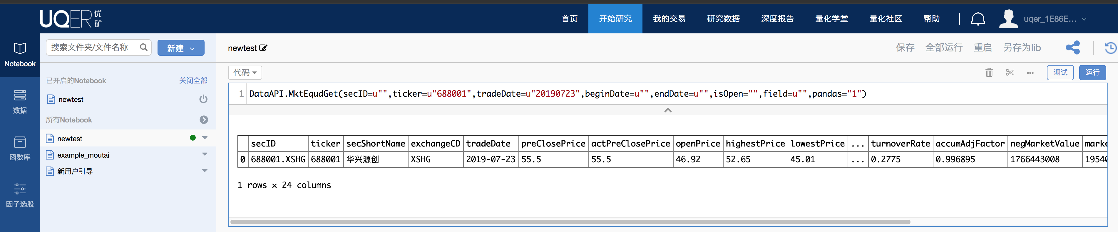
Hands on Playground

