Slide 1
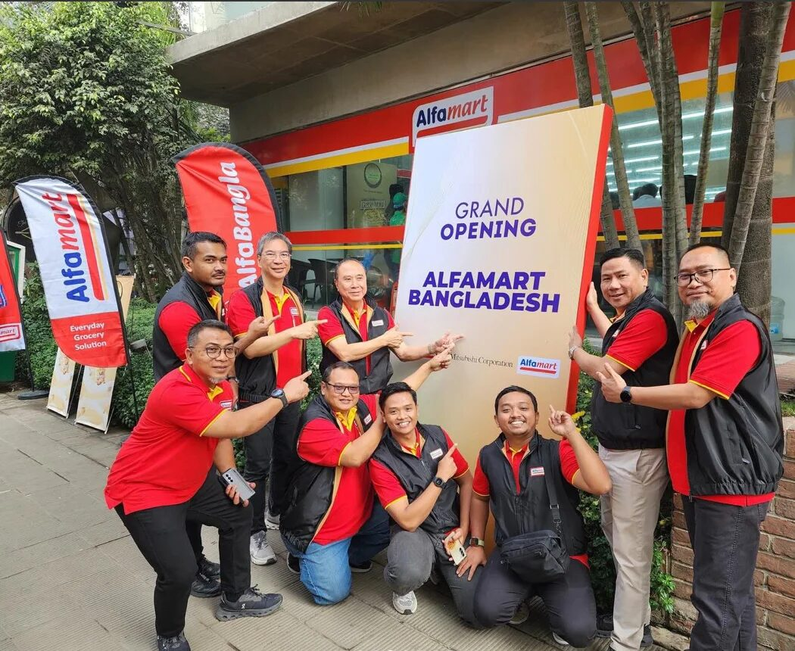


MARKETING MANAGEMENT · KKC CH.16 · MAN5221
Managing
Retail
≈23.7k
stores in 3 countries
Alfamart as the main case: from a Jakarta trading house to Indonesia, the Philippines and Bangladesh.
HOLD THIS QUESTION
If the price is the same, why do people keep choosing the same store?
We test your answer on slide 28.
Erdo · 1–10
Dwita · 11–19
Akrimni · 20–27
Group 3 · Meeting 9 · Saturday, 7 Nov 2026 · Ref: Kotler, Keller & Chernev (2022), Ch.16
Scan to vote & quiz
Opening
Street
Entrance
Shelf
Checkout
Warehouse
Synthesis
Presenter: Erdo
Notes:
Erdo membuka: perkenalan Group 3, topik Meeting 9 Managing Retail (KKC Ch.16). Foto: grand opening Alfamart Bangladesh. Minta peserta scan QR untuk vote dan quiz. Simpan pertanyaan: kalau harga sama, kenapa orang tetap memilih toko yang sama? Kita jawab di slide 28.

Slide 2
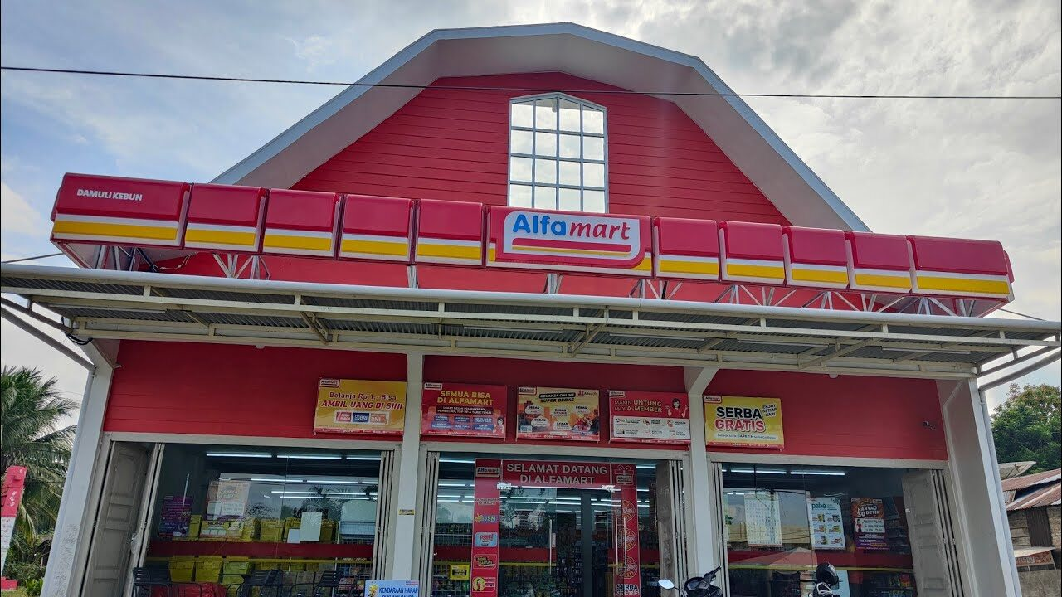
What is retailing?
OPENING · THE CONCEPT
Before the case, the definition every later slide builds on.
“Retailing includes all the activities involved in selling goods or services directly to final consumers for personal, non-business use.”
Kotler, Keller & Chernev (2022), Ch.16
A retailer's core role
Bridging producers and consumers: breaking bulk, offering assortment and convenience.
1
INDONESIA'S BATTLEGROUND
≈37%
Where the shopper decides
The store, physical or digital, is where positioning, price and experience meet demand.
2
of modern grocery trade flows through minimarkets*
Why it matters here
Minimarkets are the decisive channel, and two chains dominate most of it.
3
An Alfamart store: where strategy meets the shopper
KEY IDEA
Retailing is where strategy becomes a sale. In Indonesia, that moment usually happens inside a minimarket.
Definition: Kotler, Keller & Chernev (2022), Marketing Management 16e, Ch.16. *≈37% is the group's research figure; verify the source before presenting.
Opening
Street
Entrance
Shelf
Checkout
Warehouse
Synthesis
Presenter: Erdo
Notes:
Definisi retailing menurut KKC: semua aktivitas menjual barang atau jasa langsung ke konsumen akhir untuk pemakaian pribadi. Peran peritel, tempat pembeli memutuskan, dan kenapa minimarket penting. Angka ≈37% dari riset kelompok, cek sumbernya.

Slide 3
Types of retailers: where everyone sits
THEORY · KKC CH.16
The book classifies store retailers by format and corporate form. Every rival in this case has a slot.
Specialty store
Supermarket
Convenience store · OUR CASE
Narrow line, deep assortment
Large, low-cost self-service groceries
Small, long hours, high-turnover lines
Gramedia, Ace Hardware
Superindo, Hero, Ranch Market
Alfamart, Indomaret, Lawson, FamilyMart
Superstore / hypermarket
Discount / hard discount
Off-price retailer
One-stop, very large footprint
Standard goods, low price every day
Leftover or irregular goods, reduced prices
Transmart, Hypermart, Lotte
O!Save, Mr. DIY
Factory outlets, warehouse clubs
COOPERATIVE
LOCAL DEPARTMENT STORE
INDEPENDENT
KopDes Merah Putih (village co-op)
Toserba lokal, e.g. Toserba Yogya
Warung kelontong, Warung Madura
QUIZ Alfamart's type?
Non-store retailing: online (Shopee, Tokopedia) · direct selling · vending · buying service
KEY IDEA
Alfamart is a store retailer (convenience) that now also competes in non-store retailing through Alfagift.
Theory: store & non-store retailer typology and corporate retailing (KKC 2022, Ch.16). Examples are the group's classification.
Opening
Street
Entrance
Shelf
Checkout
Warehouse
Synthesis
Presenter: Erdo
Notes:
Tipologi peritel KKC; tempatkan semua pesaing. QUIZ: Alfamart termasuk tipe apa? Hasil ditampilkan di slide 6. Jawaban: convenience store.

Slide 4
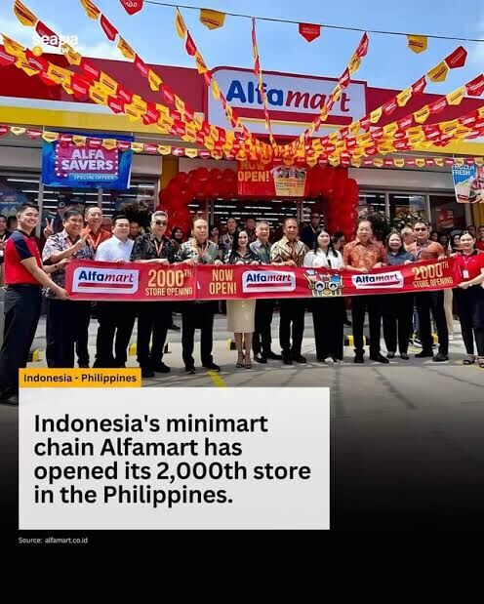
From a Jakarta trading house to Dhaka
OPENING · THE ALFAMART STORY
Thirty-seven years of the same playbook: a small-store format, franchising and in-house distribution, now exported.
1989
1999
2000s
2009
2014
2025
2026
Djoko Susanto, with Sampoerna, starts a trading & distribution firm in Jakarta. Roots: ALFA Toko Gudang Rabat.
First Alfa Minimart opens in Karawaci, Tangerang.
≈1,300 stores across Java within six years; renamed Alfamart.
IPO on the IDX as PT Sumber Alfaria Trijaya Tbk (AMRT), ≈3,000 stores.
Enters the Philippines with SM Investments: first store in Cavite, June.
Takes 70% of Lawson Indonesia. Philippines opens to franchising. Bangladesh JV announced.
First Bangladesh store, Dhaka (27 Jan). 21,442 stores in Indonesia (30 Jun).
THE PHILIPPINES · WITH SM
BANGLADESH · SINCE JAN 2026
2,300+
12
stores by 30 Oct 2026
→ target 100+ by end-2027
stores (Mar 2026), aiming for 2,500 by end-2026. Franchising since Oct 2025.
“We want to make sure we saturate first the opportunities in Luzon.” Harvey Ong, COO
JV with Mitsubishi Corp. & Kazi Farms. Second overseas market after the Philippines; first store in Gulshan-2, Dhaka.
KEY IDEA
The same playbook travels: convenience format + local partners + DC-led supply. Ch.16's franchise and wholesaling logic, exported.
Sources: Alfamart/AMRT history (Wikipedia); Philstar, 20 Mar 2026; The Financial Express (BD), 30 Oct 2026; Nikkei Asia, Jan 2026; AMRT H1 2026 report.
Opening
Street
Entrance
Shelf
Checkout
Warehouse
Synthesis
Presenter: Erdo
Notes:
Sejarah: 1989 usaha dagang Djoko Susanto (dengan Sampoerna), Alfa Minimart 1999, IPO 2009, Filipina 2014 bersama SM. Filipina 2.300+ gerai (Mar 2026); Bangladesh gerai pertama 27 Jan 2026, 12 gerai per 30 Okt 2026, target 100+ akhir 2027.

Slide 5
Retailing & the players on the same street
ACT 01 · STREET
Retailing: all activities that sell goods or services directly to final consumers for personal use. Minimarkets compete on distance, time and daily habit.
THE DUOPOLY · STORES AT 30 JUN 2026
KOPDES MERAH PUTIH
O!SAVE
±1,081*
>100
fully operating, of 10,070 prepared (village co-op)
hard-discount stores (Oct 2025)
WARUNG MADURA
WARUNG KELONTONG
24 hrs
3.9M*
open all day, near homes; ≈50,000 stores*
end-2025, down from 6.1M (2007)
Indomaret: +485 stores in H1 2026 · 36 DCs (Mar 2025) · ≈32% franchised
Alfamart: +322 stores in H1 2026 · 38 DCs, 34 branches, 9 depots · 27.5% franchised
HYPERMARKETS & SUPERMARKETS
Transmart, Hypermart, Lotte, Superindo: one-stop baskets, fewer trips.
Logistics are on par. The fight is over which store sits closer to your daily route.
LIVE VOTE Which store team are you?
KEY IDEA
The duopoly wins on network and logistics; everyone else looks for gaps in price, hours and closeness.
*Group research / APKLI claim, unverified. Sources: AMRT H1 2026 report; Databoks (Jun 2026); Fortune IDN; InvestorTrust (27 Mar 2025); Metro TV (27 Feb 2026).
Opening
Street
Entrance
Shelf
Checkout
Warehouse
Synthesis
Presenter: Erdo
Notes:
Duopoli: Indomaret 24.351, Alfamart 21.442 (30 Jun 2026). Pemain lain: KopDes, O!Save, Warung Madura, kelontong (* belum diverifikasi). LIVE VOTE: kamu tim belanja mana (boleh lebih dari satu).

Slide 6
Quiz & vote: retailer types and store teams
LIVE RESULTS · FROM YOUR PHONES
Answers update live in the web deck. Click "Show live results" during the talk.
Scan to vote
QUIZ · SLIDE 3
0
answers
LIVE POLL · SLIDE 5
0
answers
In KKC Ch.16 terms, Alfamart is a…
Which store team are you?
Specialty store
0%
Alfamart
0%
Indomaret
0%
Supermarket
0%
Hypermarket (Transmart, Hypermart, Lotte)
0%
Supermarket (Superindo, Hero)
0%
Maduramart / Warung Madura
0%
Convenience store
0%
KopDes Merah Putih
0%
Pasar tradisional
0%
Off-price retailer
0%
Warung kelontong / toserba lokal
0%
Online / e-grocery
0%
Show live results ›
Bars fill in live in the web deck; this PowerPoint page is the static version.
Opening
Street
Entrance
Shelf
Checkout
Warehouse
Synthesis
Presenter: Erdo
Notes:
Halaman hasil live: quiz tipe peritel dan vote tim belanja. Tekan Reveal untuk jawaban quiz. Komentari tim mana yang menang.

Slide 7
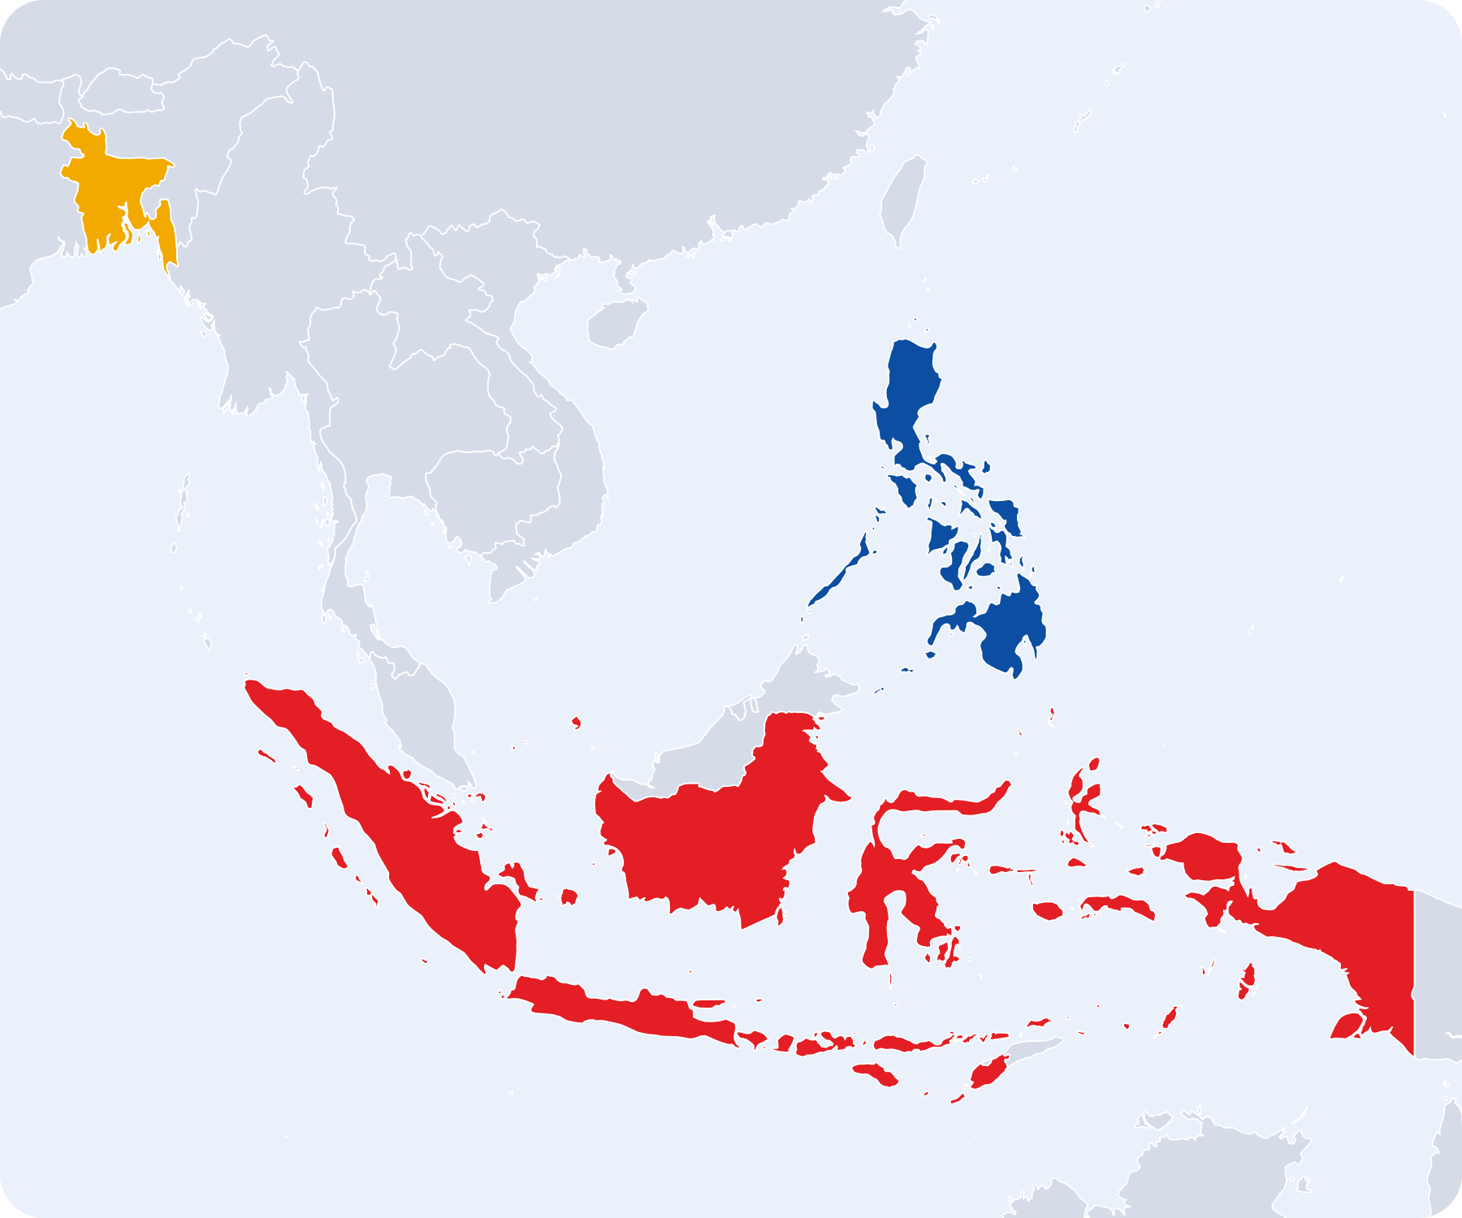
Supplier to shelf: the Alfamart network
ACT 01 · STREET · SUPPLY CHAIN
One distribution backbone feeds every format. The DCs do the wholesaler's work: buying, bulk breaking, storage, transport and risk.
1 · SUPPLIERS
2 · DISTRIBUTION
ALFAMART
ALFAMIDI
FMCG
38 DCs
21,442
2,627
Bangladesh
12 stores → 100+ by 2027
15,554 owned · 5,888 franchise (Jun 2026)
2,541 Alfamidi · 82 Super · 4 Midi fresh (Mar 2026)
Philippines
2,300+ stores · SM JV
Brand principals, local & UMKM producers, private-label makers
›
›
34 branches · 9 depots (Alfamart, 2026)
+8 Alfamidi warehouses
LAWSON
DAN+DAN
346
Beauty & care
ready-to-eat convenience (Jun 2026)
personal-care stores, plus a pharmacy arm
In-store
walk-in shoppers
Alfagift · ±8% of sales
delivery & pick-up app
Aksesmu
B2B wholesale to warung
3 · CUSTOMER
GROUP COMPANIES BEHIND THE NETWORK
Indonesia · HQ Tangerang
≈24.4k group stores (end-2025)
Alfamart
PT Sumber Alfaria Trijaya Tbk (parent)
Alfamidi · 77%
PT Midi Utama Indonesia Tbk
Lawson · 70%
PT Lancar Wiguna Sejahtera
DAN+DAN · 65%
PT Sumber Indah Lestari
Pharmacy
PT Sumber Medika Lestari
Aksesmu · 99.95%
PT Sumber Trijaya Lestari
Loyalty · 75%
PT Global Loyalty Indonesia
Overseas · 100%
Alfamart Retail Asia Pte Ltd
±40% AMRT revenue outside Java
54% Alfamidi stores outside Java
KEY IDEA
The DC network is the moat: one backbone feeds 24,000+ stores, four formats, two apps and three countries.
Sources: AMRT reports Q3 2025 & H1 2026; MIDI public expose (4 Jun 2026); Antara (5 Jun 2026); Philstar; Financial Express (BD); broker research 2026. DAN+DAN count not disclosed.
Opening
Street
Entrance
Shelf
Checkout
Warehouse
Synthesis
Presenter: Erdo
Notes:
Rantai pasok grup: supplier ke 38 DC (plus 34 cabang, 9 depo; Alfamidi 8 gudang) lalu ke Alfamart 21.442, Alfamidi 2.627, Lawson 346, DAN+DAN. Kanal: gerai, Alfagift, Aksesmu. Peta tiga negara.

Slide 8
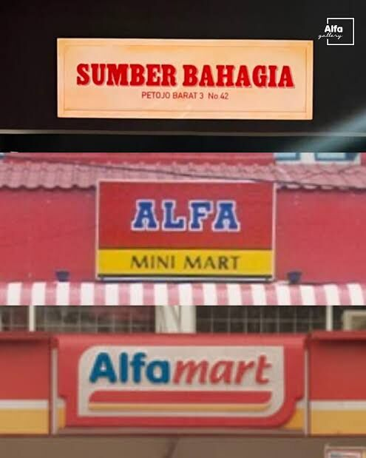
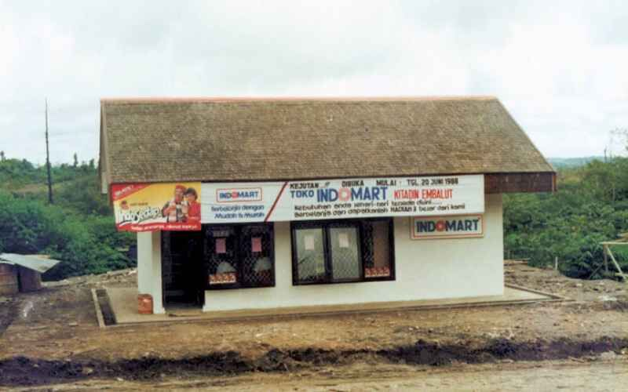
Format, seven trends & the franchise model
ACT 01 · STREET
Alfamart and Indomaret are convenience stores: small, near homes, long hours, a limited line of fast-moving goods.
SEVEN RETAIL TRENDS (KKC) AT ALFAMART
FRANCHISE ORGANIZATION
1
New formats & combinations
Alfamart + Alfamidi + Lawson
Alfamart
72.5 : 27.5
2
Retail consolidation
AMRT takes 70% of Lawson (2025)
3
Mobile retailing
Alfagift app
Sumber Bahagia → Alfa Minimart → Alfamart
4
Omnichannel retailing
one member: store + app + A-Poin
Indomaret
±68 : 32
5
Fast retailing
mainly fashion; here, fast-rotating ready-to-eat
6
Role of technology
POS data, cashless payments
Navy = company-owned · colour = franchised. Franchising let both scale fast with partners' capital.
7
Weakening middle market
big boxes squeezed by small & cheap
Indomart, opened 20 June 1988
KEY IDEA
Both grew from tiny shops, then scaled through franchising: a path newcomers can't easily copy.
Sources: AMRT H1 2026; InvestorTrust (27 Mar 2025); format typology Kotler & Keller (2016) 15e; KKC (2022) Ch.16 retail trends. Photos: Alfa Gallery archive.
Opening
Street
Entrance
Shelf
Checkout
Warehouse
Synthesis
Presenter: Erdo
Notes:
Format convenience store, tujuh tren KKC dan contohnya, franchise organization: Alfamart 72,5:27,5, Indomaret ±68:32.

Slide 9
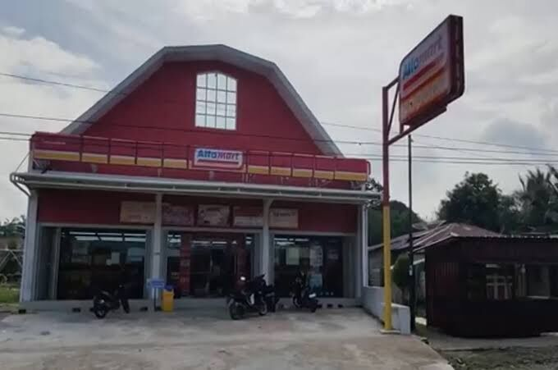
Target market & positioning
ACT 02 · ENTRANCE
The retailer's first decision. Assortment, service, price and communication all follow who is served.
1
Quick shop
Drinks & snacks → easy-access location on the daily route
2
Urgent need
The item must be in stock → prioritise core lines
3
Home restock
Choice & value → pack sizes, promos, Alfagift delivery
±40%
of AMRT revenue comes from outside Java (H1 2026): close to people, even beyond the big cities.
Minimarkets now reach small-town and rural roads
Positioning: close, practical, relevant for daily needs.
LIVE VOTE Why this store?
KEY IDEA
Alfamart's positioning is built from shopping missions, not demographics: close and practical for daily needs.
Theory: target market & positioning (KKC Ch.16; STP Ch.6–7). Missions are a learning illustration, not Alfamart's official segmentation. Data: AMRT H1 2026.
Opening
Street
Entrance
Shelf
Checkout
Warehouse
Synthesis
Presenter: Erdo
Notes:
Target market & positioning berbasis misi belanja. ±40% pendapatan AMRT dari luar Jawa. LIVE VOTE: apa yang menentukan pilihan toko.

Slide 10
Why do you choose a store?
LIVE RESULTS · FROM YOUR PHONES
Answers update live in the web deck. Click "Show live results" during the talk.
Scan to vote
LIVE POLL · SLIDE 9
0
answers
What decides which store you choose?
Closest location
0%
Price and promos
0%
Item always in stock
0%
Fast, comfortable checkout
0%
Points / member app
0%
Show live results ›
Bars fill in live in the web deck; this PowerPoint page is the static version.
Opening
Street
Entrance
Shelf
Checkout
Warehouse
Synthesis
Presenter: Erdo
Notes:
Hasil live vote alasan memilih toko. Hubungkan dengan misi belanja. Erdo menutup bagiannya, serahkan ke Dwita.

Slide 11
Retailer marketing decisions
THE FRAMEWORK · KKC CH.16
The six levers every retailer sets. They are the spine for the slides that follow.
1
Target market
2
Assortment & procurement
3
Price
Who the store is for
What is on the shelf
Margin and value
Alfamart: shopping missions, ±40% revenue outside Java
Food as destination category, private label
Price image, promos, A-Poin loyalty
Slide 9
Slides 15–16
Slide 17
4
Services & atmosphere
5
Location
6
Communications & channels
Experience in-store
Density and placement
Promotion, loyalty, digital
Self-selection plus payments and services
21,442 stores fed by 38 DCs
Alfagift omnichannel, one member ID
Slides 12–13
Slides 5, 7
Slide 19
KEY IDEA
Same six levers, different philosophies: the next slides show how Alfamart pulls each one against its rivals.
Framework: retailer marketing decisions, Kotler, Keller & Chernev (2022), Ch.16. Alfamart examples are the group's application.
Opening
Street
Entrance
Shelf
Checkout
Warehouse
Synthesis
Presenter: Dwita
Notes:
Dwita: kerangka enam keputusan pemasaran peritel (KKC) sebagai tulang punggung slide berikutnya; tiap kartu menunjuk slide pembahasannya.

Slide 12
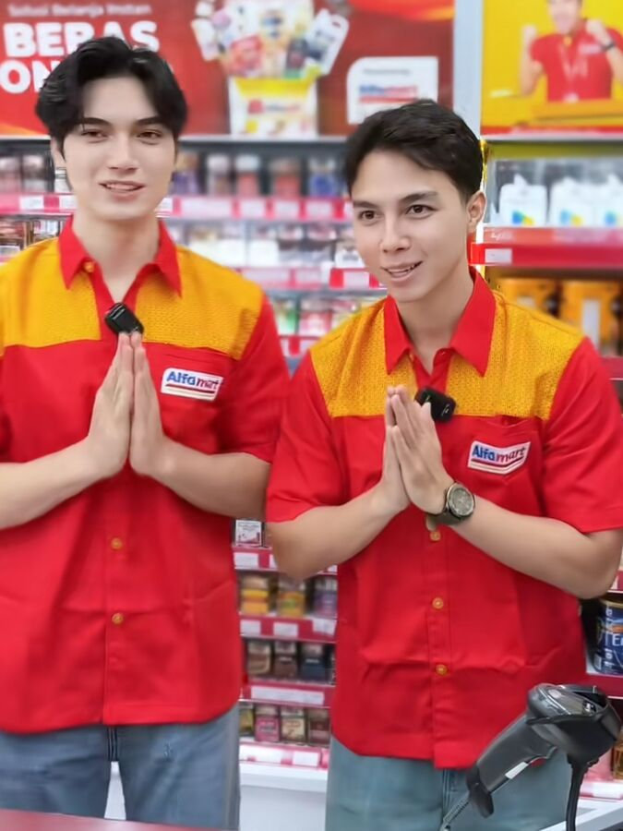
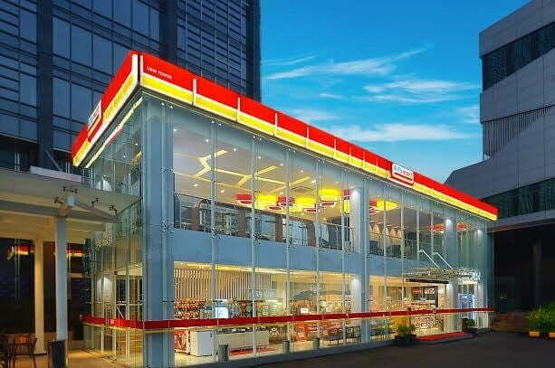
Service level & store atmosphere
ACT 02 · ENTRANCE
How much help the store gives, and the physical mood that makes customers comfortable enough to buy.
Self-service
Limited service
Full service
Alfamart sits here: self-selection, staff help when needed, plus bill payment, top-ups and parcel services.
STORE ATMOSPHERE CHECKLIST
Clear layout and signs: can I find it in seconds?
Clean and bright: do I feel comfortable?
Tidy checkout: is the queue still under control?
Local themes are fine if the store stays easy to read.
Alfamart staff today
Alfamart store at head office
People are part of atmosphere. A flagship can look premium and still stay easy to read: that is the test.
KEY IDEA
Service and atmosphere are part of the offer: fast, clean and readable beats fancy for daily missions.
Theory: levels of service & store atmosphere (KKC Ch.16; services Ch.9). Photos: social media / alfamart.co.id.
Opening
Street
Entrance
Shelf
Checkout
Warehouse
Synthesis
Presenter: Dwita
Notes:
Service level (Alfamart dekat self-service + layanan bayar tagihan) dan store atmosphere. Foto: staf Alfamart dan gerai Alfamart di kantor pusat.

Slide 13
Service levels & how retailers organize
THEORY · KKC CH.16
Two book frameworks behind the case: four levels of service, and the forms of corporate retailing.
QUIZ What form is KopDes?
FOUR LEVELS OF SERVICE
CORPORATE RETAILING FORM | WHO ON OUR STREET
Corporate chain store 2+ outlets, common ownership | Company-owned Alfamart & Lawson stores
Voluntary chain Wholesaler-sponsored independents | Grocers supplied by wholesalers
Consumer cooperative Owned by its members | KopDes Merah Putih?
Franchise organization Franchisor + franchisees | Alfamart & Indomaret
Merchandising conglomerate Diversified lines, central control | AMRT group: Alfamart, Alfamidi, Lawson
Self-service
Customers find, compare and select on their own
Self-selection
Customers find goods, can ask for help
Limited service
More sales help and shopping assistance
Full service
Salespeople assist at every stage
Alfamart ≈ self-service / self-selection, plus bill-payment services.
KEY IDEA
Both chains are franchise organizations running near-self-service stores. That theory explains their speed of scale.
Theory: levels of service & corporate retailing forms (KKC 2022, Ch.16). Mapping is the group's analysis.
Opening
Street
Entrance
Shelf
Checkout
Warehouse
Synthesis
Presenter: Dwita
Notes:
Empat level layanan dan bentuk corporate retailing. Alfamart dan Indomaret = franchise organization. QUIZ: KopDes paling dekat bentuk apa?

Slide 14
Quiz: what form is KopDes Merah Putih?
LIVE RESULTS · FROM YOUR PHONES
Answers update live in the web deck. Click "Show live results" during the talk.
Scan to vote
QUIZ · SLIDE 13
0
answers
KopDes Merah Putih is closest to which form of retailing?
Corporate chain store
0%
Voluntary chain
0%
Consumer cooperative
0%
Franchise organization
0%
Show live results ›
Bars fill in live in the web deck; this PowerPoint page is the static version.
Opening
Street
Entrance
Shelf
Checkout
Warehouse
Synthesis
Presenter: Dwita
Notes:
Hasil quiz KopDes. Reveal: consumer cooperative (koperasi milik anggota).

Slide 15
Product assortment: breadth & depth
ACT 03 · SHELF
Minimarket shelves are narrow: adding variants in one category means cutting space for another.
BREADTH → CATEGORIES
DEPTH ↓ CHOICES PER CATEGORY
71.5%
of AMRT revenue comes from food
GROWTH, Q2 2026
Food
Drinks
Personal care
Household
Services
Destination category: the category that makes people choose the store. For a minimarket, that is food.
9M 2026: media report AMRT's profit was again supported by the food segment.
KEY IDEA
For a minimarket, food is the destination category: the reason people walk in.
Sources: broker research cited in media (2026); IDX Channel (Nov 2026). Concepts: breadth, depth, destination category (KKC Ch.16).
Opening
Street
Entrance
Shelf
Checkout
Warehouse
Synthesis
Presenter: Dwita
Notes:
Assortment breadth dan depth; destination category = makanan (71,5% pendapatan). Q2 2026 makanan +7,3% vs non-makanan +1,0%.

Slide 16
Procurement & private label
ACT 03 · SHELF
Keep stock at the right point; build the retailer's own brand. AMRT network: 38 DCs, 34 branches, 9 depots.
STOCK CONTROL
THE QUALITY CHECK
Too low
Right
Too high
2.0 / 5
Lost sales, unhappy shoppers
Item there, capital under control
Holding cost, expiry risk
Procurement tools (KKC): forecasting · stock control · allocation · direct product profitability
★★★★★
Average Health Star Rating of Alfamart, Indomaret and Super Indo private labels. Up to 98% of products high in fat, sugar or salt.
WHY RETAILERS BUILD PRIVATE LABELS
Higher margin
Differentiation
Bargaining power
Private label supports margin, but only with quality assurance and trust.
Alfamart's private label supports margin (Panin Sekuritas, May 2026).
KEY IDEA
Procurement keeps the promise "it's in stock"; private label lifts margin, if quality keeps up.
Sources: ATNi Indonesia Retail Assessment (Nov 2025); Panin Sekuritas (May 2026); broker research 2026. Theory: KKC Ch.16 procurement & private label.
Opening
Street
Entrance
Shelf
Checkout
Warehouse
Synthesis
Presenter: Dwita
Notes:
Procurement: stok terlalu rendah, pas, terlalu tinggi; alat KKC. Private label: margin, diferensiasi, daya tawar; ATNi rerata HSR 2,0/5.

Slide 17
Pricing: one item vs one basket
ACT 04 · CHECKOUT
Price image is shaped by the price of memorable items, not by the whole basket.
EDLP VS HIGH–LOW
BASKET | STORE A | STORE B
Milk | Rp18,000 | Rp20,000
Bread | Rp17,000 | Rp15,000
Soap | Rp15,000 | Rp13,000
Total | Rp50,000 | Rp48,000
PRICE IMAGE
Milk is cheaper at A, but the basket is cheaper at B.
EDLP low, steady every day
High–low regular price + periodic discounts
Simulation for learning, not actual prices.
INCENTIVES & LOYALTY: A-POIN
Points from Alfamart and Alfagift. AMRT says 2025 growth came from transaction volume plus promos that keep prices attractive. Promotions are judged with margin and repeat purchase.
LIVE VOTE Which pricing wins you?
KEY IDEA
Pricing is judged together with margin and repeat purchase, not just by who is cheapest on one item.
Sources: Kontan (4 Jun 2026); Alfagift A-Poin terms. Theory: EDLP, high–low, price image, incentives (KKC Ch.16; pricing Ch.11).
Opening
Street
Entrance
Shelf
Checkout
Warehouse
Synthesis
Presenter: Dwita
Notes:
EDLP vs high–low, price image (simulasi keranjang), insentif dan A-Poin. LIVE VOTE strategi harga.

Slide 18
Which pricing strategy wins you?
LIVE RESULTS · FROM YOUR PHONES
Answers update live in the web deck. Click "Show live results" during the talk.
Scan to vote
LIVE POLL · SLIDE 17
0
answers
Which pricing strategy attracts you most?
EDLP: low every day
0%
High–low: periodic discounts
0%
Loyalty: member prices / points
0%
Bundling: value packs
0%
Show live results ›
Bars fill in live in the web deck; this PowerPoint page is the static version.
Opening
Street
Entrance
Shelf
Checkout
Warehouse
Synthesis
Presenter: Dwita
Notes:
Hasil vote strategi harga. Bandingkan dengan teori: EDLP membangun kepercayaan, high–low menarik lalu lintas lewat diskon.

Slide 19
Communication & omnichannel
ACT 04 · CHECKOUT
One customer identity joins every channel. Multichannel only offers many channels with separate benefits.
MULTICHANNEL
OMNICHANNEL: ALFAMART
±8%
Store, app, website: all present
Benefits and info are separate
Customer recognised differently per channel
One member: store + Alfagift + A-Poin
Identity and benefits integrated
Stock and promos consistent across channels
of AMRT sales via Alfagift (management, Jun 2026). KISI estimates <5%: "online" is defined differently.
ONE OFFER, READ ONCE: PRODUCT & SIZE · PRICE & PERIOD · TERMS & CHANNEL
Catalog
›
Shelf
›
Checkout
›
App
›
Delivery / pick-up
KEY IDEA
An offer must be understood in a single read, and say the same thing in every channel.
Sources: Fortune IDN (5 Jun 2026); Kontan (Jun 2026); KISI. Theory: retail communication, omnichannel (KKC Ch.16; IMC Ch.12–14; channels Ch.15).
Opening
Street
Entrance
Shelf
Checkout
Warehouse
Synthesis
Presenter: Dwita
Notes:
Multichannel vs omnichannel; satu member: gerai + Alfagift + A-Poin. Alfagift ±8% (manajemen) vs <5% (KISI). Dwita menutup, serahkan ke Akrimni.

Slide 20

Wholesaling & distribution
ACT 05 · WAREHOUSE
Selling to buyers who resell or use goods for business. Alfamart's DCs run all nine wholesaler functions in-house.
01
Buying & assortment
02
Selling & promoting
03
Bulk breaking
04
Warehousing
05
Transportation
06
Financing
07
Risk bearing
08
Market information
09
Management services
Roots: ALFA Toko Gudang Rabat
38
Alfamart DCs (2026)
+34 branches, 9 depots
36
Indomaret DCs (Mar 2025)
≈700 stores per DC
Alfamart began as a wholesale-warehouse business, so the wholesaling DNA came first.
KEY IDEA
Both chains run wholesaler functions through in-house DCs. This logistics scale is the real moat.
Sources: broker research 2026; InvestorTrust (27 Mar 2025); Alfa Gallery archive. Theory: wholesaler functions (KKC Ch.16; channels Ch.15).
Opening
Street
Entrance
Shelf
Checkout
Warehouse
Synthesis
Presenter: Akrimni
Notes:
Akrimni: wholesaling dan sembilan fungsi wholesaler; Alfamart 38 DC, Indomaret 36 DC. Akar Alfamart: ALFA Toko Gudang Rabat.

Slide 21
The wheel of retailing
THEORY · KKC CH.16
New retailers enter low-margin, low-price and low-status, then add services, raise costs, and become open to the next low-price entrant.
1
Enter low: O!Save, KopDes
Low price, low margin, no-frills basics
2
Add value: Alfamart & Indomaret today
1 · Enter low
2 · Add value
Wheel of retailing
Fresh food, coffee, Lawson ready-to-eat, services, Alfagift
3
Trade up: hypermarkets & premium supermarkets
Big footprint, higher costs: the "weakening middle" now under pressure
3 · Trade up
QUIZ Who enters low today?
KEY IDEA
The real risk: trading up without losing the everyday-value trust that new discounters are targeting.
Theory: the wheel of retailing hypothesis (KKC 2022, Ch.16). Positions are the group's analysis.
Opening
Street
Entrance
Shelf
Checkout
Warehouse
Synthesis
Presenter: Akrimni
Notes:
Wheel of retailing: O!Save dan KopDes masuk dari bawah, duopoli di tengah, hypermarket di atas dan tertekan. QUIZ: siapa yang masuk dari bawah?

Slide 22
Who plays where, with what weapon
SYNTHESIS · COMPETITOR STRATEGY
Alfamart among its rivals. Each one attacks with a different retail decision.
ALFAMART × LAWSON
INDOMARET
FAMILYMART
O!SAVE
21,442
24,351
±400
>100
+346 Lawson. Multi-format; took 70% of Lawson (2025) to boost ready-to-eat.
Largest network, fastest openings, ≈32% franchised.
Coffee & ready-to-eat, cluster expansion, no franchise (Wings Group licence).
Hard discount from the Philippines: low everyday price, no promos.
HYPER & SUPERMARKET
KOPDES MERAH PUTIH
TOSERBA LOKAL
WARUNG & KELONTONG
Big baskets
±1,081*
Local loyalty
24 h · 3.9M*
Transmart, Hypermart, Lotte, Superindo: depth, fresh food, weekly trips.
Government village co-op; enters through staple goods.
Regional department stores, e.g. Toserba Yogya: wide general merchandise.
Closeness, single-unit sales, credit (kasbon).
Pattern: the duopoly wins on network and logistics; challengers take the gaps: ready-to-eat, price, hours, closeness.
LIVE VOTE How do small stores survive?
KEY IDEA
No rival copies all seven retail decisions at once; each picks one weapon.
*Group research / APKLI claim, unverified. FamilyMart ≠ Indomaret. Sources: Bisnis.com (14 May 2025); Databoks (Jun 2026); Fortune IDN (2025–26).
Opening
Street
Entrance
Shelf
Checkout
Warehouse
Synthesis
Presenter: Akrimni
Notes:
Peta pesaing termasuk hypermarket, supermarket, toserba lokal. LIVE VOTE: cara realistis warung/KopDes bersaing.

Slide 23
Quiz & vote: the wheel and small stores
LIVE RESULTS · FROM YOUR PHONES
Answers update live in the web deck. Click "Show live results" during the talk.
Scan to vote
QUIZ · SLIDE 21
0
answers
LIVE POLL · SLIDE 22
0
answers
On the wheel of retailing, who is "entering low" in Indonesia today?
How can warung or KopDes realistically compete with chain minimarkets?
Alfamart
0%
Open 24 hours
0%
Hypermart
0%
Social closeness & credit (kasbon)
0%
Cheaper wholesale prices
0%
O!Save
0%
Local & UMKM products
0%
Lawson
0%
Go digital: QRIS & online stock
0%
Show live results ›
Bars fill in live in the web deck; this PowerPoint page is the static version.
Opening
Street
Entrance
Shelf
Checkout
Warehouse
Synthesis
Presenter: Akrimni
Notes:
Hasil quiz wheel (jawaban: O!Save) dan vote strategi warung.

Slide 24
Where Alfamart's retail system beats each rival
SYNTHESIS · ALFAMART STRATEGY
Every promise to the customer needs an operational decision behind it. Group analysis using the Ch.16 decisions.
RIVAL | THEIR EDGE | ALFAMART'S COUNTER | CH.16 LEVER
Indomaret | More stores, more franchisees | Regional scale (PH, BD), Lawson ready-to-eat, growing gross profit | Positioning, expansion
Hypermarket | One-stop, low unit price | Closer, faster for daily missions; Alfagift for bigger baskets | Location, target market
Supermarket | Fresh food & depth | Alfamidi / Lawson formats; narrow-but-right assortment | Assortment
O!Save | Lowest everyday price | Price image on key items, A-Poin, private label | Pricing, private label
KopDes M.P. | State backing, village reach | 38 DCs, systems, franchise know-how | Procurement, wholesaling
Toserba lokal | Local loyalty, wide range | Standard look, payments & services, one member ID | Services, omnichannel
Warung / Madura | 24 h, closeness, credit | Consistent stock & price, clean, cashless | Atmosphere, communication
KEY IDEA
Alfamart wins because its seven retail decisions reinforce each other; each rival brings just one.
Group synthesis of KKC Ch.16 retailer marketing decisions; not an Alfamart internal assessment.
Opening
Street
Entrance
Shelf
Checkout
Warehouse
Synthesis
Presenter: Akrimni
Notes:
Matriks keunggulan: tiap pesaing punya satu senjata; Alfamart unggul karena keputusan ritelnya saling menguatkan. Analisis kelompok.

Slide 25
Does the strategy show up in the numbers?
SYNTHESIS · EVIDENCE IN THE FINANCIALS
AMRT, nine months to Sep 2026. Gross profit tests the health of pricing, assortment and private-label decisions.
REVENUE 9M 2026
GROSS PROFIT
Rp101.29T
Rp22.20T
▲ 7.21% YoY
▲ 9.35% · margin ≈21.9%
OPERATING PROFIT
NET PROFIT TO OWNERS
Rp3.19T
Rp2.40T
Regional expansion: the 2,000th Philippine store
Gross profit grew faster than revenue: pricing, mix and private label are working. Net profit lagged on higher finance costs.
▲ 7.89%
▲ 3.80% · finance costs +35.8%
KEY IDEA
Growth is steady, not spectacular: ≈10% (2023–24) → 7.2% (2025) → 7.2% (9M 2026). New stores and countries carry more of it.
Sources: AMRT 9M 2026 financial statements via CNBC Indonesia (2 Nov 2026) & Bisnis.com (3 Nov 2026); AMRT H1 2026 report. Photo: alfamart.co.id.
Opening
Street
Entrance
Shelf
Checkout
Warehouse
Synthesis
Presenter: Akrimni
Notes:
AMRT 9M 2026: pendapatan Rp101,29 T (+7,21%), laba bruto Rp22,20 T (+9,35%), laba usaha Rp3,19 T (+7,89%), laba ke pemilik Rp2,40 T (+3,80%).

Slide 26
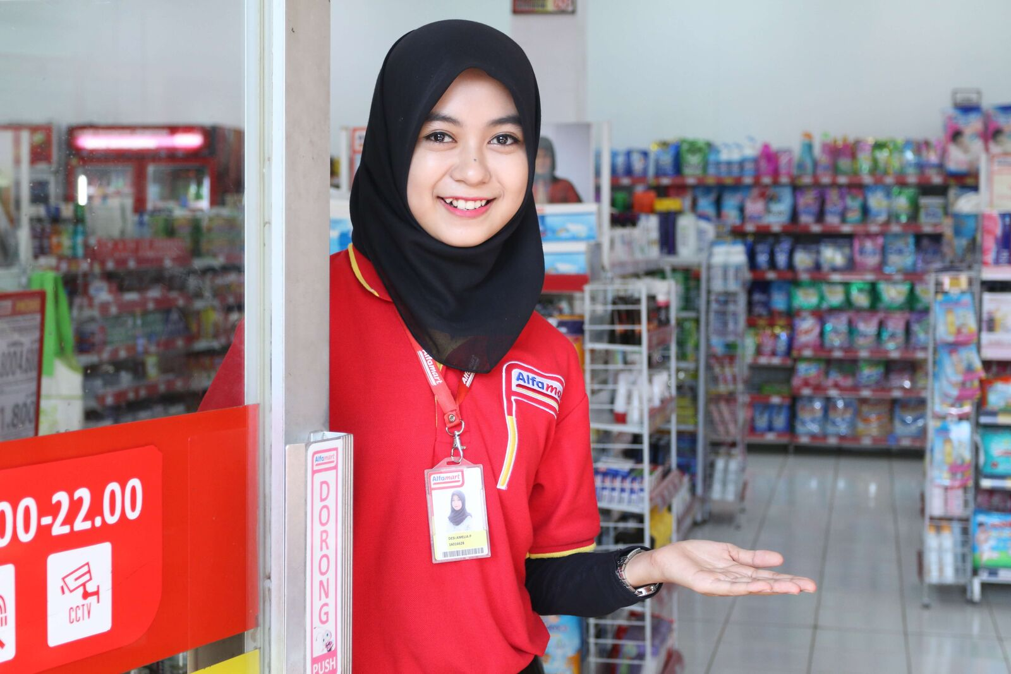
Promo or experience?
CASE DISCUSSION · 3 MINUTES
Hypothetical scenario: stores are busy during promos, but repeat purchase is low. Pick one priority.
Busy during promos
Low repeat purchase
Out of stock, long queues
A
B
C
Add more discounts
Fix availability & queues
Scale up the app campaign
Experience is made by people in the store
CLASS VOTE A, B or C? Reveal after
Diagnose before acting: product availability, queue time, repeat-purchase rate and margin. Learning Goal 3.
KEY IDEA
A poor experience weakens any promotion. Fix the promise before amplifying it.
Hypothetical scenario for class discussion, not Alfamart's actual condition. Syllabus Learning Goal 3: make marketing decisions.
Opening
Street
Entrance
Shelf
Checkout
Warehouse
Synthesis
Presenter: Akrimni
Notes:
Diskusi 3 menit. CLASS VOTE A/B/C. Foto: staf Alfamart menyambut pelanggan.

Slide 27
Class vote: promo or experience?
LIVE RESULTS · FROM YOUR PHONES
Answers update live in the web deck. Click "Show live results" during the talk.
Scan to vote
CLASS VOTE · SLIDE 26
0
answers
Busy during promos, low repeat purchase, empty shelves. Your priority?
A · Add more discounts
0%
B · Fix availability & queues
0%
C · Scale up the app campaign
0%
Show live results ›
Bars fill in live in the web deck; this PowerPoint page is the static version.
Opening
Street
Entrance
Shelf
Checkout
Warehouse
Synthesis
Presenter: Akrimni
Notes:
Hasil class vote. Reveal: B paling kuat, tapi diagnosis dulu. Skenario hipotetis.

Slide 28
Same price. So why Alfamart?
CLOSING · GROUP 3
LIVE APPRECIATION
Location, stock, convenience, speed and membership benefits: all outcomes of the retail decisions we walked through.
👏
❤️
🔥
Applause
Love
Great
1
Know the customer's mission
Start from shopping missions, not demographics.
🙏
🤩
💡
2
Align marketing & operations
Thanks
Wow
Insight
Every promise needs a decision behind it.
3
Connect the experience, then export it
COMMENTS & QUESTIONS
One member ID at home; one playbook in PH and BD.
Scan the QR to send applause, love or any emoji, plus a comment or question. Live comments appear in the web deck.
References: Kotler, Keller & Chernev (2022) Marketing Management 16e Global, Ch.16 · Kotler & Keller (2016) 15e · Kotler & Armstrong (2018) 17e · AMRT H1 & 9M 2026 · ATNi (2025) · Databoks, Bisnis.com, CNBC Indonesia, Fortune IDN, Kontan, InvestorTrust, Philstar, The Financial Express, Nikkei Asia (2025–26) · APKLI via Metro TV (2026).
Open the live wall
Click to show reactions and comments live in the web deck.
Thank you! Dwita · Erdo · Akrimni
Opening
Street
Entrance
Shelf
Checkout
Warehouse
Synthesis
Presenter: Group 3
Notes:
Penutup bersama: jawab pertanyaan awal, tiga pesan, referensi. Minta peserta kirim emoji dan komentar; tekan CELEBRATE. Lanjut tanya jawab.

